Slide 1

Access!
Making professional inclusion a success
Andrea Seeger, CEO
Access – Inklusion im Arbeitsleben gGmbH
Germany
Disabled People's Organization driving company strategies
6 March 2025, 10 – 11 h
Notes:
Andrea Seeger, CEO
Access – Inklusion im Arbeitsleben gGmbH
Germany
Disabled People's Organization driving company strategies
6 March 2025, 10 – 11 h

Slide 2
The story of Access
Coming from the self-determined living movement, started in 1998
One of the pioneers of Supported Employment in Germany
Provider for the total process: Clearing, acquisition, placement, training on the job, support after contract
70 people with and without disabilities work together (30% with disabilities)
Ongoing 350 customers
Network of around 1500 companies
High integration rate of supported employment-measures (60%-70%)

Slide 3
The network, above all
People with
disabilities
Schools
Sheltered workshops
Professional
audience
Different funding providers
Foundations
Employers
Notes:
Sample Slide: presenting three points on our project and the relationship to this year’s theme of the Zero Project Conference. Point 1; Point 2; Point 3 connect together in this way.

Slide 4
The activities to win
employers
Workshops on Inclusion
Events with best practice
Individual case acquisition
Corporate Network

Slide 5
The process, following the Supported Employment model
Client Engagement
Vocational Profiling
Jobfinding
Employer Engagement
Ongoing Jobsupport

Slide 6
The factors of success
1 jobcoach: 5 participants to achieve a job.
Best educated staff (Jobcoach-Trainings)
Non-binding company trials (place and train)
Longlasting training with Jobcoaches (minimum the first 2 days)
Every week minimum one contact in the company to support both sides
Subsidies for companies to compensate costs to support the working contract
Ongoing support as long as necessary
Create new jobs, that fit to the skills of people

Slide 7
The search
Individual
skills
Workplace requirements
Match

Slide 8
The workplace, that fits
takes into account the abilities and skills of a person with a disability and the needs of the company
is often a new, additional workplace, which can also include parts of a regular workplace and thus relieve the workload of skilled workers
often bundles work from different fields of activity (we think in terms of activities, not professions)
is the result of a systematic search by the job coach with all those involved

Slide 9
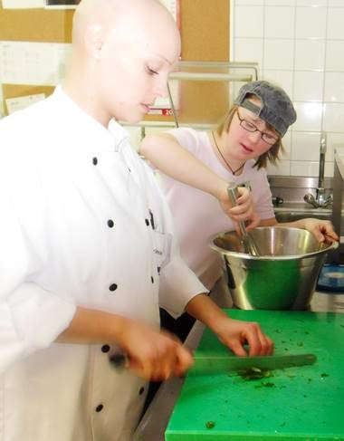
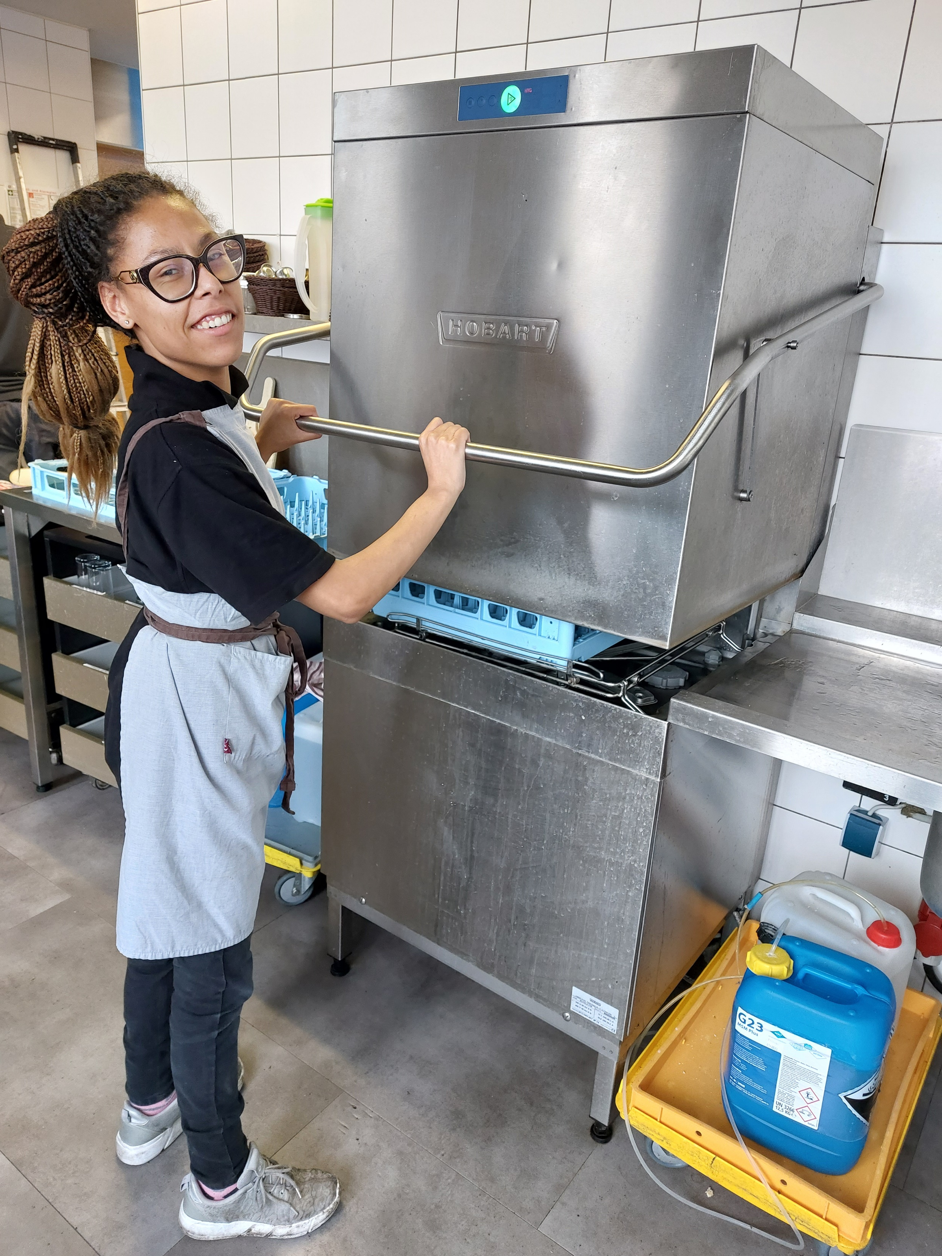
Succes stories
Transition from school to work: Vivian works in a bakery shop
Theresa works as an assistant in a hotel kitchen

Slide 10
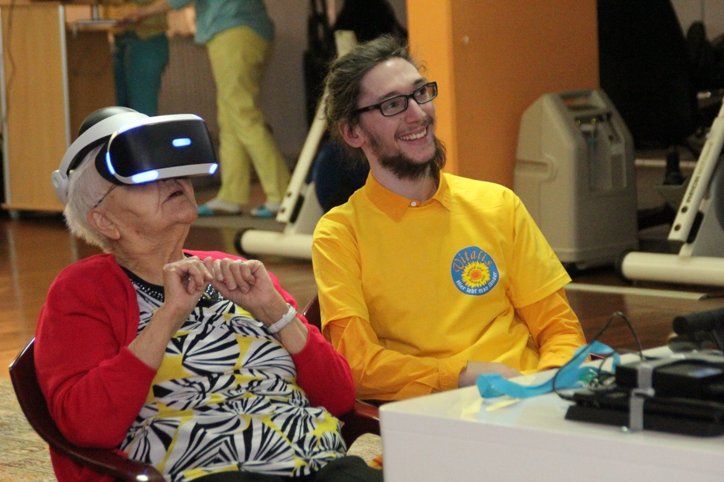
And one more
Transition from sheltered workshop to work
Manuel works as an assistant in a Retirement home

Slide 11
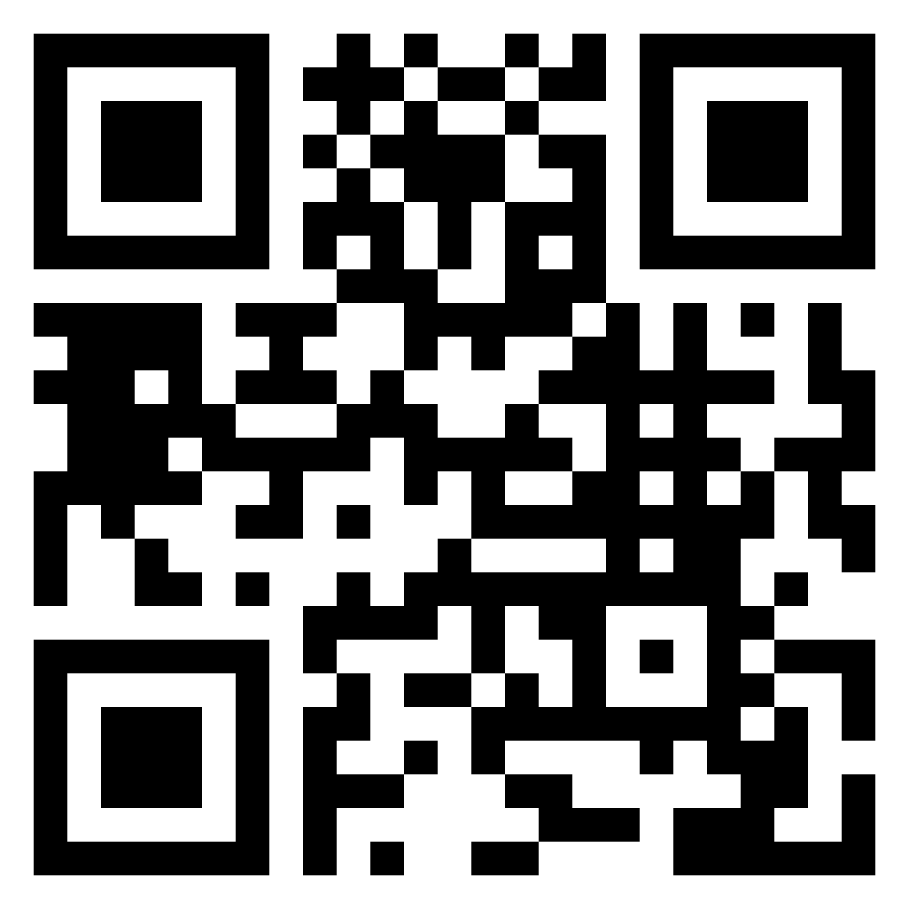
Thank you for your attention
SCAN ME
access-inklusion.de | Insta: access_inklusion | LinkedIn: access-inklusion-im-arbeitsleben
#ZeroCon25

