Slide 1




Enerjisa Distribution Companies Introduction Presentation
R&D Directorate

Slide 2
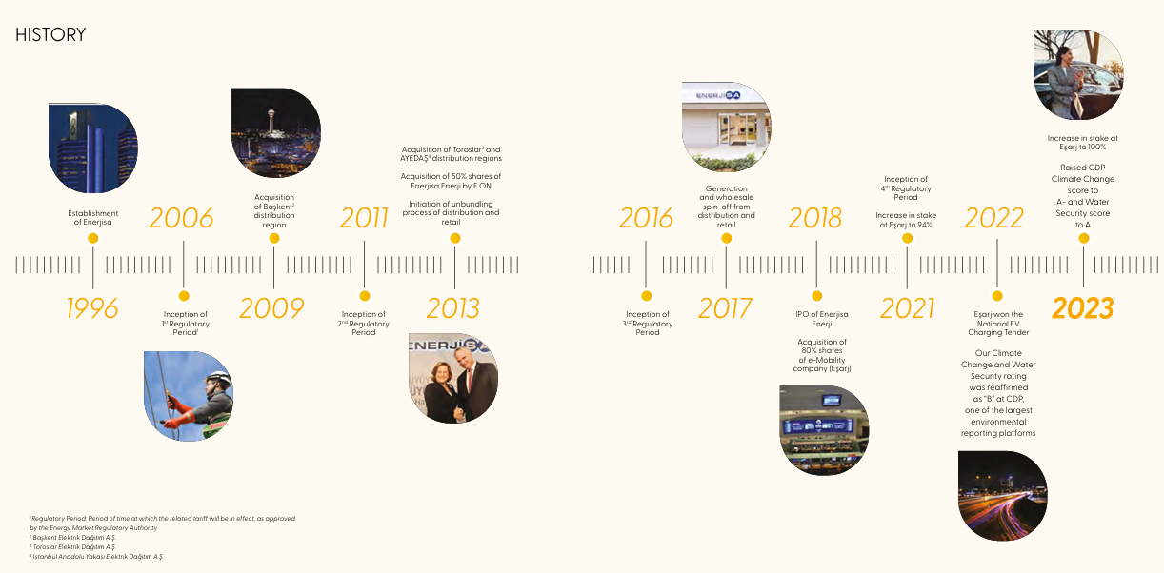
ABOUT ENERJİSA

Slide 3
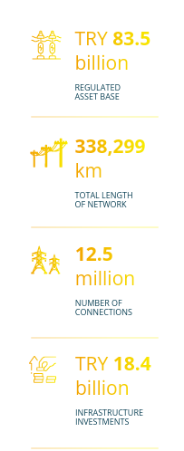
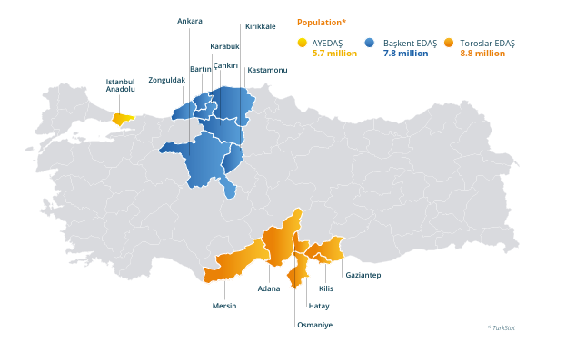
ENERJİSA DISTRIBUTION COMPANIES

Slide 4
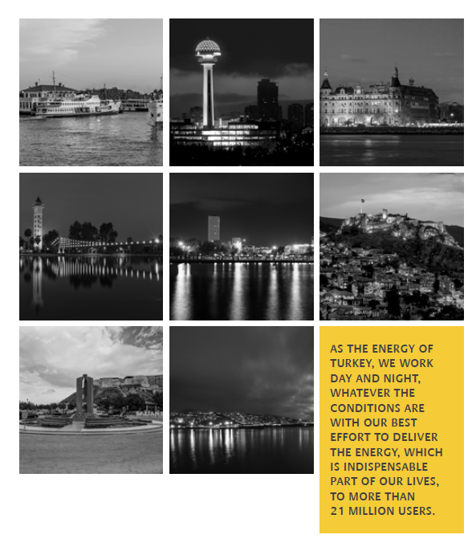
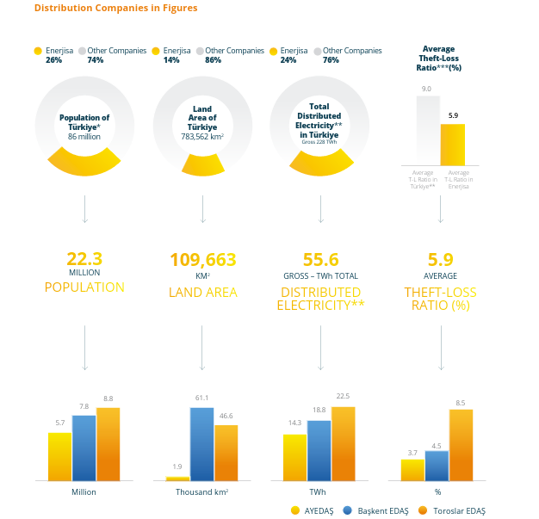

Slide 5

OUR R&D MISSION
Creating Value in the Energy Distribution Sector through Innovation and Technology Development

Slide 6






R&D WORKING AREAS
NETWORK TECHNOLOGIES
DISTRIBUTED GENERATION
MICROGRID
ENERGY STORAGE
E-MOBILITY
LOCAL SOFTWARE AND ARTIFICIAL INTELLIGENCE ECOSYSTEM
DIGITALIZATION
SMART CITIES

Slide 7
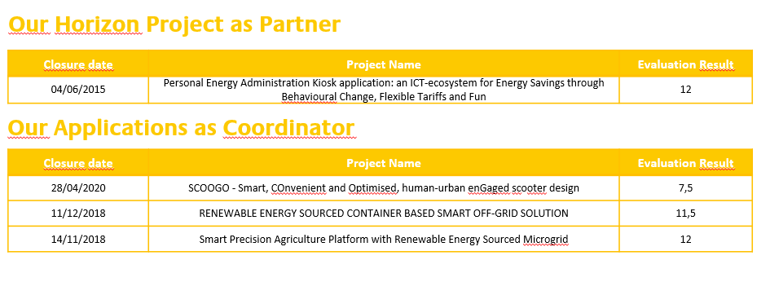
Horizon /Our Applications

Slide 8
Our Applications
Our Applications as Partner – 2025
Closure Date | Project Name | Call
15/05/2025 | ReStArt | Interreg NEXT MED – Özel Hedef 2/1
3/09/2025 | INNO4GRID | HORIZON-CL5-2025-02-D3-17
3/09/2025 | PIVOT | HORIZON-CL5-2025-02-D3-11
30/10/2025 | Smartgrid-DECT | EUROGIA2030 - Call29
30/10/2025 | SmartLight | EUROGIA2030 - Call29
12/11/2025 | Radicle | HORIZON-CL3-2025-01-INFRA-01

Slide 9
Our Applications
Our Applications as Partner – 2026
Closure Date | Project Name | Call
17/02/2026 | GENSPINE | HORIZON-CL5-2026-02-D3-19
17/02/2026 | Smart2Wise | HORIZON-CL5-2026-02-D4-02
17/02/2026 | Breal Ped | HORIZON-CL5-2026-02-D4-04
17/02/2026 | ODIN | HORIZON-CL5-2026-02-D4-02
31/03/2026 | AIGEN | HORIZON-CL5-2026-03-D3-20
31/03/2026 | RESILIENTSTORE | HORIZON-CL5-2026-03-D3-21
31/03/2026 | UniHGrid | HORIZON-CL5-2026-03-D3-21
31/03/2026 | Hybrid-AI | HORIZON-CL5-2026-03-D3-20
31/03/2026 | DINOCO | HORIZON-CL5-2026-02-D3-22
31/03/2026 | AIDE | HORIZON-CL5-2026-02-D3-22
4/05/2026 | EDGE LV Insight | COP-PILOT Horizon’s 1st Open Call
7/05/2026 | OMEGAS | HORIZON-JU-CHIPS-2026-1-RIA

Slide 10
THANK YOU

