Slide 1

Thursday 6th March 10am
Lee, Corless
British Association for Supported Employment (BASE)
United Kingdom
Disabled People’s Organization Driving Company Strategies
Notes:
Please add your notes here.
Title; First name, last name of speaker(s); Name of Organization, Name of Country, Name of Session (as written in Agenda)
#ZeroCon24
Day and Time of Session

Slide 2
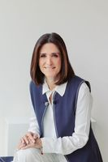
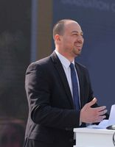
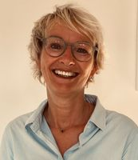
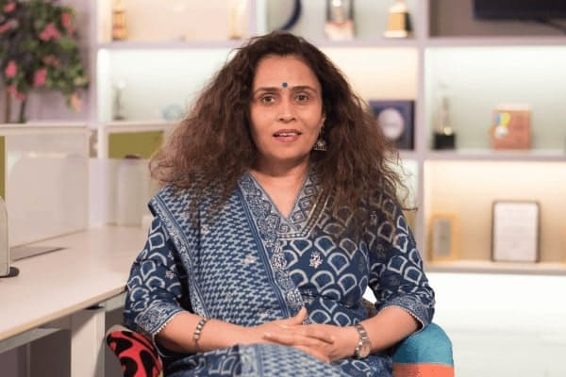
Today’s Session
Disabled People's Organization driving company strategies:
Today's Panel of Speakers are:-
Marisabel Gonzalez
Ramez Maher
Andrea Seegar
Ameesha Prabhu
Notes:
30 Seconds - This session highlights Zero Project Awardees – all of them Disabled People’s Organisations (DPO’s) – that have been the driving force behind the inclusion strategies of a large number of companies in Costa Rica, Egypt, Germany, India and BASE in the UK. Approaches and models featured in this session include occupational profile databases, company cooperation partner networks featuring thousands of companies, as well as scalable training platforms.

Slide 3
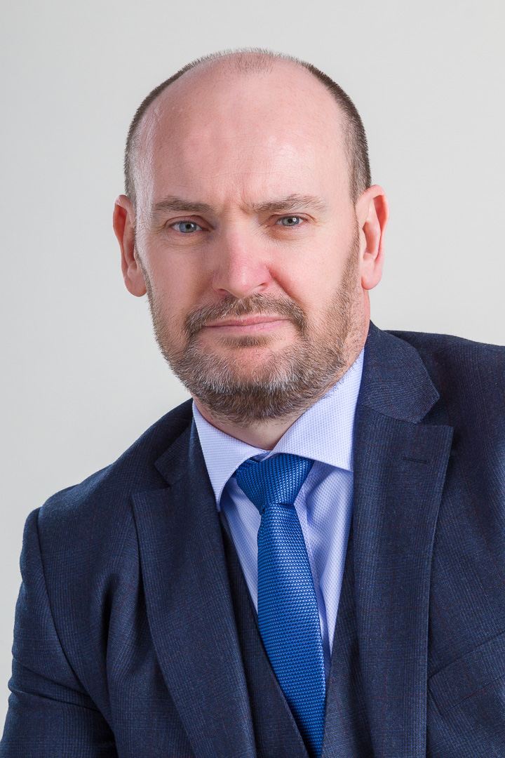
Introduction – About Me
Lee serves as a member of the National Executive Committee at the British Association for Supported Employment (BASE), where he undertakes the duties of the National Employer Lead, a voluntary role he assumed in early 2023. In this capacity, he is dedicated to expanding BASE's reach and impact, enhancing its support and knowledge-sharing initiatives with the business and corporate community.
In his professional career, Lee is the Executive Vice President of Global Expansion, boasting extensive experience across the financial, technology, and recruitment sectors. A key member of the leadership team that established one of the world’s most renowned Autism at Work programmes within a leading global investment corporation, Lee has earned recognition as a global leader in neurodiversity inclusion.
An accomplished and sought-after speaker, Lee combines his professional expertise with personal insight as an autistic self-advocate. He is committed to driving workplace adaptation for neurodiversity and inspiring neurodivergent individuals to pursue fulfilling employment opportunities
Notes:
30 Seconds

Slide 4
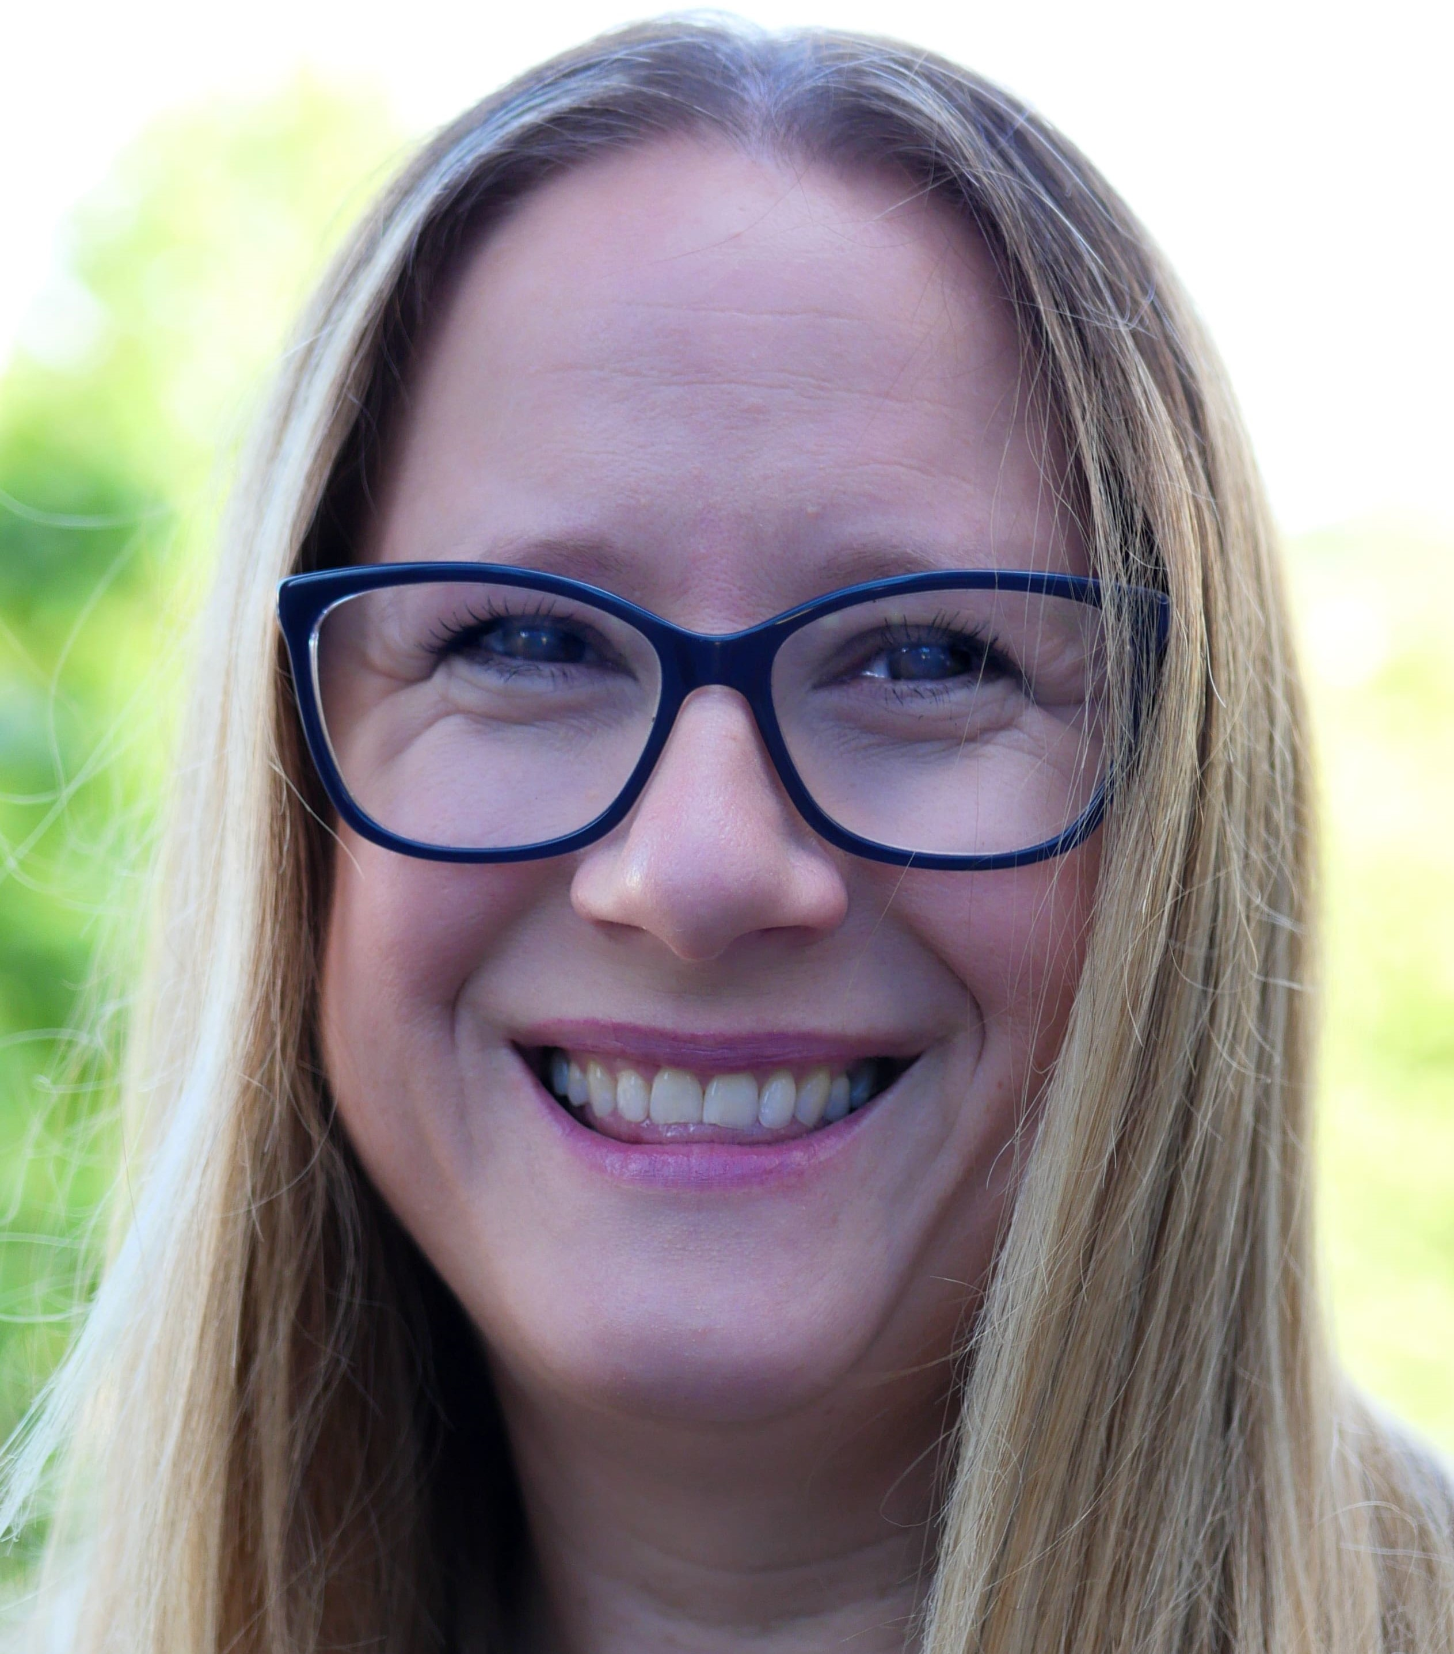
Introducing the BASE CEO – Laura Davies
Laura Davis has been working to improve the employment outcomes for individuals who are excluded from the workforce for over 20 years.
Laura took on the role of the Chief Executive Officer for The British Association for Supported Employment and Inclusive Trading CIC in 2022 and has led the organisation to become one of the leading voices in Supported Employment across the UK.
Laura works closely across policy, research and quality and has put the Supported Employment Model onto the radar of UK based employers, building positive partnerships with leaders across the UK.
Passionate in the belief that employment should be for all, Laura advocates for the Supported Employment Model and the rights of disabled, neurodivergent and disadvantaged people to access careers.
Laura is also the parent of three young disabled and neurodivergent women, a foster Mum , she’s committed to widening the participation of disadvantaged people in the workforce and raising the visibility of inclusive recruitment and the benefits it brings for individuals, community and society.
Notes:
30 Seconds

Slide 5

Introduction to BASE
Mission:
Creating an embedded culture of employment for all, by removing barriers, raising aspirations, beliefs and opportunities.
Driving quality in the sector and focussing funding on models of support that we know work
We want to create an 'Employment is for all' culture within UK Business
by removing barriers and raising aspirations for disabled, neurodivergent, and disadvantaged people
by changing beliefs within the workplace and creating inclusive recruitment opportunities.
by driving quality within the employment support sector through the use of the supported employment model and quality frameworks
Notes:
2 Minutes -

Slide 6
Introduction to BASE
Our Vision is that
Every disabled, neurodivergent, and disadvantaged person across the UK has access to the right support to access good quality careers, through a highly trained workforce.
Employers are not only signed up to Disability Confident but equipped with right support from local supported employment services to become Disability Confidence in Action.
A mixed economy of provision, with supported employment model at the heart, is available for everyone from Education to Adulthood

Slide 7
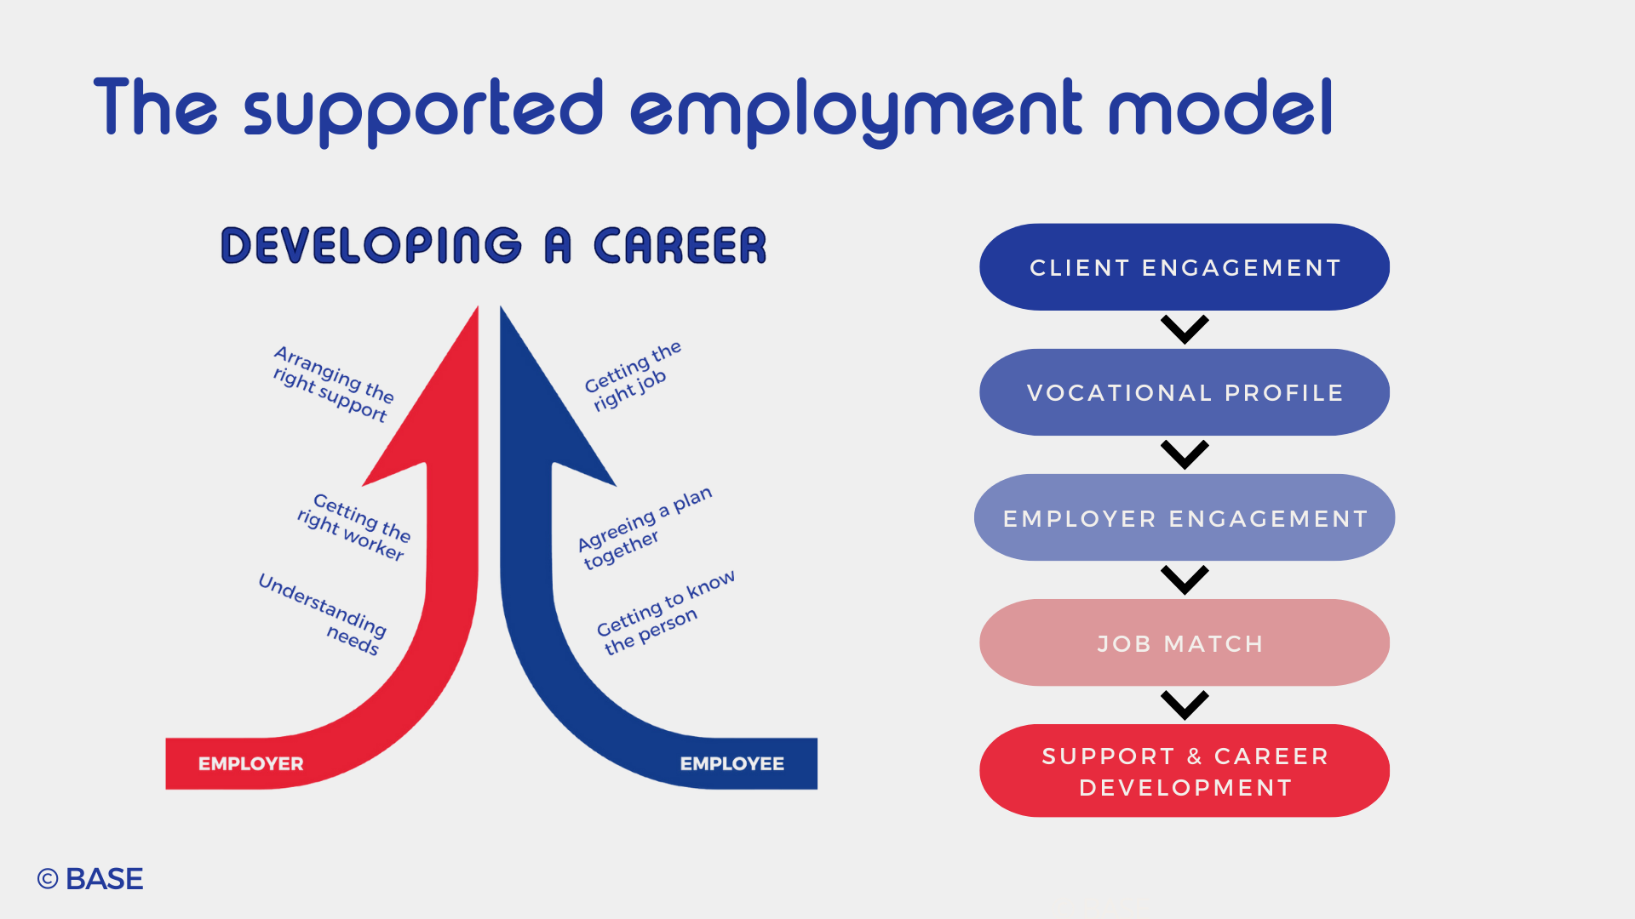


Supported Employment Model
Driving Continuous Improvement
©BASE
Notes:
4 Minutes - Supported employment is the only evidenced based model that supports people with a learning disability and autism into good quality careers, but as a model it can be applied to other individuals for whom the main stream routes to recruitment don’t work. Based on the place train and maintain model, instead of making people do endless employability courses, the model looks at supporting people to identify their strengths, match it to roles that are needed in their community and then train someone on the job. Valuing both the individual and employer as an equal partner. There are different pathways, supported internships, inclusive apprenticeships, study programs, part time and full time work, all of which have the Supported employment model at the heart of provision. High aspiration

Slide 8
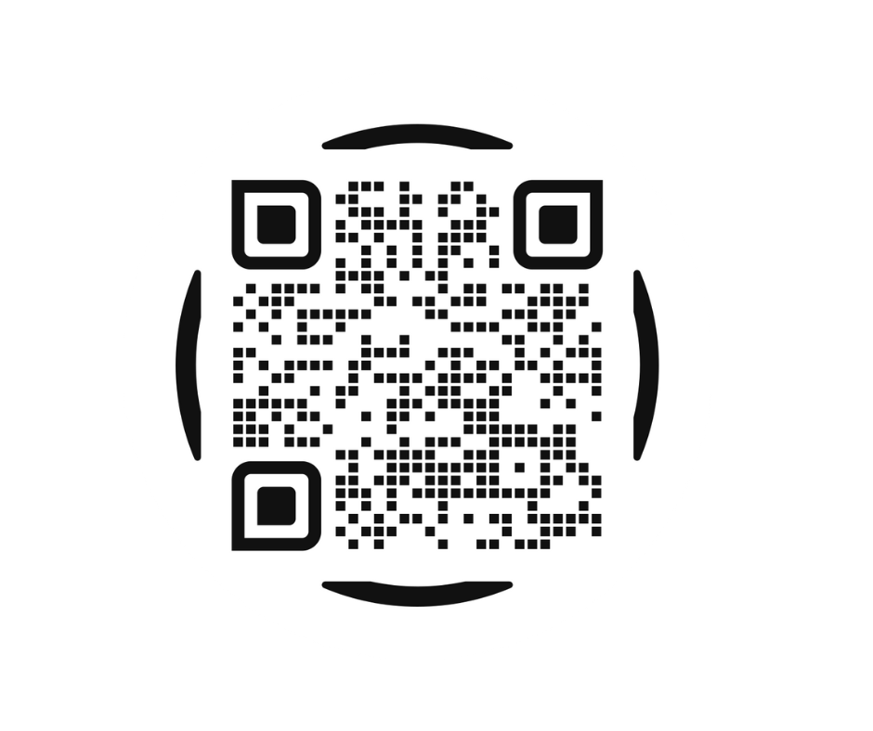
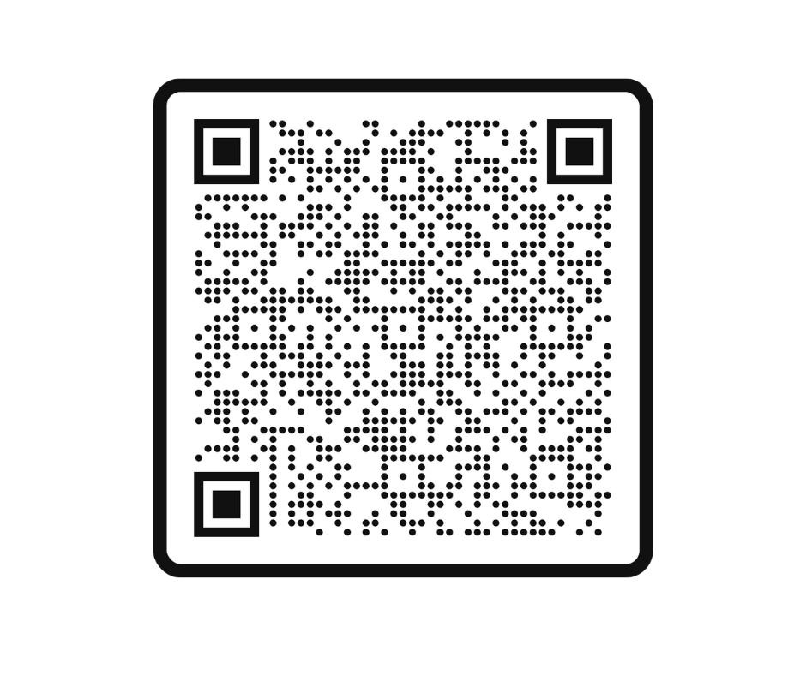
Thank You
For More Information on BASE.
To Hear More From Lee Corless

