Slide 1
European Agency for Special Needs and Inclusive Education
Margarita Bilgeri
Margarita@european-agency.org

Slide 2
Overview of Presentation
The Agency
Agency members
Agency position on inclusive education systems
Agency key principles

Slide 3




The Agency
About
An independent organisation that acts as a platform for collaboration for the ministries responsible for education in its member countries
Mission
To be an active agent of change, helping member countries improve their inclusive education policy and practice for all learners
Evidence-based information
Multi-stakeholder approach
Collective voice
Peer learning
Notes:
In case the animations are not accessible, please delete

Slide 4
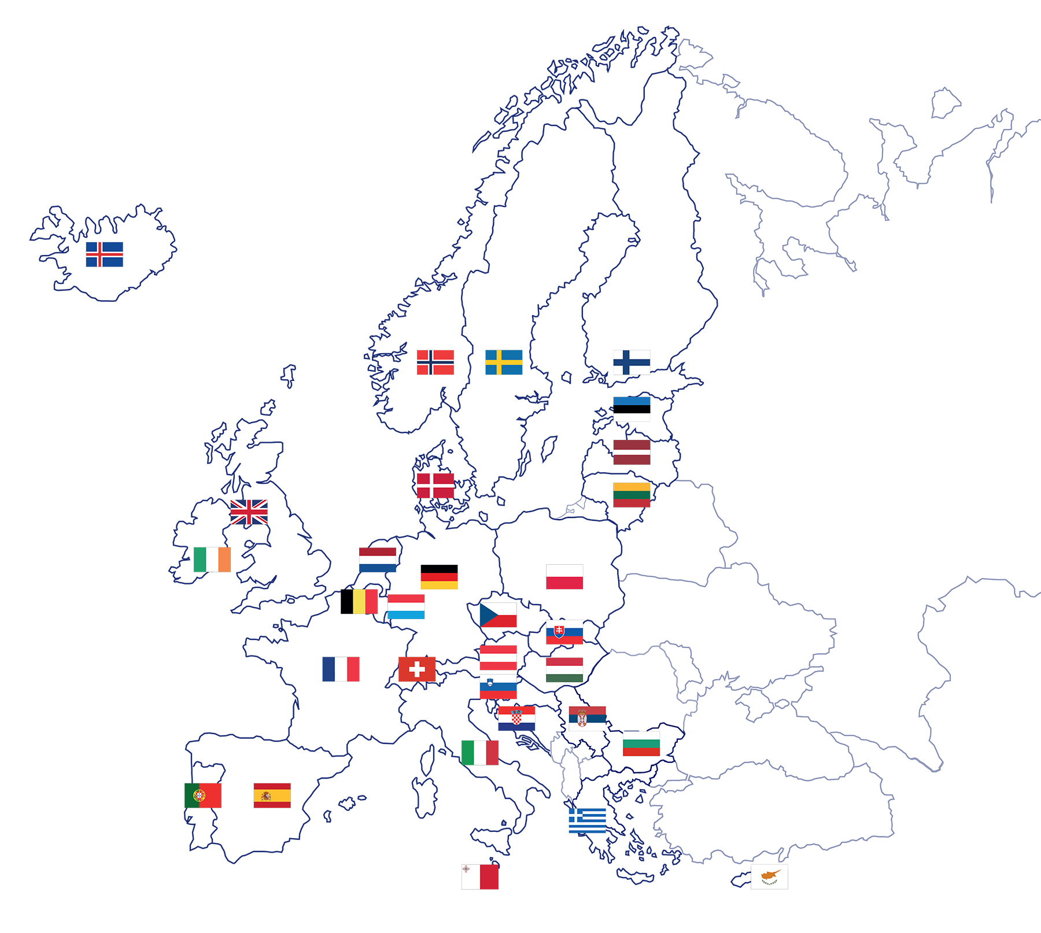
Current Agency member countries
Notes:
31 member countries (36 jurisdictions)

Slide 5
Agency position on inclusive education systems
The Agency member countries’ shared ultimate vision for inclusive education systems is that all learners of any age are provided with meaningful, high-quality educational opportunities in their local community, alongside their friends and peers.
(European Agency, 2022)
Notes:
Link to YouTube video about the Agency’s position on inclusive education systems
https://www.youtube.com/watch?v=EiUUFZog4oM

Slide 6
Agency position detailed (1)
Education needs to be a ‘shared social commitment’ strengthening capacities to care and co-operate
Greater clarity around the principles underpinning a more holistic approach to investing in quality for all learners
Widen their understanding of inclusive education to include ALL learners (UNESCO, 2020).
Inclusion in education and equity should not be seen as separate policies, but as principles that underpin and inform all national policies.
Notes:
In case the animations are not accessible, please delete

Slide 7
Agency position detailed (2)
Personalised approaches should engage all learners, support their active participation and give them a voice in the learning process.
Flexible funding and equitable resource allocation should focus on increasing the capacity of schools and communities to respond to diversity and support all learners.
Partnerships and networks with stakeholders and local communities will become increasingly important.
Post COVID-19, there may be scope to increase societal awareness of the impact of segregation, isolation and exclusion from the school system.
Notes:
In case the animations are not accessible, please delete

Slide 8

Key Principles (1)
Overarching Principle: a widely agreed concept of
rights-based inclusive education
5 requirements
funding and resource allocation;
governance;
quality assurance and accountability;
teacher professional learning;
curriculum and assessment.
(European Agency, 2021)
Notes:
In case the animations are not accessible, please delete

Slide 9
Key Principles (2)
Eight operational elements:
Enable collaboration and effective communication;
Increase participation in inclusive early childhood education;
Support all learners at times of transition;
Facilitate co-operation between schools, parents and the community;
Develop a system for data collection providing feedback;
Develop specialist provision;
Develop and support school leader(s)/teams;
Develop learning and teaching environment, focus on learner’s voice.
Notes:
In case the animations are not accessible, please delete

Slide 10
Thank you!

Slide 11
References
European Agency for Special Needs and Inclusive Education, 2022. Agency Position on Inclusive Education Systems: Background Information Paper for the Second Edition. Odense, Denmark.
European Agency for Special Needs and Inclusive Education, 2021. Key Principles – Supporting policy development and implementation for inclusive education. (V. J. Donnelly and A. Watkins, eds.). Odense, Denmark.
European Agency for Special Needs and Inclusive Education, 2015. Agency Position on Inclusive Education Systems. Odense, Denmark.

Slide 12

More information
www.european-agency.org
European Agency for Special Needs and Inclusive Education
Østre Stationsvej 33, DK-5000 Odense C, Denmark
secretariat@european-agency.org
Tel.: +45 64 41 00 20
Funded by the European Union. Views and opinions expressed are however those of the author(s) only and do not necessarily reflect those of the European Union or the European Commission. Neither the European Union nor the European Commission can be held responsible for them.

