Slide 1
WACA aims to ensure ICT-inclusion in Europe
Werner Rosenberger
Access Austria / WACA
Austria
The European Accessibility Act: How EU companies are affected
Thursday 6 March at 11:00, M3
Notes:
Please add your notes here.
Title; First name, last name of speaker(s); Name of Organization, Name of Country, Name of Session (as written in Agenda)
#ZeroCon24
Day and Time of Session

Slide 2
What is the problem?
Digital accessibility is difficult to identify – 75% of the WCAG criteria are technically based
Compliance with the WCAG criteria is rarely achievable – especially with complex websites and web shops
IT professionals use technical language – Marketing managers have little understanding of the technology
→ Make accessibility visible to the outside world
Notes:
Sample Slide: presenting three points on our project and the relationship to this year’s theme of the Zero Project Conference. Point 1; Point 2; Point 3 connect together in this way.

Slide 3
Economic studies
Supermarket “Tesco”: Investment in accessibility → ROI 37.000% (Source: Royal National Institute of the Blind)
Kantar: “75% of consumers worldwide say that inclusion and diversity influence their purchasing decisions.” (Source: Brand Inclusion Index 2024 – Kantar is the global leader in marketing data and analytics)
Notes:
Sample Slide: presenting three points on our project and the relationship to this year’s theme of the Zero Project Conference. Point 1; Point 2; Point 3 connect together in this way.

Slide 4
Goals of the WACA Certification
Certificate for German and English websites throughout Europe
Certification strictly according to WCAG 2.2-AA and based on the European Standard EN 301 549
Interdisciplinary advisory board as supervisory authority
Independent certification body: TÜV Austria
Notes:
Sample Slide: presenting three points on our project and the relationship to this year’s theme of the Zero Project Conference. Point 1; Point 2; Point 3 connect together in this way.

Slide 5
The WACA certificate is intended to
Ensure digital / ICT accessibility
Further raise awareness on the accessibility importance and on the EU-Law on the WAD and EAA.
Make a product out of the concept of accessibility, which is often difficult to grasp and convey.
Create the possibility of generating demand for accessibility and the corresponding development of skills.
Notes:
Sample Slide: presenting three points on our project and the relationship to this year’s theme of the Zero Project Conference. Point 1; Point 2; Point 3 connect together in this way.

Slide 6
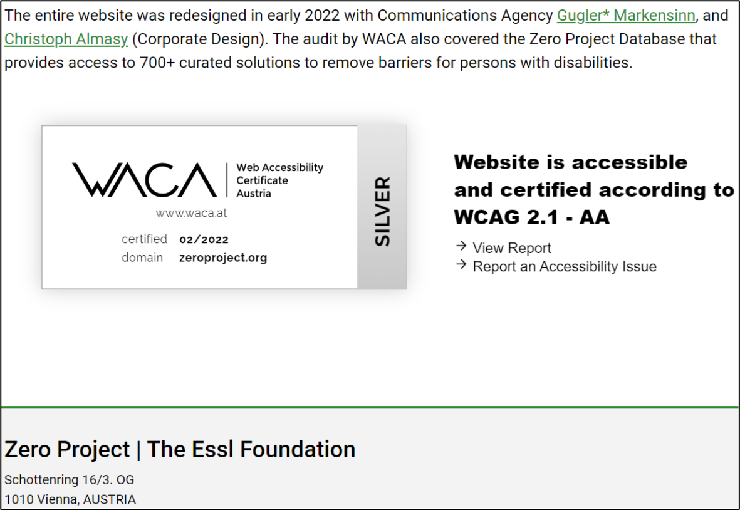
Certification
Gold, Silver, Bronze
WACA Labelling
Publication
Entry in data base
3 years valid
Costs depend on size and complexity of the website
Screenshot WACA-Label on https://zeroproject.org/
Notes:
Sample Slide: presenting three points on our project and the relationship to this year’s theme of the Zero Project Conference. Point 1; Point 2; Point 3 connect together in this way.

Slide 7
Certified websites
REWE International
XXXLutz International
ÖBB Austrian Federal Railways
Universitys in Vienna
AIT Austrian Institute of Technology
Austrian National Tourist Office
https://waca.at/en/certificates
Notes:
Sample Slide: presenting three points on our project and the relationship to this year’s theme of the Zero Project Conference. Point 1; Point 2; Point 3 connect together in this way.

Slide 8
WACA goes Europe
Only few competitors in Europe – only national providers
One certification body for all EU member states
USP: the only quality seal of conformity valid throughout Europe
WACA – an established brand in Austria since 2018
A certificate on a website reduces user complaints
More information: www.waca.at
Notes:
Sample Slide: presenting three points on our project and the relationship to this year’s theme of the Zero Project Conference. Point 1; Point 2; Point 3 connect together in this way.

