Slide 1






February 22, 2024
Bekgozhayev Dauren
Public Foundation ITeachMe competence development center
Kazakhstan
Leveraging social media, gaming, radio, and YouTube for education, networking, and employment
#ZeroCon24
Notes:
Introduction of myself, organization, country and etc.

Slide 2

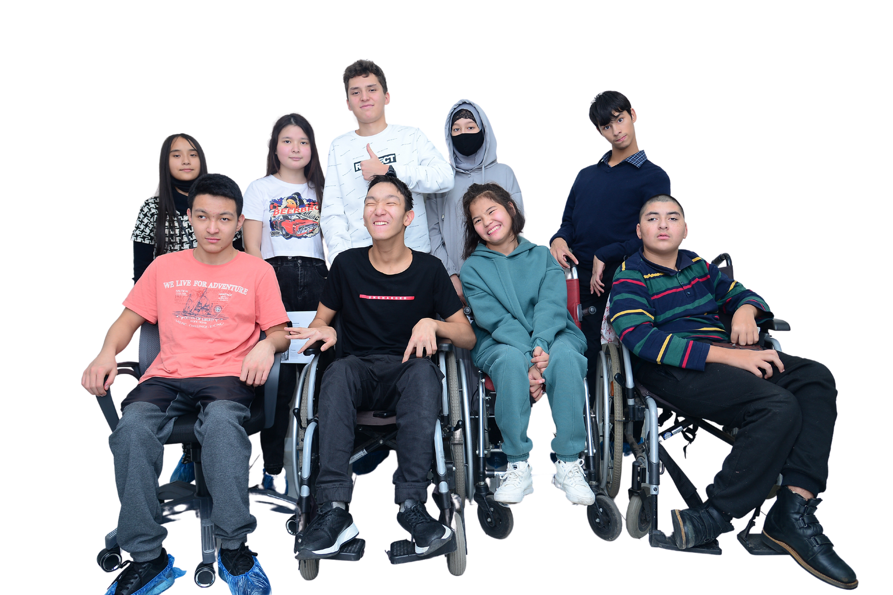
Society's problem
There are 711.8 thousand persons with disabilities in Kazakhstan
Why do we see so few persons with disabilities in society?
Notes:
Briefly explaining the upcoming problem that our project intended to solve

Slide 3


Causes of low social activity of persons with disabilities
Underdeveloped transportation and architectural infrastructure
Fear, complexes and insecurity in people with disabilities
01
03
Society's stereotype of people with disabilities
Inaccessibility of vocational education
02
04
#ZeroCon24
Notes:
Particular reasons of this problem

Slide 4
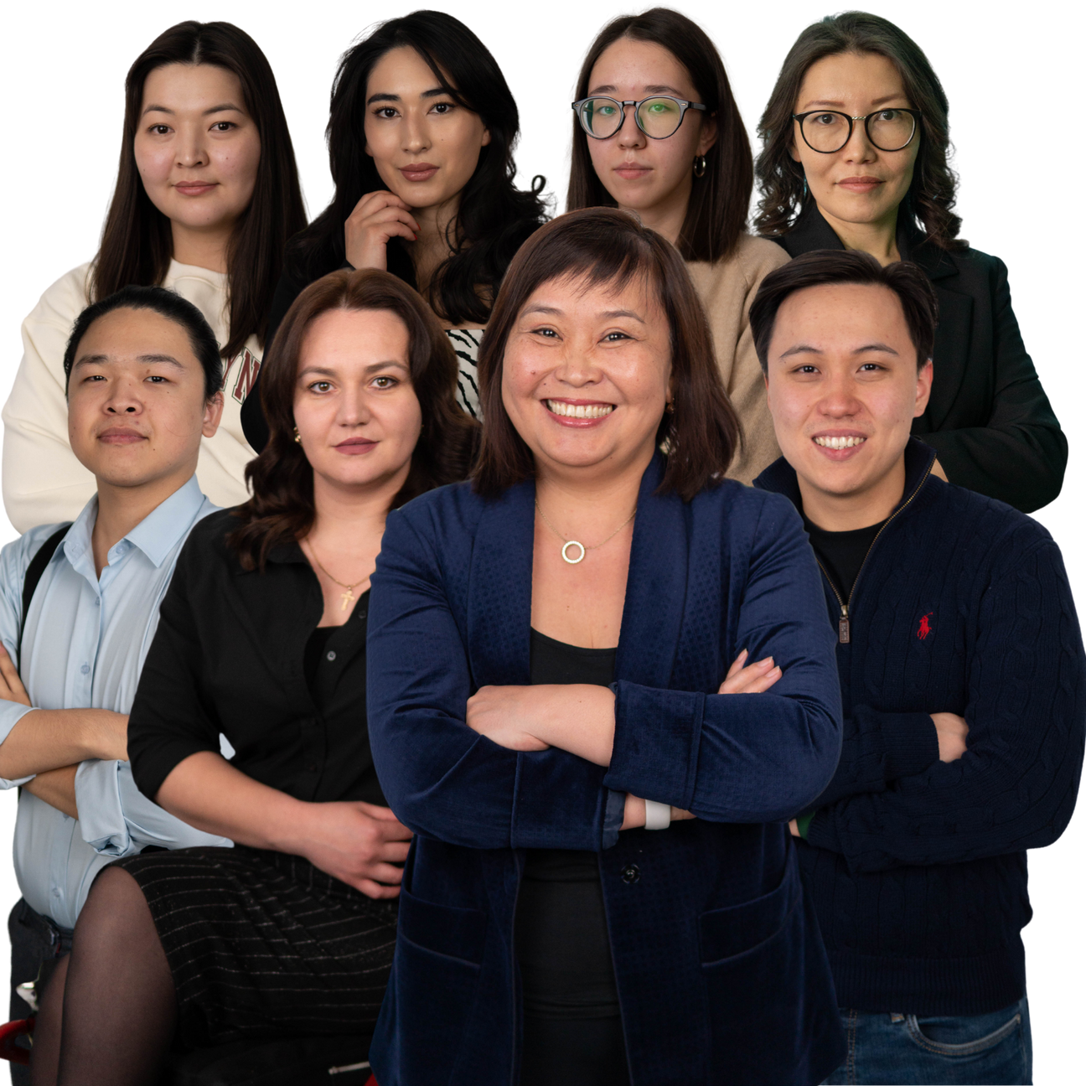

The Foundation's mission
We create equal opportunities and unlock the potential of everyone by bringing people together, teaching modern professions, inspiring them to become the best version of themselves.
Notes:
Foundation mission and why we implement such projects

Slide 5

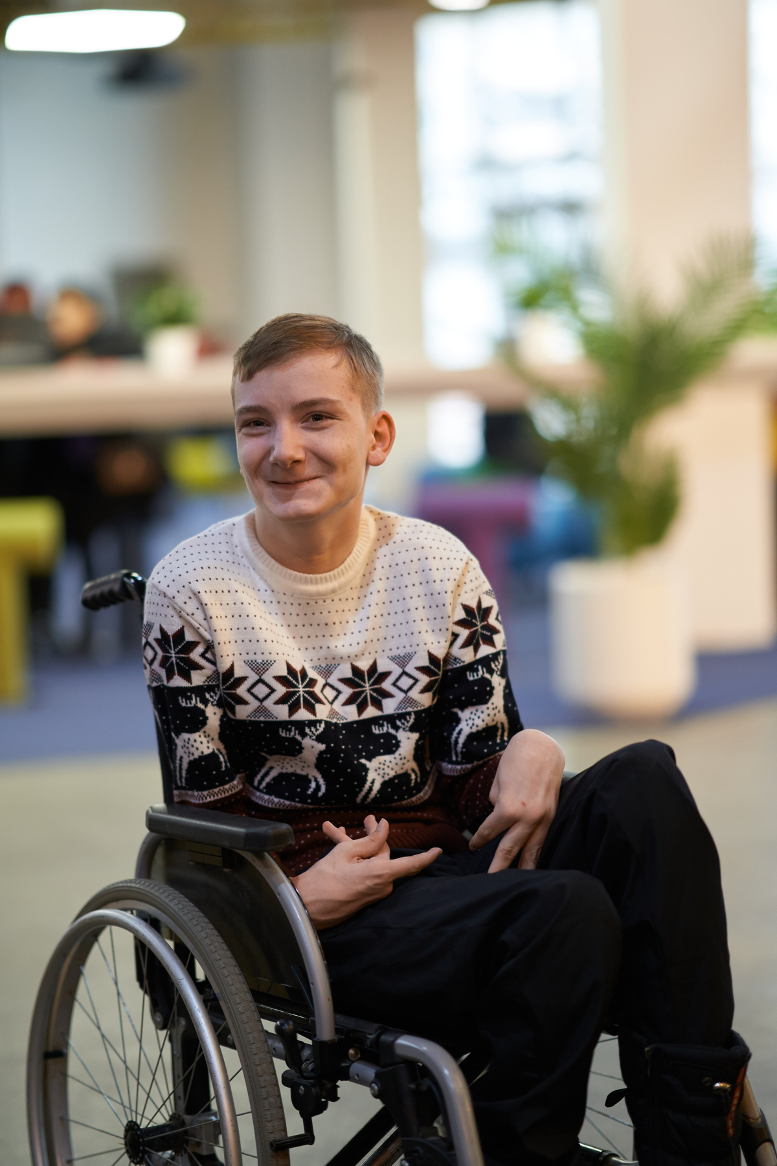
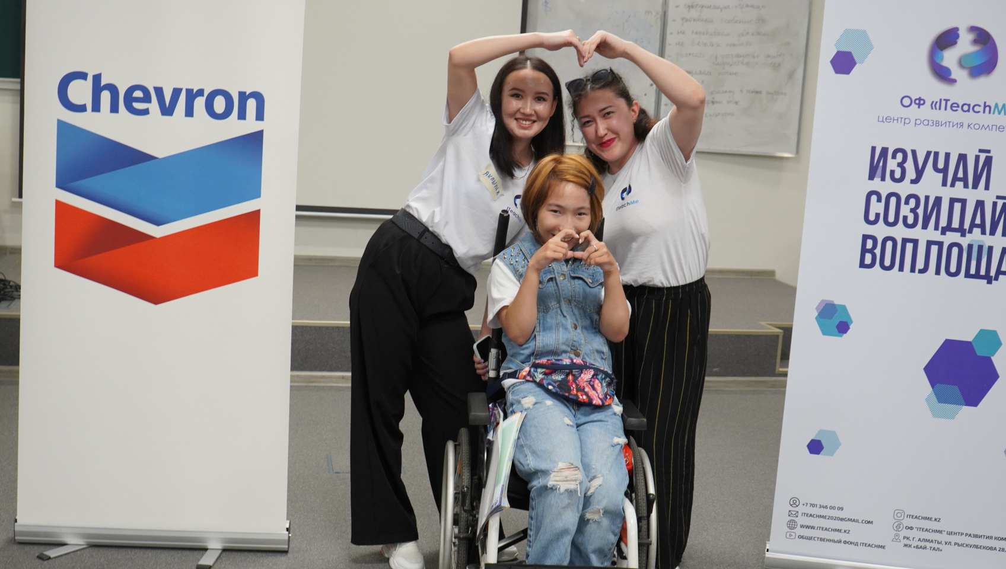


Project goal: to promote the development of an inclusive society and the inclusion of persons with disabilities in full social life
01
disability outreach
02
community outreach
03
government relations
#ZeroCon24
Notes:
Introduction to project

Slide 6
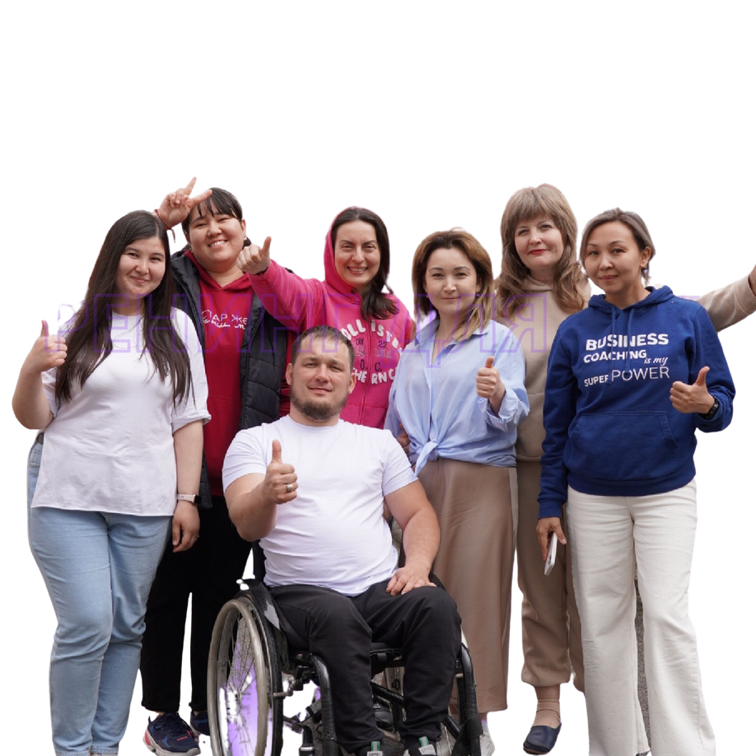


Project results
Graduates are employed
900+
Graduates
90 %
Graduates with disabilities
80 %
Notes:
Project results to showcase success of project

Slide 7
#ZeroCon24
2019
2023
  1 project
  16 graduates
  3 partners
  88 applications
  35 completed projects
  45 courses in the digital sphere
  3 languages of instruction
  900+ graduates
  90% of employed graduates
  100+ partners
  6000+ applications
Notes:
Stats of foundation

Slide 8




Implemented projects
ITEACHME
LEADER
JASSPACE
PRO BONO
QUEST ON WHEELS
CIVILTECH
FINANCIAL LITERACY
CHARITY FESTIVAL
#ZeroCon24
Notes:
Projects we implemented, will be needed to showcase the gamification

Slide 9
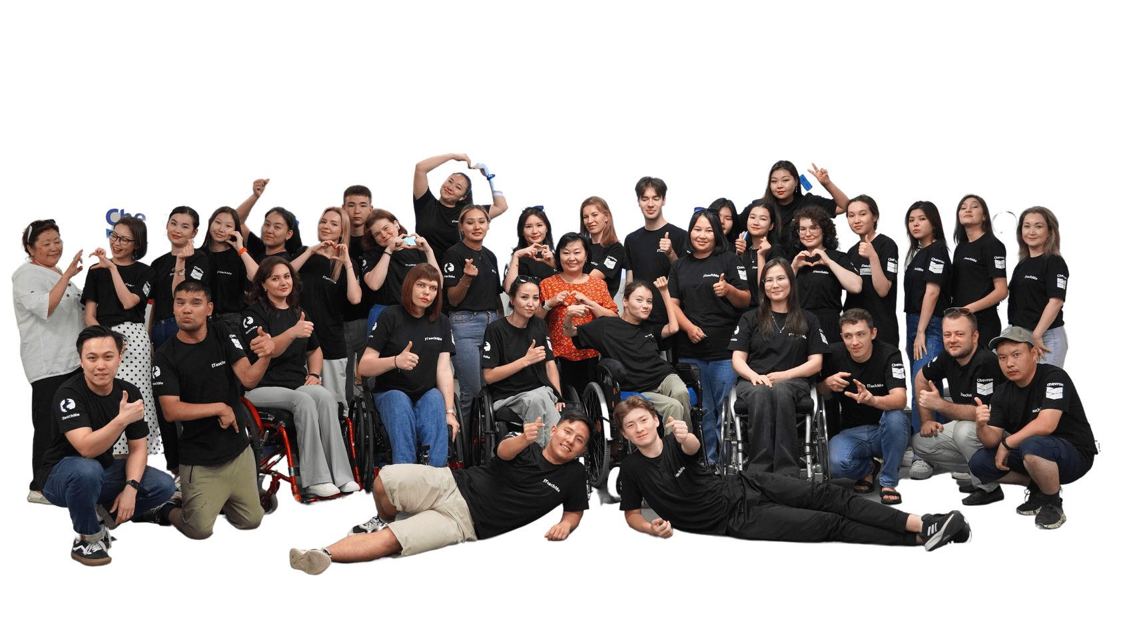
Development path and tools
01. Soft Skills
02. Hard skills
03. Employment
  overcoming fear and complexes
  new acquaintances and friends
  active social life
  self-confidence
  quality and affordable digital education under the guidance of a mentor in 5 directions
  increased financial income
  reduction of social tension
Notes:
Different stages of project

Slide 10
Introduction of Full scale Gamification
Newly added system of gamepoints
Interesting extra tasks that can be measured for gamification
01
03
Social media praise for those who were very active during different stages of learning
Extra prizes for top chart of gamification podium
02
04
#ZeroCon24
Notes:
Gamification in IT learning

Slide 11
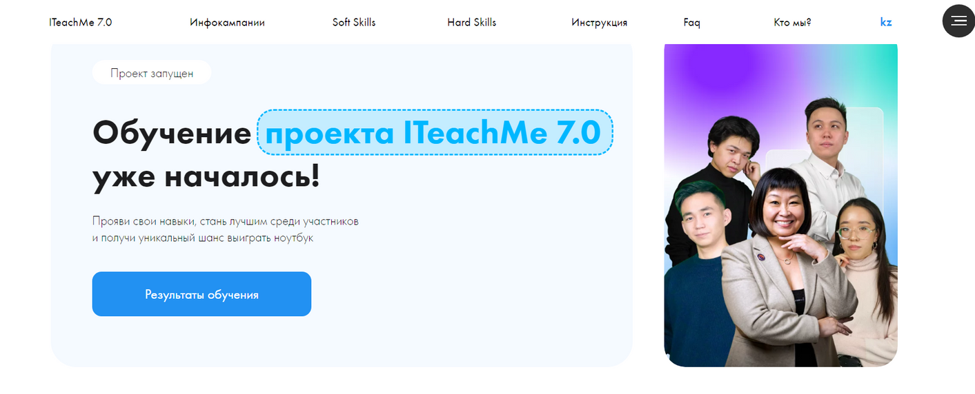
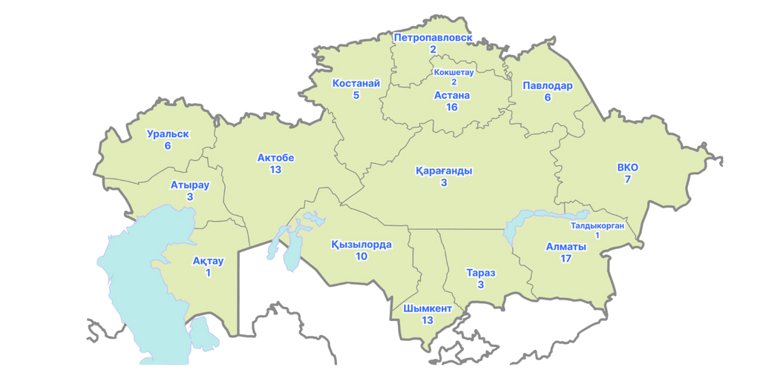
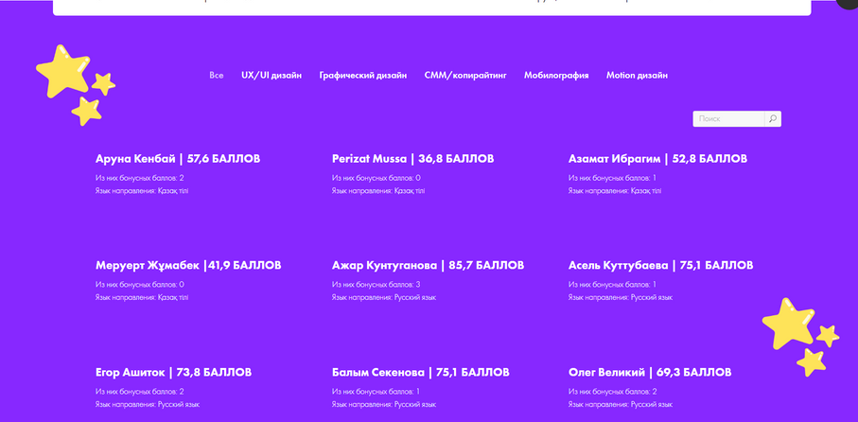
Guidebook
Notes:
Newly added feature to the project - Guidebook

Slide 12
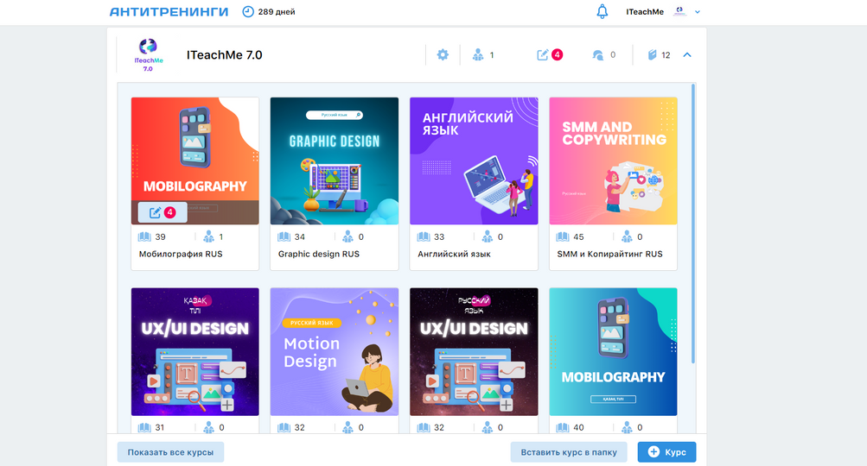
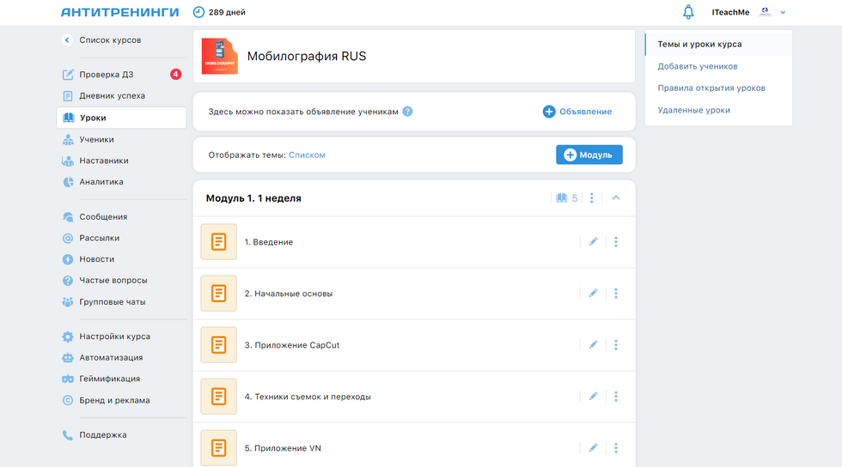
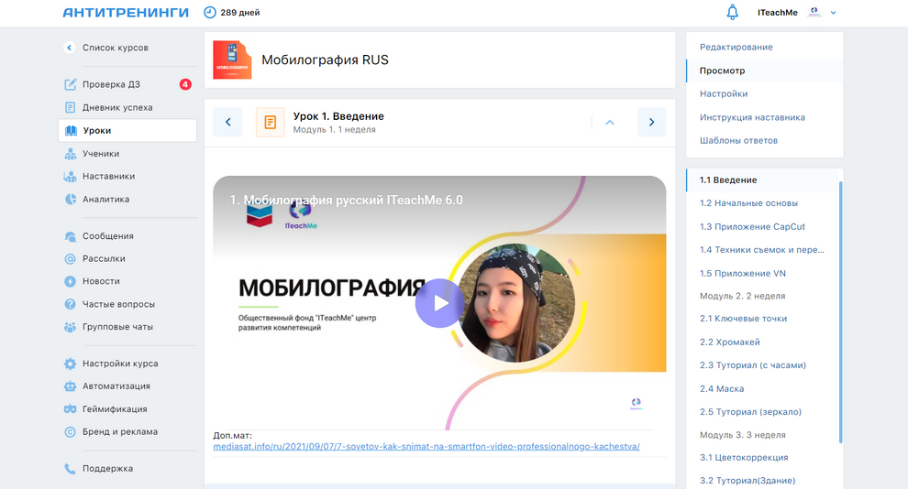

Learning platform
#ZeroCon24
Notes:
New added features inside of our learning platform

Slide 13
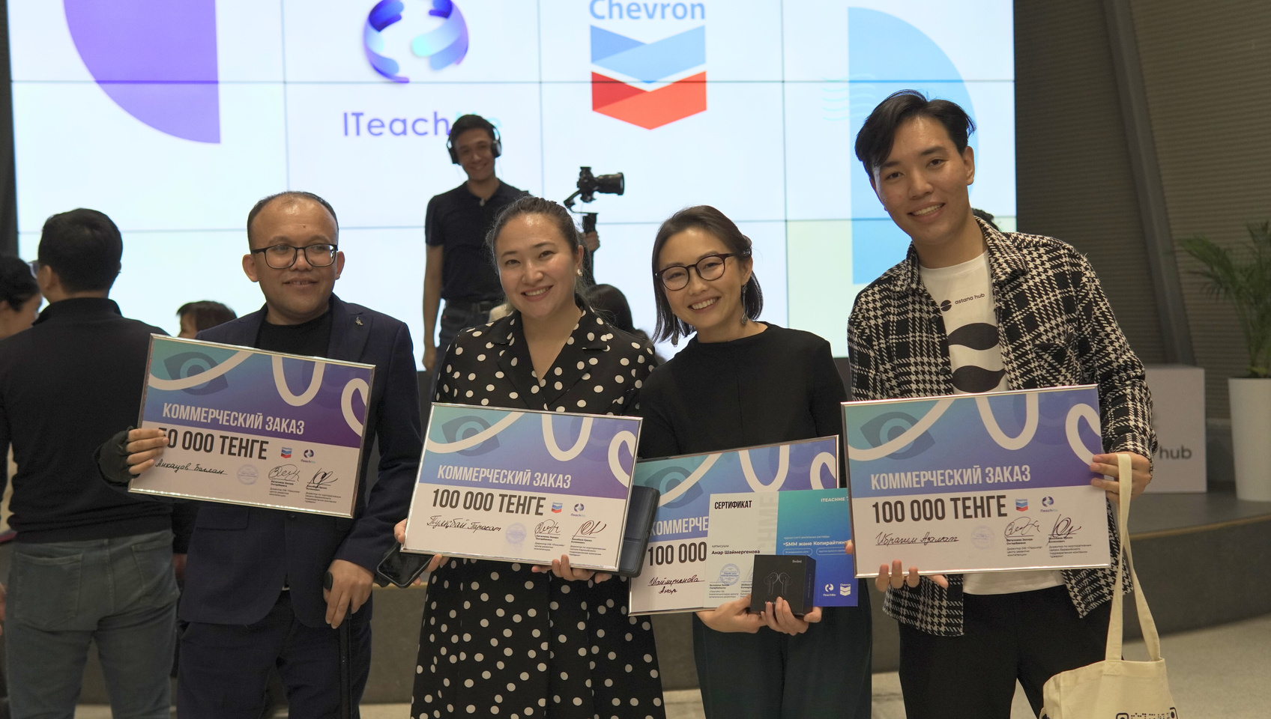
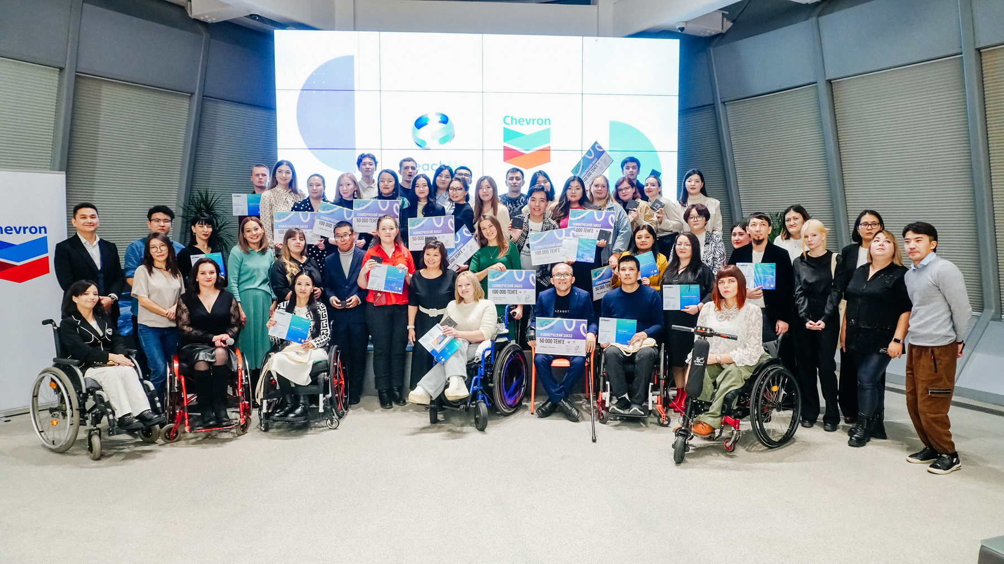
2020-2022
  ITM 4.0-6.0
  50,3% rate of successful completion
2023
  ITM 7.0 with gamification
  80% rate of successful completion
#ZeroCon24
Notes:
Showcase its success in comparison

Slide 14
Our Awards
LETTER OF THANKS FROM THE MINISTER OF LABOR AND SOCIAL PROTECTION OF THE POPULATION OF THE REPUBLIC OF KAZAKHSTAN
LETTER OF THANKS FROM THE MINISTRY OF DIGITAL DEVELOPMENT, INNOVATION AND AEROSPACE INDUSTRY OF KAZAKHSTAN
THANK YOU LETTER FROM ENBEK.KZ
AWARD OF NON-GOVERNMENTAL ORGANIZATIONS OF THE REPUBLIC OF KAZAKHSTAN
THE BEST SOCIAL PROJECT “TECHNOLOGICAL INNOVATIONS” AT THE INTERNATIONAL II SOCIAL FORUM “TIME OF OPPORTUNITIES”
GROWTH FORUM CHARITY SCORE “THE BEST SOCIAL PROJECT 2023”
#ZeroCon24
Notes:
Awards from state and various organizations as best project and solving of problems with employment

Slide 15
Plans for the future
SCALING
IMPROVING
1.We have Kazakh, Russian and sing language
1.We have social media for interaction with students
  We are looking for implementation of our project in different languages
  We can make app for our future students
2.We have working methodology
2.We have gamification in every step of our project
  We are eager to look up for foreign methodologies as exchange of experience
  We can introduce unique way of gaming with our beneficiaries
#ZeroCon24
Notes:
Plans for the future, will be discussed in two directions: 1st) making project bigger and 2nd) development of what we already have

Slide 16
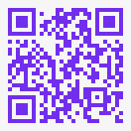


Contact Us
+7 727 970 91 52
+7 708 970 91 52
iteachme2020@gmail.com
Kazakhstan, Almaty, Ryskulbekov str., 28/5 of 94
#ZeroCon24
Notes:
End of presentation

