Slide 1
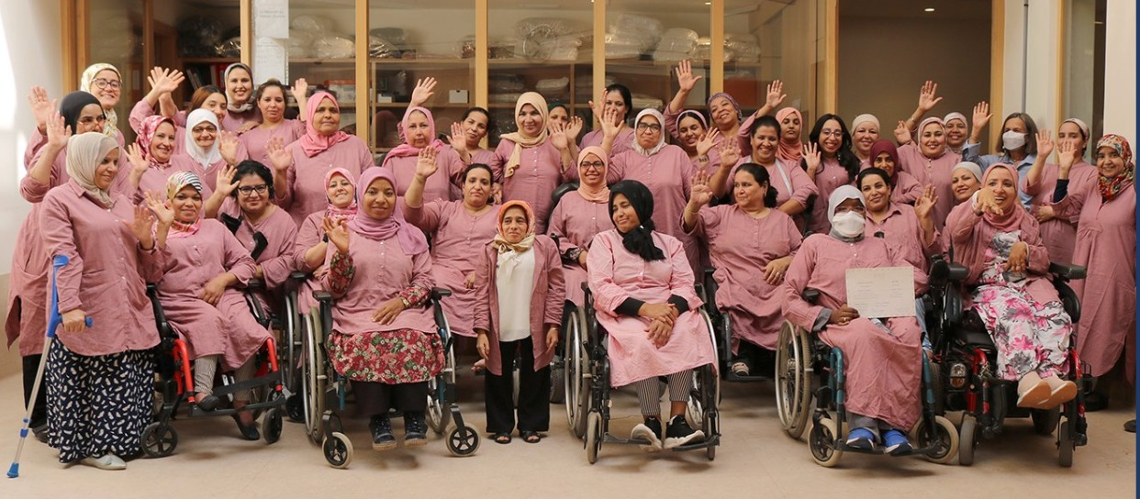
Empowering Women with Disabilities Through Social Enterprise
Jihad IBNOUELGHAZI
Al nour Association
Morocco
Women entrepreneurs with disabilities
Thursday 6 March 2025 | 14:00 - 15:00
Notes:
Imagine a world where your talents and dreams are overlooked simply because of a physical limitation. Imagine the barriers—social, economic, and emotional—that stand in the way of your independence. For many women with disabilities in Morocco, this is their daily reality. But Al Nour is changing that
#ZeroCon24

Slide 2
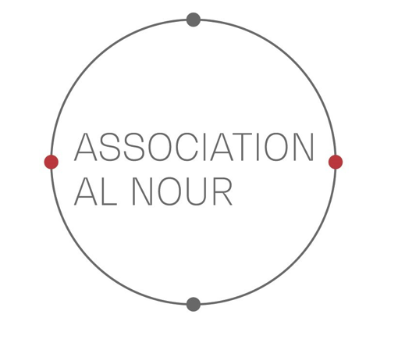
A Story of Light & Hope
About Al Nour & Our Mission
Al Nour, which translates to "light" in Arabic, was established in 2013 in Marrakech as one of Morocco's pioneering social enterprises focused on empowering women with disabilities. By providing meaningful work in the art of traditional Moroccan embroidery, Al Nour promotes economic self-sufficiency, dignity, and social inclusion for these women
Notes:
Hello everyone, I’m honored to share the story of Al Nour—an organization that is not just providing jobs, but transforming lives through dignity, inclusion, and empowerment
Sample Slide: presenting three points on our project and the relationship to this year’s theme of the Zero Project Conference. Point 1; Point 2; Point 3 connect together in this way.

Slide 3
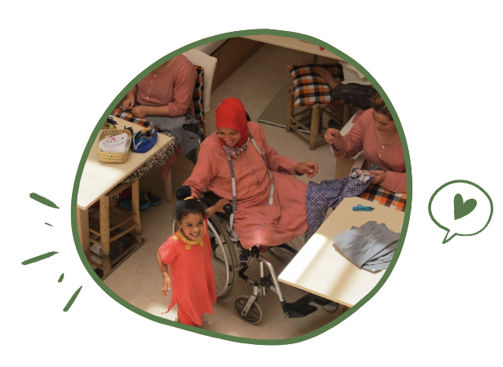
The Essence of Our Project
More than a Workplace, a Second Home
At Al Nour, work is more than a job. It’s a sense of belonging. We create accessibility, offer unwavering support, and open doors to opportunity.
Our mission is clear: We empower women with disabilities by providing inclusive training, meaningful work, and essential services, paving the way for a sustainable and independent future.
Notes:
In Morocco, most workplaces are not designed for people with disabilities. If a woman with mobility challenges manages to find work, she often faces inaccessible spaces, lack of transportation, and no support for her needs.

Slide 4
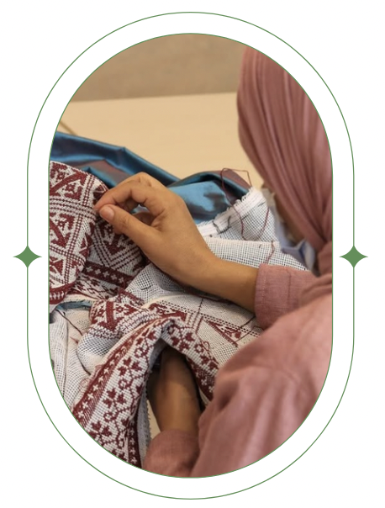
Innovation: A new Holistic Approach to Empowerment in Morocco
An Adapted Work Environment: Fully accessible, physically and emotionally supportive.
Skill Development: Training in high-quality Moroccan embroidery, a craft with global demand.
Holistic Support Services: Including healthcare, meal services, childcare, education, and transportation.
Sustainable Business Model: Revenue generated from handcrafted textiles sustains our mission.
Notes:
At Alnour ,we provide an accessible, supportive work environment with skill development in Moroccan embroidery, holistic support services, and a sustainable business model fueled by revenue from handcrafted textiles.

Slide 5
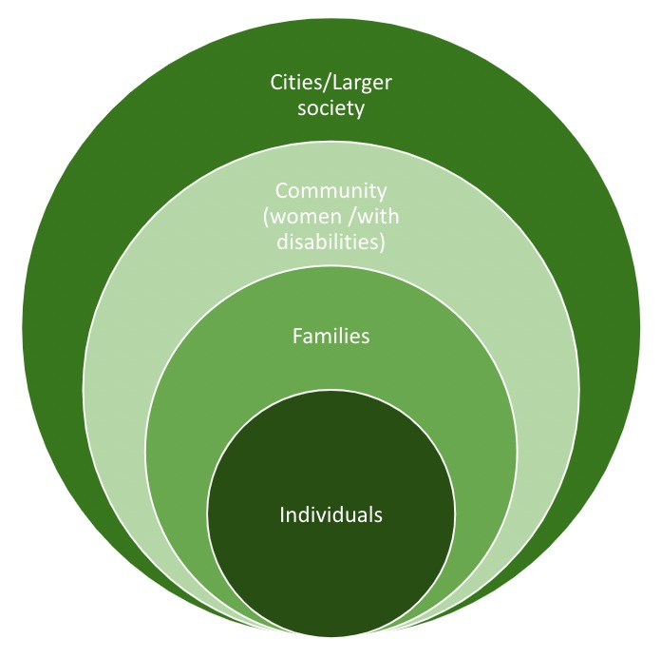
Profound Impact
Al Nour’s impact reaches far beyond the workplace:
Economic Empowerment: Women achieve financial independence, uplifting their families’ lives.
Breaking Barriers: By showcasing the capabilities of women with disabilities, Al Nour challenges stereotypes and transforms mindsets.
A Ripple of Change: Families and communities experience the profound effects of inclusion firsthand.
A Model for Growth: Our approach can be adapted to empower other marginalized groups, creating wider change.
Notes:
Al Nour empowers women with disabilities, by fostering financial independence, challenging stereotypes, and creating positive change in families and communities. Our inclusive model can be adapted to uplift other marginalized communities, sparking broader societal transformation.

Slide 6
Success Factors: Stories of Transformation -Safaa
“Am I deaf, or is the world deaf?” Safaa wonders.
Learned sign language at 5
Overcame bullying to become the first deaf female high school student in the region.
Faced barriers to higher education due to accessibility challenges.
Joined Alnour, excelling in embroidery training.
Now employed at Alnour.
Behind every embroidered piece is a story of resilience
Notes:
At just five years old, she began learning sign language at the Alkoutoubia NGO to connect with the world—a world that refuses to listen to young girls like her.

Slide 7
Stories of Transformation- Noura
Born in the High Atlas, Noura Nouam overcame her short stature and scoliosis. With determination, she pursued her studies. Noura found her calling at Alnour, where she became president and transformed the organization. She turned Alnour into a hub for vocational training and social support, empowering women with disabilities.
Jokingly, Noura says, "I might be small, but I never refrain from taking up plenty of space at the decision table!"
Notes:
Noura became the voice for the disabled community, advocating for their rights and representing Alnour at various events. Her high spirit and leadership played a key role in the association's growth.

Slide 8
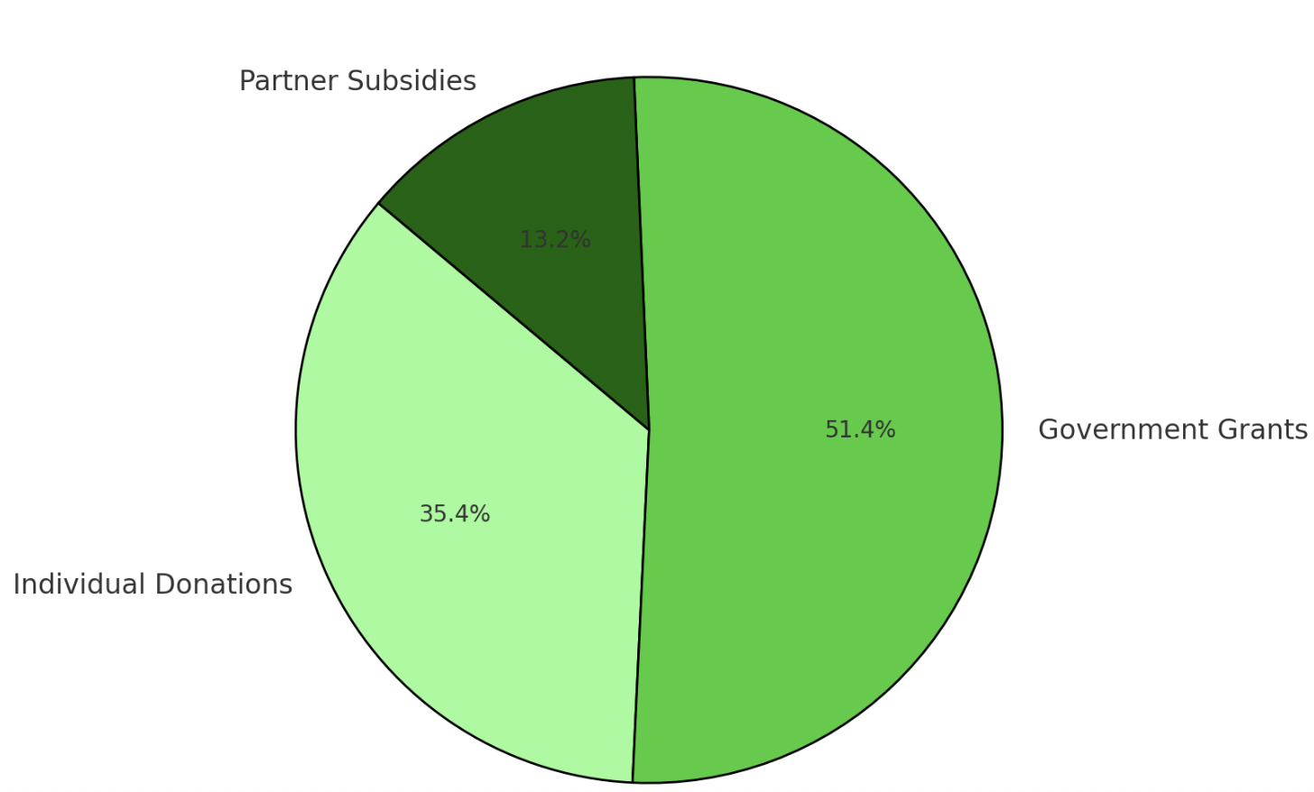
Financing & Sustainability
Al Nour runs as a social enterprise, blending purpose with sustainability:
Handcrafted Revenue: Our globally sought-after embroidery funds our initiatives, including training programs.
Strong Partnerships: We work hand-in-hand with the government, local groups, and international organizations to amplify our reach.
Sponsorships and grants: vital to scaling our training and services, enabling us to reach even more women
Government Grants: €46,739
Individual Donations: €32,136
Partner Subsidies: €12,000
Notes:
Al Nour operates as a social enterprise, combining purpose with sustainability. Revenue from handcrafted embroidery supports training programs, while partnerships with governments, local groups, and international organizations enhance impact. Sponsorships and grants are crucial for expanding services to more women.

Slide 9
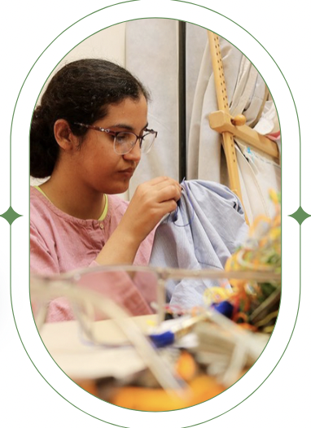
Vision Forward
Expanding Skills and Opportunities: We are launching our sewing training program soon to enhance employability and create more job opportunities for our beneficiaries – Almasar.
Daycare Center: for retired women with special needs.
Scaling Up: Replicating our model in other regions of Morocco and beyond.
Notes:
While Al Nour has achieved meaningful progress, there is still much work ahead to fully realize our vision.

Slide 10
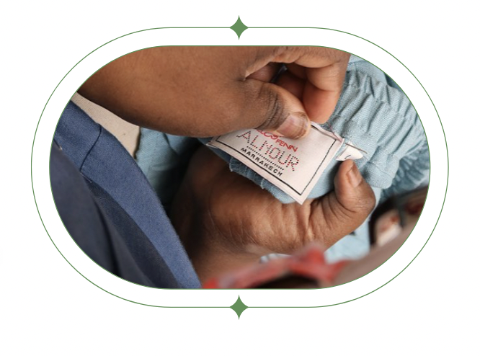
A Call to Action: Supporting Inclusive Employment
Al Nour stands as a shining example of what opportunity can achieve. When inclusivity is woven into the fabric of workplaces, entire communities thrive. Join us in amplifying our impact through collaboration, advocacy, and by supporting our beautifully handcrafted textiles. Together, we can light the way for a more inclusive future.
Notes:
Al Nour empowers women with disabilities by creating inclusive workplaces that uplift entire communities. Support our impact through collaboration, advocacy to build a more inclusive future.

