Slide 1
Medical Device Integration:
Foundation of AI and Precision Medicine
Ariana Cordos
Romanian Society of Medical Informatics
Notes:
https://www.ibm.com/think/topics/data-sharing
https://www.lotame.com/resources/data-collaboration-platforms-a-game-changer-in-digital-marketing/

Slide 2

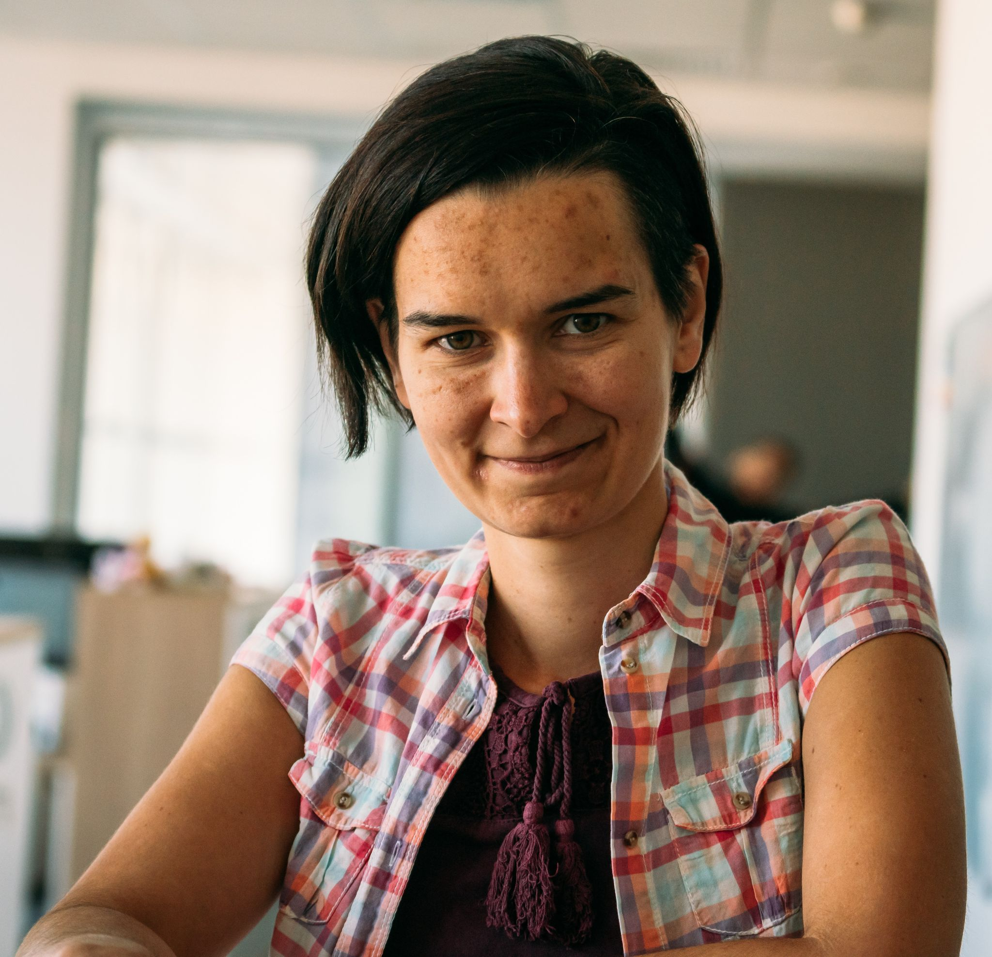


About Ariana Cordos
Bs. Midwifery + Ms. Biostatistics & BioInformatics + PhD. Medical Informatics
VP of Romanian Society of Medical Informatics
Project manager at Freshblood HealthTech
Associated Lecturer Babeș-Bolyai University, Faculty of Political, Administrative and Communication Sciences, Department of Public Health, Digital Health & Innovation
Healthcare Business
Big Pharma Consultancy
Med-Tech Strategy
Dog Owner
Traveling, Sports & Pandemic Gardener
20+ years of volunteering
15+ years of healthcare
10+ years of business strategy
5+ years of digital healthcare

Slide 3
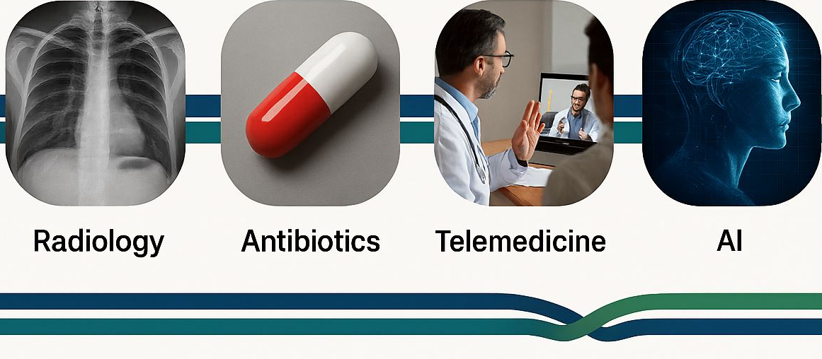
Timeline
1895–1980s
1928–1940s
1990s–2010s
2020s–Present
The Critical Difference: Unlike past innovations, AI's success depends entirely on data quality, accessibility, and continuous flow—making infrastructure the real bottleneck.

Slide 4
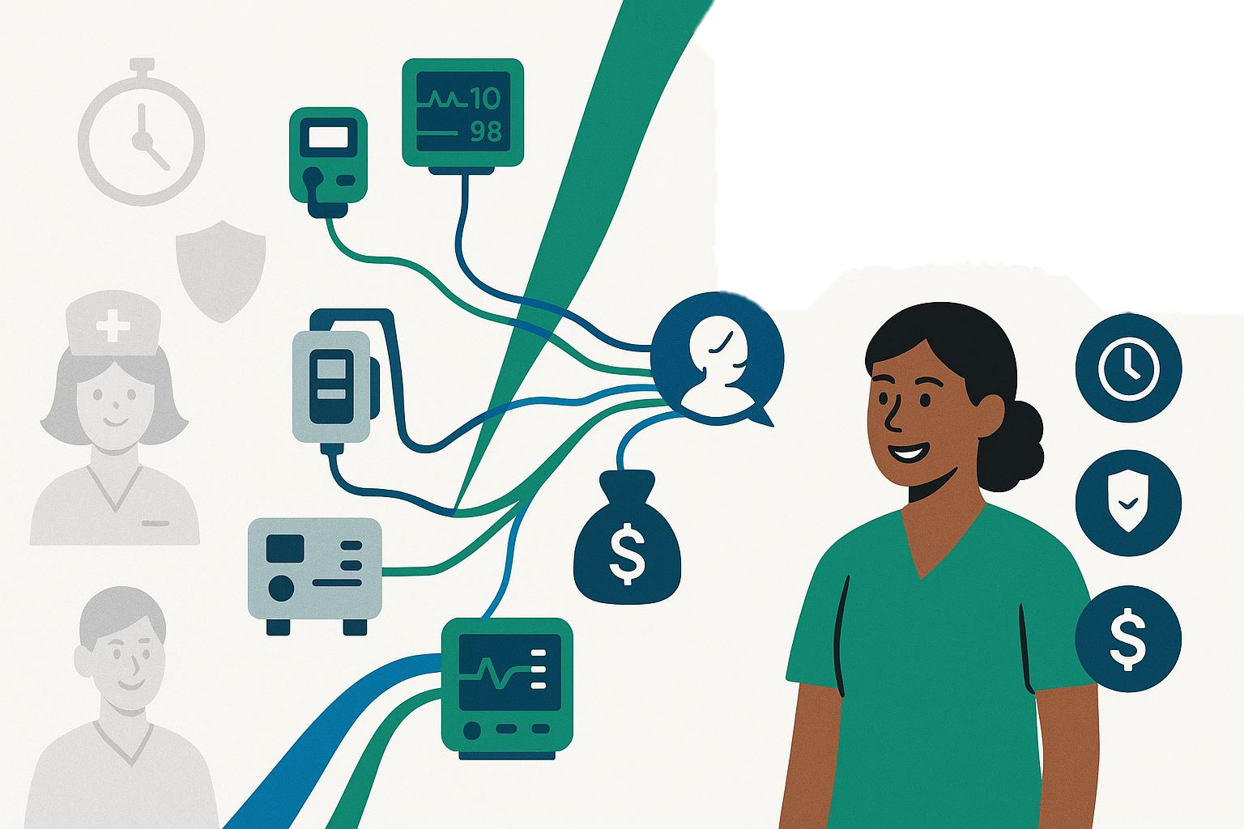
No AI without Data
No Data Without Medical Device Integration

Slide 5
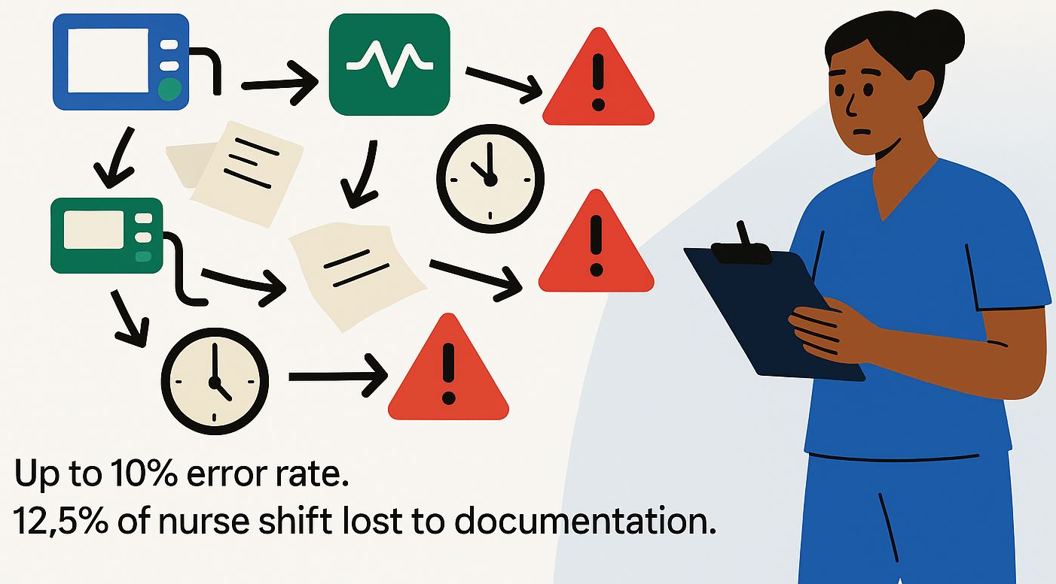
Problem

Slide 6
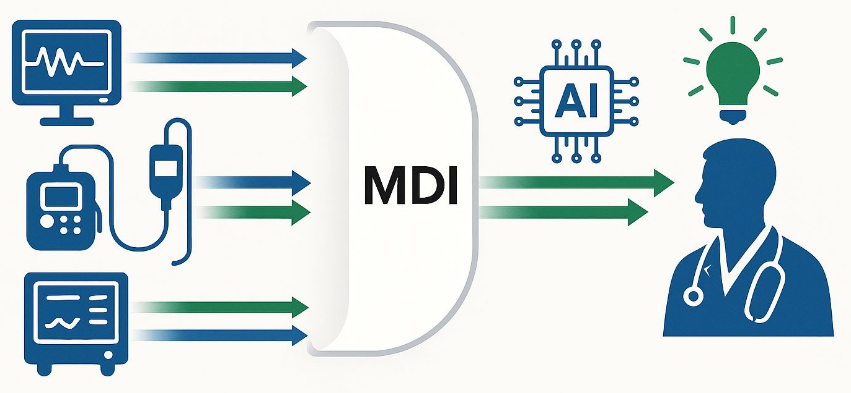
What is Medical Device Integration?
The seamless bridge from device to actionable insights

Slide 7
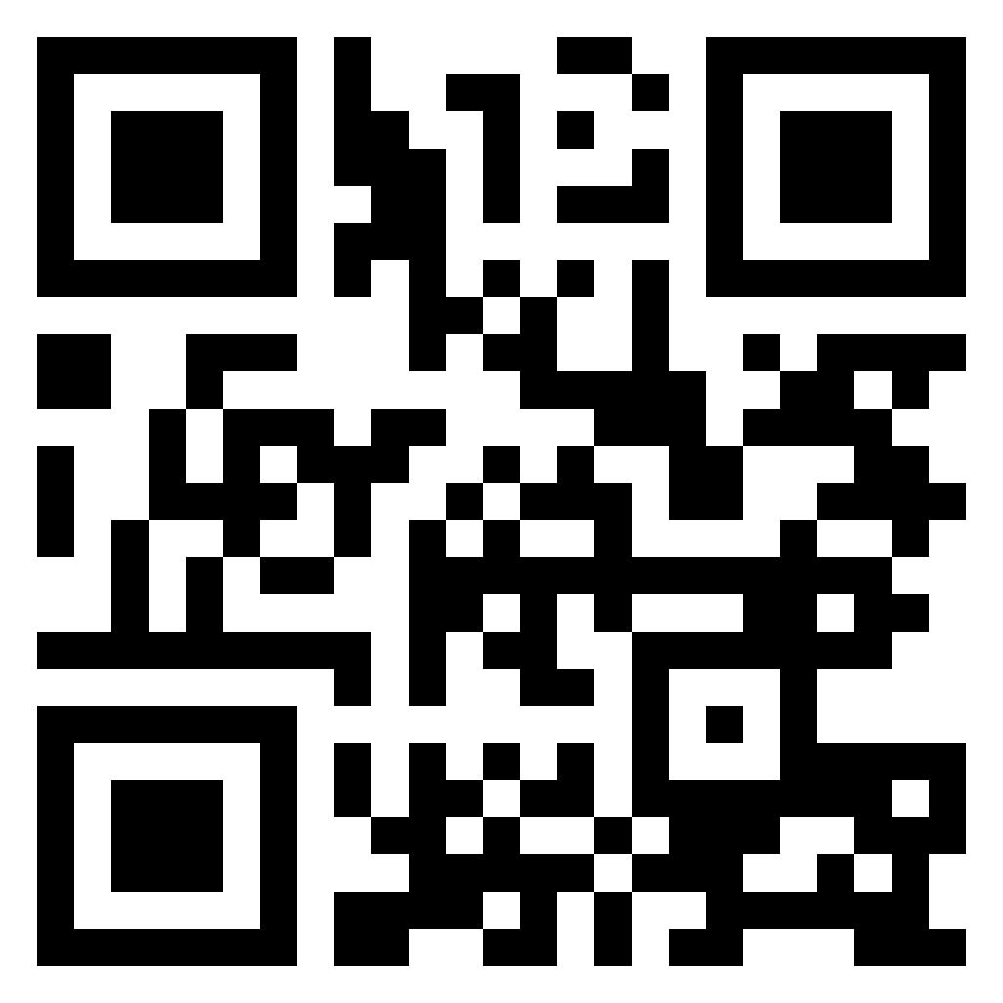
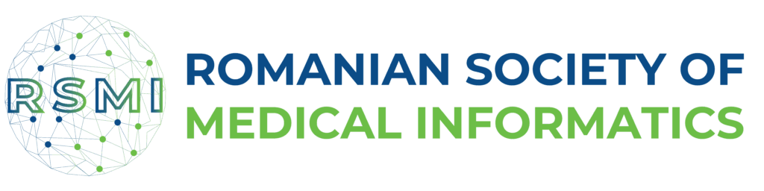
The future of science, healthcare, and society will not be shaped by the volume of data we gather, but by its quality, accessibility, and the wisdom, integrity, and collaboration with which we share and use it!

