Slide 1
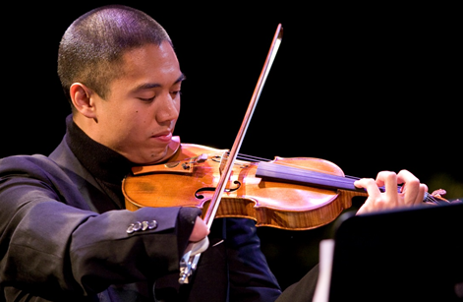

Competitive Integrated Employment in Creative Careers
Adrian Anatawan, Access/VSA International Young Musician Alumni, professional musician and educator

Slide 2
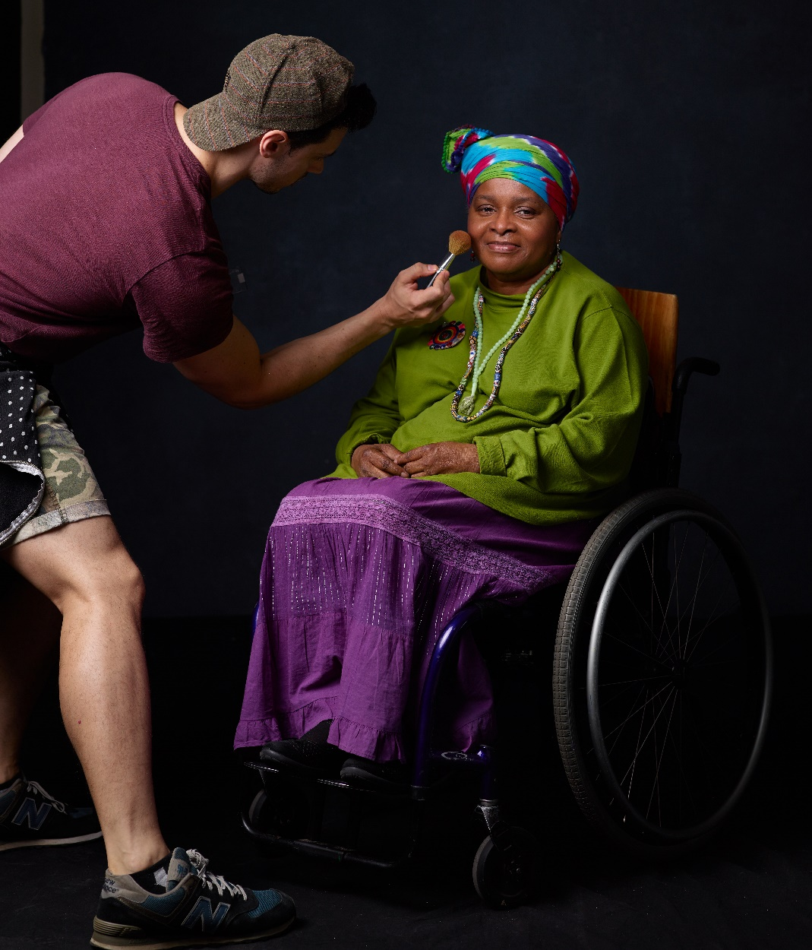
The Office of Accessibility and VSA
Our Mission:
Create a world where people with disabilities of all ages learn through, participate in, and engage with arts and culture.

Slide 3
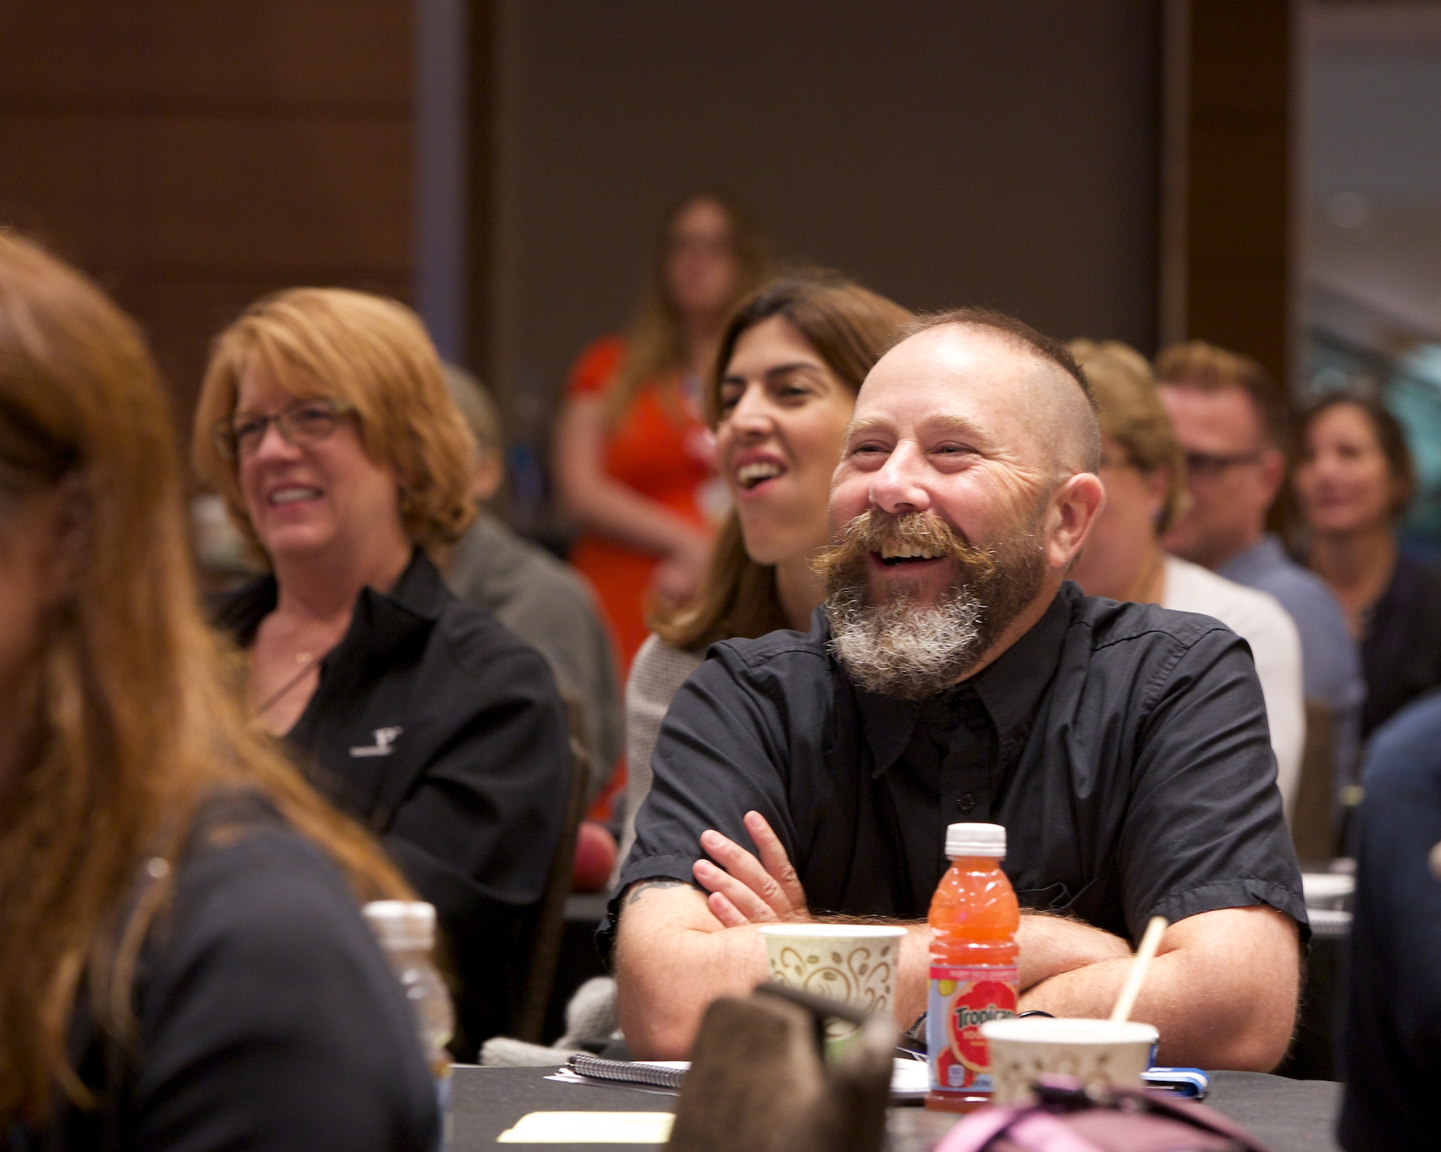
Convene …
dynamic organizations to explore promising accessibility practices in performances, exhibits, events, spaces and venues for guests and audiences, artists and staff with disabilities of all ages across all communities.
Charles Baldwin, Mass Cultural Council, Up Program

Slide 4
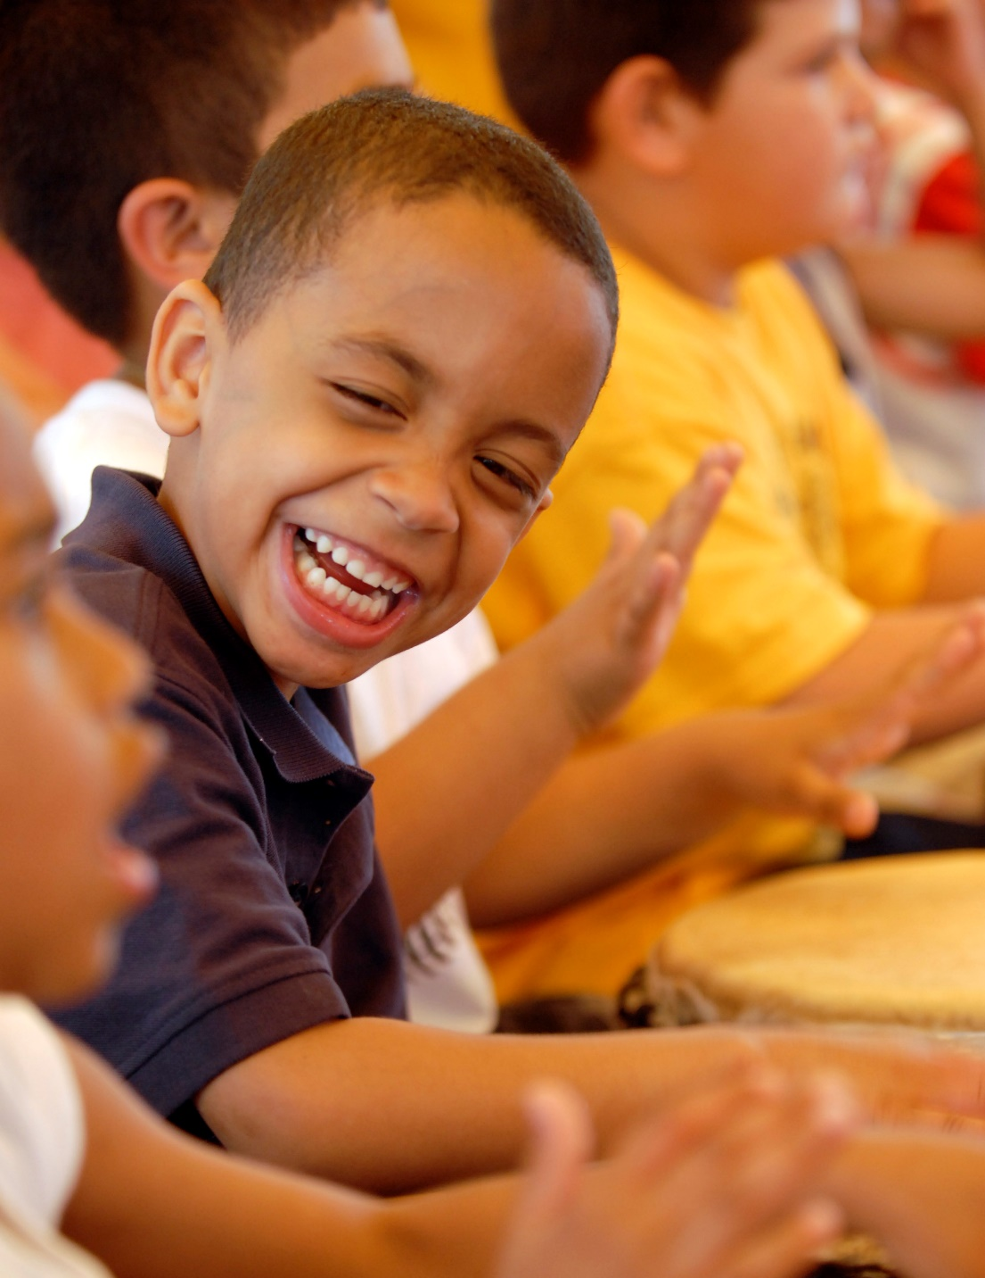
Catalyze …
powerful impactful accessible community-classroom based arts learning and cultural experiences for and with people with disabilities of all ages across all communities.
Students participating in a local program site workshop

Slide 5
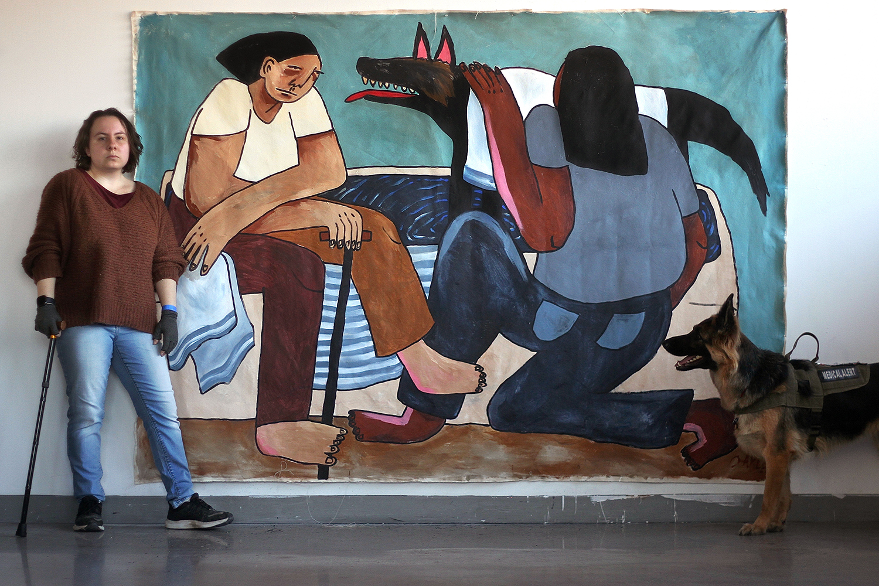
Create … opportunities for competitive integrated arts-based creative careers and employment for youth and young adults with disabilities from all communities.
Oaklee Thiele, VSA Emerging Young Artist Alumni, Artist and advocate

Slide 6
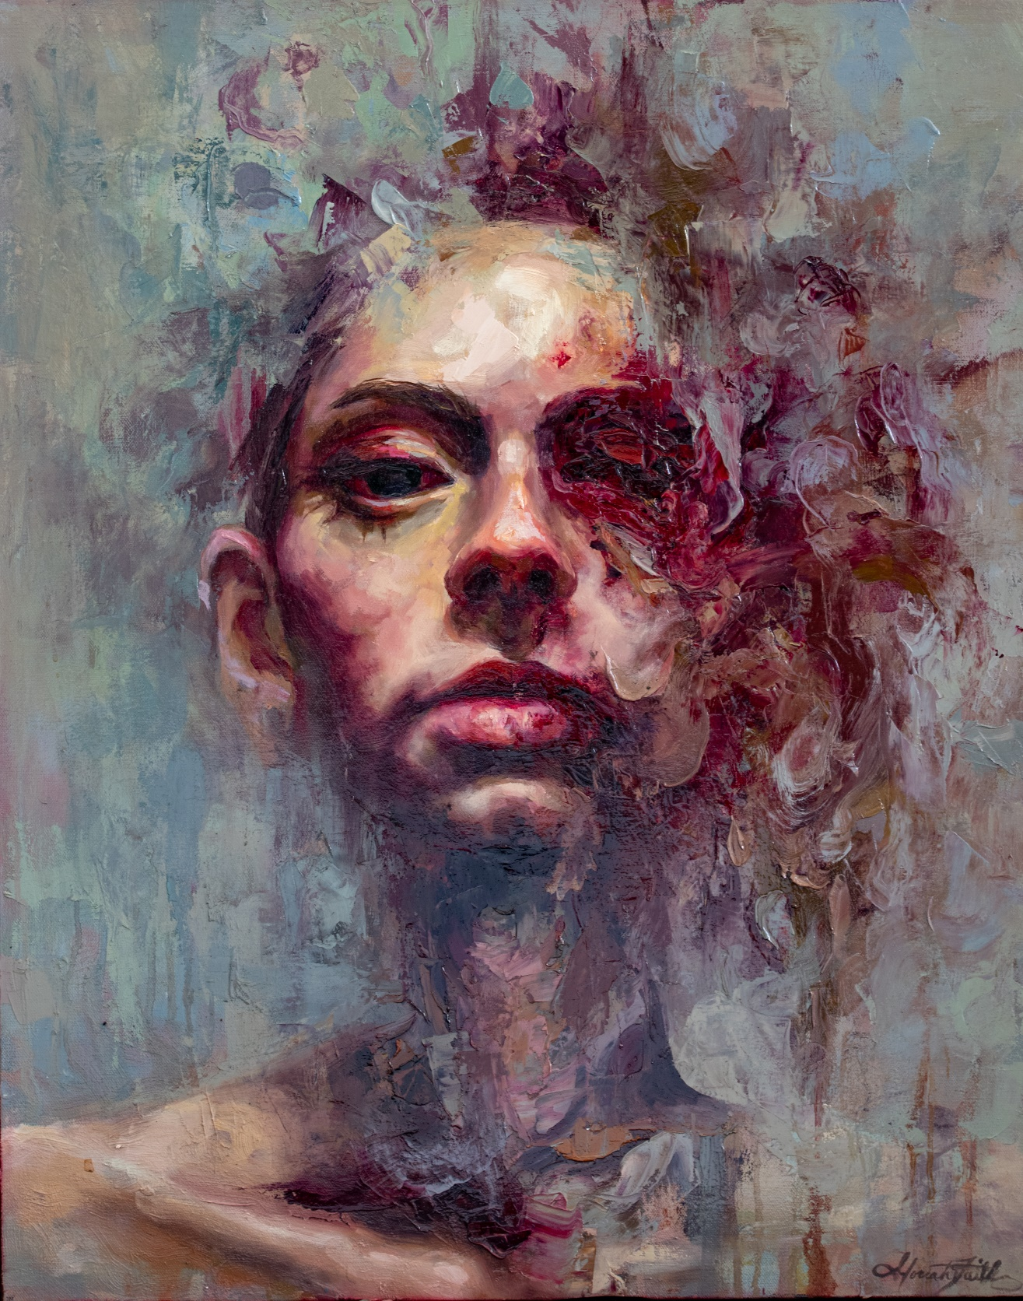
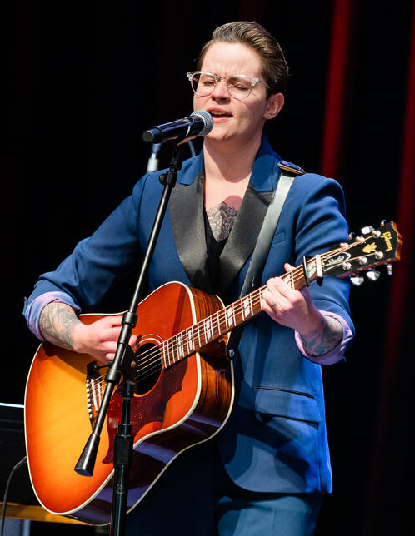
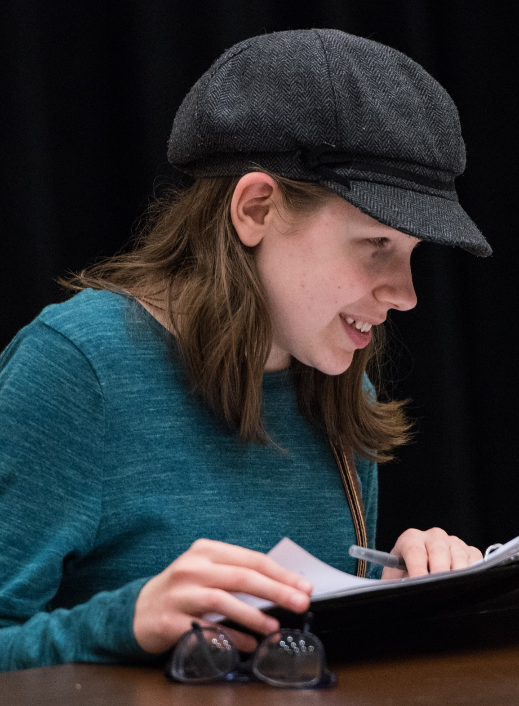
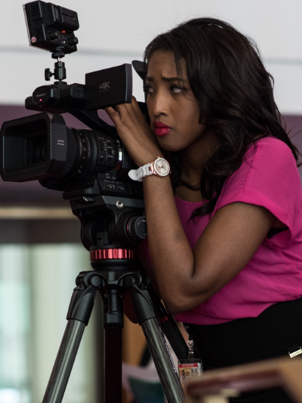
Creative Career Development Models
Intensives
  Emerging Young Artists
  International Young Musicians
  Playwright Discovery
Internships
  Rosemary Kennedy Initiative
  Experiential Education Initiatives

Slide 7
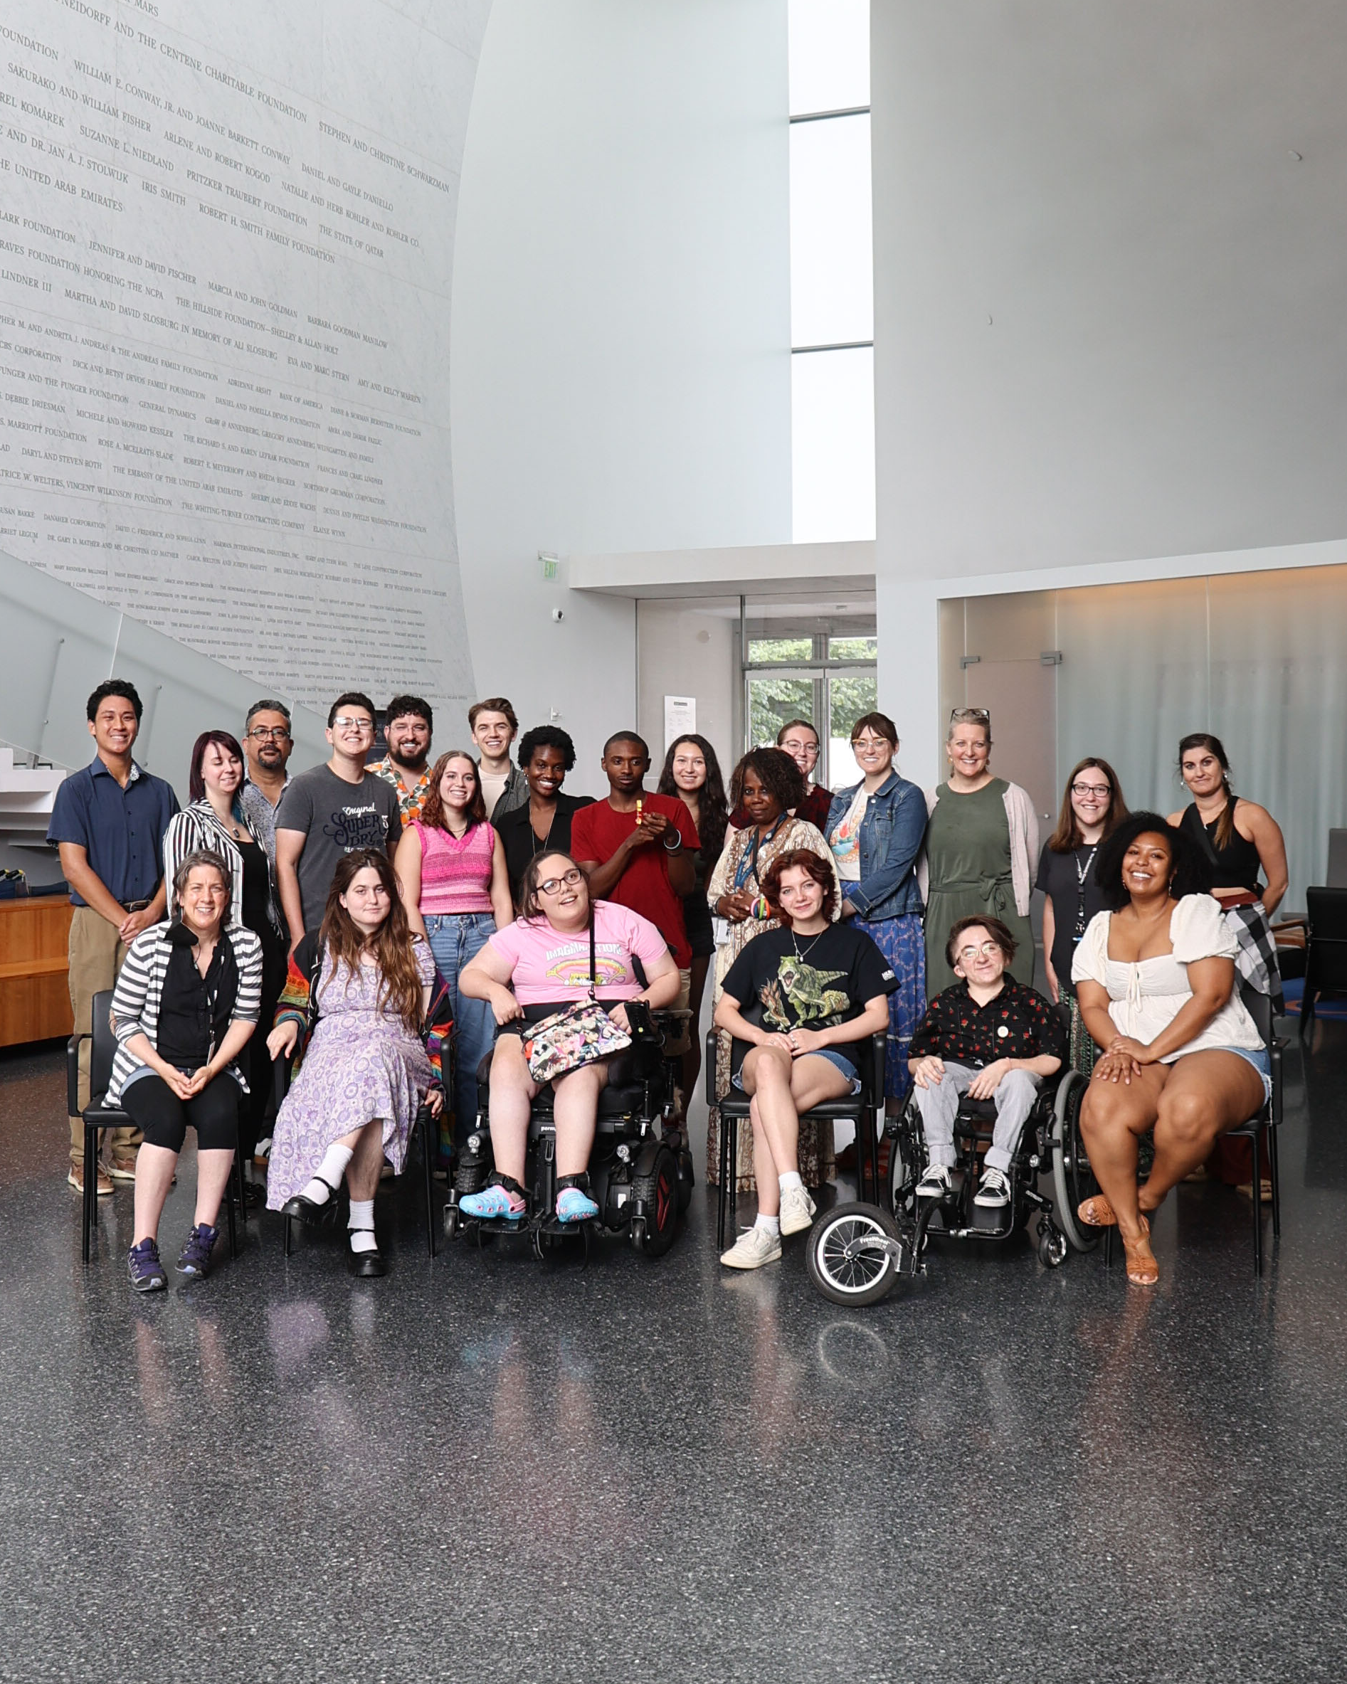
Success Factors…
Focused – participants demonstrate interest in the arts
Collaborative – built on relationships with education, vocational rehabilitation, social services, disability and arts organizations
Connections - peer-to-peer, mentors, working professionals
Playwright Discovery, 2024 cohort of participants, mentors and presenters

Slide 8
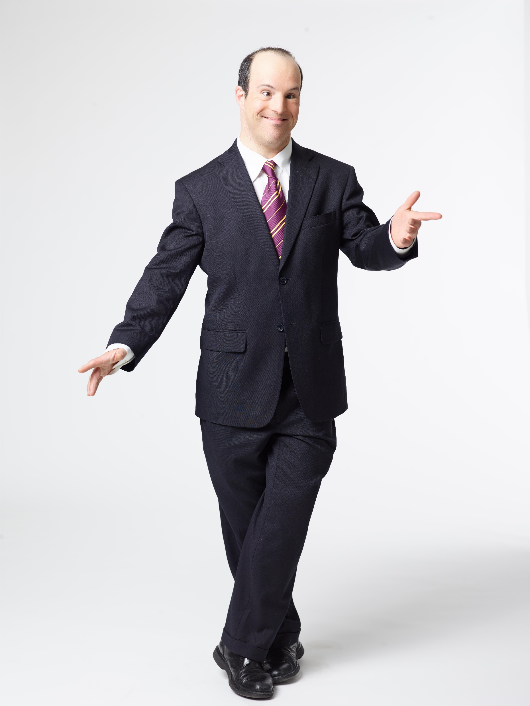
JP Illarramendi – Bag boy to usher
JP , Experiential Education Intern Alumni
Notes:
Joey Caverly – RKI placement (2006): The Theater Lab, Washington, D.C., is D.C.’s most comprehensive theatre education center for adults, teens, and kids. Joey’s internship was in production , technical theater and stagecraft where he built sets and did lighting design for the Theater Lab’s productions. Following his internship Joey returned to Gallaudet University where he got more involved in the Theater Department and ultimately switched his interest from Production to Acting. He started to shift his career, more into theater and television work, he tried his hand at playwriting, and kept in touch with the Kennedy Center. Today, you can see Joey in the Netflix special “Only Murders in the Building”.
Shannon Devido – RKI placement (2010): Amaryllis Theater Company, Philadelphia, PA is an inclusive professional theatre company whose mission is to produce new forms of theatre. Shannon’s internship was in arts administration where she was able to work on marketing, fund development, program design and execution, outreach services. After completing her internship she continued to seek out work in theater, begin acting. She returned to the KC to perform, notably appearing on the same stage as comedian Josh Blue. Today she is an accomplished actress, comedian, and singer, and recently appeared in the movie “Best Summer Ever”.
JP Illarramendi – RKI placement (2001): The Kennedy Center, Washington, D.C. is a performing arts center with a variety of theater venues and performances. JP, interned at the Kennedy Center as a production assistant, helped with rehearsals, hospitality, and some office work. After his internship was completed, the Kennedy Center hired JP as a paid usher, additionally JP went back to acting, singing and dancing at ArtStream a local theater group. 20 years later he is still working as a paid usher at the Kennedy Center.
Tori Baker – RKI placement (2023): Interned last year at the Kennedy Center in the Office of Accessibility where she did worked as a program assistant, assisting visiting artists and program participants or a semester. Following her internship, she returned to finish her final semester in college and took on part-time paid work for the Kennedy Center. This summer she helped coordinate access services at the Smithsonian Folklife festival, and is heading off to Colorado where she will be working as a stage manager at the Phamily Theater.

Slide 9
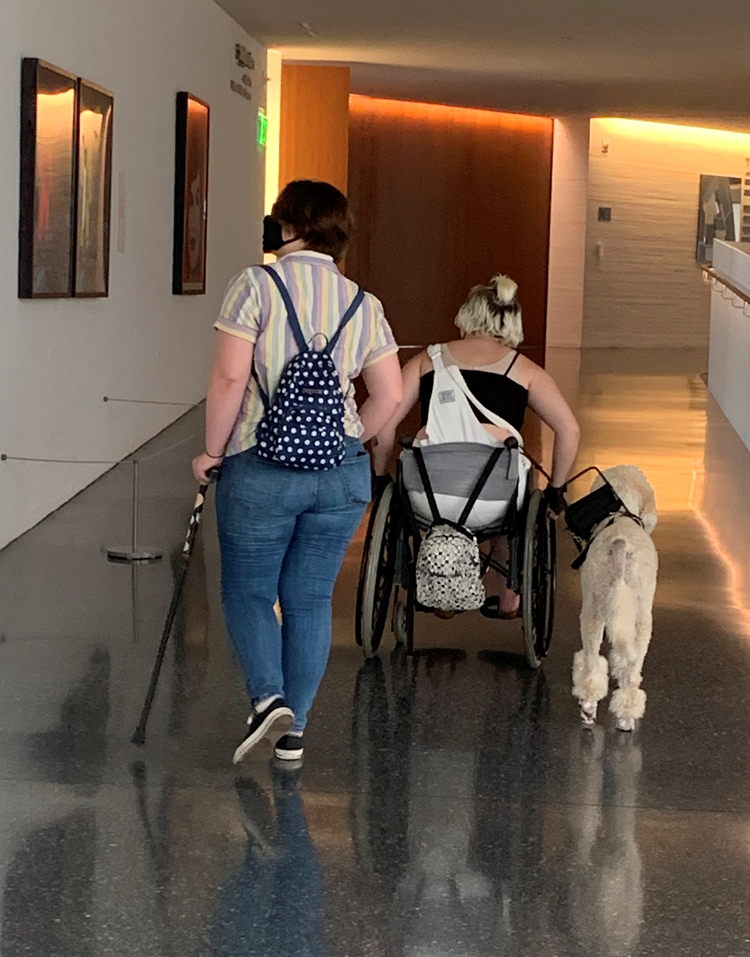
JP Illarramendi – Bag boy to usher
Tori Baker – college student to production stage manager
Tori Baker, Internship Alumni
Notes:
Joey Caverly – RKI placement (2006): The Theater Lab, Washington, D.C., is D.C.’s most comprehensive theatre education center for adults, teens, and kids. Joey’s internship was in production , technical theater and stagecraft where he built sets and did lighting design for the Theater Lab’s productions. Following his internship Joey returned to Gallaudet University where he got more involved in the Theater Department and ultimately switched his interest from Production to Acting. He started to shift his career, more into theater and television work, he tried his hand at playwriting, and kept in touch with the Kennedy Center. Today, you can see Joey in the Netflix special “Only Murders in the Building”.
Shannon Devido – RKI placement (2010): Amaryllis Theater Company, Philadelphia, PA is an inclusive professional theatre company whose mission is to produce new forms of theatre. Shannon’s internship was in arts administration where she was able to work on marketing, fund development, program design and execution, outreach services. After completing her internship she continued to seek out work in theater, begin acting. She returned to the KC to perform, notably appearing on the same stage as comedian Josh Blue. Today she is an accomplished actress, comedian, and singer, and recently appeared in the movie “Best Summer Ever”.
JP Illarramendi – RKI placement (2001): The Kennedy Center, Washington, D.C. is a performing arts center with a variety of theater venues and performances. JP, interned at the Kennedy Center as a production assistant, helped with rehearsals, hospitality, and some office work. After his internship was completed, the Kennedy Center hired JP as a paid usher, additionally JP went back to acting, singing and dancing at ArtStream a local theater group. 20 years later he is still working as a paid usher at the Kennedy Center.
Tori Baker – RKI placement (2023): Interned last year at the Kennedy Center in the Office of Accessibility where she did worked as a program assistant, assisting visiting artists and program participants or a semester. Following her internship, she returned to finish her final semester in college and took on part-time paid work for the Kennedy Center. This summer she helped coordinate access services at the Smithsonian Folklife festival, and is heading off to Colorado where she will be working as a stage manager at the Phamily Theater.

Slide 10
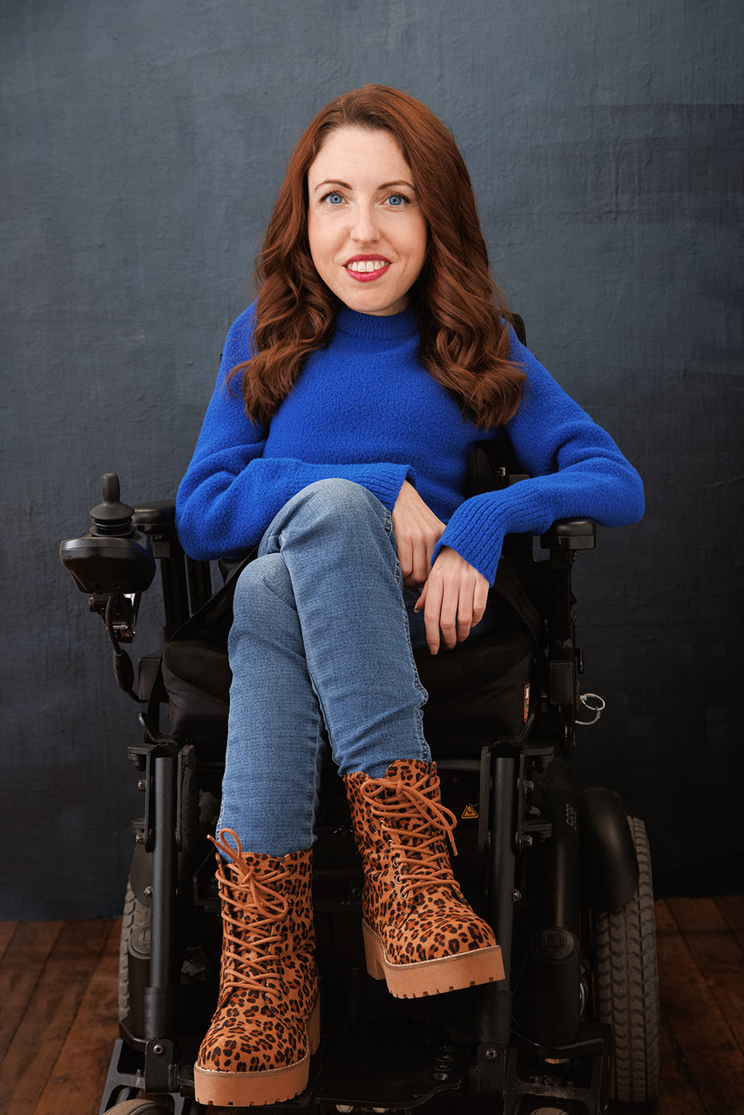
JP Illarramendi – Bag boy to usher
Tori Baker – college student to production stage manager
Shannon DiVido –arts administrator to comedian/actress
Shannon DeVido, Internship Alumni
Notes:
Joey Caverly – RKI placement (2006): The Theater Lab, Washington, D.C., is D.C.’s most comprehensive theatre education center for adults, teens, and kids. Joey’s internship was in production , technical theater and stagecraft where he built sets and did lighting design for the Theater Lab’s productions. Following his internship Joey returned to Gallaudet University where he got more involved in the Theater Department and ultimately switched his interest from Production to Acting. He started to shift his career, more into theater and television work, he tried his hand at playwriting, and kept in touch with the Kennedy Center. Today, you can see Joey in the Netflix special “Only Murders in the Building”.
Shannon Devido – RKI placement (2010): Amaryllis Theater Company, Philadelphia, PA is an inclusive professional theatre company whose mission is to produce new forms of theatre. Shannon’s internship was in arts administration where she was able to work on marketing, fund development, program design and execution, outreach services. After completing her internship she continued to seek out work in theater, begin acting. She returned to the KC to perform, notably appearing on the same stage as comedian Josh Blue. Today she is an accomplished actress, comedian, and singer, and recently appeared in the movie “Best Summer Ever”.
JP Illarramendi – RKI placement (2001): The Kennedy Center, Washington, D.C. is a performing arts center with a variety of theater venues and performances. JP, interned at the Kennedy Center as a production assistant, helped with rehearsals, hospitality, and some office work. After his internship was completed, the Kennedy Center hired JP as a paid usher, additionally JP went back to acting, singing and dancing at ArtStream a local theater group. 20 years later he is still working as a paid usher at the Kennedy Center.
Tori Baker – RKI placement (2023): Interned last year at the Kennedy Center in the Office of Accessibility where she did worked as a program assistant, assisting visiting artists and program participants or a semester. Following her internship, she returned to finish her final semester in college and took on part-time paid work for the Kennedy Center. This summer she helped coordinate access services at the Smithsonian Folklife festival, and is heading off to Colorado where she will be working as a stage manager at the Phamily Theater.

Slide 11
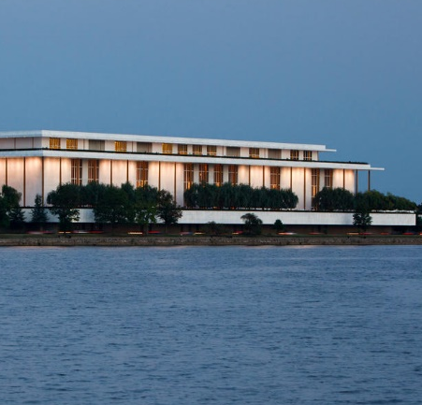

Contact Information
Access/VSA Office
Betty Siegel, J.D.
Director of Accessibility & VSA
The Kennedy Center
(202) 416-8727 bsiegel@kennedy-center.org
Access@kennedy-center.org
Disclaimer
Information contained in this presentation is for general guidance. The information in this presentation is not intended to be legal advice nor a rendering of legal advice, opinion or services. Recipients should consult with their own professional legal advisor.
© 2023 The John F. Kennedy Center for the Performing Arts, Office of VSA and Accessibility

