Slide 1
Inclusive education at universities - triad for education, work and multiplication
Prof. Dr. Matthias Morfeld
(matthias.morfeld@h2.de)
Hochschule Magdeburg-Stendal, Kompetenzzentrum Inklusive Bildung Sachsen-Anhalt
Germany
Job creation for persons with intellectual disabilities
March 6, 2025 4pm- 5pm

Slide 2

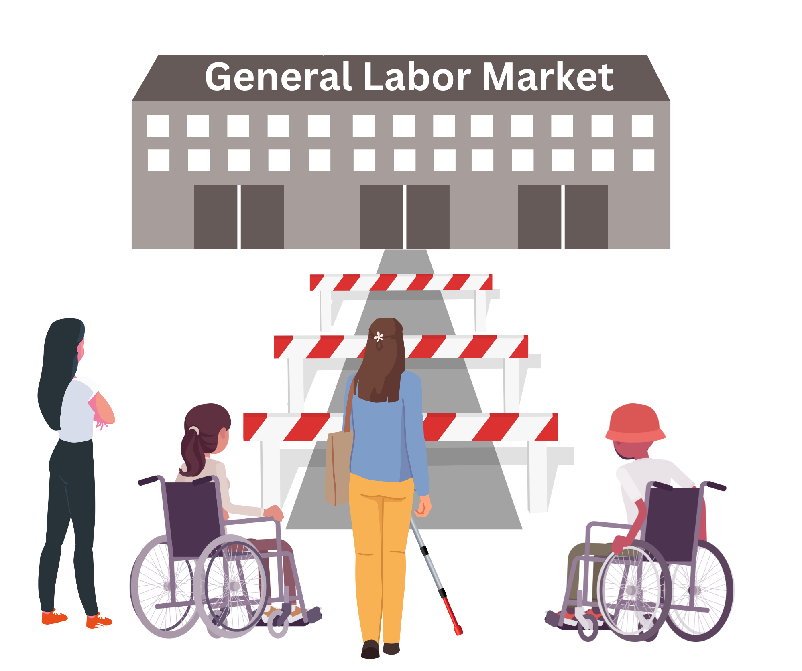
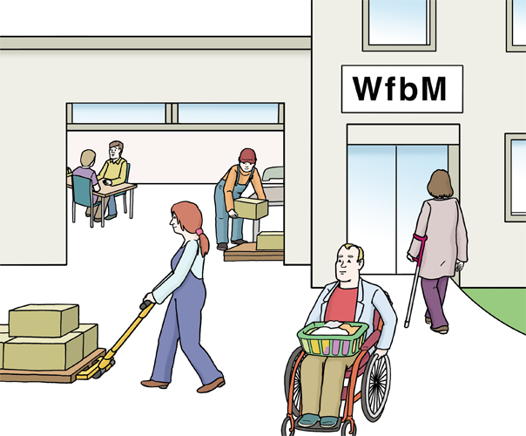
Initial situation in Germany: segregated labor market
transition rate < 1%
~ 310.000 workshop employees (as of 2023)
~ about 222 euro/month (as of 2022)

Slide 3
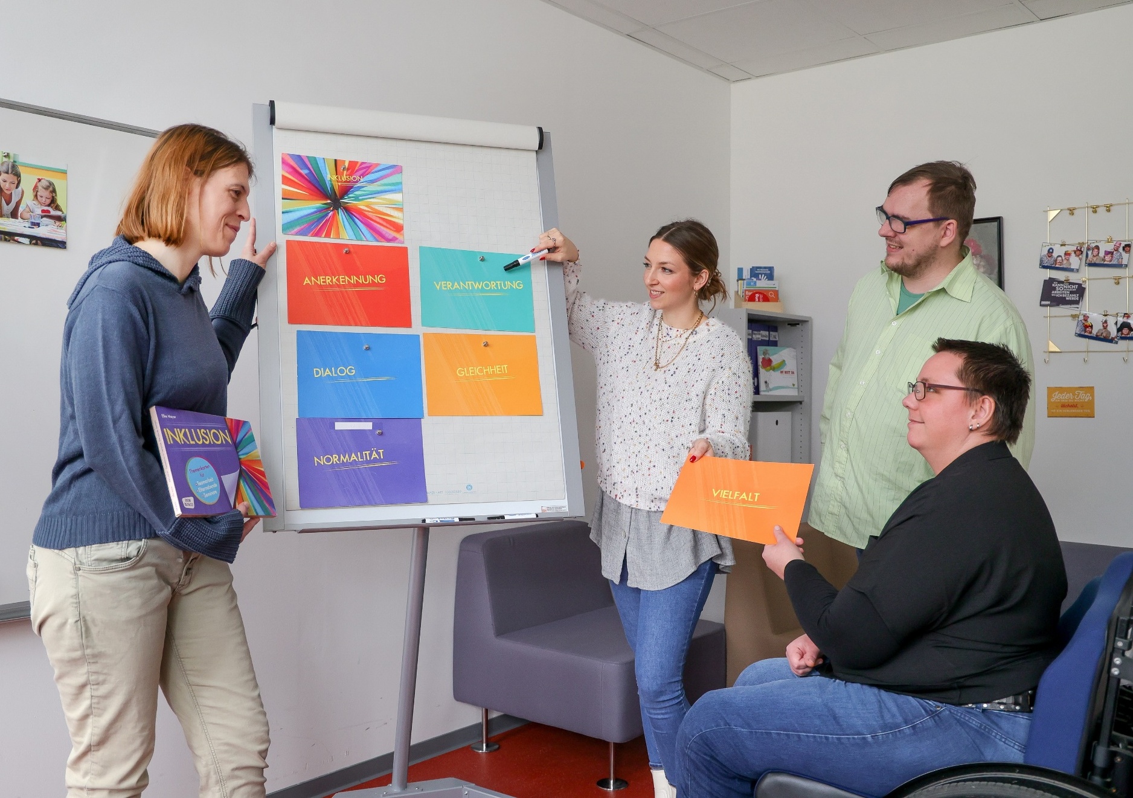
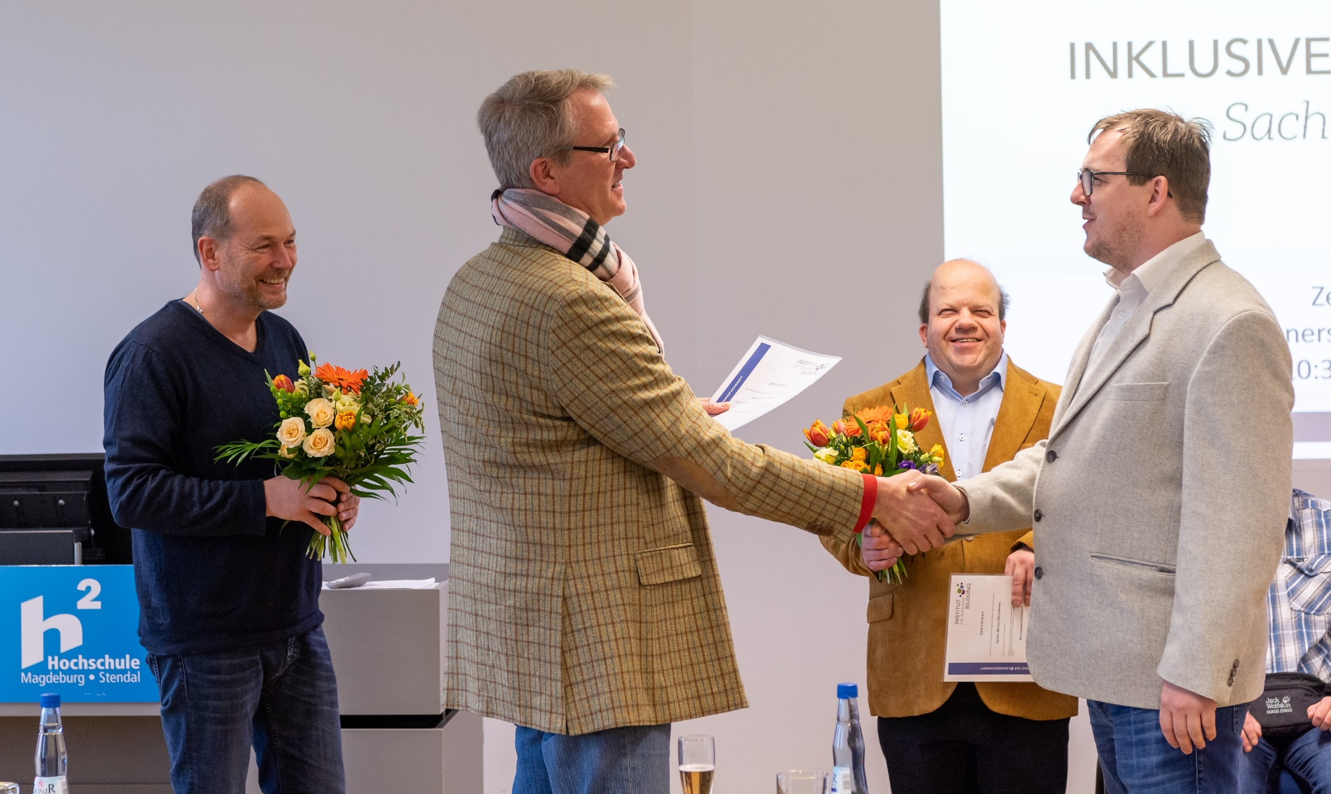
Educational specialists: qualification
Notes:
Basics
What is the basis of qualification?
A 3-year curriculum with topics such as: education, work, political education, and life environments
Who is part of the Team of the competence center?
Our bus

Slide 4
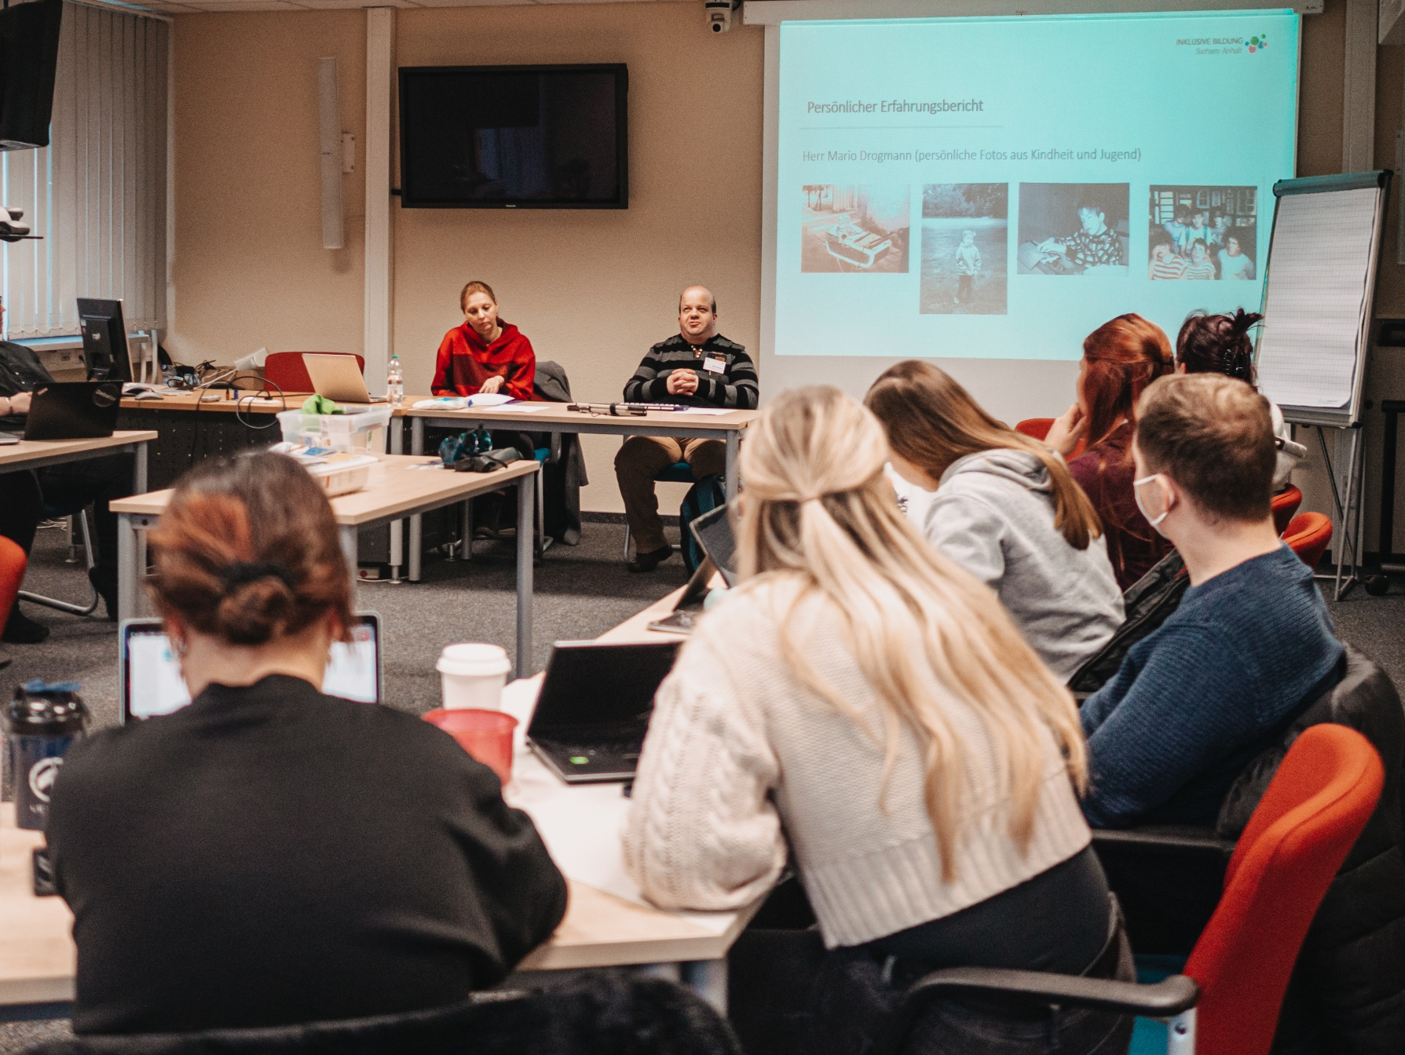
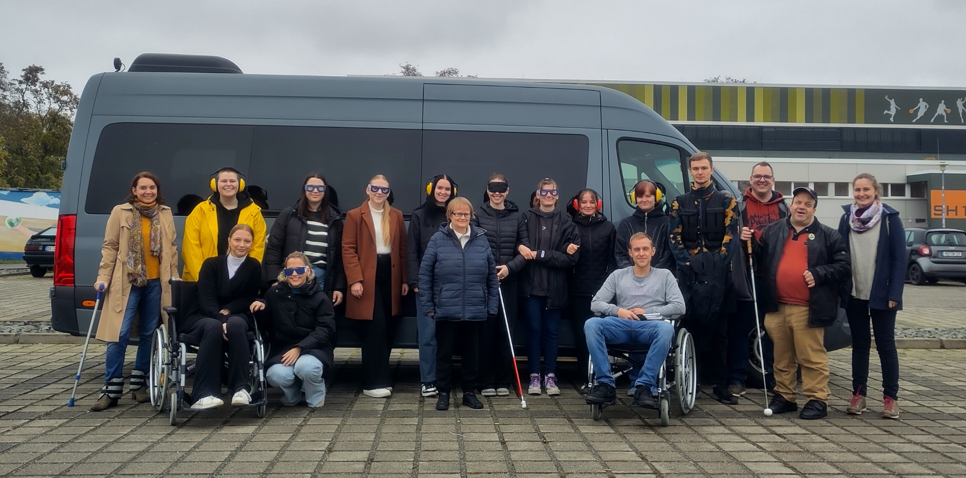
Educational specialists: work
Notes:
What has changed for the education specialists in the meantime?
Confident people who are needed for important topics
Going into self-employment, own apartment
Initiative regarding public relations, inclusion advisory board, etc.
Receiving own money

Slide 5
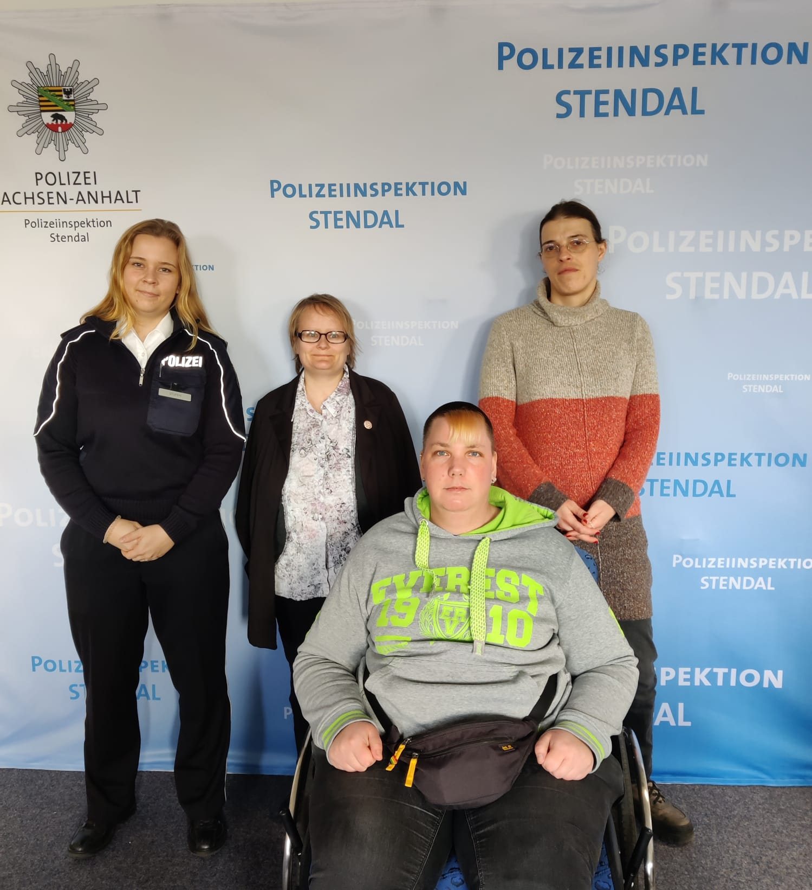
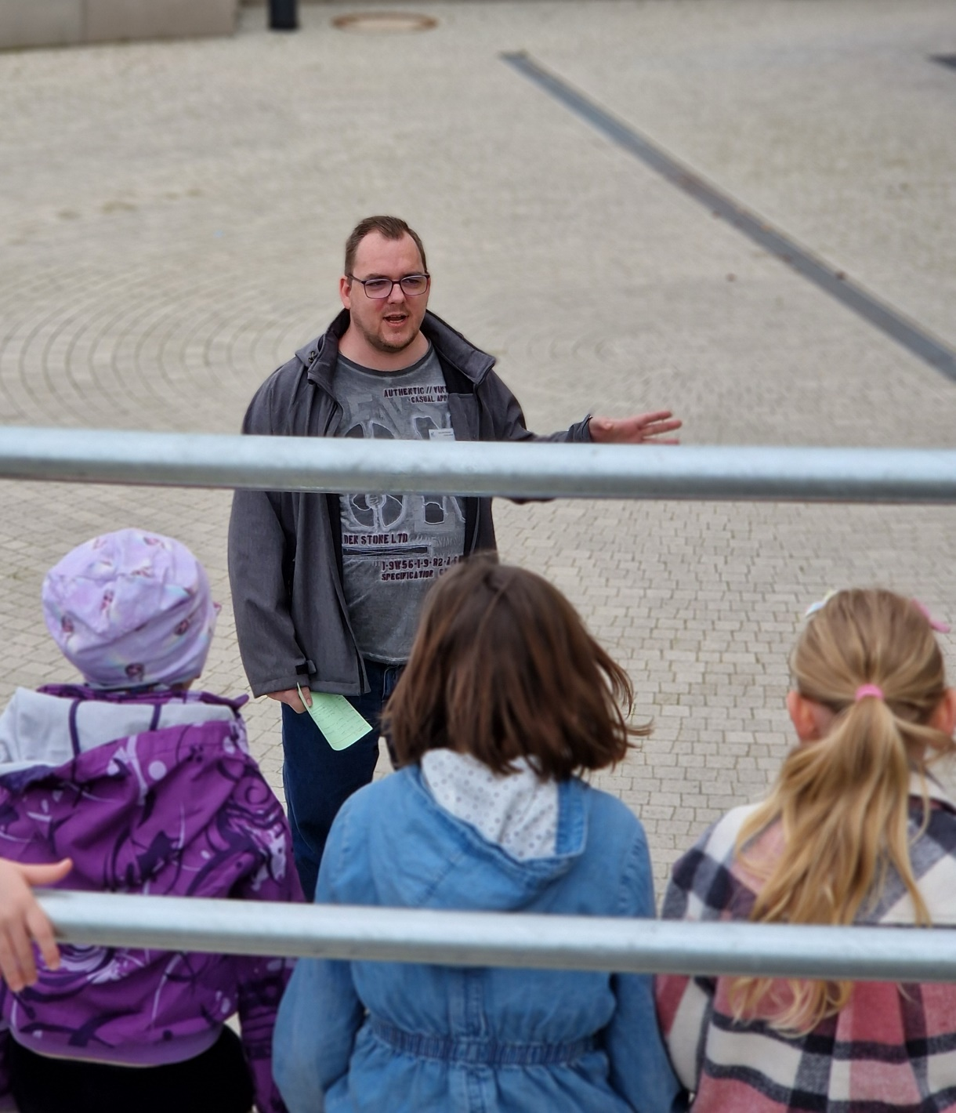
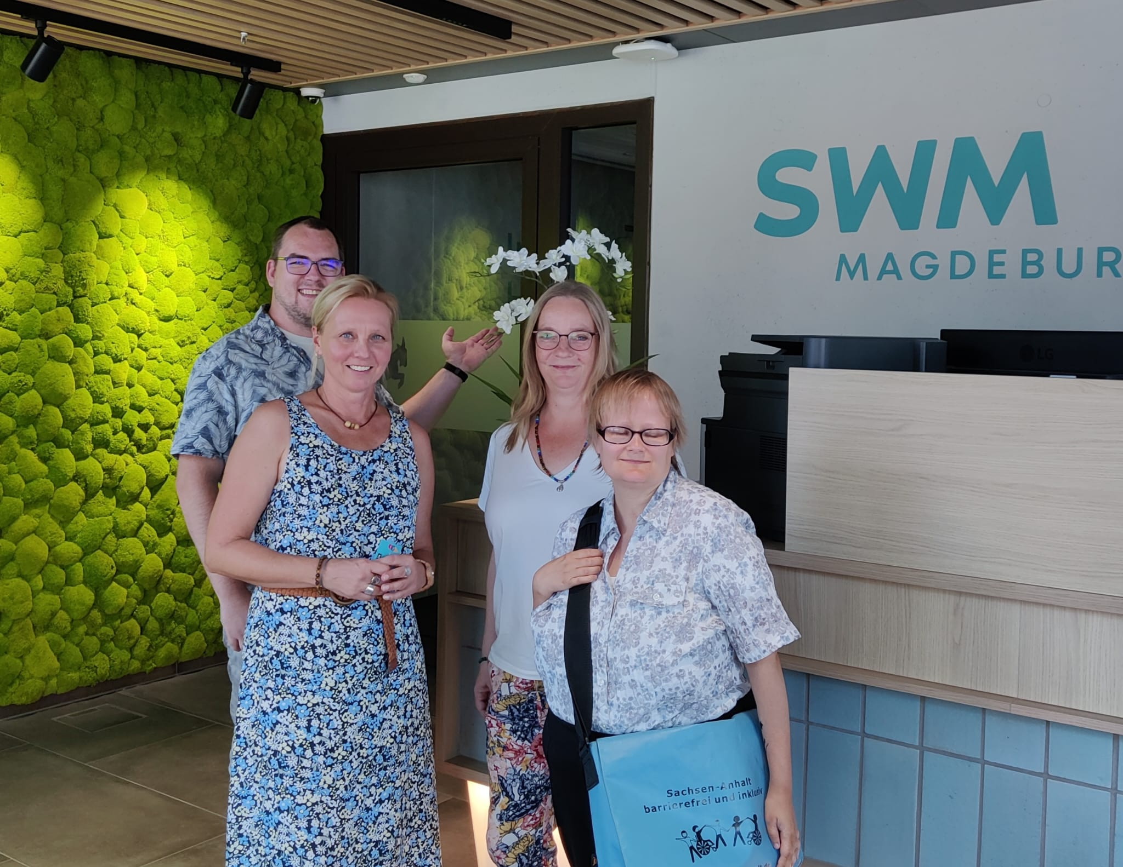
Educational specialists: impact
Notes:
Outlook
BMAS
Teacher training
Research: what is the impact on which levels?
! Hinweis auf Session der BFK am Freitag

Slide 6
Thank you very much for your attention!
Final tip: opportunity to meet the Bildungsfachkräfte (Education Specialists)
Friday, March 7, 2025 13:15 pm -14:45pm Room M3
Forum der Selbstvertreter von Menschen mit Lernschwierigkeiten (with English translation)

