Slide 1
Reverse Integration Policy
Elisabeth Schaludek-Paletschek (teacher)
Martin Dobrev (student)
Schulzentrum HTL HAK Ungargasse SZU (school)
Vienna, Austria
Integration strategies for mainstream schools and youth services
Thursday, February 22, 2024, 12:20 pm - 01:40 pm CET
Notes:
E(lisabeth): Hello everybody, it is a pleasure to speak to you today. My name is XX, I am a teacher at a school in Vienna, Austria, called SZU Ungargasse. We are a vocational school with a technical and a commercial department.
M(artin): Hello from me as well. I am Martin Dobrev and I am a student at this school called SZU Ungargasse.

Slide 2
Brief Introduction to our school
reverse integration policy – classes filled with students with disabilities first! (>20%)
specializes in technical and commercial subjects
1,150 students, 140 teachers, therapists and social pedagogues
Notes:
E:Our school centre provides future-oriented and practice-oriented education and has a focus on integration and equal opportunities for everybody. We specialize in technical and business subjects for students aged 14-19.
M:The SZU follows a reverse integration policy when admitting new students. This means that young people with physical and sensory disabilities are admitted first. Only when this process is complete are the classes then filled with other students. This ensures that our starting point is the needs of our students with disabilities. We provide our students with disabilities with the necessary support to participate in the lessons, such as free assistive devices and support teachers. The school provides barrier-free architecture and boarding facilities.
E:The school has about 1,150 students, 140 teachers, therapists and social pedagogues (boarding house staff) and it has constantly grown since it was established. The reverse integration policy targets a >20 per cent proportion of pupils with special needs. SZU embraces a multicultural community of 34 nationalities and 13 religions.

Slide 3
Features of our school model
standard national curriculum
assistive personnel and technical support
additional services and programmes
Notes:
E:All students are taught according to the Austrian national curriculum, but students with additional needs are provided with assistive personnel and technical support as well as individual tutoring if required.
M:When required, students with disabilities are granted extended time for exams. Additional activities such as special language programmes and sports weeks as well as services such as physiotherapy and wheelchair sports ensure integration into regular school life.

Slide 4
Further details
smaller class sizes
individual tutoring if necessary
special facilities
Notes:
E:We have smaller class sizes than usual in Austria, special sports equipment, and offer individual tutoring for students with special needs if required.
M:Our additional facilities include, for example, an accessibility system for viewing presentations/whiteboards and FM hearing loop systems.

Slide 5

The innovative aspects
Notes:
(pic) You see a simple cartoon illustration showing the meaning of the word 'innovative' with a plant.
E:The whole school model is designed for integrative education: the reverse integration policy described above, the high proportion of students with special needs (target of >20%), support teachers, barrier-free architecture (e.g. ramps, extra-wide hallways, etc.) and the boarding house to allow young people from other regions to go to the school.
M:We do not know of another school like this in the EU.

Slide 6
The impact
basis for a self-determined life
success in the job market
effects on the mindset of students without disabilities
choice for parents
Notes:
E:A high proportion of our students with special needs have success in the job market as we prepare them for real life. The students without disabilities develop a lot of important social skills by taking part in the integrative processes and being part of the solutions to problems that arise, e.g. through our peer mediation programmes (extracurricular activity). Parents have access to high-quality integrative education for their children that would not be available anywhere else.

Slide 7

Martin’s story
Notes:
(pic) You see a minimalistic black and white illustration of an Olympic-style K1 sprint kayak. The image is in 2D, showcasing a side view of the sleek and streamlined racing kayak.
M:I am one of the 360 students with disabilities at our school. Every day I get to go to school and work towards graduating in my dream subject, IT Networking, while receiving support achieving my dream of canoeing for Austria in the Paralympics. All my teachers give me a lot of moral support as well as academic help.
I benefit a lot from the school's infrastructure: From the accessible corridors, lifts at every staircase, ramps outside to avoid stairs, to the therapy wing of our school where I can do my swimming practice, and I can get physiotherapy on site.
I am now in my final year of school and less than a year before the Paralympics in Paris. I can only say that I will miss this school with all my heart and will always be grateful for the amazing opportunities I have been given. Maybe you will see me on TV in Paris.

Slide 8
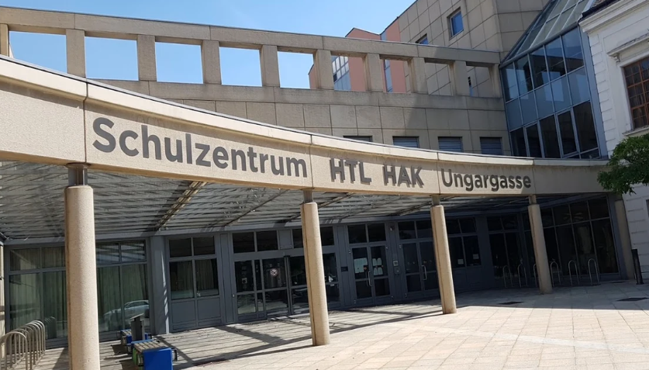
Financing, transferability and challenges
state funded
importance of political will
real-world considerations
adaptive educational approach
www.szu.at
Notes:
(pic) You can see the front view of our school from Ungargasse.
E:The school is funded by the Austrian state like any other state school.
Replicating our model would be possible elsewhere, perhaps on a different scale, but it requires the necessary political will. Up to now our model has not yet been replicated, especially not in the secondary sector as a technical and business school.
The challenge faced by the school is to provide an education that is as integrative as possible while taking into account real-world practical and financial considerations.
We involve our students with disabilities through our adaptive educational approach. This comprises regular consultation with our students with disabilities to take into account their needs, recognizing that the students are the experts and that this is work in progress.

Slide 9

Outlook for the future
Notes:
(pic) You see a glass sphere on a stand, depicting a bright future with a diverse group of people inside, including a person in a wheelchair, surrounded by flowers, trees, and happiness.
M:The school aims to implement and evaluate technological innovations (e.g. students’ digital devices and systems), increase technical support and expand physical education opportunities.

Slide 10
Added value for all SZU students
social skills
resilience
empathy
We live and learn together by embracing diversity!
Notes:
E:The school supports the independence of people with disabilities and helps them to lead self-determined lives. Our approach to education emphasises social skills, resilience and empathy. Students without disabilities learn to appreciate the challenges that people with disabilities face. The SZU embraces a multicultural community of 34 nationalities and 13 religions. So integration is just one aspect of our extremely diverse school community.
M:We live and learn together by embracing diversity!
E:The SZU spirit can always be felt, both in the respect and in the appreciation between students as well as between students and teachers.

