Slide 1
Por Talento Latam
Edurne Alvarez de Mon
ONCE FOUNDATION
Colombia, Costa Rica, Ecuador, Dominican Republic & Uruguay
Disabled People Organizations as 360°
Friday, March 7, 2025. 1:40 PM
Notes:
Please add your notes here.
Title; First name, last name of speaker(s); Name of Organization, Name of Country, Name of Session (as written in Agenda)
#ZeroCon24
Day and Time of Session

Slide 2

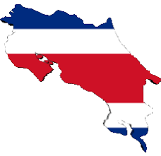
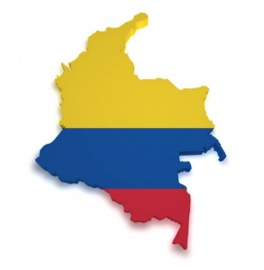
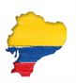
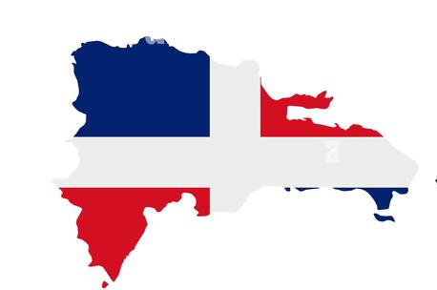

Our Goal
Our Goal: To improve labor inclusion opportunities for persons with disabilities by implementing a comprehensive job placement mechanism tailored to existing conditions, structures, and initiatives, in both the private (including self-employment and entrepreneurship) and public sectors.
Building capacity and changing lives. Five countries – five approaches:y
    Lead by a Public – private colaboration – Costa Rica
    Lead by Family Compensations Funds - Colombia
    Lead by a Disability NGO with the private sector suport - Ecuador
    Lead by UNPD and public institutions – Dominican Republic
    Lead by a social enterprise - Uruguay

Slide 3
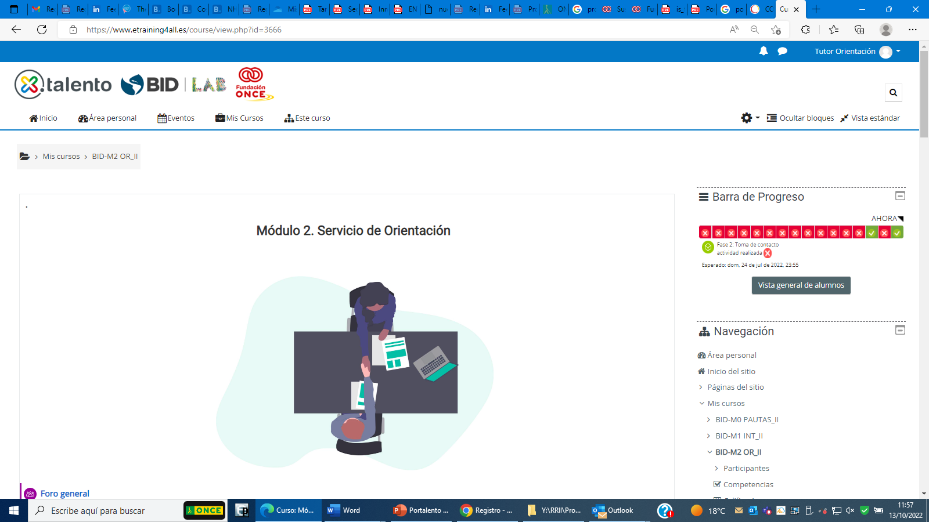
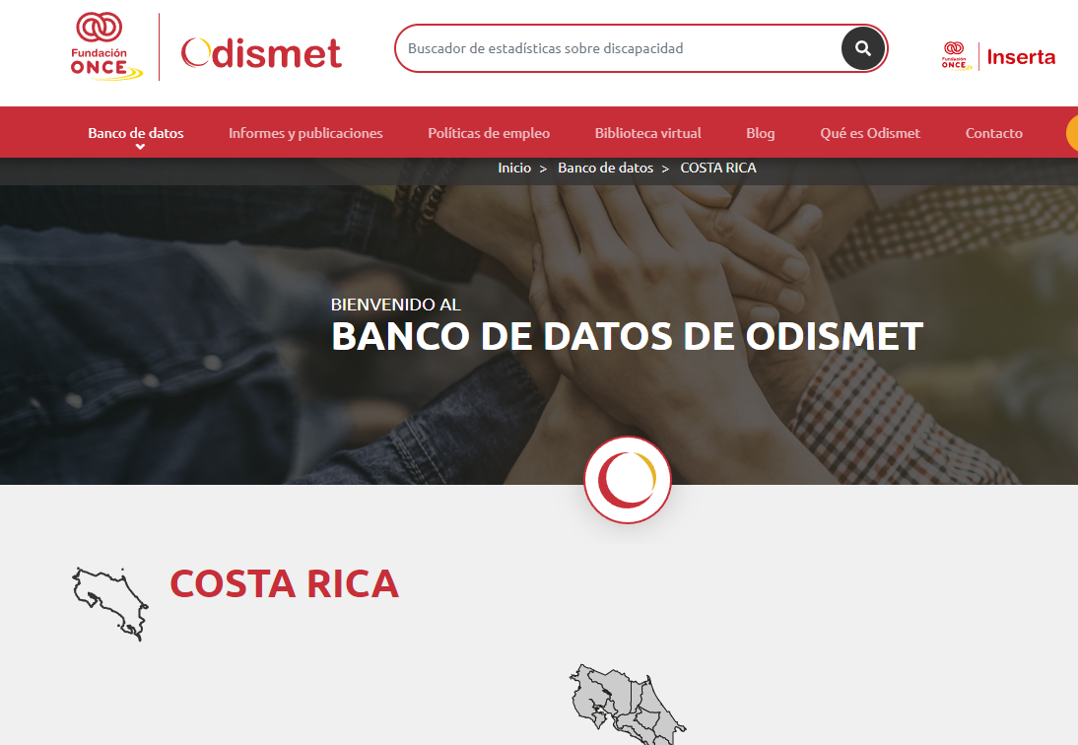
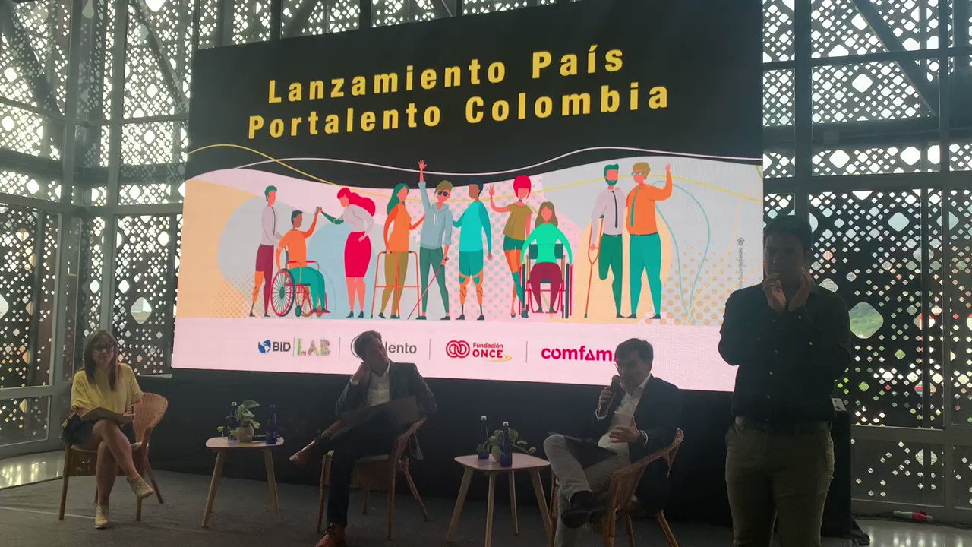

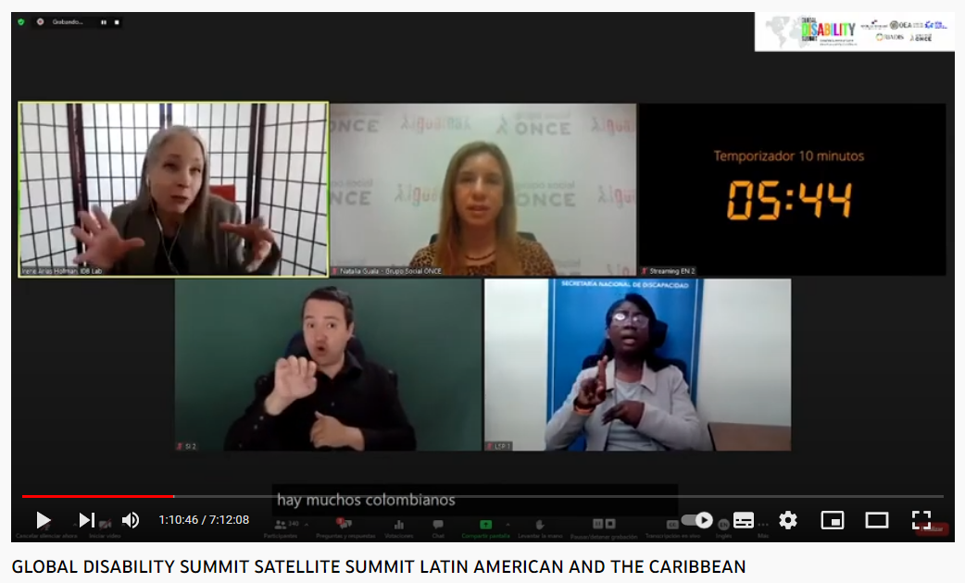
About our work
Diagnostic assessment by country and engagement of stakeholders – Ex. Training in ONCE Foundation methodology
Creation of the Inserta ecosystem: an open, inclusive, and accessible labor market – Ex. ODISMET
Comprehensive management of labor inclusión – Ex. Inserta Network
Lessons learned and scalability – Ex. Global Disability Summit

Slide 4






Governance : General of the Whole

Slide 5
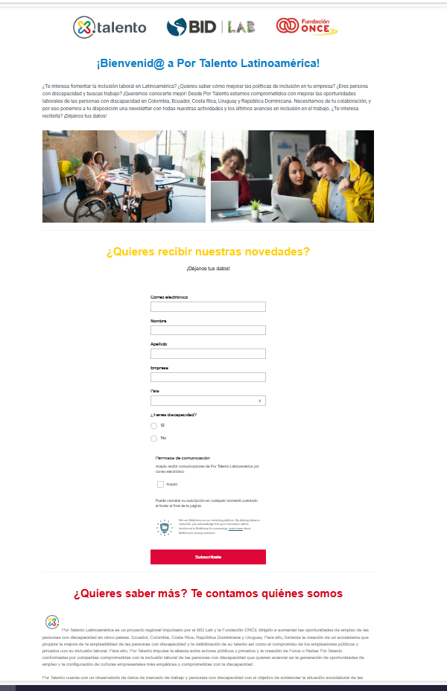
Stay in the loop
Subscribe to our monthly newsletter and follow us on social media

