Slide 1
Inclusive Dance
Connie Vandarakis
In Dancing WE
United States
Realistic representation of persons with disabilities
in the arts and media
Wednesday, February 21, 1pm
Notes:
Please add your notes here.
Title; First name, last name of speaker(s); Name of Organization, Name of Country, Name of Session (as written in Agenda)
#ZeroCon24
Day and Time of Session

Slide 2
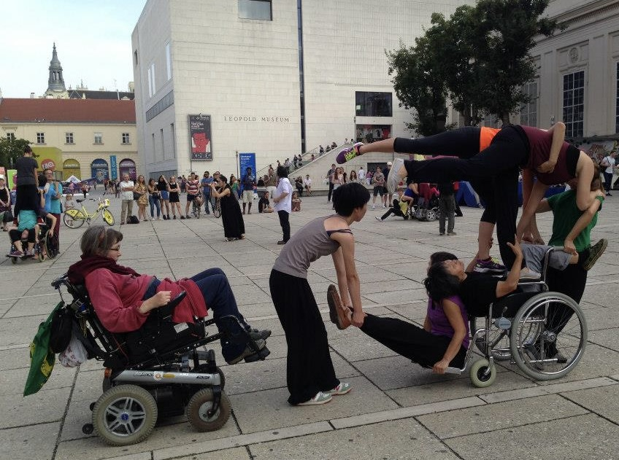
DanceAbility International at ImPulsTanz International Dance Festival, Austria
Notes:
There are two photos of a mixed ability dance performance as part of the ImPulsTanz International Dance Festival in 2018. Photos by Connie Vandarakis. In the photo on the left are four Caucasian female dancers in red shirts and black pants who are creating a group shape in the Museum Quarters in Vienna Austria. One dancer is a wheel chair users and the three other dancers are making shapes around and on the wheelchair creating a sculpture together.
The photo on the right is of a group of dancers some with wheelchairs creating a image together with each other. There are four dancers creating images on one wheelchair and one dancer holing the feet of one dancer who is seating on the foot rest of the wheelchair and another wheel chair user is creating a shape on the other side of the woman holding the dancers feet to create a symmetrical image.

Slide 3
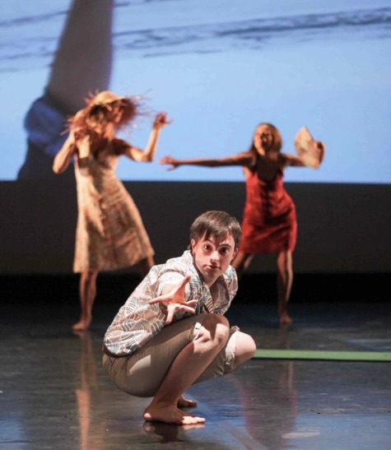
Ensemble BewegGrund Trier, Germany
Notes:
These two photos are of the performance “Sea you shortly” by Ensemble Bewegrund Trier in the TUFA theater.
In the photo on the left there six dancers in colorful summer time dresses and the men are in short sleeve button up shits and tan pants. They are all in a Congo line traveling across the stage with both arms up in various relaxed positions. In the background is a film of three wheelchair users who are headed to the beach in their chairs.

Slide 4
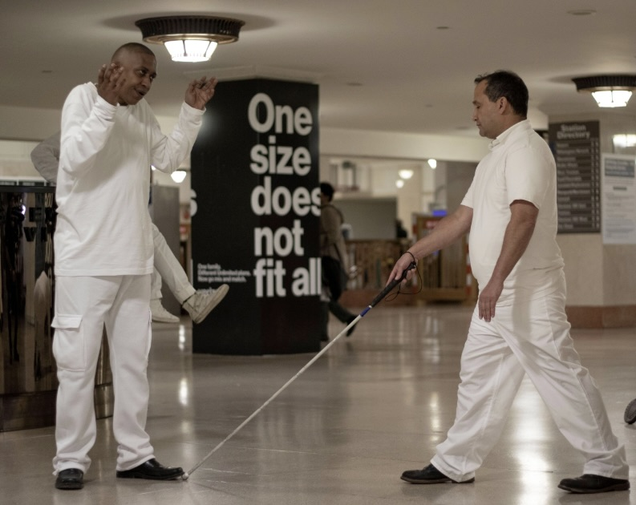
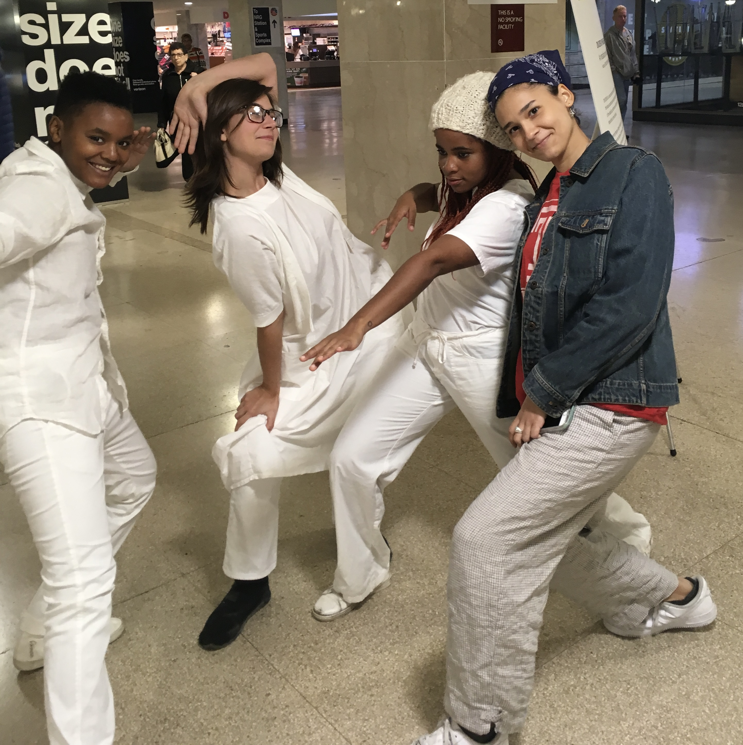
In Dancing WE, Philadelphia, PA, USA
Notes:
In these two photos In Dancing We is performing at one of Philadelphia’s main train stations. In the photo on the left two men are dressed in white. One man is black and has his hands moving up to either side of his face and the other man, blind and of Latin heritage is making a shape with his walking cane pointed to the shoes of the other man. The advertisement on the column of the train station says One size does not fit all. The second photo on the right has three young dancers in their twenties, two are black and one white who are creating an sculpture image. A forth person a young black woman with autism who was watching the the dance joins in the image with the three other dancers. Photo credit Mali Fenning and Connie Vandarakis

