Slide 1


ECI support provided by three ministries: The case manager role
Miguel, Valles
CECD Mira Sintra – Cooperative for Inclusion
Portugal
Universally applicable early childhood interventions
22 February 11:00-12:00
Notes:
Please add your notes here.
Title; First name, last name of speaker(s); Name of Organization, Name of Country, Name of Session (as written in Agenda)
#ZeroCon24
Day and Time of Session

Slide 2
Premises that lead to the construction of a National ECI System
Economic crisis of 2008-2009
The start
Ratification of the UNCRPD and the optional protocol
Academic papers that supported a new generation of early childhood intervention
Identification of champions of the system in each ministry
High costs of the current system per user
Inneficient information management between services
Notes:
Sample Slide: presenting three points on our project and the relationship to this year’s theme of the Zero Project Conference. Point 1; Point 2; Point 3 connect together in this way.

Slide 3
Premises that lead to the construction of a National ECI System
What we wanted to build
A cost-effective full coverage national system and free for all users
A team that represents all ministries and consolidates all the information
A system that enables parental decision, competencies and knowledge
Notes:
Sample Slide: presenting three points on our project and the relationship to this year’s theme of the Zero Project Conference. Point 1; Point 2; Point 3 connect together in this way.

Slide 4

Premises that lead to the construction of a National ECI System
In order to:
Increase the learning oportunities of the child
Strengthening care givers competencies
Promote family participation and engaging community resources
Notes:
Sample Slide: presenting three points on our project and the relationship to this year’s theme of the Zero Project Conference. Point 1; Point 2; Point 3 connect together in this way.

Slide 5
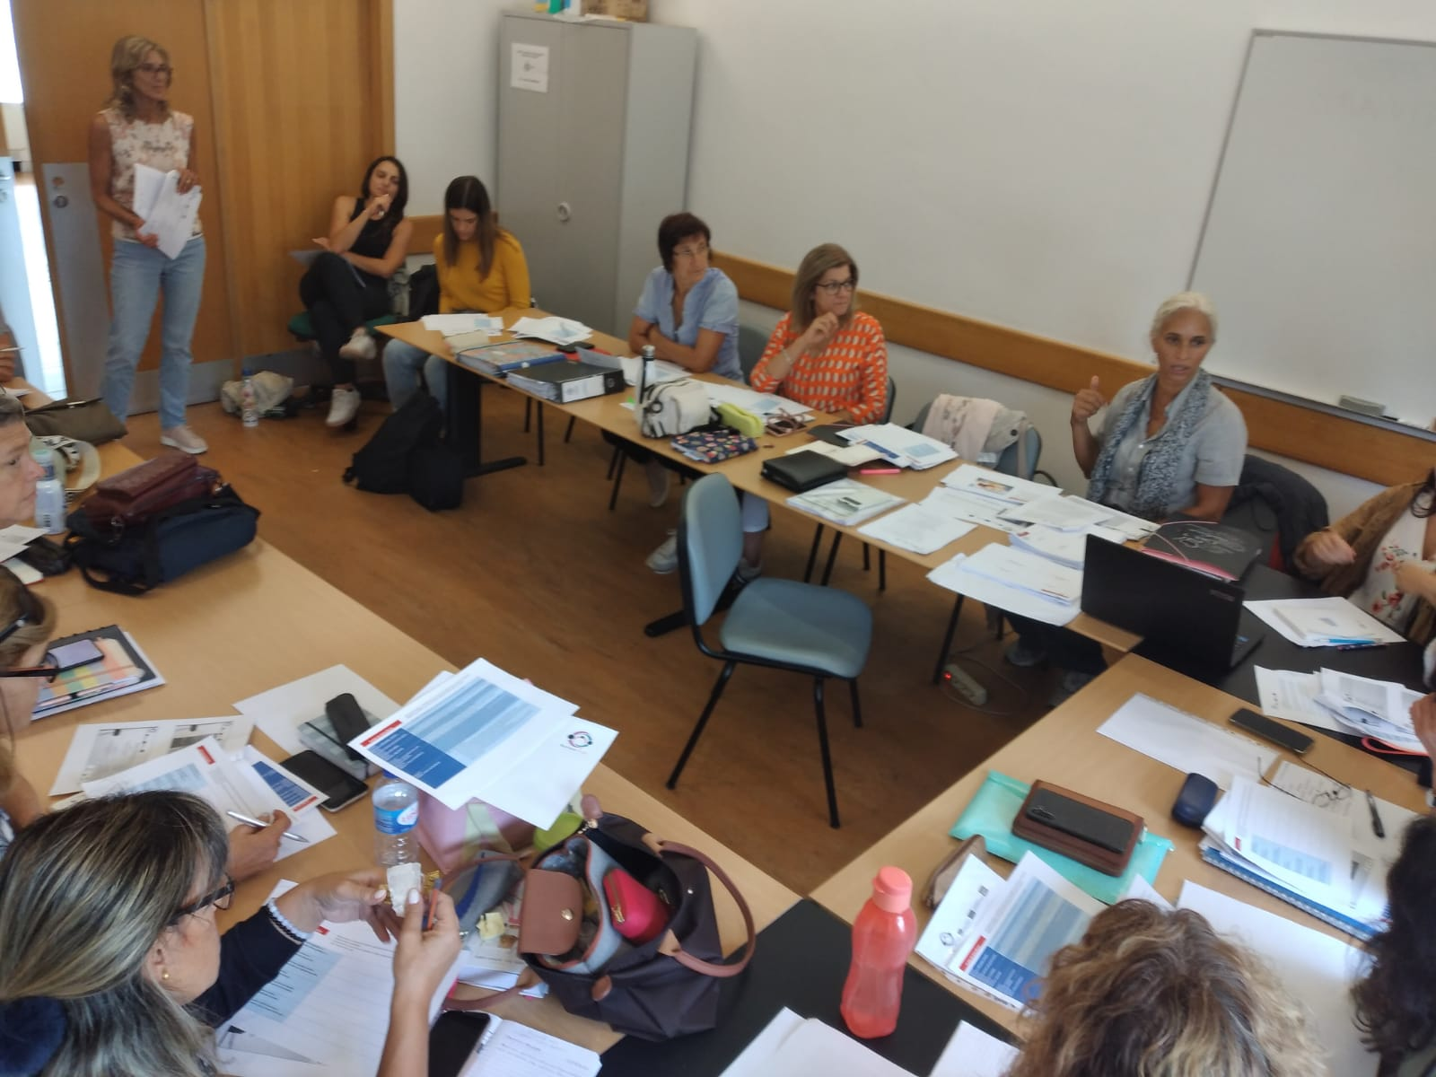
The National ECI System
Joint resources allocation:
Ministry of Health
Ministry of Education
Ministry of Labour and
Social Affairs
Sharing their:
Budgets
Human resources
Information and database management
Complementary assistive technology
Partnerships
Notes:
Sample Slide: presenting three points on our project and the relationship to this year’s theme of the Zero Project Conference. Point 1; Point 2; Point 3 connect together in this way.

Slide 6

The National System
1
National Coordination
Regional Subcomissions
Local ECI Teams
5
Numbers in 2022:
27.000 Children supported
80.000 persons supported
1.676 ECI professionals
155
Notes:
Sample Slide: presenting three points on our project and the relationship to this year’s theme of the Zero Project Conference. Point 1; Point 2; Point 3 connect together in this way.

Slide 7
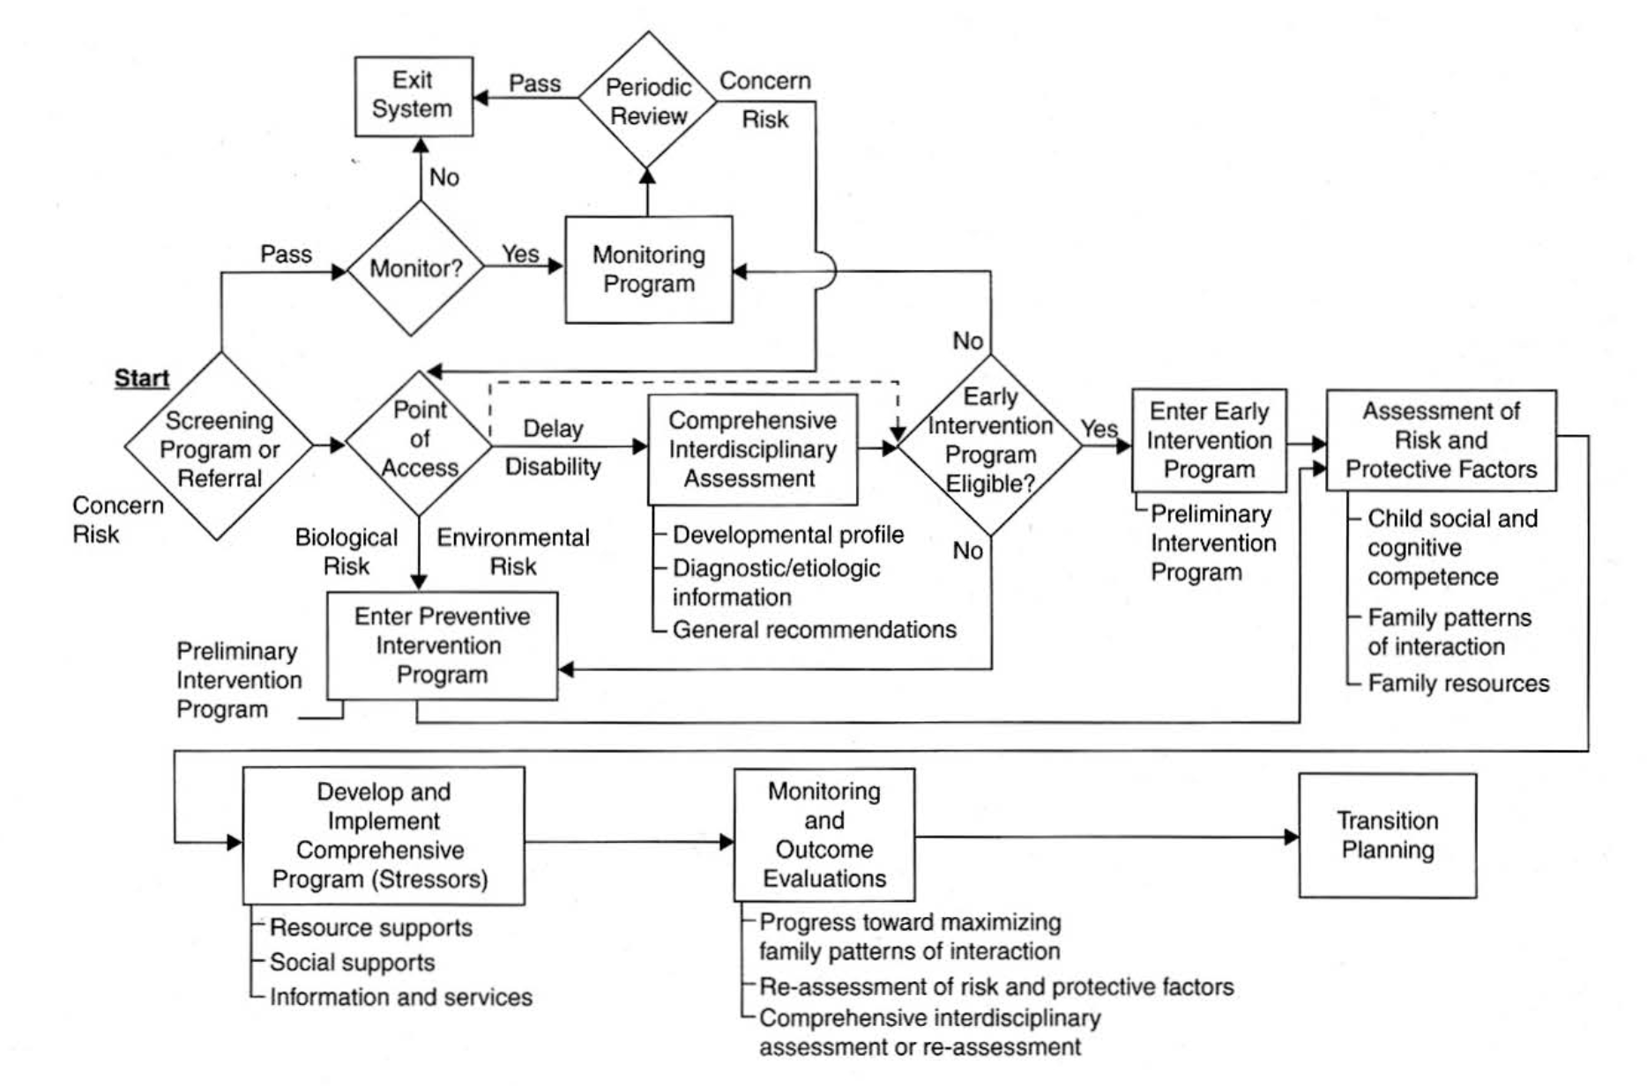
The National System
Transdisciplinary
Team Assessment
Notes:
Organogram of the

Slide 8
The role of the ECI case manager
A transdisciplinar ECI professional that responses to family concerns about the development of their child.
Focused of the family expectations and resources available
Establish intervention objectives with the family regarding family and child needs
Put in practice strategies and activities in several natural contexts of the child and monitor those processes
Evaluate the results of the intervention, family satisfaction about their control over the process and plan the transition to another context.

Slide 9

Thank you!
Miguel, Valles
CECD Mira Sintra – Cooperative for Inclusion
Portugal
22 February 11:00-12:00

