Slide 1



Put title here
Overview

Slide 2



Inowise & Faircom
Franz
Mike Bowers
CEO & Founder
Inowise
inowise.io
Chief Architect
FairCom
faircom.com

Slide 3

The FairCom Way
We are passionate about using technology to empower our customers.
We believe there is a better method to building data technology—and we’re leading the way to that future.

Slide 4

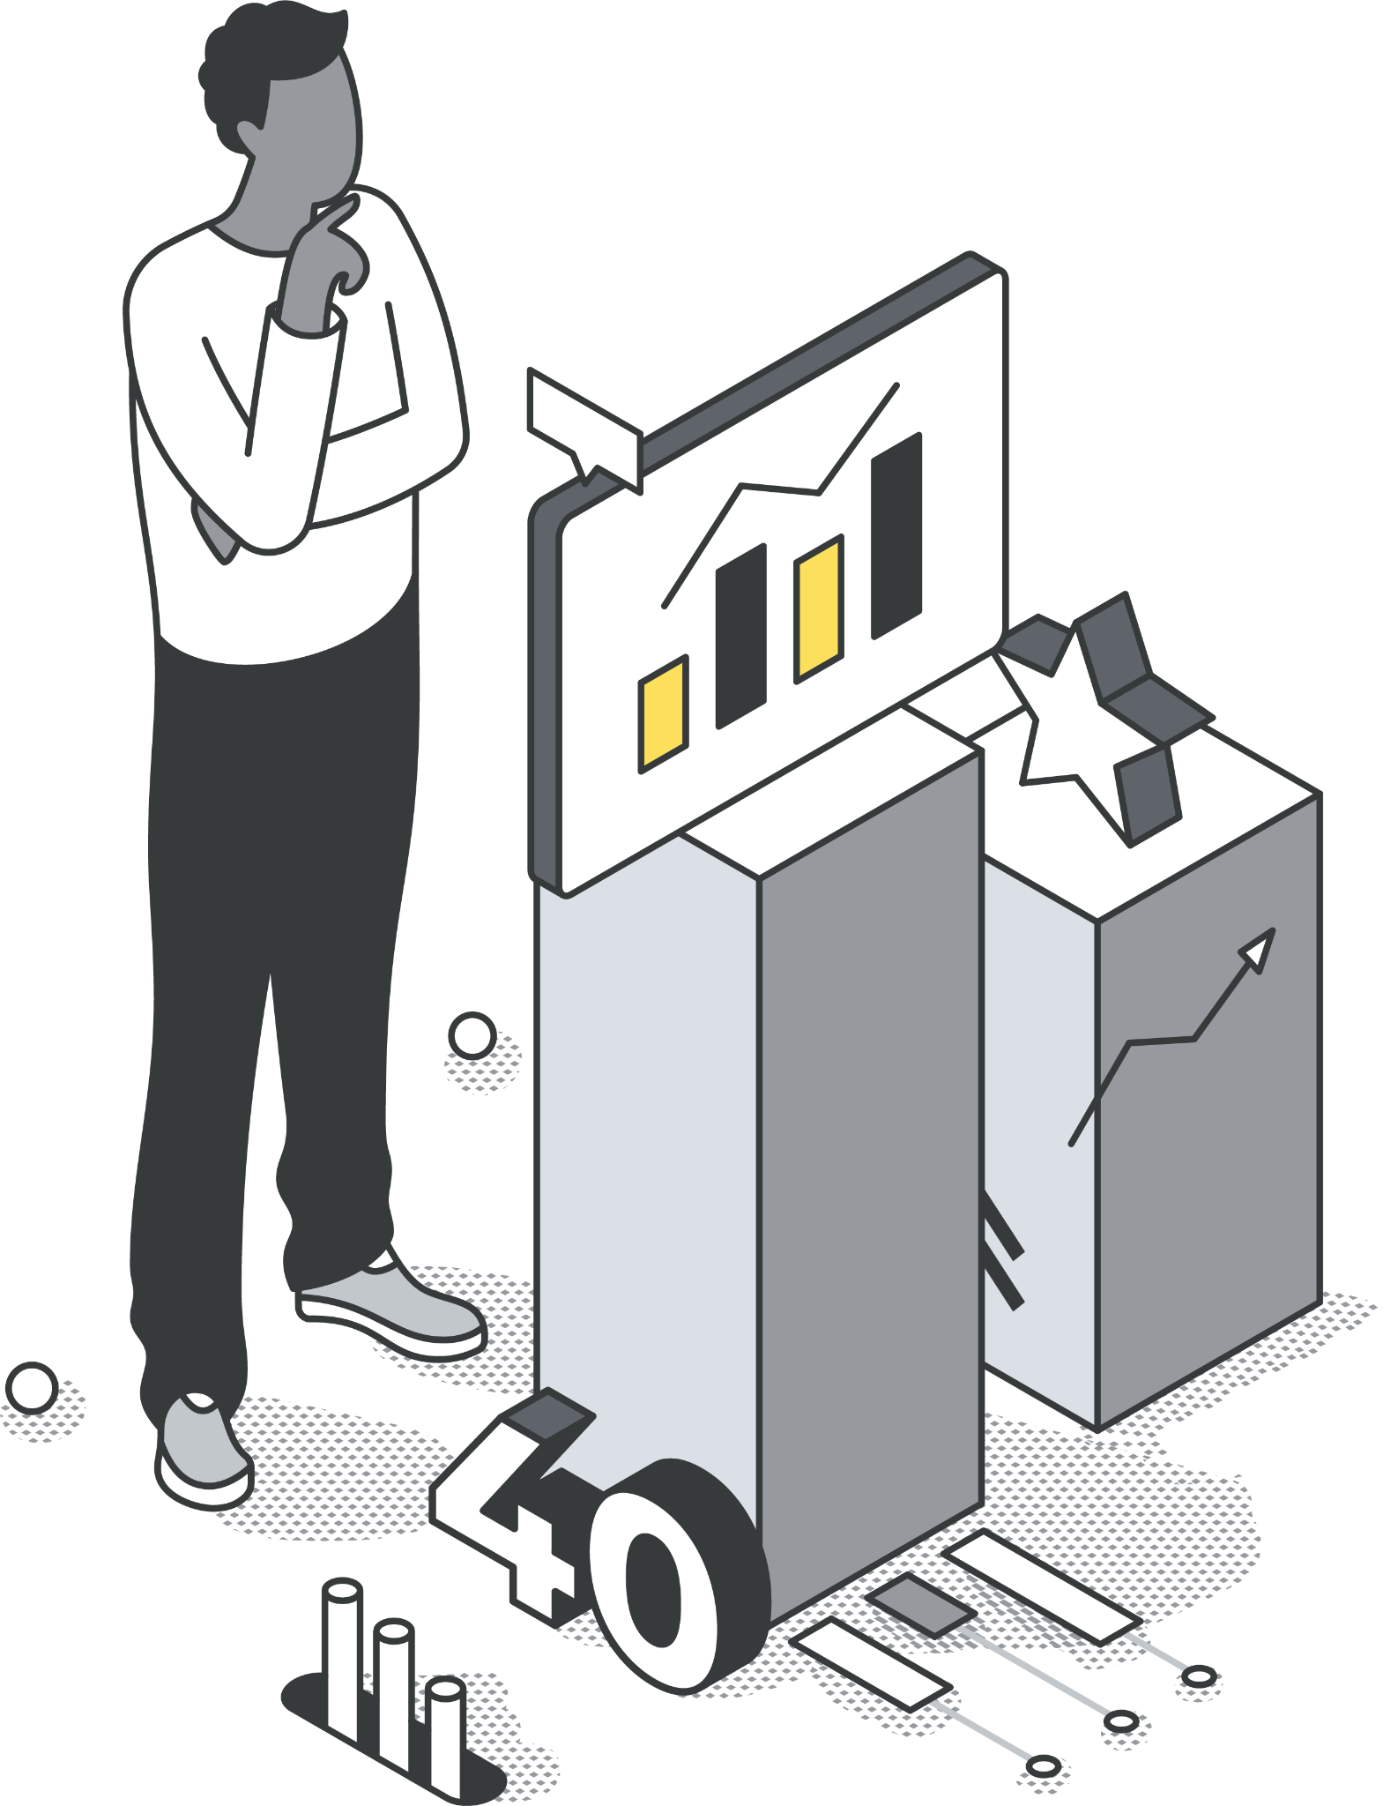
More Than 40 Years of
Development Excellence
We've spent years refining our products to be the operational heart of the most pivotal applications and systems around the world.
When reliability, speed, and power are critical, organizations turn to FairCom to power their systems.

Slide 5






Trusted Expertise and Unparalleled Service
Deployed in tens of thousands of mission-critical applications among the Fortune 100 and across the world.

Slide 6
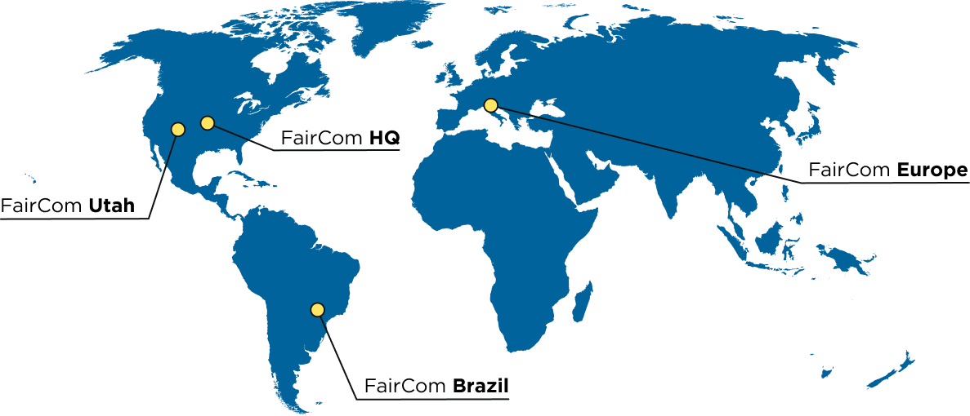
Our Footprint

Slide 7



Industrial IoT platform
Collect • Store • Transform • Deliver
Data Anywhere
Inside equipment to factory
Within factory to software
Between cloud and factory

Slide 8



Integrate Your Factory
IoT Solution
Collect
Store
Transform
Deliver

Slide 9

Deliver Equipment Data
Equipment
Software
Collect
Store
Transform
Deliver

Slide 10

Build IoT Software
Development Platform
Collect
Store
Transform
Deliver

Slide 11


Slide 12
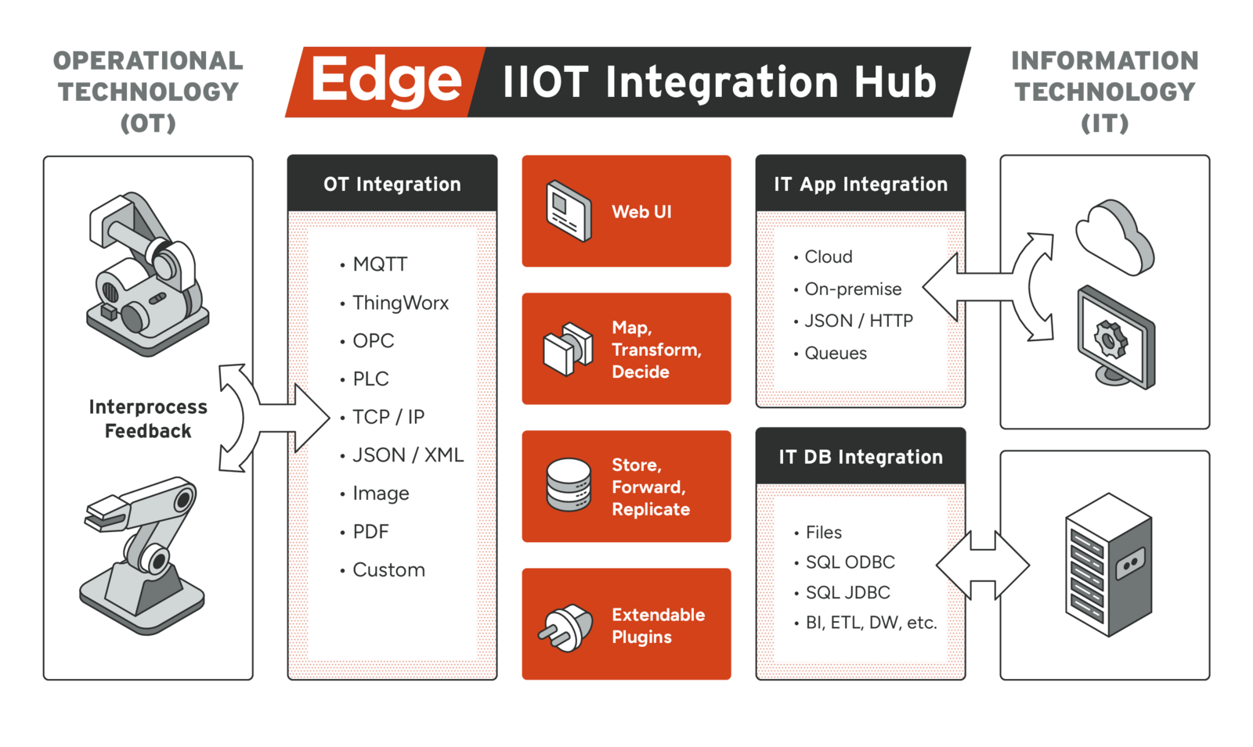

Slide 13


Collect
Store
Transform
Deliver

Slide 14
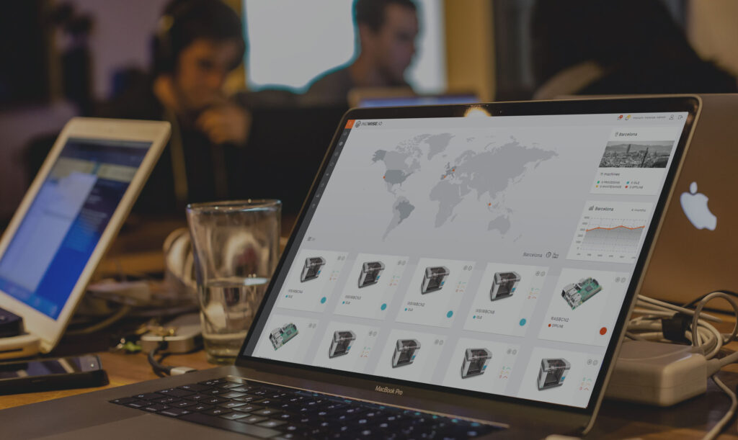

POWERED BY

Slide 15


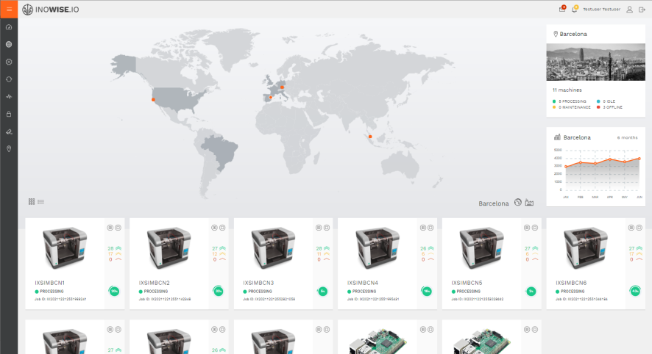
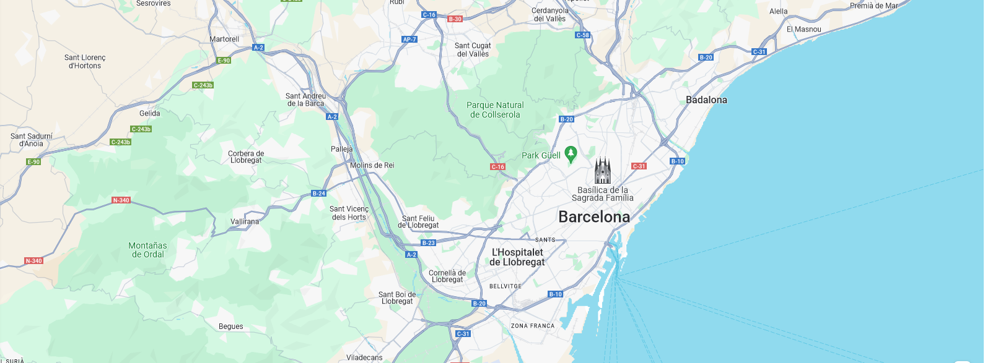
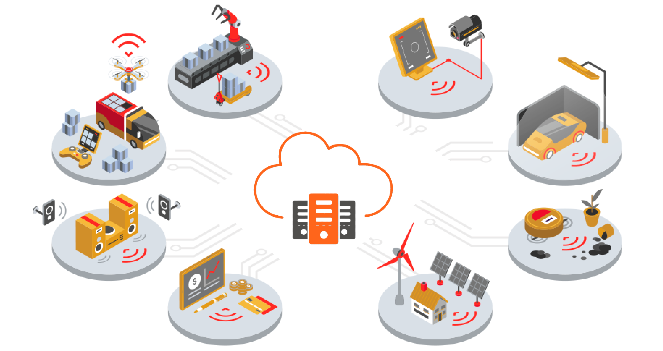
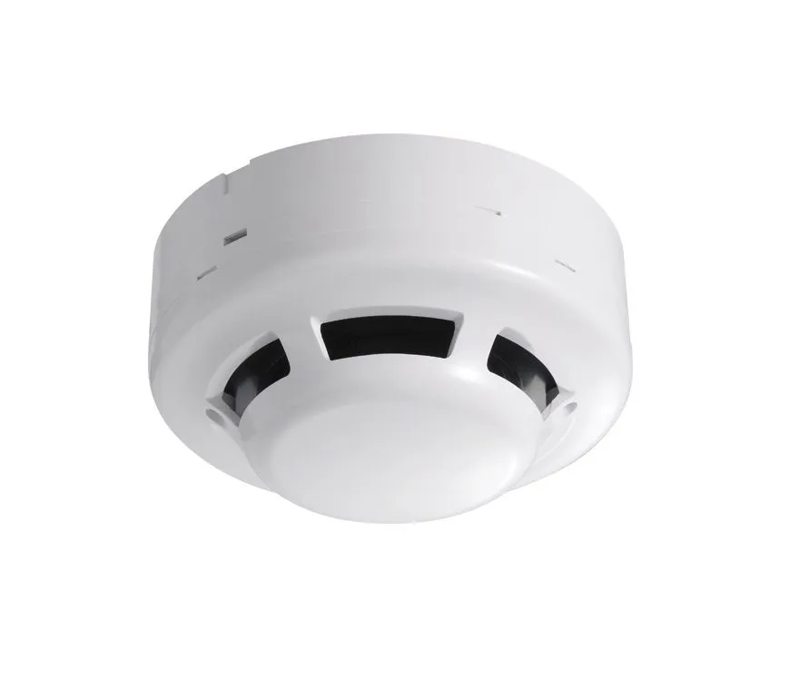
What is inowise.io?
Industry 4.0 / Real estate Management / Asset TRACKING
INOWISE CLOUD
Manage AND Monitor YOUR BUSINESs
Powered by

Slide 16

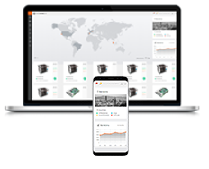


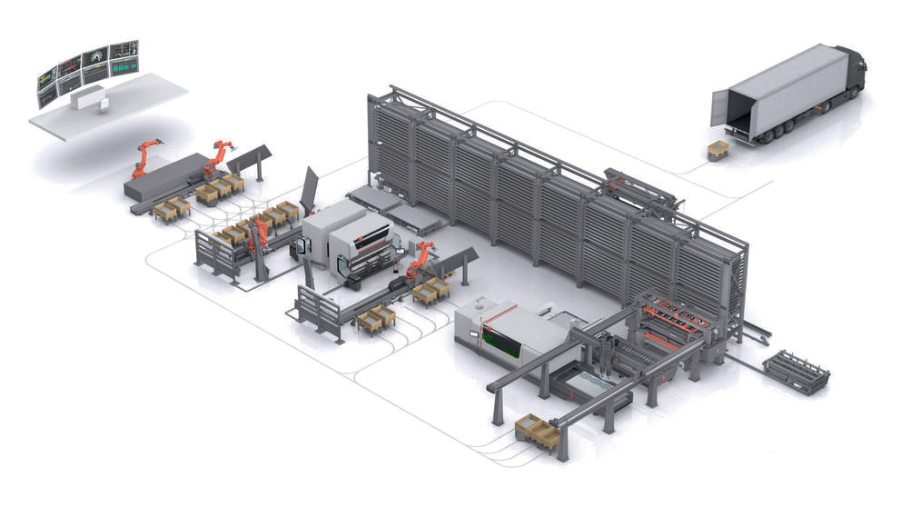





FAIRCOM / Inowise.io landscape
INOWISE.IO Webapp
INOWISE.cloud
Gateway
ERP/MES
Sensor data
INOWISE.IO experts
Your factory, your devices

Slide 17
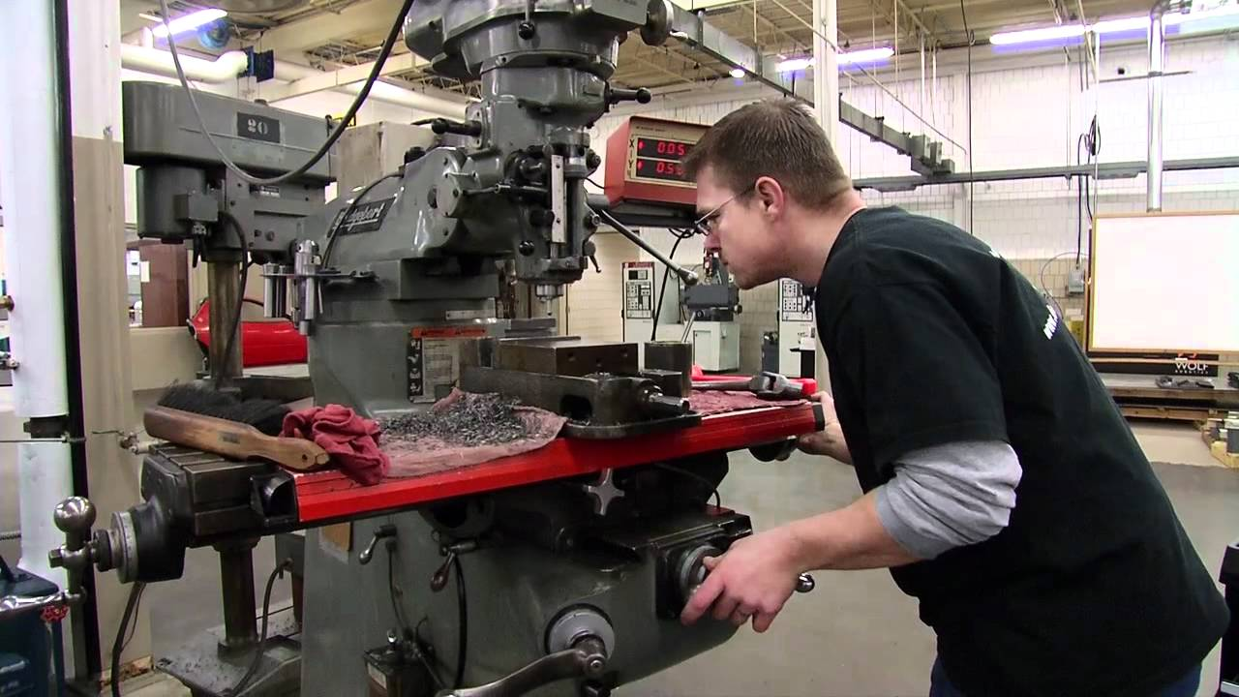
USE CASE
HDK MANUFACTURING

Slide 18
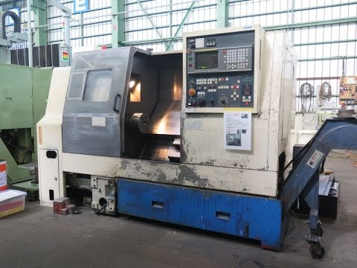
LEGACY MACHINES
Powered by

Slide 19
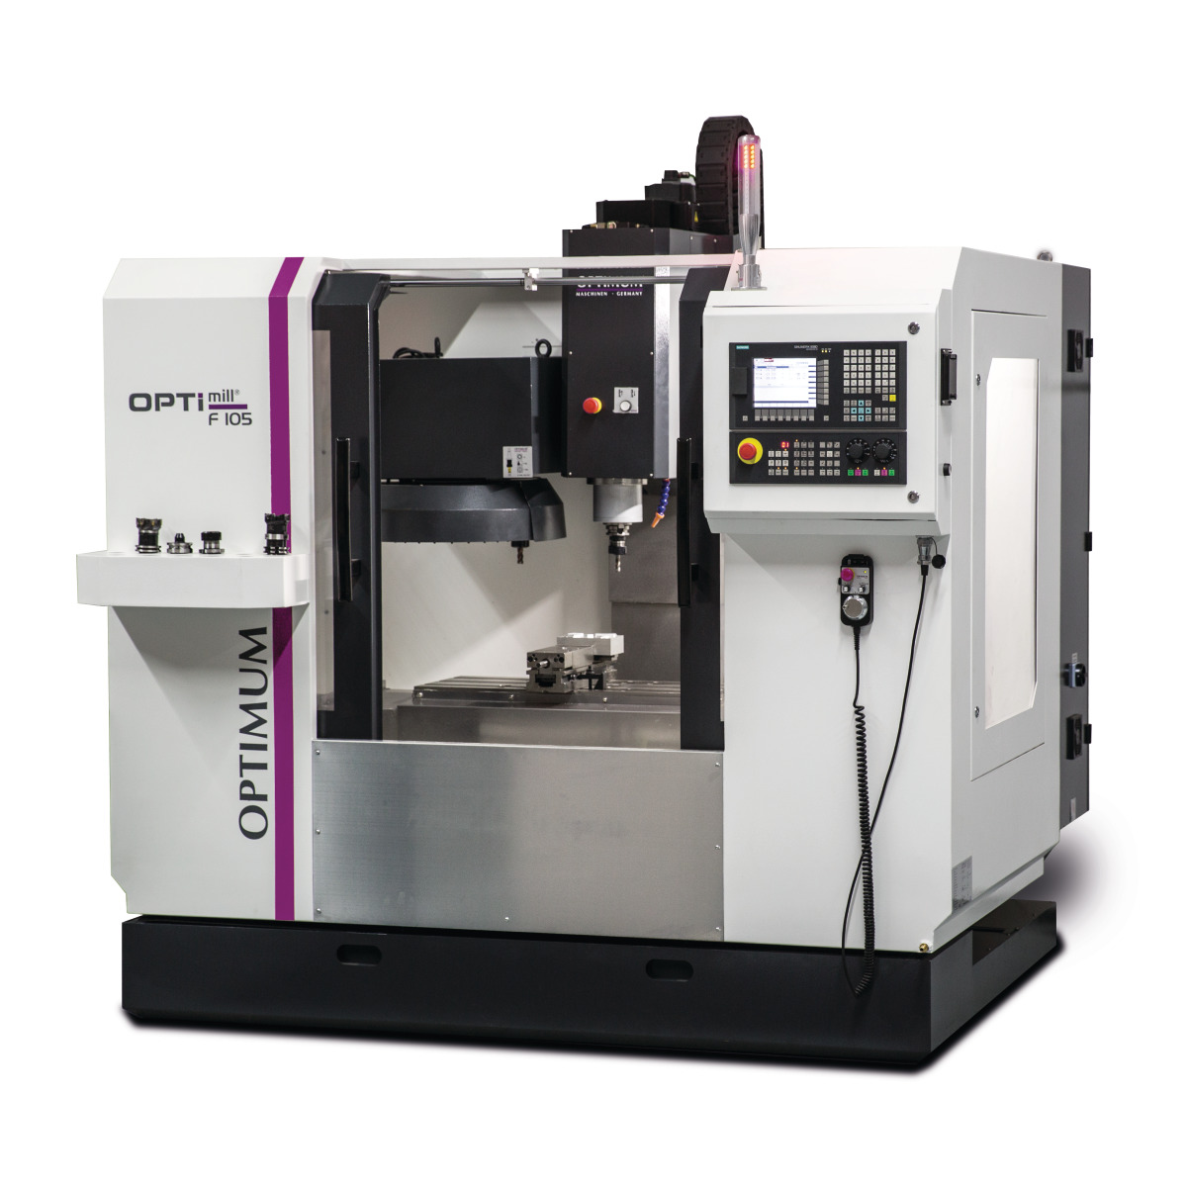
Machine connecting to faircom
Machine
FairCom Edge Connector
FairCom MQTT
FairCom Database
Inowise Cloud
Powered by

Slide 20

PRODUCTION planning VS. reality
Powered by

Slide 21

Missing PRODUCTION insights
Powered by

Slide 22



Production FAILURE during night shift
Error
NIGHT
Powered by

Slide 23
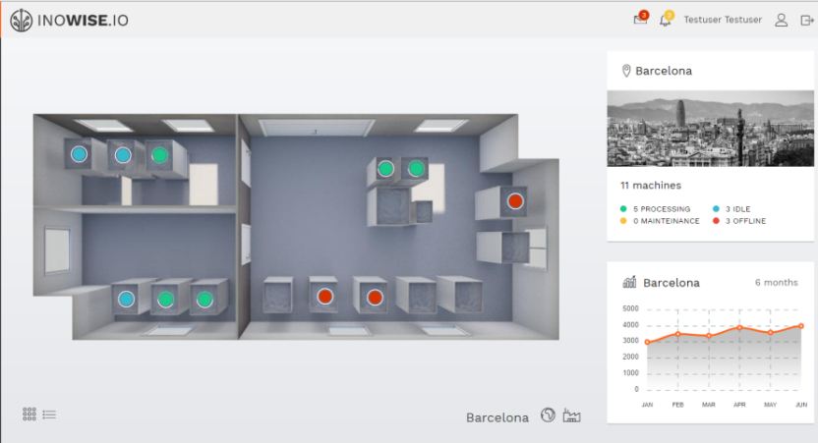
SOLUTION HDK Manufacturing
machine status overview
quick overview of selected location
zoomable map to visualize all machine locations
visualize your machines or assets on various levels, e.g. within a building or urban area.

Slide 24




BENEFITS HDK Manufacturing
20 %
30 %
Production
Deliver on time
BETTER
Employees satisfaction
Time based pricing model
Powered by

Slide 25

USE CASE
SMOKE DETECTORS

Slide 26
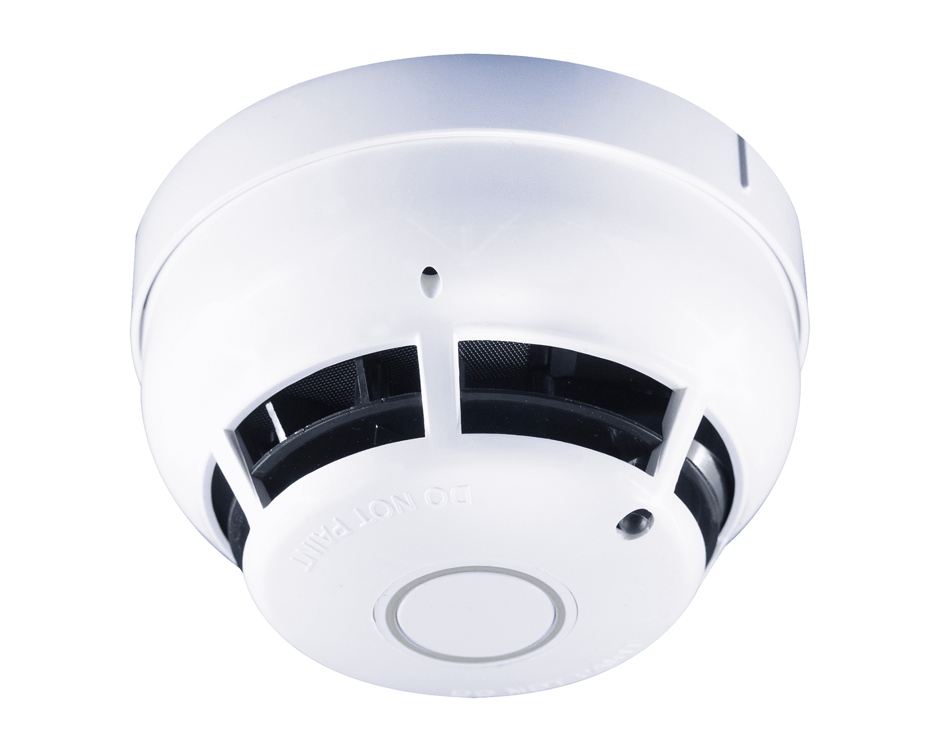
Up to 30.000 sensors
+ 30.000 Sensors
Powered by

Slide 27
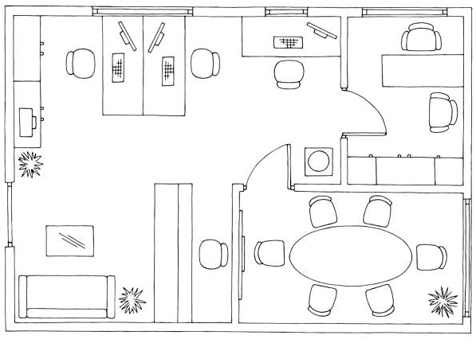
Little knowledge of status
Sensors Status
Offline
Idle
Online
Powered by

Slide 28

Maintenance of sensors
Powered by

Slide 29


Legal responsibilities
Offline sensors can cause legal responsibilities!
Powered by

Slide 30
Smoke detectors connecting to faircom
Sensors
FairCom Edge Connector
FairCom MQTT
FairCom Database
Inowise Cloud
Powered by

Slide 31
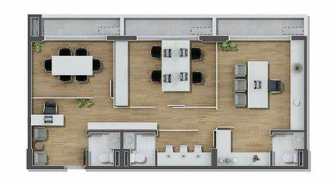
SOLUTION Smoke Detectors
detector status overview
quick overview of selected location
zoomable map to visualize all detectors locations
visualize your detectors on various levels, e.g. within a building or urban area.

Slide 32



BENEFITS Smoke detectors
Legacy responsabilities
solved
30 %
§
€
Maintenance costs
Smoke detectors
insights
Real time alerts
Powered by

Slide 33
THANK YOU FOR YOUR ATTENTION
POWERED BY

