Slide 1
Increasing impact through partnerships and innovations
Dr. Bernd Schramm
GIZ, Global Project Inclusion of Persons with Disabilities
Germany
Collaborative Approaches for Sustainable Impact: Exploring the Zero Project Scaling Solutions and its Partners
Wednesday, 21 February 2024 | 12:00 - 13:00
Notes:
Welcome, my name is Bernd Schramm.
I am the Head of the Global Project Inclusion of Persons with Disabilities at „Deutsche Gesellschaft für Internationale Zusammenarbeit (GIZ) GmbH“.
I want to share with you how we at GIZ want to reach our goals through partnerships and innovations and why we have joined the Zero Project Scaling Programme as a partner.

Slide 2

Deutsche Gesellschaft für Internationale Zusammenarbeit (GIZ)
GIZ works in the field of international development cooperation mainly on behalf of the German Federal Ministry for Economic Cooperation and Development (BMZ)
Currently around 1,500 technical cooperation measures in 120 countries to promote sustainable development (SDG) and human rights
Inclusion and empowerment of persons with disabilities is a priority: Global Disability Summit 2025, OECD-DAC Inclusion Marker, Global Disability Inclusion Programme
Notes:
Let me give you a brief backround about GIZ (Deutsche Gesellschaft für Internationale Zusammenarbeit).
GIZ works in the field of international development cooperation mainly on behalf of the German Federal Ministry for Economic Cooperation and Development (BMZ).
Currently we are implementing around 1,500 projects in 120 countries to promote sustainable development (SDG) and human rights.
Inclusion and empowerment of persons with disabilities is a priority: Global Disability Summit 2025, OECD-DAC Inclusion Marker, Global Disability Inclusion Programme etc.

Slide 3
Why GIZ has joined the Zero Project Scaling Solutions programme as a partner
Linking the innovative disability-tech ecosystem with the world of development cooperation
Identifying and scaling innovations to tackle global challenges, advancing digital inclusion and accessibility
Strengthening of partnerships and networks to leverage synergies and potential for increased sustainable impact
Notes:
Now, why GIZ has joined the Zero Project Scaling Solutions programme as a partner?
Mainly for the following three reasons:
We want to link the innovative disability-tech ecosystem (which Zero Project and its members represent) with the world of development cooperation.
We want to support the identification and scaling-up of innovations to tackle global challenges and to advance digital inclusion and accessibility.
We want to strengthen partnerships and networks to leverage synergies and potential for increased sustainable impact.

Slide 4
What GIZ brings to the partnership with Zero Project, how innovators can benefit from this
Opportunities to showcase innovations and connect expertise for digital innovations worldwide (e.g. GDS 2025)
Access to global BMZ / GIZ initiatives and networks such as ‘digital.global’ or the ‘living inclusion network’
Financial and technical support through German development funds or public-private partnerships
Notes:
What can we as GIZ bring to the partnership with Zero Project, how can innovators / Scaling Fellows benefit from this?
GIZ can provide opportunities to showcase innovations and connect expertise for digital innovations worldwide (e.g. GDS 2025).
We can provide access to global BMZ / GIZ initiatives and networks such as ‘digital.global’ or the ‘living inclusion network’.
And we can provide financial and technical support through German development funds or public-private partnerships.

Slide 5
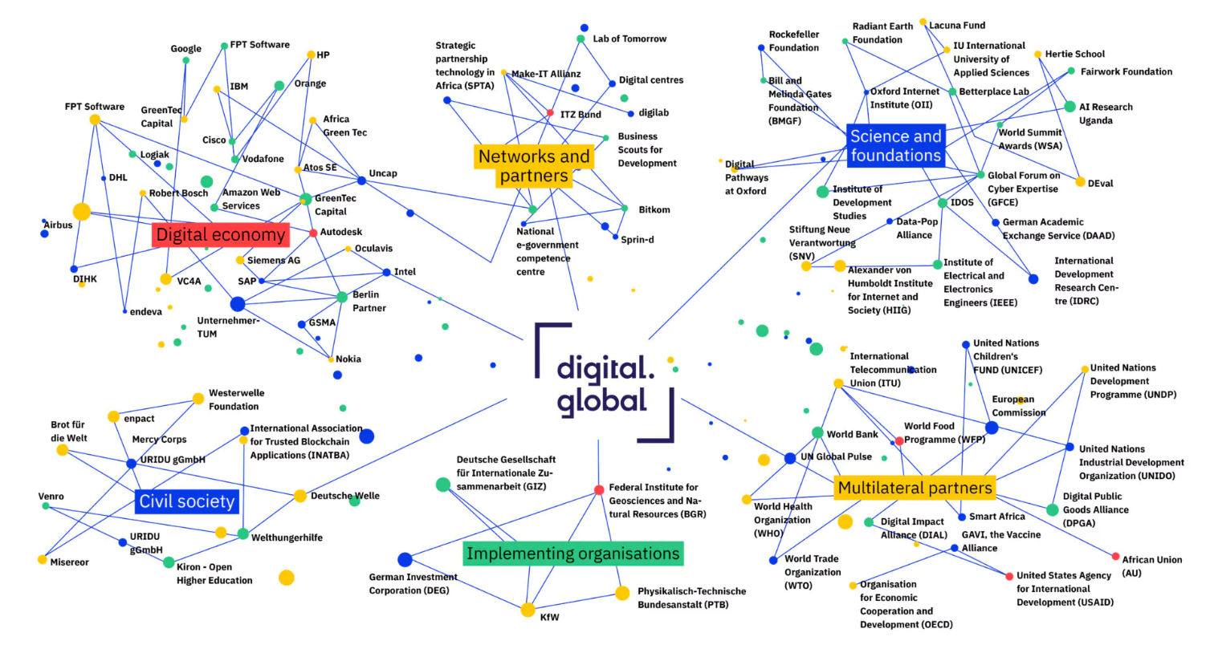

BMZ / GIZ ‘digital.global’ network for digital innovations and leaps in development to achieve the SDGs
Notes:
On the next three slides, I would like to briefly present the current approach and some key projects of BMZ / GIZ on how we increase the impact of our development cooperation through partnerships, innovation and scaling.
The "digital.global" network presented here is a flagship initiative of the BMZ / GIZ and provides an overview of all digital projects, networks and funding opportunities with which German development cooperation aims to address global challenges and achieve the Sustainable Development Goals through digital technologies and innovations.
The core element of digital.global is that BMZ / GIZ have established a broad multi-stakeholder-network, as shown here in the picture.
By working in partnership with all stakeholders, BMZ / GIZ want to contribute to a fair digital transformation worldwide where no one is left behind.

Slide 6
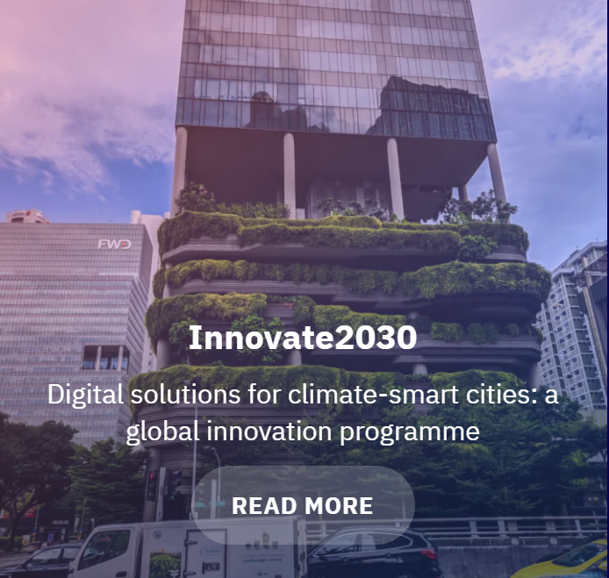
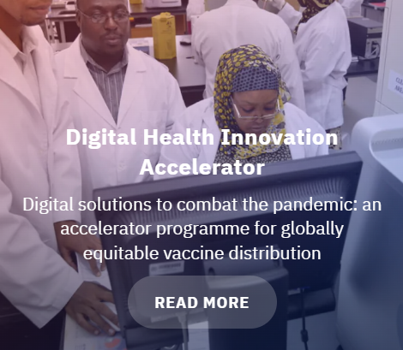
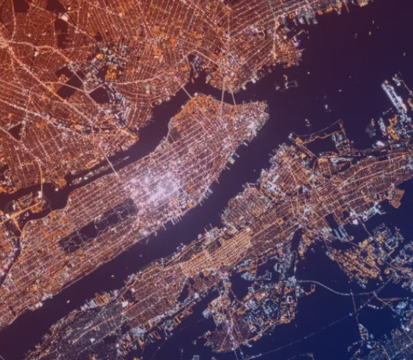
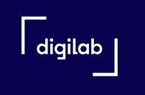
BMZ / GIZ ‘digilab’, an innovation lab and booster for the best digital ideas in international cooperation
Inclusive Innovation 2030
Ensure open access to high-quality, machine learning-ready Earth observation data
Innovate 2030
Digital solutions for
climate-smart cities: a global innovation programme
Digital Health Innovation Accelerator
Digital solutions to combat the pandemic Covid-19
Inclusive
Innovation 2030
Ensure open access to high-quality Earth observation data suitable for machine learning
Notes:
As part of the digital.global network, the ‘digilab”, which is shown here, is a dedicated innovation lab and booster for the best digital ideas in international cooperation.
The digilab supports innovation competitions on the most pressing global challenges of our time and supports the scaling of innovations and the development of sustainable business models for innovators in developing and emerging countries.
The topics of the most recent competitions included digital innovations in the areas of climate-friendly cities, healthcare services, climate change, artificial intelligence and more.

Slide 7
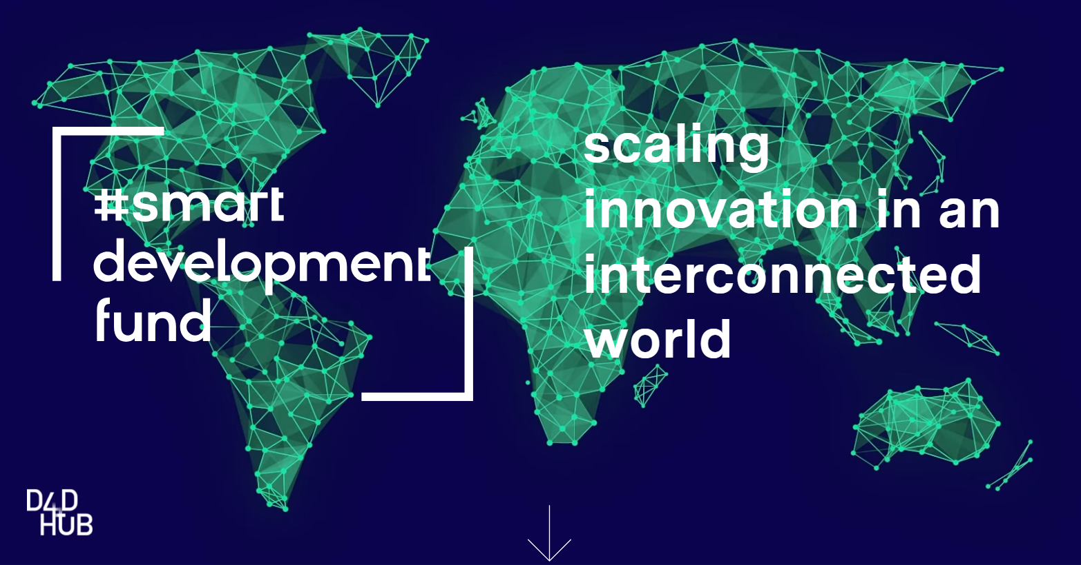
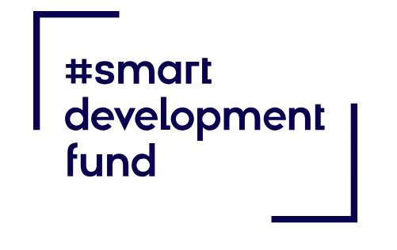
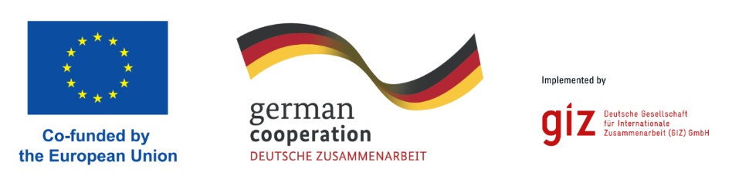
Scaling digital innovation with the
#Smart Development Fund by BMZ / GIZ
Notes:
The #Smart Development Fund, under the leadership of the BMZ, is a multilateral partnership initiative to promote a fair, inclusive and human-centred digital transformation.
The Fund is co-financed by the European Union and other donors and especially supports tech start-ups, non-governmental organisations and social enterprises in the development and scaling up of digital innovations.
This fund could therefore be of interest to many of the innovators and scaling fellows in the room.

Slide 8
Thank you!
Dr. Bernd Schramm
Deutsche Gesellschaft für Internationale Zusammenarbeit (GIZ) GmbH
Global Project Inclusion of Persons with Disabilities
Bernd.Schramm@giz.de
www.giz.de
Notes:
I would like to mention that the topics of digital inclusion and accessibility are not yet sufficiently considered in the aforementioned BMZ / GIZ networks and projects.
This is one of the reasons why we have joined forces with the leading global network Zero Project (together with Atos and Escubreme) to promote and scale digital innovations for greater inclusion and accessibility for persons with disabilities worldwide.
And I would be very happy if, through our partnership with Zero Project and in collaboration with all of you, we could make digital inclusion and accessibility a necessary standard in our entire BMZ/GIZ portfolio.
Thank you very much!
Dr. Bernd Schramm
GIZ
Global Project Inclusion of Persons with Disabilities
Email: Bernd.Schramm@giz.de

