Slide 1
Empowerment Through Coding
Dr. Antal Karolyi
SignCoders
Hungary
ICT career paths for the deaf community
Friday 7 March, 13:00
Notes:
Title: Empowerment Through Coding Author: Antal Károlyi
Organization: SignCoders, We are based in Budapest, Hungary
#ZeroCon24

Slide 2
SignCoders Background
Mission: digital career opportunities for the Deaf community
Impact: ALL employees are hearing-impaired
Services: Software development, Web design and Testing
Notes:
SignCoders Background. Summary of our mission, impact and services

Slide 3
The Essence of SignCoders
Equal career opportunities
Accessible communications
Empowerment
Notes:
We show an example for how equal career opportunities can be implemented in the tech industry
We have accessible communication processes
Empowerment is key. As a digital agency, we compete on the software development services market as equals
We have numerous ongoing EU-wide collaborations to produce educational and training material in Hungarian Sign Language

Slide 4
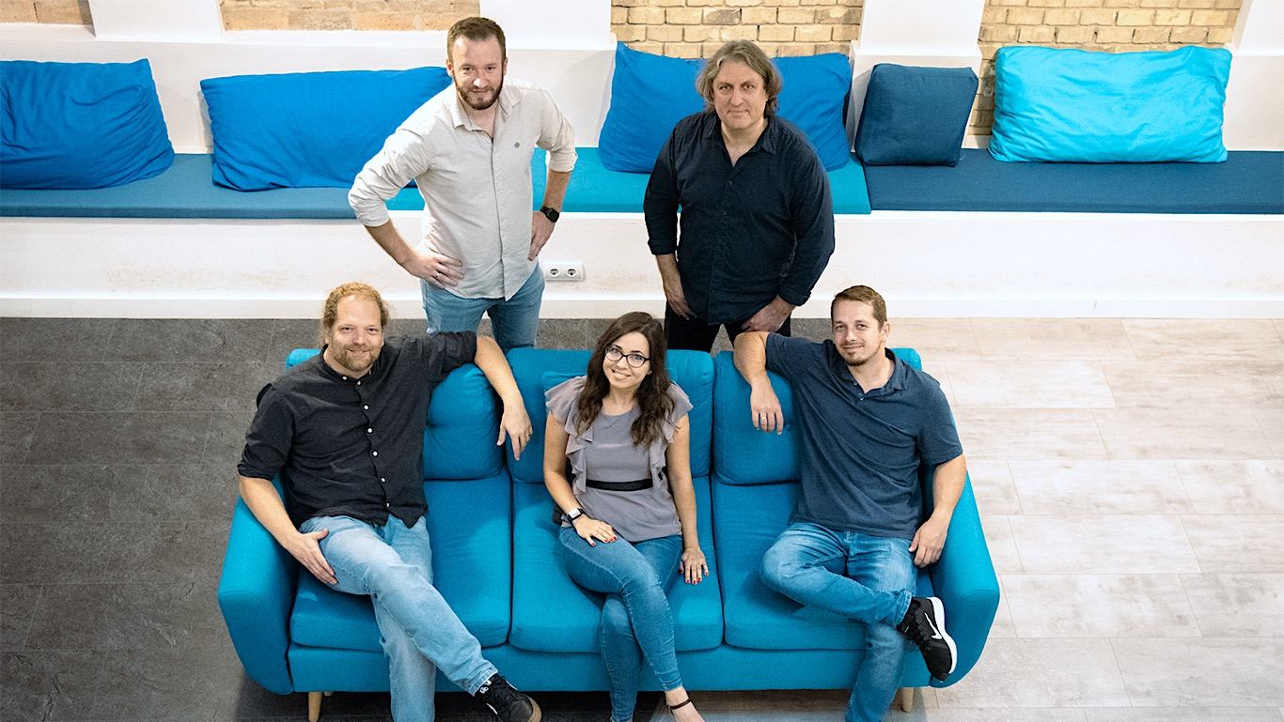
Core Team
Notes:
SignCoders team photo.
Standing on the left: Zoltan, CEO
Standing on the right: Antal, Co-Founder
There is a sofa in front of them
Sitting on the sofa from left to right:
Robert, disability adviser
Anna, web designer
Erik, CTO and Co-Founder

Slide 5
Social innovation via Digital Transformation
SOCIAL INNOVATION
IT careers
Inclusive tech trainings
Equal opportunities
DIGITAL TRANSFORMATION
Digital products
AI tools
Inclusive digital education materials
Notes:
SOCIAL INNOVATION
We provide IT careers for the hard-of-hearing, traditionally inaccessible to them in Hungary
We provide inclusive tech trainings tailored for persons with disability
We promote equal opportunities and career paths in the tech industry
DIGITAL TRANSFORMATION
We build digital products as an agency
AI tools help our day-to-day work to be barrier-free
We create inclusive digital education materials tailored for Deaf and hard-of-hearing individuals

Slide 6
The Impact Created
Empowerment
Inclusive workplace
Employment Opportunities
Social change
Scalable model
Notes:
Empowerment. We help equip the hearing-impaired community with digital skills for sustainable careers
Inclusive workplace. Our team love the fact that the company has been founded specifically to cater their needs
Employment Opportunities. Our community gains marketable skills
Social change: We contribute to breaking down barriers in the tech industry
Scalable model: We show the potential to replicate and expand impact across borders and to other marginalised groups

Slide 7
SignCoders is a love project
Deaf CEO
Committed team members
International network
Role models
Notes:
Our newly appointed CEO is a Deaf team member
We are not just an average workplace. Team members are extremely committed as they identify with the company mission
We are proud to work with international partners and clients mostly
Our hearing-impaired colleagues are role models in the community

Slide 8
Societal recognition
SozialMarie Prize for Social Innovation, Vienna
HRBEST Award
HRmaster Most Innovative HR Professionals
Notes:
SozialMarie Prize for Social Innovation, Vienna Finalists 2023
HRBEST Award in Category 1LIFE, 2023
HRmaster Most Innovative HR Professionals, 2023
OPEN Spotlight Award Special Mention in category Mission Possible, 2019

Slide 9
Financing, sustainability, challenges
We are raising funds for further business development
Notes:
Initial funding: angel investment by one of the co-founders
Two-way revenue Model: Income from client assignments and Erasmus+ grants
The financials are break even but we need to reach economy of scale for a resilient operation
We are raising funds for further business development

Slide 10
Next steps
Grow our service footprint in website accessibility
Open Vienna operations
Notes:
Our primary focus is on business development to reach economy of scale. The two main components toward this goal:
Grow our service footprint in website accessibility
Open Vienna operations

