Slide 1
DISH- Disability Innovative Solutions Hub
Sayomdeb Mukherjee
EnAble India
India
DISH is one of a kind AI-based digital platform where the person and the problem are kept at the centre to identify assistive solutions.
Thursday, February 22, 2024
Notes:
Please add your notes here.
Title; First name, last name of speaker(s); Name of Organization, Name of Country, Name of Session (as written in Agenda)
#ZeroCon24
Day and Time of Session

Slide 2
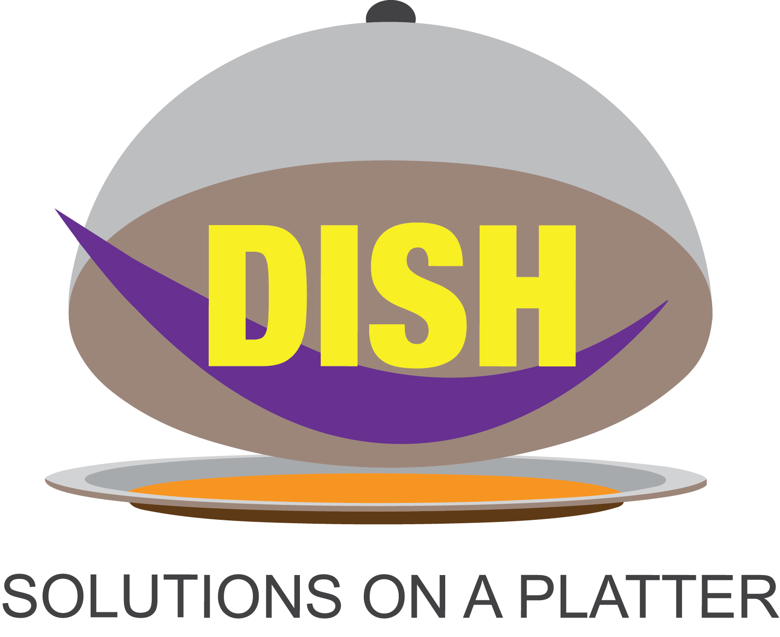
Definition of assistive solutions
As promised last year
An assistive solution can either be a product, process or program that helps a person with disabilities to overcome their barrier.

Slide 3
How does it work?
Zero project
Other Aggregators
Project Discovery
Unifying layer
Technology Solution​
With AI/ML search engine

Slide 4

The areas in which Dish works
Education
By Humans
Political Participation
Employment
For Humanity
Enablers
Wellbeing’s, Growth & fairness
Information & communication Technology (ITC)
Independent living

Slide 5
Innovation Solutions Ecosystem
Start-ups ecosystem
Problem faced
Solutions in hand
Grassroot Innovations
Marketplace
Barriers
Access
Government and International project

Slide 6
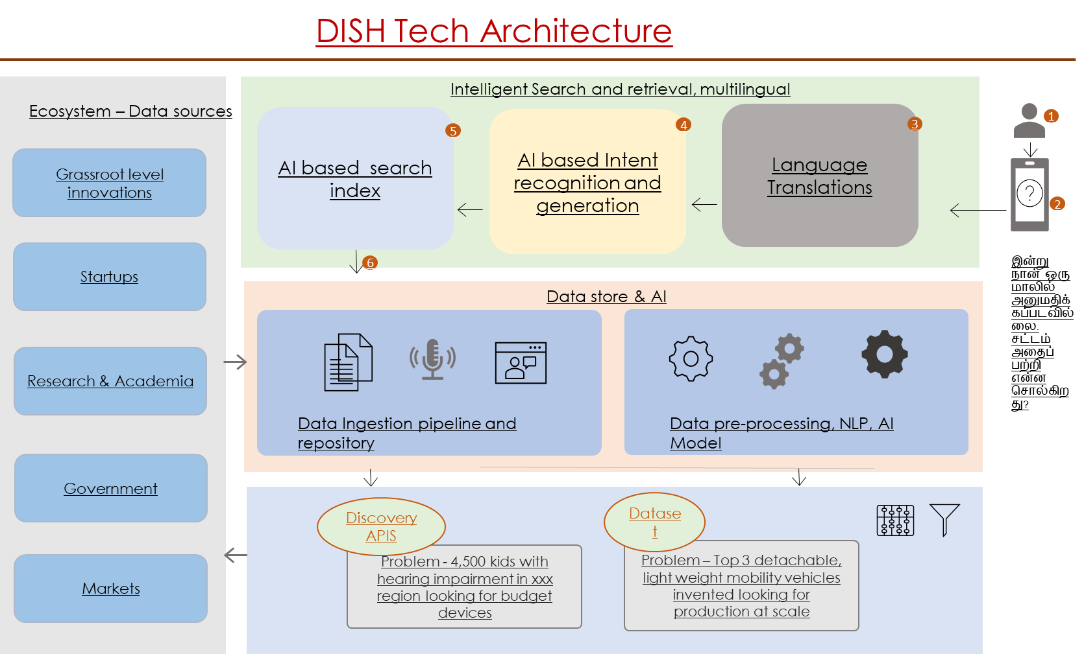
Dish Tech Architecture

Slide 7
What Next?

Slide 8
THANK YOU

