Slide 1
Inclusive Education in Emergencies for children in displaced settings
Ifedinma Nwigwe
Maple Leaf Early Years Foundation
Nigeria
Focus on Sub-Saharan Africa: Comprehensive teaching frameworks
Wednesday February 22, 2024 at 14:40 – 16:00
Notes:
I bring you very warm greetings from our Transitional Learning Centres in Nigeria
It is indeed an honour to be here in Vienna to receive this prestigious award and to be here with other organizations who work with persons with disabilities all around the world.
I salute all my co-awardees and all participants, both in-person and online.

Slide 2
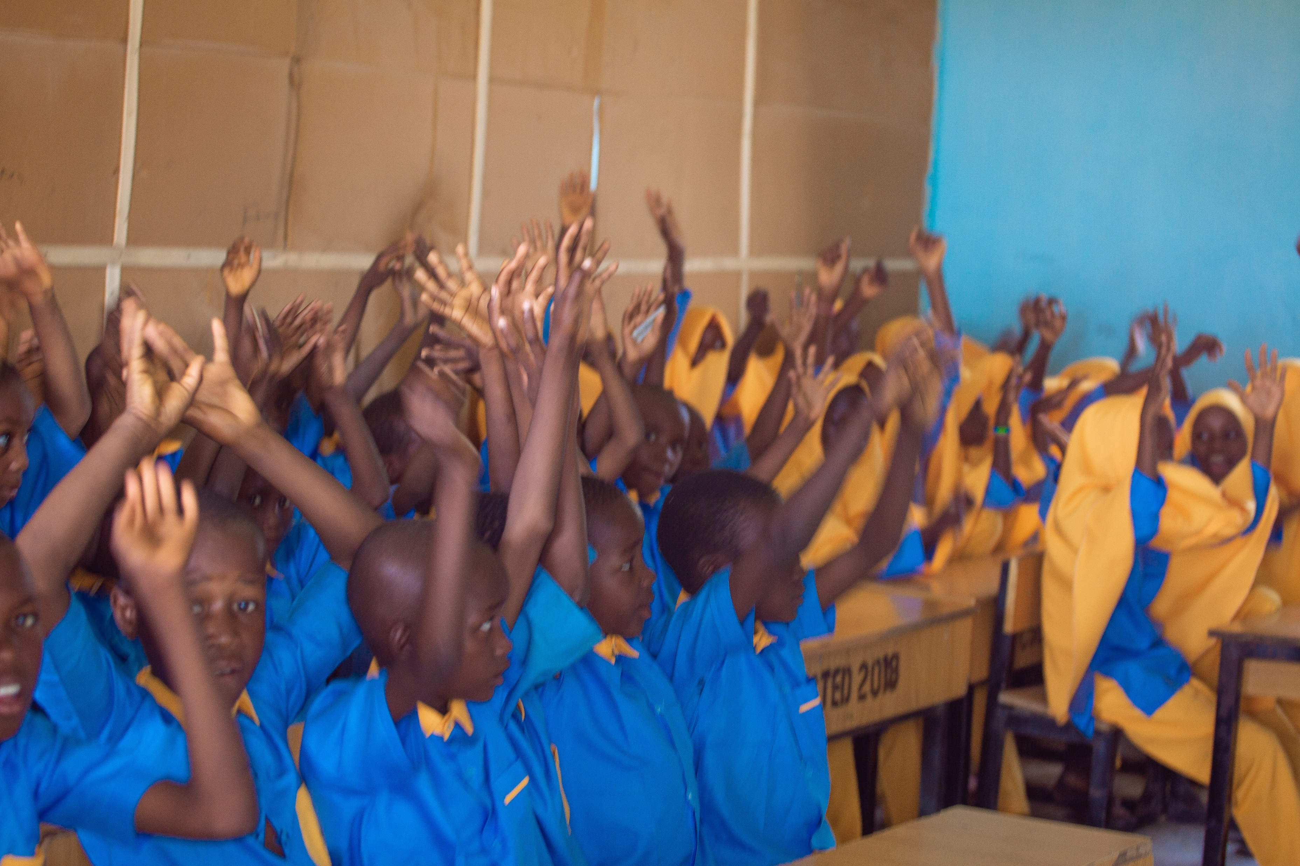
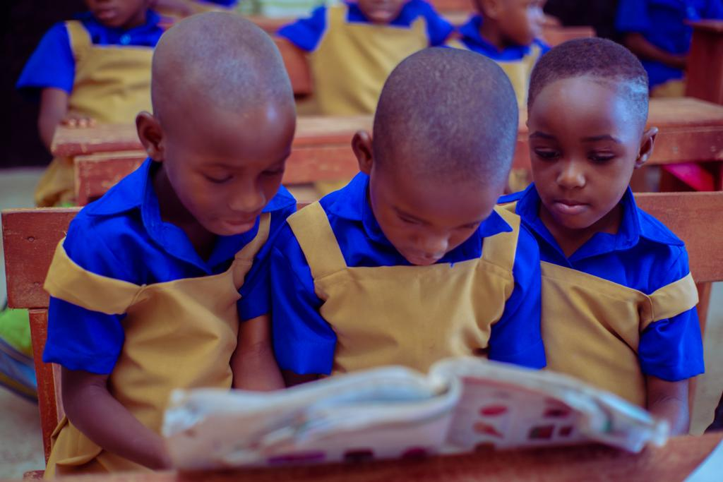
About Maple Leaf Early Years Foundation
Our Transitional Learning Centres (TLCs) are unapologetically inclusive as a matter of necessity as well as sustainability
We work in displaced settings where children typically develop different types of learning and psychosocial disabilities due to the trauma they have experienced
Our holistic approach to education in the TLCs aims to create safe spaces where every child fits in.
#ZeroCon24
Notes:
This year’s Zero Project Conference 2024 theme of inclusive education is very apt for us at Maple Leaf because it is a strategy that we have used that transforms our learning environment (both formal and informal)
Because we work in displaced settings, it is imperative to accommodate all children, regardless of their physical, intellectual, social, emotional, linguistic, or other conditions

Slide 3
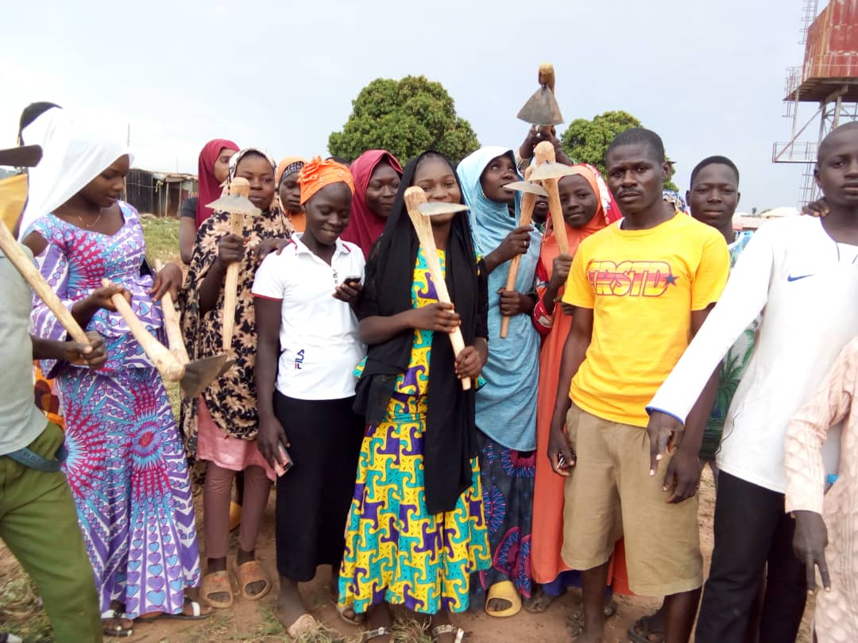
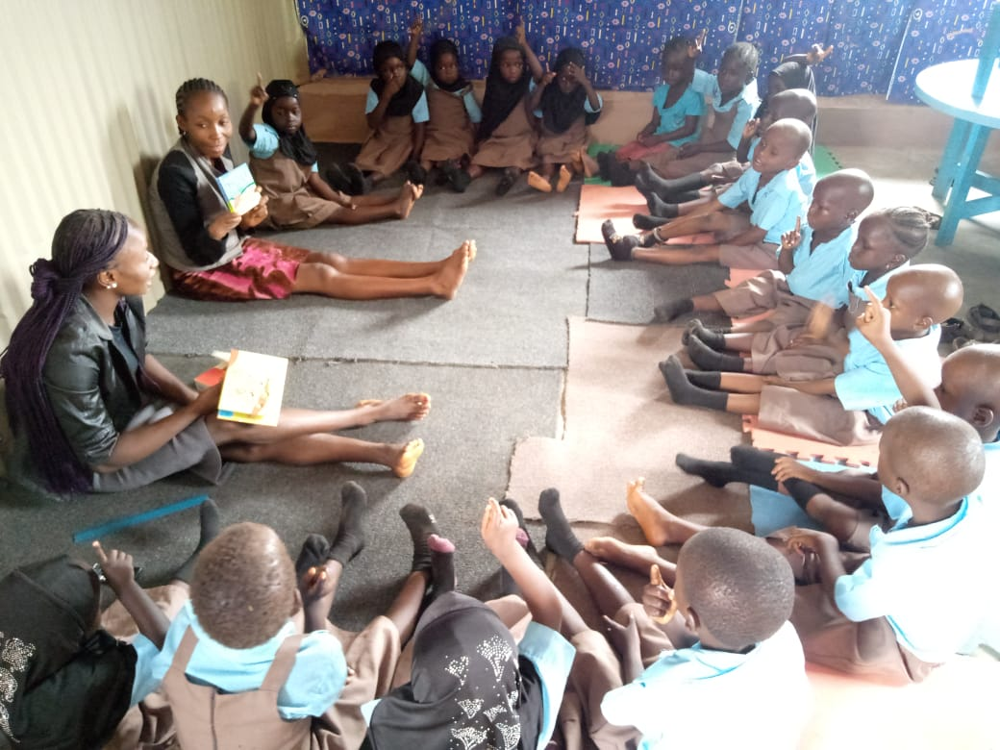
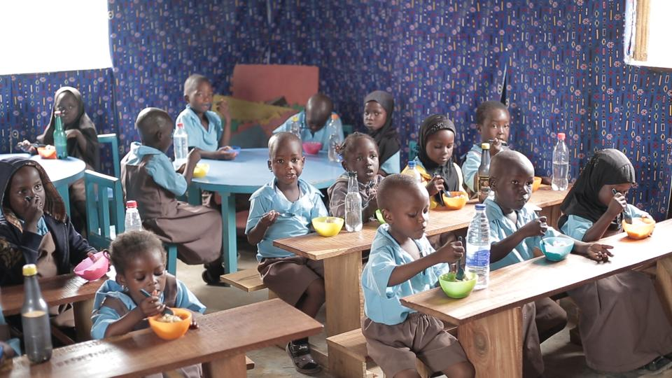
Our Innovation
Holistic by design, to include every child. Every child is eligible
We also are inclusive of staff with disabilities.
Inclusive not just of different abilities but ages as well
Different components enrich the experience for the beneficiaries –
#ZeroCon24
Notes:
Our inclusive culture extends to staff. The children learn by having a teacher with a disability that having a disability does not signal the end of your productivity and your ability to contribute to your community and be a positive influence.
Ms. P. reads a book showing the children the pictures in spite of a disability she was born with in one of her arms

Slide 4
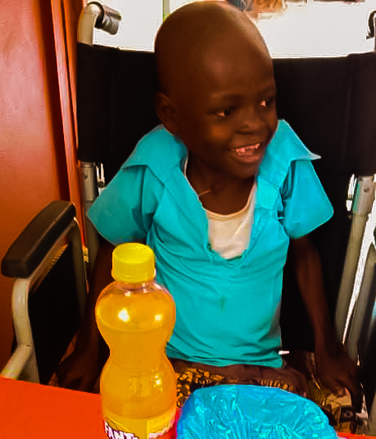
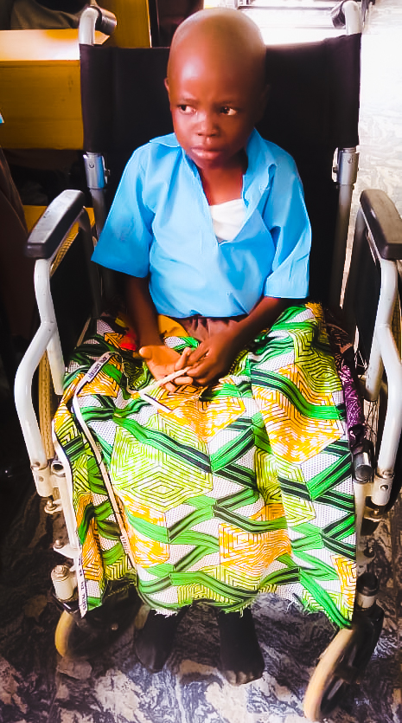
The Impact we are creating
Meet Abdul
Notes:
Abdul’s story
Was not born with this disability
Had to drop out of school as a result of his accident

Slide 5
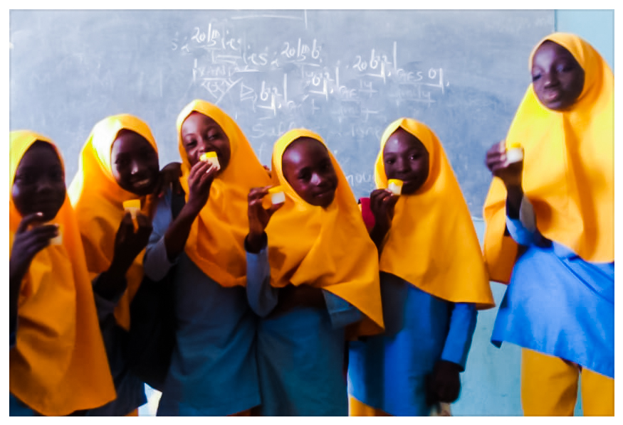
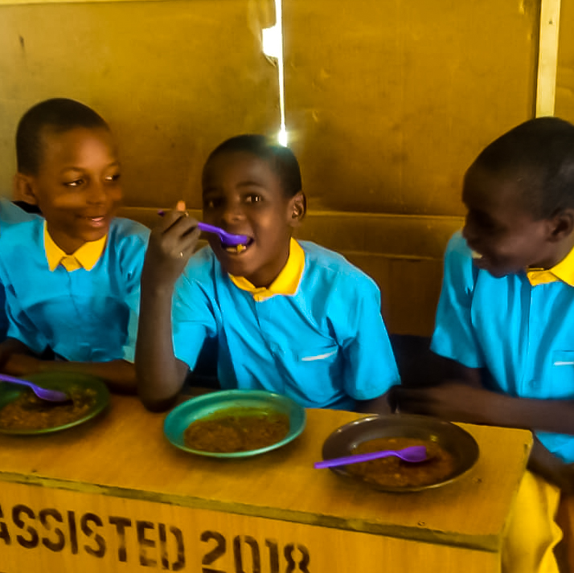
Stories about Maryam and Mus’ab
Notes:
Maryam’s story of her struggles with mental disabilities caused by trauma
Mus’ab’s triumphant recovery as a result of Psychosocial support system.
All three of these children suffer from differing disabilities, but with the right tools, the right attitude and the necessary support, their resilience shines through.

Slide 6
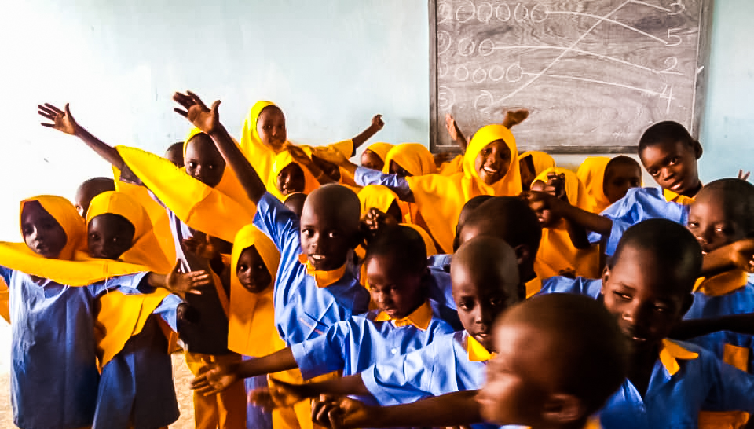
Success Factors
Inclusive of all children with or without disabilities
Inclusive of teachers with disabilities – no discrimination and no biases
Everyone is trained to be accepting of each other through our psychosocial support sessions
The community is highly involved and participatory
Notes:
What successes can we point to with this project?
Children are learning to remove the stigma of having a disability of any kind through inclusive projects such as this
Teachers with disabilities are sources of inspiration for all children and other staff

Slide 7
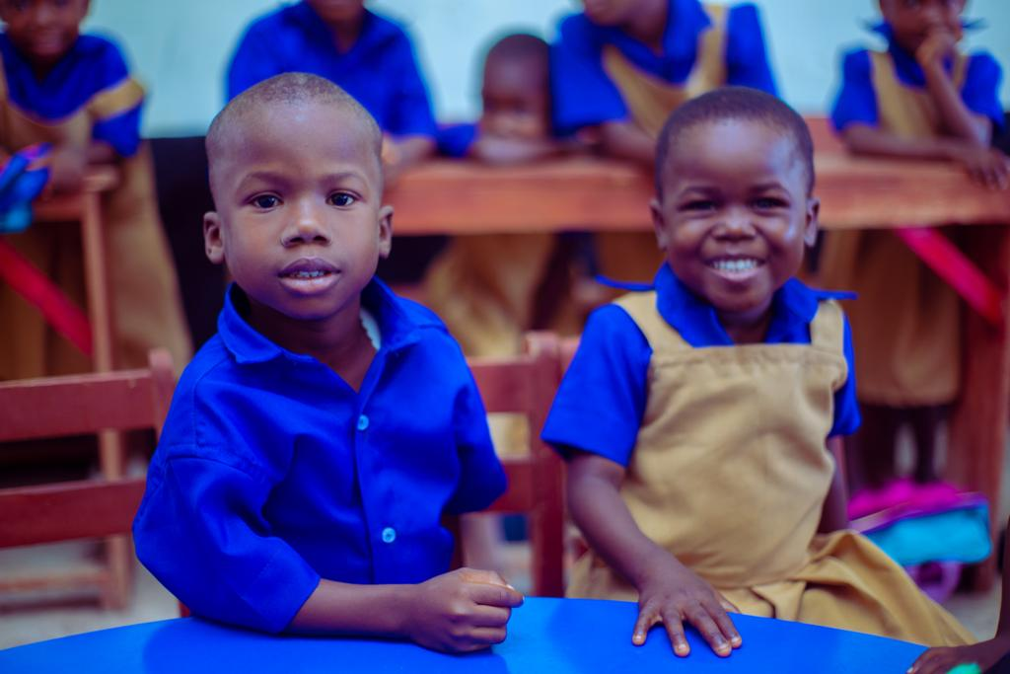
Financing and Sustainability
Financing
Sustainability
Partnerships with:
  The National Commission for Refugees, Migrants and IDPs (Nigeria)
  National Commission for People Living with Disabilities
  Theirworld UK
  Life for Relief and Development, USA
Partnership with the local government areas where the centres are located
Participation of the members of the community – they work with the program
Partnerships with stakeholders and donor organizations
Notes:
Our partnerships help sustain our work with their grants and donations
The communities participate in our programs, thereby helping to keep the program relevant in their communities.
Their involvement in our decision-making process gives them a sense of belonging and ownership.

Slide 8
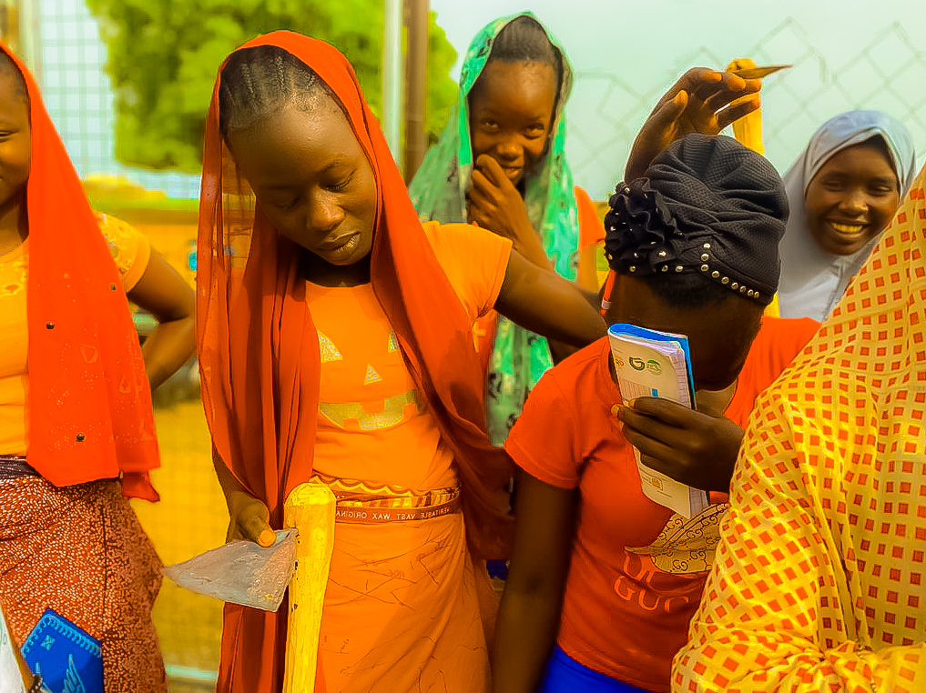
Challenges
Additional and regular professional development for staff – training for inclusive education
A proper/robust referral system for the cases that need to be escalated
Access to assistive equipment for children with mobility and other disabilities
Additional funding to include more children, better infrastructure and additional learning materials
Notes:
If we were asked what our wish list would look like, these are the things we would wish for.
The referral system would involve collaborating with organizations who can provide services that will improve the basic health of the children with disabilities
There are still children we are unable to accommodate due to limited funding and space

Slide 9
Next Steps
Scaling up our programs to reach more children in more communities
Strengthening our existing partnerships with the National Commission for People Living with Disabilities as well as the National Commission for Refugees, Migrants and IDPs.
Conducting more robust advocacy programs that sensitize against the stigmatization of children and persons living with disabilities, including learning and psychosocial/mental disabilities
Notes:
What is the next step in our journey?
We want to reach more children and cover more ground in Nigeria and also in other parts of Africa
Partnerships with the Nigerian government is an advantage as we lend our support as an NGO.
Government cannot do it all

Slide 10
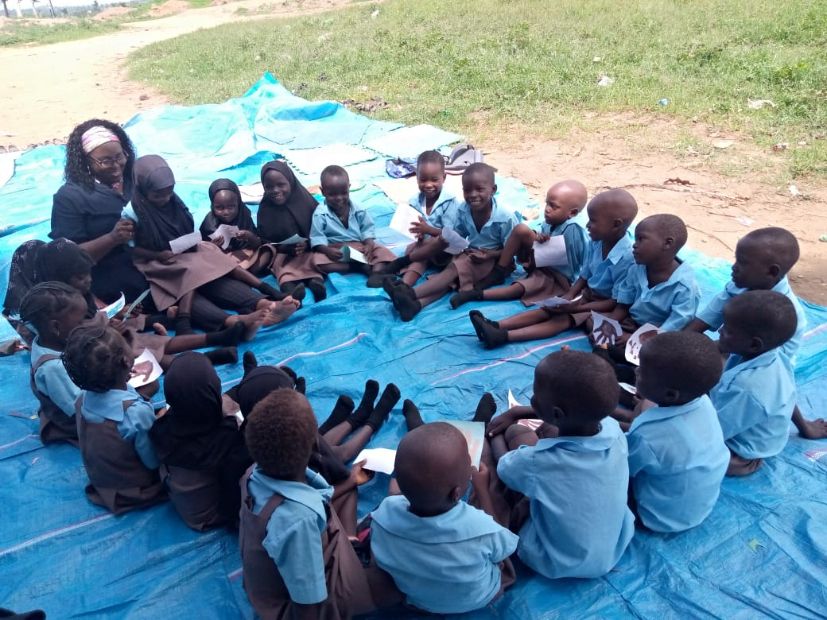
Thank you
It is an honour to be a part of this great community of service
Notes:
Thank you for this opportunity and for the honour of being nominated for this award

