Slide 1
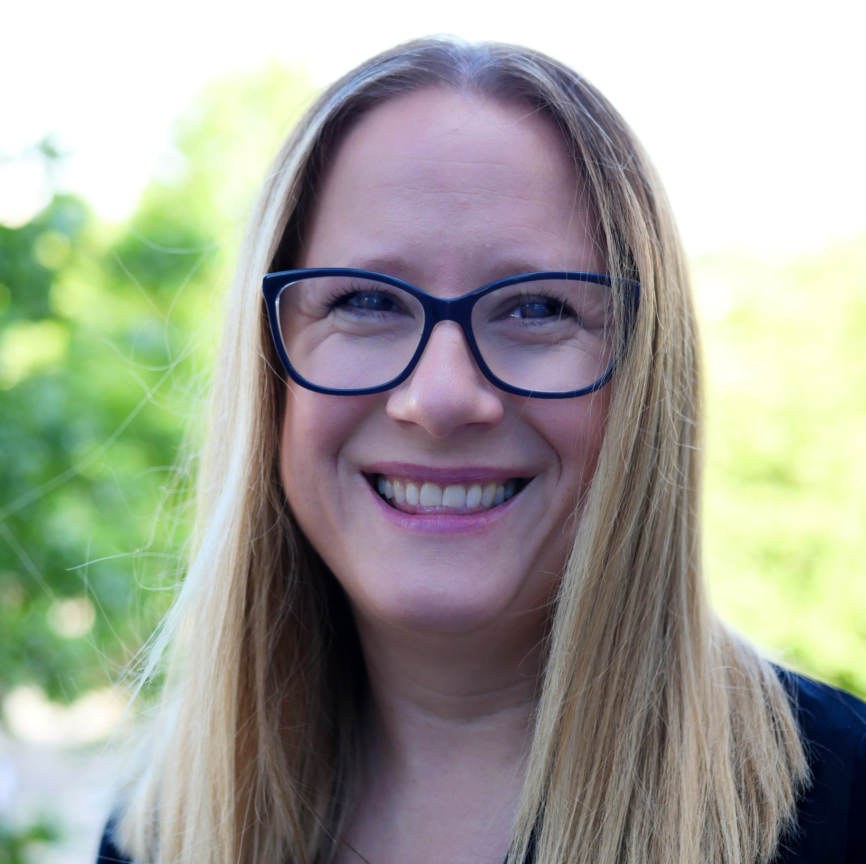
The Right job, not just any job- Supported Employment
Laura Davis

Slide 2
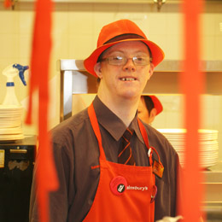
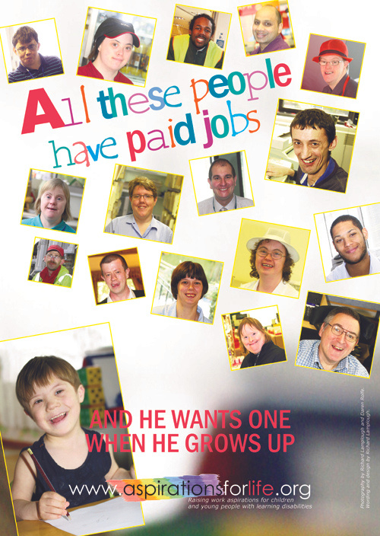
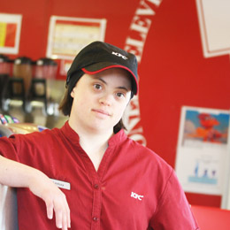
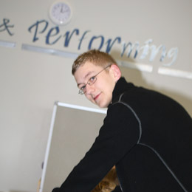
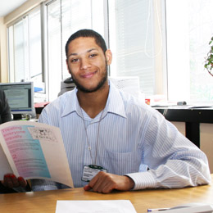
© BASE
Notes:
Laura - This is what is all about, high aspirational jobs

Slide 3
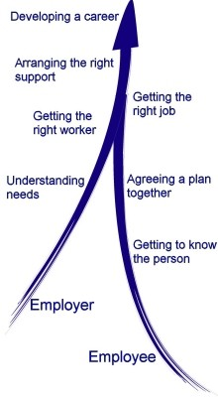
The supported employment methodology
Client engagement
Vocational profile
Employer engagement
Job match
Support & career development
ASEE
BASE
Notes:
Nerise -Supported Employment has been successfully used for decades as a personalised model for supporting people with significant disabilities to secure and retain paid employment.
The model uses a partnership strategy to enable:
people with disabilities to achieve sustainable long-term employment, and
businesses to employ valuable workers.
Increasingly, supported employment techniques are being used to support other disadvantaged groups such as young people leaving care, ex-offenders and people recovering from drug and alcohol misuse.
Work plays a pivotal role in defining an individual's quality of life and must be an integral part of a person's overall life experience.

Slide 4
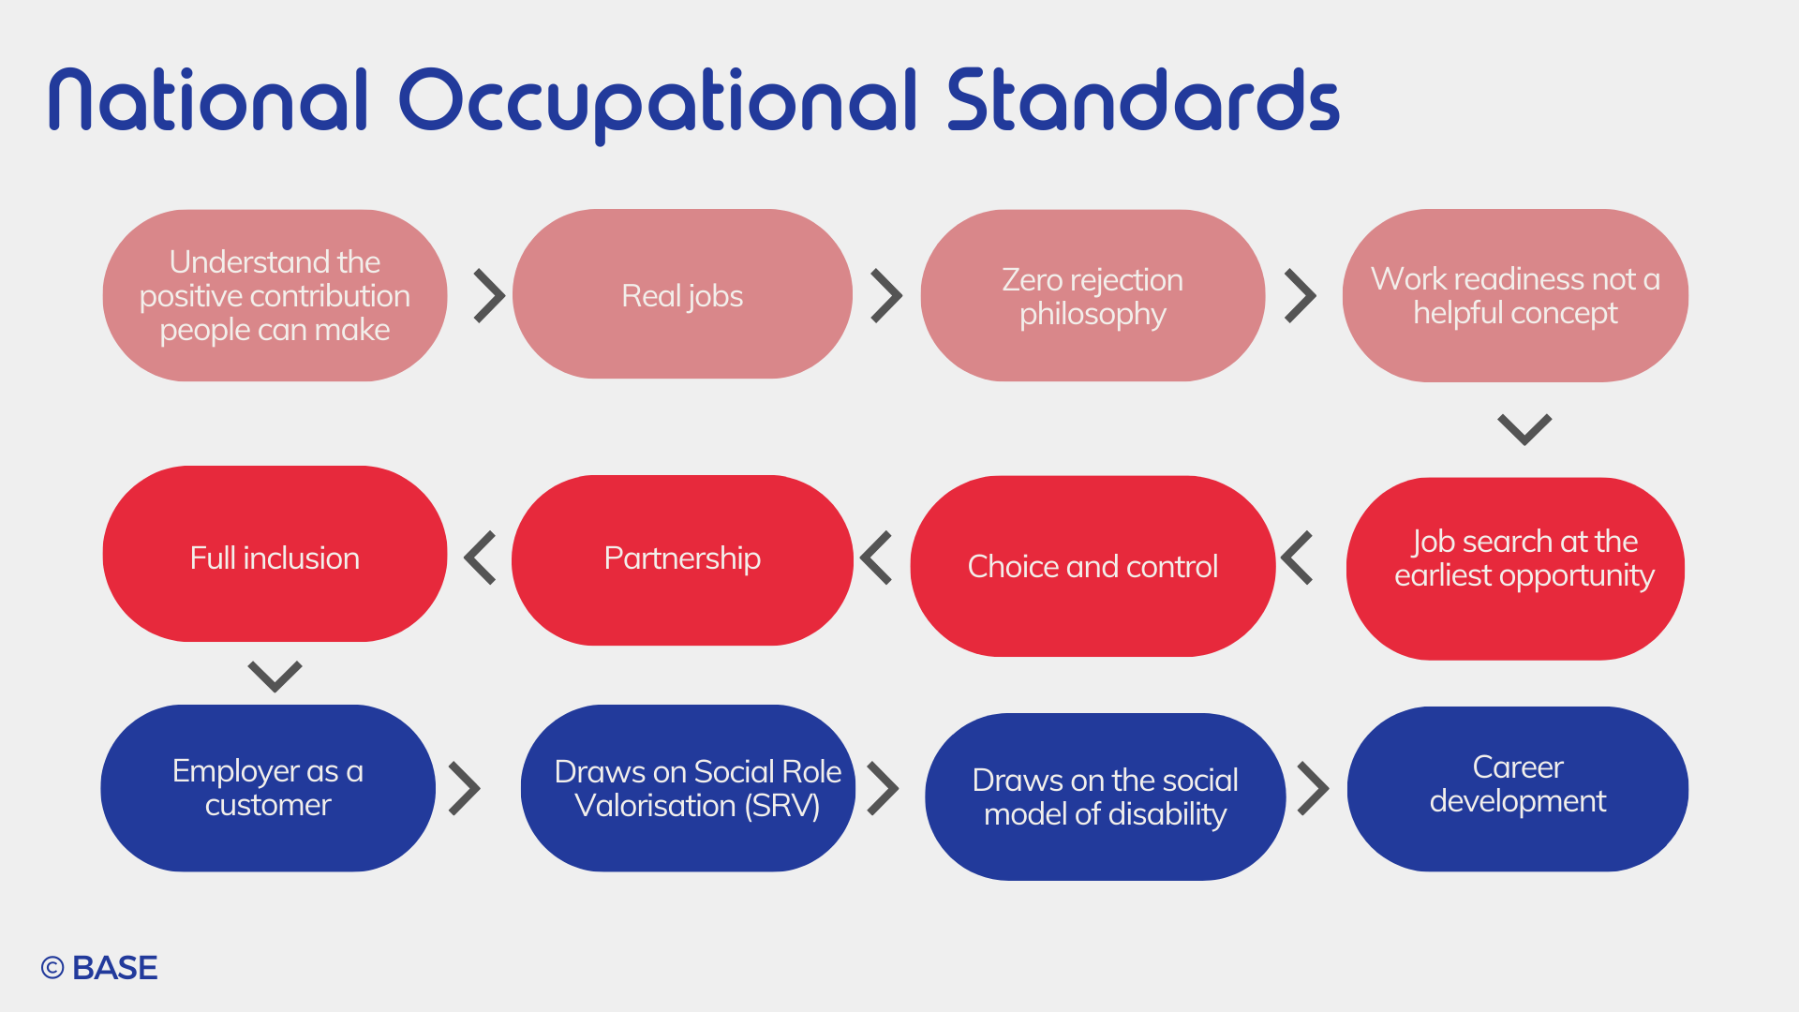
N
Notes:
Nerise - Supported employment is values based and quality driven- look at Zero rejection and work readiness – why this is different than other employability provisions
To practice competently, practitioners must apply skills and knowledge that is informed by a set of values.
These are set out in the National Occupational Standards for Supported Employment.
The core values are throughout the SEQF.

Slide 5
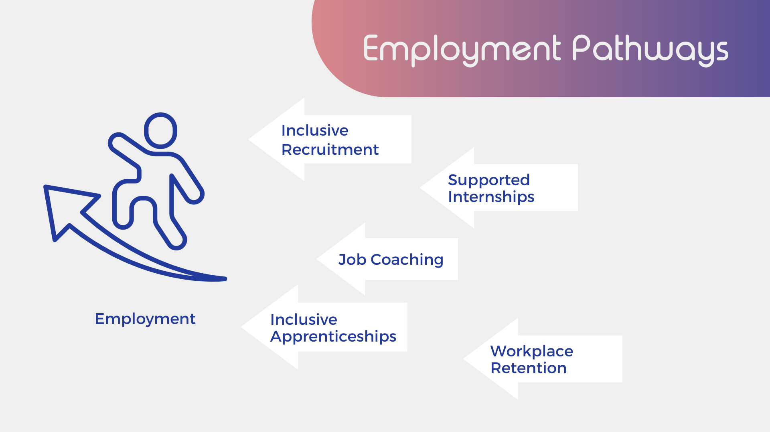
Employment Pathways
Notes:
Laura- Go through each model.

Slide 6

Emails:
laura.davis@base-uk.org
Notes:
Both.

