Slide 1
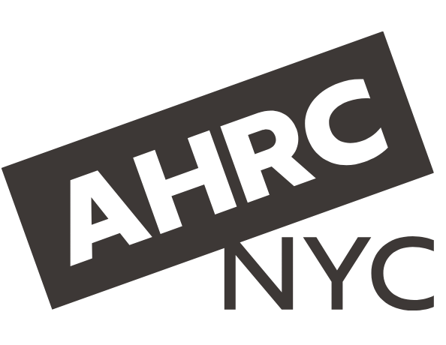
The Partnership for Inclusive Internships
Hannah Millson, Michele Shapiro
AHRC New York City
United States of America
“The Power of Internships”
#ZeroCon25
Thursday, March 6th 13:00
Notes:
Title Slides: The Partnership for Inclusive Internships
Hannah Millson, Michele Shapiro
AHRC New York City
United States of America
“The Power of Internships”
Thursday, March 6th 13:00

Slide 2
The Partnership for Inclusive Internships (PII) at AHRC New York City
Founded in 1949 by a parent of a child with a disability, AHRC New York City is the largest nonprofit supporting people with developmental disabilities in New York State.
Notes:
An overview of AHRC New York City, a large nonprofit that supports people with developmental disabilities in NYC.

Slide 3

Internships in the Public Sector
The PII Program connects qualified candidates with internship opportunities in government agencies
Local government is one of the largest employers in NYC
People with disabilities are underemployed in this sector
Public sector jobs are consistent, well-paying, and offer a career pathway
Notes:
PII Program is an inclusive internship program that partners with local governments. This slide explains why government is a good option for developing an internship program. This slide includes a photo of interns in a board room.

Slide 4
NYC Department of Social Services & The Taft Foundation
NYC Mayor’s Office for Talent and Workforce Development
Partnership formed in 2019 when DSS came to AHRC NYC with an idea to formally host interns with disabilities
Funding provided by the Taft Foundation for a 3-year project
Program funded as a demonstration project by the Center for Workplace Accessibility and Inclusion (CWAI) in 2023
Interim funding provided by the NY Community Trust
Notes:
Slide outlines the funding partners for the start up of the program, and the current funding model in partnership with the City of NY.

Slide 5
PII Program Model
The PII Program works by connecting:
Disability service providers who can source talented candidates, provide targeted support, and understand funding streams for paid internships
    with
Local government agencies who have internship opportunities and jobs available
The PII Program connects the dots, and provides training and programming for supervisors and interns
Notes:
The slide gives an overview of the PII Program model, including how it connects disability service providers to local government.

Slide 6
PII Program Goals: Win-Win
Provide valuable work experience for people with disabilities
Provide valuable resources for government agencies and staff
Catalyze a ‘culture shift’ in government agencies towards more inclusive hiring
Create a talent pipeline for City, State, and Federal hiring
Notes:
This slide describes how the program seeks to bring positive results to both government agencies and people with disabilities.

Slide 7
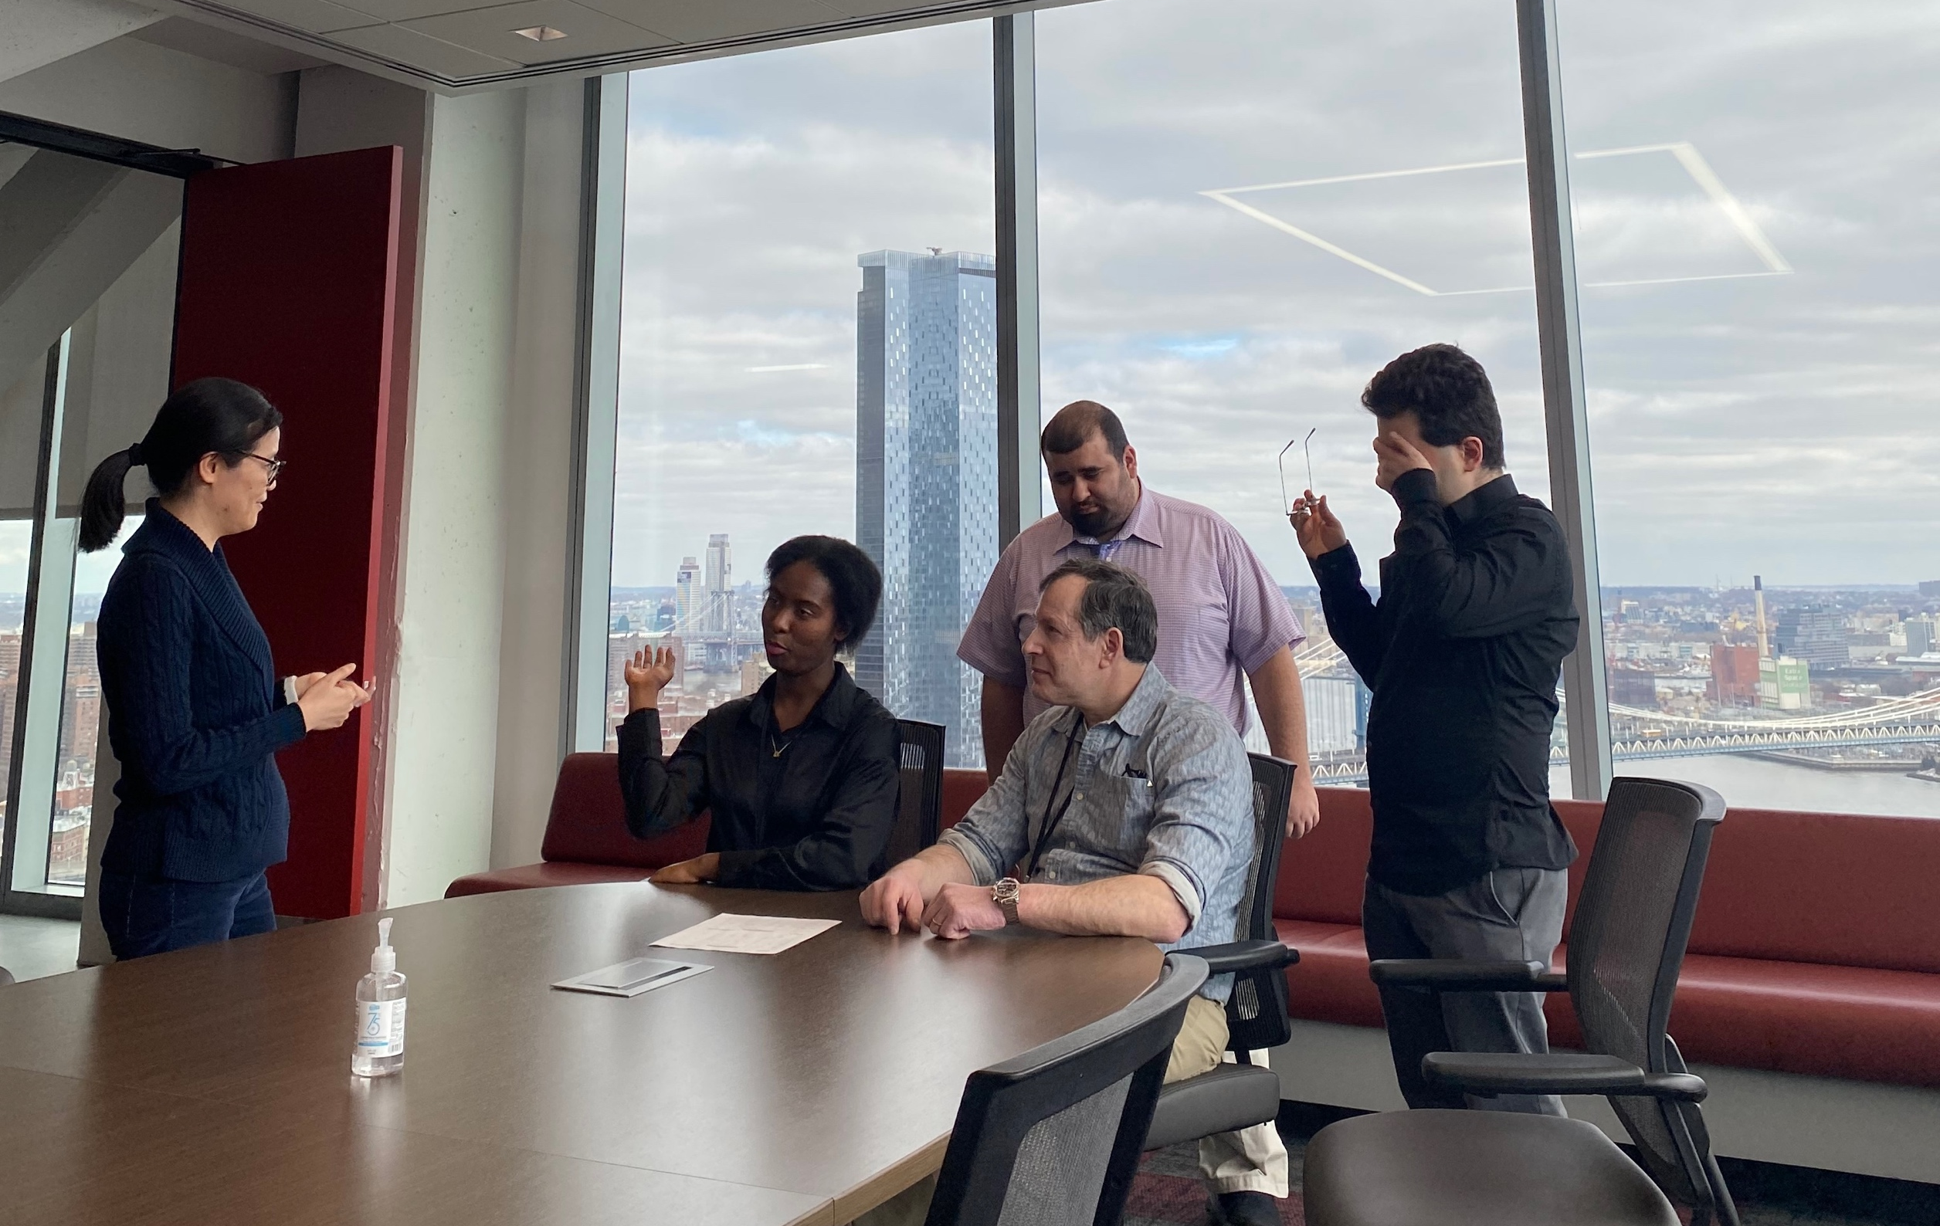
PII Program Elements
Paid Internships
Real-World Work Experience
Concierge Support for Supervisors
Well-Rounded Support for Interns
Notes:
Slide highlights four specific elements of the PII Program: that internships are paid by vocational rehabilitation services, internships reflect real and meaningful work, providing concierge support to supervisors who host an intern, and coaching and supports to interns.

Slide 8
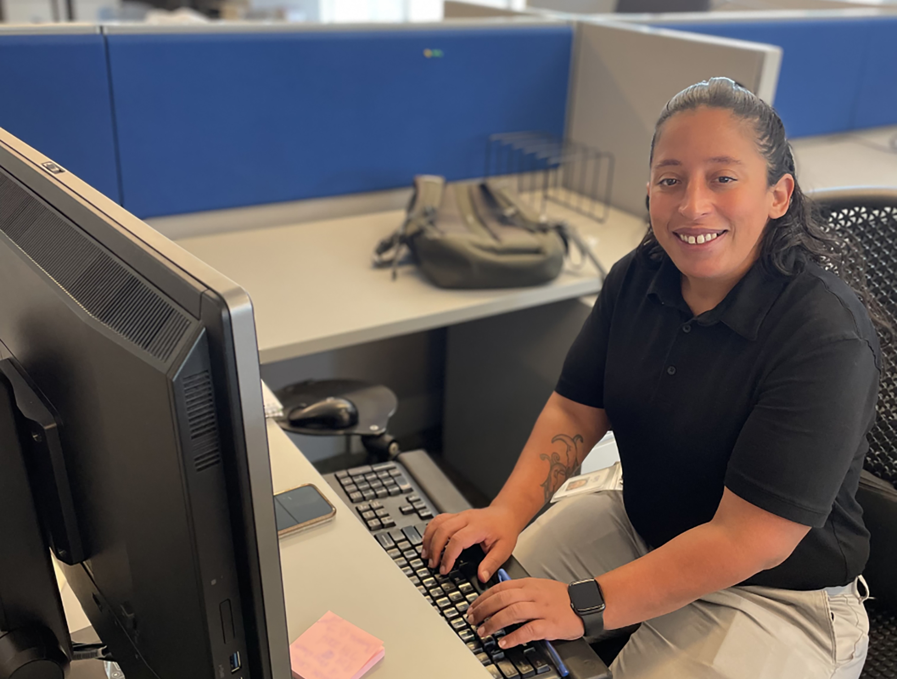
The Value of Internships
Internships are an effective way to challenge stereotypes about people with disabilities, while creating a pipeline of talented candidates for full-time opportunities
38% of our interns go on to work for the organization who hosted their internship
57% of interns go on to competitive employment
Notes:
This slide focuses on why internships are valuable. Internships allow organizations to evaluate potential employees first hand, gaining access to a diverse talent pipeline. Slide has an image of a female intern sitting at a computer, looking at the camera.

Slide 9
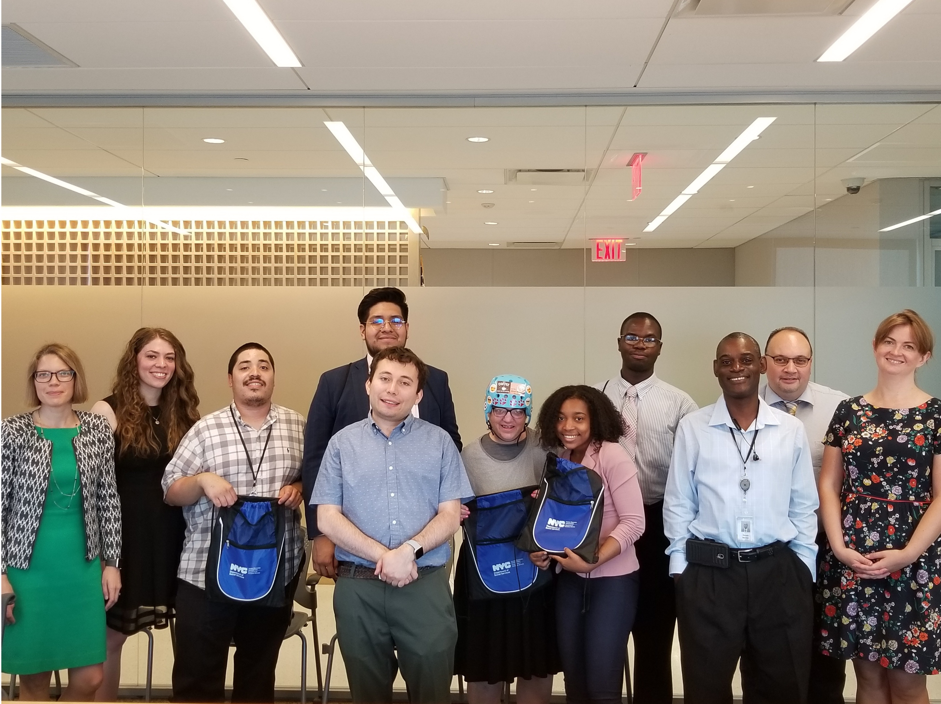
Scalable Solution
The inclusive internship model for local governments is a proven, scalable solution, making it easy for new partners to implement right away.
Internships allow organizations to evaluate potential employees first hand, gaining access to a diverse talent pipeline
Notes:
Slide notes that inclusive internship programs for governments are easily scalable and impactful. Slide includes an image of 10 interns and supervisors smiling in a board room. Some interns are holding up bags that say “New York City Department of Social Services”

Slide 10
Contact Information
Michele Shapiro
Director for Business Development
Michele.Shapiro@ahrcnyc.org
Hannah Millson
Regional Director, Employment and Business Services
Hannah.Millson@ahrcnyc.org

