Slide 1
BE/Bi 205 – Lecture 4
David Van Valen MD, PhD
04/13/2023

Slide 2
Today’s Lecture
Additional machine learning concepts and details
  We covered a lot of ground with the linear classifier, but there were details that we missed.
  Today we’ll go over some of them
Data annotation

Slide 3



Linear classifier recap
Class 0
Class 1
$$\left[\begin{matrix}y_{0} \\ y_{1}\end{matrix}\right]=\left[\begin{matrix}W_{00} & … & W_{0n} \\ W_{10} & … & W_{1n}\end{matrix}\right]\left[\begin{matrix}x_{0} \\ x_{1}\end{matrix}\right]$$
$$p_{i}=\frac{e^{y_{i}}}{e^{y_{0}}+e^{y_{1}}}$$

Slide 4
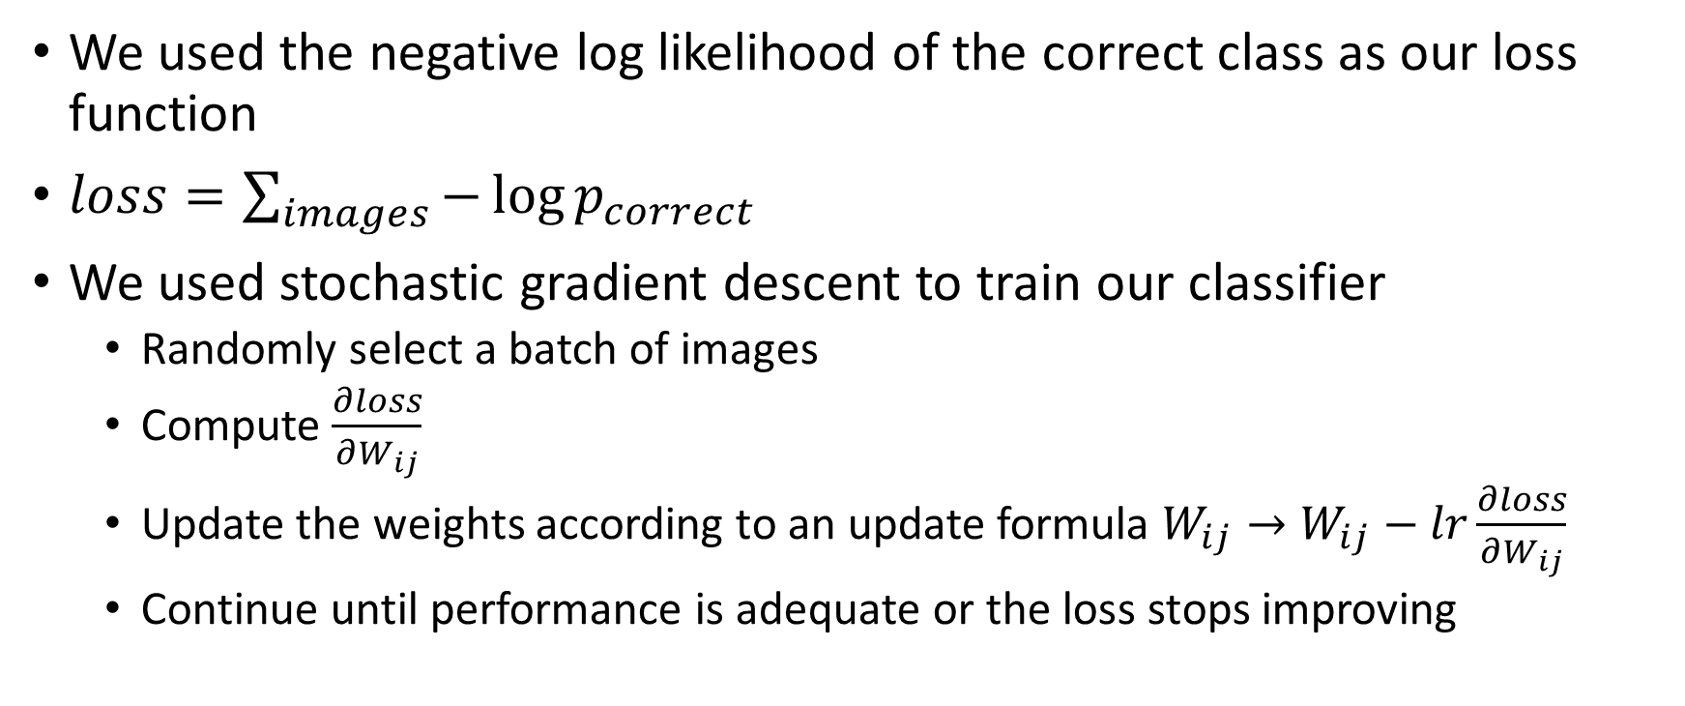
Linear classifier recap
We used the negative log likelihood of the correct class as our loss function
$loss=\sum_{images}{−\log{p_{correct}}}$
We used stochastic gradient descent to train our classifier
  Randomly select a batch of images
  Compute $\frac{∂loss}{∂W_{ij}}$
  Update the weights according to an update formula $W_{ij}→W_{ij}−lr\frac{∂loss}{∂W_{ij}}$
  Continue until performance is adequate or the loss stops improving

Slide 5
Linear classifier recap
We left out some important details, so here we will go over them
Backpropagation: What about more complicated functions?
Regularization: What is overfitting and how do we deal with it?
Training data: Where do we get our labeled training data from?

Slide 6
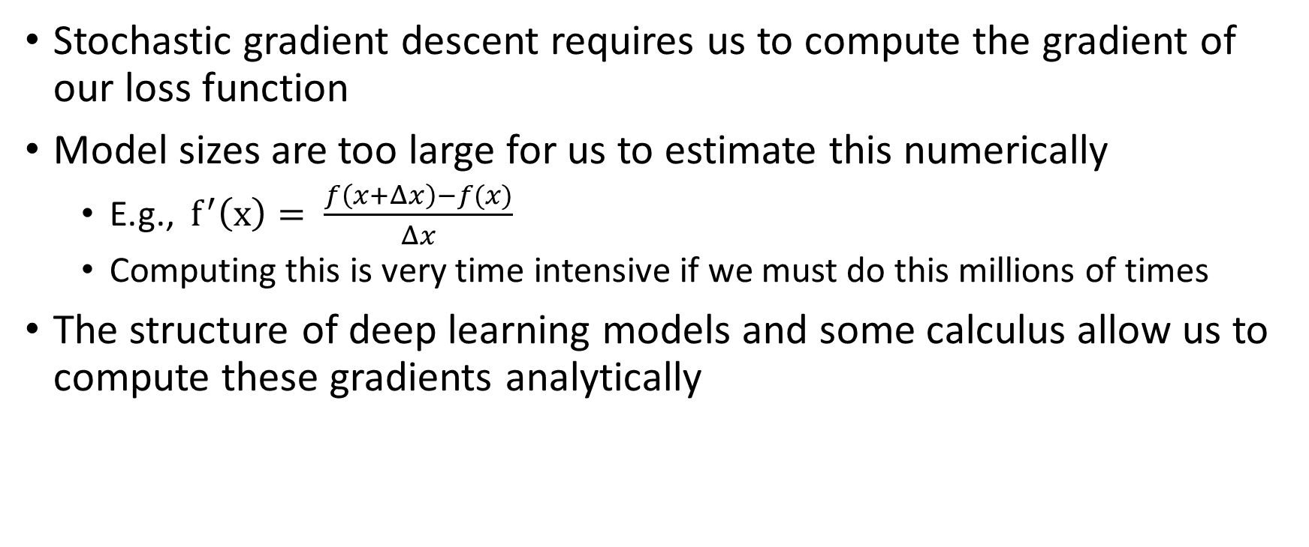
Automatic differentiation
Stochastic gradient descent requires us to compute the gradient of our loss function
Model sizes are too large for us to estimate this numerically
  E.g., $f^{′}\left(x\right)= \frac{f\left(x+Δx\right)−f(x)}{Δx}$
  Computing this is very time intensive if we must do this millions of times
The structure of deep learning models and some calculus allow us to compute these gradients analytically

Slide 7
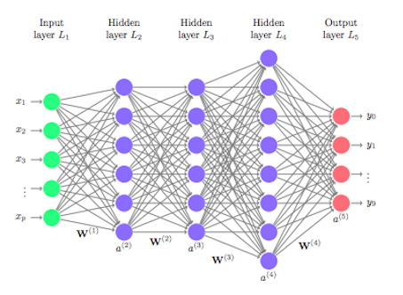
Automatic differentiation
The mathematical structure of deep learning models is compositional
Deep learning models are composed of layers
These layers specify specific mathematical operations
  Example: Matrix multiplication with weights, activation function, softmax transform, etc.

Slide 8
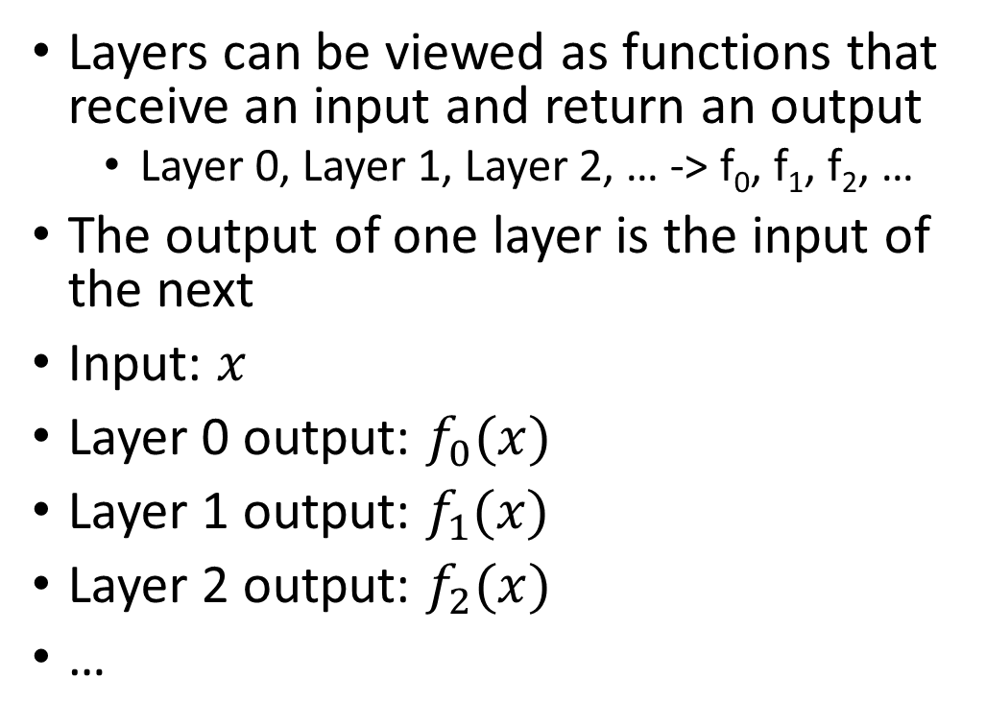
Automatic differentiation
Layers can be viewed as functions that receive an input and return an output
  Layer 0, Layer 1, Layer 2, … -> f₀, f₁, f₂, …
The output of one layer is the input of the next
Input: $x$
Layer 0 output: $f_{0}(x)$
Layer 1 output: $f_{1}(x)$
Layer 2 output: $f_{2}(x)$
…

Slide 9
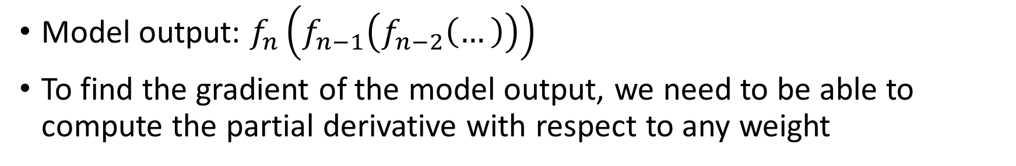
Automatic differentiation
Model output: $f_{n}\left(f_{n−1}\left(f_{n−2}\left(…\right)\right)\right)$
To find the gradient of the model output, we need to be able to compute the partial derivative with respect to any weight

Slide 10
Automatic differentiation
Because the model is compositional, we can iteratively apply the chain rule to compute the partial derivative
  Provided that each layer is differentiable
This algorithm is called backpropagation – it allows us to compute the gradient analytically

Slide 11
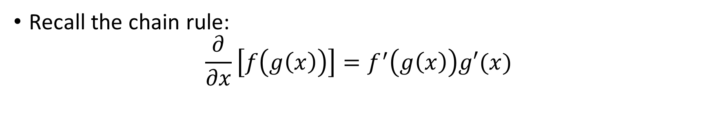
Automatic differentiation
Recall the chain rule:
$\frac{∂}{∂x}\left[f\left(g\left(x\right)\right)\right]=f^{′}\left(g\left(x\right)\right)g′(x)$

Slide 12
Backpropagation
Forward pass: Compute local derivatives along side the original computation for each layer

Slide 13
Backpropagation
Backwards pass: Use the chain rule in conjunction with the local derivatives to compute the derivative of the loss function with respect to each weight

Slide 14
Model capacity and overfitting
As you likely saw during the Jupyter notebook exercise, the linear classifier performs poorly on real data
This is because of the “architecture” of our model
  Models work well when their “structure” match the structure of the data
  Finding a hyperplane in image space (which is high dimensional) that neatly separates images of cats and dogs is unlikely
A model’s ability to learn from data is called the model capacity

Slide 15
Model capacity and overfitting
The model capacity is a nebulous term.
  It is also hard to measure.
A good practice to evaluate a model’s capacity is to benchmark its performance on a standard dataset
  Example: Image classifier’s performance on ImageNet can be used as a surrogate measure of model capacity
  Be careful if the evaluation dataset is substantially different from the dataset you plan to use in practice
Number of parameters/FLOPs is a poor proxy for model capacity

Slide 16
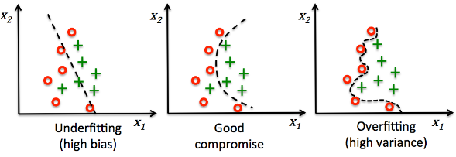
Model capacity and overfitting
Higher model capacity isn’t always better, and with deep learning high model capacity can be a failure mode
A model with high capacity can learn to use dataset specific features in the training data to perform a task

Slide 17
Model capacity and overfitting
Because these features are unique to training data, the model will underperform when used in production
  Machine learning terminology: A model is “in production” when its being deployed in the real world on real data

Slide 18
Model capacity and overfitting
This phenomenon is called overfitting
  In statistics, it is also called the bias-variance trade off
Overfitting is one of the most serious problems with deep learning – practitioners need to pay constant attention to make sure it isn’t present

Slide 19
Model capacity and overfitting
Measuring overfitting is difficult – a general metric for whether a model is overfit doesn’t really exist
A good proxy is to evaluate a model on a held-out validation dataset during training and see whether the training loss and validation loss diverge during training

Slide 20
Model capacity and overfitting
Make sure held-out data is different from the training data!
Data leaks occur when training data appears in held-out datasets
Data leaks are a serious problem in practice and can still occur even if you’re doing a proper training/validation/testing split

Slide 21
Regularization
In machine learning, regularization refers to a set of methods that minimize overfitting
Different regularization methods operate at different parts of the machine learning life cycle

Slide 22
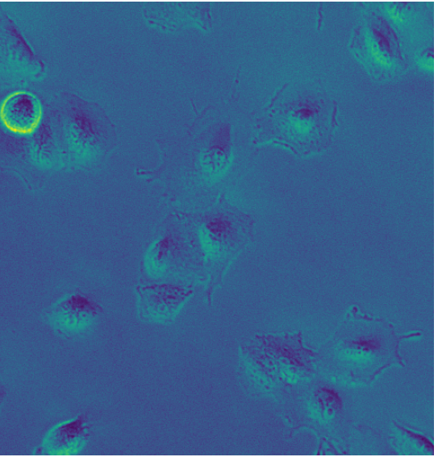
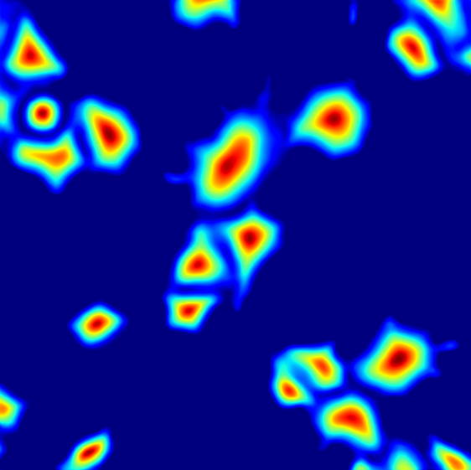
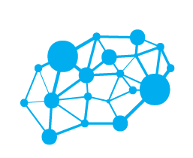
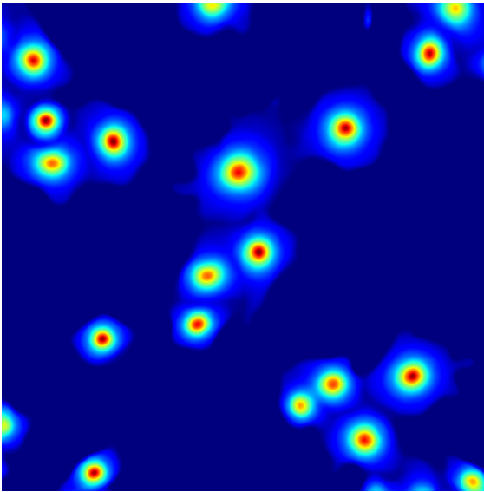

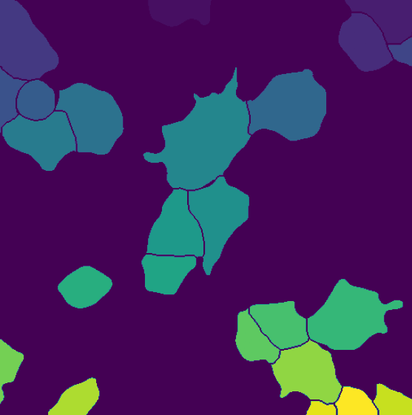
Regularization
Training Data
Data Augmentation
Model
Specification
Model
Training
Post
Processing

Slide 23
Regularization
Training Data
Data Augmentation
Model
Specification
Model
Training
Post
Processing
Increasing the amount and diversity of training data
Performing data augmentation
Including architectural elements that regularize
Dropout
Batch Normalization
Hard-coding respect for problem symmetries
Including regularization in the loss function
L2 regularization

Slide 24
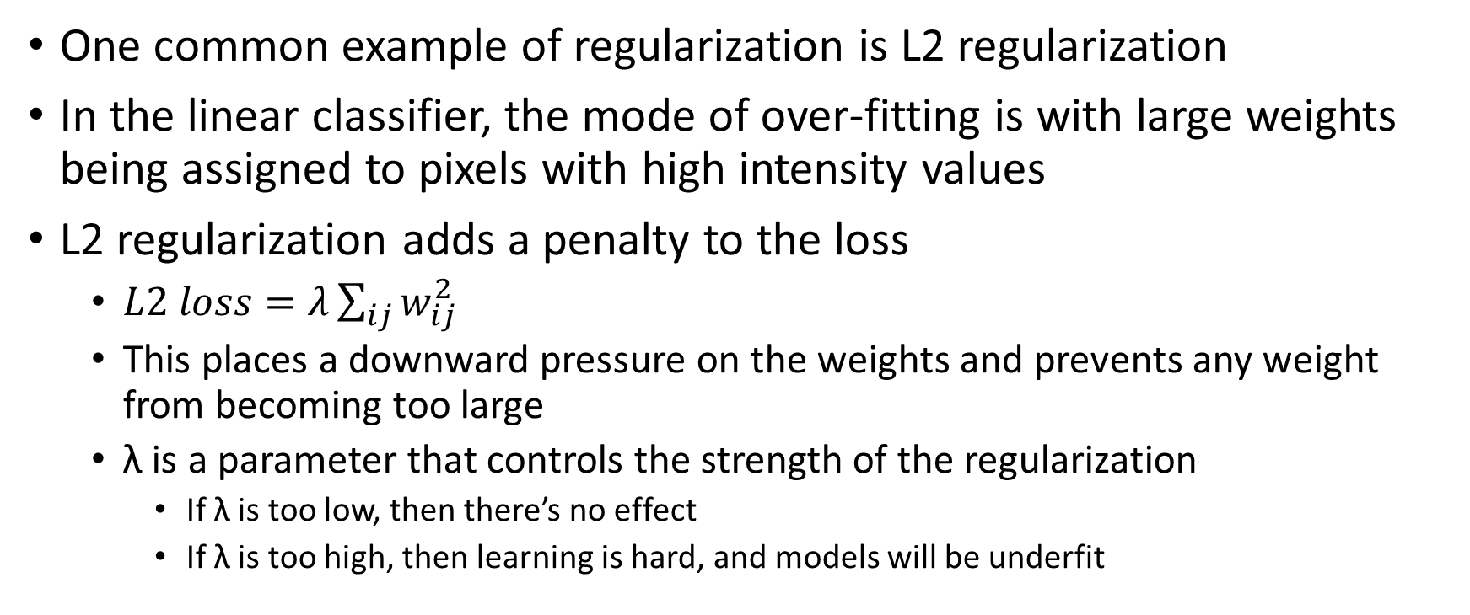
Regularization: L2 regularization
One common example of regularization is L2 regularization
In the linear classifier, the mode of over-fitting is with large weights being assigned to pixels with high intensity values
L2 regularization adds a penalty to the loss
  $L2 loss=λ\sum_{ij}{w_{ij}^{2}}$
  This places a downward pressure on the weights and prevents any weight from becoming too large
  λ is a parameter that controls the strength of the regularization
    If λ is too low, then there’s no effect
    If λ is too high, then learning is hard, and models will be underfit

Slide 25
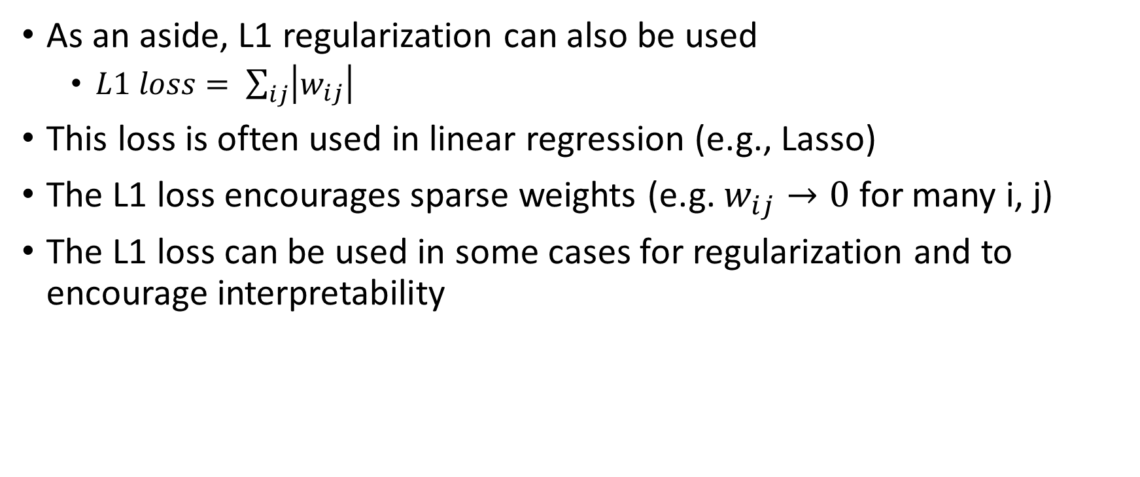
Regularization: L1 regularization
As an aside, L1 regularization can also be used
  $L1 loss= \sum_{ij}{\left|w_{ij}\right|}$
This loss is often used in linear regression (e.g., Lasso)
The L1 loss encourages sparse weights (e.g. $w_{ij}→0$ for many i, j)
The L1 loss can be used in some cases for regularization and to encourage interpretability

Slide 26
Initialization
How weights are initialized has a large impact on model training
  Poorly initialized models can have gradients vanish or explode
  Even if they train, most of the training time is spent figuring out how to leave the bad area of parameter space
  This issue is primarily solved
The most common initialization settings include:
  Kaiming or He initialization: Only depends on the number of input channels. Preserves mean and standard deviation of weight layers.
  Glorot or Xavier initialization: Depends on both the number of input and output channels.
  Orthogonal initialization: Weight matrices are constrained to be orthogonal, preserving the independence of the input signal.

Slide 27
Initialization
Most software libraries have default initialization settings for deep learning layers
For most cases, changing the default setting isn’t necessary
  Exceptions include custom layers and when things aren’t working
Practical advice:
  Pay close attention to custom layers
  Avoid initialization with zero values – it can be very hard to leave local minima
  Compare the model performance to random chance – poor initializations will often perform worse than this

Slide 28
Initialization: pretrained networks
Initial network spends time learning non-task-specific things
  E.g., correlations between amino acids, ”what is an edge, ” etc.
This is a problem when data is expensive
A good solution is to use include a pre-trained network as part of your model and then perform additional training (fine tuning) on your own data
HuggingFace and Keras Applications are good sources of pre-trained networks

Slide 29
Pretrained networks
Benefits:
  Can significantly improve training time
  Can efficiently use task-specific data
  Can make use of unlabeled data for pretraining
    Usually, unlabeled data vastly outnumbers labeled data!

Slide 30
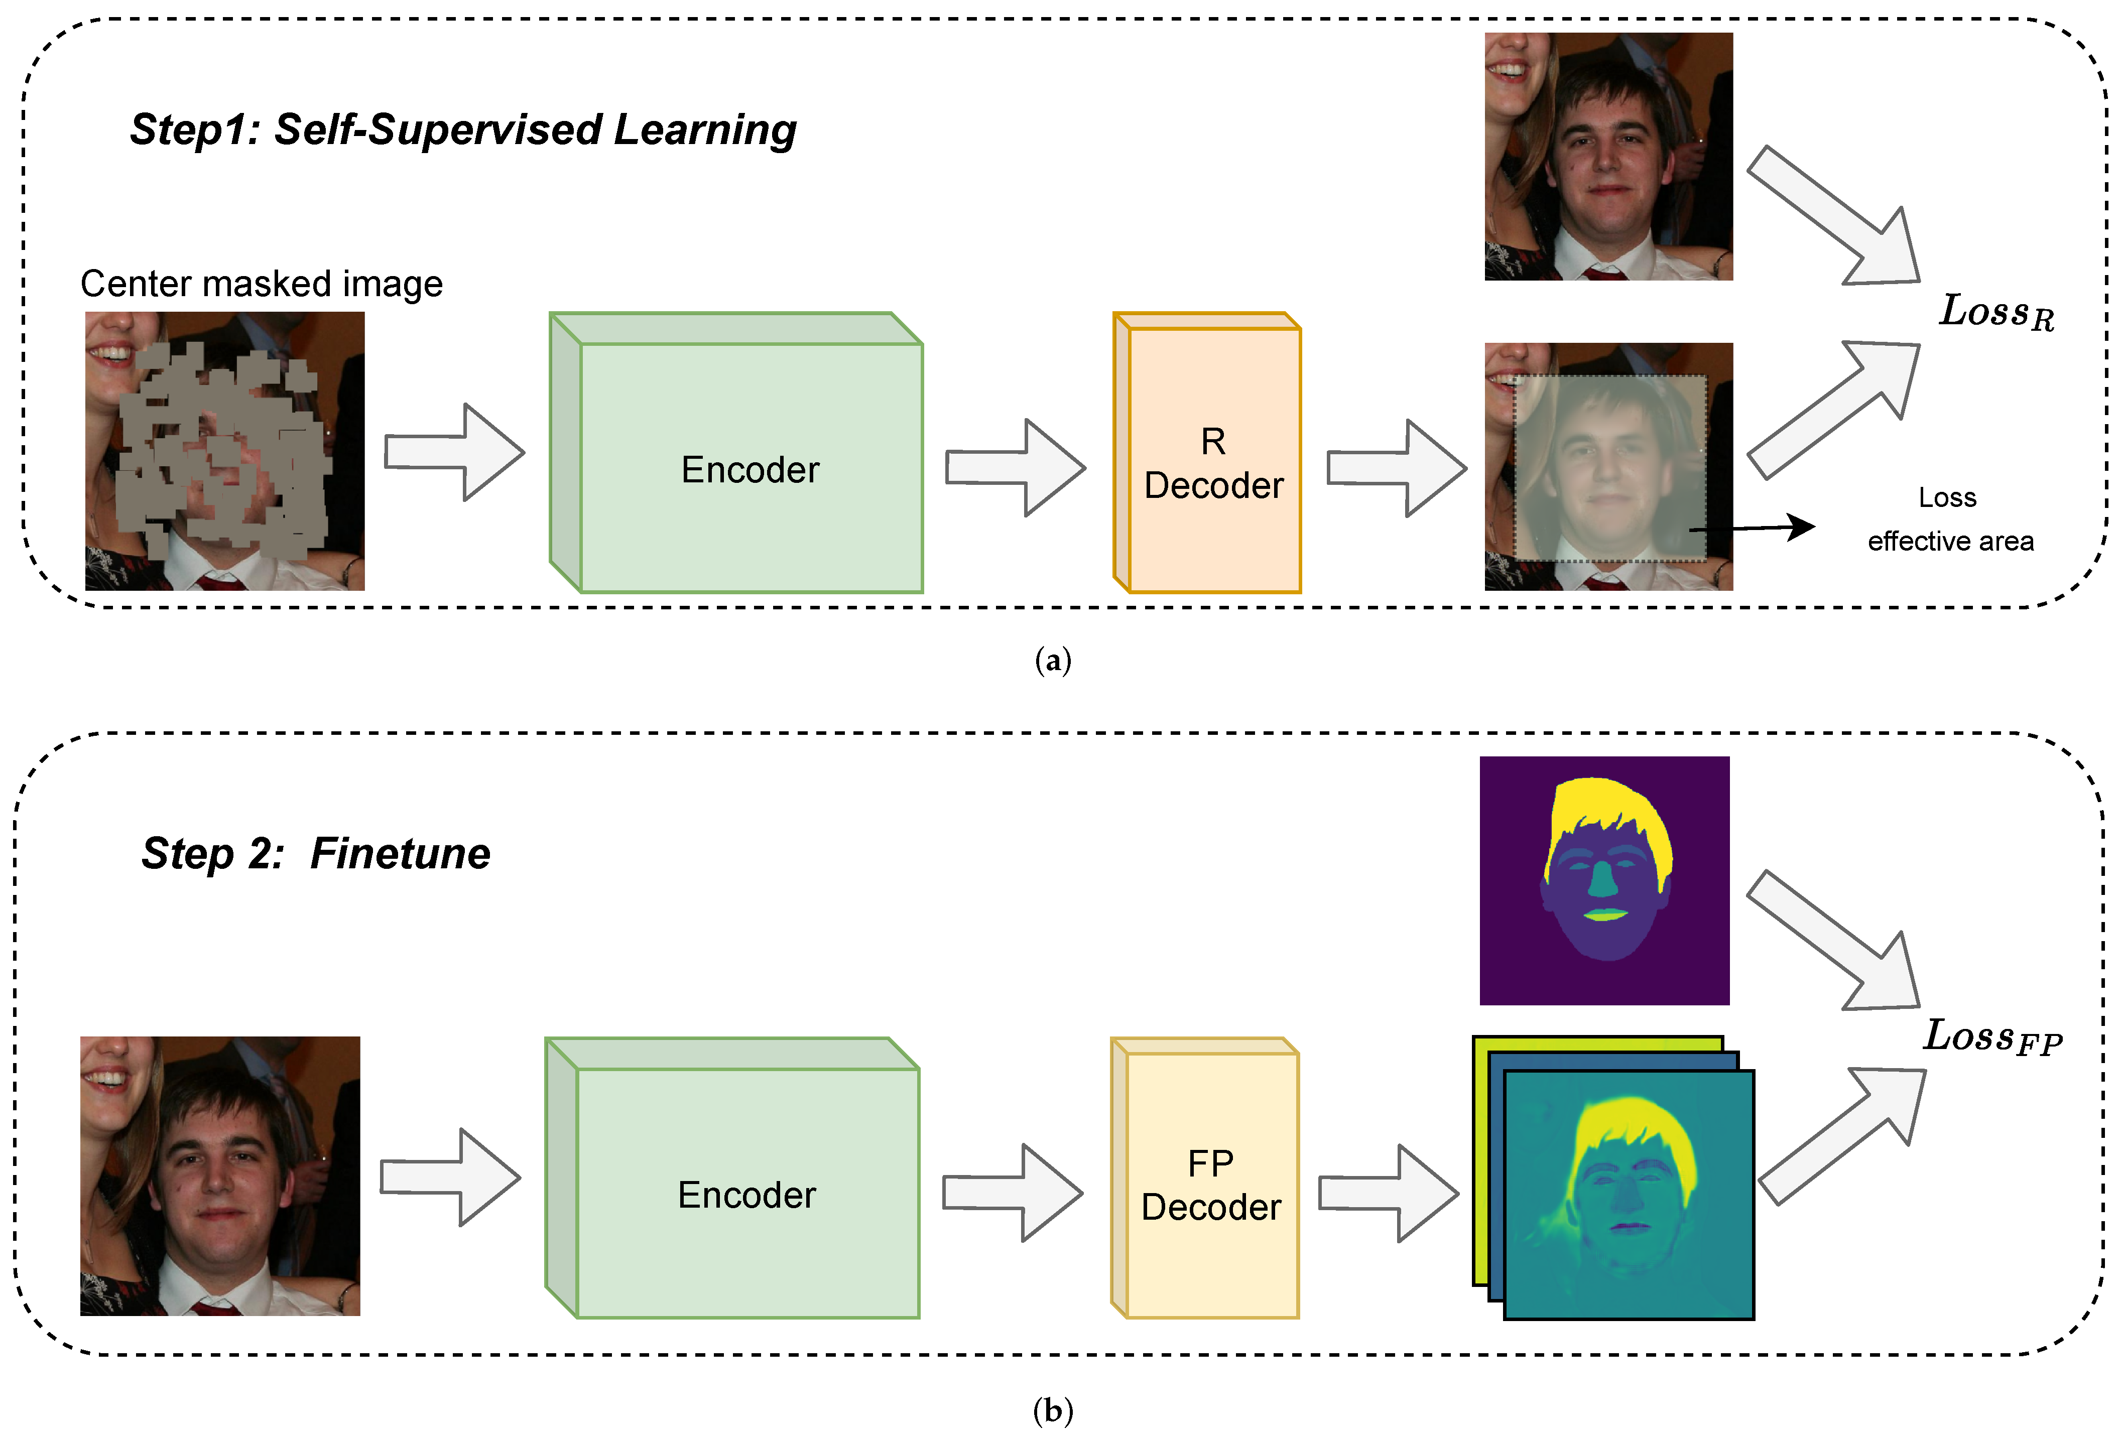
Image from: https://www.mdpi.com/mathematics/mathematics-10-02002/article_deploy/html/images/mathematics-10-02002-g001.png

Slide 31
Pretrained networks
Benefits:
  Can significantly improve training time
  Can efficiently use task-specific data
  Can make use of unlabeled data for pretraining
    Usually, unlabeled data vastly outnumbers labeled data!
  Can access “expensive” weights
Drawbacks:
  Limited ability to adjust parts of the model architecture
  Can impose a constraint on which frameworks you can use
  Requires reading and using another person’s code base

Slide 32
The cost of large models
GPUs are expensive! Larger models can require hundreds of GPUs training over long periods of time
  Marginal cost of ~1 USD/hour
Training larger models requires good CPUs, fast data I/O, and large memory bandwidth.
  Specific hardware is required for fast read/write times.
Data acquisition and labeling: Quality data and labels are expensive!
  Datasets can be expensive to acquire (e.g., cryo-EM for neuron tracing)
  Labeling is also expensive - a good labeler without domain knowledge is ~6 USD/hour. Domain experts can cost over ~100 USD/hour

Slide 33
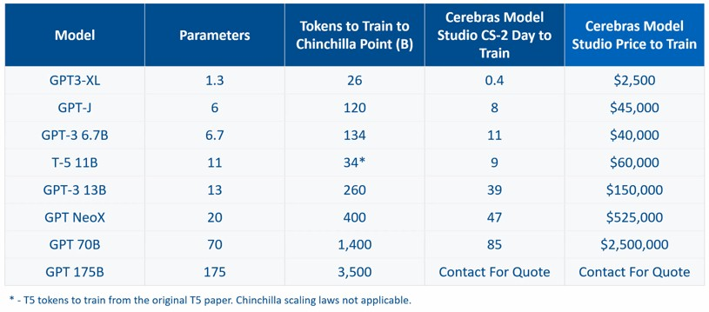
Image from http://www.nextplatform.com/wp-content/uploads/2022/12/cerebras-model-training-price-table.jpg. Estimation of costs for training LLMs.

Slide 34
Data annotation
Data annotation is one of the most important parts of developing deep learning methods
The information to perform the desired task is stored in the labels
The type of each possible label differs substantially, and the utility of each type depends on the problem you need to solve
Labels are often generated by human experts
  But not always. Machine and novice generated labels can be useful if used correctly
Labels vary by cost and difficulty – think carefully about what you need
There are methods to use weaker labels to perform tasks if “ideal” labels are too difficult to obtain

Slide 35
Image annotation: Image-level
Class 0
Class 1
An integer label for each image denoting which class that image belongs to
The labels can also be in a one-hot encoded format
  This is easier to use for machine learning purposes – we often convert from integer labels to one hot encoding
Relatively inexpensive to obtain
  Only one click per annotation

Slide 36
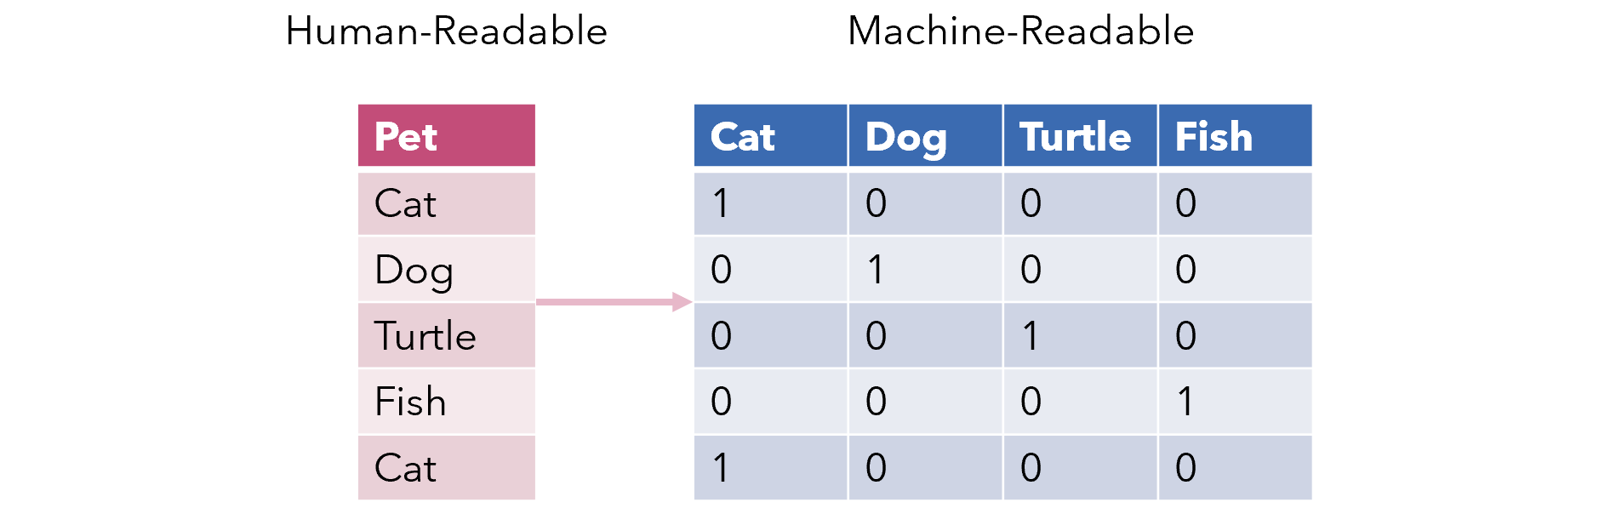
One hot encoding
Helper functions exist in ML libraries (e.g. sklearn) to convert categorical data into a one hot encoded format!

Slide 37
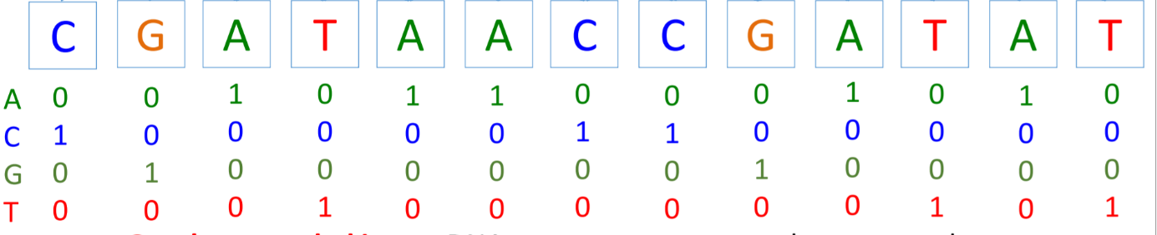
One hot encoding
One hot encoding is not just for labels! One hot encoding is used to convert sequences data into a machine learning friendly format.

Slide 38
Image annotation: Points
A list of coordinates (x, y) for each image
Relatively inexpensive to obtain
  Only one click per annotation

Slide 39
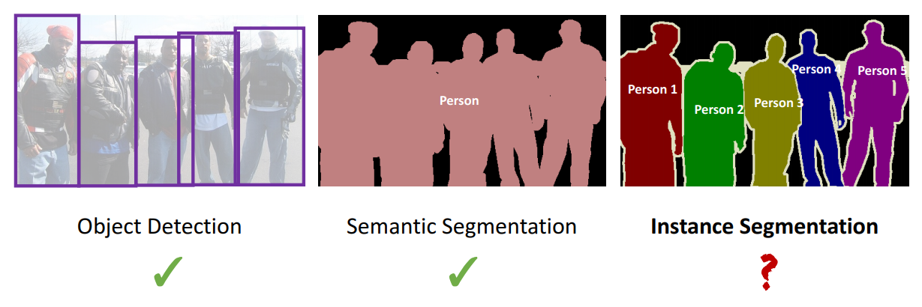
Image annotation: Bounding boxes
A list of coordinate pairs for each image
  (x_{ul}, y_{ul}), (x_{br}, y_{br})
Used to train deep learning models for object detection
Relatively inexpensive to obtain
  Only two clicks per annotation

Slide 40
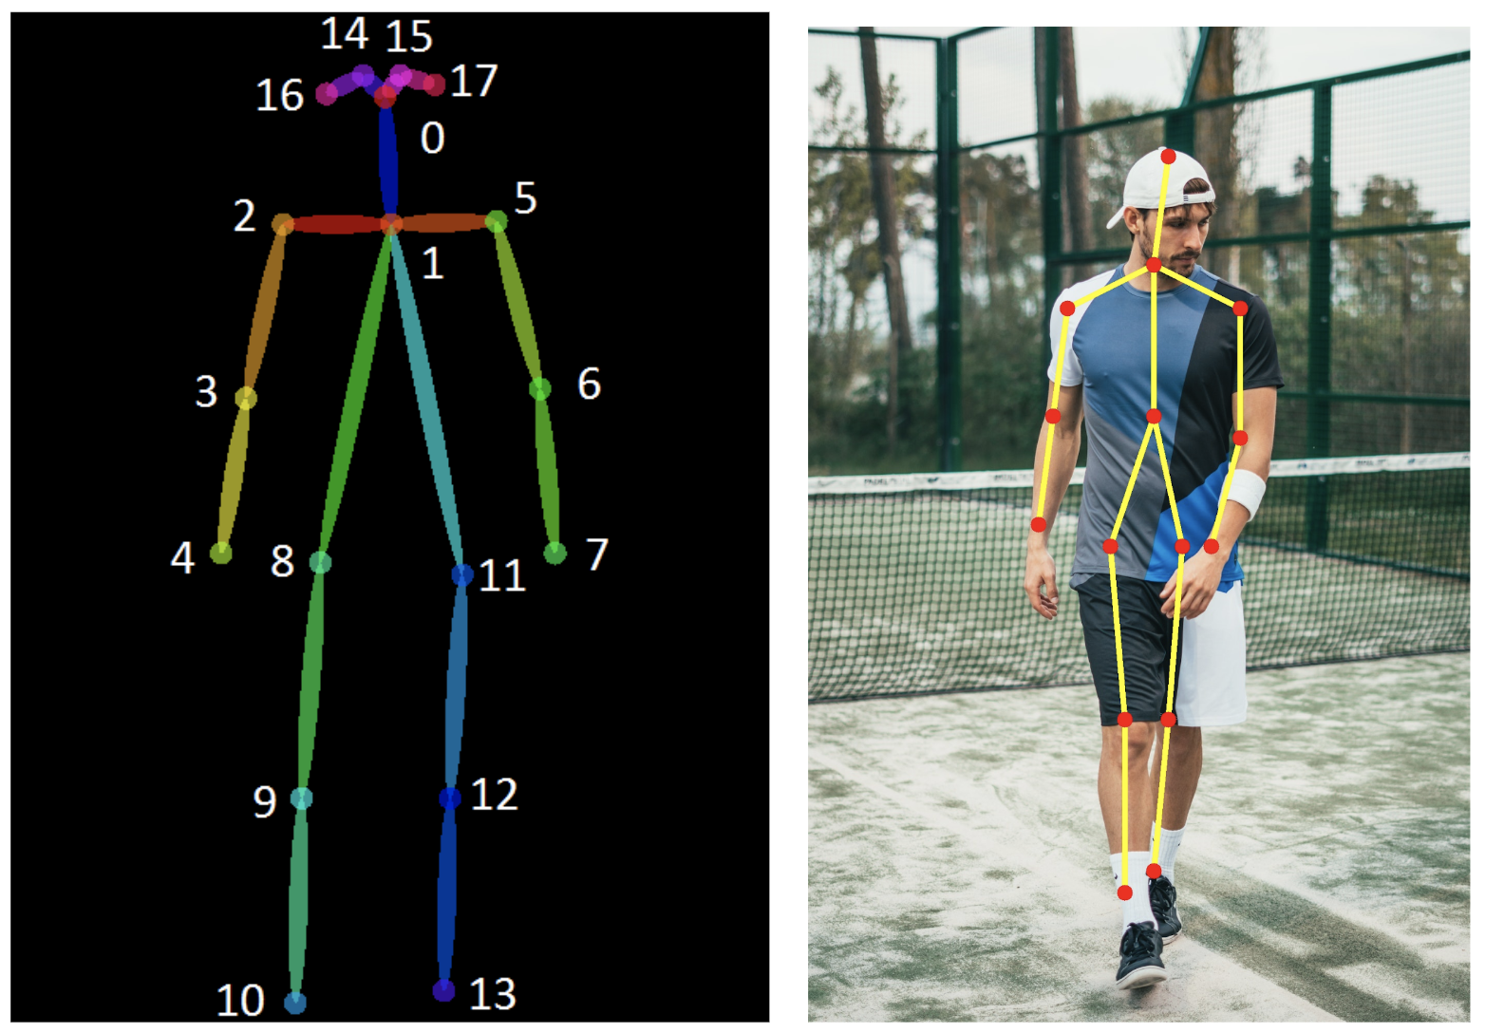
Image annotation: Pose
A list of coordinate pairs for each image
  (x_{ul}, y_{ul}), (x_{br}, y_{br})
A list of coordinates for each annotation
  One for each keypoint
Relatively inexpensive
  2-20 clicks per annotation

Slide 41
Image annotation: Pixel-level
A paired “label image” for each image where each pixel has been given a pixel value denoting its label
  Semantic segmentation: Pixels are labeled by semantic meaning
  Instance segmentation: Pixels belonging to distinct objects are given unique integer ids
The most general type of label
  Previous label types can be derived from pixel-level labels
Expensive
  Dozens of clicks or more per annotation, depending on the tool

Slide 42
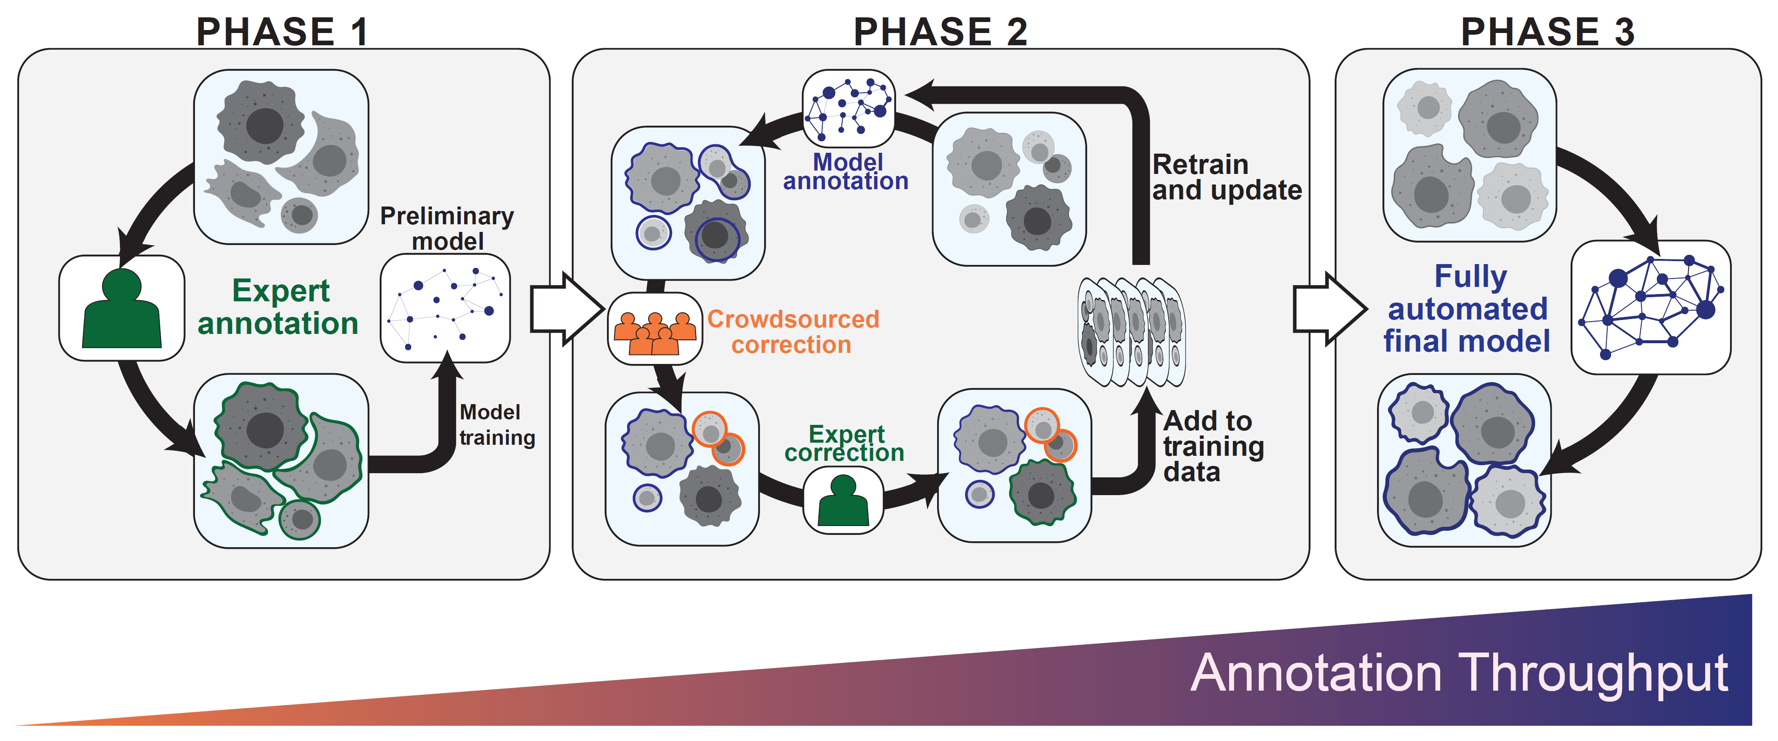
Image annotation: Human-in-the-loop

Slide 43
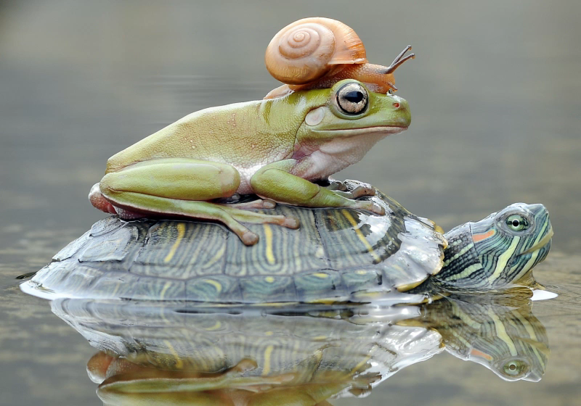
Image annotation: Human-in-the-loop
Integrated development of datasets and models can substantially reduce the amount of time to create labels
One recent example of this is Segment Anything by Meta
  A model takes in a prompt (e.g., a point, a text description, etc.) and produces a mask
  Creating masks can be reduced to a single click
https://segment-anything.com/

Slide 44
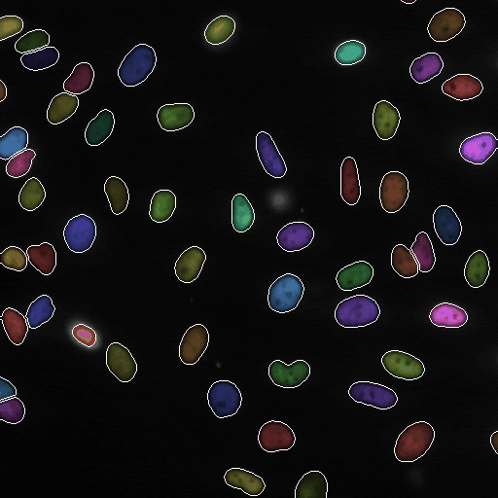
Image annotation: Videos and higher-dimensional images
All the previous label types can be used to label videos and higher dimensional images
Again the type of label is determined by the desired task
Multiple label types might be required
  Example: Cell segmentation and cell tracking

Slide 45
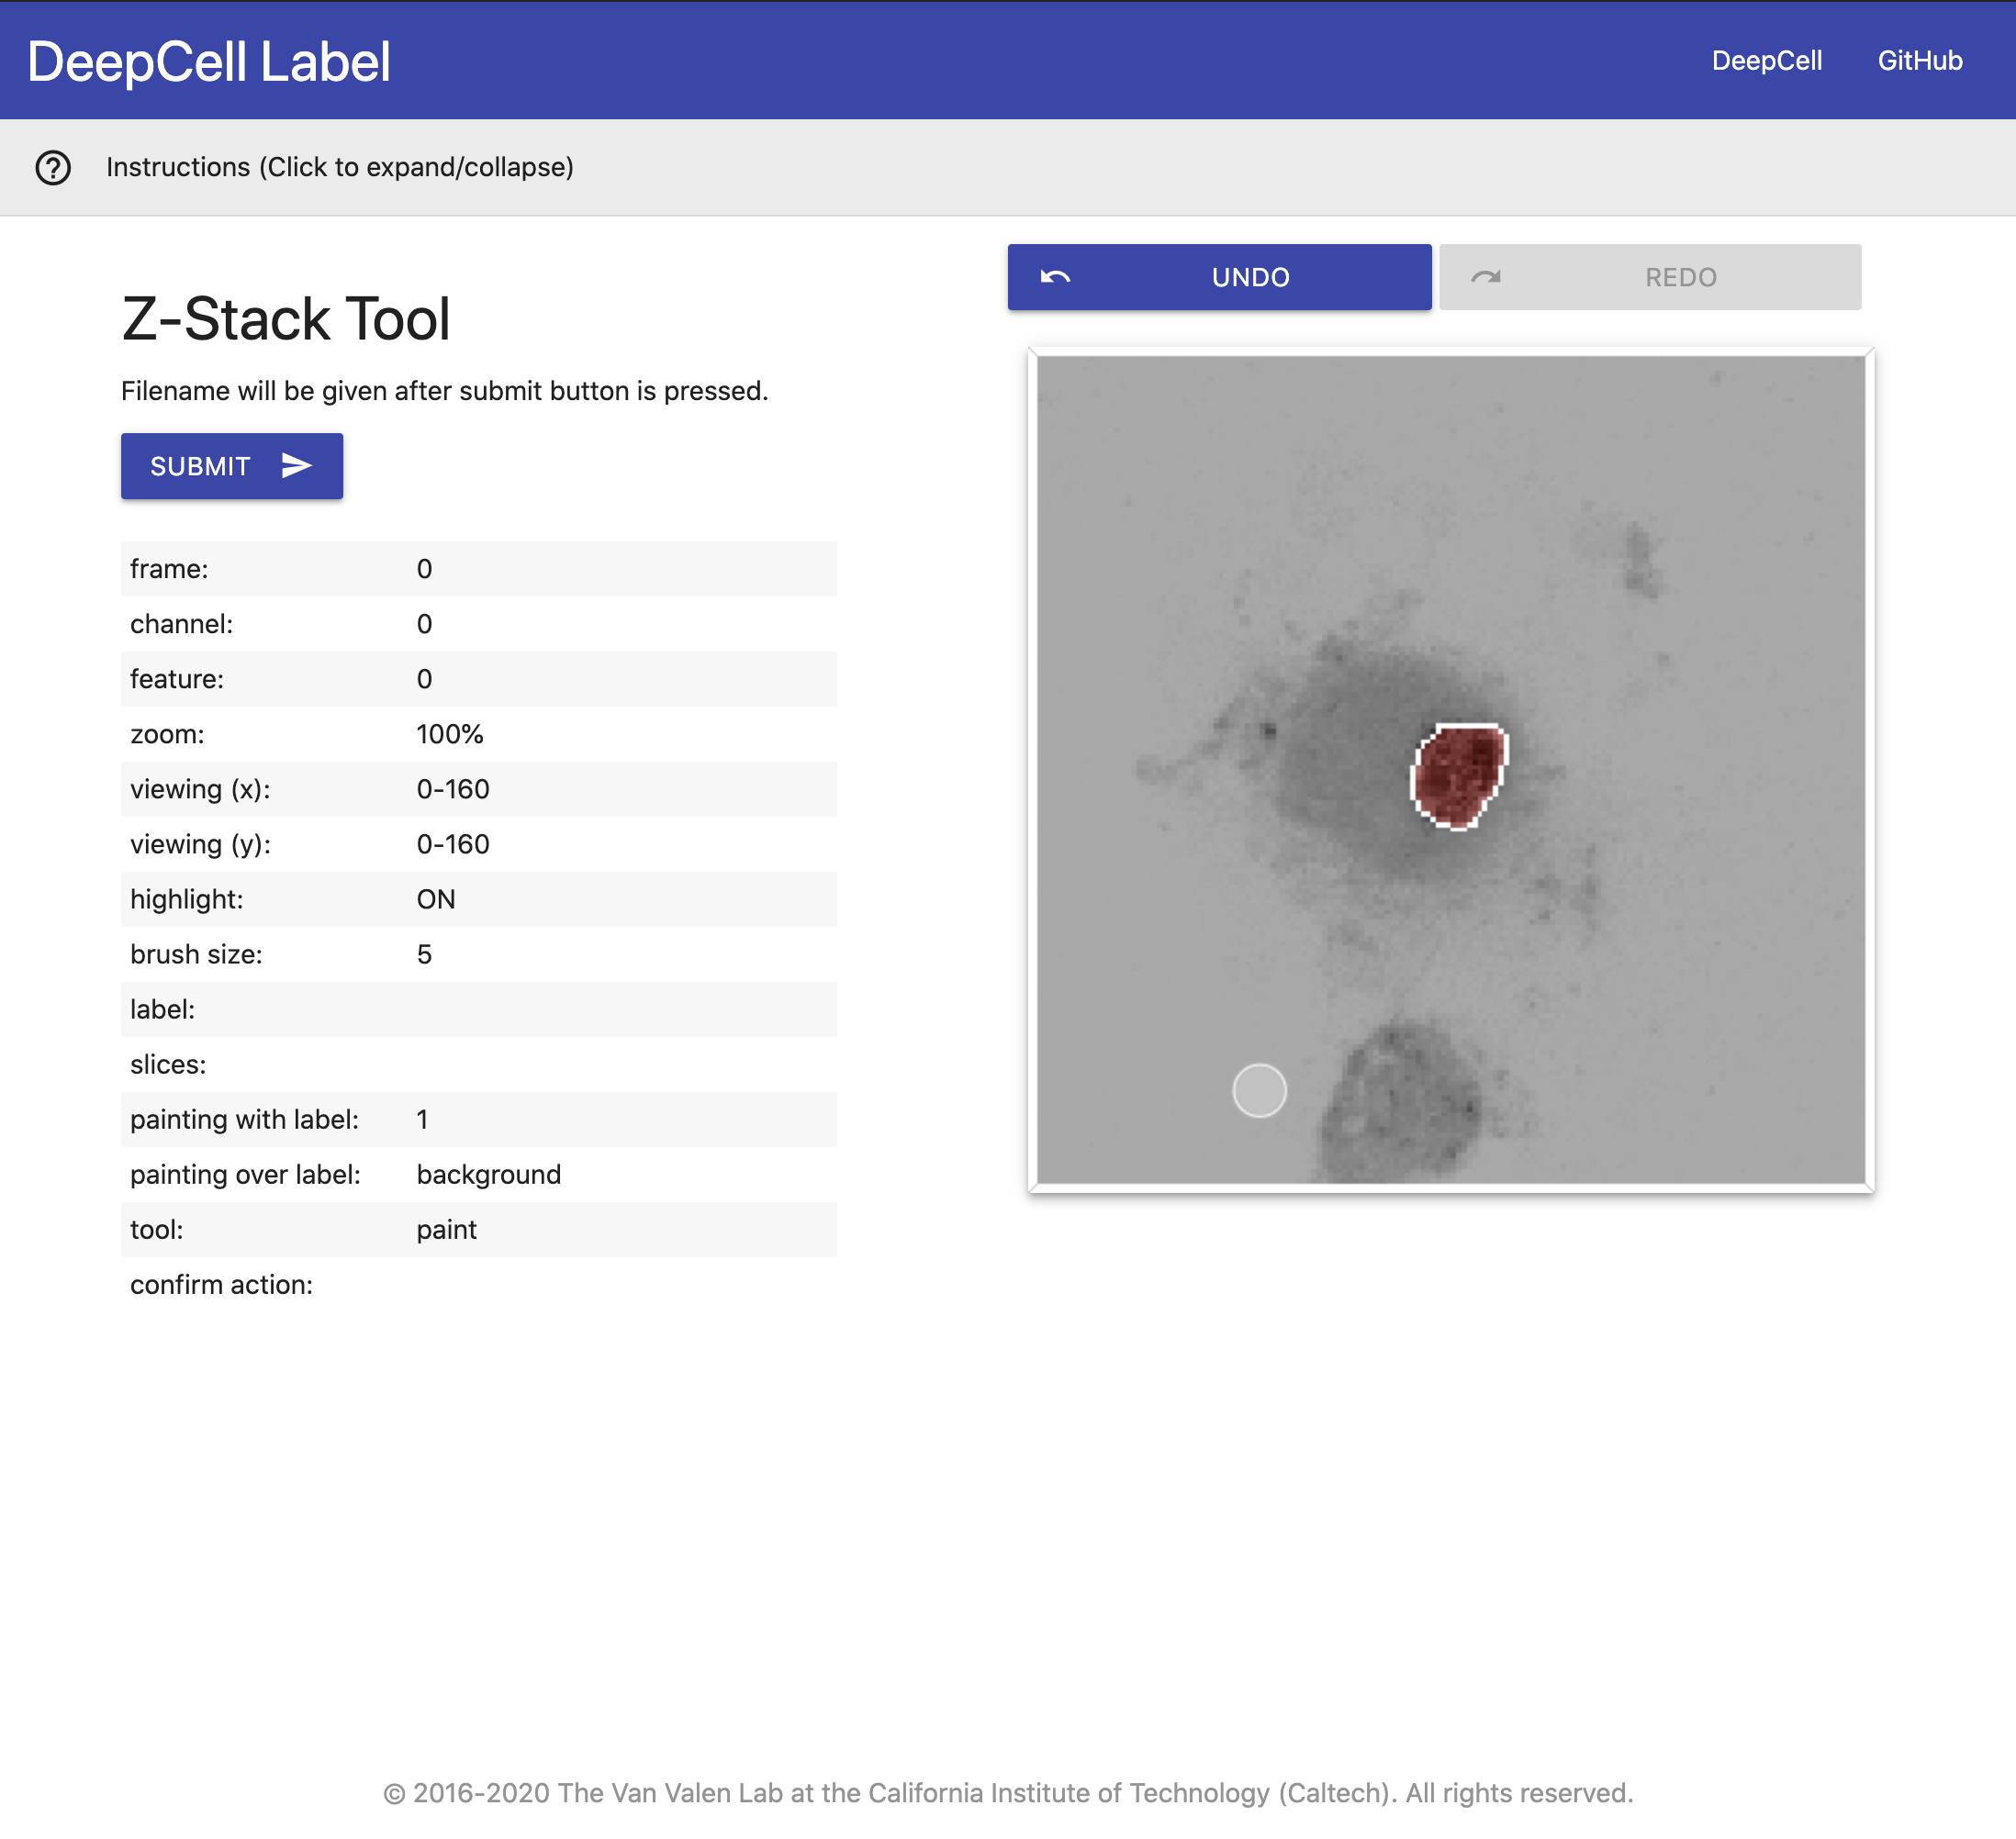
Labeling software: Images
ImageJ
Napari
DeepCell Label
Other labeling tools exist based on the use case
  E.g., neuron tracing, behavior analysis, etc.
Write your own!

Slide 46
Crowdsourcing
Unmanaged
No management
In unmanaged crowds, any worker in a crowd can work on any given task
Its on the job creator to identify who performs well and who doesn’t
Amazon Mechanical Turk
In managed crowds, workers report to a manager who monitors productivity and progress
Managed crowds offer the opportunity for feedback and instruction
Management often requires a substantial overhead fee
Appen, Anolytics, Labelbox

Slide 47
Crowdsourcing
Crowdsourcing reduces the expert labor but comes with a cost
  Labeling software must be browser based and able to handle several people annotating a data collection
  Data must be in a format amenable to novice labelers
  Tasks must be structured for novice laborers
Novice labor costs ~USD $5-8
  If you’re paying more than this, you’re overpaying
  Management fees vary by company
    Platform fees ~$10⁴
    Management fee ~25%
Most projects in the hobbyist phase do not need crowdsourcing

Slide 48
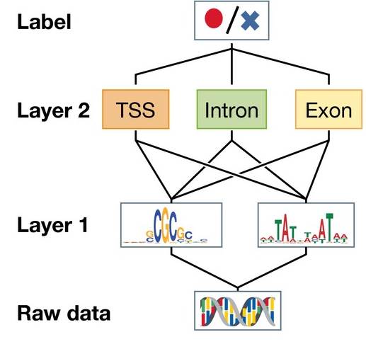
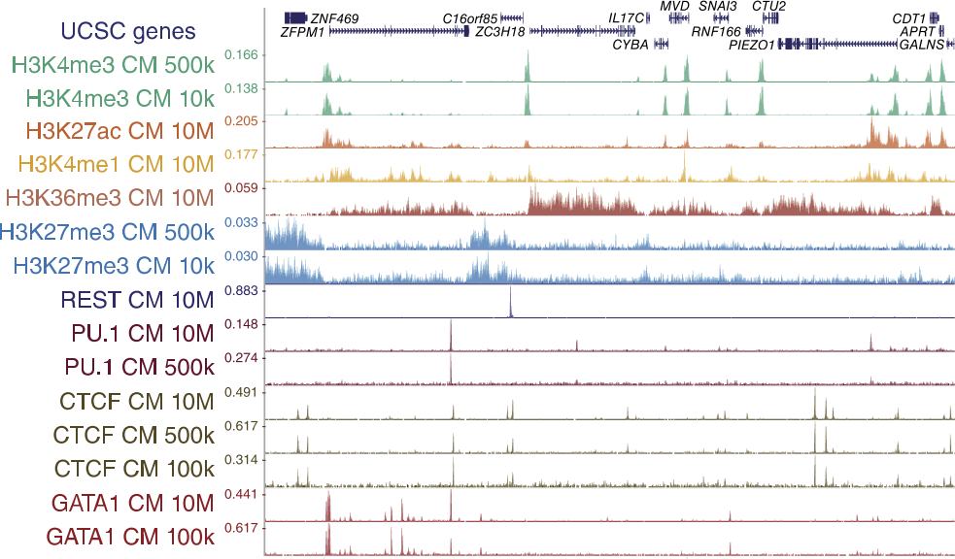
Sequence annotation
Sequence level
Token level
While sequences have their nuance, we can think of them as 1-dimensional images

Slide 49
Sequence annotation: Labels
As with images, the label format depends on the task
Some common tasks include:
  Secondary structure prediction (classification): Labels are categorical labels designating helix, strand, or other.
  Contact prediction (classification): Pairwise amino acid task. Labels are {0, 1}, designating whether amino acids are in contact.
  Remote homology detection (classification): Each protein is mapped to a categorical label {1, …, 1195}. Each integer represents a different protein fold.
  Fluorescence landscape prediction (regression): Regression task, predict log fluorescence intensity.
https://academic.oup.com/bioinformatics/article/34/8/1295/4708302

Slide 50
Sequence annotation: Labeling software
Labeling sequences usually relies on data from sequencing assays
Creating labels is usually a programming task

Slide 51
Structure Annotation
Labels still depend on the task!
Regression tasks: any molecular property regression!
  QM9: quantum energy levels
  Aqueous solubility
  Accelerated molecular dynamics simulations
  Folding (via torsion angles)
Structural reconstruction (e.g., cryo-EM): Labels are the final 3D structure, inputs are 2D images
Molecular docking: Labels are the location and pose of the docked molecule

