Slide 1
BE/Bi 205 – Lecture 5
David Van Valen MD, PhD
04/18/2023

Slide 2
Today’s lecture
Problem framing
  Most machine learning applications map onto three key tasks – classification, regression, and vector embedding.
  We will go over example mappings of different real-world tasks onto this set

Slide 3
Vision and sequence tasks
Vision Tasks
Sequence Tasks
Image Classification
Object detection
Pose detection
Semantic segmentation
Instance segmentation
Multi-object tracking
Sequence level classification
Token level classification

Slide 4
Vision and sequence tasks
Sequence/Structure Tasks
Protein structure prediction
Protein design
Molecular property prediction
Protein docking

Slide 5
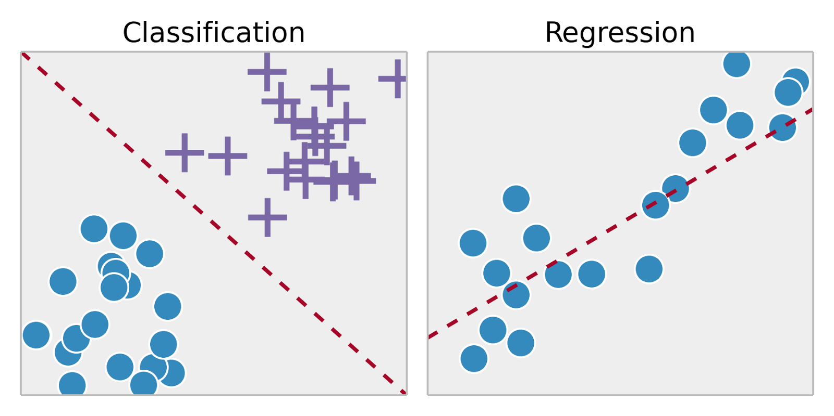
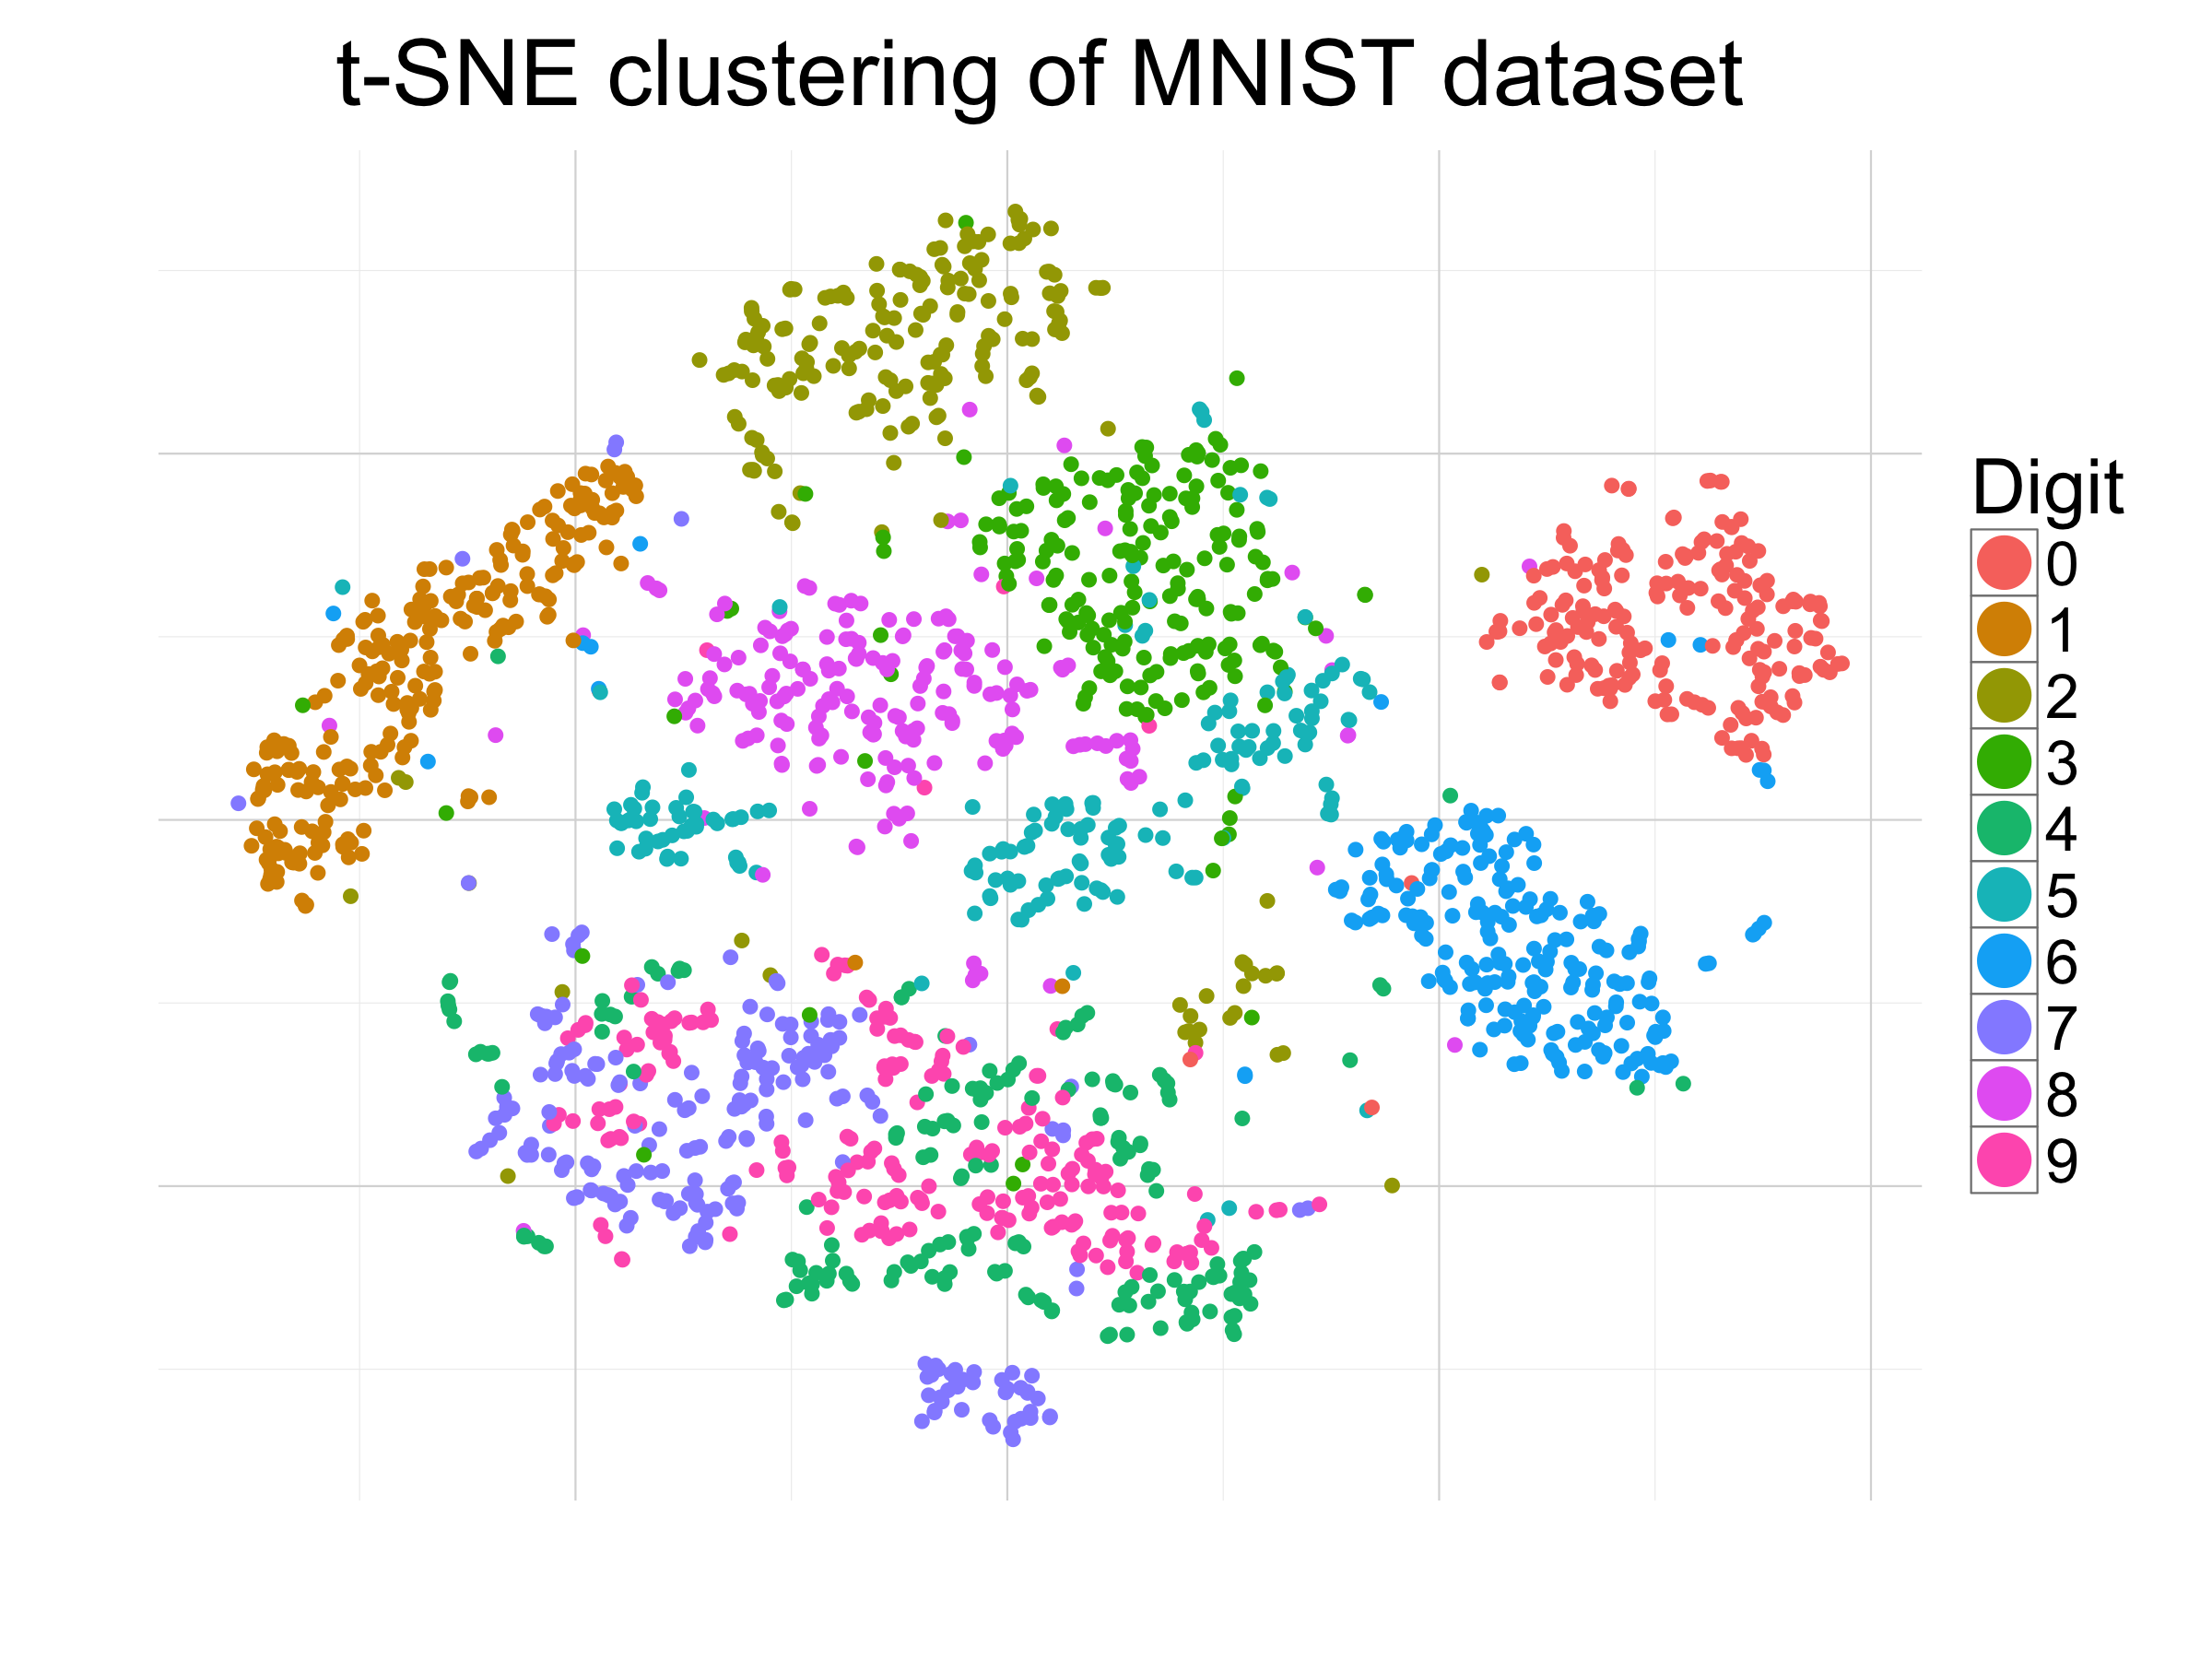



Machine learning tasks
Classification
Regression
Vector embedding
Predict a class label for a given
piece of input data
$$X→i; i∈\{0,…, N−1\}$$
Predict a continuous value for a given
piece of input data
$$X→j; j∈[y_{min}, y_{max}]$$
Map an input image to a vector and
require this mapping to have
certain properties
$$X→\vec{k};k∈R^{n}$$

Slide 6
Machine learning tasks
We can usually map our desired task/problem onto one of these three machine learning tasks
Each method has strengths and weaknesses

Slide 7

Classification
Advantages
Usually this is the most straightforward approach
Classification problems are well-defined and have a pre-existing bag of tricks
Loss function: Cross-entropy and its variants
Predict a class label for a given
piece of input data
$$X→i; i∈\{0,…, N−1\}$$

Slide 8
Classification
Disadvantages
Posing problems in this way often leads to issues with class imbalance
  This is when you have substantially more examples of one class than others
  There are methods to deal with this
Spurious misclassification errors can break downstream analyses
  The overconfidence of deep learning methods can make this a serious issue
Predict a class label for a given
piece of input data
$$X→i; i∈\{0,…, N−1\}$$

Slide 9

Regression
Advantages
Resulting models are often able to produce smooth outputs
  Models can interpolate between values
  Don’t need to make hard, binary decisions like in classification
Loss function: Mean squared error
Predict a continuous value for a given
piece of input data
$$X→j; j∈[y_{min}, y_{max}]$$

Slide 10
Regression
Disadvantages
Versions of the class imbalance problem still exist
  These can be less clear because you don’t have defined classes
Can be more challenging to debug
  No classes -> No confusion matrix
Predict a continuous value for a given
piece of input data
$$X→j; j∈[y_{min}, y_{max}]$$

Slide 11

Vector embedding
Disadvantages
Embeddings can be endowed with properties that solve challenging problems
  E.g., segmentation of overlapping objects, enzyme function prediction, etc.
Loss function: It varies!
  The properties of the embedding are given to it through the loss function
Map an input image to a vector and
require this mapping to have
certain properties
$$X→\vec{k};k∈R^{n}$$

Slide 12

Vector embedding
Disadvantages
Can be challenging to get to work in practice
  Loss functions require significant expertise to design and program
  Very difficult to debug – unclear whether a decrease in loss means the model is performing as desired
Dave’s view: Very promising but the hardest to do right
Map an input image to a vector and
require this mapping to have
certain properties
$$X→\vec{k};k∈R^{n}$$

Slide 13
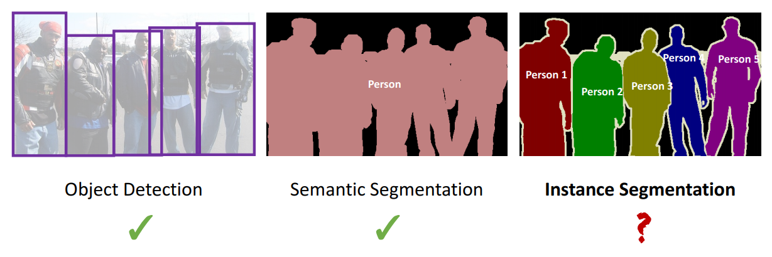
Segmentation can be framed as classification, regression, or vector embedding tasks

Slide 14
Object detection as classification and regression
Let’s go through some examples to show how “real world” tasks can be thought of as “machine learning” tasks.
The first example is object detection – finding bounding boxes that encapsulate objects in an image
Object detection can be mapped to classification and regression
  Find the boxes: classification
  Refine the boxes: regression

Slide 15
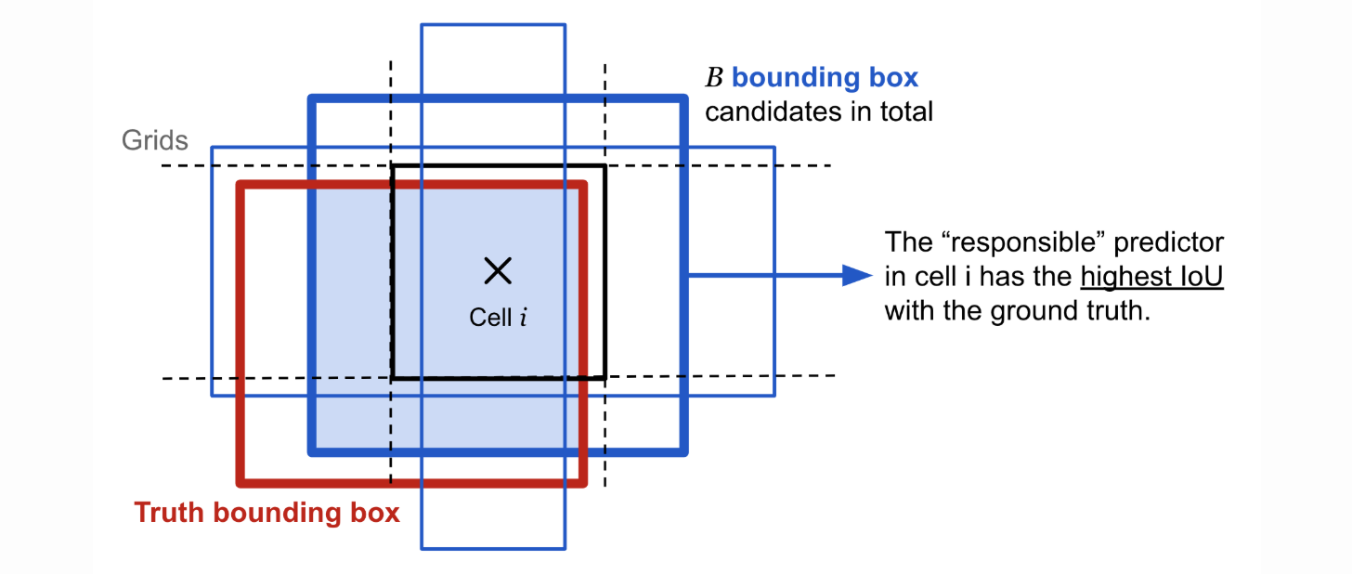
Object detection as classification and regression
To detect objects, we tile our image with candidate boxes called “anchors”
We can tile with different strides, and with anchors of different sizes and aspect ratios
If a ground truth box has a high enough overlap with a candidate box, we call that anchor “positive”
  If not, its negative
  Positive anchors likely contain objects

Slide 16
Object detection as classification and regression
Our object detection task is now reduced to finding all the positive anchors in an image
  Its fine if anchors overlap, because there are post-processing steps to deal with that
This is a classification problem!
  We need to classify all the anchors in an image as positive or negative
  Each anchor will have a features associated with it that is created by a convolutional neural network

Slide 17
Object detection as classification and regression
This problem usually has a massive class imbalance – there are usually many more negative anchors in an image than positive anchors
Methods for solving this class imbalance problem exist
  Two stage detection – find anchors that are most likely to be positive, then classify those
  Use loss functions that are tolerant to class imbalances (e.g., the focal loss)
  We will go over these!

Slide 18
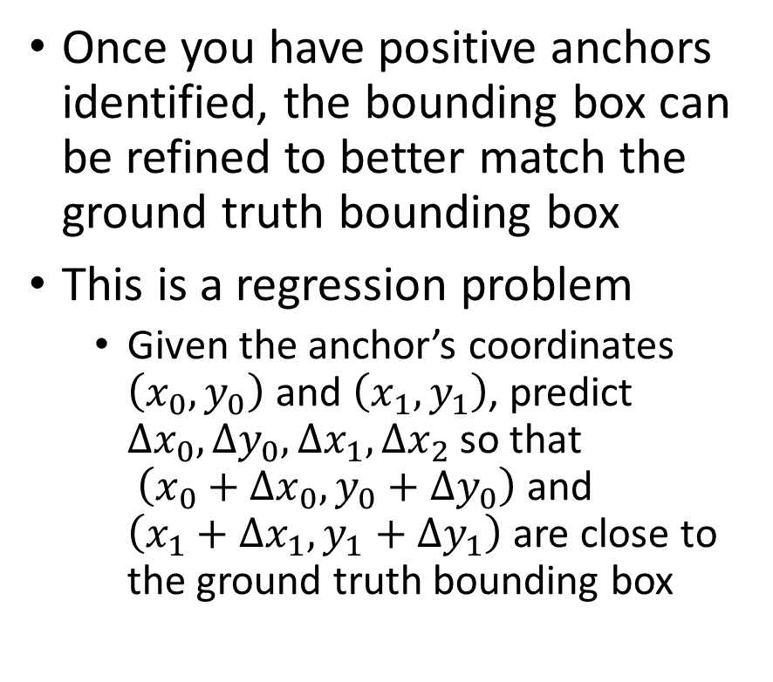
Object detection as classification and regression
Once you have positive anchors identified, the bounding box can be refined to better match the ground truth bounding box
This is a regression problem
  Given the anchor’s coordinates $\left(x_{0},y_{0}\right)$ and $\left(x_{1},y_{1}\right)$, predict $Δx_{0},Δy_{0},Δx_{1},Δx_{2}$ so that
  $\left(x_{0}+Δx_{0},y_{0}+Δy_{0}\right)$ and $\left(x_{1}+Δx_{1},y_{1}+Δy_{1}\right)$ are close to the ground truth bounding box
Finding these offsets is
a regression task

Slide 19
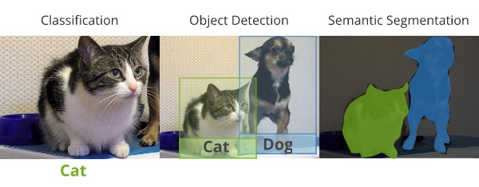
Semantic segmentation as classification
Semantic segmentation can be viewed as a pixel-level classification task
  Each pixel gets assigned to one class
A convolutional neural network needs to produce predictions for every pixel rather than the whole image

Slide 20
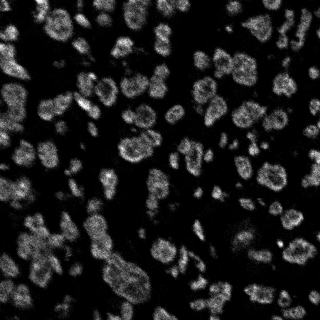
Instance segmentation as classification
Interior
Background
Boundary
Instance segmentation can be viewed as a pixel classification problem
  This example is cell segmentation, which is an instance segmentation problem
For every pixel in an image, can we determine whether it is inside of a cell, at the cell boundary, or part of the image background
https://journals.plos.org/ploscompbiol/article?id=10.1371/journal.pcbi.1005177

Slide 21
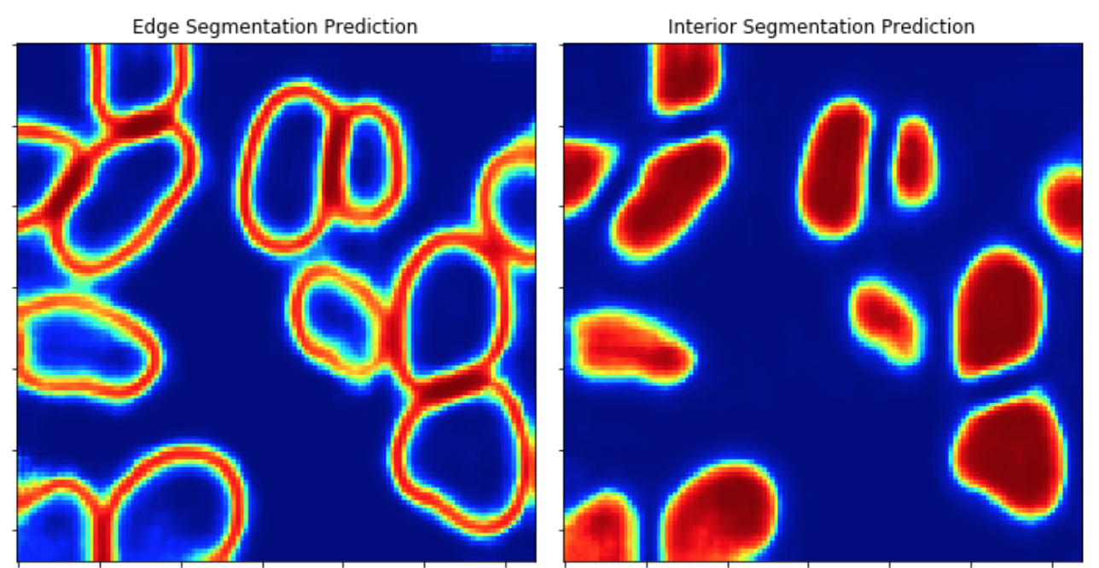
Instance segmentation as classification
If we can do this task (almost) perfectly, we can just threshold our prediction of the interior class and we are done
  We can apply the label function from skimage on the interior prediction image (after thresholding) to assign unique ids to each cell
  This requires us to nail the boundary of each cell – if we are off by one pixel, we are likely to have a merge or splitting error

Slide 22

Instance segmentation as classification
New methods like Meta’s segment also fall in the classification task category
Given an image and a prompt, classify pixels as foreground or background
  E.g., predict a binary mask
https://arxiv.org/pdf/2304.02643.pdf

Slide 23
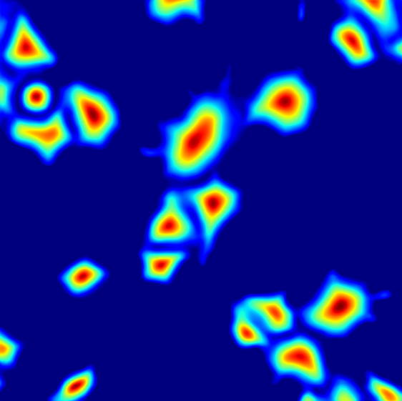
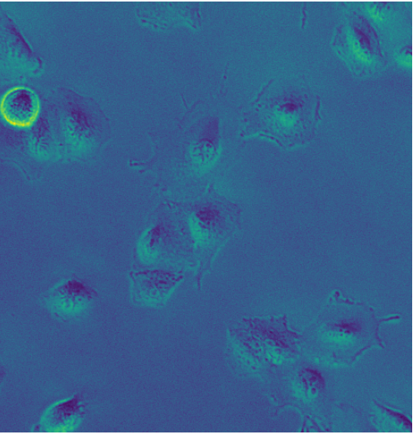
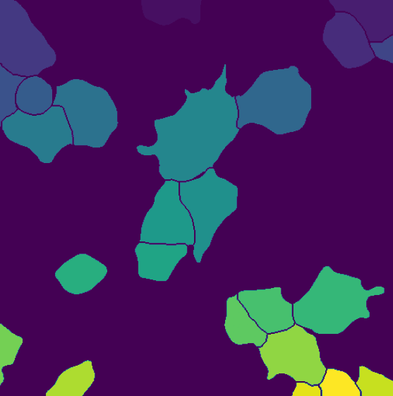
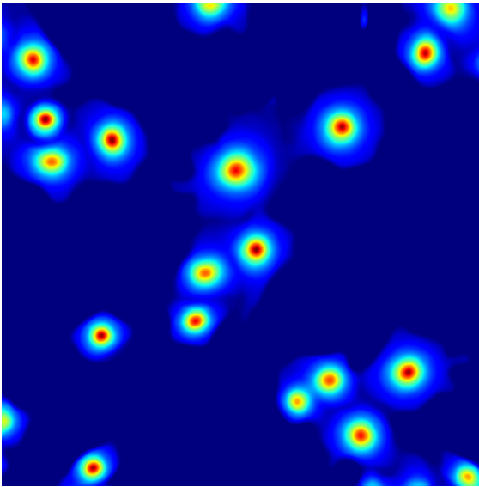
Instance segmentation as regression
The marker-based watershed relies on two inputs
  The outer distance transform – how far each pixel is from the background
  Markers indicating the location of different objects to initialize the algorithm
    One often uses the local maxima in the outer distance transform as markers
https://arxiv.org/abs/1908.11211

Slide 24
Instance segmentation as regression
We can treat instance segmentation as a regression problem
The goal is to produce two outputs that recreate what marker-based watershed needs
  A prediction of the outer distance transform
  Seed locations for objects
https://arxiv.org/abs/1908.11211

Slide 25
Instance segmentation as regression
For each image we predict perform two regression tasks
  For each pixel, predict how far it is from a background pixel (the outer distance transform)
  For each pixel inside of a cell, predict how far it is from the cell’s center of mass
Simple post-processing combined with marker-based watershed let us turn these two predictions into instance masks
https://arxiv.org/abs/1908.11211

Slide 26
Instance segmentation as vector embedding
We can also treat instance segmentation as a vector embedding problem
Every pixel in an image is mapped to a vector
We can design a loss function to encourage pixels from the same object to be mapped to the same vector
Pixels from different objects are mapped to different vectors
https://arxiv.org/abs/1708.02551

Slide 27
Instance segmentation as vector embedding
Unsupervised clustering in the embedding space creates the final segmentations
This approach has unique properties, like being able to segment overlapping objects
https://arxiv.org/abs/1708.02551

Slide 28

Instance segmentation as vector embedding
https://arxiv.org/abs/1708.02551

Slide 29
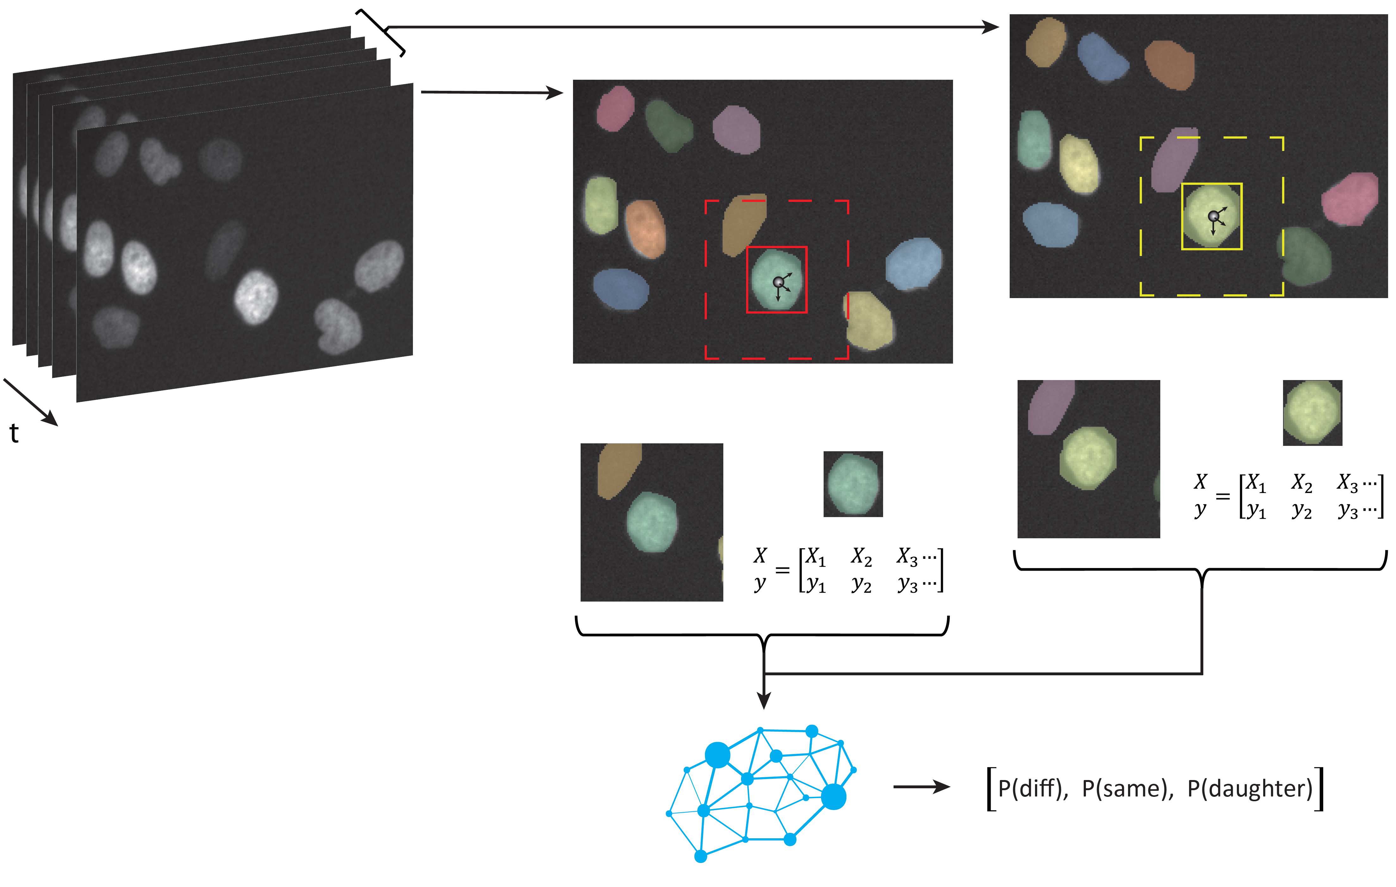
Multi-object tracking as classification
Moen et al, biorxiv 2019

Slide 30
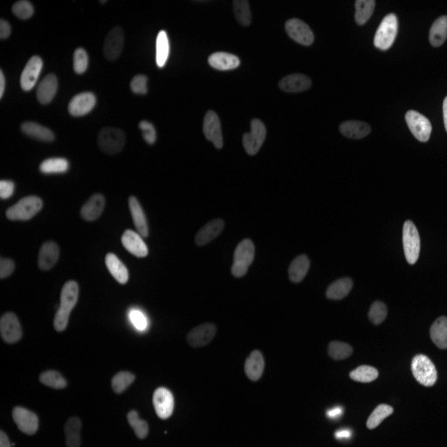

Tracking single cells with deep learning
Notes:
Using Caliban, we have been able to get entire movies annotated at a reasonable cost. The marginal cost for a nuclear annotation is ~1 cent. With these data, we can train models for segmentation and tracking. Here we see we are able to track cells and successfully detect when cells divide.

Slide 31
Predicting transcription factor binding as a classification task
The DeepBind paper introduced deep learning models for a variety of tasks for sequence data, including finding binding sites for transcription factors
This is a classification problem with two classes
  Candidate sequences can be placed into two categories – bound and background
Models can be trained on in vitro or in vivo data
  Either protein binding microarrays (PBMs) or ChIP-Seq
https://pubmed.ncbi.nlm.nih.gov/26213851/

Slide 32
Predicting viral fitness and escape mutations with vector embeddings
Viral sequences experience a trade off between fitness and immune escape during their evolution
  Mutations allow them viruses to escape detection from the immune system, but can lead to a reduction in fitness
  In He et al, this is modeled as a trade off between grammaticality semantics
    Grammar: Am I following the rules of viral sequences?
    Semantics: Did my meaning change?
https://science.sciencemag.org/content/371/6526/284.abstract

Slide 33
Predicting viral fitness and escape mutations with vector embeddings
Grammaticality can be approximated with a self supervised learning task
  Predict a token based on its neighbors
The layer prior to the output layer can be viewed as vector embeddings
  Not surprisingly, these embeddings contain semantic meaning
https://science.sciencemag.org/content/371/6526/284.abstract

Slide 34
Enzyme sequence classification with contrastive learning
Categorizing enzymes into functional classes based on sequences can be viewed as a classification problem or a vector embedding problem
  There are 7 major classes of enzymes, but many subclasses
  This makes it hard to get good performance if framed as a pure classification task
A vector embedding task maps enzyme sequences to a vector space
  Enzyme sequences with the same enzyme commission number are encouraged to be close
  Enzyme sequences with a different EC number are pushed apart
https://www.science.org/doi/10.1126/science.adf2465

Slide 35
Enzyme sequence classification with contrastive learning
Once trained, an EC number for an enzyme sequence is determined by finding the nearest EC in the embedding space
  An EC’s embedding is taken as the average embedding vector of its member sequences
https://www.science.org/doi/10.1126/science.adf2465

Slide 36
Conclusion
Biological data analysis tasks can be mapped on to three different machine learning tasks
Problem framing is a critical part of adapting deep learning methods to problems in biological data analysis

