Slide 1
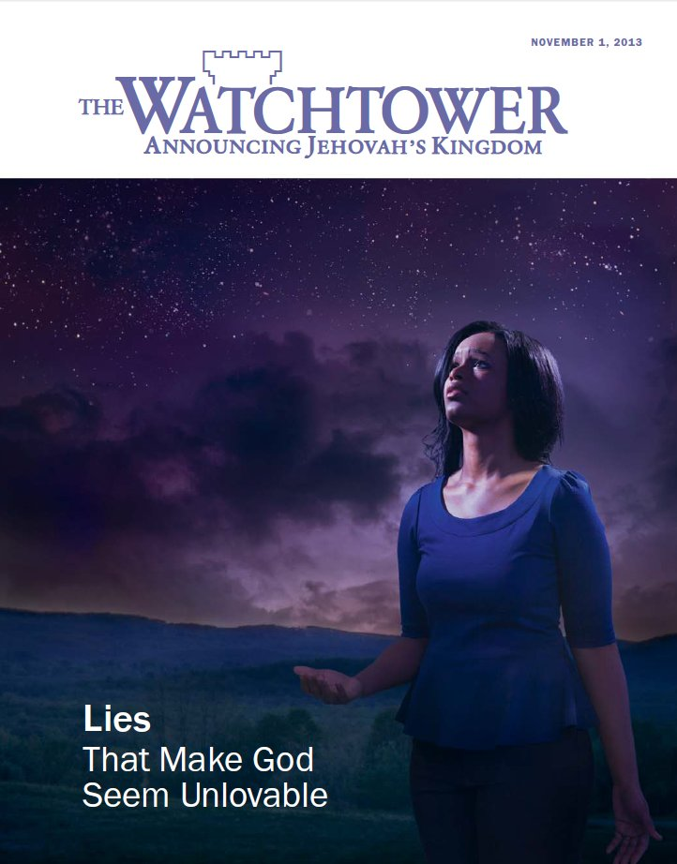

Slide 2
Detecting Counterfeit Christianity
2 Peter 2:1-2 for Today

Slide 3
The Foundation
Acts 17:11
Knowing your Bible well
2 John 9-11
Heed warnings about false teachers

Slide 4
What to Watch for …
The Bible plus something else
Don’t ask questions – just listen and do what you’re told.
One verse wonders.
Building everything on difficult passages.
What God told me directly.
The church’s official interpretations.
Latter day revelation.
A creed book.
Decision of church councils.

