Slide 1
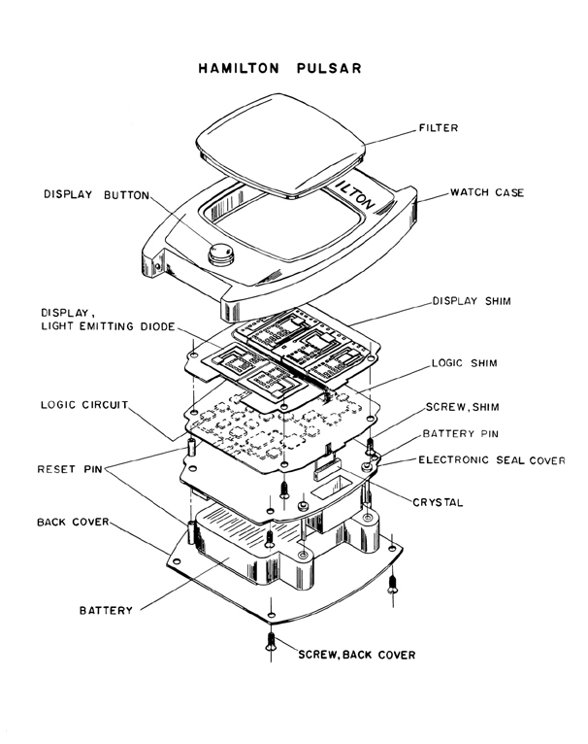

Slide 2
The KINGDOM of god

Slide 3
The Kingdom is saved people …

Slide 4
Family of God - Ephesians 2:19
Temple of God - 1 Peter 2:5
Church - Matthew 16:16
Body - Romans 12:5
Bride of Christ - Revelation 21:9
Flock - 1 Peter 5:2
Church of God - Acts 20:28

Slide 5
The Kingdom is saved people …

Slide 6
The Kingdom is saved people who submit to the rule of the king …

Slide 7
The Kingdom is saved people who submit to the rule of the king as He rules over His spiritual kingdom …

Slide 8
The Kingdom is saved people who submit to the rule of the king as He rules over His spiritual kingdom in its fight with the devil.

Slide 9
The Kingdom is saved people who submit to the rule of the king as He rules over His spiritual kingdom in its fight with the devil.

