Slide 1

Artificial intelligence
Teacher Notes

Slide 2
Reminder
Before delivering this computing lesson, pupils must have completed the start-of-project survey. If you have not already done so, please follow the instructions below:
Run a session with pupils to complete the survey. They will each need access to a desktop, laptop or mobile device that they can use to complete the online survey. This can take place as a whole class or in smaller groups as long as all pupils complete the start-of-project survey before you deliver the first CodeStars lesson.
Explain to your pupils that they will be taking part in a project to test some new resources. You will be delivering a new lesson to them and their parents/carers might be receiving some text messages.
Explain to your pupils that they will be asked to complete a survey at the beginning and end of the project. Please encourage them to be honest with their opinions.
Explain that they can choose to opt out of the research, which will mean that they should not complete the surveys and none of their data will be collected.
Ask your pupils to complete the start-of-project survey, which you will receive in September via email. The survey is a set of questions about the children’s attitudes to computing, and it will take around twenty minutes to complete.
Please check that each child has correctly completed the information about themselves and chosen the correct school from the drop-down list at the beginning of the survey before they move on to the main survey questions. Please be available to help your pupils to read the questions if they have difficulties, but allow them to answer independently.

Slide 3
Lesson plan
Suggested Total Time (1 hour) | Activity | Detail
5 minutes | Starter | Slide 6
10 minutes | Introduction to Artificial Intelligence | Use slides 8 - 17 Class discussion
10 minutes | Train an A.I. robot to clean the ocean (teacher-led) | Teacher to go to link on slide 18 As a whole class, classify the items as ‘fish’ or ‘not fish’ to train the A.I. robot. Go to the next page to see how the robot does when it classifies by itself. Class discussion
15 minutes | Train an A.I. robot to clean the ocean (pupil activity) | On laptops or iPads, pupils go to the link on slide 19 Pupils continue to classify items based on if they belong in the ocean Pupils can continue to the later levels of the activity if they finish quickly
15 minutes | Quickfire questions: Is it Artificial Intelligence? | Use slides 20 - 30 Quickfire questions and discussion
5 minutes | Plenary/Home learning task | Slide 31 - 33

Slide 4





Need to know
There is video and web page content in this lesson.
Check the links and visuals are working before the lesson.
Pupils need access to a laptop, computer or tablet for this lesson.
Pupils receive a certificate at the end of the lesson for completing the task.
Please print these before the lesson.
You don’t need any knowledge of artificial intelligence to teach this lesson!
Read our Action Guide before the lesson for some tips on teaching computing inclusively.
These tips are useful for today and future lessons.

Slide 5
Reminder: encourage the girls in your class
In today’s lesson, take a moment to tell at least three female pupils that you think they’d be great at computer science.
Research shows that boys and girls of primary age have a similar level of interest in computing. However, girls are half as likely to be encouraged to explore it. Pupils who are told by a parent or a teacher that they’d be good at computer science are three times more likely to be interested in computer science in future.
Find more tips on inclusive computing teaching in our short Action Guide!

Slide 6
Artificial intelligence

Slide 7
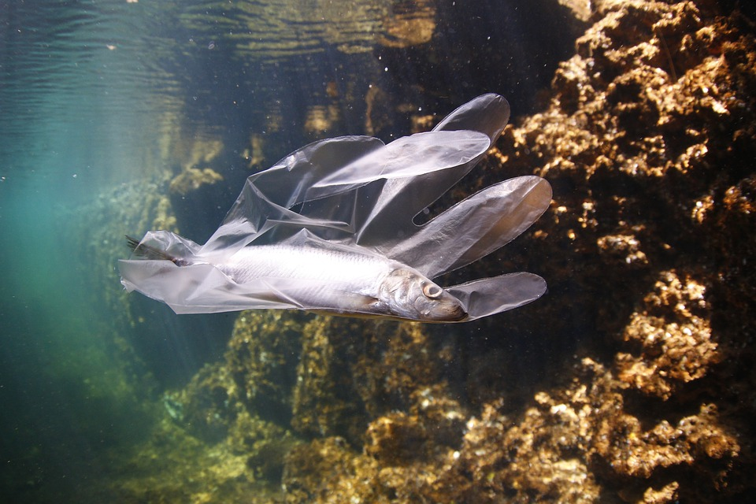
Starter
What do you see in the picture?
What problems might this lead to?
How does it make you feel?
Discuss with your partner for two minutes.

Slide 8
Lesson objectives
Understand what makes artificial intelligence ‘robots’ different to other machines
Teach an artificial intelligence ‘robot’ to tell the difference between sea creatures and rubbish in the ocean
Notes:
Explain to pupils that artificial intelligence refers to computers being able to mimic human intelligence. This concept will become clearer as you progress through the lesson.

Slide 9
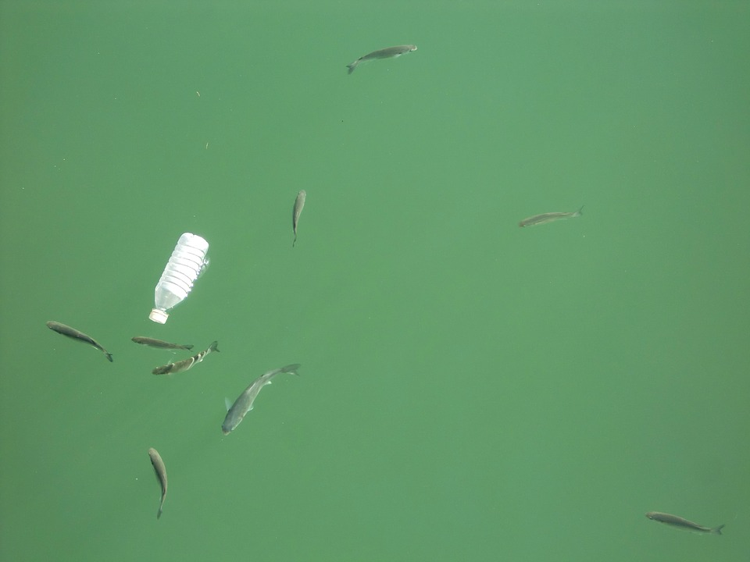
How could we clean the oceans?
INTRODUCTION TO A.I.
The oceans are HUGE and FILTHY. By 2050, there will be more plastic in the oceans than fish.
It would take a VERY long time to clean by humans.
In today’s lesson we will be learning how computers could help solve this problem.
Notes:
Put the question to the class and invite them to share their suggestions. After taking a few suggestions, reveal the remaining two paragraphs of text. Explain that in today’s lesson we will be thinking about how computers might be able to solve this challenge.

Slide 10
We can teach computers to clean the ocean
INTRODUCTION TO A.I.
For a computer - or a robot - to clean the ocean, they will need to be able to tell the difference between sea creatures and rubbish.
How will they do this?
With something called
Artificial Intelligence!

Slide 11
What is artificial intelligence (AI)?
INTRODUCTION TO A.I.
Sometimes, humans create A.I. ‘robots’ to do tasks that require human skills and intelligence. Normally only humans can do these tasks!
Such as...

Slide 12
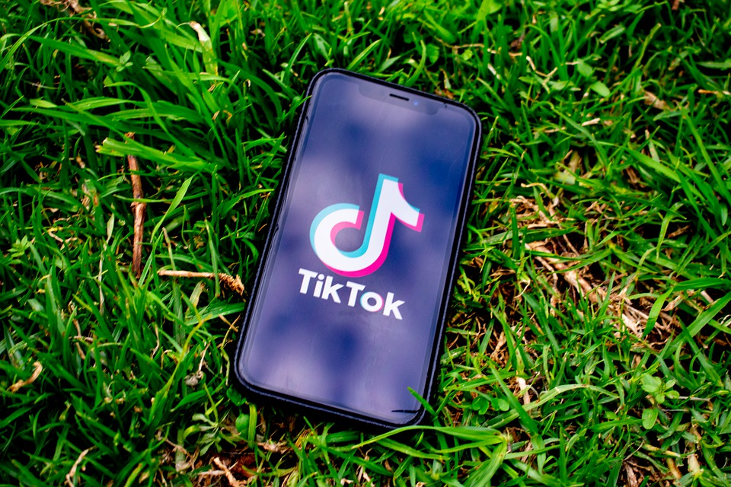

INTRODUCTION TO A.I.
… artificial intelligence robots that recommend things...

Slide 13
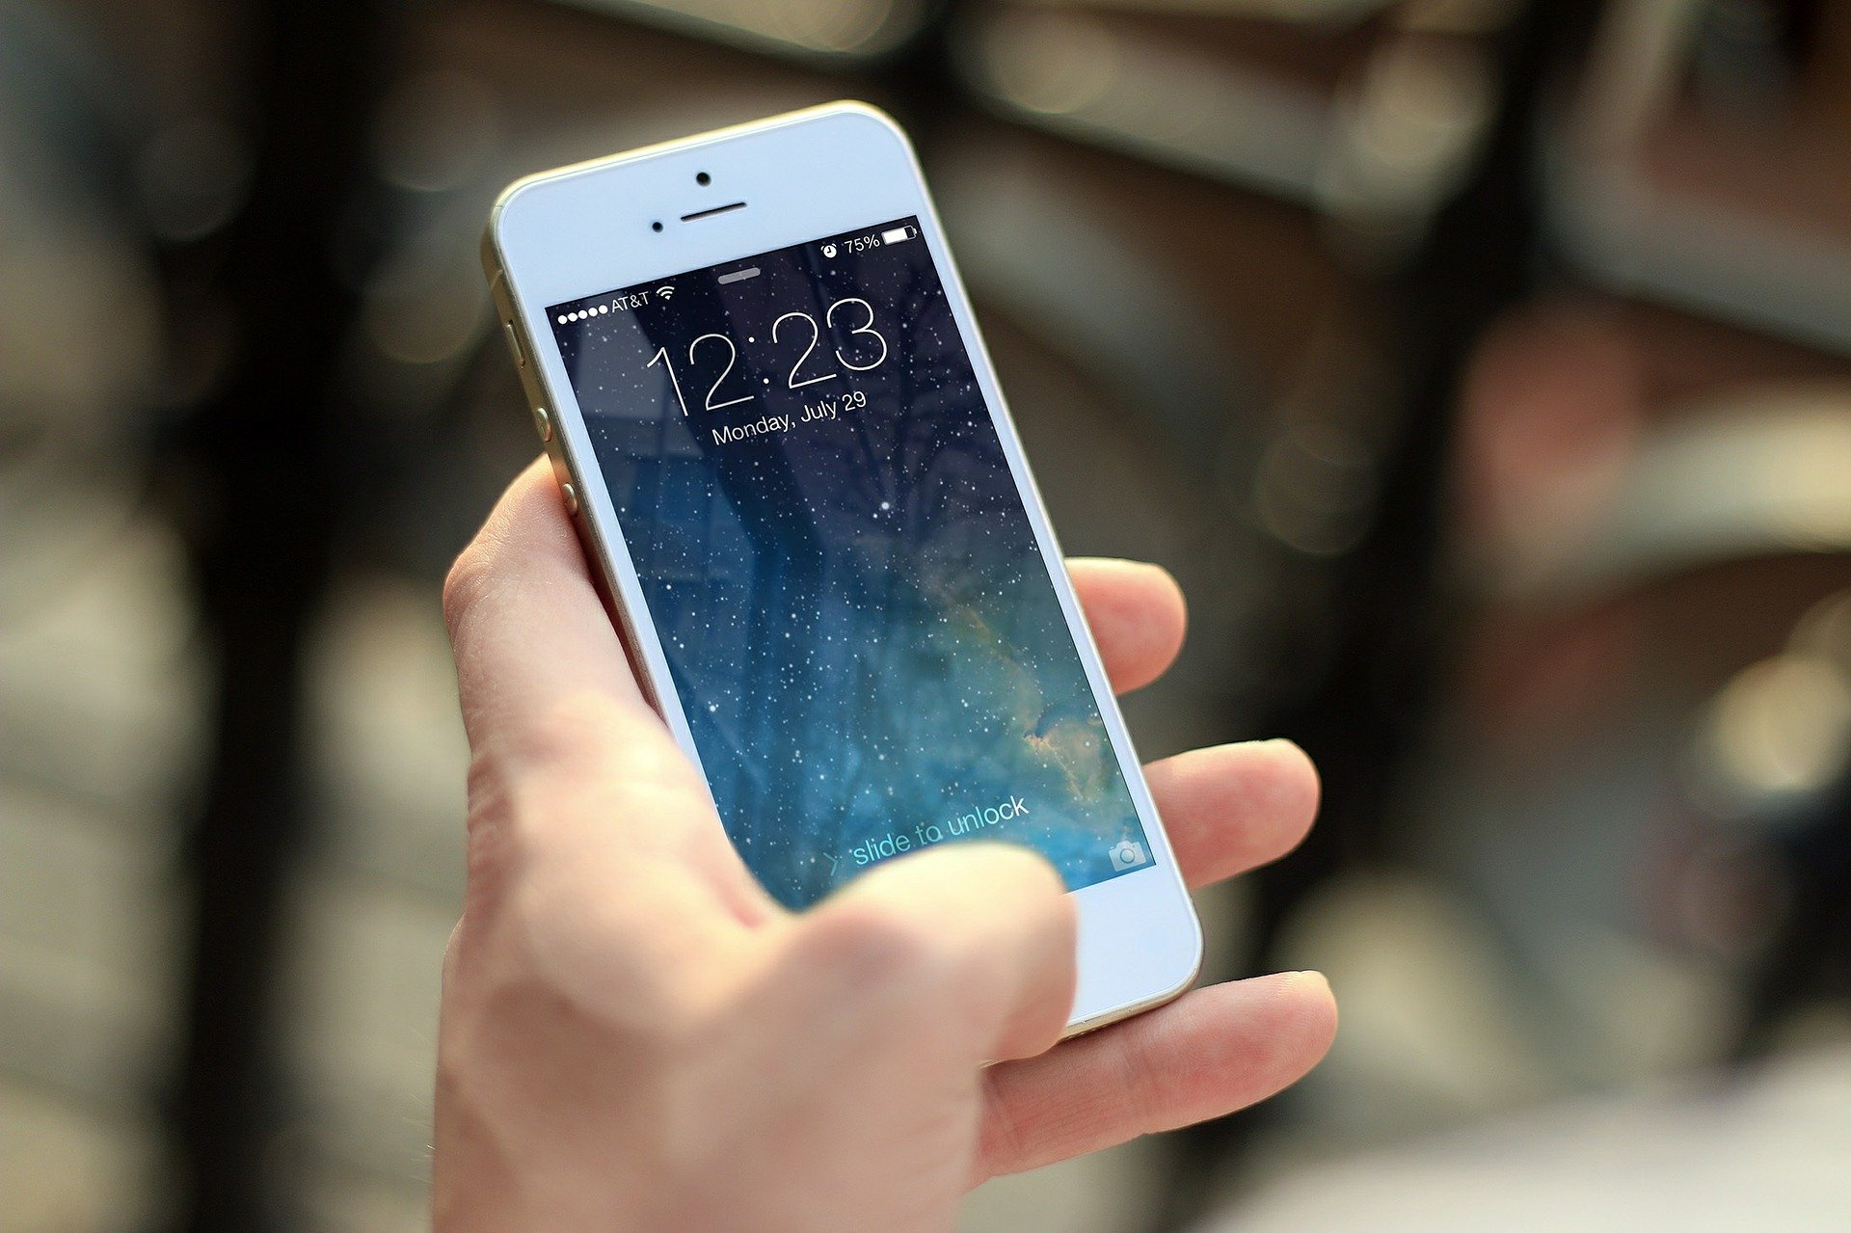
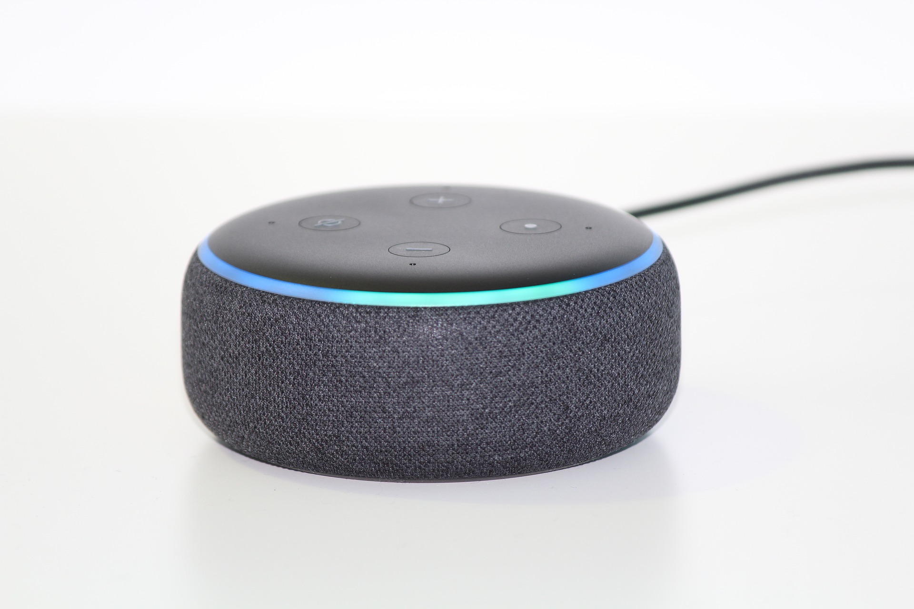
INTRODUCTION TO A.I.
… artificial intelligence robots that listen and recognise speech...
“Hey Siri, I lost my homework”

Slide 14

INTRODUCTION TO A.I.
… artificial intelligence robots that predict what you want to know...

Slide 15
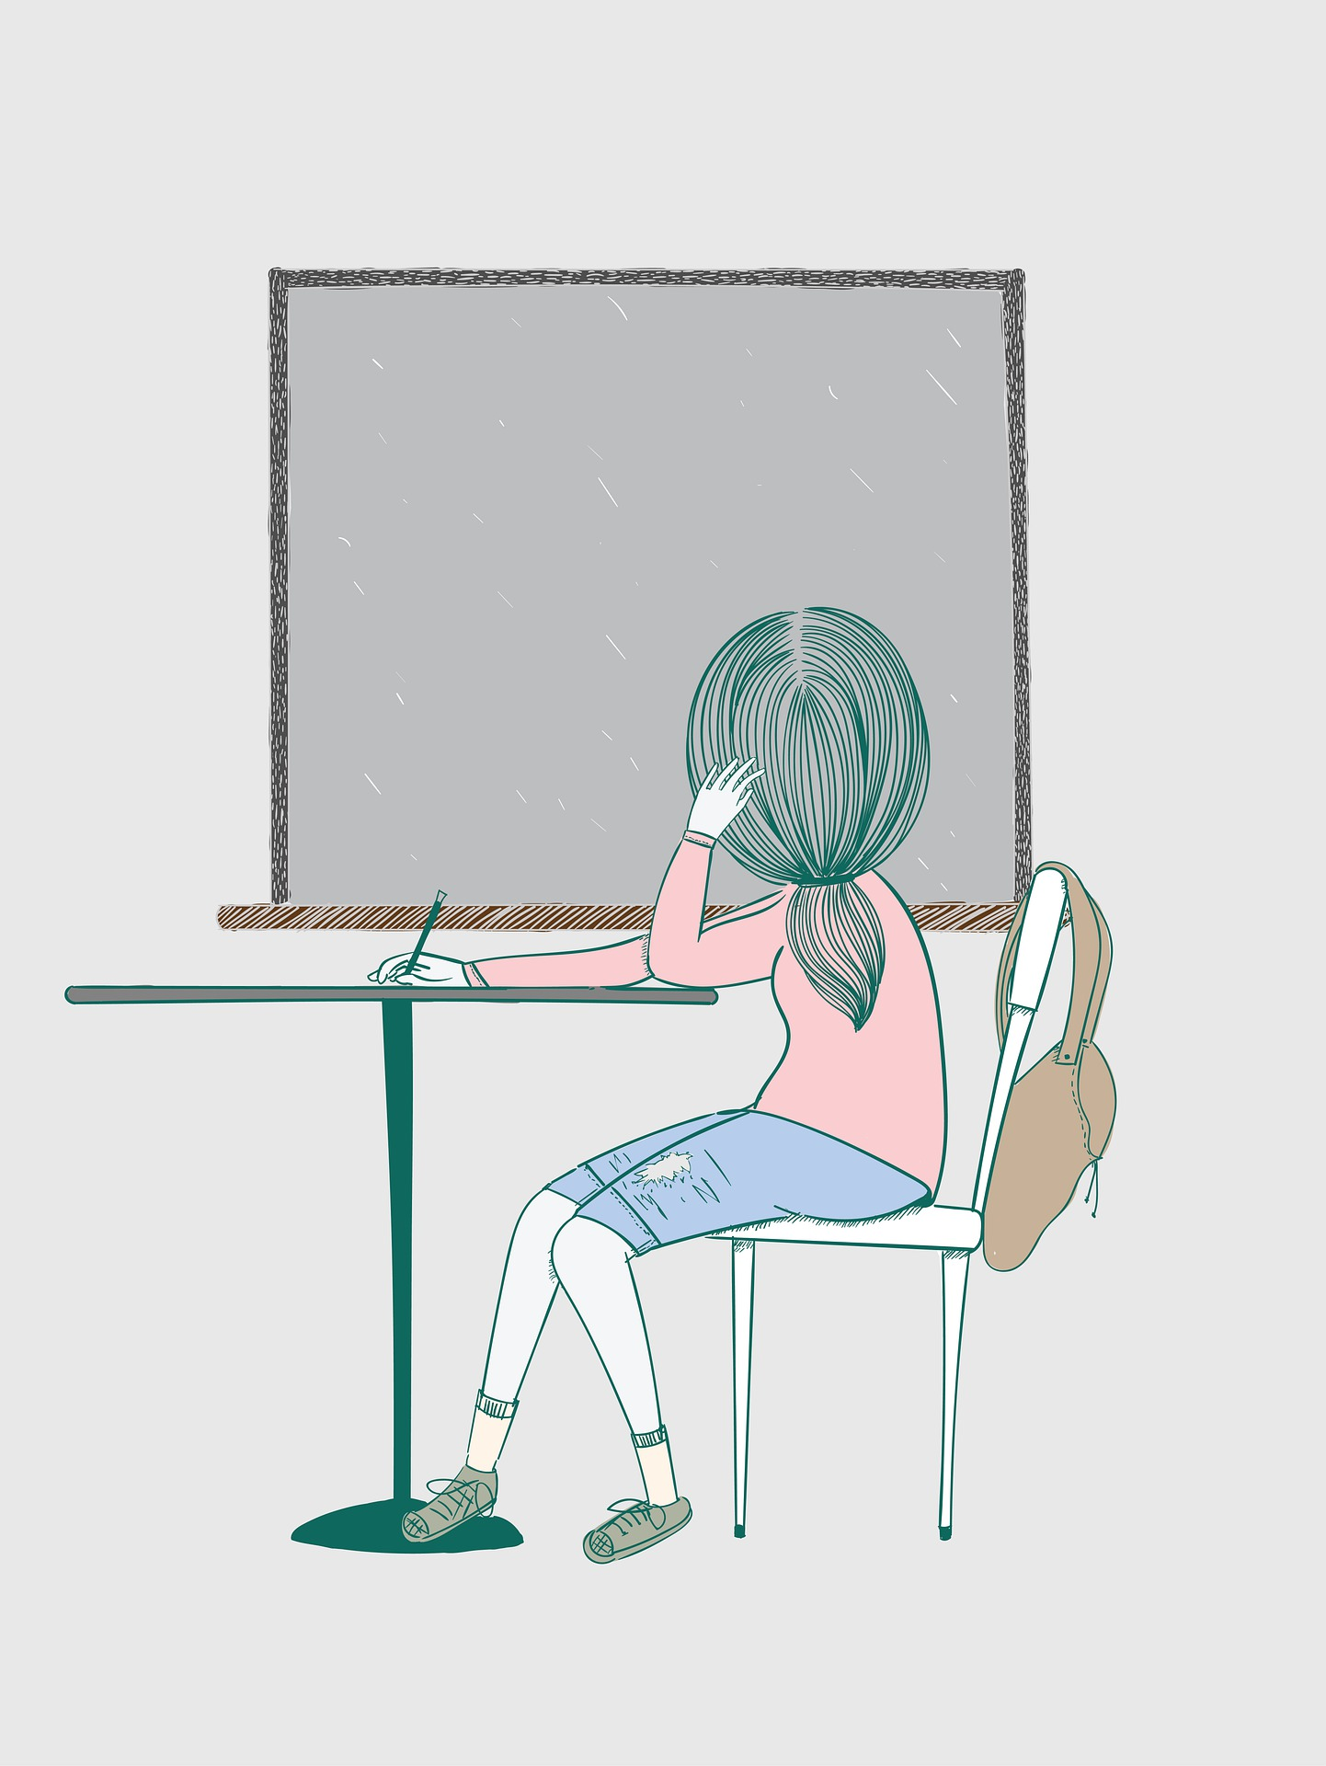
“Can machines think?’” Alan Turing - Father of Computer Science
“In 2-5 years, I see social robots helping families with things that really matter, like education, health, eldercare, entertainment, and companionship.”
Cynthia Breazeal - Chief Scientist
INTRODUCTION TO A.I.
How do AI robots do things without humans telling them exactly what to do, step by step?
Notes:
If pupils have views and thoughts, encourage them to share with the class. Otherwise move on to the next slide.

Slide 16
We can train (or program) Artificial Intelligence robots
to spot patterns in information
INTRODUCTION TO A.I.
and the more training the robots do, the better they will be at making decisions

Slide 17
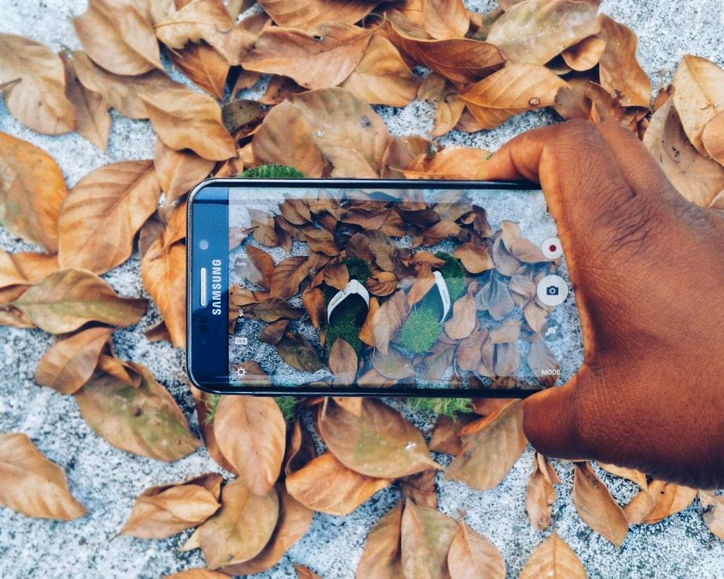




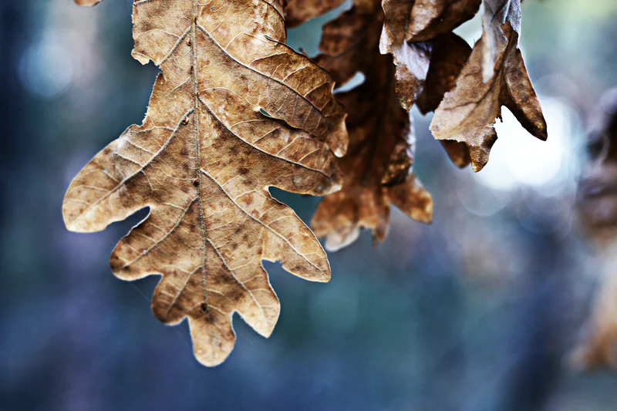
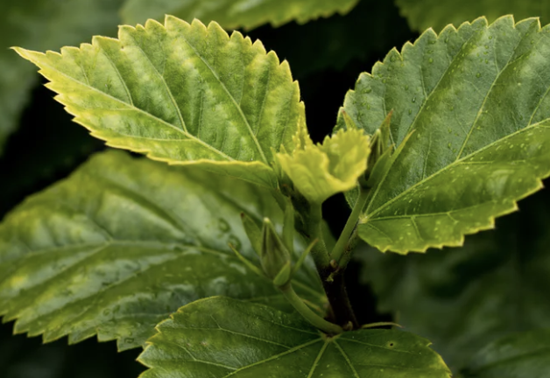
Example: AI robot that can identify and clean up brown leaves
AI robot uses sensors to spot patterns in information and make decisions towards the goal
Sensors
gather information
Spot patterns
Humans tell the A.I. robot which ones are brown leaves. It learns what brown leaves look like by spotting patterns.
Make decisions to reach the goal
The A.I. robot can decide which things to clean up
Clean up the brown leaves
INTRODUCTION TO A.I.

Slide 18
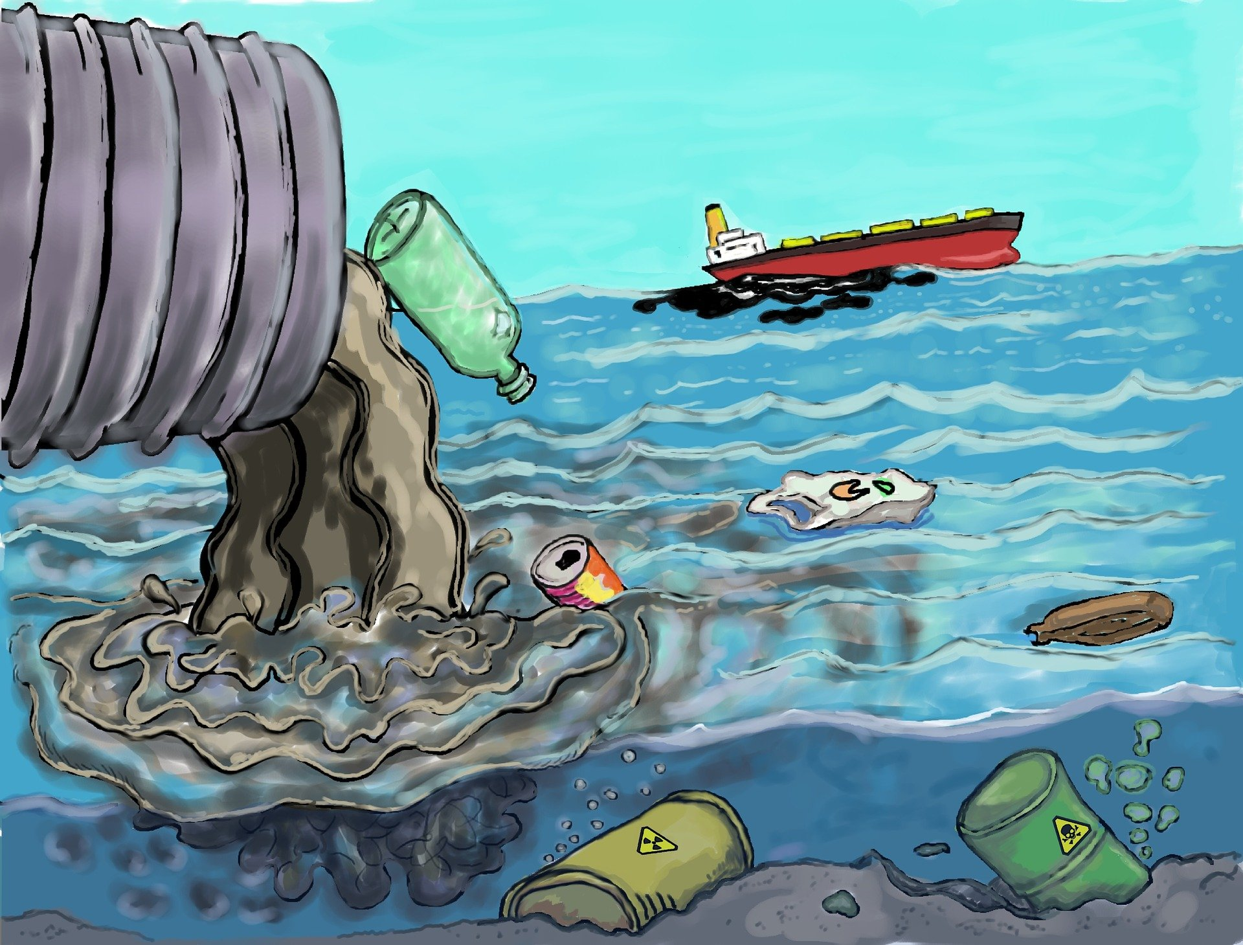
Can we teach a computer to tell the difference between sea creatures and rubbish?
ACTIVITY 1

Slide 19
We can teach the computer!
ACTIVITY 2
We’re going to have a go together now…
https://tinyurl.com/v3web3g
Notes:
Click the link on the slide.
Explain to pupils that they are going to train an artificial intelligence ‘robot’ to tell the difference between sea creatures and rubbish so that it can begin to clean the ocean. Mention to pupils that once you have trained the robot, you will be testing it out to see how it gets on.
Work through levels 2 and 3 as a whole class. We recommend having the website on the board and allowing pupils to call out whether the item is a sea creature or not.
Emphasise that the A.I. robot is learning what to leave in the ocean based on the ‘training’ they are providing it. The more training, the more accurate it will be.
After training the AI robot, the pupils will test it to see how well it does.

Slide 20
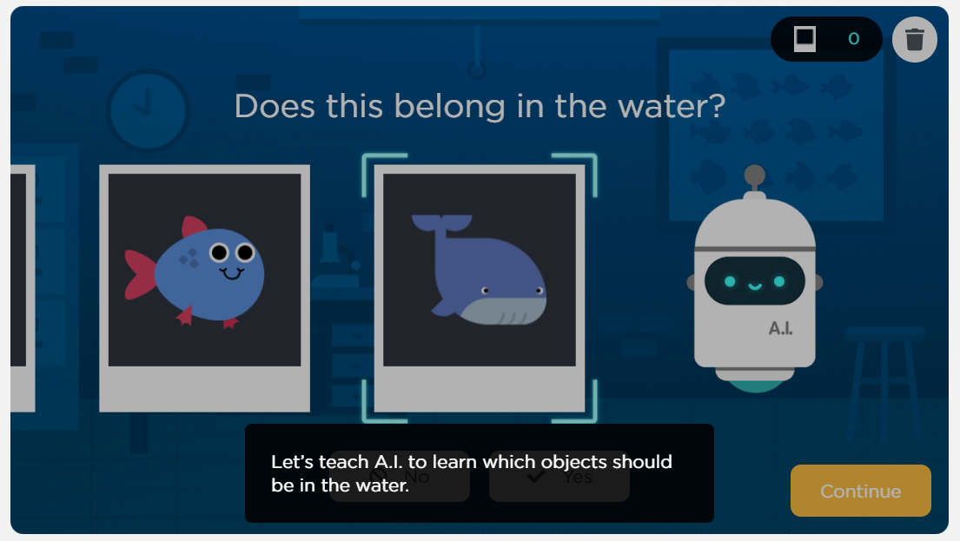
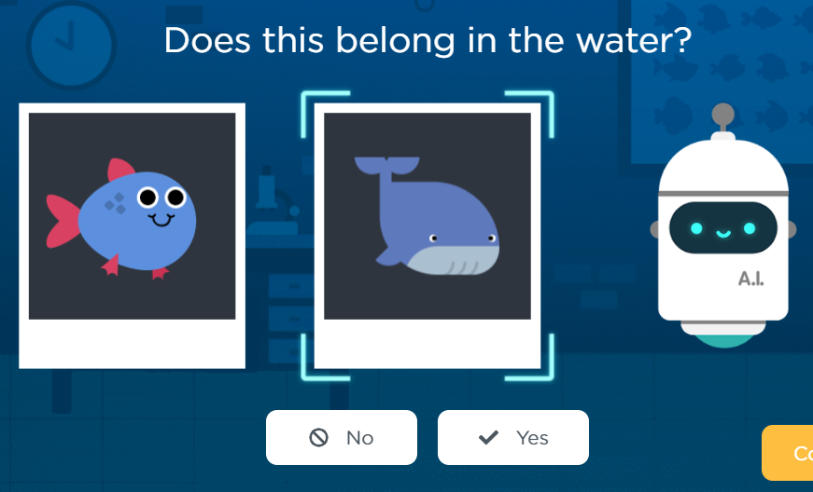
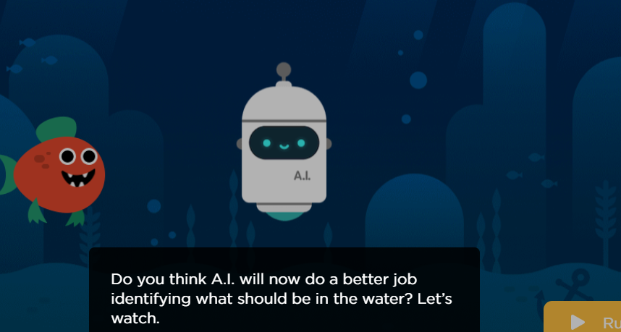

QUICKFIRE QUESTIONS
Now your turn...
https://tinyurl.com/yasu7472
Click continue
Classify each item
Once you’re done, click run
No headphones? Click the mute button!
Notes:
Ask pupils to open their laptops or iPads and follow the link on the screen. Pupils are to work through level 4.
In this activity, they will continue to train the A.I. robot to recognise sea creatures. Once most pupils have come to the end of level 4, ask pupils to stop what they are doing.
If pupils finish quickly, they may continue with some of the later levels of the activity. However, this is not required for the lesson.
Ask pupils whether it made (or if they think it would have made) a difference if they gave the wrong answers when they were training the AI robot (e.g. if they said no when the real answer is yes)? Why?
This point can be emphasised by starting the class version again and then making the wrong decisions consistently for the triangular fish. What will happen when it comes to testing the AI robot? Get pupils to make a prediction.

Slide 21
QUICKFIRE QUESTIONS
Quickfire activity
What makes Artificial Intelligence different from other machines?
REMINDER
Artificial intelligence robots….
Gather information
spot patterns
in the information
Achieve goal
Notes:
The last activity of the lesson involves pupils thinking about what makes AI different to other machines. Before beginning the next slide, remind pupils of the key characteristics of AI (summarised in the box on this slide).

Slide 22
Teacher note: the answers are in the speaker notes!
QUICKFIRE QUESTIONS
Directions
Is this an A.I. agent? Point to the left or right wall….
A.I.
Not A.I.
Notes:
Ask pupils to point to the left or right wall to choose their side. If there’s a technology that the class is split on - have a conversation.
Key questions for those conversations: Can it sense its environment? Can it take actions towards a goal?

Slide 23
Alarm that turns on every day at 6:45 am
QUICKFIRE QUESTIONS
A.I.
Not A.I.
Notes:
Not AI - this is just a technology programmed to do the same thing at the same time always (no sensing of environment)

Slide 24
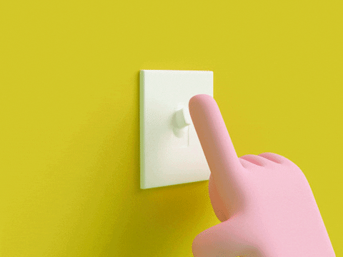
QUICKFIRE QUESTIONS
Turning on a light switch
A.I.
Not A.I.
Notes:
Not AI - light switches like this don’t sense their environment

Slide 25
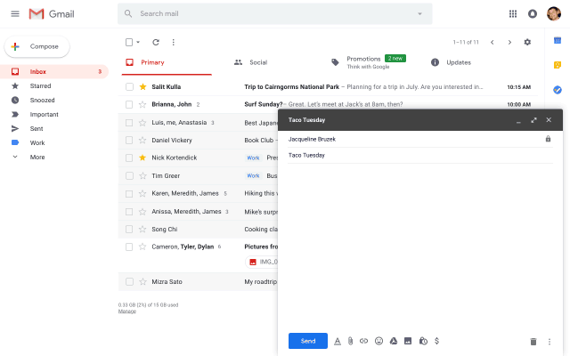
QUICKFIRE QUESTIONS
The computer making suggestions about what to write in an email
A.I.
Not A.I.
Notes:
AI - sensing words entered to guess what information might come next

Slide 26

QUICKFIRE QUESTIONS
Changing channel with a remote control
A.I.
Not A.I.
Notes:
Not AI - can’t sense their environment - a human is controlling the TV through the remote

Slide 27
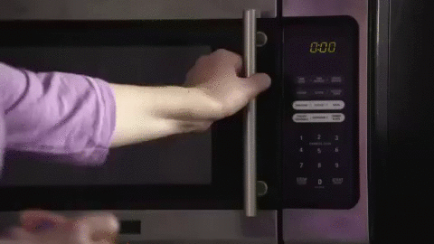
QUICKFIRE QUESTIONS
Microwave to heat up food or drink
A.I.
Not A.I.
Notes:
Not AI - microwaves don’t sense their environments to change actions. Humans tell them what to do at all times.

Slide 28
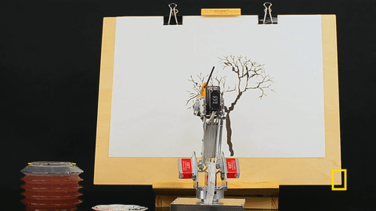
QUICKFIRE QUESTIONS
A robot learning what a painting ‘should’ look like and then painting its own
A.I.
Not A.I.
Notes:
AI: the robot is creating paintings without human help. It’s doing this by looking at millions of real paintings and learning what a painting ‘should’ look like.

Slide 29
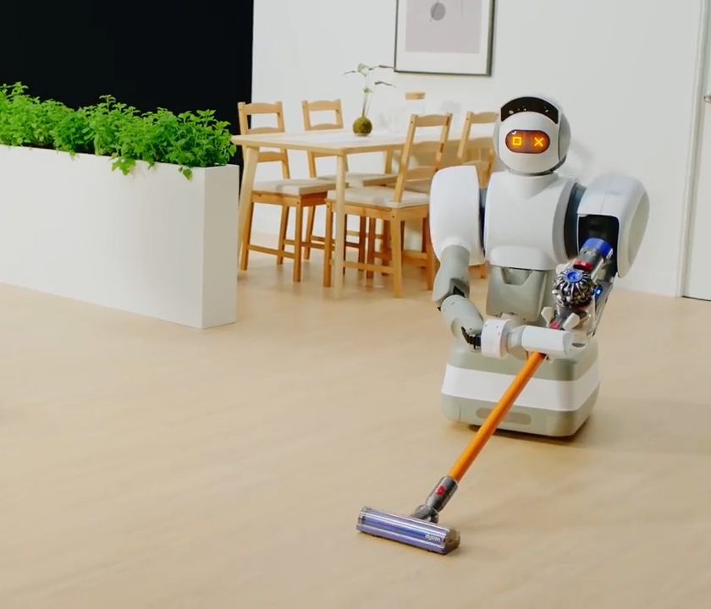
A vacuum that learns the layout of your home and where it’s always dirty
QUICKFIRE QUESTIONS
A.I.
Not A.I.
Notes:
AI! It’s sensing the layout of your home and taking actions to clean

Slide 30
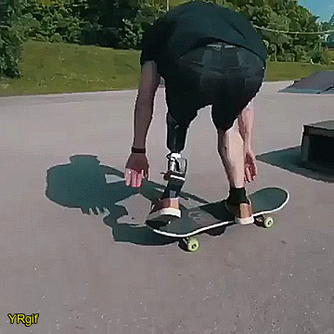
QUICKFIRE QUESTIONS
A prosthetic leg that this person is using to skateboard (an artificial replacement body part)
Not A.I.
A.I.
Source: giphy.com
Notes:
Not AI: While prosthetics with AI are being developed, this prosthetic leg does not have AI. It’s not sensing it’s environment - the person’s brain is telling it how to move.

Slide 31
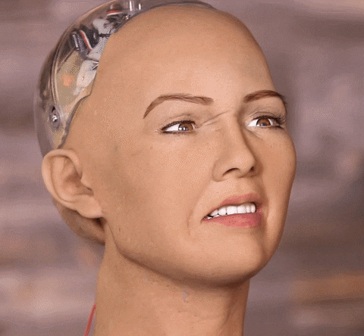
QUICKFIRE QUESTIONS
A robot that can detect your emotions and respond with appropriate facial expressions
A.I.
Not A.I.
Notes:
AI: this robot mimics detects human emotions by looking at your facial expressions and can then respond with appropriate facial expressions.

Slide 32
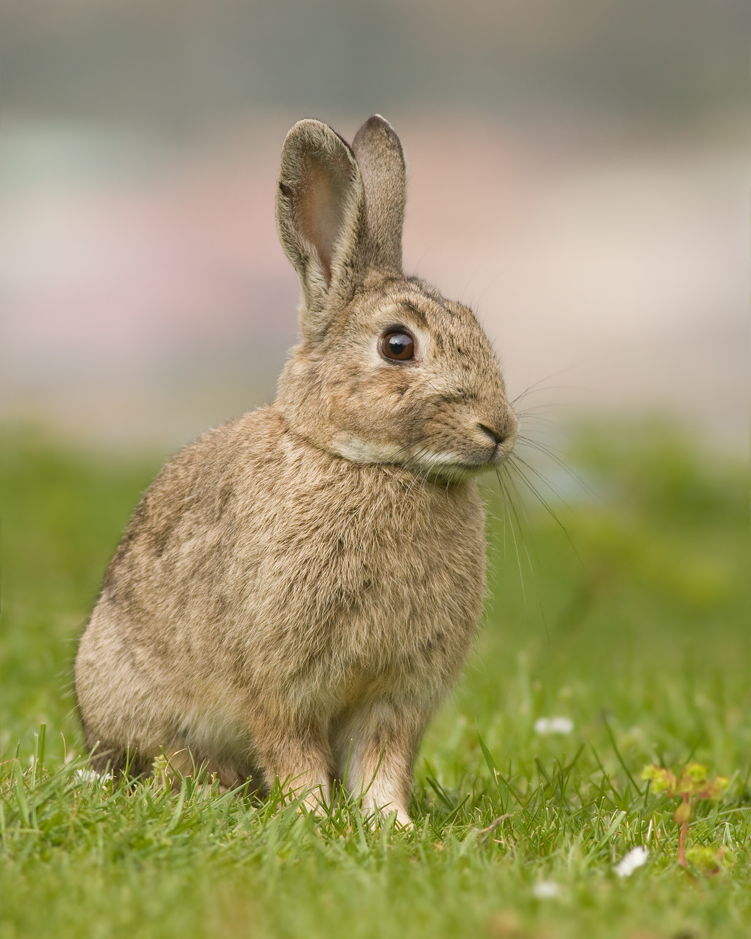
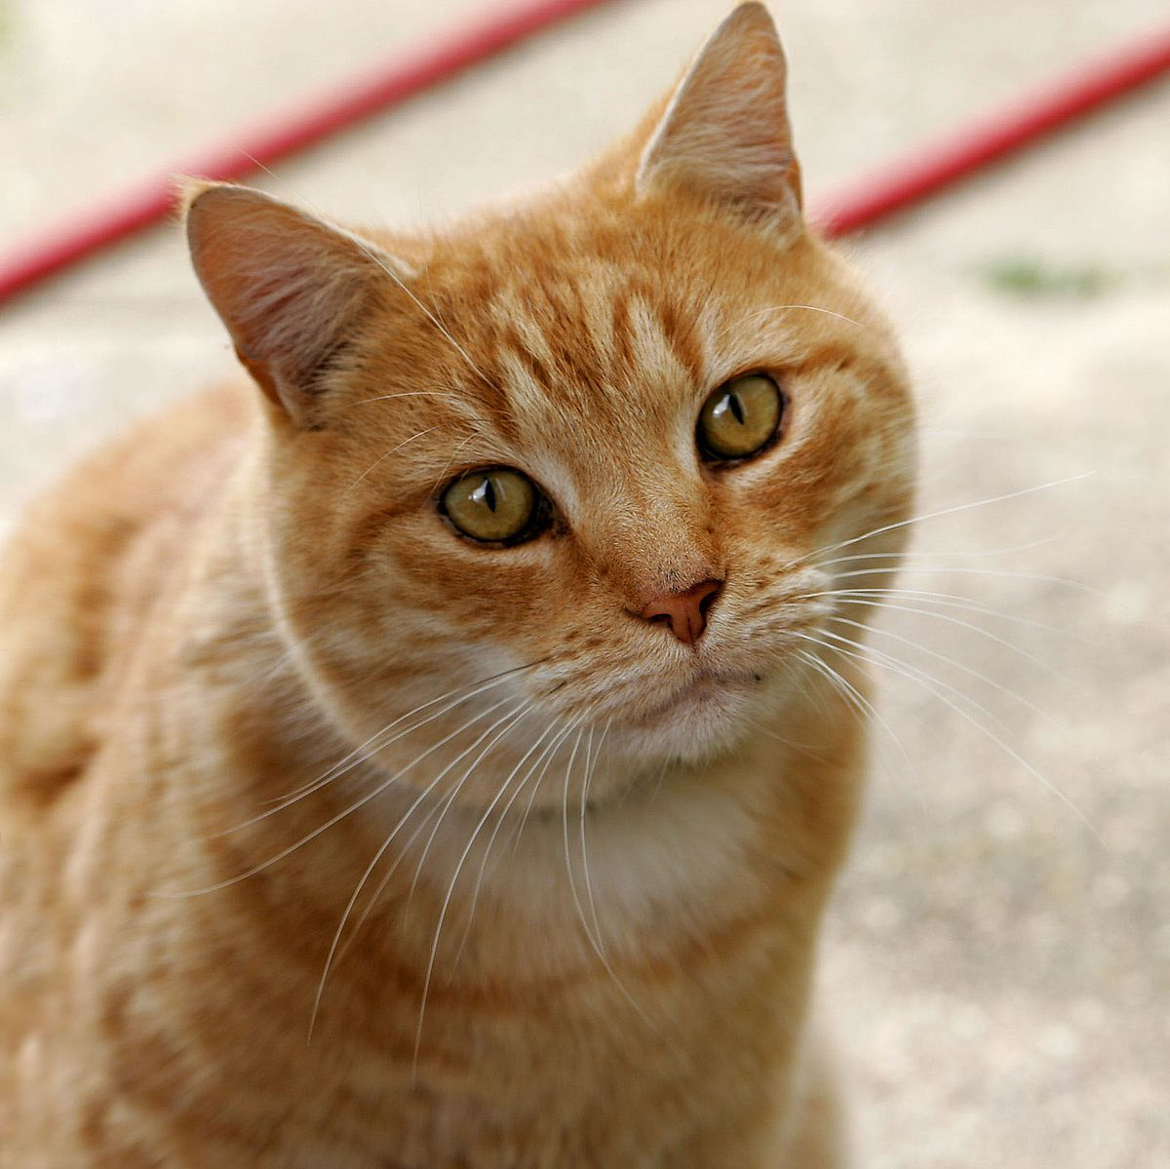
Plenary
PLENARY
You are training an A.I. robot to recognise pictures of different animals. You use:
1000 pictures of rabbits
20 pictures of cats
After training, you show the A.I. robot more pictures. Which option below is right?:
a) It will be worse at recognising cats than rabbits
b) It can’t tell you which pictures are foxes
c) Both of the above
Click to see answer
Notes:
Think, Pair, Share. Ask pupils the question on the slide. Give pupils 30 seconds to think about the question in their heads before sharing their thoughts with their partner, and then the whole class. The question is designed to be challenging, so encourage them to think carefully.
If pupils are struggling, remind them of the earlier activity in which the A.I. robot was more accurate when cleaning the ocean if they were provided with more data. Also remind them that the A.I. robot could not spot unusually shaped fish unless it had seen one before.

Slide 33
Plenary
PLENARY
a) It will be worse at recognising cats than rabbits
b) It can’t tell you which pictures are foxes
c) Both of the above
Notes:
a) It will be worse at recognising cats than rabbits
b) Ia) It will be worse at recognising cats than rabbits
b) It can’t tell you which pictures are foxes
c) All of the above
d) None of the above
t can’t tell you which pictures are foxes
c) All of the above
d) None of the above

Slide 34
Home learning task
HOME LEARNING TASK
Watch the video on the home learning task page (ask your parents/carers to join you)
Write down two things that you learned from the videos about what robots and computers can do.
Write down two ways that your parents/carers used computers this week (this includes phones/tablets).
Imagine you could teach a robot to do anything you like. What would you teach it to do? How would computing help you do this?
We will be talking about your discussions with your parents/carers in a future lesson.
Notes:
The follow-up lesson is centered around the home learning task so we recommend scheduling the follow-up lesson soon after the main lesson.

Slide 35
Image credits
Slide 6: https://pixabay.com/photos/plastic-fish-recycling-trash-4234205/ joelsaucedosaucedo
Slide 8: https://pixabay.com/photos/fish-water-river-garbage-pollution-1663770/ efes
Slide 11 Netflix: https://pixabay.com/photos/netflix-tv-home-video-digital-5336006/ vickygharat
Slide 11 Tiktok: https://pixabay.com/photos/tiktok-social-media-app-tik-tok-5323007/ konkarampelas
Slide 12 Alexa: https://pixabay.com/photos/alexa-echo-smart-home-box-4758340/ hamburgfinn
Slide 12 Iphone: https://pixabay.com/photos/iphone-smartphone-apps-apple-inc-410324/ JESHOOTS.com
Slide 14 Google search: https://unsplash.com/photos/PuNW11NRjI4 Visuals
Slide 15 girl studying: https://pixabay.com/illustrations/student-studying-classroom-5734455/ Saydung89
Slide 18 rubbish in sea: https://pixabay.com/illustrations/pollution-trash-degradation-1603644/ Rilsonav
Slide 17 leaves: https://unsplash.com/photos/aR_1wKSN1f8, Fredy Jacob; https://unsplash.com/photos/rJiuEfMdjO0 Annie Spratt, https://unsplash.com/photos/i06CxweqdsQ Maeva Vigier; https://unsplash.com/photos/6a9cIhfUoLE Emilo Pascual, https://unsplash.com/photos/UiVvnF9IoLc David Boca, https://unsplash.com/photos/LjlZoRzvlb8 Amy chen
Slide 24 lightswitch: https://giphy.com/gifs/animation-cute-illustration-3ohzdFHDBEG32PmWJO
Slide 25 autocomplete: https://www.blog.google/products/gmail/subject-write-emails-faster-smart-compose-gmail/
Slide 26 remote control: https://giphy.com/gifs/moodman-KZe02gpoAj4yVjxKQt
Slide 27 microwave: https://giphy.com/gifs/best-gifs-amazon-dash-dy5pmvUvIdF1C
Slide 28 robot painting: https://giphy.com/gifs/natgeochannel-yearmillion-13EDZJjyAvuQb6
Slide 30 prosthetic leg: https://giphy.com/gifs/boy-NMgihlpTGqmwU
Slide 31 facial expressions robot: https://giphy.com/gifs/reaction-mrw-FsxRmuWIlHbMY

