Slide 1

Title IX for Carl Albert Housing and Athletics

Slide 2
The Law
Title IX states:
No person in the United States shall, on the basis of sex, be excluded from participation in, be denied the benefits of, or be subjected to discrimination under any education program or activity receiving Federal financial assistance.

Slide 3
Title IX Timeline
Law passed in 1972 as part of the Higher Education Amendments Act
Dear colleague letter (2011)
VAWA Amendments to Clery (2014 regulations)
Department of Education Regulations (August 2020)
Department of Education Regulations [in limbo] (August 2024)
Title IX protects both students and employees, AND other participants in an educational program or activity.

Slide 4
A (short) breakdown of Title IX Prohibitions
Discrimination
Harassment
  Sexual Assault
  Dating and Domestic Violence
  Stalking
  Quid Pro Quo
  Hostile Environment
Retaliation

Slide 5
Housing and Athletics
You are on the front lines of significant personal interaction.
This means you must FIRMLY draw a professional line: (1) You are not fully confidential (2) You must maintain detached and impersonal to an extent in order to be perceived and trusted as a professional (3) This is especially difficult for young professionals – who are frequently new hires in these areas.

Slide 6
Housing and Athletics Professionalism
Maintain professional and detached demeanor.
Avoid entangling relationships of any kind, treat people equitably.
Avoid risqué or otherwise problematic jokes, innuendos, etc.
Never assume that time and proximity always equal trust.
Avoid personal cell use with students and colleagues, text messages and social media in particular.
Professional “aura” in demeanor, dress, and mannerisms.

Slide 7
Discussion Case Study
The Pilot School Mentor

Slide 8
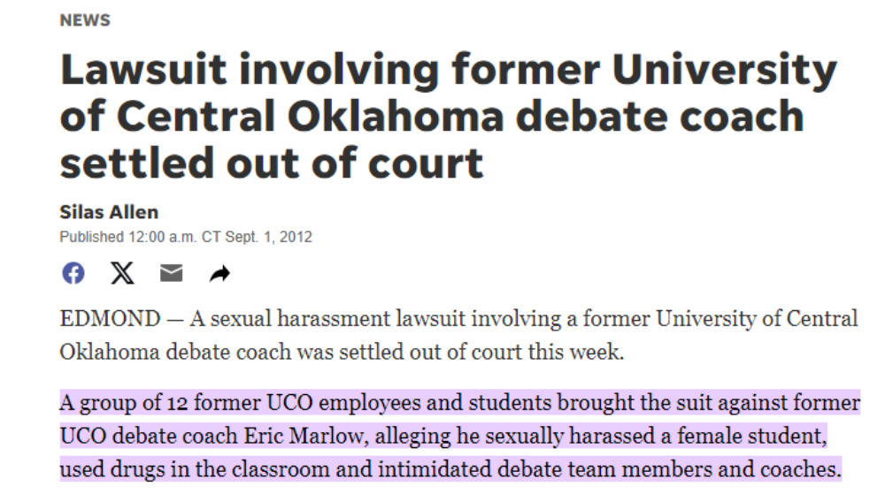
Some Headlines…

Slide 9
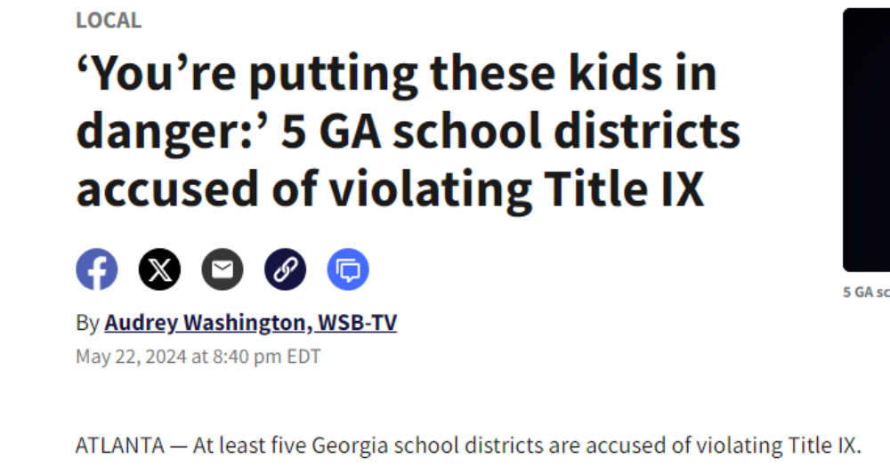

Slide 10
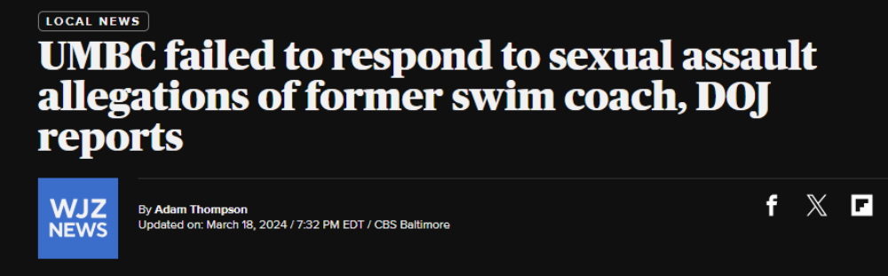

Slide 11


Slide 12
For those who are Supervisors…
The buck stops with you. Even if you lack knowledge, you will then be scrutinized for a culture of non-transparency within your department. You must demand reporting from your subordinates and encourage a culture of reporting.
Hire carefully – screen intentionally for whether you can trust the employment candidate with Title IX.
Do not ever, ever, ever discourage or disincentivize complaints.

Slide 13
What does the Department of Education say?
“A recipient institution that receives Department funds must operate its education program or activity in a nondiscriminatory manner free of discrimination based on sex, including sexual orientation and gender identity.”
The precise scope of Title IX and “on the basis of sex” is hotly contested currently in the Federal Courts.

Slide 14
What is Title IX Retaliation according to OCR?
“Also, no recipient or other person may intimidate, threaten, coerce, or discriminate against any individual for the purpose of interfering with any right or privilege secured by Title IX or its implementing regulations, or because the individual has made a report or complaint, testified, assisted, or participated or refused to participate in a proceeding under Title IX.”

Slide 15
Mandatory Reporting
Employees are expected to report information they become aware of that may constitute sex discrimination (including harassment and retaliation) in any program or activity no matter whether that information is incomplete or uncertain, so that a trained investigator can inquire deeper into the matter when and if necessary.
Therefore: even the slightest hint of possible discrimination, harassment, or retaliation creates a reporting burden.

Slide 16
Avoid Self-Delegation
Do not investigate potential discrimination, harassment, or retaliation on your own – simply report facts as you have them immediately.
Definitely do not conduct interviews! Parties have rights that you may inadvertently violate. Among these rights are highly particularized notice requirements prior to an investigation.

Slide 17
In Your Professional Role:
Consider how to foster an environment where individuals feel more safe coming forward and reporting discrimination, harassment, and retaliation.
Have frank and semi-frequent reinforcement of your openness to such complaints, and SIGNAL this by putting reporting information (Title IX Contact information, pamphlets, etc) in prominent places in lobbies, locker rooms, break rooms, etc.

Slide 18
In Your Professional Role:
Retaliation is a high risk, because of its sweeping definition.
When you personally notice or merely “hear about” any kind of intimidation or slandering, etc, in relation to a person who has made a complaint, or even merely participated in a complaint process, this must be reported to the Title IX Coordinator.
If the Title IX Coordinator has asked for your help in implementing supportive measures, diligently help to implement them.

Slide 19
What happens after a report to the Title IX Coordinator?

Slide 20
Mandatory and Discretionary Dismissals
The Title IX Coordinator is obligated to dismiss a formal Title IX complaint or any allegations therein if, at any time during the investigation or hearing, it is determined that:
The conduct alleged in the formal complaint would not constitute sexual harassment, even if proved; and/or
The conduct did not occur in an educational program or activity controlled by the College (including buildings or property controlled by recognized student organizations), and/or
The College does not have control of the Respondent; and/or
The conduct did not occur against a person in the United States.

Slide 21
Mandatory and Discretionary Dismissals
The Title IX Coordinator has the discretion to dismiss a formal Title IX complaint or any allegations therein if, at any time during the investigation or hearing, it is determined that:
A Complainant notifies the Title IX Coordinator in writing that the Complainant would like to withdraw the formal complaint or any allegations therein
The Respondent is no longer enrolled in or employed by the recipient
Specific circumstances prevent the recipient from gathering evidence sufficient to reach a determination as to the formal complaint or allegations therein.

Slide 22
Before an investigation
Pre-Investigation Process Documents for the parties
  Sexual Violence Supportive Measures Checklist
  Summary of Resources
  Investigation Process Overview
  Investigation and Hearing Flow Chart
  Investigation Notice
  Information about Informal Resolution

Slide 23
Notice
Must provide notice of the allegations of sexual harassment, including sufficient details known at the time and with sufficient time to prepare a response before any initial interview.§106.45(b)(2)(A)
For an employee respondent, can interview the respondent without disclosing the complainant’s identity, as long as no disciplinary action is taken without following the grievance process. 85 Fed. Reg. 30287

Slide 24
List of Notice Requirements
The letter of notification must include the following and take place PRIOR TO ANY INVESTIGATIVE MEETING OF ANY KIND:
[§106.45(b)(2)(B)]:
  Statement that respondent is presumed not responsible and that a determination of responsibility is made at the conclusion of the grievance process
  Inform parties they may have an advisor of their choice, who may be an attorney
  Inform parties they may inspect and review evidence.
  Inform parties of any provision in policy/code of conduct that prohibits knowingly making false statements or knowingly submitting false information during the grievance process.
  Written notice of the date, time, location, participants, and purpose of all hearings, investigative interviews, or other meetings, with sufficient time for the party to participate.

Slide 25
Supplemental Notice
If the investigation uncovers additional allegations which were not included in the initial notice, must provide notice of the additional allegations to the involved parties whose identities are known.§106.45(b)(2)(ii)

Slide 26
Who has the burden of proof?
The burden is now clearly on the institution to compile evidence.
  Never, EVER, characterize the complainant in a way that makes it sound like evidence production is their burden. It is an institutional burden, and any evidence coming from the Complainant is merely requested from them by the institution.

Slide 27
Evidence Gathering
Must provide an equal opportunity for the parties to present witnesses, including fact and expert witnesses, and other inculpatory and exculpatory evidence.§106.45(b)(5)(ii)
  Parties do not have a right to depose others or issue subpoenas. 85 Fed. Reg.30306
Cannot restrict the parties’ ability to discuss the allegations being investigated.§106.45(b)(5)(iii)

Slide 28
Evidence Review
Both parties must have an equal opportunity to inspect and review any evidence obtained as part of the investigation that is directly related to the allegations, including the evidence upon which the institution does not intend to rely in reaching a determination regarding responsibility and inculpatory or exculpatory evidence, whether obtained from a party or other source. § 106.45(b)(3)(vi)
  Inculpatory – evidence that tends to show Respondent is responsible
  Exculpatory – evidence that tends to show Respondent is not responsible

Slide 29
Presumption of not-responsible, for the Respondent
It is a REQUIREMENT of Title IX Regulations that investigators and hearing decision-makers maintain an understanding that the Respondent is presumed not-responsible for misconduct until all the evidence has been collected and analyzed, and a hearing has ended, and deliberations have begun.
In your role, you should also maintain neutrality as much as possible, pending the process.

Slide 30
What if you are a witness?
You might be asked to testify at a hearing.
You might be asked to speak about what you know with a Title IX investigator.
If the Title IX case overlaps with a criminal or civil case, you might receive a subpoena to testify in a court of law. You may also be requested by police to provide information to law enforcement.

Slide 31
Discussing Specifics

Slide 32
Harassment as defined in the regulations
(i) An employee conditioning educational benefits on participation in unwelcome sexual conduct (i.e., quid pro quo);
(ii) Unwelcome conduct that a reasonable person would determine is so severe, pervasive, and objectively offensive that it effectively denies a person equal access to the educational institution’s education program or activity; or
(iii)Sexual assault (as defined in the Clery Act), or dating violence, domestic violence, or stalking as defined in the Violence Against Women Act (VAWA).

Slide 33
Unwelcome Conduct and the Reasonable Person Standard
Look at the conduct as if you were a reasonable person in the same position, and same unique circumstances of the complainant’s position in the case. (The position itself may be contested)
Would a reasonable person in such a position feel the conduct was unwelcome?
Dept. of Ed. Says: “[it]depends on a constellation of factors including the ages and numbers of parties involved.” 85 Fed. Reg. 30150

Slide 34
Dating Violence, Domestic Violence, Sexual Assault, and Stalking
These are defined in policy using the mandatory Clery Act definitions from the 2014 regulations.
No “severe, pervasive, and/or objectively offensive” analysis is needed – only a determination of whether the definitions are met.
Even a single instance of sexual assault can be a violation.
Definition of consent is highly important in these cases.

Slide 35
What is Sexual Assault?
The Clery amendments state that sexual assault is, “[a]n offense that meets the definition of rape, fondling, incest, or statutory rape as used in the FBI's UCR program...”
Those corresponding definitions are:

Slide 36
What is Sexual Assault?
Rape: The penetration, no matter how slight, of the vagina or anus with any body part or object, or oral penetration by a sex organ of another person, without the consent of the victim.
Sex Offenses: Any sexual act directed against another person, without the consent of the victim, including instances where the victim is incapable of giving consent.
  Fondling—The touching of the private body parts of another person for the purpose of sexual gratification, without the consent of the victim, including instances where the victim is incapable of giving consent because of age or temporary or permanent mental incapacity.
  Incest—Sexual intercourse between persons who are related to each other within the degrees wherein marriage is prohibited by law.
  Statutory Rape—Sexual intercourse with a person who is under the statutory age of consent.

Slide 37
What is Dating Violence?
Violence committed by a person who is or has been in a social relationship of a romantic or intimate nature with the victim.
The existence of such a relationship shall be determined based on the reporting party’s statement and with consideration of the length of the relationship, the type of relationship, and the frequency of interaction between the persons involved in the relationship.
Dating violence includes, but is not limited to, sexual or physical abuse or the threat of such abuse. Dating violence does not include acts covered under the definition of domestic violence.

Slide 38
What is Domestic Violence?
A felony or misdemeanor crime of violence committed:
  By a current or former spouse or intimate partner of the victim;
  By a person with whom the victim shares a child in common;
  By a person who is cohabitating with, or has cohabitated with, the victim as a spouse or intimate partner;
  By a person similarly situated to a spouse of the victim under the domestic or family violence laws of the jurisdiction in which the crime of violence occurred;
    By any other person against an adult or youth victim who is protected from that person’s acts under the domestic or family violence laws of the jurisdiction in which the crime of violence occurred.

Slide 39
What is Stalking?
Engaging in a course of conduct directed at a specific person that would cause a reasonable person to fear for his/ her safety or the safety of others; or suffer substantial emotional distress.

Slide 40
More on Stalking
Course of conduct means two or more acts, including, but not limited to, acts in which the stalker directly, indirectly, or through third parties, by any action, method, device, or means follows, monitors, observes, surveils, threatens, or communicates to or about, a person, or interferes with a person’s property.
Substantial emotional distress means significant mental suffering or anguish that may, but does not necessarily, require medical or other professional treatment or counseling.
Reasonable person means a reasonable person under similar circumstances and with similar identities to the victim.

Slide 41
Hypothetical Scenario
A student comes to Coach Smith stating that he keeps receiving texts from an ex girlfriend who is “obsessed” and he has received about 19 texts in the past day. Coach Smith says, “just block her.”

Slide 42
Simultaneous application of other laws
Campus Save Act
Violence Against Women Act
Civil Rights Act of 1964 (Title VI)

