Slide 1

Welcome to
Communication Strategies

Slide 2


Agenda
Course Overview
  Introductions with team builder
  Norms
  Data
  Learning Objectives
Strategies for Improving Communication
  Developing a meeting structure
  Check-ins
Summary
Reflection

Slide 3


Introductions
Name, role and answer to this question:
What superpower would you want and why?
Notes:
Introduce yourself, have the producer introduce his/herself, have participants introduce themselves with the information requested

Slide 4
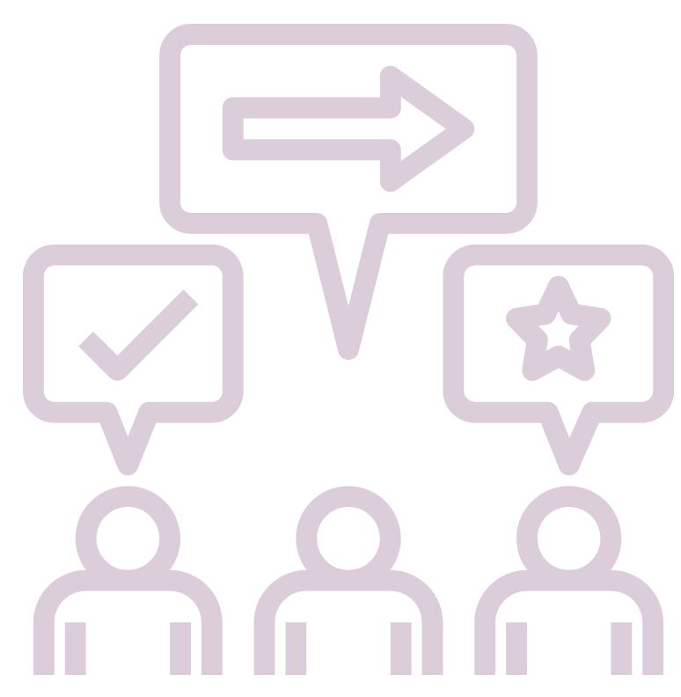
Norms
Be present and actively engaged.
Use the raise hand reaction when you want to speak.
Remain on mute unless you are speaking.
Enter questions in the chat.

Slide 5
What our data says:
How would you rate your connectedness to your team?
How would you rate the effectiveness of virtual meetings?
Connected
Effective
Disconnected
Ineffective
We have 2 new team members and I feel like I don’t know them at all.
I leave our meetings and I’m not sure what I’m supposed to be doing.
I rarely talk to my manager anymore and have not received
any feedback.
Our meetings are incredibly unproductive.

Slide 6
Does this data surprise you?
What other things are you hearing/ feeling since we have switched to working remotely?
Discussion
Notes:
Participants can unmute to share

Slide 7

Objectives
By the end of this training, I will be able to…
Summarize how adding a meeting structure will improve communication.
Describe the required elements of the agenda that will be implemented.
Describe the purpose of each type of check-in.
Explain how check-ins will improve communication.

Slide 8

Why is improving communication important?
Discussion
Notes:
Waterfall discussion:
Provide question, time to type into the chat (but NOT hit enter) when I say waterfall, hit enter, all answers appear at approximately same time making it look like a waterfall. This is an activity that you can implement into your virtual meetings.

Slide 9
Meeting Structure
Why?
Establish purpose
Promote collaboration
Stimulate communication

Slide 10
Meeting Structure
What?
Agendas
Objectives
Roles
Engagement
Time Allocations
Leader
Purpose
Efficiency
Focus
Facilitator
Recorder
Timekeeper

Slide 11
Meeting Structure
Roles
Leader- Plans meeting
Facilitator- Guides discussion
Recorder- Takes notes
Timekeeper- Keeps meeting moving
How will adding roles to your meetings increase engagement?

Slide 12
Sample Agenda
Notes:
explain

Slide 13

Work together to create an agenda for your next meeting.
Collaboration- Breakout rooms

Slide 14
Check-ins
Why?
Feel connected
Share progress
Build relationships

Slide 15
Check-ins
What?
One-on-One
Ask questions
Team
Short & informal
Provide feedback
Individual support
Appx. 1x/month
Increase trust
Team-building
Appx. 1x/week

Slide 16

Fact or Fiction?
Team Building

Slide 17


What are some activities that can be done during team check-ins?
ⓘ Start presenting to display the poll results on this slide.

Slide 18

Summary
Improve Communication
Increase Productivity
Improve Morale

Slide 19
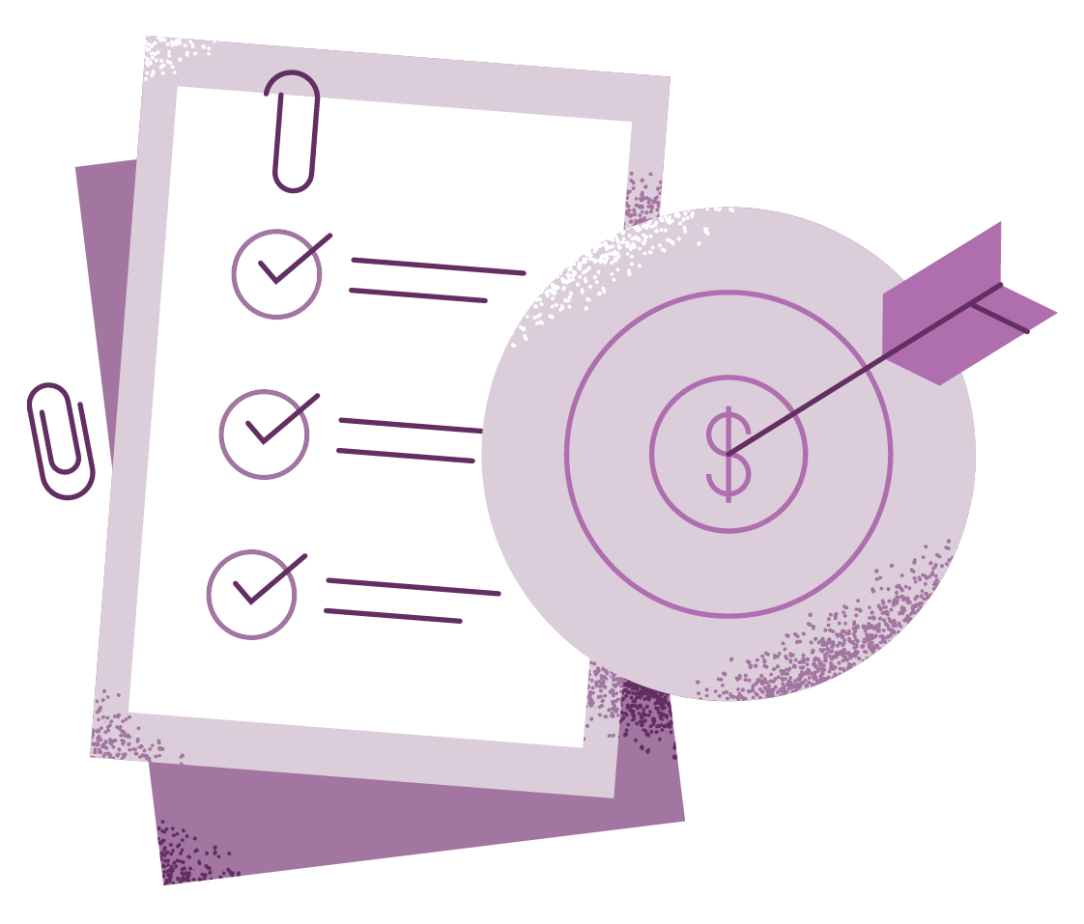
Next Steps
Implement Meeting Agendas
Begin Regular Check-Ins

Slide 20
Objectives
By the end of this training, I will be able to…
Summarize how adding a meeting structure will improve communication.
Describe the required elements of the agenda that will be implemented.
Describe the purpose of each type of check-in.
Explain how check-ins will improve communication.

Slide 21

Reflection
What have you learned?
Complete the reflection.

Slide 22
Thank you!

