Slide 1
CONTENT TEMPLATE
for the bexio App Marketplace

Slide 2
How-to
You are the experts of your app: You know your pitch, the key benefits, the pricing etc. With that content template you can deliver the content directly how your application will be listed in the bexio marketplace (e.g. like https://www.bexio.com/de-CH/marketplace/qlerqs ).
Please consider the following:
Please fill out the content only in the languages your app is available in.
Wording guidelines:
Please use the polite form («Sie»-Form).
Please always write bexio in lower case (even at the beginning of a sentence).
The design and structure of a marketplace page is standardized and can not be adapted. Only those elements which are mentioned in this document.
Please return the complete content in one finalised document. We retain the right to change smaller parts of the document if necessary. You will have the possibility to review changes.
Please also send us the following attachments (e.g. as .zip folder):
Your logo in 2 versions:
1x in colour (transparent and in Vector Format *.svg or alternatively *.png)
Media content (if available):
Youtube links for videos (full videos can not be included, only via Youtube)
Product images or screenshots (in all relevant languages) in good resolution

Slide 3
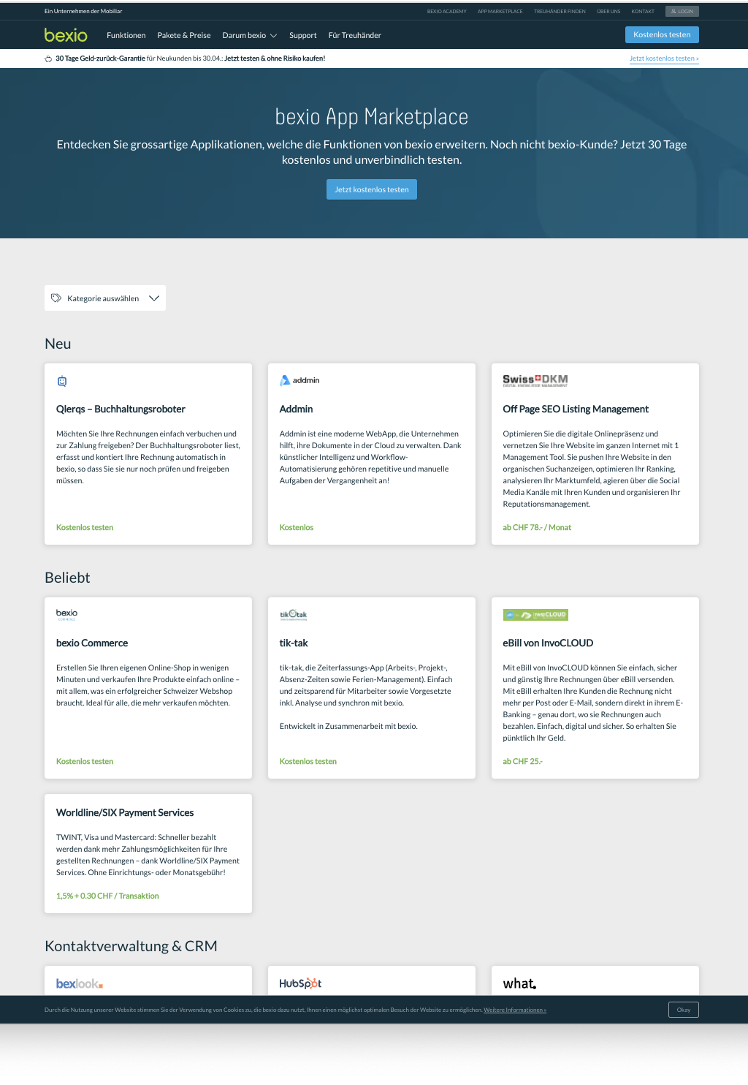
URL: https://www.bexio.com/marketplace
Element | Copy EN | Copy DE
TITLE
SUMMARY COPY
ADDON LOGO
Vector Format *.svg (alternatively *.png)
2 colour versions: 1x in colour
→ SEE LAST SLIDE
TITLE max. 15 Characters
SUMMARY COPY max. 220 Characters incl. spaces
Element | Copy FR | Copy IT
TITLE
SUMMARY COPY

Slide 4
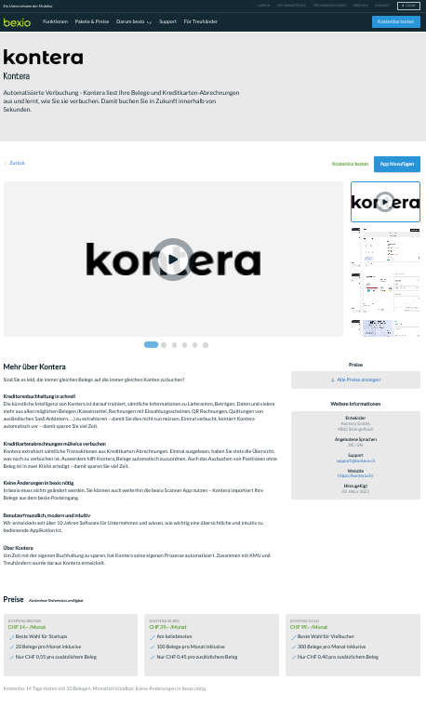
Element | URL EN / DE / FR / IT
Call to Action Link (please provide a UTM Link to a dedicated landingpage for bexio clients, so that trackability is ensured or Link that triggers API Consent Screen Workflow)
CALL TO ACTION Provide Link - same link
for all languages
MEDIA Provide images, screenshots and instructional videos of the addon
DETAILS - Developer (address)
- Languages provided
- Support
- Website
FULL DESCRIPTION - 1st Part Marketing Description - 2nd Part Functionality Details
- 3rd Part Advantage List
OFFER(S) Provide 3-4 bullet points for each agreed package

Slide 5
CALL TO ACTION Provide Link - same link
for all languages
Element | Remarks
MEDIA | Please provide Images at least 1200 x 800px If possible, provide screenshots in EN, DE, FR, IT Preferred image format *.png, for videos only one YouTube video can be added, will show up first in list
MEDIA Provide images, screenshots and instructional videos of the addon
DETAILS - Developer (address)
- Languages provided
- Support
- Website
FULL DESCRIPTION - 1st Part Marketing Description - 2nd Part Functionality Details
- 3rd Part Advantage List
OFFER(S) Provide 3-4 bullet points for each agreed package

Slide 6
CALL TO ACTION Provide Link - same link
for all languages
MEDIA Provide images, screenshots and instructional videos of the addon
Element | Copy EN / DE / FR / IT
Full address
Languages provided
Support Details | Website with FAQ (if available) E-Mail address for support (if available) Telephone number for support (if available)
App / Service Website
DETAILS - Developer (address)
- Languages provided
- Support
- Website
FULL DESCRIPTION - 1st Part Marketing Description - 2nd Part Functionality Details
- 3rd Part Advantage List
OFFER(S) Provide 3-4 bullet points for each agreed package

Slide 7
Element | Copy EN
More about App (Usual Format: Use Case: how to use the app together with bexio (what is done in the app, what in bexio) Marketing description Functionality details Advantages (list of Pros))
CALL TO ACTION Provide Link - same link
for all languages
MEDIA Provide images, screenshots and instructional videos of the addon
DETAILS - Developer (address)
- Languages provided
- Support
- Website
FULL DESCRIPTION - 1st Part Marketing Description - 2nd Part Functionality Details
- 3rd Part Advantage List
OFFER(S) Provide 3-4 bullet points for each agreed package

Slide 8
Element | Copy DE
More about App (Usual Format: Use Case: how to use the app together with bexio (what is done in the app, what in bexio) Marketing description Functionality details Advantages (list of Pros))
CALL TO ACTION Provide Link - same link
for all languages
MEDIA Provide images, screenshots and instructional videos of the addon
DETAILS - Developer (address)
- Languages provided
- Support
- Website
FULL DESCRIPTION - 1st Part Marketing Description - 2nd Part Functionality Details
- 3rd Part Advantage List
OFFER(S) Provide 3-4 bullet points for each agreed package

Slide 9
Element | Copy FR
More about App (Usual Format: Use Case: how to use the app together with bexio (what is done in the app, what in bexio) Marketing description Functionality details Advantages (list of Pros))
CALL TO ACTION Provide Link - same link
for all languages
MEDIA Provide images, screenshots and instructional videos of the addon
DETAILS - Developer (address)
- Languages provided
- Support
- Website
FULL DESCRIPTION - 1st Part Marketing Description - 2nd Part Functionality Details
- 3rd Part Advantage List
OFFER(S) Provide 3-4 bullet points for each agreed package

Slide 10
Element | Copy IT
More about App (Usual Format: Use Case: how to use the app together with bexio (what is done in the app, what in bexio) Marketing description Functionality details Advantages (list of Pros))
CALL TO ACTION Provide Link - same link
for all languages
MEDIA Provide images, screenshots and instructional videos of the addon
DETAILS - Developer (address)
- Languages provided
- Support
- Website
FULL DESCRIPTION - 1st Part Marketing Description - 2nd Part Functionality Details
- 3rd Part Advantage List
OFFER(S) Provide 3-4 bullet points for each agreed package

Slide 11
CALL TO ACTION Provide Link - same link
for all languages
MEDIA Provide images, screenshots and instructional videos of the addon
DETAILS - Developer (address)
- Languages provided
- Support
- Website
Element | Copy EN | Copy DE
PRICING PACKAGE 1 | Bullet point 1 Bullet point 2 Bullet point 3 Bullet point 4
PRICING PACKAGE 2 | Bullet point 1 Bullet point 2 Bullet point 3 Bullet point 4
PRICING PACKAGE 3 | Bullet point 1 Bullet point 2 Bullet point 3 Bullet point 4
PRICING PACKAGE 4 | Bullet point 1 Bullet point 2 Bullet point 3 Bullet point 4
FULL DESCRIPTION - 1st Part Marketing Description - 2nd Part Functionality Details
- 3rd Part Advantage List
OFFER(S) Provide 3-4 bullet points for each agreed package

Slide 12
CALL TO ACTION Provide Link - same link
for all languages
MEDIA Provide images, screenshots and instructional videos of the addon
DETAILS - Developer (address)
- Languages provided
- Support
- Website
Element | Copy FR | Copy IT
PRICING PACKAGE 1 | Bullet point 1 Bullet point 2 Bullet point 3 Bullet point 4
PRICING PACKAGE 2 | Bullet point 1 Bullet point 2 Bullet point 3 Bullet point 4
PRICING PACKAGE 3 | Bullet point 1 Bullet point 2 Bullet point 3 Bullet point 4
PRICING PACKAGE 4 | Bullet point 1 Bullet point 2 Bullet point 3 Bullet point 4
FULL DESCRIPTION - 1st Part Marketing Description - 2nd Part Functionality Details
- 3rd Part Advantage List
OFFER(S) Provide 3-4 bullet points for each agreed package

