Slide 1
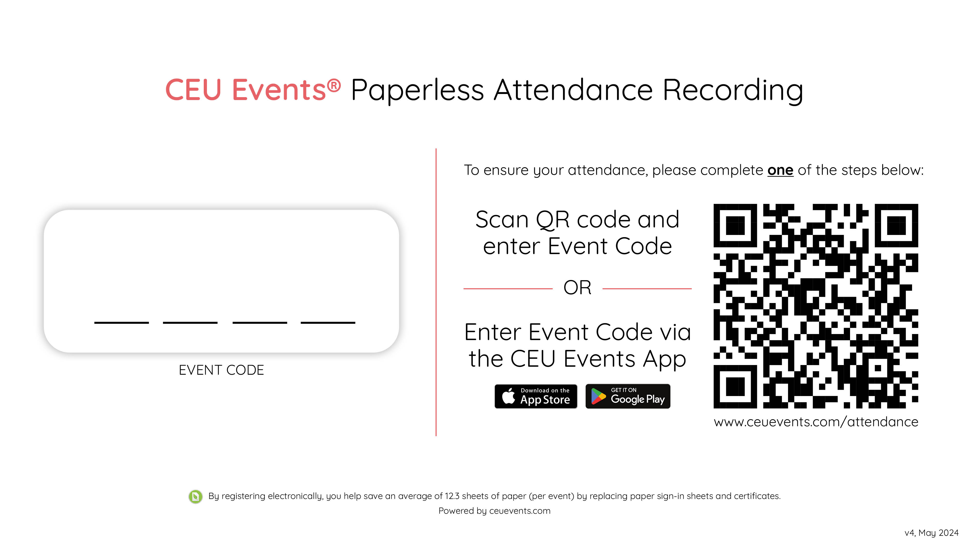
xxxx
Notes:
Attendance
For Instructors: Enter the Event Code in the text box above the dashes for attendees to see. We recommend entering lower case letters. Where to find the unique Event Code for this event? https://ceuevents.zendesk.com/hc/en-us/articles/360022509031
As I take your questions, ensure your attendance for this event by following the instructions on the screen. Once you complete this step you will be able to see this event under your CEU Events Account and you will be able to download your certificate of completion.
For Instructors: Please confirm the attendance.
As an Instructor, sign in to www.ceuevents.com on your device OR open CEU Events App, mark the attendees present (https://ceuevents.zendesk.com/hc/en-us/articles/115001211791) and instantly, via their CEU Events Attendee Account, participants will be able to download their Certificate of Completion.
www.ceuevents.com/attendance

