Slide 1
Genomic Prediction of Cross Performance in RTB crops: a module in Bioflow
Lorena Guimaraes Batista
Quantitative Geneticist
Accelerate (B4T)

Slide 2
Overview
Genomic Prediction of Cross Performance (GPCP)
Optimal contribution selection
Bioflow: GPCP new module

Slide 3
Genomic Prediction of Cross Performance
“The frequency of alleles with beneficial additive genetic effects in homozygous state needs to be increased to improve the additive value of the breeding population.”
“Heterozygosity needs to be preserved to exploit dominance effects and keep the dominance value high in the breeding population.”

Slide 4
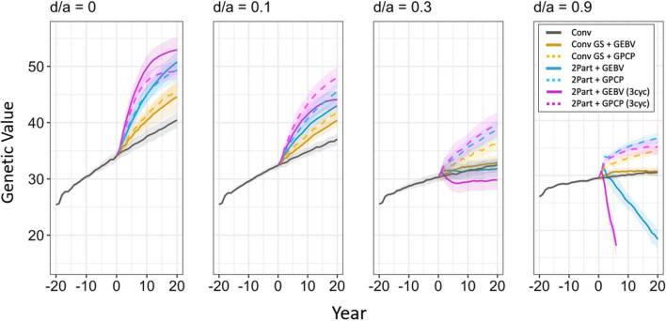
Genomic Prediction of Cross Performance
Solid line: GEBVs
Dashed line: GPCP

Slide 5
Genomic Prediction of Cross Performance
Solid line: GEBVs
Dashed line: GPCP
Yellow -> Blue -> Pink
Less aggressive -> More aggressive

Slide 6
Genomic Prediction of Cross Performance
The higher the dominance degree, and the more aggressive the breeding strategy, the higher the benefits of using GPCP instead of GEBVs

Slide 7
Genomic Prediction of Cross Performance
Allele frequency (dosage) in one parent
Allele frequency difference between parents
Predicted dominance effects
Predicted additive effects
Predicted progeny mean (cross performance)

Slide 8
Genomic Prediction of Cross Performance
Allele frequency (dosage) in one parent
Allele frequency (dosage) difference between parents
Predicted dominance effects
Predicted additive effects
Predicted progeny mean (cross performance)

Slide 9
Genomic Prediction of Cross Performance
Gather phenotypic and genotypic data
Predict additive and dominance effects
Use predicted effects for prediction of cross performance of all possible cross combinations between parental candidates
Rank crosses
Select best N crosses (N = desired number of crosses)

Slide 10
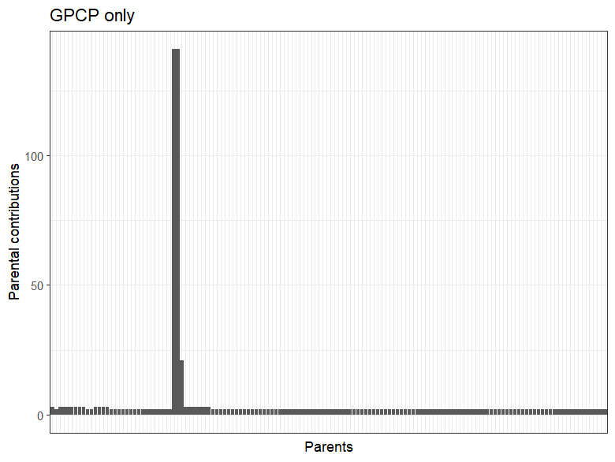
Genomic Prediction of Cross Performance
On practical implementations of GPCP, we noticed a single parent being used in many of the crosses

Slide 11
Optimal contribution selection
Optimal contribution selection is a known research strategy used to maintain genetic diversity without decreasing genetic gain
An optimization algorithm selects parents and crosses according to a specified trade-off between genetic gain and genetic diversity
OCS
90°
0°
Genetic gain gets full priority
Genetic diversity gets full priority

Slide 12
Optimal contribution selection
Extensive simulation work shows that 30° results in the best trade-off
It is an effective strategy to maintain diversity in the crossing block
OCS
90°
0°
Genetic gain gets full priority
Genetic diversity gets full priority

Slide 13
GPCP + OCS

Slide 14
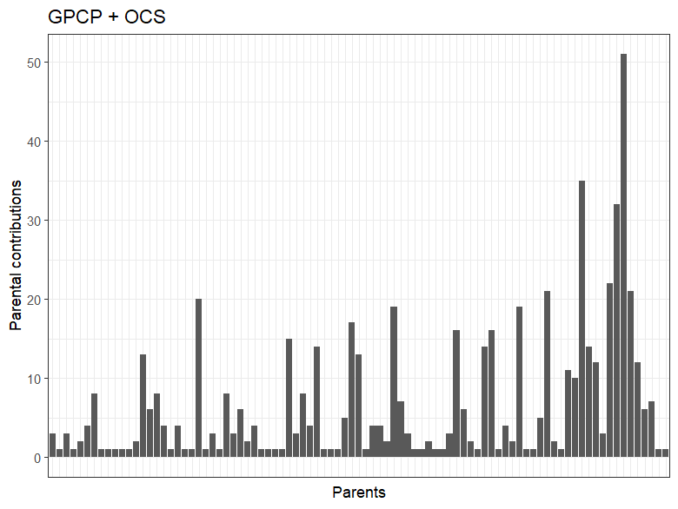
GPCP + OCS

Slide 15
GPCP + OCS
Chosen approach for Bioflow GPCP module

Slide 16
Now let’s demo!

