Slide 1
Breeding Resources – Knowledge Exchange Program (KEP)
Stefan Einarson – Breeding Resources

Slide 2
Agenda
- Welcome by Julie
- Background and overview – Stefan
- KEP experiences – by program participants
- What will happen in this year’s program and next steps– Stefan
- Questions and closing by Julie

Slide 3
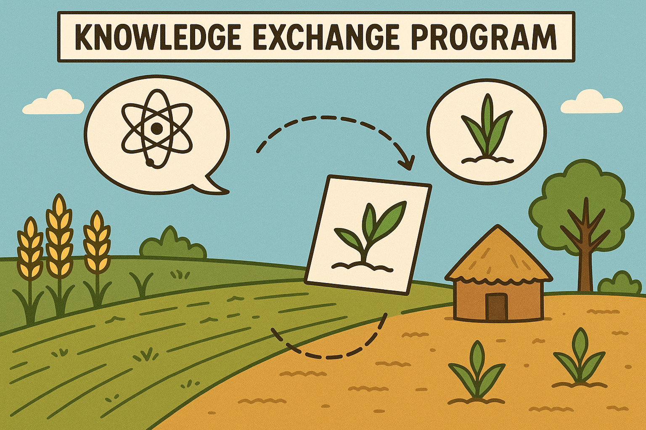
Background and Overview

Slide 4
What is the Knowledge Exchange Program (KEP)
The Knowledge Exchange Program (KEP) is a transformative initiative launched in late 2024 to accelerate capacity building across CGIAR and National Breeding Programs. KEP pairs participants with expert mentors for short, targeted, in-person collaborations that address specific knowledge gaps through real-world problem solving. Each exchange produces practical outputs—such as SOPs, guides, or tools—that benefit broader communities of practice.
KEP stands apart by emphasizing mentorship, contextual learning, and tangible outcomes that strengthen both people and systems.

Slide 5
What KEP does and involves
Short-Term, High-Impact Engagements
Each exchange lasts up to two weeks, focusing on a well-defined skill, tool, or process essential to breeding operations.
Collaborative Planning
Mentor-mentee pairs co-develop a proposal outlining objectives, activities, outputs, and benefits to the wider community.
Deliverables with Broader Value
Exchanges result in user-focused resources—such as tutorials, SOPs, checklists, or guides—that are shared across programs.
Selective & Strategic
A limited number of proposals (5–8) will be funded in the next phase, prioritizing relevance, replicability, and institutional alignment.
Toward a Scalable Model
If successful, the program will be expanded through future grant funding to reach more institutions and services.

Slide 6
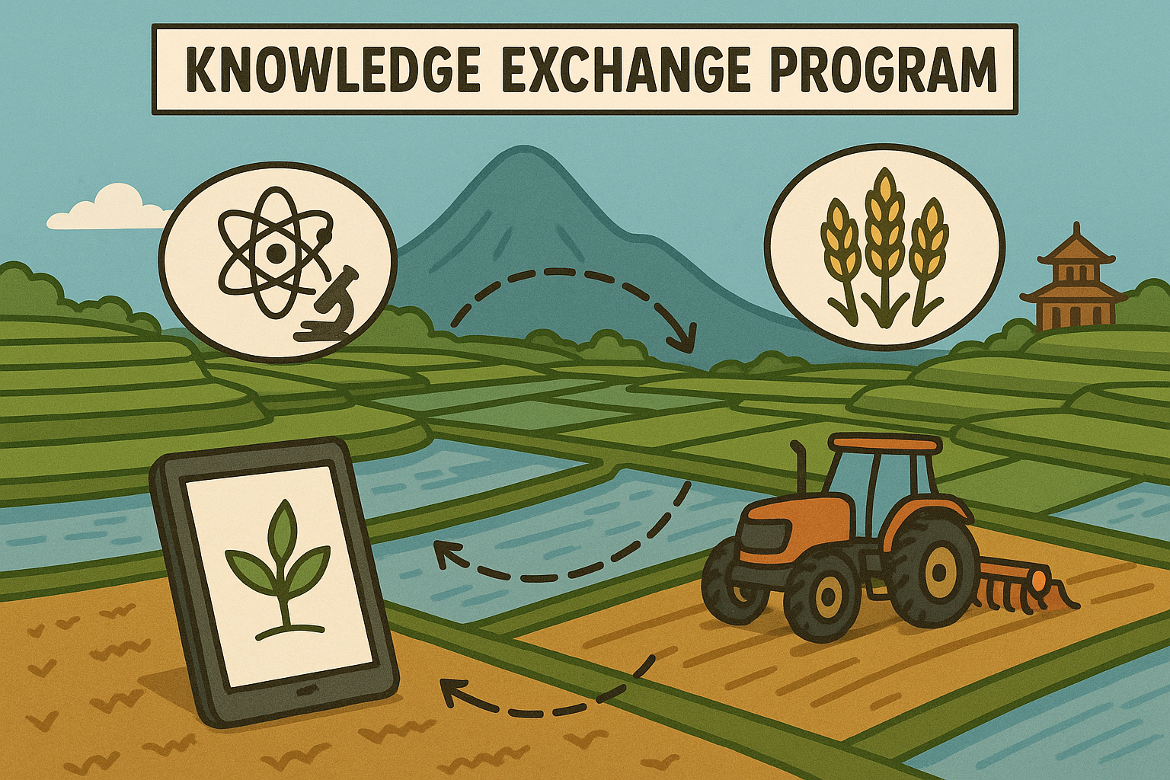
KEP experiences – by program participants

Slide 7
KNOWLEDGE EXCHANGE PROGRAM
Armand Yambisa
Research Associate
International Institute of Tropical Agriculture

Slide 8
KEP, a game-changer.
Transforming breeding operations & information sharing through innovation; the case of EBS.
The Process: simple and convenient.
Application.
Travel arrangements.
The Training: tailor-made and solution based.
Tailored: specific skillset with global impact.
Networking: exposure to various experts - DS, GUS.
Learning environment: world class learning equipments & facilities.
The Impact: global - innovative, sustainable, long-term.
Training achievements: user guides, templates, graphQL connections.
Systems transformation: facilitating EBS adoption & transforming breeding programs.
Knowledge transfer/giving back: RSN, GSN, NARs.
Collaboration: CGIAR and NARs.
Skills development.

Slide 9
Knowledge Exchange Program CIMMYT, Obregón – Mexico / KALRO Njoro – Kenya Dates: 22nd November – 10th December 2024
Presented by: Peter Kiprotich

Slide 10
Objectives of the Visit
Gain insights into advanced sustainable farming techniques
Explore the integration of modern machinery in wheat production
Learn methods for enhancing yield and operational efficiency
Build networks with international wheat research experts
Apply acquired knowledge to improve KALRO research farm operations

Slide 11
Lessons & Observations.
Toured a state-of-the-art seed processing facility
Gained insights into organic insect fertilizer production
Observed a large-scale irrigation reservoir serving the valley
Visited neighboring farms to learn local practices
Enjoyed rich cultural experiences in Obregon
Sampled a variety of local delicacies

Slide 12
Summary of Learning Experience from Wheat Research Exchange Visit to Obregón, Mexico
Traveled from Kenya and spent 10 days in Obregón, Mexico
Engaged extensively with the farm management team, administrators, and wheat scientists
Gained hands-on experience in calibration, trial setup, marking, fertilization, and standard operating procedures (SOPs)
Upon returning to Kenya, developed eight SOPs to enhance farm operations
Successfully shared the knowledge gained with my team
Found the learning experience highly impactful and would welcome more opportunities like this in the future

Slide 13
Peter Kiprotich Farm Manager, CIMMYT/KALRO Njoro Kenya Email: [peter.Kiprotich@kalro.org Pkiprotich2009@yahoo.com] Thank you Any question?

Slide 14
Knowledge Exchange Program on Centralization of Nurseries, Trials, and Operations workflow at IRRI
Presenter : Sheila Limo

Slide 15
Centralisation workflow
Cost recovery method
digitalize the process –ICT-OCS
Standard Operating Procedures following ISO guidelines
Approved and reviewed by research unit
Set key metrics/KPI for sub-unit
Activity consolidation
paid as one service
Monitoring and evaluation of KP1-Management review
internal audits
Feedback Mechanism
Continuous improvement of the plan-
Invest in the right technologies
Customer satisfaction
-ISO compliant

Slide 16
Highlights of the visit
The value in investing time and effort into:
centralized tracking systems,
standardized protocols-SOP etc
capacity-building programs that align everyone toward the same goals.
Exposure cutting edge strategies for streamlining research operations
Inspired by structured coordination across departments-power of collaboration and good planning.

Slide 17
Breeding Research Services(BRS)
Knowledge Exchange Program (KEP) experience with IRRIs GSL team
Advanced Genotyping Workflows
Dr. Revathi Ponnuswamy,
Senior Scientist (Plant Breeding)
ICAR-Indian Institute of Rice Research, Hyderabad, India
revathi.ponnusamy@gmail.com

Slide 18
KEP Learnings at IRRI from November 24th to December 1st,2024
Gained knowledge on Advanced Genotyping Workflows
Understanding of Breeding Forecasting
Quality Management & SOP Implementation (ISO 9001 & ISO7001)
Data-Driven Breeding with Enterprise Breeding System (EBS)
Hybrid Rice Research
Understanding of Centralized Breeding Operations
Collaboration & Research Discussions - Productive meetings
Visit to Key IRRI Facilities –
Explored the Plant Growth Facility (PGF) and Speed Breeding Facility (SBF) for climate-smart breeding, understood seed health regulations for global seed distribution and Gene Bank
Overall, the visit was truly enriching, provided valuable technical knowledge,
research collaborations, and hands-on experience in cutting-edge rice breeding
and genotyping workflows

Slide 19
KEP is different from traditional training program
Traditional training after the training and feedback mostly ends
KEP- after the program is the starting point for collaboration and building a partnership, planning and projects etc.,
KEP-Participant centric program, before planning the program, a thorough discussion and understanding between the mentee and mentor took place to enhance the efficiency of KE program
I strongly support this initiative, it is a first of its kind and its going to be a great success in building strong collaboration with CG and NARES partners

Slide 20
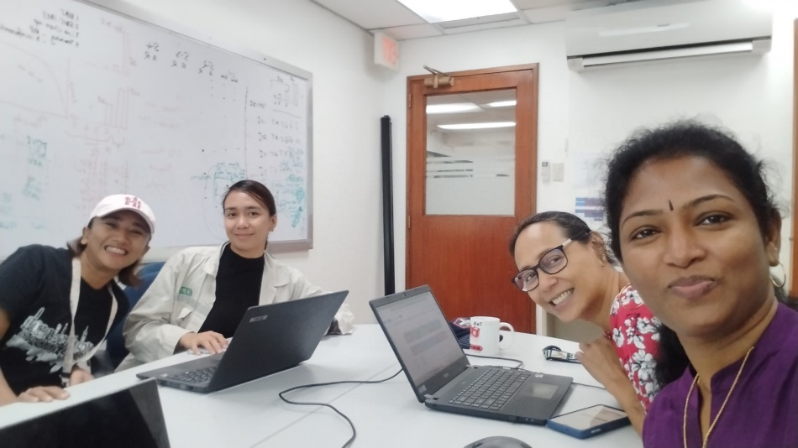
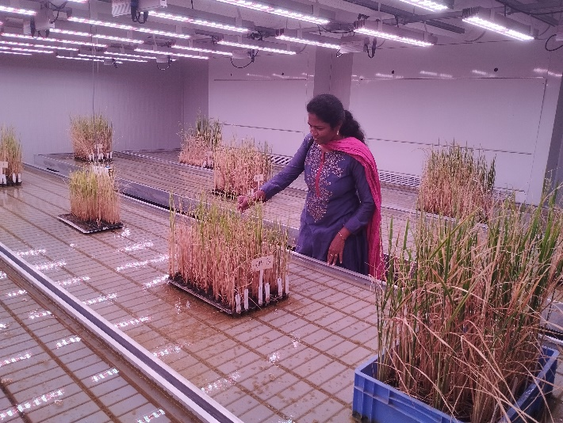
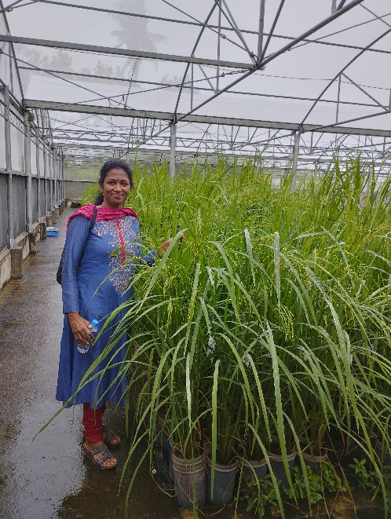
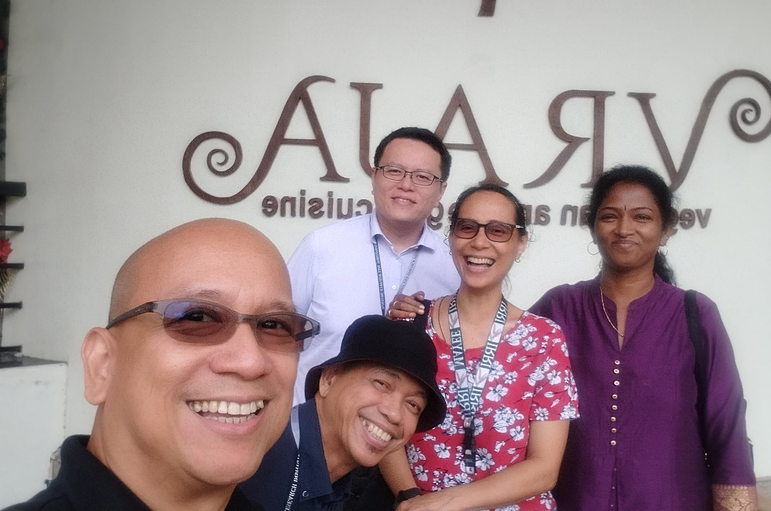
Thank You!

Slide 21
EXPERIENCES ON BREEDING RESOURCES (EBS) KNOWLEDGE EXCHANGE PROGRAM
DAVID MURUU
Research Associate - Tropical Forages
Alliance Bioversity & CIAT

Slide 22
Why KEP
It is a transformative initiative in agricultural innovation that goes beyond traditional training by emphasizing real-world experience, personalized learning, and sustainable impact.
KEP Focus: Deciphering of CIAT Forages use cases and customization of workflows by EBS adoption team
For Mentees: It is more than a training – It is a transformation
Real-world experience: Work on actual breeding programs.
Tailored learning: Skills are relevant to your specific context.
Confidence building: Apply knowledge with tangible impact.
Global connections: Join an international professional network.
For Mentors: It lets you shape the future of agricultural innovation
Mutual learning: Gain insights from mentees’ fresh perspectives.
Long-term impact: Build future leaders in agriculture.
Collaborative partnerships: Strengthen institutional ties.
Personal reward: See your mentorship translate into success.

Slide 23
Why KEP Continued
For Supporters: It is a high-impact investment in people and systems
High return on investment: Strengthens individuals & systems.
Bridges training gaps: Fosters practical innovation.
Scalable model: Adaptable across regions and institutions.
Human stories: Real-life impact from real people.
What Sets KEP Apart:
Focus on mentorship, contextual learning, and collaboration
Engagement in real projects, not just simulations
Designed for long-term, systemic impact, not quick certifications

Slide 24
Feedback from surveys mentors and mentees
Program Impact
✅ High Satisfaction: All mentors & 80% of mentees rated the experience 4–5/5.
🎯 Relevance & Preparedness: 80% of mentees found content highly relevant; all mentors saw strong mentee alignment.
📘 Effective Learning: High ratings for mentor clarity and mentee confidence in applying new knowledge.
📈 Organizational Gains: All respondents cited positive impact—e.g., “CIAT Forages now using EBS.”
Challenges & Feedback
⏳ Time Constraints: Limited duration hindered deeper engagement.
🗓️ Scheduling Issues: Mentors noted need for better coordination.

Slide 25
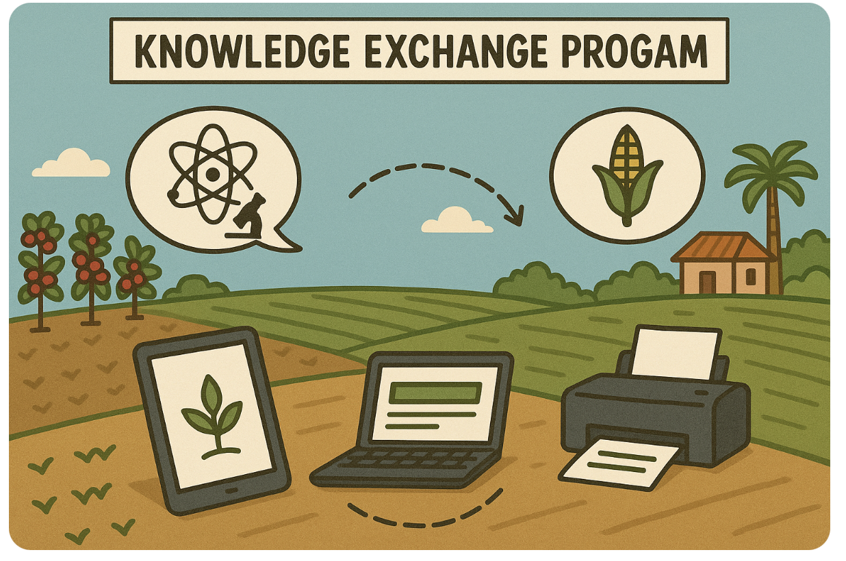
What will happen in this year’s program and next steps

Slide 26
New KEP Program
Will begin in Q3 and Q4
Will be 50% bigger than the pilot year – more participants
Covers areas related to Breeding Resources (T&N, Genotyping, Digital Solutions, Continuous Improvement, Breeding Analytics)
Will cover transportation room, board and logistics for 1-2 weeks of mentor/mentee interactions
These collaborations should address specific knowledge gaps for the participant, and they must produce, as output, some kind of material or resource that will be helpful to other users of that service. Example material could include how-to guides, SOPs, videos, tutorials, cheat-sheets, checklists, web pages, and so on.

Slide 27
Link for nominations open now
https://forms.cloud.microsoft/Pages/ResponsePage.aspx?id=ZkN-XZsbz0WOebFLJ99G4U203YoZ4ehOpNHoHdUlhS9UQlVTUDFJNVdaQkFSWEJWMFdKVkE3MktYOC4u
This will be put in the chat for your use

Slide 28
Next Steps
🔹 Nominate a Mentee
Organizations may nominate staff members with clear skill development needs and the potential to contribute broadly through shared outputs.
🔹 Self-Nomination Option
Motivated individuals can express interest directly. We welcome proactive learners with specific goals and ideas for knowledge exchange.
🔹 Start the Conversation
Identify knowledge gaps, potential mentors, and ideas for practical outputs. Use the proposal template to begin shaping your exchange concept.
🔹 Proposal Submissions Open Now
We encourage early planning. Final proposals will be due by end of August 2025.
🔹 Second Year Launch: Q3–Q4 2025
Selected exchanges will be implemented in late 2025, with funding and coordination support from BRS.
Note – In the past CG or NARS have wanted to add more people to the program and we welcome that at their expense

Slide 29
Selection Process: From Nomination to Implementation
🔹 Step 1: Nominations Received
Individuals may be nominated by their organization or nominate themselves. Nominations should briefly describe the skill gap, proposed area of learning, and potential impact.
🔹 Step 2: Initial Review by BR Leadership
Small committees—including managers from Digital Solutions, Trial & Nursery, Lab Services, and other relevant areas—will review nominations.
🔹 Step 3: Invitation to Submit Full Proposals
Selected nominees will be invited to submit a more detailed proposal using the standard KEP template, outlining objectives, activities, outputs, and expected benefits.
🔹 Step 4: Technical Team Review
Proposals will be evaluated by the relevant service team(s) for feasibility, alignment, and broader value. Feedback or refinements may be requested.
🔹 Step 5: Final Selection & Preparation
Final selections will be made by early Q3. BR will coordinate planning, logistics, and mentorship alignment for implementation in Q3–Q4 2025.

Slide 30
Knowledge Exchange Program – 2025 Timeline
📅 May–June
Program launch & outreach
Nominations open (self and organizational)
Info sessions & initial idea development
📅 Late June – Early July
BR area managers review nominations
Selected nominees invited to develop full proposals
📅 July – Mid August
Full proposals submitted and reviewed by technical teams
Feedback and refinements completed
📅 Mid–Late August
Final selection and logistical preparation
📅 September – December (Q3–Q4)
🚀 Pilot Exchanges Start
In-person collaborations begin
Outputs developed and shared
Feedback gathered to refine the model

Slide 31
Thank You! Any questions?

