Slide 1
Digital Solutions
Q1 2025 webinar
May 13, 2025
Notes:
Self-introduction

Slide 2

Agenda
General Information
Global User Support
Solutions Enablement
Solutions Engineering and Innovation
  Operational Genotyping
  Breeding Analytics
  Core Breeding
  Hiphen and EBS Integration
AgPile
Q&A

Slide 3


Welcome message
Notes:
Self-introduction
Greet the attendees and thank them for taking the time to join

Slide 4
Breeding Resources & Digital Solutions Latest News

Slide 5
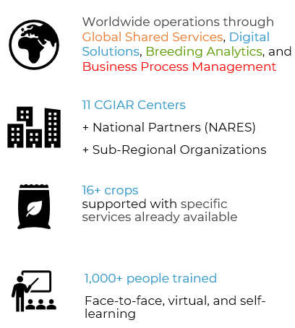


BR did very well during the initiative cycle and the progress will continue in 2025-30
2022-24
2025-2030
Breeding Resources Initiative
Breeding Resources:
a B4T’s Area of Work (AoW)
Want to know more about BR? →
Notes:
A reminder of how we are structured as part of the Science Programs in the new CG P25 Portfolio
Services provided include: Genotyping, Elemental Analysis, Agronomic Practices, Engineering, Breeding Data Management, Tailored Digital Solutions, Breeding Analytics, Process Improvement, Capacity Development

Slide 6
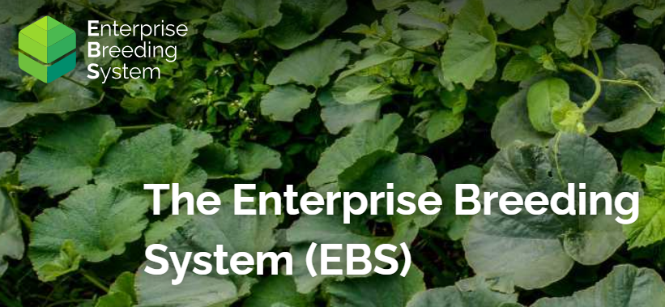
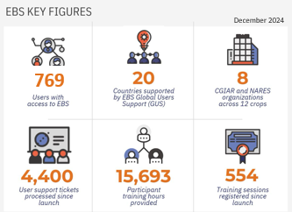
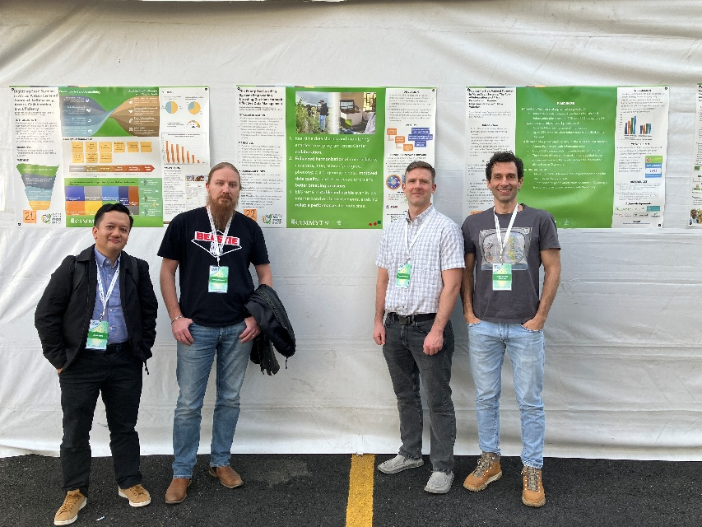
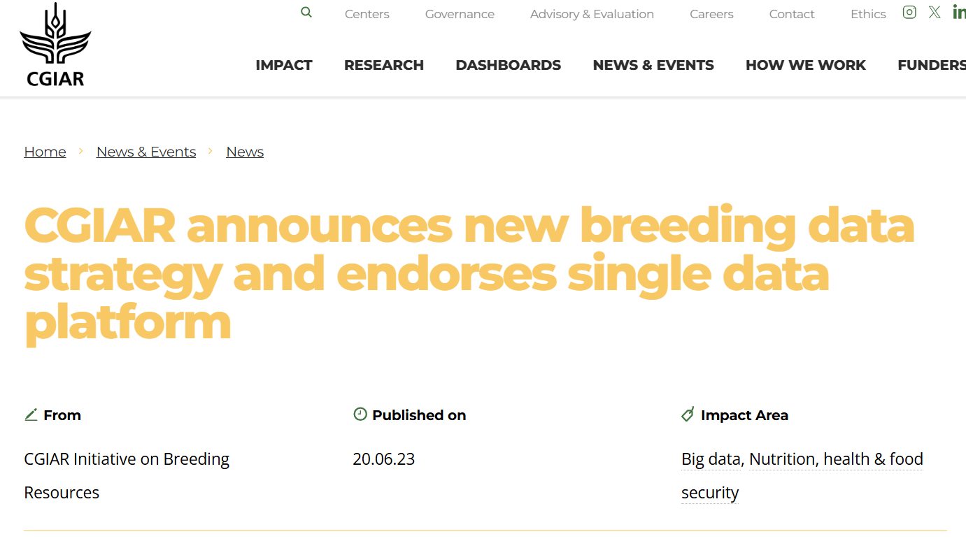
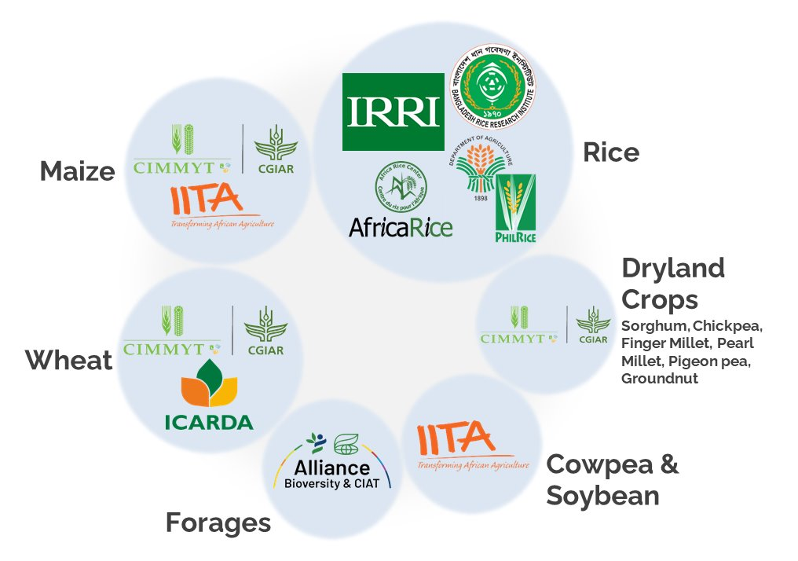
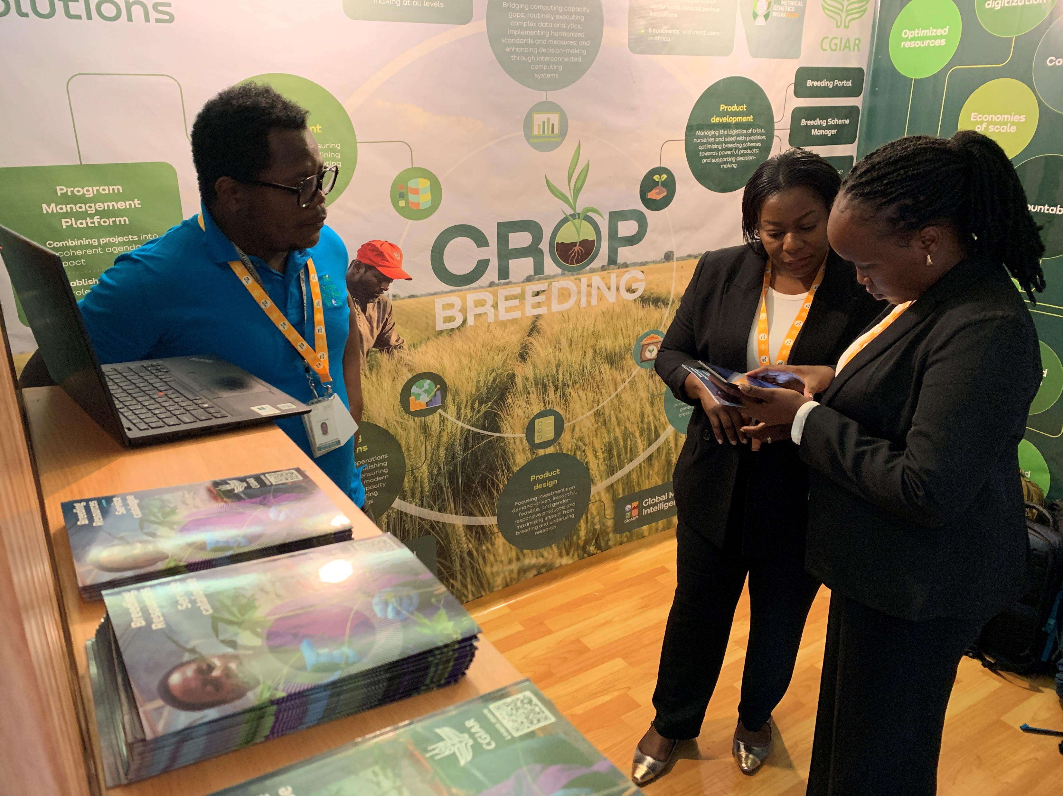
For Digital Solutions, the 2022-24 cycle was a great opportunity for consolidation
February 2025
December 2024
April 2025
June 2023
Notes:
As you know, we are the team behind EBS and we are very proud of it
Consolidation started with the initiatives and those are some of the figures that express how much we achieved by end of 2024
Now, as we keep growing, we are also being recognized for all the hard work and commitment.

Slide 7
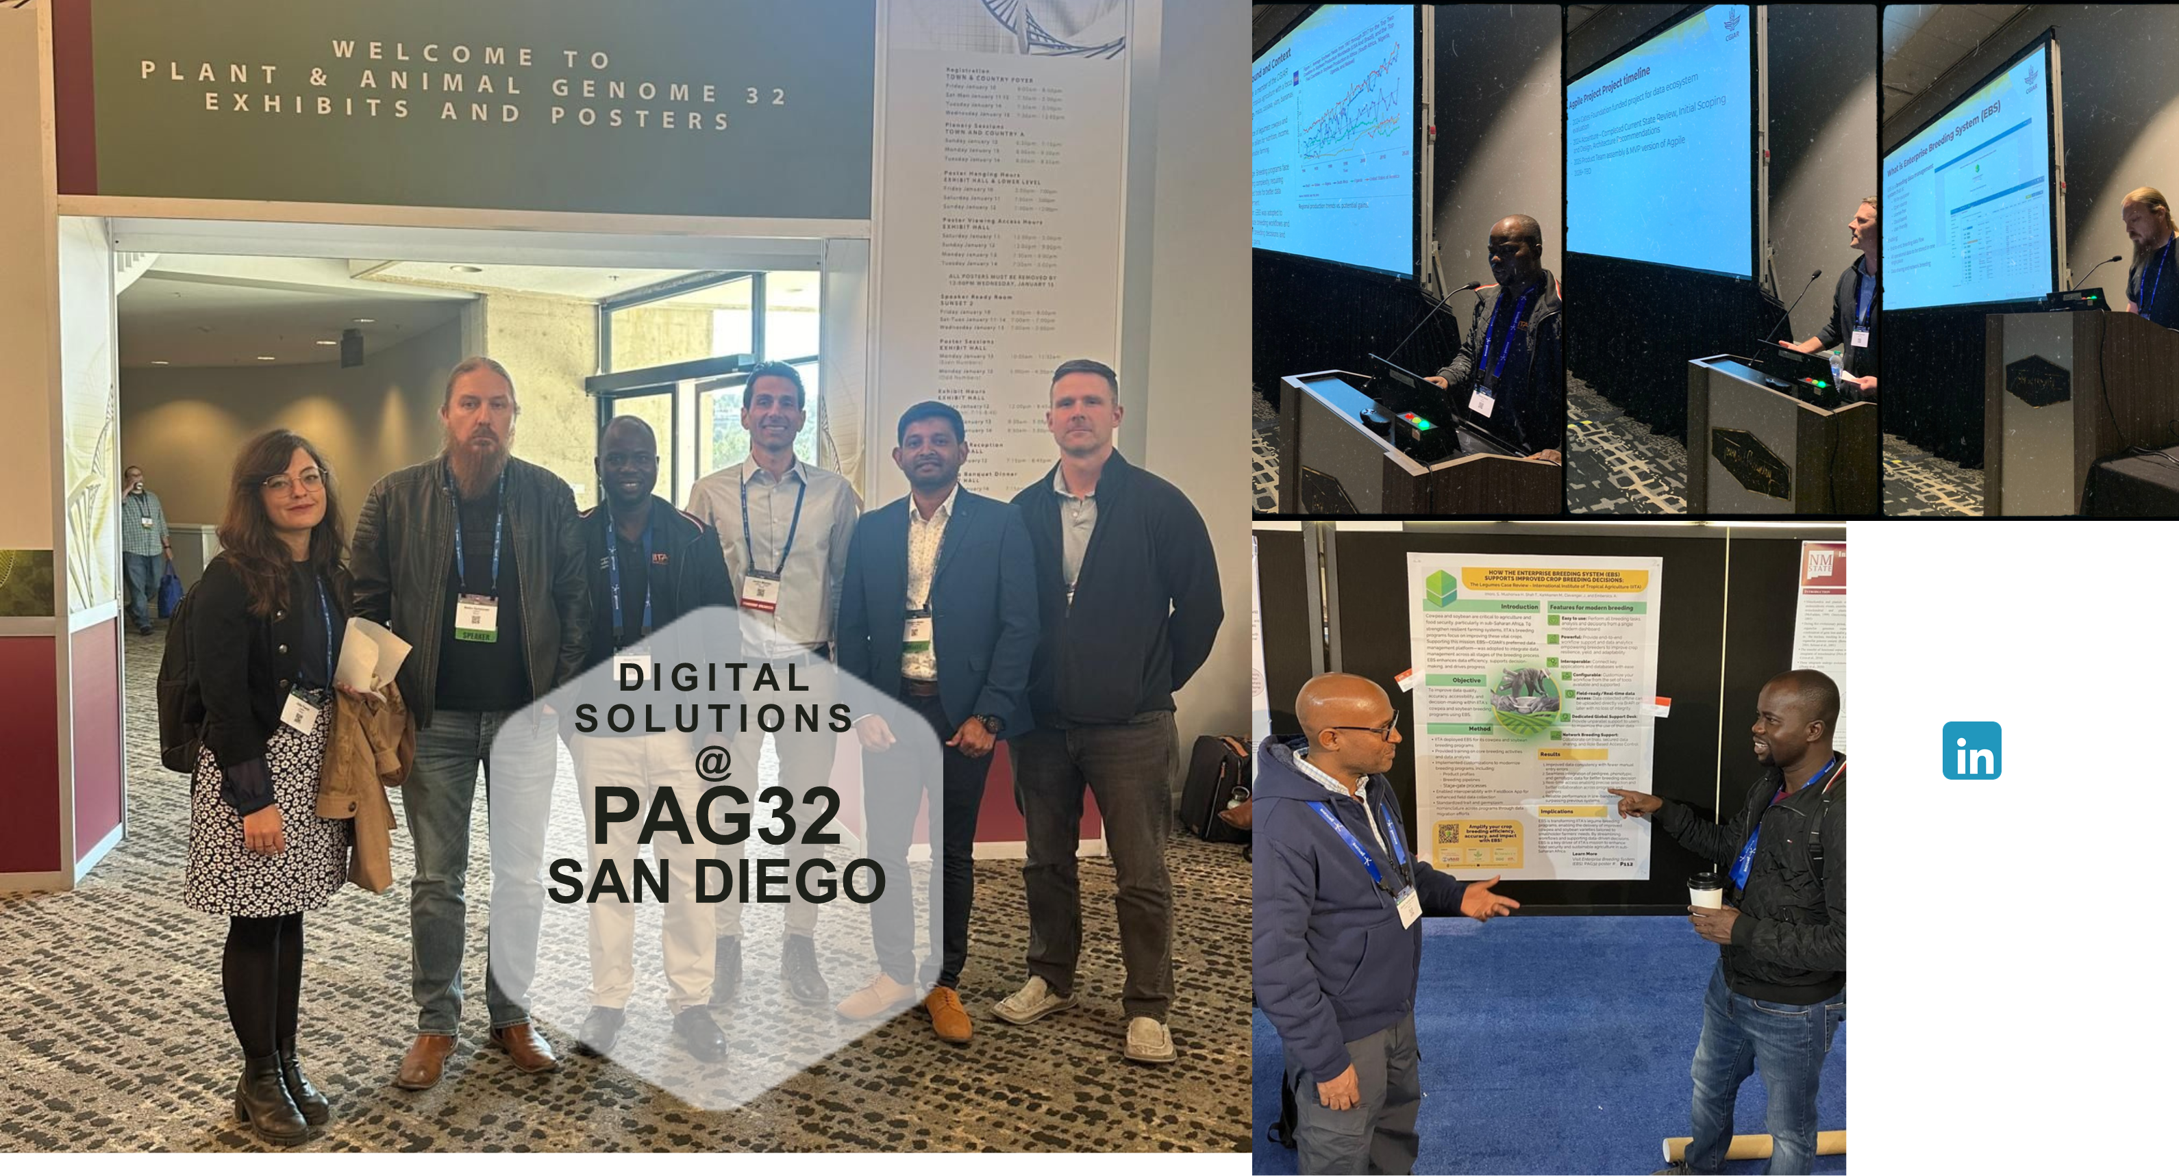
PAG32 in San Diego Jan2025

Slide 8
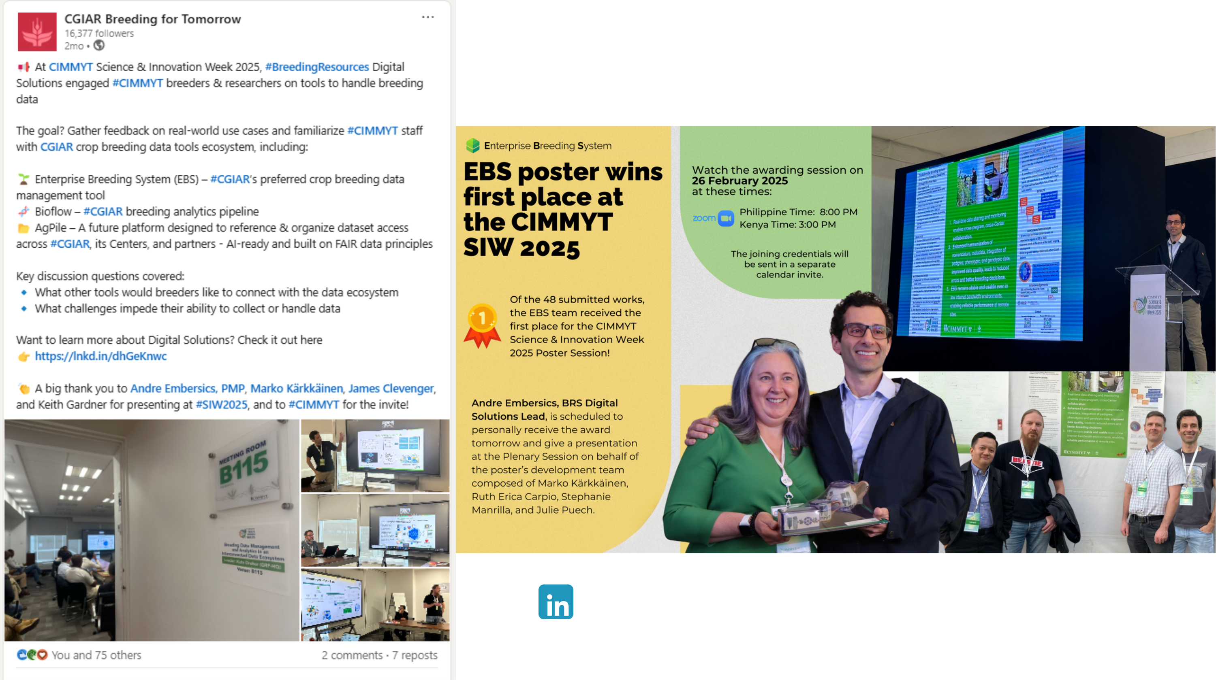
EBS Poster wins @ CIMMYT Science Week Feb 2025

Slide 9
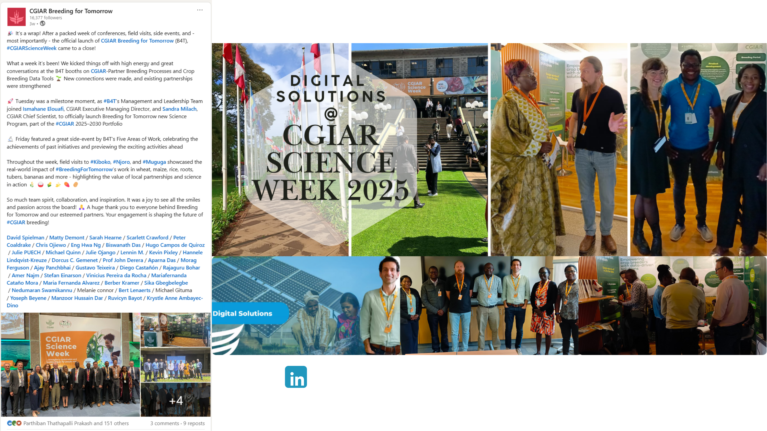
B4T Official Launch @ CGIAR Science Week April 2025

Slide 10
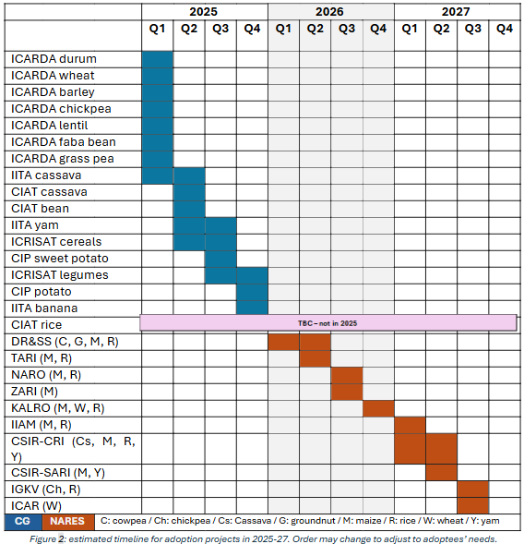
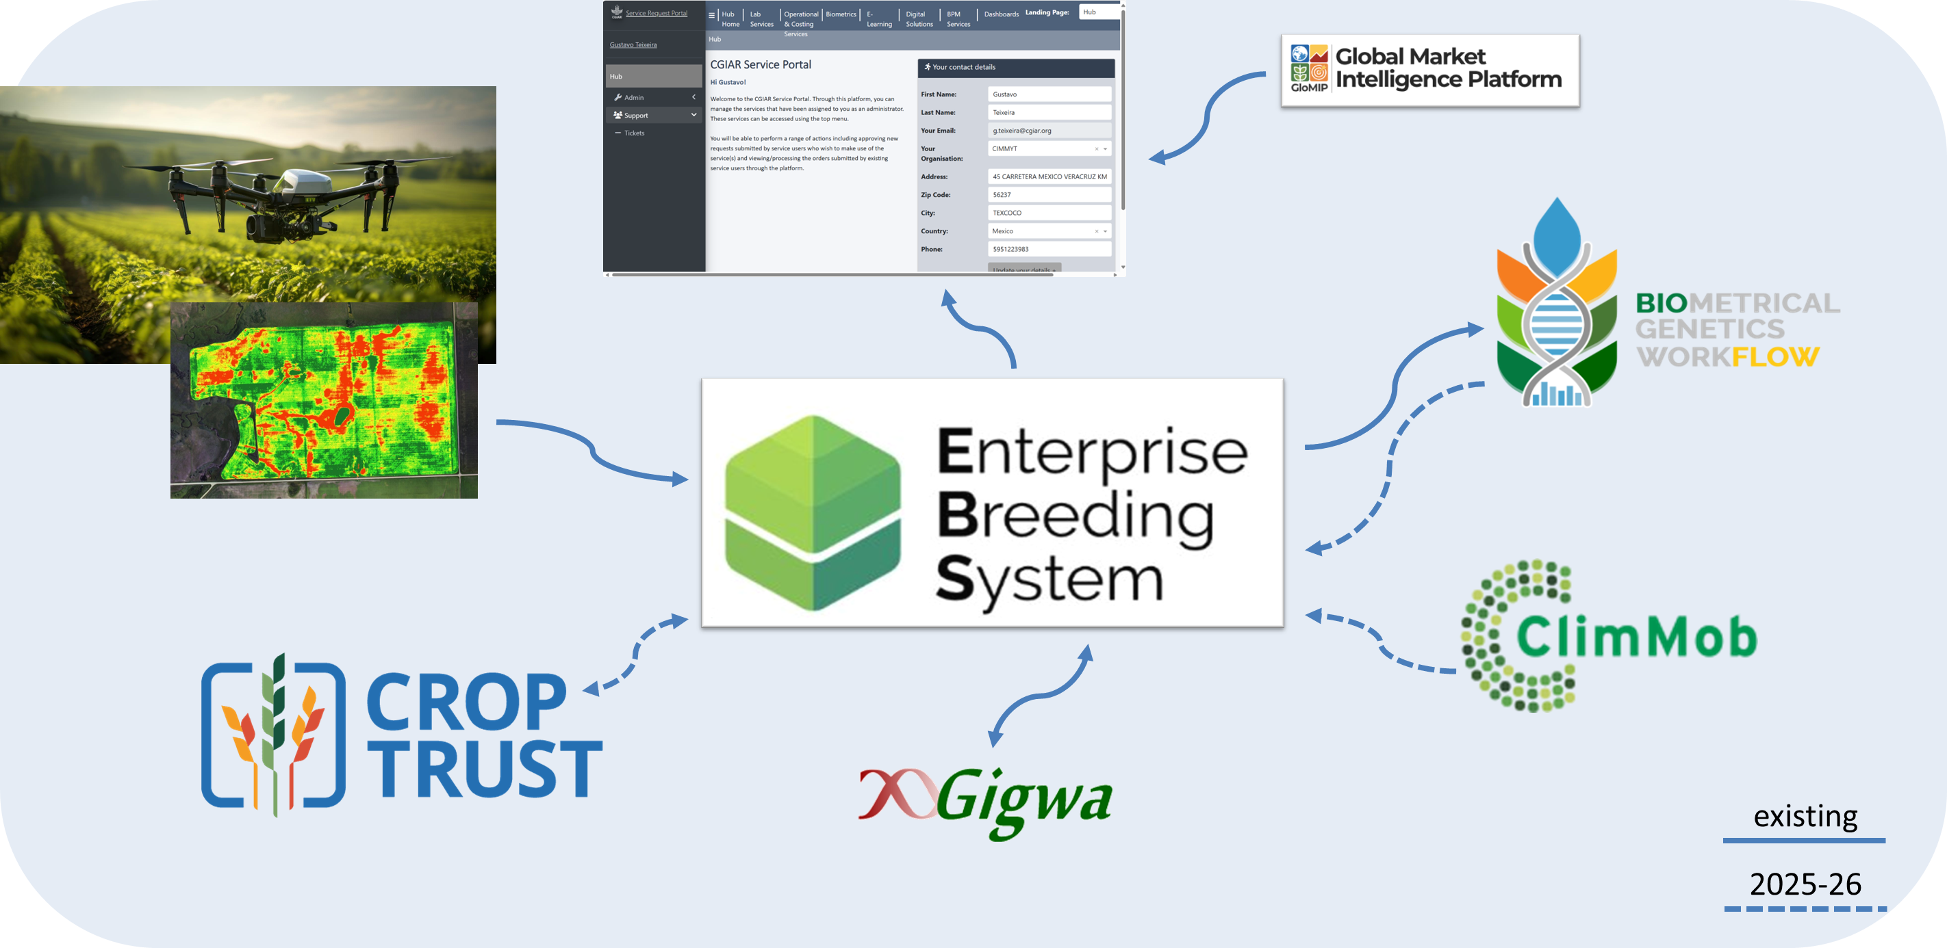
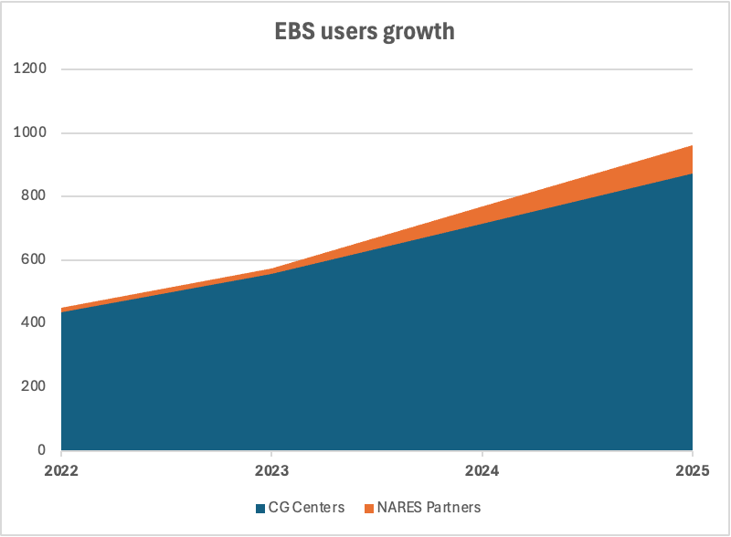
In 2025 we are prioritizing the co-creation of an entire CG Research Ecosystem
Notes:
The numbers until 2024 show that growth will continue in a solid and sustainable way, thanks also to our ambitious plan for EBS adoption
EBS will start to become the core of a CG Research Ecosystem that we are helping to build and maintain
During the webinar today we will talk more about the plans for EBS and other projects that DS is leading in 2025

Slide 11



Global User Support

Slide 12
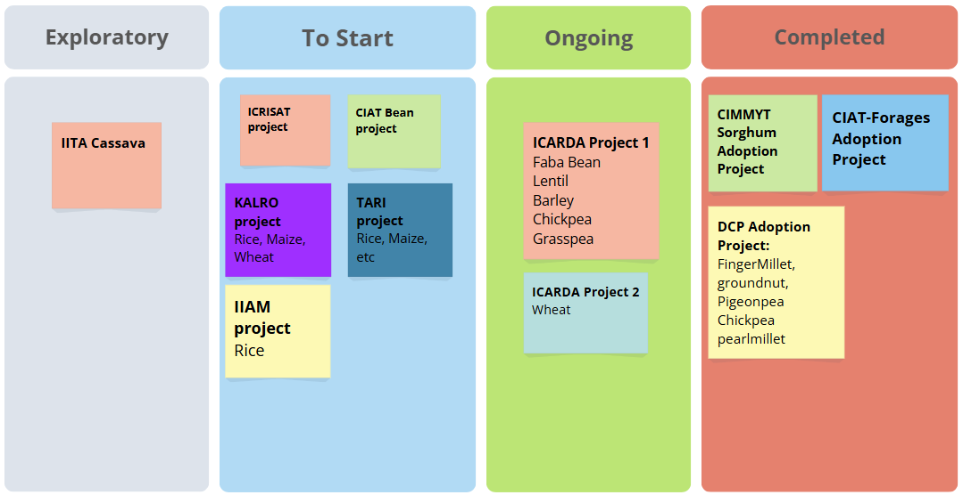

Adoption Projects
Adoption Inquiries
Notes:
Our adoption process is composed of 3 main activities: Migration, Configuration and Training.
It is time-bound and a shared responsibility between our team and the adopting institute
If you require more information on what is being done in an adoption process, you may reach out to us through this QR code.
The following are the updates on our adoption projects.
An institute can opt to have an exploratory project, as in the case of IITA Cassava. They will look at the system and see of their workflows are in tune or doable in EBS.
Other CG centers in line to start, are CIAT Bean and ICRISAT.
There are also NARES that already started the Initiation. Specifically, IIAM, TARI, KALRO, most of which are for different crops.
The ongoing projects are ICARDA which are actually 2 projects: 1 for all their non-wheat crops, and the wheat crop which will be joining the CIMMYT wheat instance.
We finished the CIMMYT Dryland Crops, along with the CIMMYT Sorghum, and also the CIAT Forages.

Slide 13
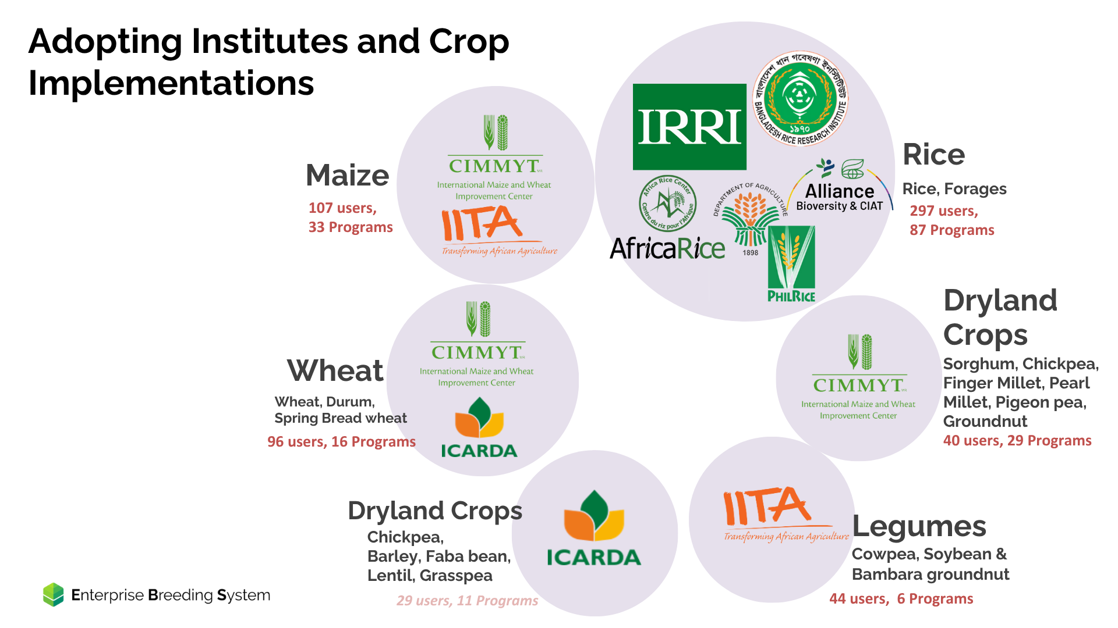
Increasing our user base from 20 countries to 22!
for 20 crops
Notes:
1 additional Production instance (ICARDA)
Increasing our userbase from 20 to 22 countries

Slide 14
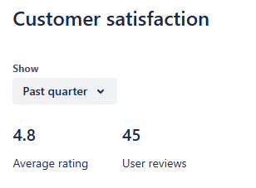

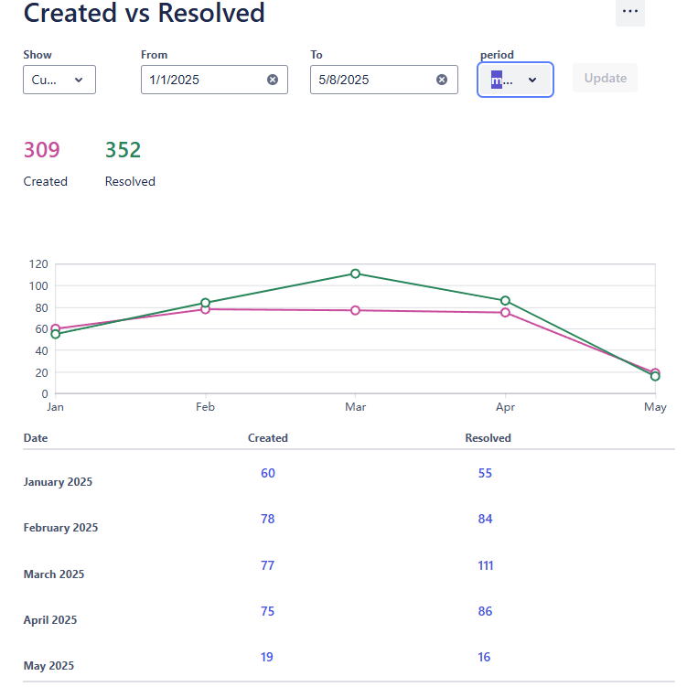
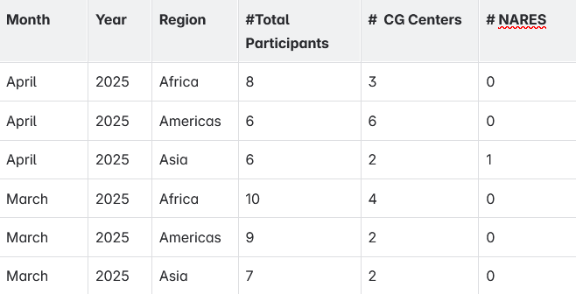
General Support
Service Desk
Regional Support Network
Notes:
For the General support, there are decreasing number of support tickets received. Which means that users are now able to do a lot of activities and may not need to contact support.
The General Support team also facilitates the development of a regional network to provide comprehensive support for the implementation, usage, and continuous improvement of Digitial Solutions products. . Currently established in three regions—Americas, Asia, and Africa—the RSN serves as a platform for key institute data managers to connect, exchange information, and engage in collaborative learning.
The table shows how many participant and CG centers are participating.

Slide 15
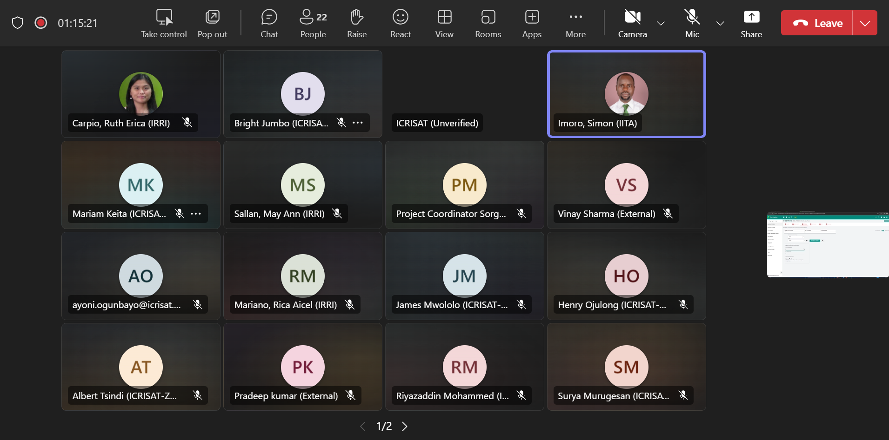
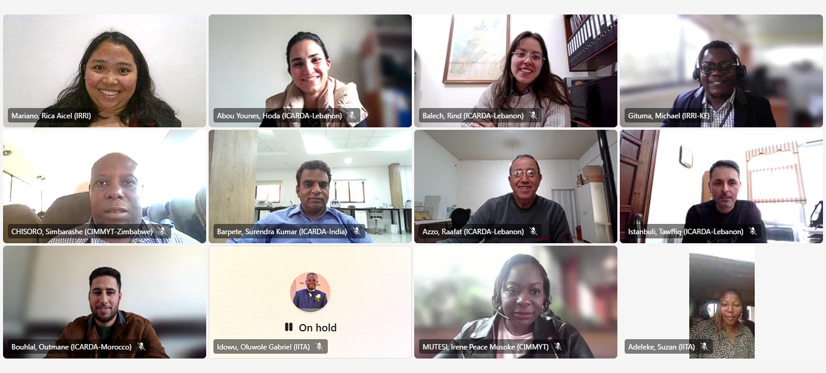

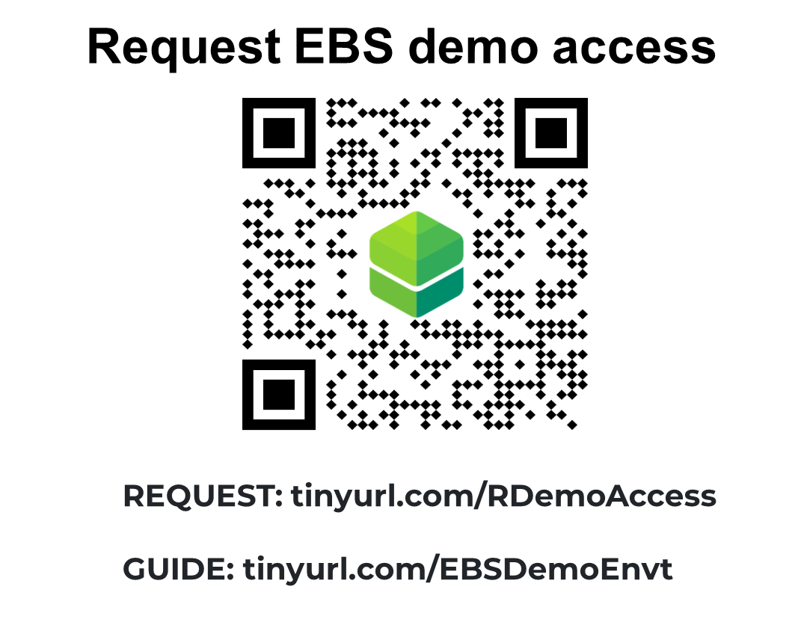

Training
Demo Sessions to ICRISAT Crop Teams
Train-the-Trainer (TtT) online workshop conducted for crop
DMs and Support staff
📅March 17-28, 2025
📅Feb 19-20,2025 ‍ 25 participants
13 users (Male-7, Female-6) from ICARDA, IITA, and CIMMYT trained.
Upcoming Trainings/Seminars for Q2
April 7: EBS <-> Field Book Connection via BrAPI [DONE]
May: Experiment Creation: New Trial Design Interface
May: Demo Sessions for Cassava Teams: IITA,CIAT and NAREs
June: Post-Harvest Data Collection and Inventory update

Slide 16
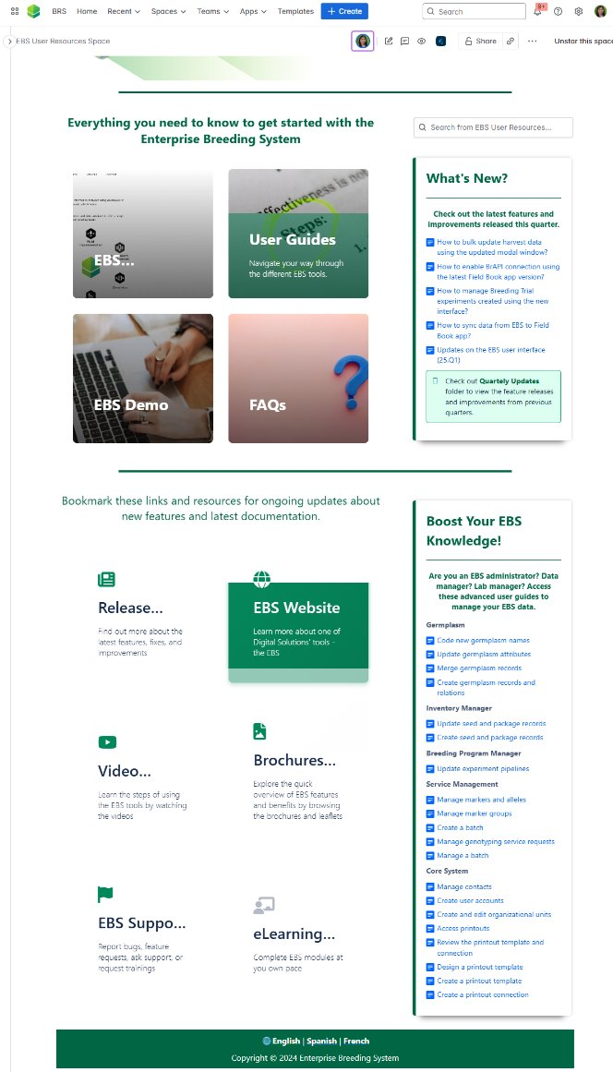
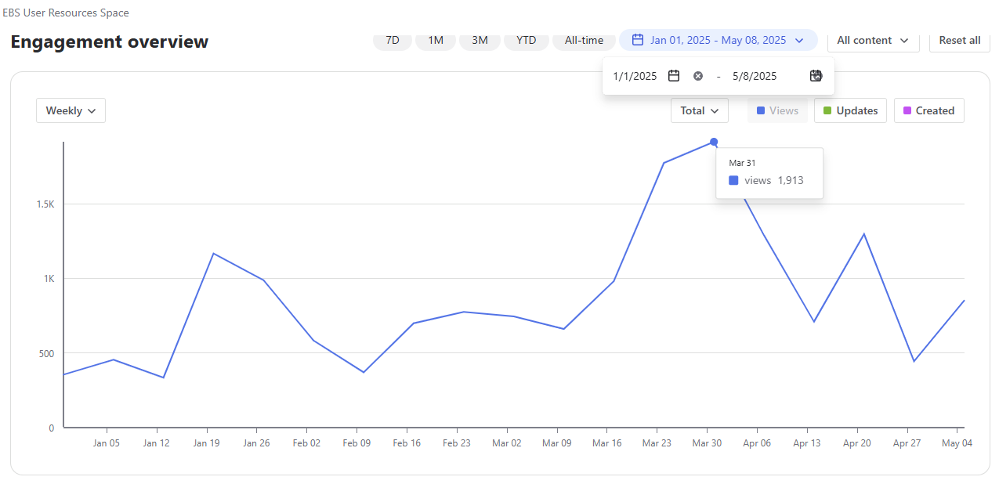
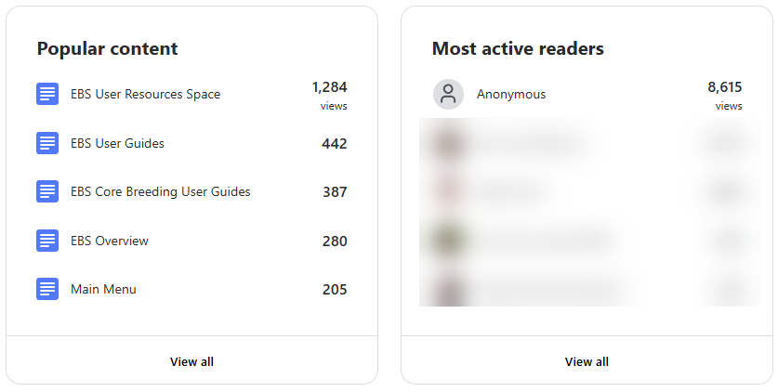

Documentation
Documentation
User Guide

Slide 17
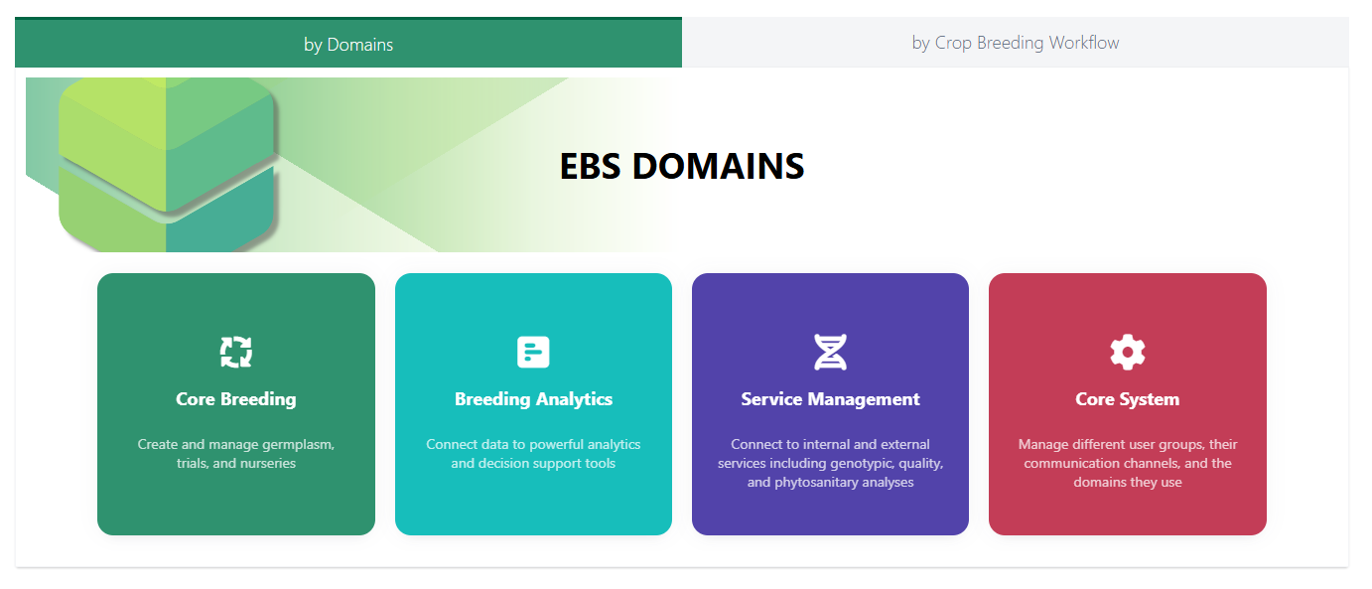
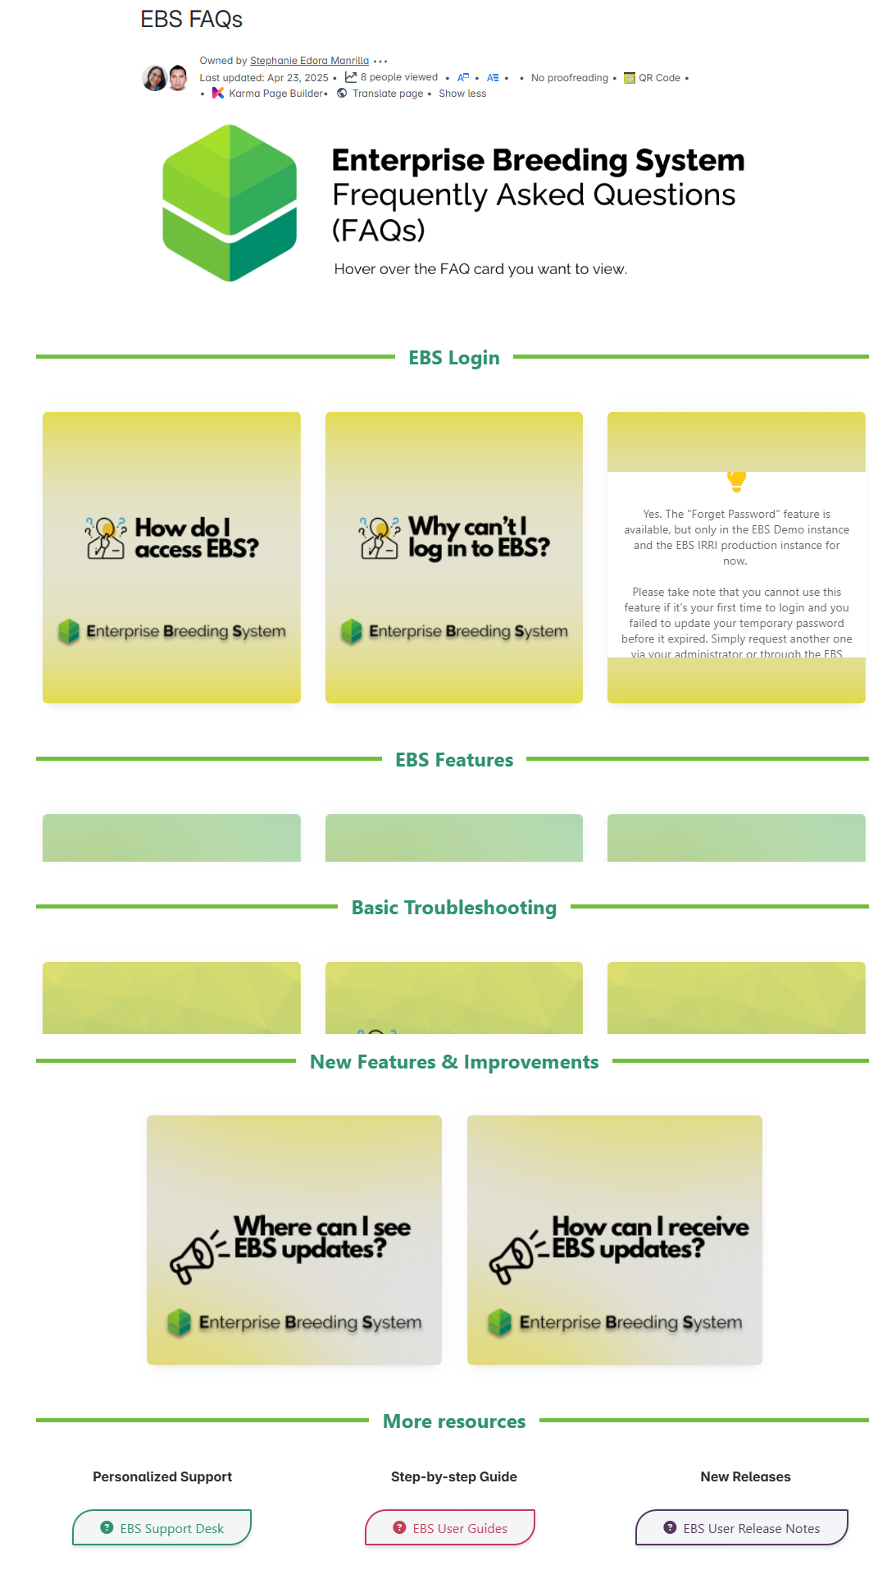
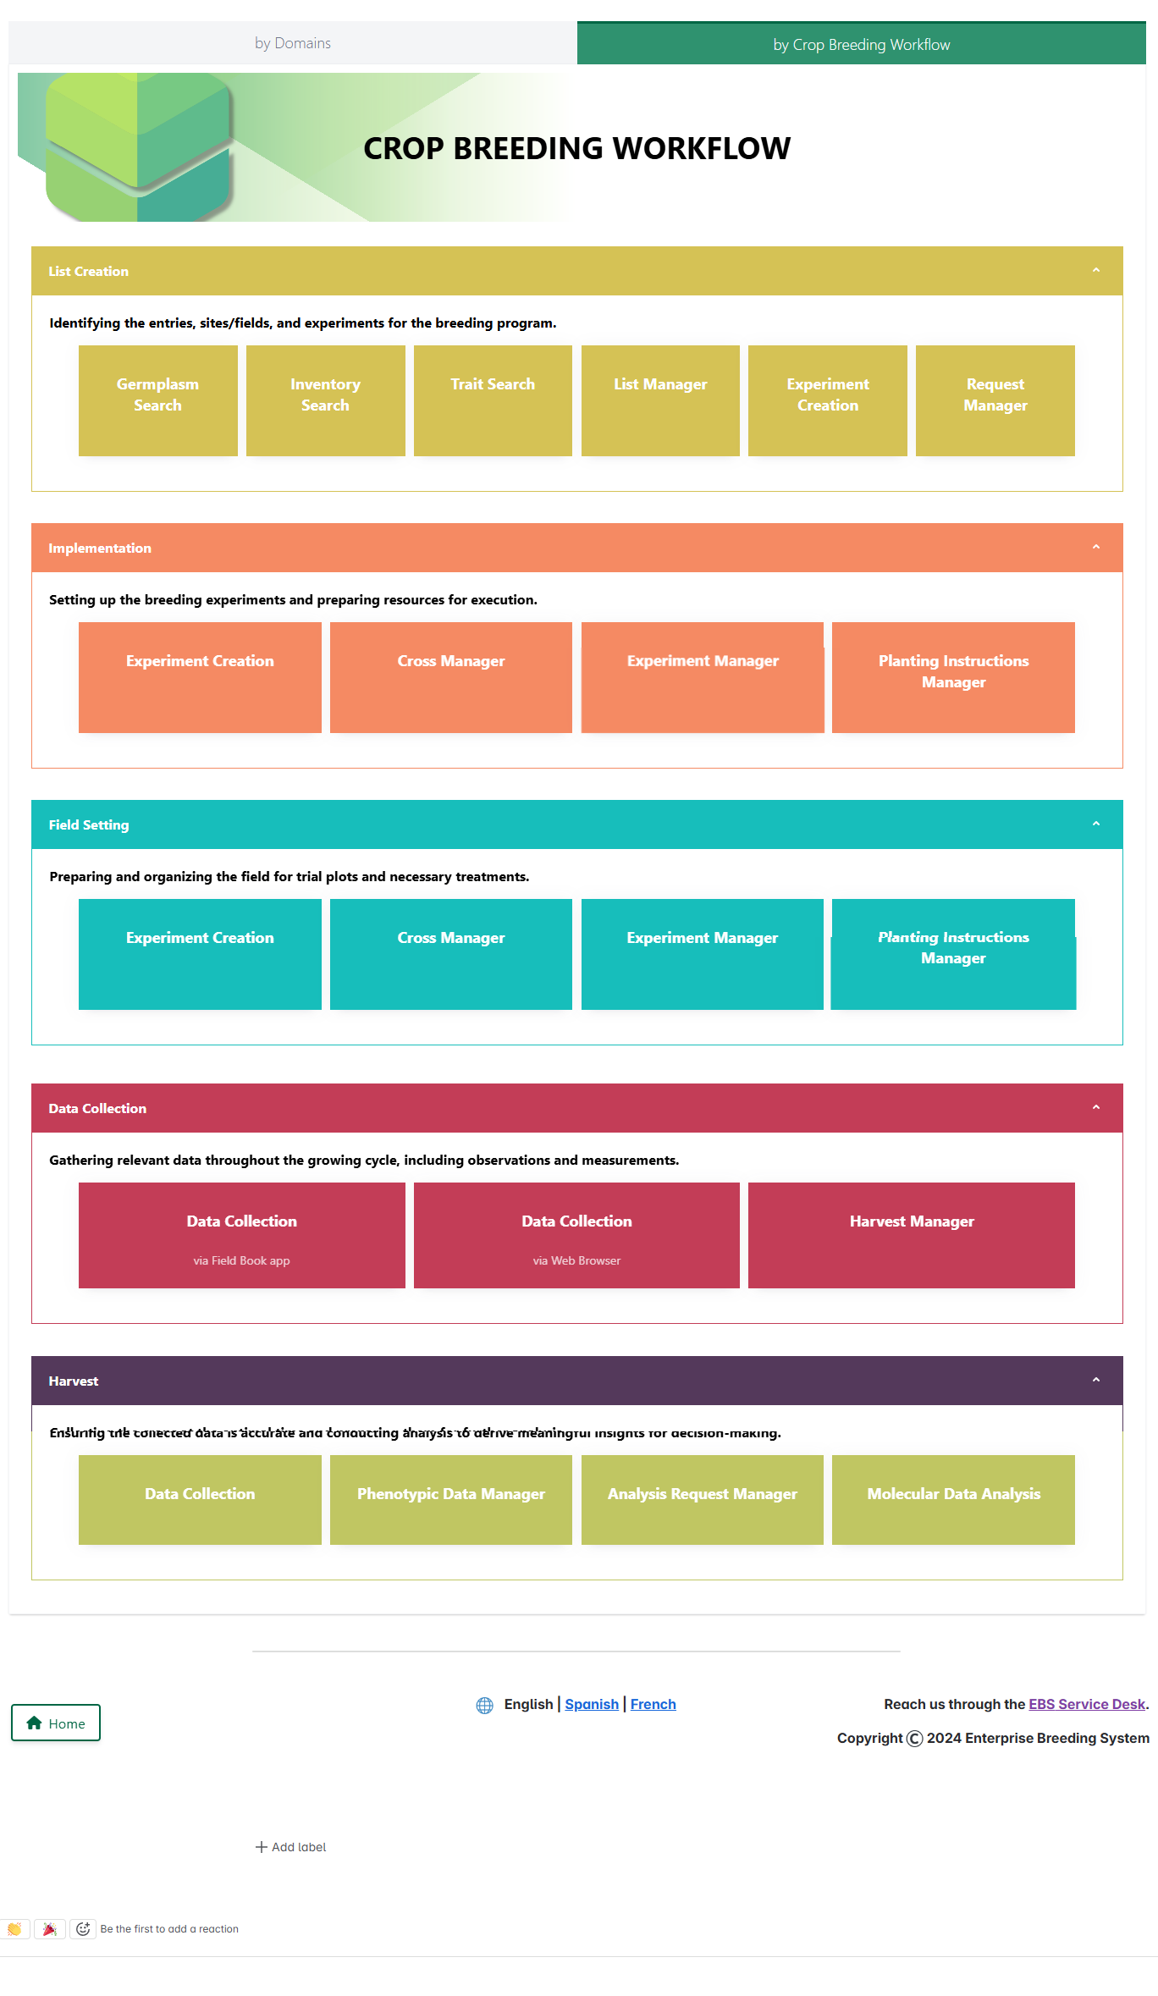
EBS User Guide Landing Pages

Slide 18
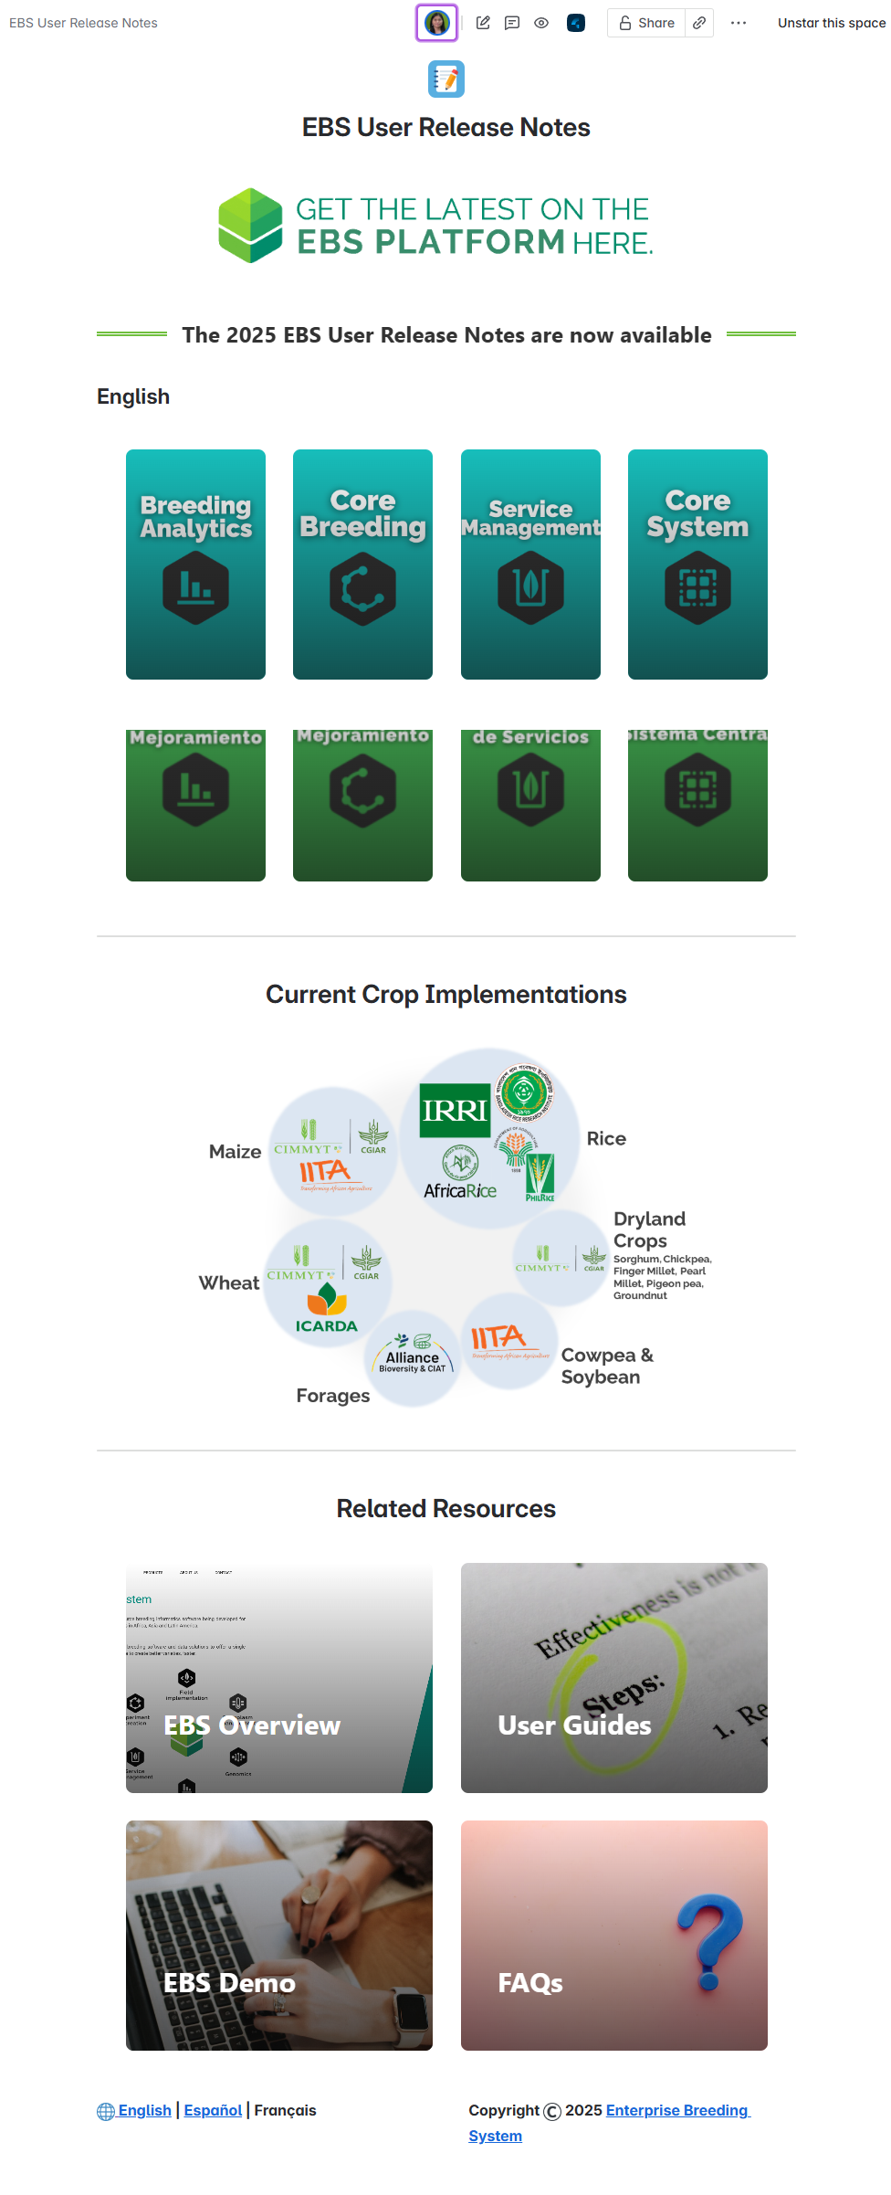
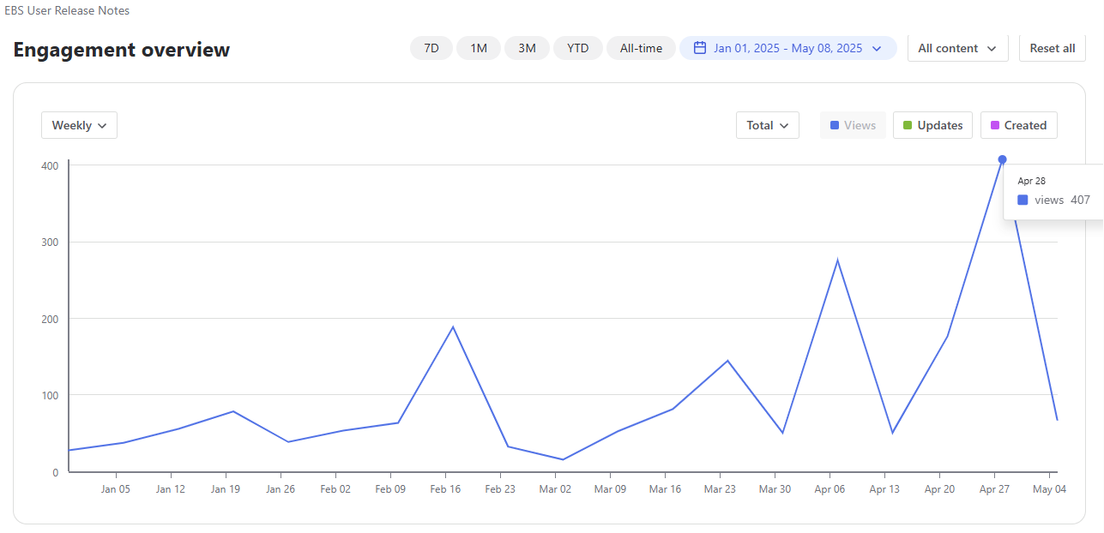
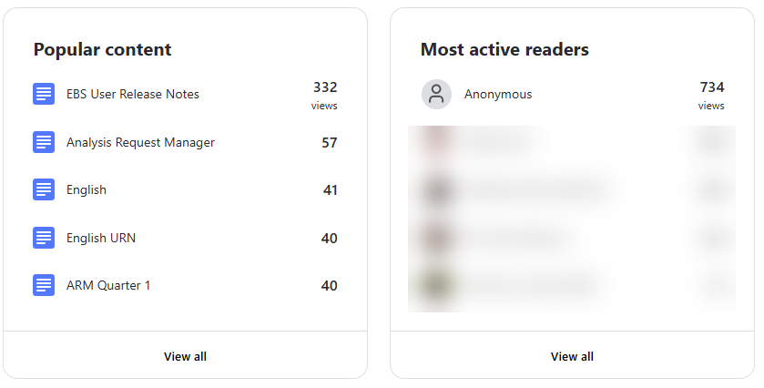

Documentation
User Release Notes

Slide 19
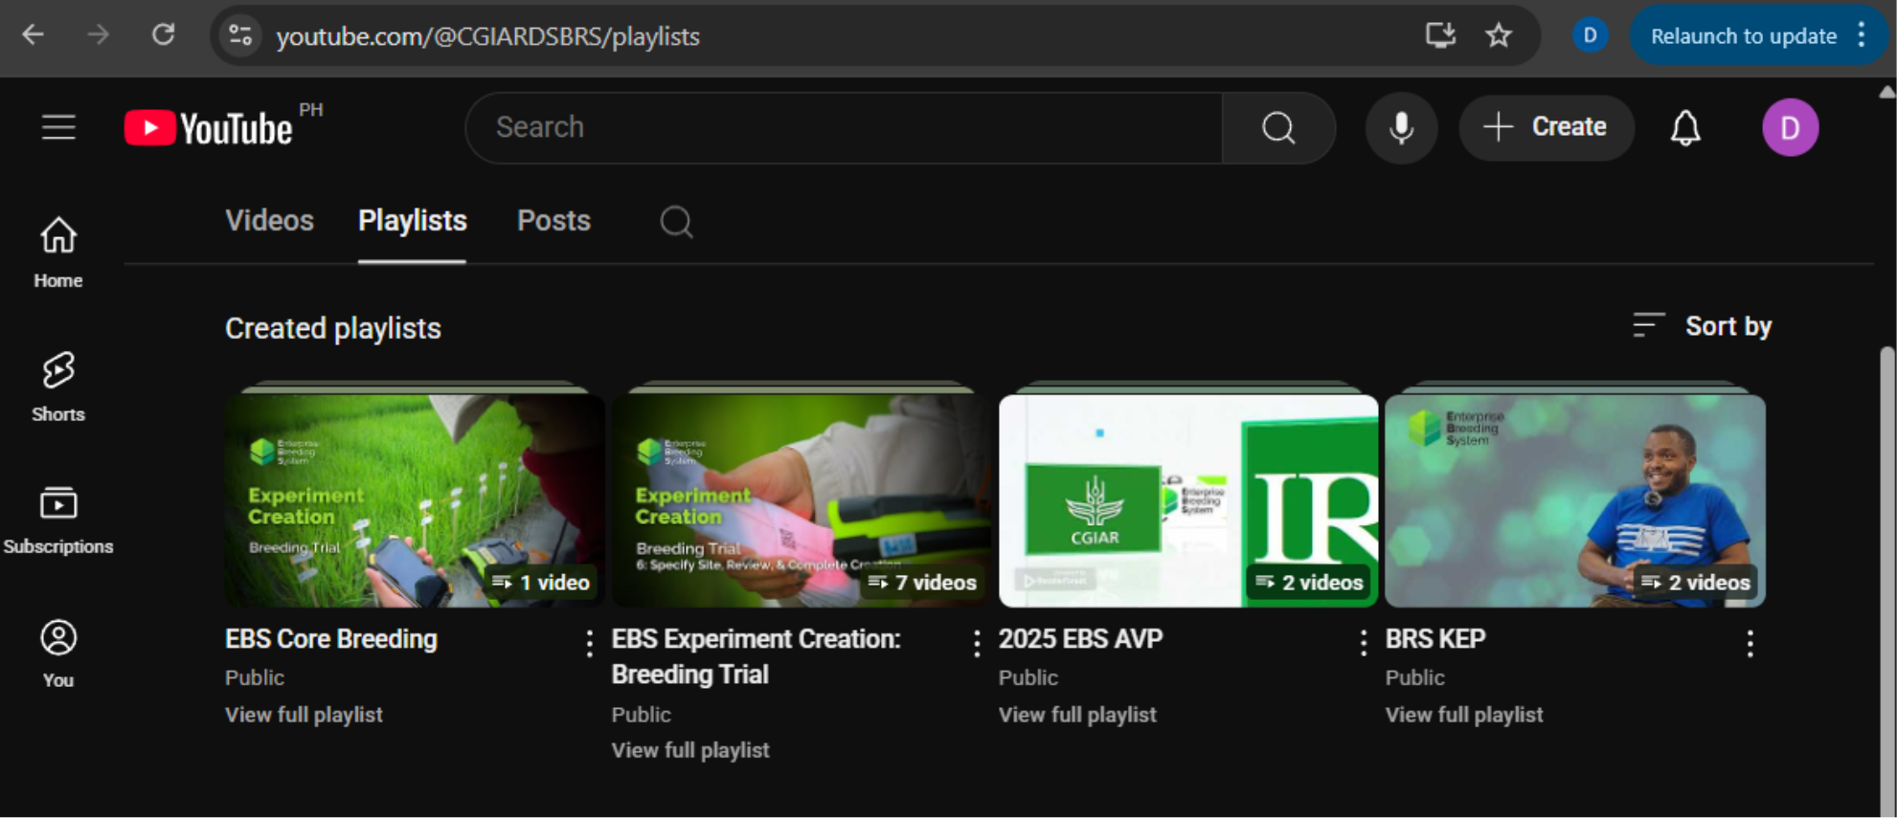

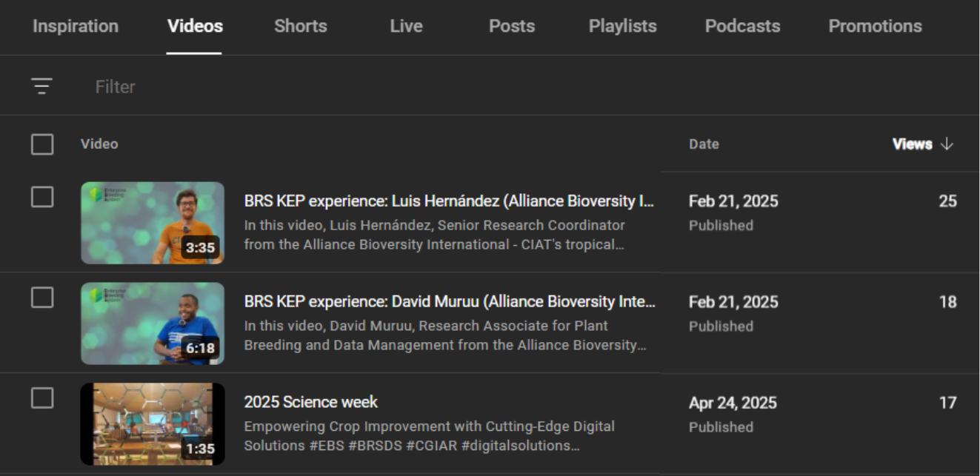

WWW.YOUTUBE.COM/@CGIARDSBRS/PLAYLISTS

Slide 20
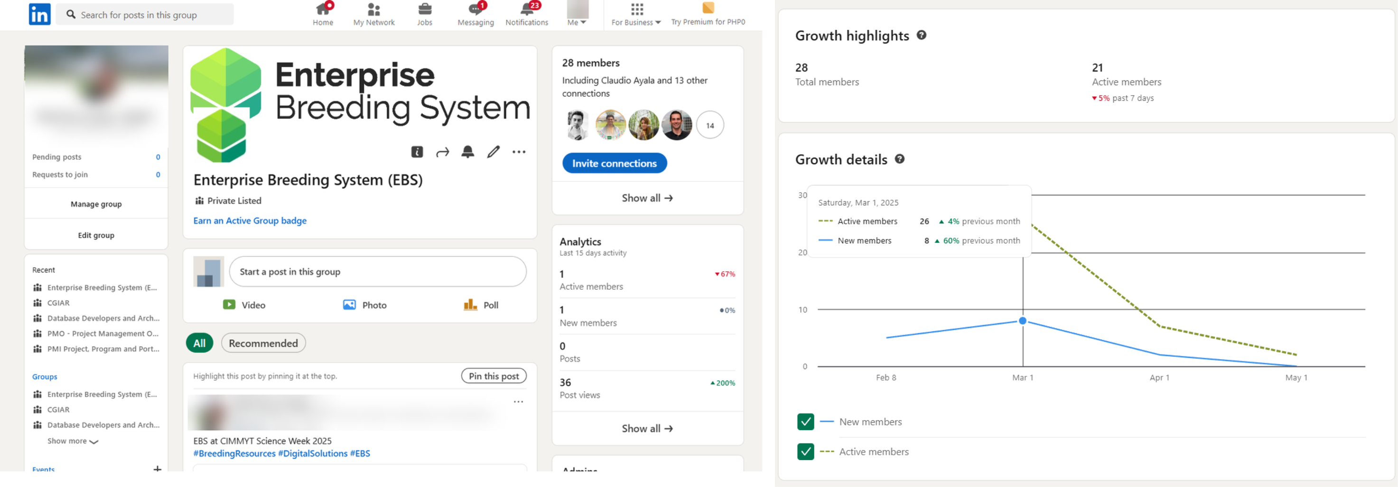

EBS LinkedIn group (Membership)

Slide 21
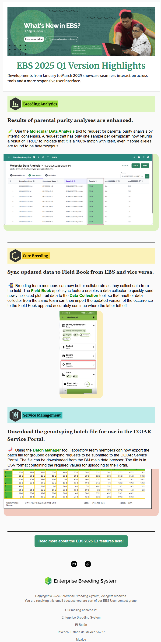
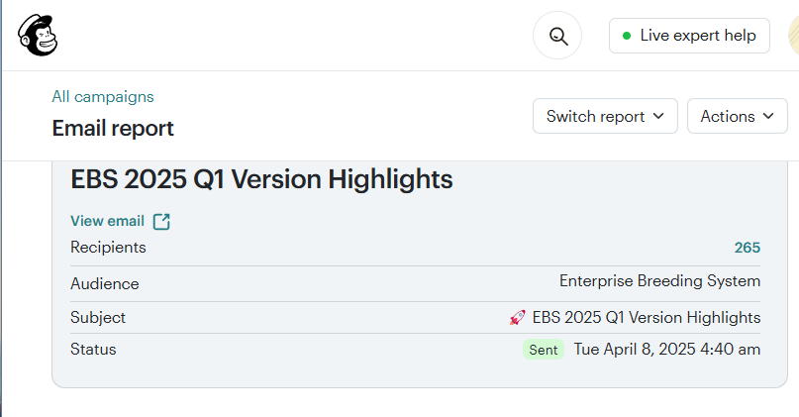
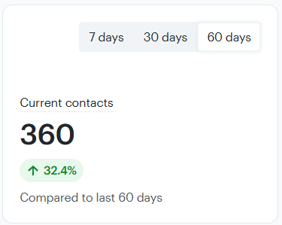
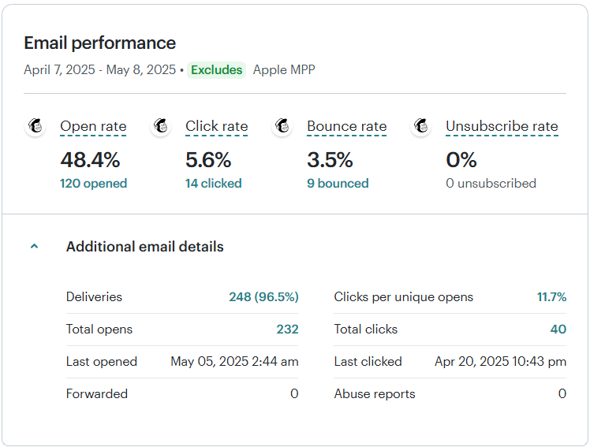
EBS Newsletter
EBS 2025 Q1 Version Highlights

Slide 22

Solutions Enablement

Slide 23
EBS Lite
What is EBS Lite?
  A version that only has the core functionalities for managing a breeding program
  Shorter turnaround time for adoption
  Lower operational costs
Q1 2025 Updates
  Cost Baselining
  Cost Optimization
    Application improvements
    Guardrails to prevent resource utilization spikes
What’s next?
  Extensive automated testing to ensure fully-functional core components
  Preparations for customer onboarding

Slide 24
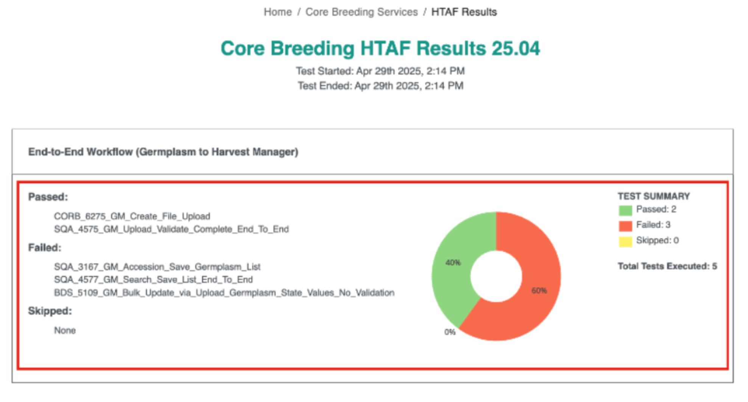
Hybrid Testing Automation Framework (HTAF)
Helps in assessing the readiness of a release candidate of EBS through automated tests going through various workflows
Q1 2025 Outcomes
13 new smoke tests (non-destructive validation of production environments) and 10 regression tests
Maintenance of existing tests to ensure they are up-to-date
Mapping of crop-specific and crop-independent tests

Slide 25
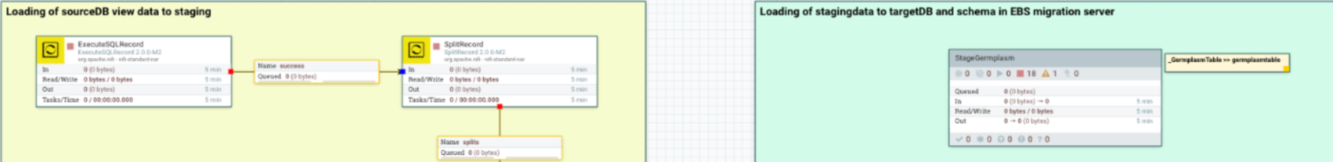
BMS to EBS data migration pipeline
Implemented using Apache NiFi
Aids in ensuring that the automated database-to-database migration process is fast, reliable, and scalable.
Transparency in terms of flow definitions to ensure faster troubleshooting and better optimization
Q1 2025 Outcomes
Tenant-related data are now being loaded through the pipeline
Germplasm and experiment data (entries, occurrences) can now be loaded (source to staging to EBS)

Slide 26



EBS Account Consolidation
Last March 2025, in collaboration with the CIMMYT KMIT team, we successfully transferred EBS CIMMYT Maize and EBS CIMMYT Wheat from a third-party provider to BR Digital Solutions.
As of Q1 2025, BR Digital Solutions is now managing 4 EBS Production Environments.
BETTER ALIGNMENT OF
TOOLS AND PROCESSES
ENHANCED TECHNICAL
SUPPORT
COST SAVINGS

Slide 27

Cloud-based High-Performance Computing (HPC) for Accelerated Breeding Initiative (ABI)
Breeding optimization simulations requiring a high level of compute resources
We offered Cloud Engineering and Services Support
Continuous Improvement
Pre-Onboarding
Mid-2024
Requirements Gathering
What are existing tools and processes?
What were the pain points?
What is the definition of success?
Proof-of-Concept
Validation
Deployment
Testing/Feedback
Onboarding
User Training
Production Environment
Technical Support
Q1 2025
Post-Onboarding
Ongoing
SCALABILITY AND FLEXIBILITY
COST OPTIMIZATION
SHORTER TURNAROUND TIME

Slide 28


Amazon Web Services (AWS) POCs
Our close working relationship with AWS started with EBS.
We are continuing to explore opportunities together with them as an enabling partner for various initiatives.
Next month, we will start working on a couple of proof-of-concepts using AI applications as building blocks:
  EBS Knowledge Bank
  EBS Adoption Dashboard
More updates next time!

Slide 29
Plant Diseases Dashboard Discovery Phase
In 2024, there was a discussion to explore the feasibility of implementing a CGIAR Plant Diseases Dashboard.
During Q1 2025, BR Digital Solutions proposed and led a discovery phase for the initiative.
The discovery phase is designed to give us a better understanding of what customers need and start with the fundamental requirements.
The discovery phase ended with the following outcomes:
  Product requirements document for a minimum viable implementation;
  Gap analysis on existing solutions based on requirements; and
  Documented recommendations based on the findings.

Slide 30
Solutions Engineering & Innovation

Slide 31
Operational Genotyping

Slide 32
Operational Genotyping
EBS: Request
Identify materials
EBS: Sampling
Create plate layout
Collect samples
CG Service Portal: Submit
Create request
Generate vendor documents
EBS: Manage data
Load vendor results file
Specify purpose
Review data in MDA
Define technology and vendor

Slide 33
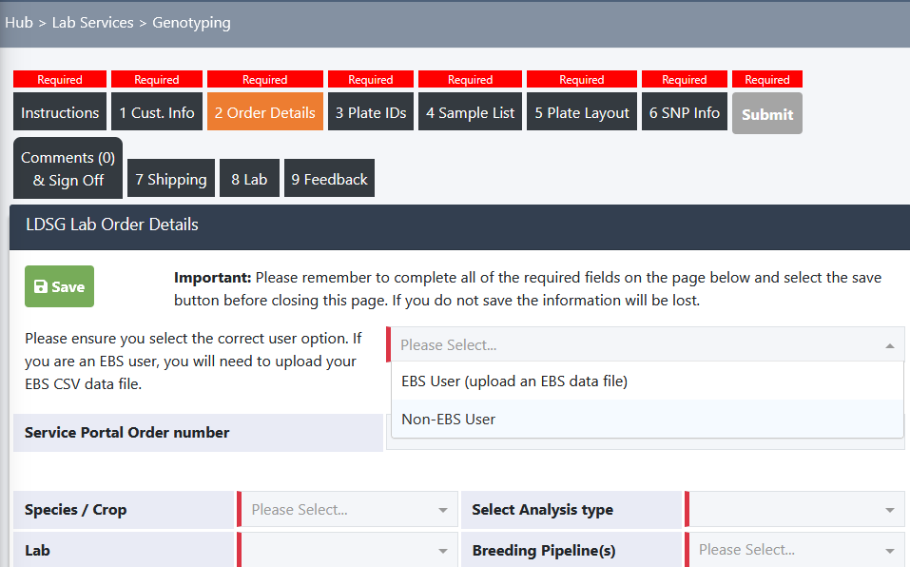
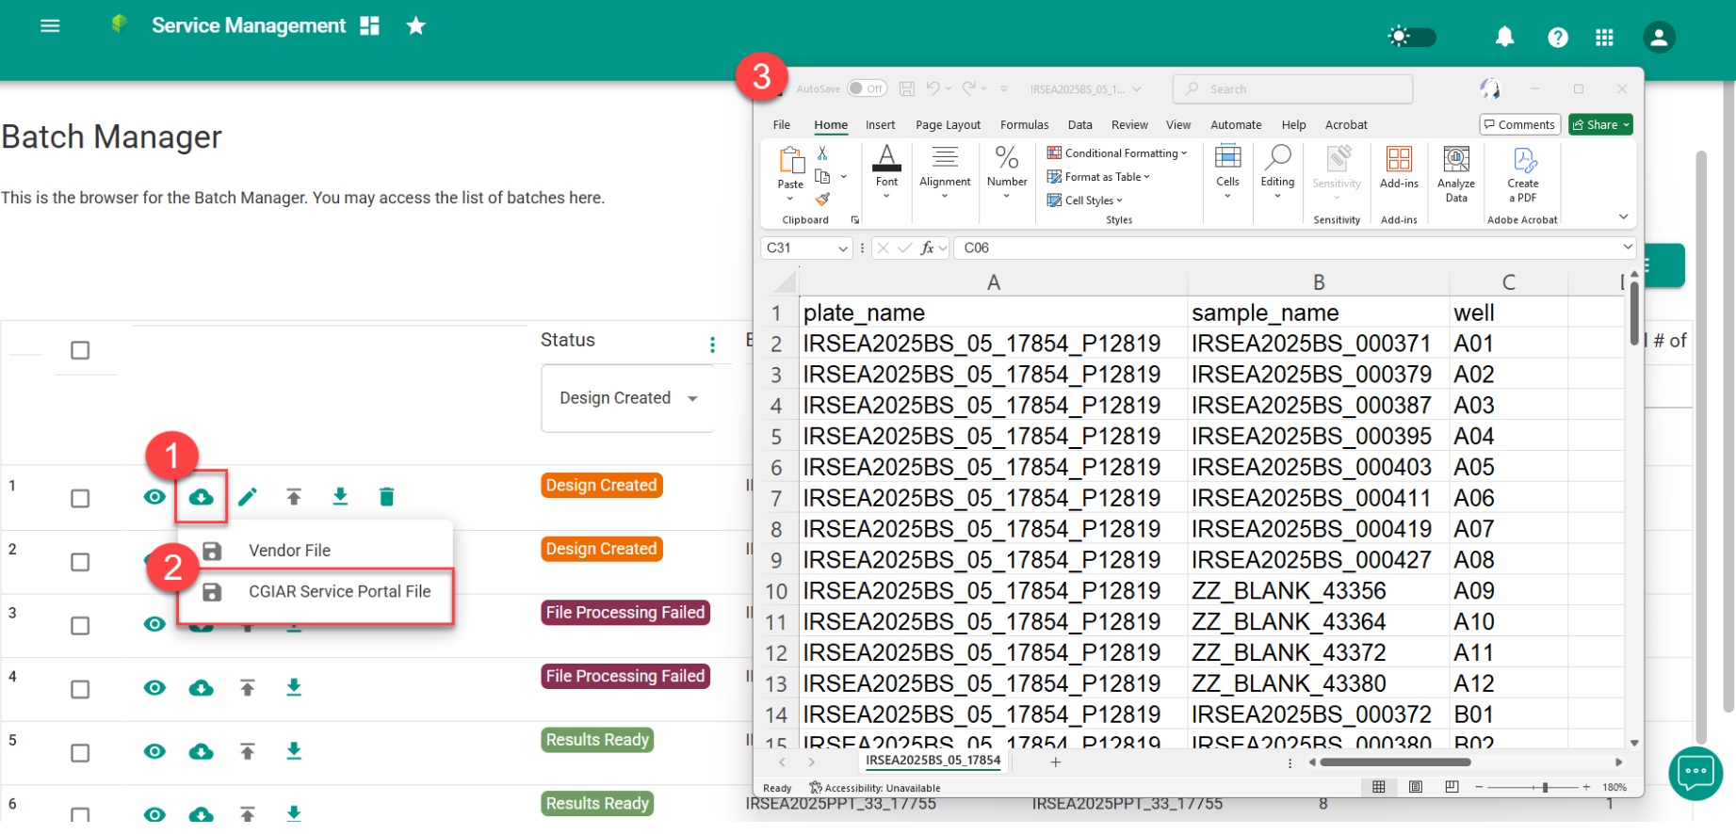
Operational Genotyping - Interoperability
The interoperability between EBS and CGIAR Service Portal ensures that the sample codes match between the systems

Slide 34
Breeding Analytics

Slide 35
Statistical Design Models
Generate and upload randomization for various designs
Faster uploads and validations through optimized data retrieval and processing
Clearer validation messages mean no more guesswork when something breaks or fails during randomization

Slide 36
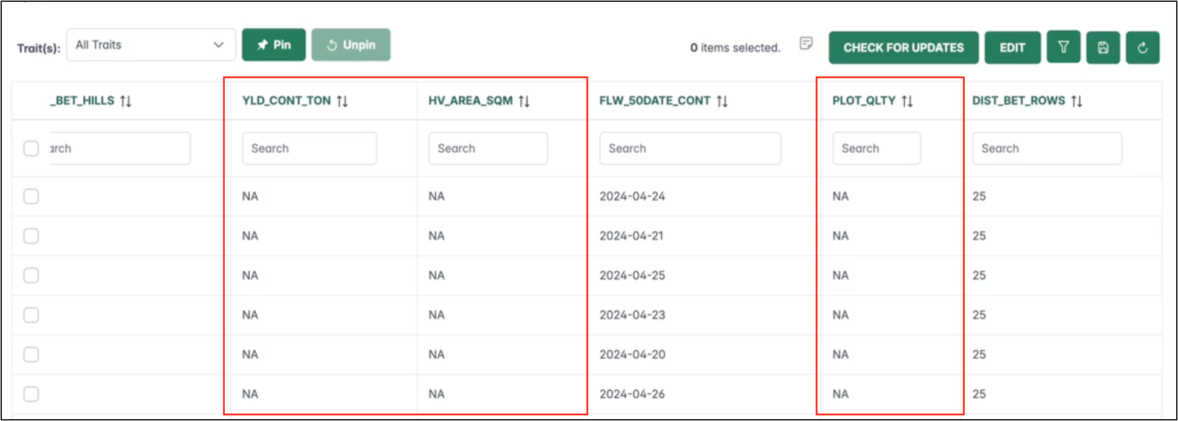
Phenotypic Data Manager
Perform quality checks on collected trait data
Synchronized stats and trait data tables after opening/reloading
Faster save times when updating QC transactions

Slide 37
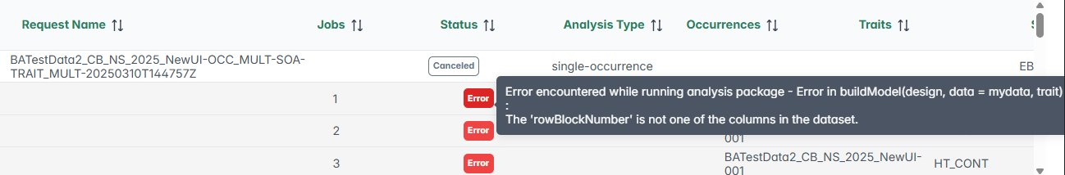
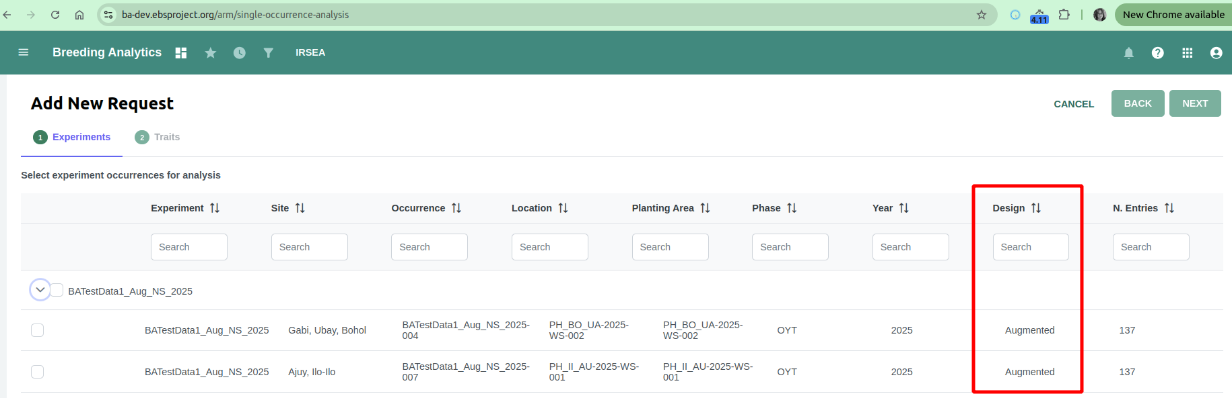
Analysis Request Manager
Process analysis requests and download results
Clearer validation messages and fixes for Augmented and Row-Column designs
Easier traceability with new source tags (EBS or Bioflow), occurrence-level designs, and EBS IDs included in shared RData

Slide 38
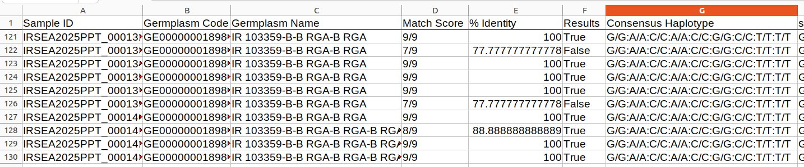
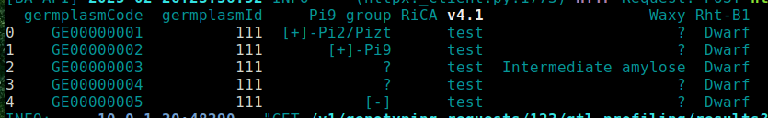
Molecular Data Analysis
Run molecular analyses on key analytical pipelines
Added support for single-sample germplasm and heterozygous alleles in Parental Purity Testing
Cleaner reports with the removal of extra/irrelevant data
Enhanced F1 Hybridity Testing and laid groundwork for the upcoming QTL Profiling

Slide 39

Core Breeding

Slide 40
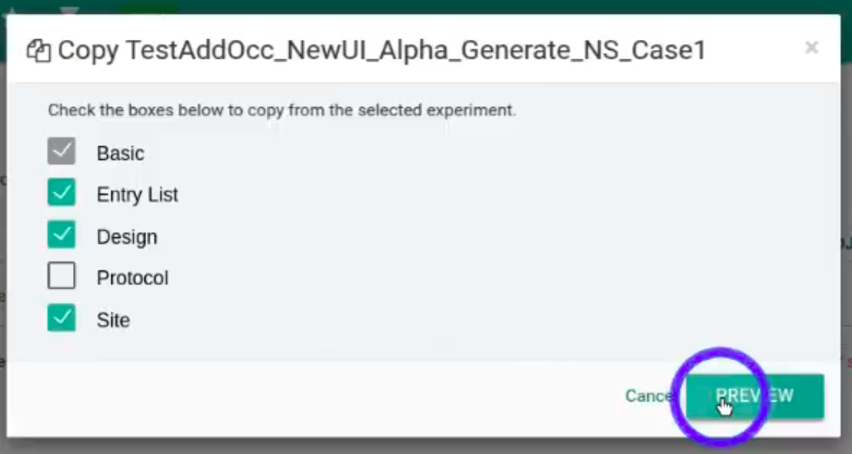
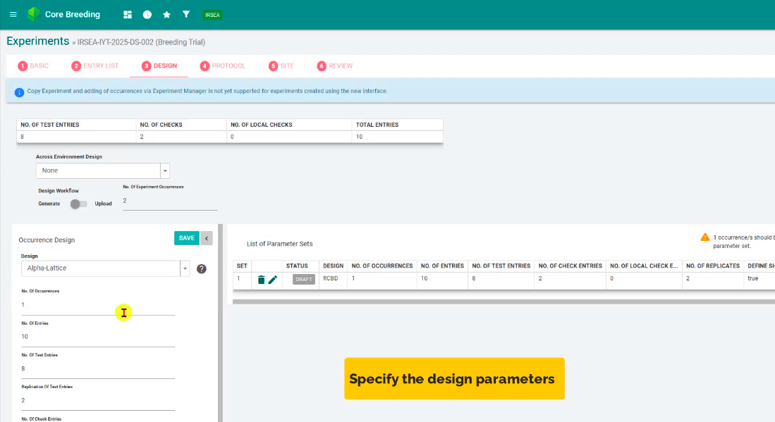
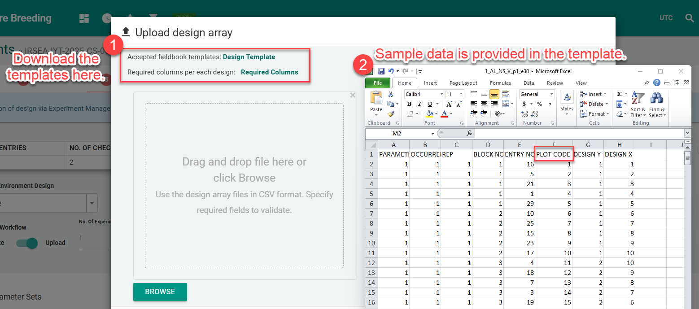
Experiment Creation
Copy Trial experiments whose randomizations were generated using the new design interface.
Generate and upload Augmented Design (non-sparse) using the new design interface.
Upload design files using the new template

Slide 41
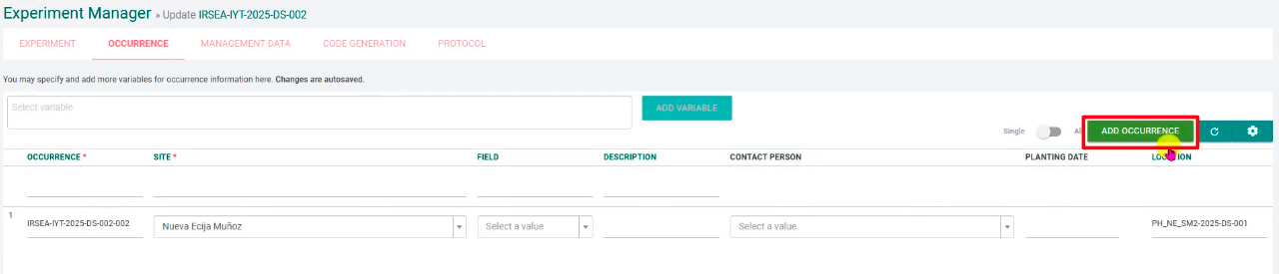

Experiment Manager
Add occurrences to Trial experiments that used the new Design interface to generate randomizations for non-sparse testing
Faster loading times when editing occurrences

Slide 42



Data Collection
Field book app upgrades from version 5.6 to version 6.0.7
Sync updated data to Field Book from EBS and vice versa.
Upload trait data for harvested crosses.
Direct printing of harvest labels via the Post Harvest tool

Slide 43



Harvest Manager
Harvest summary to show additional information about the harvested germplasm and its source
Only new seed lots and packages are created when harvesting DCP materials that are not yet fixed
Harvest F3 generations using bulk method for cowpea and soybean
Easily provide harvest data​
See updated germplasm names for harvest records​
Harvested crosses now reflect correct origin

Slide 44

Germplasm Manager
Provides required and optional data relevant to a crop program when creating germplasm records.
Improved notification when generating printout report

Slide 45

List Manager
More information when viewing, managing, and downloading list contents.

Slide 46



EBS: General Improvements
20 minor improvements
12 hotfixes
38 bug fixes

Slide 47

Hiphen and EBS Integration

Slide 48





Objective
AS IS (2024) | TO BE (Q2 2025)
Derived phenotype data from Hiphen's drone-based solution that enables high-throughput plant phenotyping (HTP) cannot be stored in EBS. | Derived phenotype data from Hiphen or other image analysis service provider can be stored in EBS and target file is available to support analysis in Bioflow or other external analytical tools.
Phenotypic data will be centralized in one data repository, operational efficiency will be improved and enhanced decision-making capabilities will be enabled

Slide 49

Updates and next plans
Q1 2025 Updates | What's next?
Project initiation, finalized key objectives & integration scope Documented preferred approaches, workflows, and expected outcomes Identified and finalized data model to store time series data Defined Hiphen and EBS data mapping Created test data Enabled downloading of mapping file in EBS for uploading in Hiphen | Complete the implementation of the Hiphen data integration to EBS Upload time series data from Hiphen Download the actual uploaded file of committed transaction Download file with times series data to support analysis with external tools such as Bioflow

Slide 50

AgPile

Slide 51

Why AgPile?
Data is one of the most valuable assets for advancing research and decision-making across all agricultural disciplines from policy and product development to cultivation and processing
However, access to high-quality data and its comparability, compatibility, and reusability across disciplines remain limited
To address this, CGIAR has recently launched the AgPile project, funded by the Gates Foundation
AgPile aims to transform CGIAR’s digital assets to enable better collaboration and knowledge sharing across the global agricultural research community

Slide 52



AgPile: What is in it for me?
Key benefits
Access and use data and tools from other research groups Improve the usability and quality of your organization's data | Know what you've got - use the tools to track and easily find assets Enable data re-use and sharing | Enable curation and versioning of data Securely store data Allow for governance and privacy policies
AgPile provides the functionality and tools that enable you to search and integrate data sources, within CGIAR or external, to produce visualizations, predictions, new datasets, and more.
• Dashboards
• Predictive Models
• Reports
• New data sets
Get more from your data... and also external data!

Slide 53


Slide 54


Slide 55


Slide 56
AgPile Program Plan
Hackathon
Work Stream/ Work Package | Q1 ‘25 |  |  | Q2 ‘25 |  |  | Q3 ‘25 |  |  | Q4 ‘25 |  |  | Q1 ‘26 |  |  | Q2 ‘26
Engagement Events
1. Building the AgPile PoC and MVP
1.1. AgPile PoC - Drone Project
1.1.1. PoC infrastructure & environments 1.1.2. PoC Asset Registry 1.1.3. Enable data sharing in and beyond CGIAR 1.1.4. PoC key analytics Testing
1.2. Transition AgPile PoC to MVP 1 – 1000 Farms
1.2.1. MVP infrastructure and environment 1.2.2. MVP Asset Registry 1.2.3. MVP key analytics Testing and Training
1.3 AgPile Product Delivery
2. Governance and Product Management
2.1 Product Development & Change Management Strategy
2.1.1. Product Strategy for AgPile MVP 2.1.2. Change Management Process Implementation
2.2 Governance Structure for the AgPile
2.2.1. Develop AgPile governance framework 2.2.2. Implement AgPile governing bodies
2.2a Key Governance Decisions
Onboard
Vendor
Knowledge
Transfer
MVP 2: Cassava Data Lake
MVP 3: EBS
AgPile Product Pipeline
Train the Trainer =>
Train Users =>
Marketing =>
Sustained Product Portfolio- and Lifecycle Management
Sustained Change Management
New Name
Key Project Meeting
Steering Team Meeting
Milestone
Notes:
Beyond PoC, the Drone Project will be continue managed under the “Sustained Product Portfolio and Lifecycle Management”

Slide 57


Q&A

Slide 58


Slide 59

Bioinformatics Support

Slide 60
Haplotype/Variant Tracing
Objective: Build a public-facing repository of released varieties of CG-mandated crops.
Purpose: Serve as a centralized "source of truth" for varietal identity.
Current activities:
  Data generation underway:
    Sample collection of released varieties of CG-mandated crops
    Creating SNP-based fingerprints for released varieties across CG-mandated crops
  Complements varietal identity and QTL profiling workflows in the Enterprise Breeding System (EBS)
Platform update:
  Germinate selected and deployed as repository platform
  Collaborating with Jack Lagare and Ernesto Briones of the Digital Solutions team for the deployment and configuration of Germinate and the deployment and maintenance of the IMAGE Project's analysis workflow
  Test instance populated with initial data (working with kate Dreher, CIMMYT Research Data Management Team)
  Transition to production planned soon.
Impact:
  Enhances traceability, transparency, and credibility
  Supports breeders, seed systems, and donors with a reliable reference

Slide 61
Development/Improvement of Mid-Density SNP Marker Panel Design
Objective: Support crop breeding teams in developing or improving mid-density SNP marker panels
Service model: Collaborative support to optimize marker panels for key breeding needs
Technical approach:
  Based on Integer Linear Programming (ILP) algorithm
  Developed by Loc Mansueto (SCU) and Ramil Mauleon (IRRI)
  Selects highly informative and representative SNPs for panel design
Collaborators:
  Southern Cross University (SCU) provides implementation support
  IRRI Bioinformatics Team
Progress and adoption:
  Rice – Completed
  Pearl millet – Completed
  Sesame – Completed
  Cassava – Currently in progress
Impact:
  Improves genotyping efficiency and cost-effectiveness
  Enhances resolution for key breeding applications like fingerprinting, genomic selection, and trait tracking

Slide 62
Reference Genome Sequencing Service
Objective: Provide cost-effective, high-quality reference genome sequences for CG-mandated crops
Partnerships:
  In collaboration with Rajaguru’s team and Corteva (as sequencing vendor)
  Genome annotation for selected crops supported by Earlham Institute
  Digital Solutions team for data transfer and storage provisioning.
Service features:
  Generates platinum-quality reference genomes
  Initially funded through Crops to End Hunger (CtEH)
  Also available to crop teams through their own funding sources
Progress to date:
  21 genome sequences generated across 8 crops under CtEH funding
  Public access to CtEH-funded data: https://data.cimmyt.org/dataverse/ctehdvn
  Additional outputs:
  4 sorghum accessions completed
  1 finger millet accession completed
  5 finger millet and 4 pigeon pea accessions in progress
Applications and impact:
  Serves as foundational resource for genotyping, trait discovery, and genome annotation
  Can be used to improve SNP marker panels and inform trait-based marker design pipelines
  Accelerates breeding precision and effectiveness across diverse crops

Slide 63
Operational Genotyping
EBS: Request
What to genotype
EBS: Sampling
Sampling
Plating
CG Service portal: Submit
Create request
Generate vendor documents
EBS: Load data
Vendor result file is loaded to the genotyping database
Purpose

Slide 64



















AgPile in theory:
How it will work
Data
Tools
AgPile
Notes:
To enable better collaboration and knowledge sharing across the global agricultural research community, AgPile brings together Digital Assets and enables their multilateral sharing and re-use
A User can browse Digital Assets (data and tools) shared through AgPile and select those for combined analysis or use according to her/his needs
This way that User will produce Digital Assets
... which she or he can then share back to AgPile
Another User can then browse pre-existing and new Digital Assets, select them for analysis or use and will produce new Digital Assets
...which she or he can also share back to AgPile
Yet another User might just be interested in data to create her/his own dashboard in their individual AgPile workspace

Slide 65













AgPile from a user perspective:
Your own Digital Workshop
Weather sensor data
Genebank manager
Plant disease images
Genebank passport data
GIGWA
Breeding data
Molecular Breeder
Plant Breeder
Historical trial data
BioFlow
Crossing list
On-farm preference data
Market demand data
Image recognition model
List of
candidate genes
Funder
Breeding Impact
Dashboard
Notes:
You can think of the AgPile product as a workshop that contains materials and tools (digital assets).
When you are in the workshop (AgPile) this collection (portfolio) of materials (data) and tools (models, applications, visualizations, etc) can be combined in many ways.
Different craftsmen can choose different sets of materials and tools according to what they want to build (use cases).
Peter as a Genebank Manager might just be interested in associating Genebank passport data with Breeding data
Damien as a Molecular Breeder might want to analyze data from GIGWA and Bioflow in context with Breeding data
to create a list of candidate genes
Boukar as a Breeder might want to pull together Breeding data, Market demand data and On-farm preference data
to create a crossing list
Young Wha as a Funder might want to use the same data as Boukar
to put together a Breeding Impact Dashboard

Slide 66
Life cycle of a Trial experiment
Creation
Field Management
Data collection
Harvest
Post Harvest
Data Analysis
Planning
Planting
Breeding Program Manager
Experiment Manager
Data collection
Harvest Manager
Post Harvest
Phenotypic Data Manager
Analysis Request Manager
Experiment Creation
Planting Instructions Manager

Slide 67




AgPile in action:
A real-life example
Data
Tool
New Data
1. Survey data from the CIMMYT Dataverse
3. Genesys API
2. Genebank Accession data from Genesys
Dashboard
“Use of Genetics by Gender”

Slide 68






Hidden slide: Copy of possible team presenter

