Slide 1
Population Improvement: The Driving Force Behind Breakthrough Products
Christian Werner
Accelerated Breeding Team
5th June 2025

Slide 2
Sustainable development of breakthrough products is not possible without constant and efficient population improvement

Slide 3
Breakthrough Products Replace Widely Grown Varieties
Varieties with proven on-farm yield and profitability gains that motivate small-scale commercial producers to adopt them along with farming practices for optimised yield and profit.
Target only major market segments through carefully selected, high-impact product pipelines.
Achieve ≥25% productivity and/or value improvement over current leading varieties.
Ensure high offtake potential to support increased farmer income.
Leverage strong market demand to drive rapid adoption.

Slide 4
Target Traits to Drive Replacement
Climate resilience/adaptation: drought, heat, flooding tolerance
Pest and disease resistance
Quality attributes: grain, tuber, or forage traits valued by processors and consumers
Agronomic characteristics: days to maturity, growth habit, adaptability to diverse farming systems
A breakthrough product should be validated within 5 years.
Substantial replacement of dominant varieties should follow within 5 to 10 years, depending on the crop.

Slide 5
First breakthrough product validated within 5 years?

Slide 6
Prioritisation for Impact in Challenging Times
Prioritisation is about maximising impact with existing resources
CGIAR invests in too many traits, pipelines, market segments, and countries. Spreading efforts thin won’t deliver breakthrough products.
Breeding teams report needing more funding to boost genetic gain, but budgets have been drastically cut.
Prioritisation must come from Crop Leads. Neither breeding teams nor B4T can drive this.

Slide 7
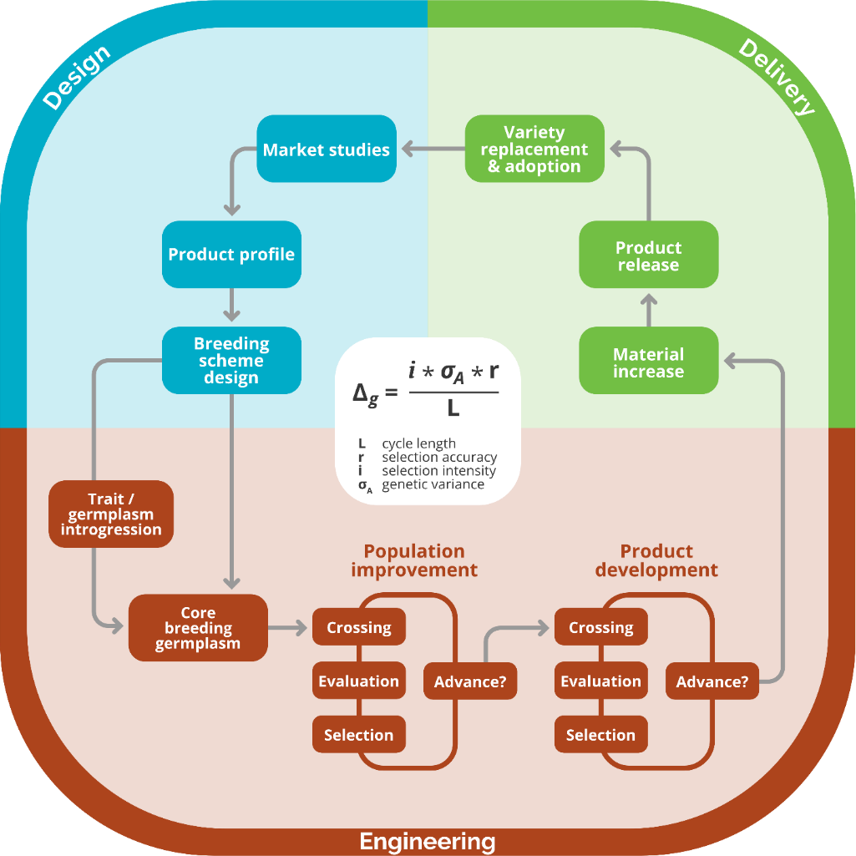
Know your target!
Target Product Profile (TPP)
Feasible
Impactful
In demand
Population Improvement
Long-term gains:
Slower, but sustainable
Continuous improvement
Accumulation of beneficial alleles
High number of genes
Numerous traits
Breeding Scheme
Prioritisation & Optimisation
Change System / Product
Trait Discovery & Deployment (TD&D)
Short-term gains:
Fast, but static
Major gene fixation
Limited number of traits
Limited number of genes
Product Introgression
Short-term gains:
Fast, but static

Slide 8
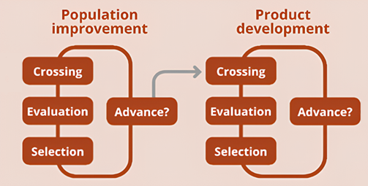
Alignment with GATES FOUNDATION investment priorities
Continuous improvement of breeding to maximize genetic gain per year and dollar spent
Increase chance of better product in the population
Minimised cycle length (closed population)
Increased parent selection accuracy
Identify best candidates
Increase H² in MET and on-farm testing
Measure genetic gain
Progress towards targets is monitored annually
Breeding Portal and Program Management Platform (PMP)
Bioflow for standard analytics → database (EBS, BMS, BreedBase)
Continuous improvement supported through Breeding Scheme Manager (BSM)

Slide 9
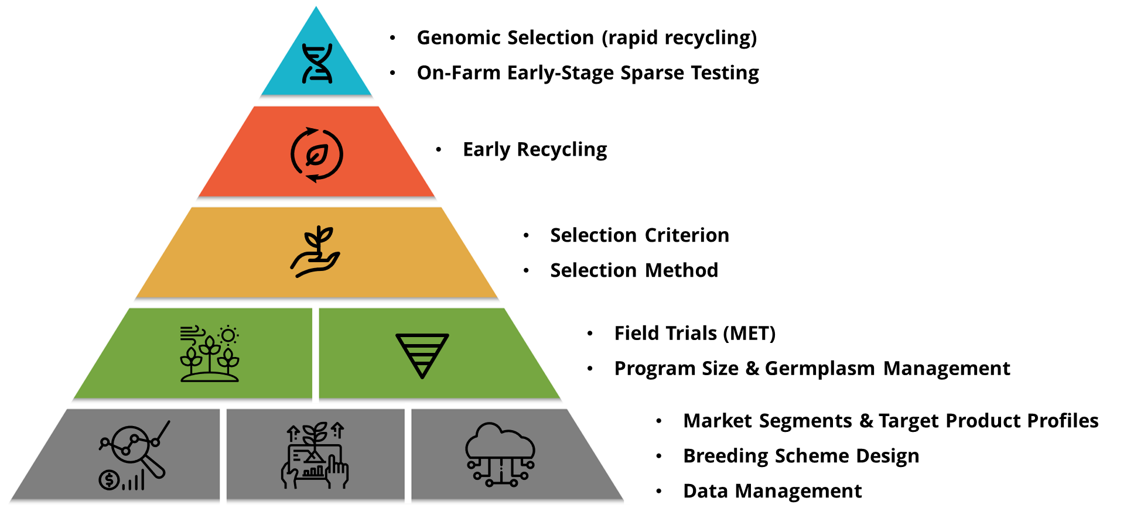

Slide 10
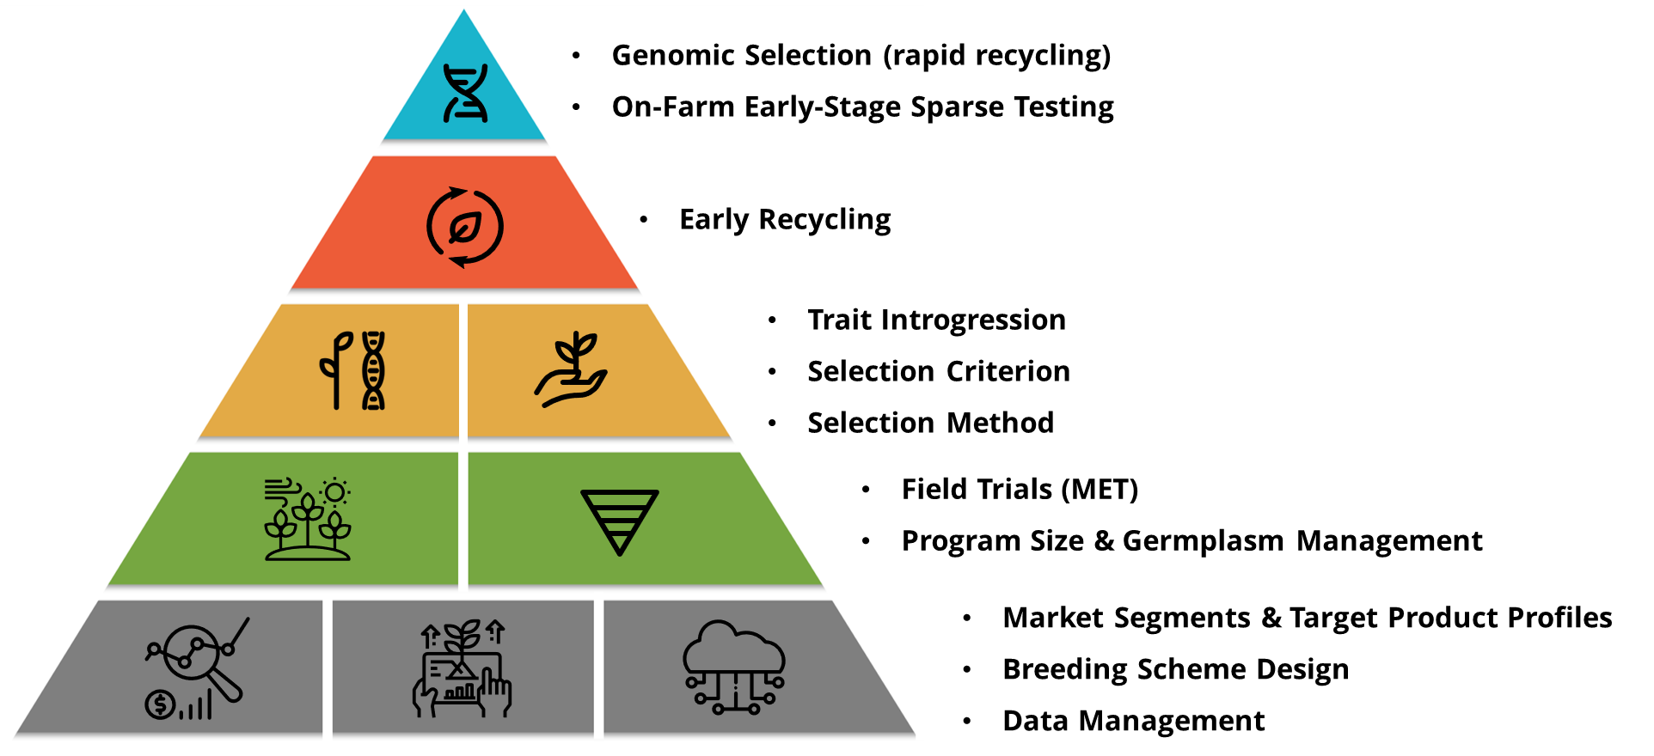

Slide 11
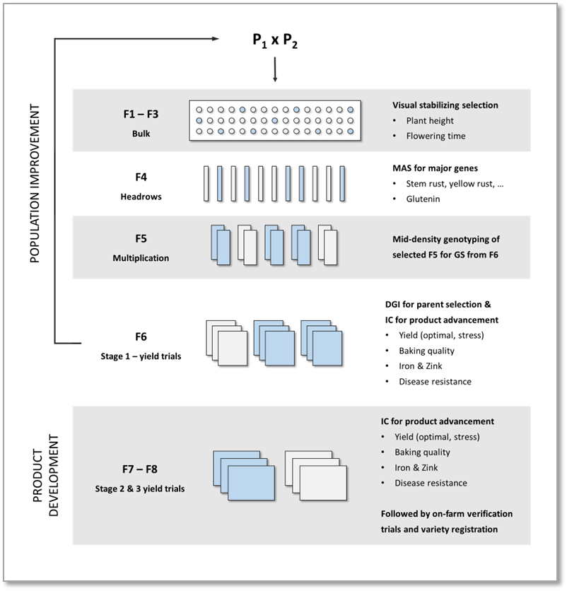
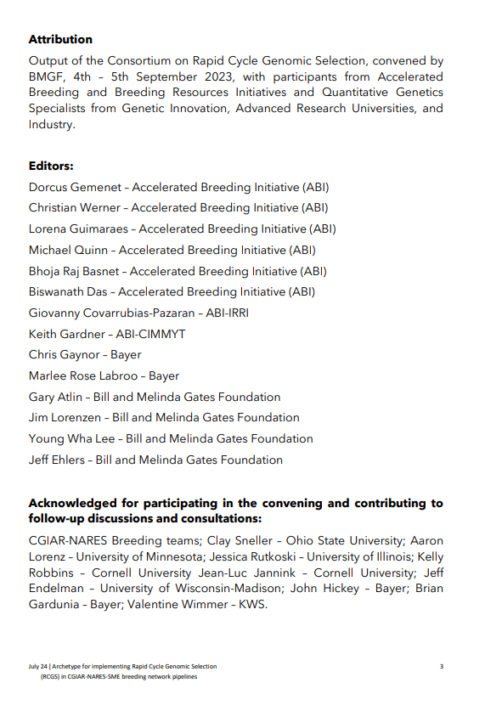
Archetype for implementing RCGS in CGIAR-NARES-SME breeding network pipelines
https://excellenceinbreeding.org/toolbox/tools/archetype-implementing-rapid-cycle-genomic-selection-rcgs-cgiar-nares-sme-breeding

Slide 12
First breakthrough product validated within 5 years!
And then we move on …

Slide 13
Thank You! Questions and Discussion

