Slide 1
Breeding for Where It Matters: Increasing Genetic Gain in the Target Population of Environments (TPE)
Christian Werner
Accelerated Breeding Team
3rd July 2025

Slide 2
OUTLINE
GxE Interaction defines the TPE
What is the TPE?
The TPE guides your breeding efforts
GxE interaction modelling to understand your TPE
Collecting and using the right data (TPE!) to make the right decisions (breed for the TPE!)

Slide 3
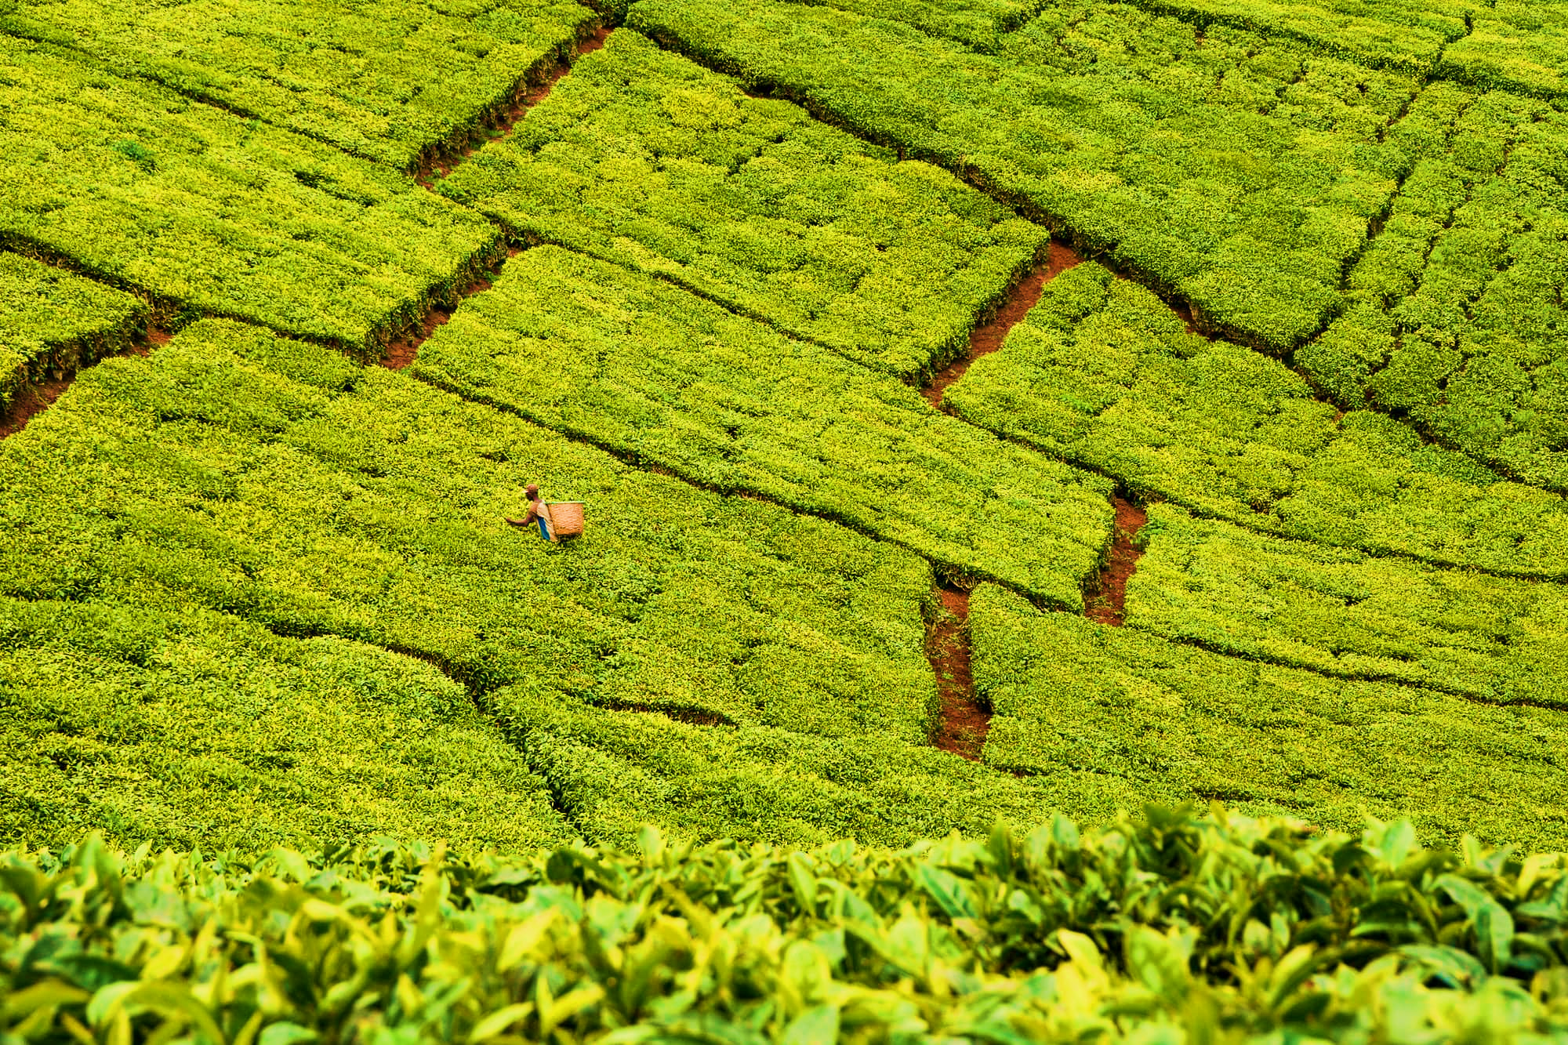
THE OBJECTIVE OF PLANT BREEDING
… is to develop improved plant varieties with enhanced productivity and quality, benefiting farmers while meeting societal needs and preferences.
→ breakthrough products
Breeders must match genotypes with environments (TPE) in which they can deliver exceptional performance.

Slide 4
WHAT IS GxE INTERACTION, ANYWAY?
GxE interaction is the differential response of genotypes to varying environmental conditions
Scaling GxE
(Non-crossover GxE)
METs
2 1 3
2 1 3
Crossover GxE
(Reranking)
2 1 3
1 3 2

Slide 5
GxE INTERACTION – IGNORE, REDUCE, LEVERAGE?
TPE
Ignore
Reduce
→ Adjust TPE
Leverage
→ Understand and model GxE

Slide 6
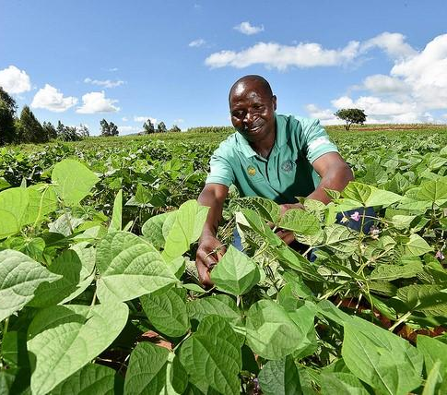
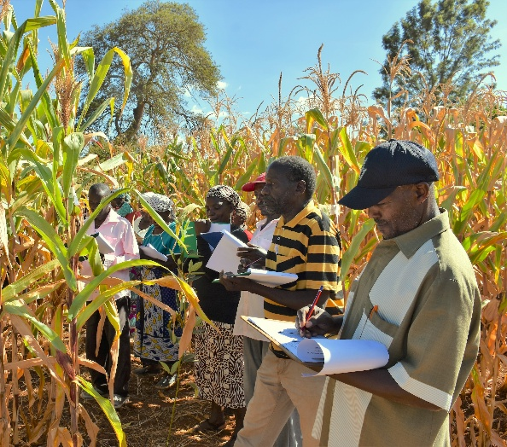
TARGET POPULATION OF ENVIRONMENTS (TPE)
“The set of farms and future seasons in which the varieties produced by a breeding (breakthrough products) program will be grown”
Environmental factors
Altitude
Temperature
Humidity
Sunlight
Rainfall
Soil type
…
Socio-economic factors
Farm type
Market opportunity
Subjective preferences
…
GxE INTERACTION

Slide 7
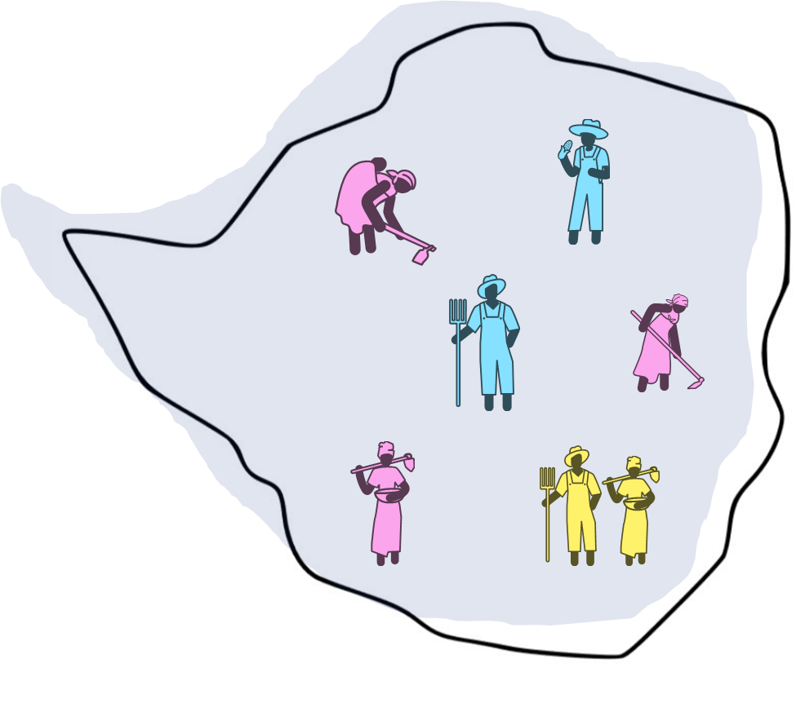
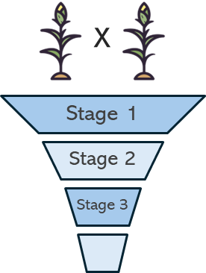
TARGET POPULATION OF ENVIRONMENTS (TPE)
Target Product Profile
TPE
Breeding Pipeline
Market Segment

Slide 8
MODELING GxE INTERACTION – 2 PHILOSOPHIES
… or: how to understand your target population of environments
Two-way ANOVA
$$σ_{P}^{2}=σ_{G}^{2}+σ_{E}^{2}+σ_{GxE}^{2}+σ_{ε}^{2}$$
Regression on the „quality“ of an environment
→ Sensitivity of a genotype to changes in the environment
Genetic correlation between environments
→ Correlation of genotypic performance (population) in different environments
Ronald A. Fisher
Invented ANOVA in 1918

Slide 9
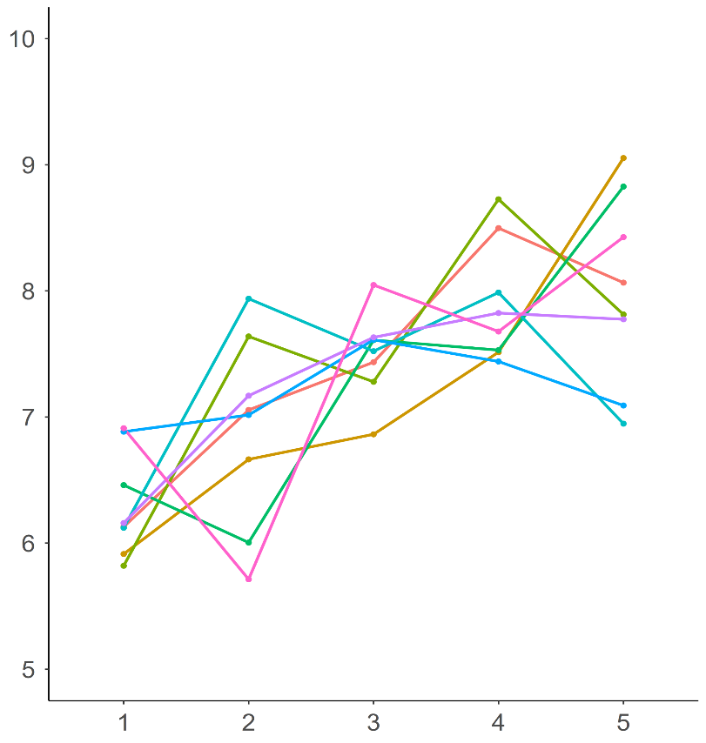
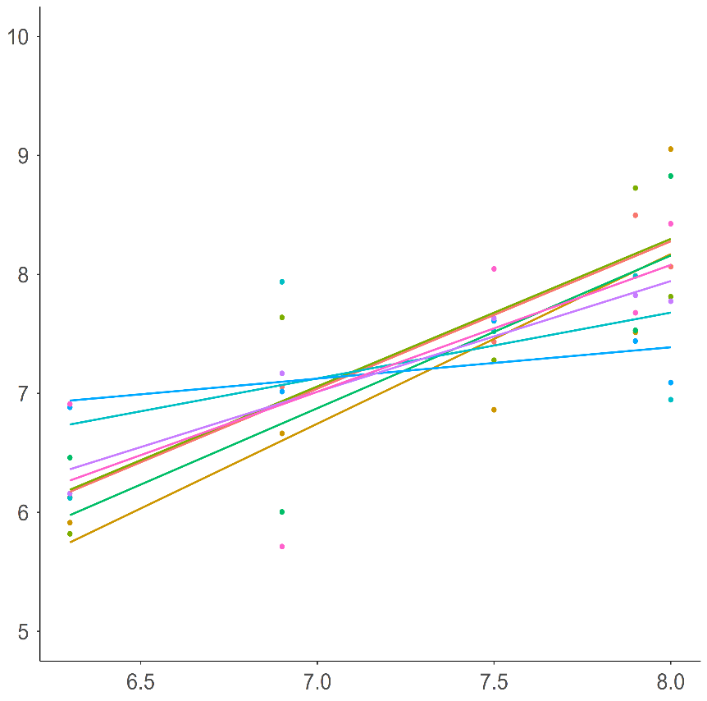
FINLAY-WILKINSION’S REGRESSION ON THE ENVIRONMENTAL MEAN
Slope = genotype-specific sensitivity
8 Genotypes
5 Locations
$$P=G+βE+ε$$
Genotype-specific measure of stability
Cause of GxE not explained
Captures only small fraction of the GxE interaction variance
Yield (tons/ha)
Environmental gradient (mean performance)
Environment (trial site)

Slide 10
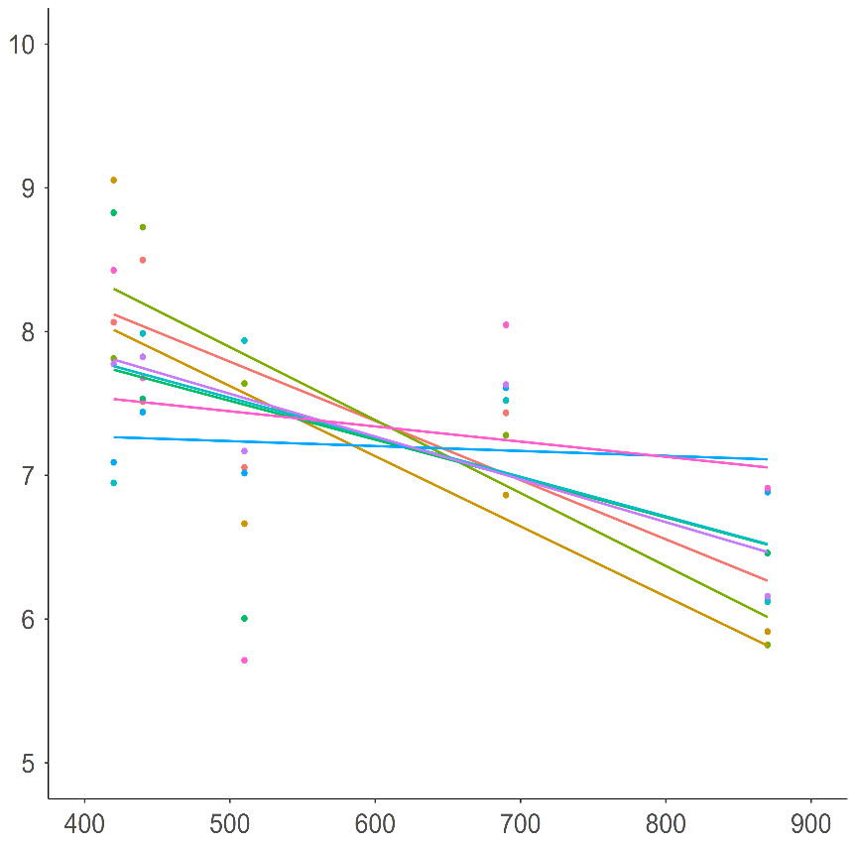
REGRESSION ON ENVIRONMENTAL COVARIATES
Slope = genotype-specific sensitivity
8 Genotypes
5 Locations
$$P=G+βE+ε$$
Genotype-specific easure of stability
Cause of GxE partially explained
Captures only small fraction of the GxE interaction variance
Yield (tons/ha)
Environment (trial site)
Seasonal rainfall (mm)

Slide 11
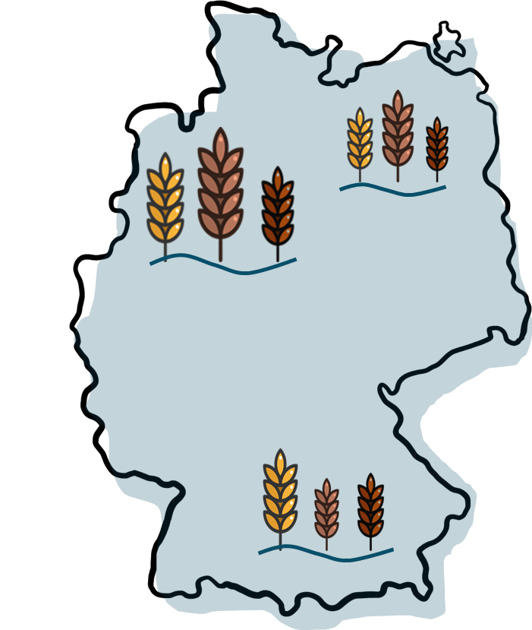
GxE INTERACTION – A LACK OF GENETIC CORRELATION
METs
Low GxE interaction between yield in E1 and yield in E2
 | E1 | E2 | E3
E1 | 1 | 0.85 | -0.47
E2 | 0.85 | 1 | -0.33
E3 | -0.47 | -0.33 | 1
E₂
E₁
E₃
High GxE interaction between
yield in E1 and yield in E3
yield in E2 and yield in E3

Slide 12
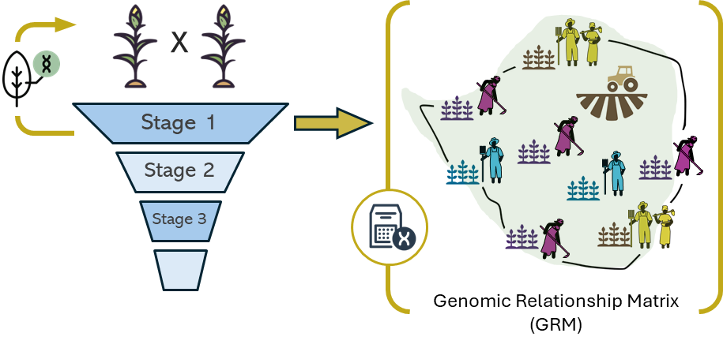
UNDERSTANDING THE TARGET POPULATION OF ENVIRONMENTS
… requires testing in the TPE

Slide 13
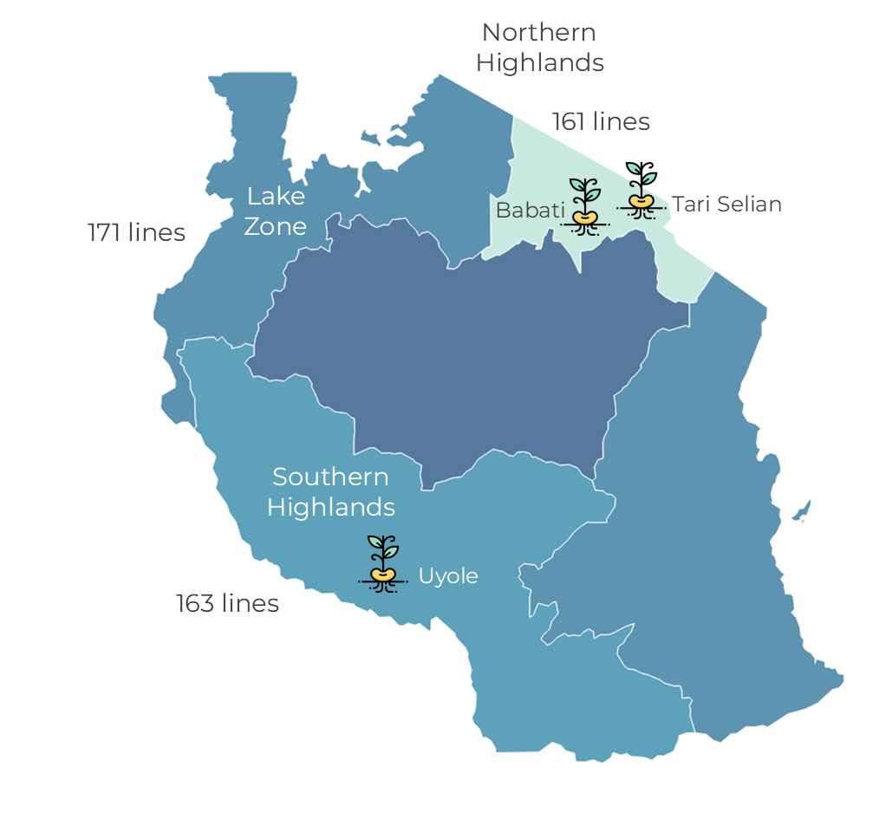
EARLY-STAGE ON-FARM SPARSE TESTING
419 breeding lines
1179 SNP markers
3 plots / farm on 309 farms
… to sample the TPE
On-Farm | Lines | Farms
Lake Zone | 171 | 103
Northern Highlands | 161 | 103
Southern Highlands | 163 | 103
On-Station | Lines | p-rep
Babati | 354 | 1.20
Tari Selian | 386 | 1.82
Uyole | 417 | 1.31

Slide 14
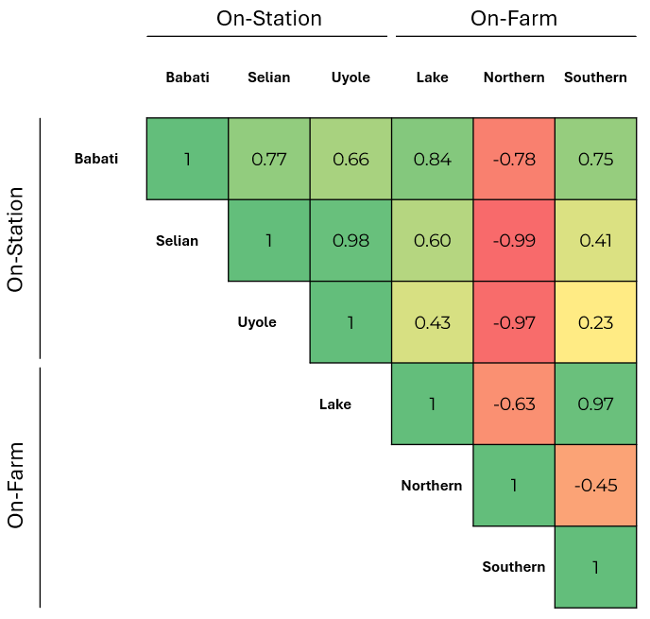
ALIGNING BREEDING EFFORTS WITH THE TPE
 | Repeatability (H²) | Genetic Correlation
On-Station | 0.72 | 0.37
On-Farm | 0.61

Slide 15
WHAT ELSE CAN WE DO?
… early-stage on-farm sparse testing is a lot of effort
Data is a prerequisite, not a suggestion
Clues to the bigger picture → define and test your hypothesis
On-farm verification trials (… but post-selection)
Regions where dominant varieties are currently grown (representative?)
Regional variety trial data (VCU – representative?)
Environmental information – key factors: management, altitude, climate … (complex!)
Early-stage on-farm trials with a genotype sample tested on a few representative farms
Your knowledge and experience
…

Slide 16
ON-STATION TRIALS ARE NOT THE TPE
… they should aim to simulate the TPE
The TPE represents the ground truth that breeding must target
One of yesterday’s comments:
“… find by regression what climate factors have an effect on yield at the station (i.e., possible TPE) and then look for places around the world that have the same climate conditions at the station” – very problematic!
The TPE defines your on-station testing conditions, not vice versa
Your Market Opportunities are not defined by the conditions you would like to breed for
GxE interaction is complex and not sufficiently explained by individual climate factors

Slide 17
Thank You! Questions and Discussion

