Slide 1
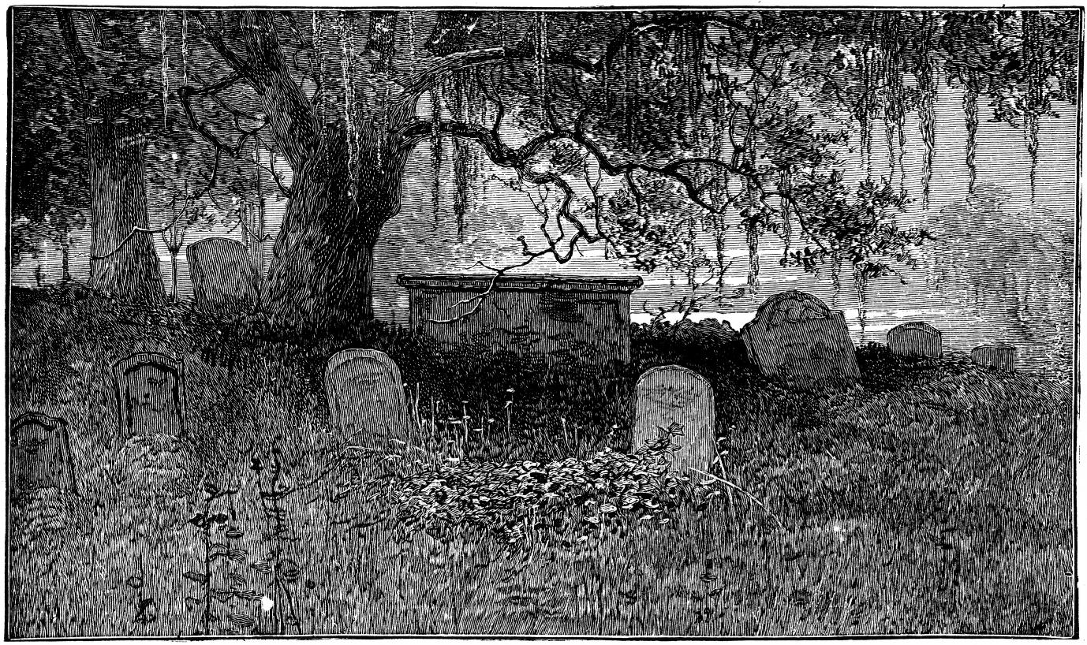
Ghosts of Sussex County (DE)
Dr. Carol A. Pollio
October 14, 2023 at 6 p.m.
Georgetown Train Station

Slide 2
Ghosts of Delaware
by Dr. Carol A. Pollio

Slide 3
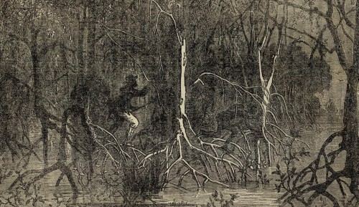
Ghosts of Delaware
by Dr. Carol A. Pollio

Slide 4

The
Ghosts of Sussex County
October 14, 2023 at 6 p.m.
Old Georgetown Train Station
A Presentation by
Dr. Carol A. Pollio

Slide 5
Ghosts of Delaware
Dr. Carol A. Pollio
October 24, 2018 at 7:00 p.m.
CAMP Rehoboth - Rehoboth Beach

