Slide 1

Analyzing Anxiety Measures in Learning Sensing Technologies within a Mixed Reality Environment
Mariam Tomori, Joshua Ofori, Jasmine Cobb, Duen Horng Chau, and Omobolanle Ogunseiju
Georgia Institute of Technology
ASC 2026 International Conference
62nd Annual Associated Schools of Construction International Conference
April 15th – 17th

Slide 2
Introduction & Background
Why study anxiety in MRLEs?
The Context: Mixed reality learning environments (MRLEs) support immersive, hands-on learning experiences that bridge digital and physical worlds. Sensing technologies, like drones, GPS, and laser scanners, are increasingly critical in modern construction.
The Gap: Anxiety can either facilitate or hinder learning, but this relationship remains significantly underexplored in construction education. Understanding this dynamic is essential for designing effective MRLEs. Anxiety Effects in MRLE Still Unclear
If Anxiety is Too Low: Insufficient arousal may reduce engagement
If Moderate: Optimal anxiety supports focused attention
Too High: Overwhelming anxiety impairs performance
Aim: This study examines how anxiety changes while students learn sensing technologies in a mixed reality learning environment, and whether those anxiety changes influence knowledge gain.

Slide 3
Research questions
RQ1: How does interaction with a Mixed Reality Learning Environment (MRLE) impact anxiety across different interaction conditions for learning sensing technologies?
RQ2: Does anxiety influence knowledge acquisition of sensing technologies in an MRLE?

Slide 4
Theoretical Lens: Attention Control Theory (ACT)
Anxiety reduces attentional control capacity, causing attention to shift from task-relevant cues to perceived threats or distractions. In MRLEs, unfamiliar interfaces, information overload, or sensory conflicts may reduce learning efficiency by consuming limited cognitive resources.
Low Anxiety
Better focus on task
High Anxiety
Distraction by threats
Reduced cognitive capacity
Enhanced working memory
Stronger learning outcomes
Weaker learning outcomes

Slide 5
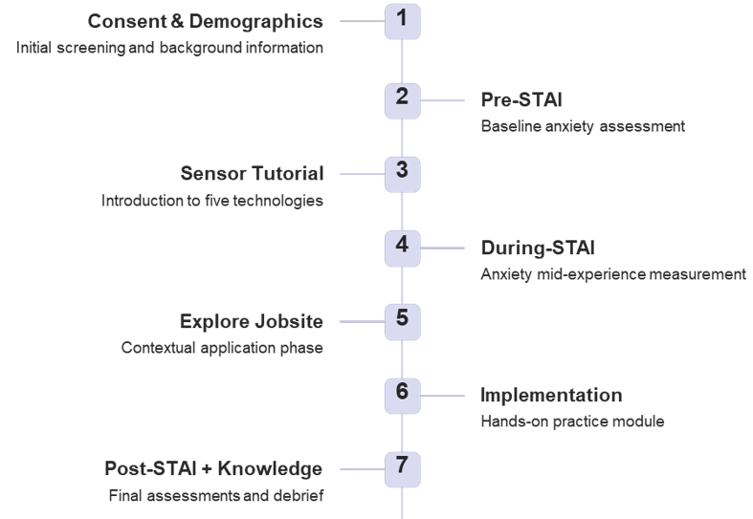

Methods: Data Collection and Analysis
Participants (N = 22) are construction-engineering students
Measures & Analysis: State-Trait Anxiety Inventory (STAI) administered before, during, and after MRLE exposure. Pre/post knowledge ratings for each of five sensing technologies on 5-point scales
Descriptive statistics (means, standard deviations)
Shapiro-Wilk test for normality
Friedman test for within-subject effects
Wilcoxon signed-rank tests
Spearman correlation
Tool: Mixed Reality Learning Environment, Built in Unity3D, Delivered through Microsoft HoloLens 2 with 3 Learning Scenes
What students learned: Five Sensing Technologies: Laser Scanner, Drone, RFID, IMU, GPS
Experimental Procedure

Slide 6
Results: Anxiety Measures/ Pattern
Figure 1. Anxiety and Emotional States Before MRLE Interactions
Figure 2. Anxiety and Emotional States During MRLE Interactions
Before MRLE: Students began with low baseline anxiety and
and high positive affect (calm, secure, confident).
During MRLE: Tension, strain, and dizziness increased while calmness and relaxation declined
After MRLE: Partial recovery occurred in most students
Key takeaway: Observed anxiety changes are interaction-induced, not preconditioned. MRLE introduced manageable, temporary anxiety rather than overwhelming distress.
Figure 3. Anxiety Measures After MRLE Interaction

Slide 7
Results: Knowledge Improved Across All Five Technologies
Significant learning gains were observed for all five sensing technologies, with strongest improvements where baseline knowledge was lowest. RFID and IMU showed particularly strong gains, likely reflecting their novelty to construction students.
Figure 4. Level of Knowledge Before and After Interacting with MRLE

Slide 8
Results: Anxiety-learning relationship
Some Anxiety Changes Were Linked to Lower Learning Gains
Negative Relationships: Increases in these states were associated with lower knowledge gains
Nervousness → RFID, IMU
Jitteriness → Laser, RFID, IMU
Confusion → Laser, GPS
Discomfort → Drones
Positive Relationships: Increases in these states were associated with better knowledge gains:
Self-confidence → Laser Scanner
Satisfaction → GPS
Table 1. Significant Correlations Between Changes in Anxiety Measures and Knowledge Gain (Spearman’s ρ)r
Anxiety Change (Δ) | Technology | ρ | p-value | Anxiety Change (Δ) | Technology | ρ | p-value
Δ self-confident | Laser Scanner | 0.427 | 0.048 | Δ nervous | IMU | −0.521 | 0.013
Δ confused | Laser Scanner | −0.431 | 0.045 | Δ jittery | IMU | −0.604 | 0.003
Δ jittery | Laser Scanner | −0.429 | 0.046 | Δ satisfied | GPS | 0.469 | 0.028
Δ nervous | RFID | −0.443 | 0.039 | Δ confused | GPS | −0.455 | 0.033
Δ jittery | RFID | −0.530 | 0.011 | Δ uncomfortable | Drones | −0.574 | 0.005
Interpretation: While overall anxiety remained moderate, specific negative states like nervousness, jitteriness, confusion, and discomfort reduced learning gains in particular modules. Conversely, confidence and satisfaction enhanced learning for some technologies.

Slide 9
Discussion
MRLE supported learning despite mild anxiety increases. Anxiety did not become extreme for most students. Moderate strain may accompany immersive engagement, but specific negative states can reduce gains in some modules.
Dizziness and discomfort should be minimized through optimized interface design and session pacing
Confusion and jitteriness may indicate cognitive overload requiring instructional adjustments
Limitations: Reliance on Self-reported anxiety measures. Lack of Objective Physiological validation (EEG, heart rate)
Future Research: Investigate Longitudinal adaptation effects, Thresholds of optimal anxiety, Integration of physiological data

Slide 10
Conclusion
Students entered MRLE with low anxiety
Anxiety rose temporarily during interaction
Most students adapted over time
Knowledge increased across all sensing technologies
MRLEs should be designed not only for learning performance, but also for emotional comfort.
Practical Implication
Gradual Onboarding: Start with simpler interactions
Short Breaks: Allow recovery periods
Visual Stability: Reduce motion sickness
Ergonomic Tuning: Optimize comfort
Clear Feedback: Guide user understanding
Adaptive Pacing: Adjust to individual comfort

