Slide 1

Insert Evaluation for High School Students’ Perceptions of Augmented Reality for STEM Education: A Three-Year Comparison (2023–2025)
Amani Qasrawi, Dr. Tulio Sulbaran, Dr. Sandeep Langar
The University of Texas at San Antonio
ASC 2026 International Conference
62nd Annual Associated Schools of Construction International Conference
April 15th – 17th

Slide 2

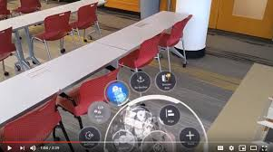

Introduction & Background
Augmented Reality (AR) has gained increasing attention in STEM education for its potential to enhance visualization, engagement, and experiential learning.
AR can transform abstract STEM concepts into tangible, interactive experiences, fostering deeper conceptual understanding and skill acquisition among students.
However, to capitalize on the potential of AR in education, its adoption and use must be understood

Slide 3

Research Aim, Scope, Objectives
The aim is to gain a deeper understanding of student AR adoption at a cohort level over the last three years. The specific objectives of this research are:
    1- Evaluate the challenges and difficulties these students faced while using AR; and
    2- Assess their interest in the long-term use of AR technologies.

Slide 4
Research Approach
Timeline
Summer Camp 2023
Summer Camp 2024
Summer Camp 2025
AR Experience - Trimble XR10
AR headset, 3D model, rotation/resize tools.
Survey & Data Collection
Post-Test Survey (Qualtrics)
Closed questions
Statistical Analysis
Chi-Square Test

Slide 5
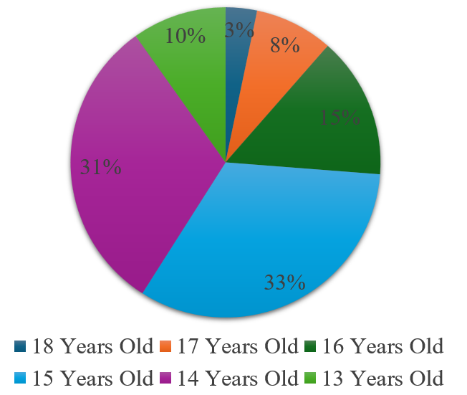
Results/Findings
Demographic Information
Figure 1. Age of Students

Slide 6
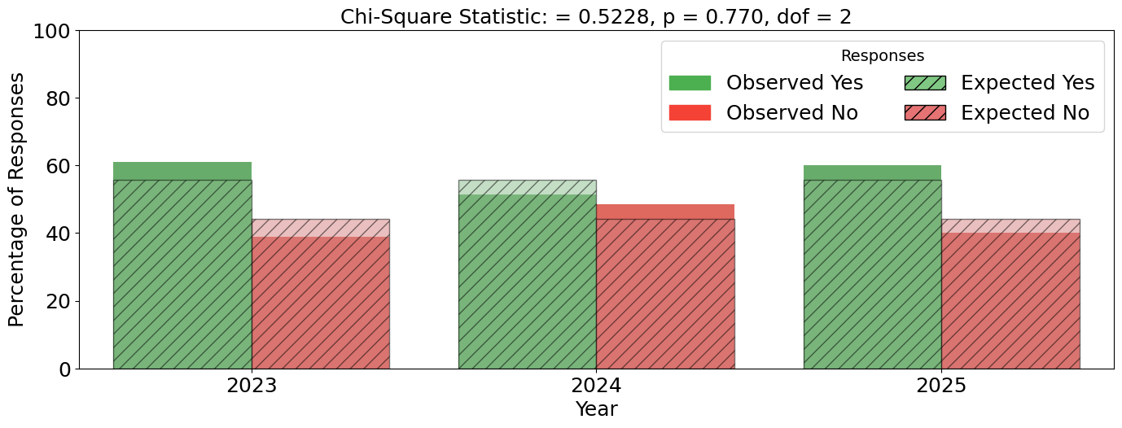
Results/Findings
Challenges/Difficulties with AR use
Figure 2. Challenges/Difficulties Responses

Slide 7
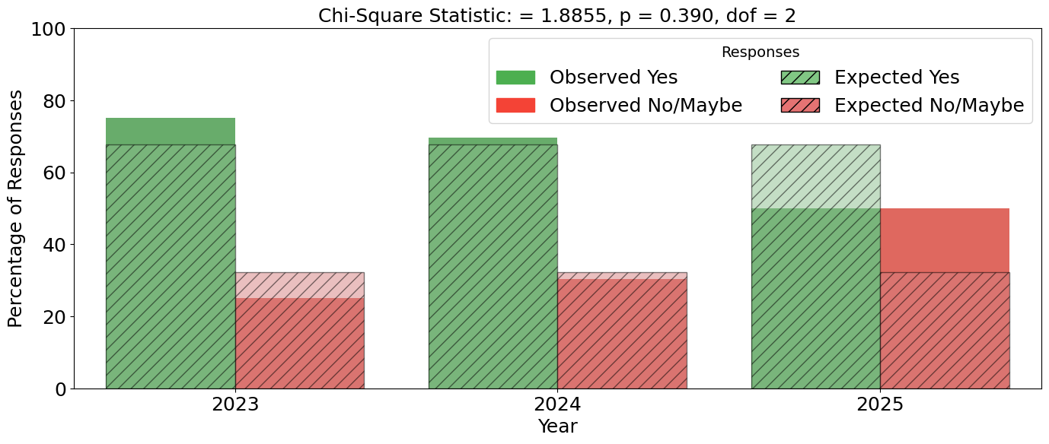
Results/Findings
Challenges/Difficulties with AR use
Figure 3. Interest in Extended Use Responses

Slide 8

Recommendations / Future Research
  Conduct longitudinal studies to track learning gains over multiple sessions.
  Compare different training levels, exposure durations, or AR task complexity.
  Examine specific AR challenges (navigation, model manipulation, element selection, measurement accuracy).

Slide 9
Questions???

