Slide 1

A Royal Review of Soft Skills in the AI Era
Andrew Barnes, PhD
University of North Florida
ASC 2026 International Conference
62nd Annual Associated Schools of Construction International Conference
April 15th – 17th
Notes:
Hello, It's great to see everyone. I’m Dr. Drew Barnes, Assistant Professor of Construction Management at the University of North Florida. Before I get started, I would like to say thank you for attending this session. The title of my paper is A Royal Review of Soft Skills in the AI Era. It reports the results of a three-phase futures workshop held at the Royal Institute of Chartered Surveyors (RICS) in London, England in the fall of 2025. Participants of the workshop were asked to provide their insights about the lack of soft skills in the current “AI” generation of CM students and to provide recommendations on how to correct it.

Slide 2
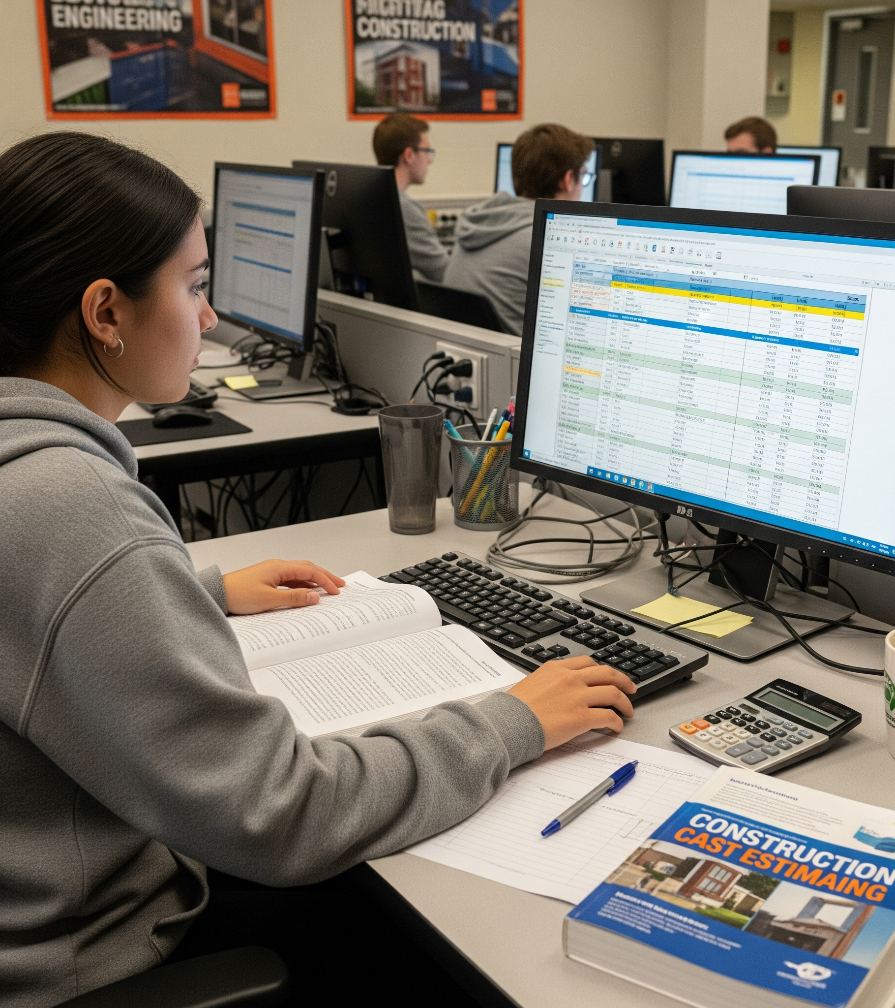

Hard Skills
project management, scheduling, cost and material estimating, budgeting, purchasing and procurement, permitting, logistics, quality control, safety
Soft Skills
communication, teamwork, leadership, negotiation, critical thinking, planning, integrity, conflict resolution, resilience, decisiveness, empathy, creativity, reliability, professionalism
Notes:
Hard skills and soft skills are both critical for the future of the construction industry, as they have been in the past.
HARD SKILLS, in a construction management context, are the core, technical competencies that college or university students should learn in school to help them manage construction companies.
SOFT SKILS, in a construction management context, are the interpersonal and communication skills that college or university students must develop to help them manage construction companies.
Just like the rest of the professional world, soft skills are in decline in construction management. What are the causes of this decline? I found two notable theories (Well, three if you include that the current average screen time for teenagers in the USA is 7.5 to nearly 9 hours, excluding schoolwork. Social media alone accounts for about 5 of those hours in front of a screen. But other than that, two key theories are).
First, the technological complexity of the modern construction landscape. The rapid technological advancements in the construction industry over the past half-century have shifted the focus away from the soft, interpersonal domain to the hard, technical domain.
Second, which is connected to the first, is that educational institutions sometimes de-emphasize or altogether ignore teaching soft skills, instead, prioritizing hard skills in service to the modern construction industry.
This “soft skills gap” has become so wide that employers now prioritize soft, interpersonal and leadership skills over hard, technical skills in their hiring.
Talking is now considered more valuable than typing or tapping. This is true when looking at the literature, but you can test this assertion anecdotally with almost any company looking to hire by just talking to them.
So, what is to be done with this current trajectory? As technology and AI continue to advance, can symmetry between hard skills and soft skills be achieved for future generations of CM professionals? If so, how?
Introduction & Background
Use this slide to introduce what influenced the study and any background information, identified problem/current research gaps.
You can use bullet points, tables or figures.
Please do not exceed one slide.
Sources:
https://www.aacap.org/AACAP/Families_and_Youth/Facts_for_Families/FFF-Guide/Children-And-Watching-TV-054.aspx

Slide 3

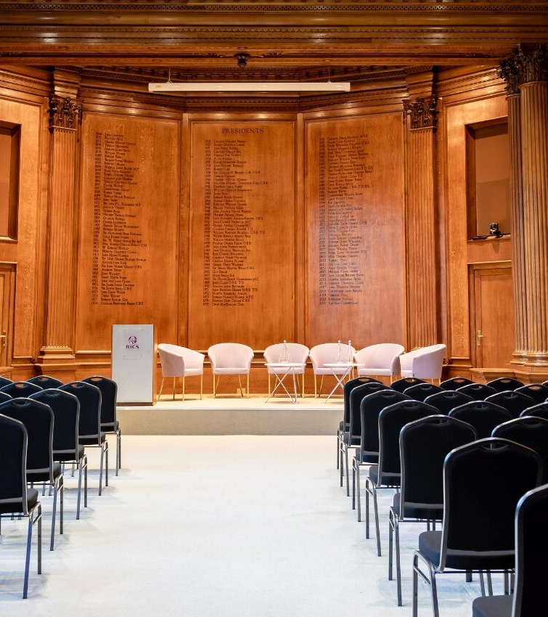
Future Facing Learning: Digital, AI and Skills
Innovation in Built Environment Education (IBEE)
Council of the Heads of the Built Environment (CHOBE)
Royal Institute of Chartered Surveyors (RICS)
Notes:
Last year in September, I held an exploratory workshop session at the Royal Institute of Chartered Surveyors (RICS) to find out new ways CM teachers could help their students balance the tension between
(a) developing soft, interpersonal and communication skills, and
(b) the technology-saturated learning environment that can conflict with students engaging with other humans, particularly in the AI era.
Research Aim, Scope, Objectives
Use this slide to outline what the aim, objectives and/or scope of the research/study/endeavor was.
Use bullet points.
Please do not exceed one slide.

Slide 4

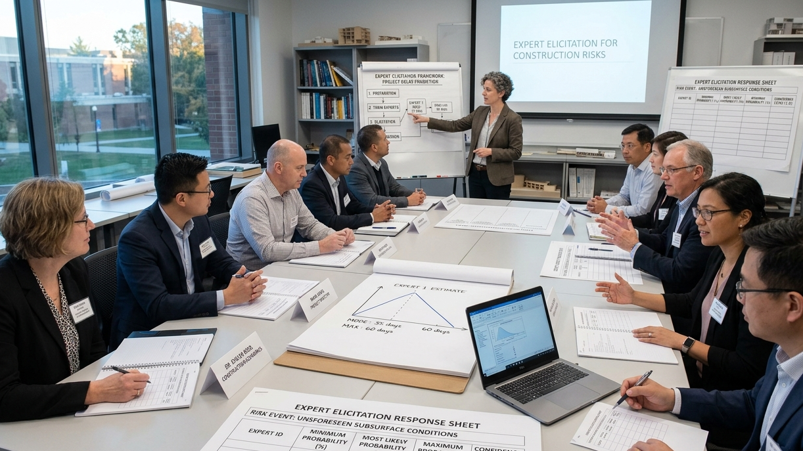
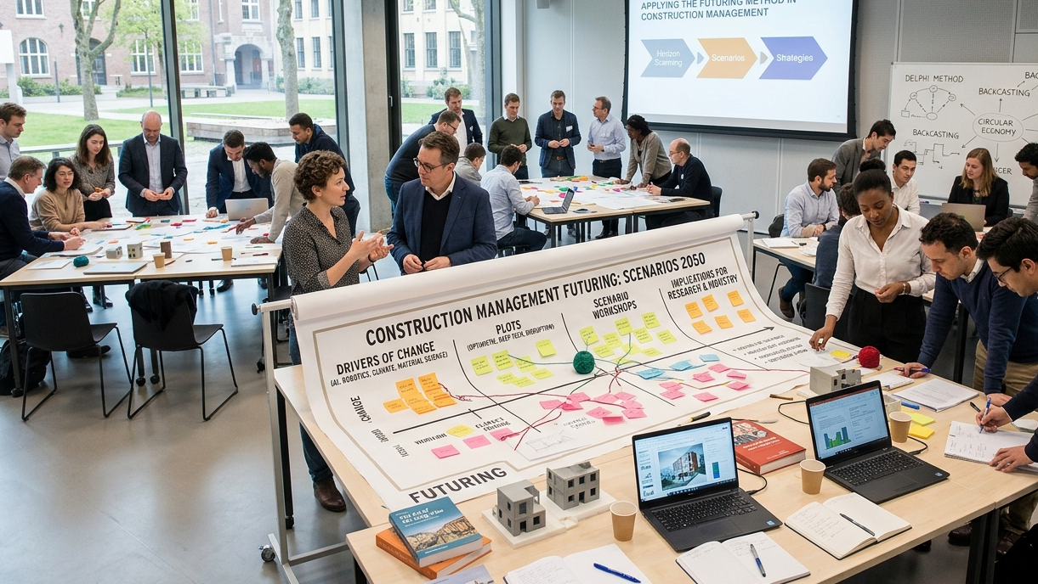
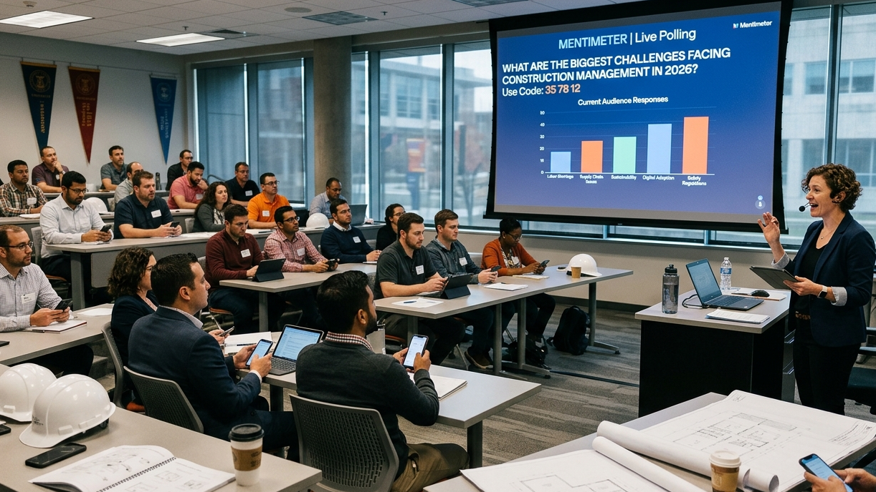
Research Approach
Notes:
The methods I used at the workshop were expert elicitation and futuring.
Expert elicitation is a way to gather informed opinions from knowledgeable and competent specialists when data on a particular subject is scarce and limited.
FUTURING is a planning and strategy method in which experts are tasked with imagining a variety of potential outcomes, or “futures”, on a specific topic depending on actions taken in the present. Futuring typically has three phases: critiquing, visioning, and implementation.
Workshop participants were primarily senior academic leadership, representing 16 MAJOR UNIVERSITIES in the United Kingdom (England, Scotland, and Northern Ireland) and the United States. Their titles consisted of
eight CM program leaders
six senior lecturers
two assistant professors
one associate dean
one associate professor
The remaining participants were industry professionals, including
two construction software representatives,
a construction education manager, and
an executive director.
Their median work experience was 25 years. The combined total work experience of the group was 544 years. The duration of the workshop was one hour.
After an introduction, overview, definitions, and short discussion on the topic of AI, participants were asked ten Likert-style and open-ended questions about their opinions on soft skills and technology.
Data collection was facilitated by MENTIMETER, a popular online platform for creating and delivering interactive presentations.
Data analysis was conducted using inductive thematic coding for open-ended questions to identify any meaningful trends in responses from participants.
Descriptive statistics were used to evaluate responses to the questions.
Research Approach
Use this slide to present the approach used to execute the project.
You can use bullet points, diagram, or a combination of the two.
Please do not exceed one slide.

Slide 5
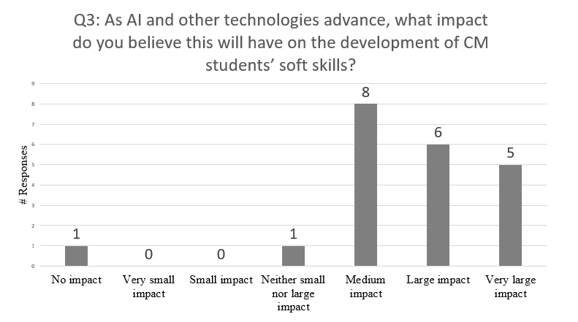
Notes:
Now, for the results. For the sake of time, I’m only going to focus on the questions with the most interesting findings.
Question 1 asked participants to rank their level of agreement or disagreement with the statement “AI and other technologies have had little impact on the development of CM students’ soft skills.”
The average response was 3.2 out of 7, indicating a slight overall disagreement with the statement. Dividing the responses into agree and disagree CATEGORIES, only six participants (27% of them) “strongly agreed”, “agreed”, or “mostly agreed” with the statement. Nearly two-thirds of the participants (64%, n=14) “strongly disagreed”, “disagreed”, or “mostly disagreed”. Comparing the POLES of the Likert scale, four participants strongly disagreed with the statement, compared to zero who strongly agreed with the statement.
QUESTION 3 asked, “As AI and other technologies advance, what impact do you believe this will have on the development of CM students’ soft skills?”.
The average score across all responses was 5.5 out of 7, indicating a large majority of the participants believed AI would have an impact on CM students' soft skills in the future. Over half (52%) believed it would have either a “large” or “very large impact”. Only one person believed it would have a “small impact”, a “very small impact”, or “no impact”.
Results 1
Outline the key results and main findings of the project.
You can use bullet points, tables and/or figures.
Use one slide for results & findings.

Slide 6
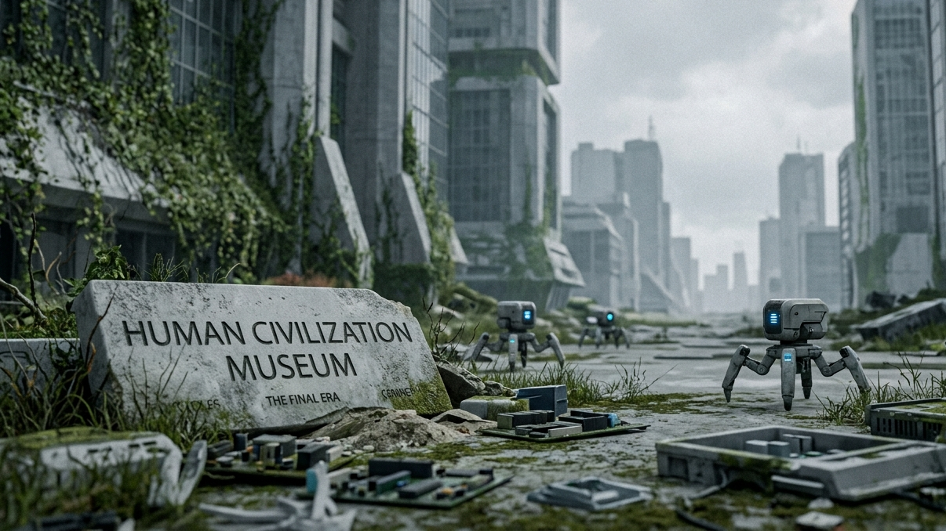
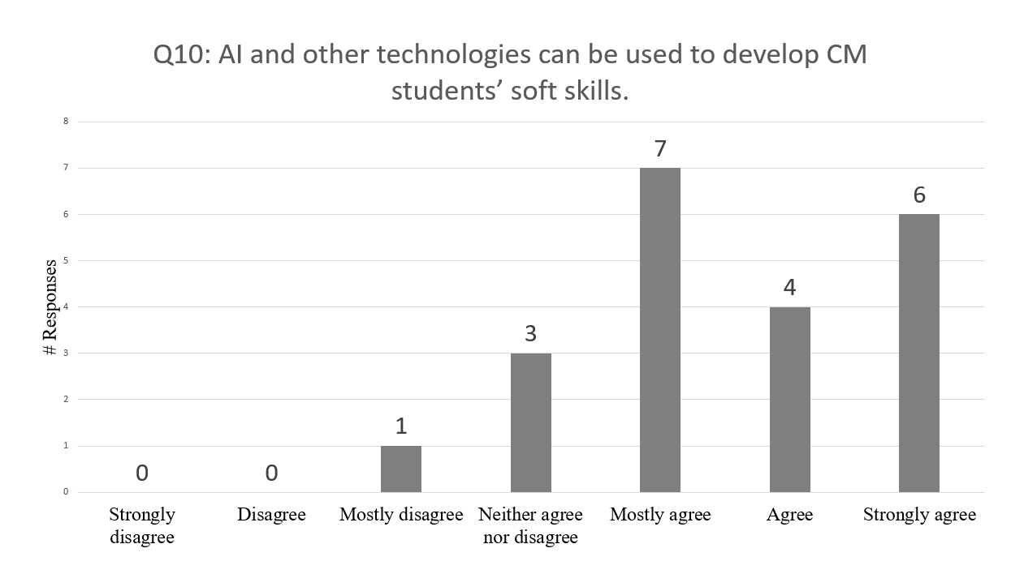
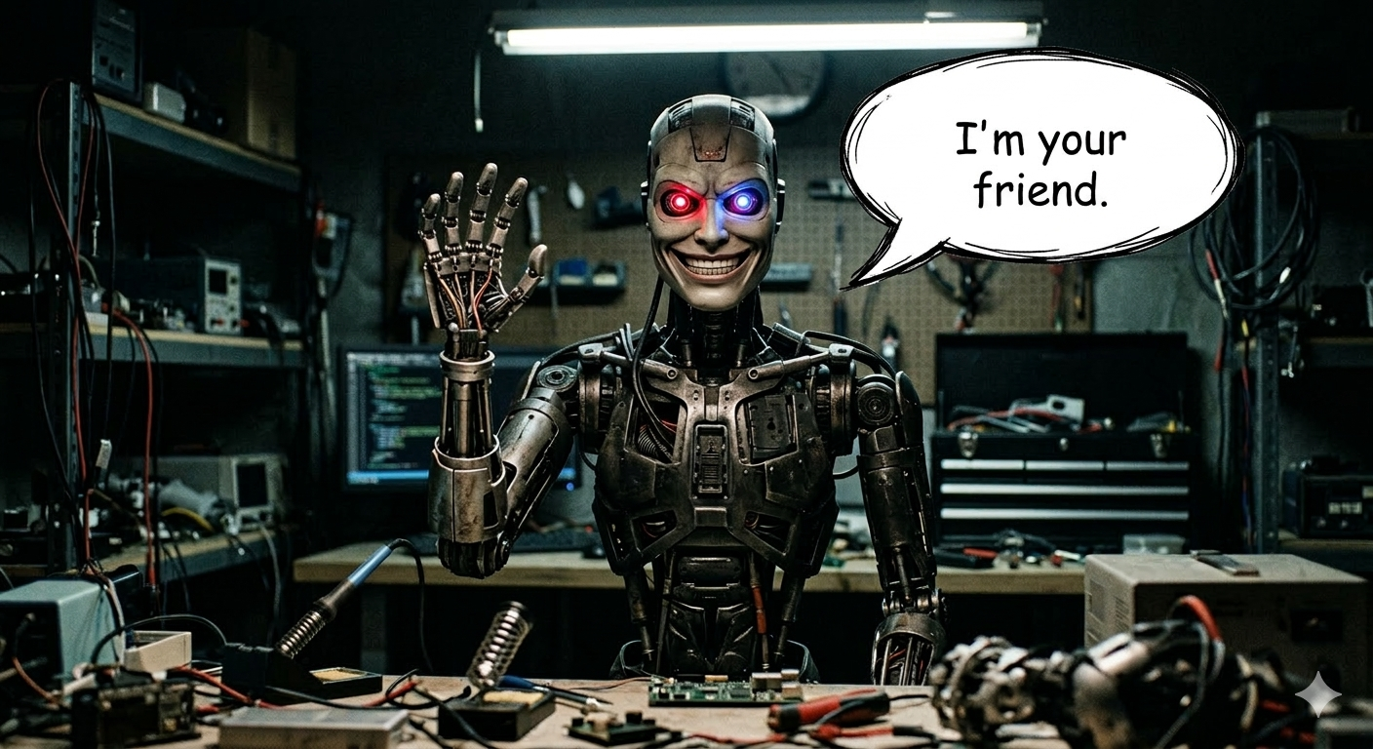
“AI will be the most important tool a student will have to refer to, so they have to develop their literacy in using, communicating, and justifying its reasoning.”
“You can imagine some soft skills in the future being improved by AI. Imagine a real-time AI agent training a person in public speaking, presentations, as an example
“AI will be [able to] develop its own emotional intelligence so prompts and engagement with a bot will become as crucial as human-to-human interaction
“AI might play a role in changing students' habits when communicating or interacting; however, soft skills can be learnt alongside AI.”
“Use of AI for development of s[oft] s[kills].”
“Use AI as another ‘FRIEND’”
Q6: In the era of AI, what do you think will happen if CM students fail to adequately develop their soft skills?
“[CM students will] achieve less, be less effective [in] engaging with and leading people. [They will] have poorer professional and personal outcomes.”
“End of the human species as we know it in the longer term.”
Notes:
Question 6 asked, “In the era of AI, what do you think will happen if CM students fail to adequately develop their soft skills?”
By far the most recurrent theme in the responses was career stagnation and joblessness (from 17 participants). One of these respondents said, “[CM STUDENTS WILL] achieve less, be less effective [in] engaging with, and leading people. [They will] have poorer professional and personal outcomes.” Another pessimistic response said, “END OF HUMAN species as we know it in the longer term.”
The final question, QUESTION 10, asked respondents to rank their level of agreement or disagreement with the statement, “AI and other technologies can be used to develop CM students’ soft skills.”
The average score was 5.5 out 7, indicating a large majority of participants believed AI could be used to help CM students develop their AI skills. Dividing the data into “agree” and “disagree” categories, 17 of the respondents (81%) “mostly agreed”, “agreed”, or “strongly agreed” with the statement, while only one of the respondents (5%) disagreed with the statement. The remaining three respondents (14%) neither agreed nor disagreed.
A recurrent theme throughout nearly all workshop questions was the potential of AI to have a positive impact on soft skills.
Here are some EXAMPLES: (*****PAUSE FOR 10 SECONDS TO LET THE AUDIENCE READ*****)
“AI will be the most important tool a student will have to refer to, so they have to develop their literacy in using, communicating, and justifying its reasoning.”
“You can imagine some soft skills in the future being improved by AI. Imagine a real-time AI agent training a person in public speaking, presentations, as an example
“AI will be [able to] develop its own emotional intelligence so prompts and engagement with a bot will become as crucial as human-to-human interaction
“AI might play a role in changing students' habits when communicating or interacting; however, soft skills can be learnt alongside AI.”
“Use of AI for development of s[oft] s[kills].”
“Use AI as another ‘FRIEND’”
Results 2
Presentations are to be done in person at the time scheduled on the conference website (forthcoming). At least one author must present the paper. Sessions will include a 10-minute presentation and a 5-minute Q&A.
Presentations are restricted to the 9 slides in this template deck including the cover slide & this slide.
Please follow the instructions provided on each slide.
You may use this slide as necessary anywhere within the presentation if needing extra slide space for any of the provided sections.
If you don’t need this extra slide, then just delete it from the presentation.
You can use bullet points, tables, figures, images etc.

Slide 7

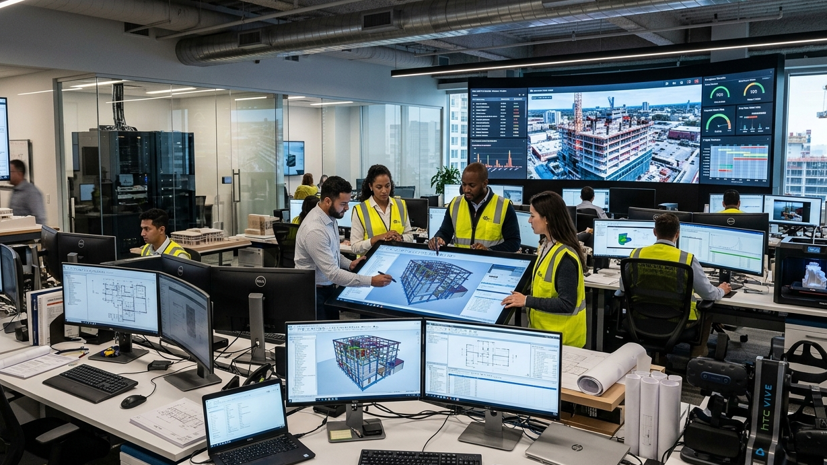
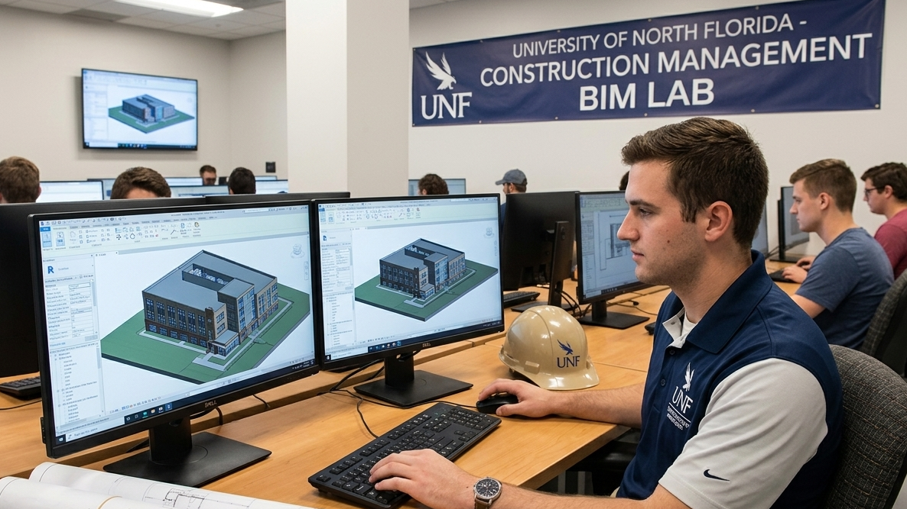
Notes:
Moving on to the discussion,
There was some support from the workshop for the theory that the technological complexity of the modern construction landscape is contributing to a lack of soft skills.
I think it would be strange to disagree.
THERE WAS ALSO support for the theory that educational institutions bear some responsibility for de-emphasizing or ignoring soft skills.
One possible explanation for this result is that soft skills are sometimes considered complementary and subsequent to hard skills, leading CM teachers to believe that learning hard, technical skills should precede soft skills, reflective of a typical CM career path in which entry-level jobs emphasizing materials, schedules, and software come first and only later will the responsibilities of managing people be a central part of their scope.
THE MOST INTERESTING result of the workshop was the disagreement between workshop participants about whether AI is any different from previous technologies.
A large portion of the respondents believed that AI could partner with students to help them develop certain soft skills.
A separate faction of respondents dissented from this view, doubting that AI has, or ever could have, the capacity to nurture skills involving human connections.
Discussion, Conclusions, Recommendations (1)
Use this slide to outline your main discussion points, conclusions and recommendations.
Use bullet points.
You may use a maximum of two slides for this section.

Slide 8
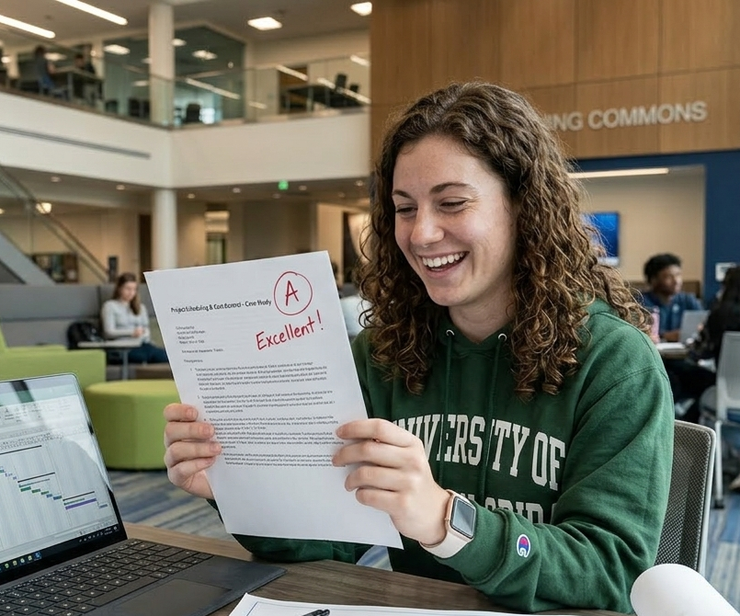

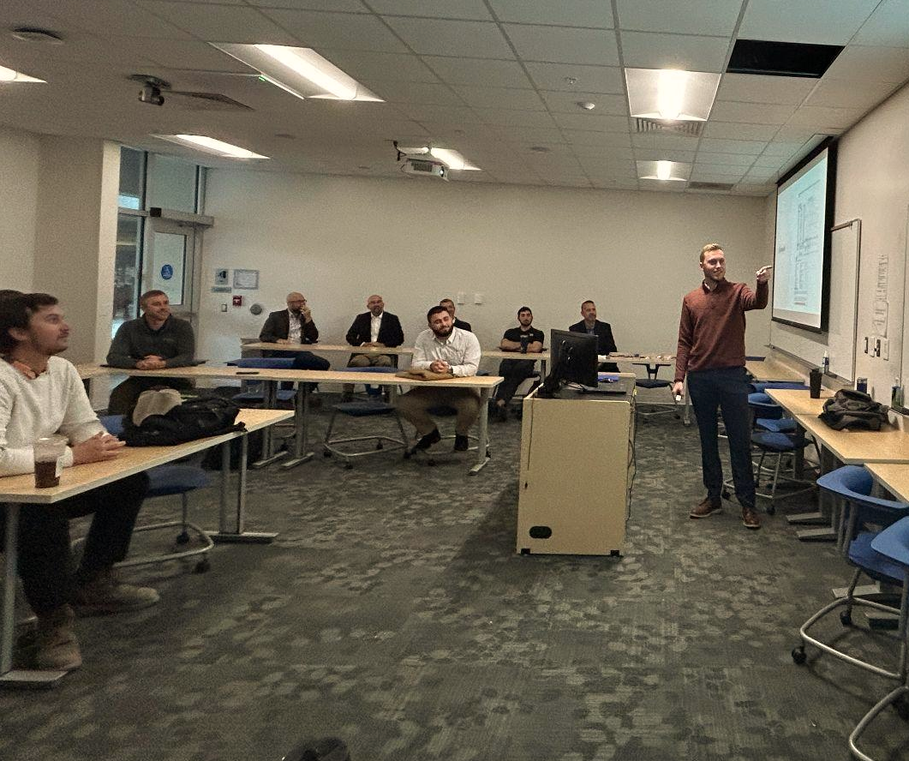

Be together when you’re together.
Focus on results.
Forward may be backward.
“And”, not “Either”.
Notes:
Considering the findings, I have four recommendations.
FIRST: Be together when you’re together. The velocity of technological change in the school and work environments will accelerate with AI. As such, teaching tools and methods will be widely advertised and hyped. In this excitement, teachers should not miss the unique classroom opportunities to teach soft skills themselves when physically gathered with their students.
SECOND: Focus on results. One solution endorsed throughout the workshop for the dearth of soft skills in CM students was AI. Some of these AI technologies may be developed into tools and pedagogies that help CM students develop their soft skills. Instructors should be open to exploring these capabilities and trying out new innovations that might benefit their students. They should also remain vigilant for fashionable and vacuous technological products and services that overstate AI’s abilities and fail to provide meaningful results for their students.
THIRD: Forward may be backward. Removing certain technologies may be more beneficial to students than adding them. Technologically regressive pedagogies and learning environments—old-fashioned, discussion-based, laptop- and phone-free classrooms—may be one of the most accessible and reliable ways for CM students to develop their soft skills with minimal effort and intervention by their teachers. So, when selecting technologies, maybe paper, pencil, and conversations are the most advanced technologies that you need to adopt.
FOURTH: “And”, not “Either” hard skills are sometimes considered precursory to soft skills, causing teachers to delay or avoid teaching them to their students. Soft skills need to be taught concurrently with hard skills in every course throughout post-secondary education to provide CM students with all the skills they need to succeed in the workforce.
Discussion, Conclusions, Recommendations (2)
Use this slide to conclude your main discussion points, conclusions and recommendations.
Use bullet points.
If you don’t need this slide for this section then you may use it in another area of the presentation if needed.

Slide 9


Thank you. Questions?
Notes:
Thank you.
Use this as your ending slide to start the Q&A portion of the presentation.

Slide 10

















