Slide 1

Bridging the Gap: Barriers to Effective Collaboration Between Technology Startups and Construction Firms
Busra Yucel and Salman Azhar, PhD
Auburn University
ASC 2026 International Conference
62nd Annual Associated Schools of Construction International Conference
April 15th – 17th

Slide 2
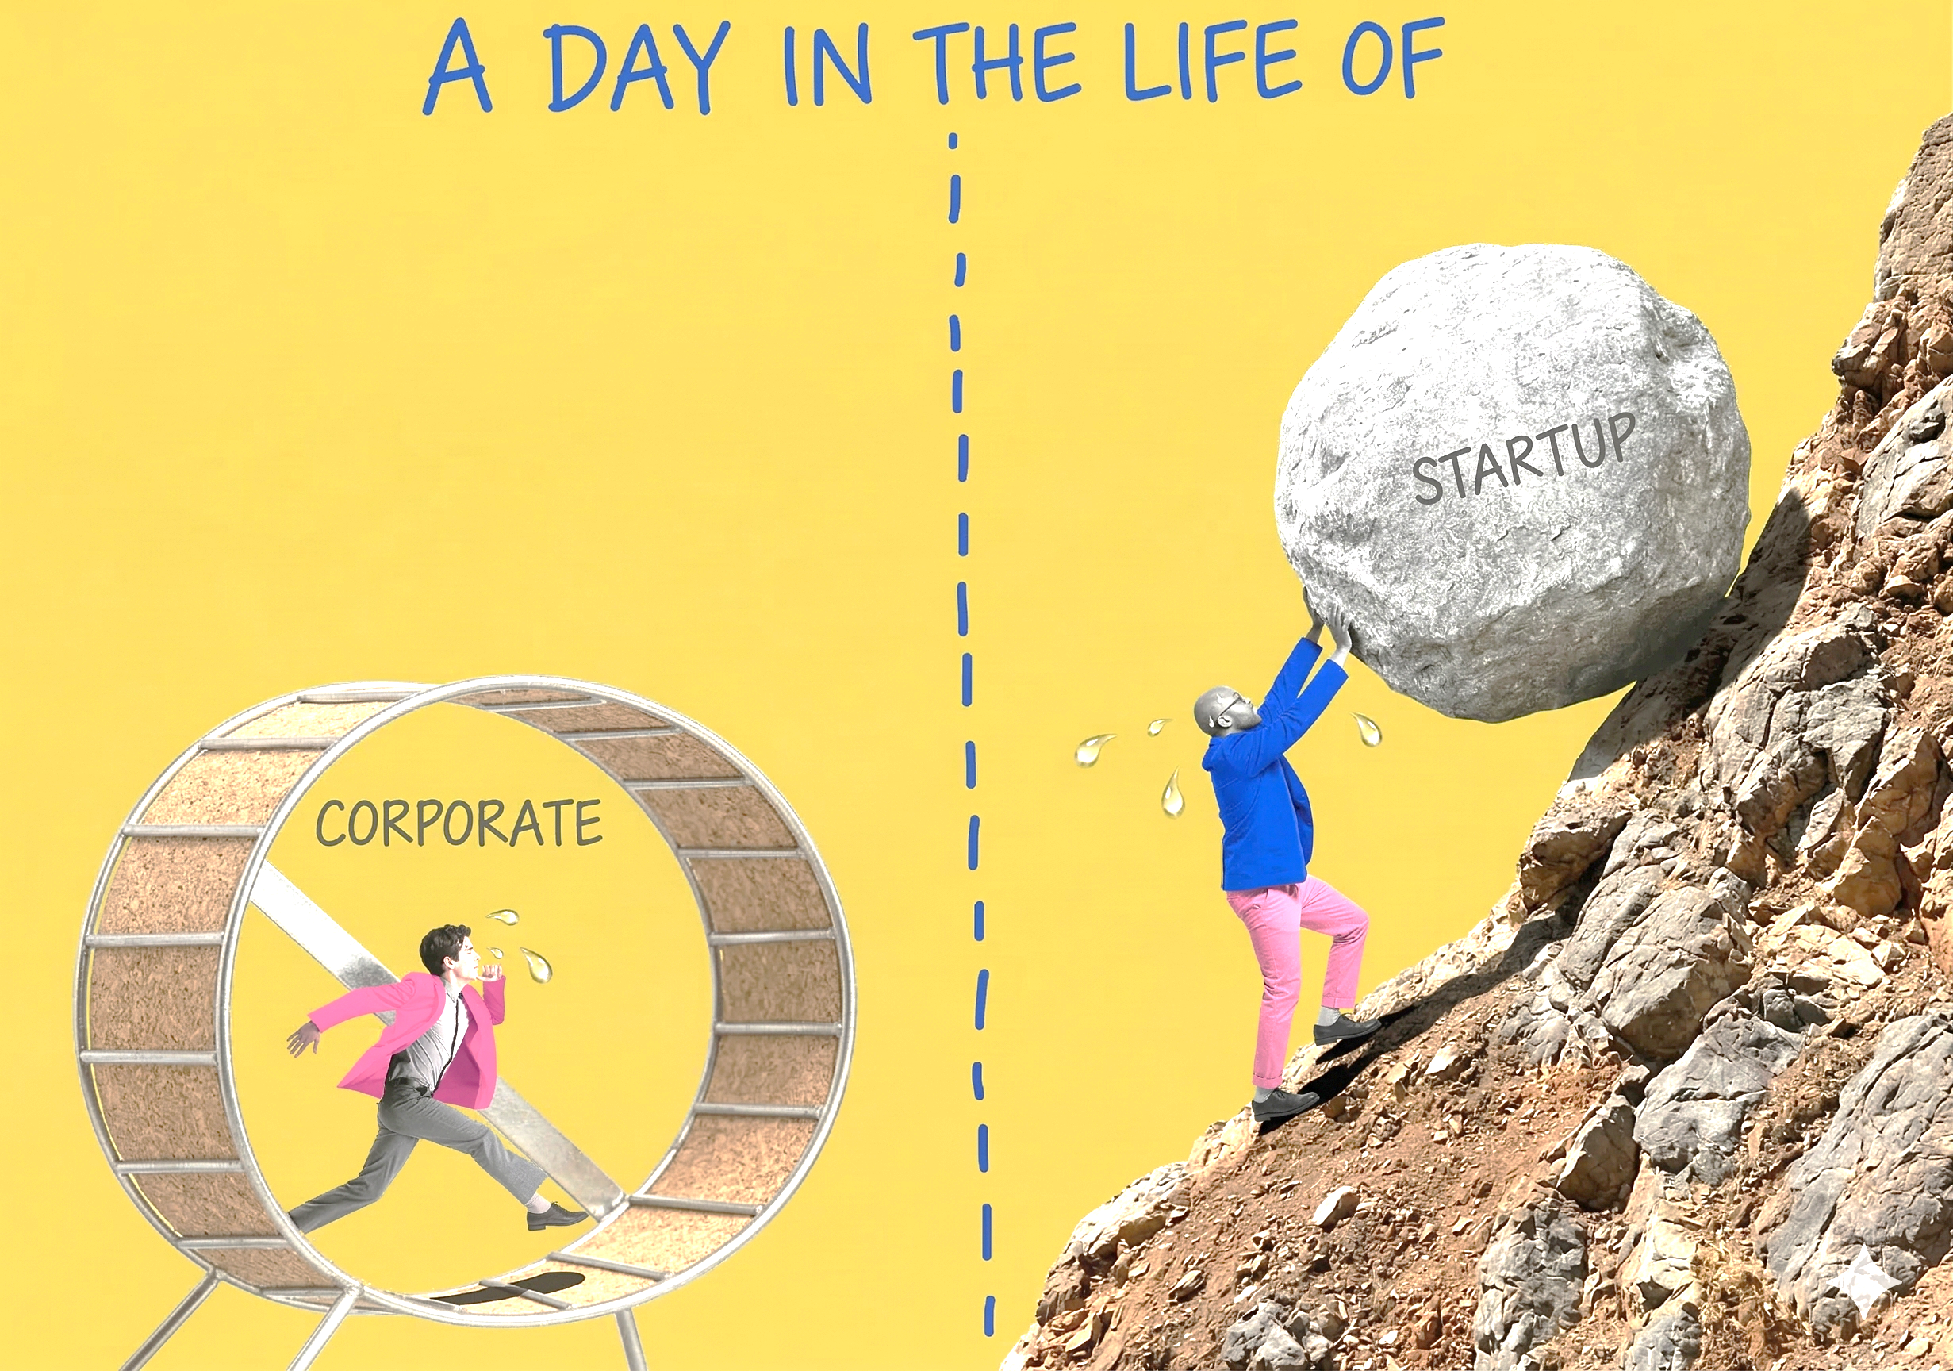
Introduction & Background
Corporate–startup collaborations facilitate technology adoption and industry-wide innovation (Bertin & Mavoori, 2024)
They strengthen collaborative ecosystems and align firms around shared goals (Zhang & Chen, 2021) and integrate diverse knowledge bases across organizations (Nissen et al., 2014)
However, the strategic approaches and barriers shaping these partnerships remain underexplored in construction management research.

Slide 3
Research Aim, Scope, Objectives
To reveal how large and mid-sized U.S. construction firms collaborate with startups to drive innovation
Evaluate factors that affect these partnerships from the perspective of established construction firms.
To identify the common partnership modes and barriers to these engagements.
Scope: Mid-to-Large US companies

Slide 4
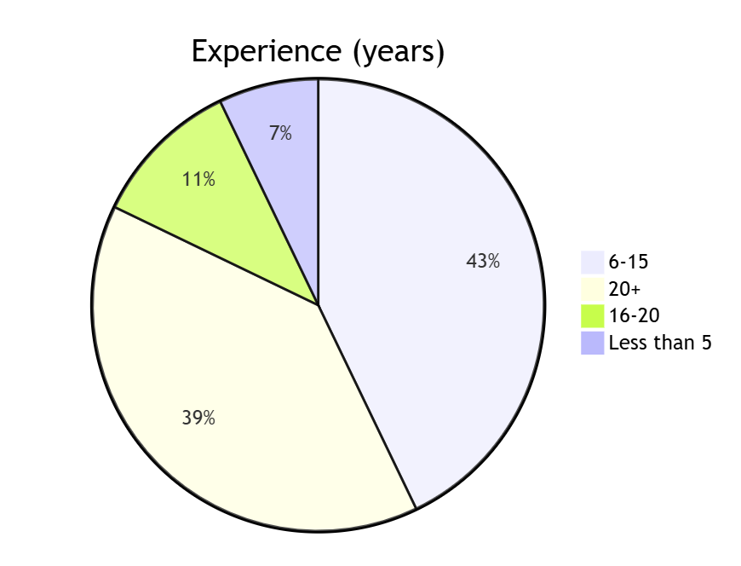
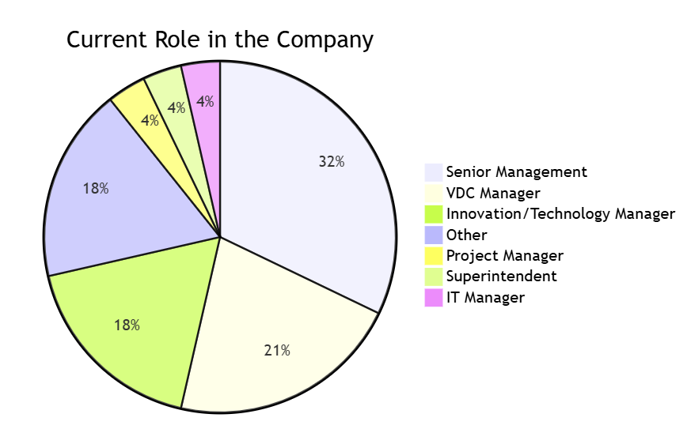
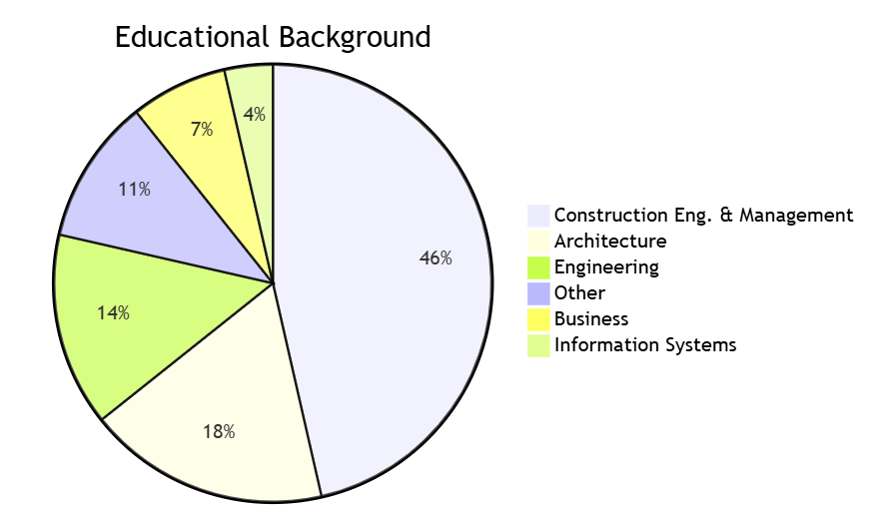
Research Approach
Online survey designed as a mixed-methods tool
Questions developed through three industry expert interviews, a literature review, and academic feedback.

Slide 5
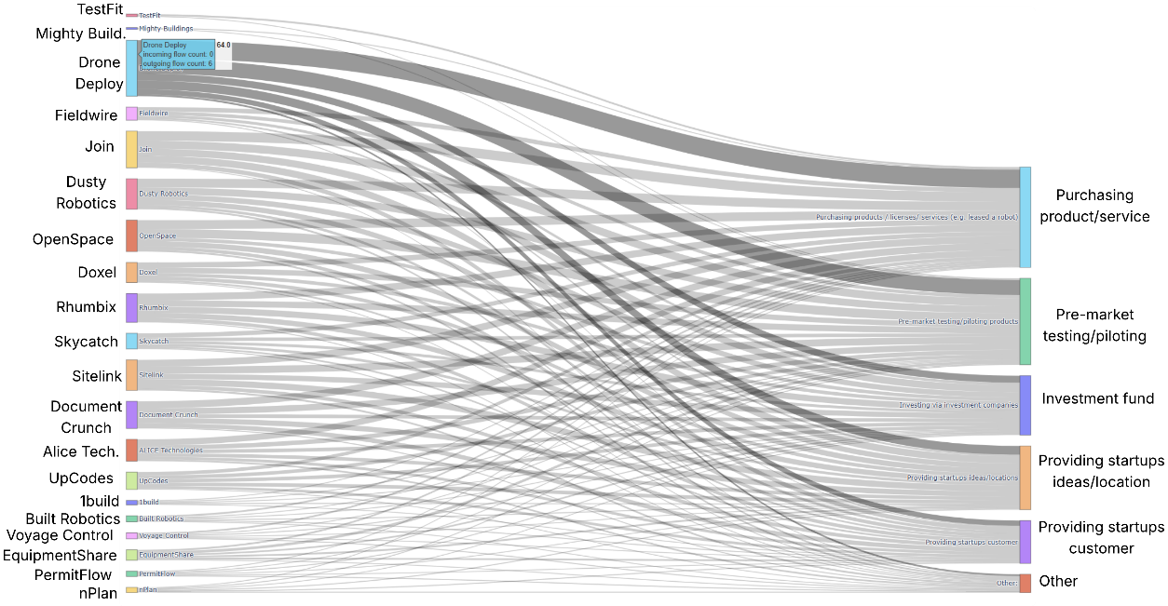
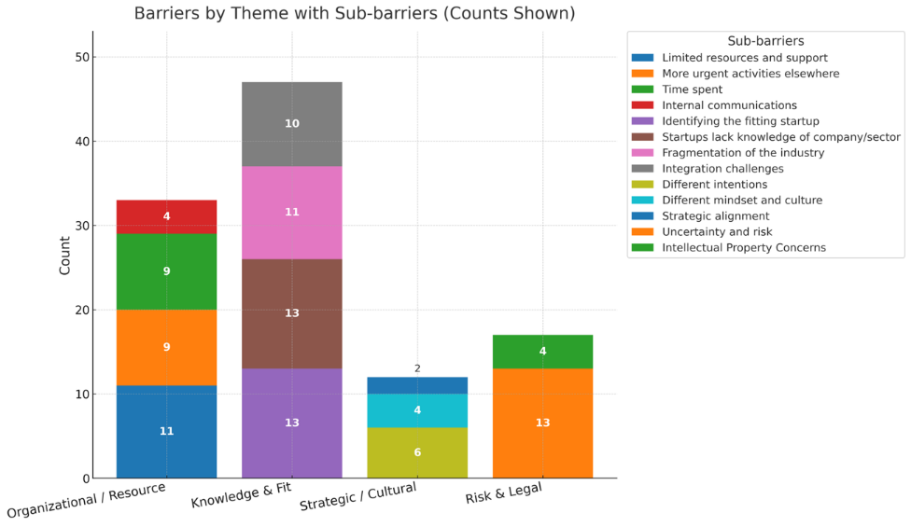
Results/Findings

Slide 6
Discussion, Conclusions, Recommendations (1)
Knowledge & Fit (Most Critical): Corporations struggle to identify suitable startups.
Startups often lack sector-specific knowledge, a major issue in fragmented industries like construction.
Intellectual Property (IP) vs. Operational Risk: Unlike digital/tech sectors where IP is a core asset, IP ownership is a low concern
Operational and financial risks (e.g., startup failure rates) take precedence over legal IP concerns
Strategic & Cultural Misalignment: Requires intentional efforts to build trust and align long-term visions.

Slide 7
Discussion, Conclusions, Recommendations (2)
The Catalyst: Startups are a vital mechanism for driving digitalization, enhancing productivity, and solving project delivery inefficiencies.
The "Co-Innovator" Gap: Persistent barriers (knowledge gaps, lack of readiness, cultural friction) keep construction firms as cautious adopters rather than true co-innovators.
Study Contributions: Reconceptualizes corporate-startup friction into a construction-specific diagnostic framework, isolating the four core barrier clusters that stall industry innovation.
Limitations: Sample size, cross-sectional data, and self-reporting biases, paving the way for future mixed-method research.

Slide 8
Discussion, Conclusions, Recommendations (3)
Institutionalize Learning & Evaluation: Move beyond isolated pilot projects by creating transparent, structured evaluation frameworks.
Enhance Mutual Fit: Prioritize open communication and sector-specific knowledge sharing during the selection phase.
Develop Organizational Readiness: Commit dedicated resources and secure leadership support.
Build the internal integration capacity required to scale pilots into long-term strategies.
Foster Co-Learning Mechanisms: Shift the goal from "eliminating all risk" to creating structured environments for adaptation, balancing agility with strategic control.

Slide 9

Thanks for Listening! Q&A

