Slide 1

Leveraging Digital Games for Construction and Engineering Education: Development of a Beam Design Learning Tool
Busra Yucel¹, Alper Turgut², Salman Azhar¹, and Jose Henriques²
¹Auburn University, AL, USA
² Hasselt University, Belgium
ASC 2026 International Conference
62nd Annual Associated Schools of Construction International Conference
April 15th – 17th

Slide 2
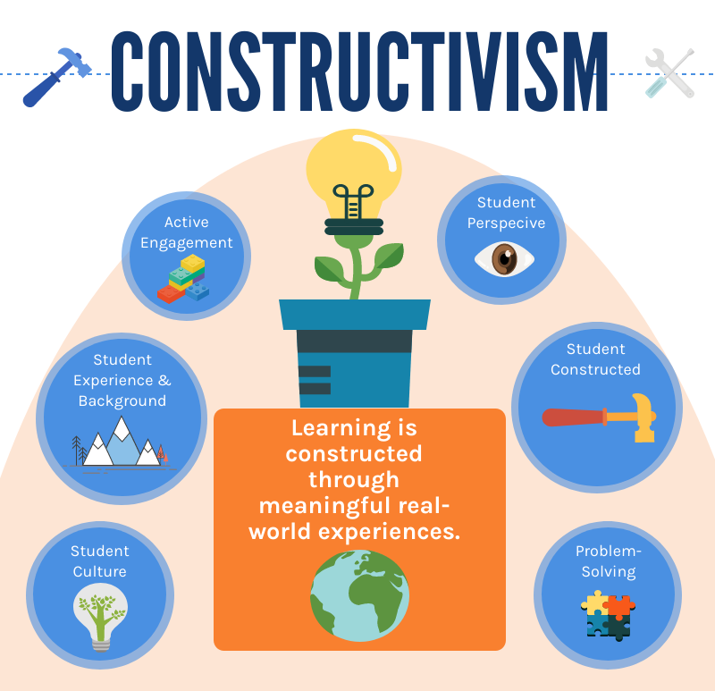

Introduction & Background
The Gen Z‘s attention span is only 8 seconds
3D-lacking teaching in statics/structural modeling education
Constructivist learning is based entirely around each individual's own perspective and experiences

Slide 3
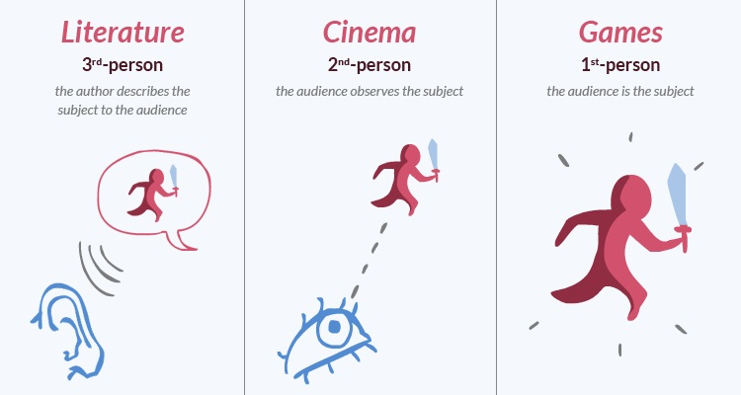
Research Aim, Scope, Objectives
Research Question:
How can the integration of constructivist learning and gamification within a timber beam design workflow simultaneously enhance usability, ensure standards compliance, and improve perceived learning effectiveness?

Slide 4
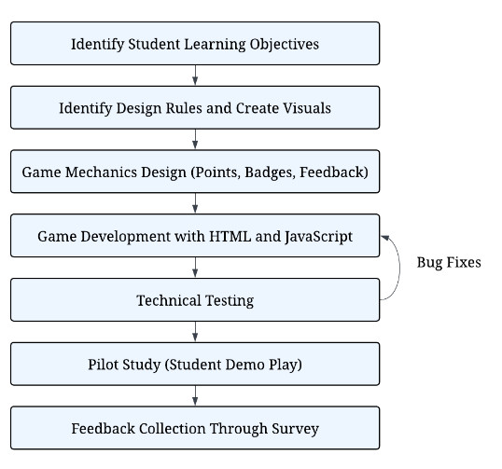
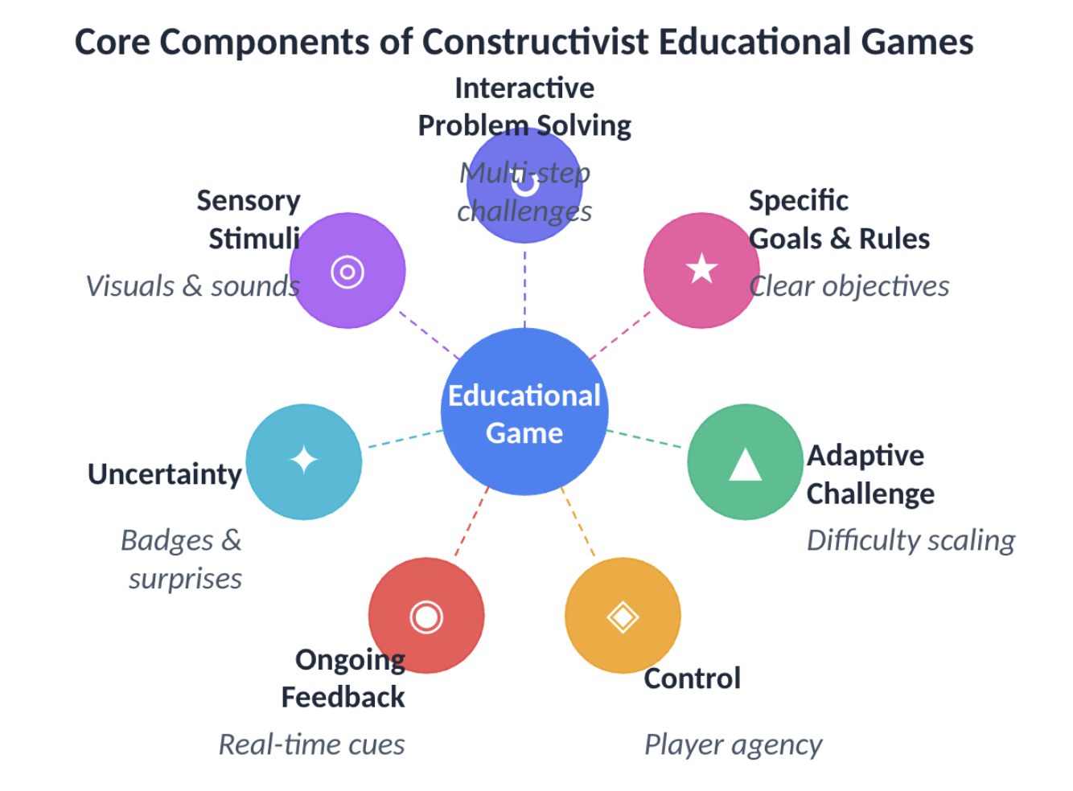
Research Approach

Slide 5
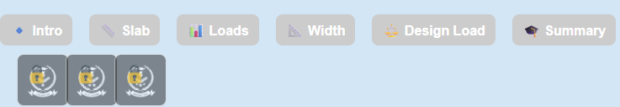
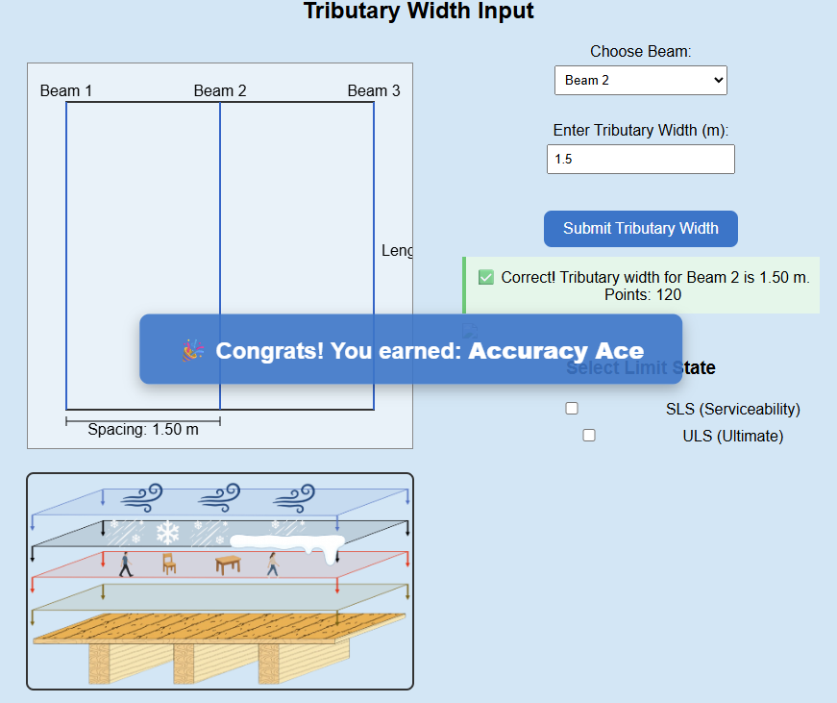
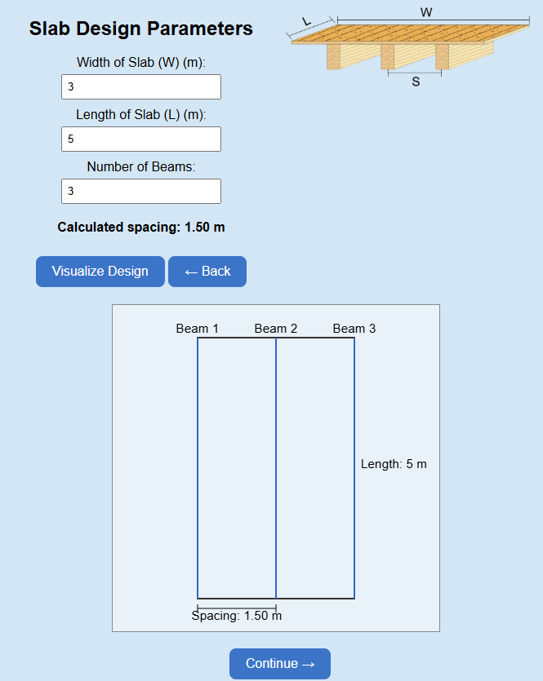
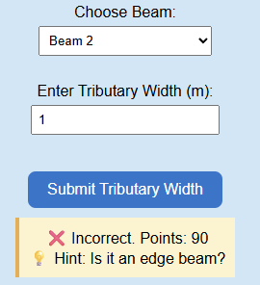
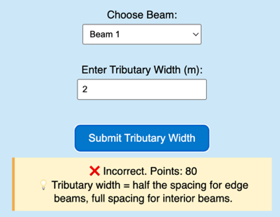
Development
Progress Bar
Badge Earning
Locked Badges
User Input
Dynamic Floor Plan
Gradual Feedback

Slide 6
Results/Findings
Formative Proof-of-Concept Feedback:
Immediate feedback, progressive hints, and visual representations helped students understand design steps
Reward system motivated continued engagement
These data serve a formative rather than evaluative purpose: demonstrate usability and perceived value and inform subsequent tool refinement

Slide 7
Discussion, Conclusions, Recommendations (1)
The project demonstrates that constructivist learning principles and gamification can be systematically embedded into a rigorous structural design workflow
The tool establishes a working model for digital structural education by applying adaptive scaffolding techniques, including progressive hints, varied feedback, and tolerance-based scoring
Ongoing work prioritizes the development and integration of full accessibility features to ensure the tool is usable for all learners

Slide 8



Discussion, Conclusions, Recommendations
Qualitative Comparison: Cross-Cultural
Quantitative Comparison: Test and Control group
T-test for exam scores
T-test for exam scores
Test Group
Control Group
Test Group
Control Group

Slide 9
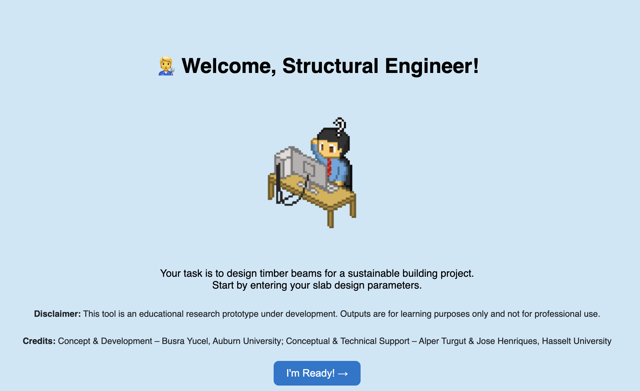
Thanks for Listening! Q&A

