Slide 1
Amani Rashid, PhD, Senior Research Associate
Liquor and Cannabis Board
March 2024
Long-Term Evaluation of
Initiative 502
WASHINGTON STATE INSTITUTE FOR PUBLIC POLICY

Slide 2
How WSIPP Receives Assignments
WSIPP projects are initiated and funded in the following ways:
Washington State Legislature
Policy bills
Budget provisos
WSIPP’s Board of Directors
Directs a limited number of studies
Can approve non-legislatively directed work. The work must be:
Of importance to the state
Consistent with WSIPP’s nonpartisan mission

Slide 3
WSIPP’s Initiative 502 (I-502) Assignment
RCW 69.50.550
WSIPP shall conduct cost-benefit evaluations for the implementation of [this act]…The evaluations shall include, but not necessarily be limited to:
Public health and health care,
Public safety,
Substance use,
Criminal justice,
Economic impacts, and
Administrative costs and revenues
Report deadlines: 2015, 2017, 2023, and 2032
**abbreviated assignment language**

Slide 4
Published Reports (2023)
A 10-Year Review of Non-Medical Cannabis Policy, Revenues, and Expenditures (June 2023)
Relevant policy
Past-decade revenues and expenditures
Initiative 502 and Cannabis-Related Public Health and Safety Outcomes (September 2023)
Reported cannabis use
Cannabis, opioid, and alcohol use disorder diagnoses
Traffic fatalities
Cannabis possession convictions
Licensed Non-Medical Cannabis Retail Access and High School Outcomes (December 2023)

Slide 5
Reported Substance use: National Comparison
Examined how reported cannabis use and other substance use changed after I-502 (12/12) and commercial sales (07/14)
Separate for two age groups: 21+ and 12-20
Results
No evidence that reported cannabis use changed in WA after the passage of I-502 or the advent of retail (compared to similar states)
No evidence that reported alcohol, cigarette, or other substance use changed in WA after the passage of I-502 or the advent of retail (compared to similar states)

Slide 6
Non-Medical Cannabis Retail access
Retail market rolled out over several years, with varying accessibility across regions
Difficult to detect the impact of non-medical cannabis (NMC) retail using a comparison at a single point in time
The impact of NMC retail on cannabis use and subsequent outcomes may differ depending on retail accessibility
Access measured as the average drive time (in minutes) to the nearest retailer for the average resident in a geographical unit (i.e., ZIP code, census tract, etc.)
Licensed NMC retail information come from the LCB (address, first and last sales dates)

Slide 7
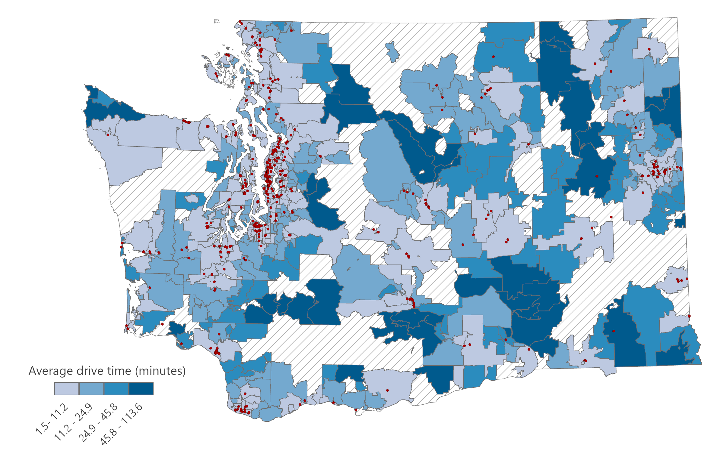
Average Drive Time to Nearest Retailer in Minutes, ZIP codes 2019

Slide 8
ZIP Code Characteristics by Retail Status, 2019
 | Operational NMC retailers | No operational NMC retailers | Difference
Percent population White | 73.15 | 76.1 | -2.95*
 | (1.15) | (1.59)
Percent population Hispanic | 11.48 | 11.7 | -0.216
 | (0.81) | (0.95)
Percent population Asian | 6.24 | 3.14 | 3.10***
 | (0.57) | (0.32)
Percent population Black | 2.87 | 1.59 | 1.275***
 | (0.3) | (0.18)
Percent population other race/ethnicity | 5.07 | 4.117 | 0.95***
 | (0.2) | (0.24)
Percent population age 25+, at least a bachelor’s degree | 32.25 | 26.44 | 5.81***
 | (1.18) | (0.91)
Percent households renting | 35.65 | 27.78 | 7.86***
 | (1.06) | -0.98
Median household income | 70,007 | 65,766 | 4,241**
 | (1,588) | -1424
Unemployment rate | 5 | 5.86 | -0.86**
 | (0.16) | (0.31)
Observations | 204 | 385
Notes: ZIP code characteristics come from 2019 American Community Survey. Differences estimated using a standard difference in means t-test.
***Significant at the 0.001-level, **significant at the 0.05-level, *significant at the 0.01-level.

Slide 9
Retail access and related outcomes
Reported cannabis use (WA State data)
A shorter drive time to a licensed retailer relates to a higher probability of reported cannabis use among adults ages 21+
E.g., a 50% reduction in drive time increases the probability of reporting past-month use by 6.0% and the probability of reporting heavy past-month use by 8.6%
Fatal traffic crashes
A shorter drive time to a licensed retailer relates to a modest increase in the number of drivers involved in a fatal traffic crash
E.g., a 50% reduction in the average drive time to the nearest retailer predicts about 6% more drivers involved in a fatal crash annually
A shorter drive time to a licensed retailer relates to an increase in the prevalence of drivers who test THC-positive

Slide 10
Retail access and related outcomes
Substance use disorder diagnoses (Medicaid claims)
A shorter drive time to a licensed retailer relates to a higher probability of cannabis use disorder (CUD), alcohol use disorder, and opioid use disorder diagnoses among legal-aged adults
E.g., a 50% reduction in drive time relates to a 2.3% higher likelihood of an annual CUD diagnosis
More nearby retailers (within 5-10 minutes) predicts a higher probability of CUD
A shorter drive time to a licensed retailer relates to a higher probability of annual CUD diagnoses among adolescent age 12-17

Slide 11
Retail Access and High School Outcomes
Examined the relationship between attending a school within 5 minutes of an NMC retailer and reported cannabis use
Several ways retail access can relate to adolescent cannabis behavior
Advertising (Donnelly et al., 2022 ; Firth et al., 2022)
Normalize cannabis use (Madras et al., 2019; O’Loughlin et al., 2022)
Access through legal-aged family and/or friends (Firth et al., 2022)
10th and 12th grade students that attend a school nearby an operational retailer are more likely to report (frequent) past month cannabis use
Map

Slide 12
Retail Access and High School Outcomes
Examined the relationship between attending a school within 5 minutes of an NMC retailer and administrative high school outcomes
Results
Students attending a school near a retailer have a 7% higher number of average monthly unexcused absences
Students attending a school near a retailer have a 2.5% lower likelihood of graduating high school in four years
Results driven by students attending schools in rural regions
A larger number of nearby retailers relates to more unexcused absences (one more retailer correlates with a 3% increase)

Slide 13
Forthcoming work
Health care (2025)
Retail access and cannabis-related health care utilization (e.g., emergency department visits)
Retail access and behavioral health outcomes
Labor market
Cannabis industry employment and wages

Slide 14
Publications
A 10-Year Review of Non-Medical Cannabis Policy, Revenues, and Expenditures
Initiative 502 and Cannabis-Related Public Health and Safety Outcomes: Third Required Report
Supplemental Reports:
Technical Report—Licensed Cannabis Retail Access and Substance Use Disorder Diagnoses
Technical Report— Initiative 502 and Cannabis-Related Convictions
Technical Report— Licensed Cannabis Retail Access and Traffic Fatalities
Technical Report— The Relationship Between Initiative 502 and Reported Substance Use
Licensed Non-Medical Cannabis Retail Access and High School Outcomes in Washington State

Slide 15
Thank you!
Questions?
Amani Rashid, PhD
I-502 Evaluation Project Lead, Senior Research Associate
amani.rashid@wsipp.wa.gov

Slide 16
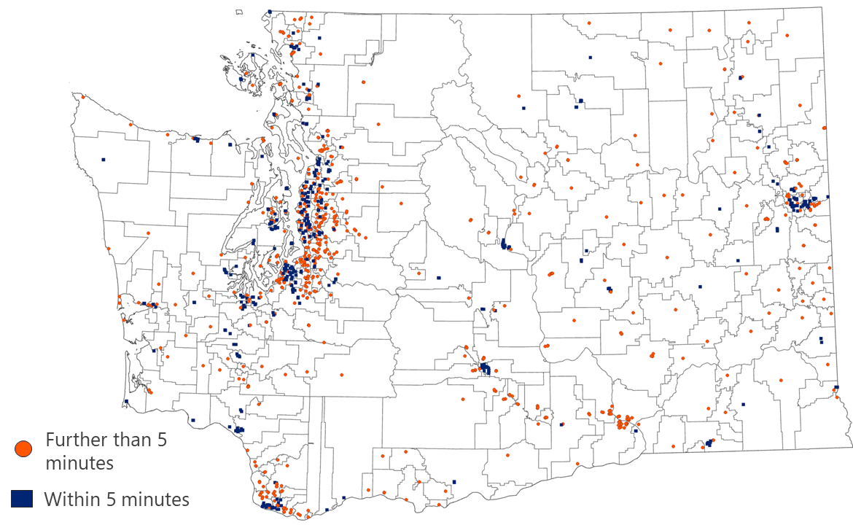
School Access to the Nearest Licensed NMC Retail, 2019
Back

