Slide 1


Beyond Deterministic Models:
On the Importance of Modeling Variability for Designing Fair and Effective Contrail Impact Mitigation Strategies.
Rémi Chevallier - Airbus/ENAC - CICONIA Project
Advisors :
Daniel Delahaye OPTIM, ENAC Toulouse, France
Manuel Soler Aircraft Operation Lab, UC3M Madrid, Spain
Notes:
Good afternoon everyone, I am remi chevallier, from Airbus,
Today we will talk about the importance of modeling uncertainties in order to propose effective and fair climate impact mitigation strategies..

Slide 2
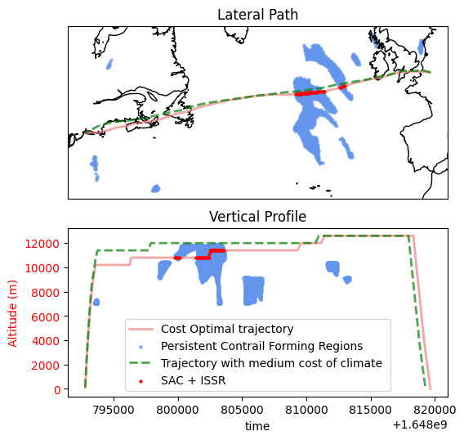

What is the effectiveness of my climate mitigation strategy?
Red Flight Plan : Business as usual
Cost function = Fuel + CI x Time
Green Curve : Climate aware trajectory with a certain climate incentive
Cost function = Fuel + CI x Time
+ 𝛂 x Climate Impact estimation
Result with current set of assumptions and models : A Climate aware trajectory with significantly less climate impact than the business as usual flight
Not statistically significant + subject to many assumptions.
Notes:
You have all seen this kind of plots, with a baseline trajectory that produces a large amount of contrails. by taking into account the climate impact in the cost function, you can make the optimizer decide if we need to avoid this or that contrail forming. In this case the rerouted flight avoids the contrail forming region, thus reduce the climate impact from your flight.
These demonstrations are great, because they show that assuming we can build a climate impact estimation model that we can trust, we have the possibility to mitigate aviation non-CO2 impact by a significant amount for a relatively sustainable cost.
However, these plots and the resulting numbers are only true under a certain set of assumptions, about the model used, the inputs, etc.

Slide 3
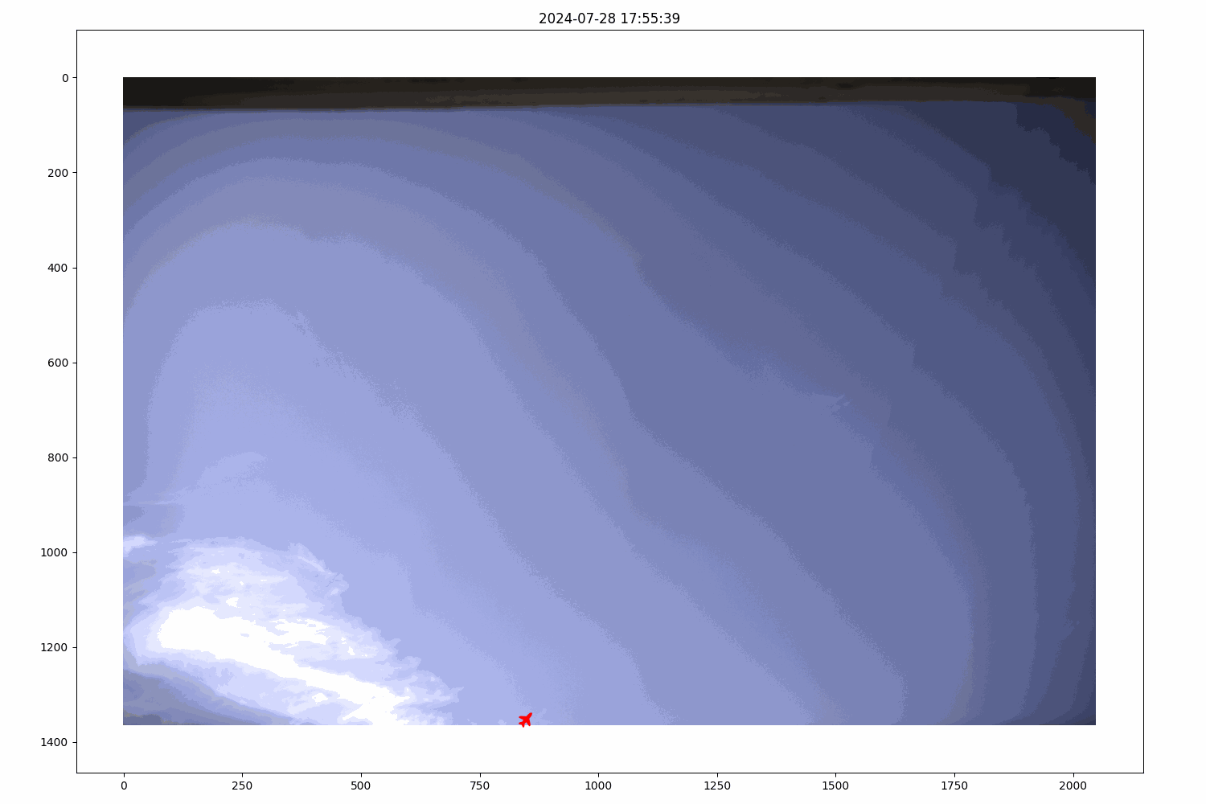
Uncertainties in non-CO2 climate impact estimations
Example of ground camera footage for a long lasting contrail that was created in non forecasted ISSR and non forecasted SAC region.
Contrail formation prediction : Precision of around 69% for the three month of data during summer 2024.
Fairness issues
Confidence/trust on our actions
Effectiveness of the Climate impact reduction
Incentive design issues
Notes:
Just a quick example to illustrate why these underlying assumptions could matter :
Here is an example of a long lasting contrail captured as part of our ground observation study. This contrail lasted more than 35 min in our field of view. The flight is identified, but it was flying in subsaturated air (not in ISSR), and SAC was not verified. This is a completely cherrypicked example, so don’t draw any conclusions from these slide, except this one : contrail prediction pipelines could sometimes be wrong. Then what?
This could cause fairness issues, confidence and trust issues on our actions, and most importantly harm the effectiveness of our climate impact mitigation strategies. This results also in difficulties linked to the design of the climate incentive.
Today, I am only going to be talking about the effects on the climate mitigation, but remember that it comes with a set of other problems as well.

Slide 4







Sources of errors in the model reducing the final mitigation potential
(neglected in most studies)
Weather Uncertainties
Aircraft data (Perfo …)
Uncertainties
Contrail models Uncertainties & parametrisations
Climate modeling Uncertainties
Operational Constraints
Question : What is the impact of each of these elements?
Subsequent questions :
1/ How to evaluate the loss?
2/ How to solve the issue?
Notes:
The example of flight planning that I showed at the beginning of the presentation lacked several things in the simulation. Several assumptions were made.
Each of these elements that I neglected are going to have a detrimental effect on our capacity to reduce the climate impact of our flights, this is logic. The question I think we really need to ask ourselves is what is the impact of each of these elements, and how to solve this if the impact if significant.

Slide 5
Sources of errors in the model reducing the final mitigation potential
(neglected in most studies)
Weather Uncertainties
Aircraft data (Perfo …)
Uncertainties
Contrail models Uncertainties & parametrisations
Climate modeling Uncertainties
Operational Constraints
Question : What is the impact of each of these elements?
Subsequent questions :
1/ How to evaluate the loss?
2/ How to solve the issue?
Notes:
We’ll focus in today’s presentation on the ERA5 weather uncertainty, neglecting all the rest of them. This is a very strong assumption, we don’t try to provide results and numbers. Here, we only want to illustrate what the impact of the uncertainties in ERA5 weather reanalysis could look like, and suggest ways of dealing with these uncertainties. It is crucial to remember here that the numbers themselves don’t mean anything!!

Slide 6
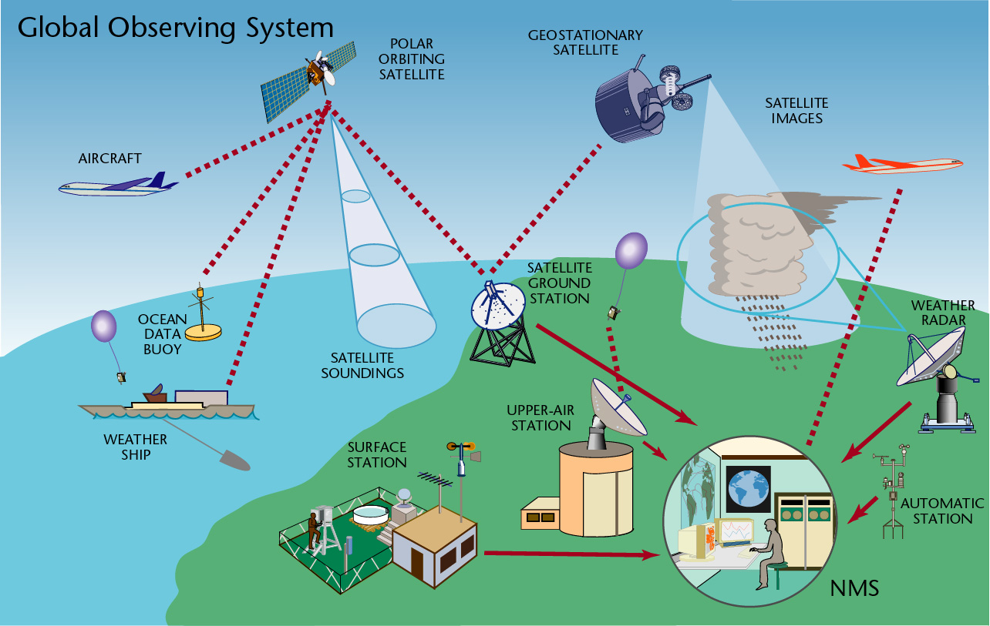
The main steps of the weather forecasting process
Input:
Weather observations
Weather assimilation produces ⇒
weather Analysis
Source : WMO
Notes:
In order to understand when these uncertainties come from and how to deal with them, we need to get back really quickly on how these weather data are produced. How do we make a weather forecast?
A weather forecast process starts by observing the earth. There is a huge array of sensors that record different variables and informations about the state of the atmosphere, sea, land, etc. The first step of the process is to combine them all to produce one “snapshot” of the state of the atmosphere at a given time. This is called the weather assimilation, and the “snapshot” is called the weather analysis.

Slide 7
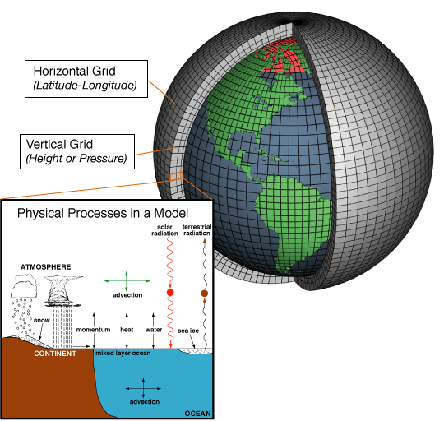
The main steps of the weather forecasting process
Input:
Weather observations
Weather assimilation produces ⇒
weather Analysis
Future Weather simulation (Numerical Weather Prediction - NWP)
Source : WMO
Source : NOAA
Notes:
Then, we use the numerical weather prediction, basically a big pile of equations trying to capture as much as possible the physical processes at stake in the evolution of the atmosphere. You initialize it with your weather analysis, and let this predict how the system will evolve. Obviously, because we are talking about trying to predict the evolution of a chaotic system with time, it comes with a significant uncertainty.

Slide 8
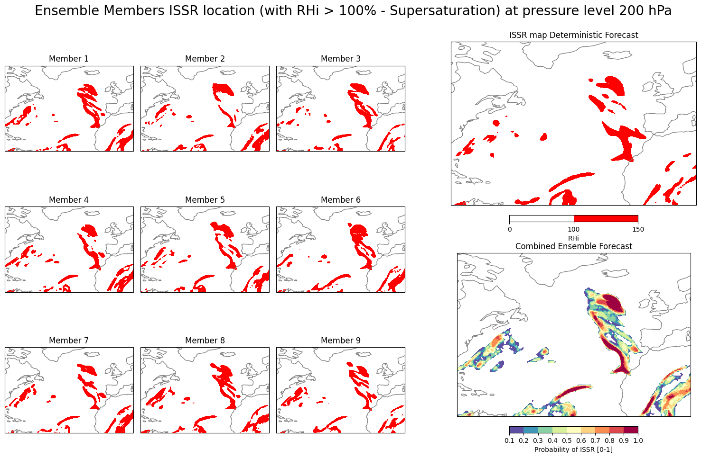
The main steps of the weather forecasting process
Input:
Weather observations
Weather assimilation produces ⇒
weather Analysis
Future Weather simulation (Numerical Weather Prediction - NWP)
NWP output Analysis & expertise
Output:
Weather forecast
Source : WMO
Source : NOAA
Notes:
Then you have an expertise phase, and you get the weather information you need.

Slide 9
The principle of the weather reanalysis process
Input:
Weather observations
Weather assimilation produces ⇒
weather Analysis
Future Weather simulation (Numerical Weather Prediction - NWP)
NWP output Analysis & expertise
Output:
Weather forecast
Source : WMO
Source : NOAA
Notes:
In a reanalysis, like ERA5, it’s a bit different. No need to predict the future, we work with historic data. There is no longer uncertainties coming from the fact that we are trying to predict the future. However, there is still uncertainty in reanalysis like ERA5. It is however usually much lower than the one of the forecast.
And today, we’ll work with that : we are going to try to study the impact of the uncertainties coming from ERA5.
But where does this come from? Well sometimes we lack measurements, sometimes the measurements are imprecise, biased, or sensors contradict each other… To deal with that, we make assumptions to produce the analysis, which is a sort of “best guess”.

Slide 10
What is an ensemble forecast? From deterministic to probabilistic models
Ensemble forecast :
Instead of a “Best Guess”, ensembles provides a set of equiprobable situations.
These can be used to estimate to what uncertainties are the weather variables subject to.
Mosaic presenting each ensemble member, and two images on the right : one with the issr deterministic prediction, one with the combined probabilistic result of the ensemble
Notes:
However, instead of one single best guess, it is possible to produce a set of best guesses, each of them totally equiprobable.
What is interesting about these is that they capture some of the variability/ uncertainty induced by the analysis.

Slide 11
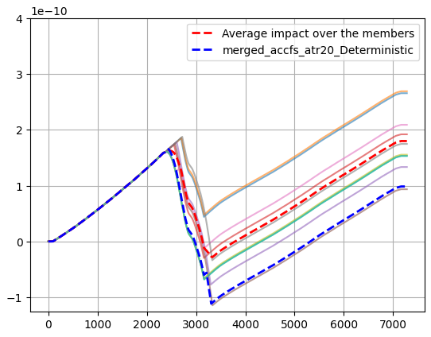
Evaluation of this effect : Replay the flight plan in Ensemble weather data
Flight Plan
Ensemble Weather data
Aircraft Performance and Emissions
Climate
impact model
Member 1
Aircraft Performance and Emissions
Climate
impact model
Member 2
…
…
Aircraft Performance and Emissions
Climate
impact model
Member n
Notes:
So now, instead of having one flight plan optimized with one weather data and evaluated in the same deterministic weather data, we replay each of our flights in each of the ensemble members (each version of the weather). This could produce different results every time, and you get an idea of the spread of this impact, and also its average value.

Slide 12
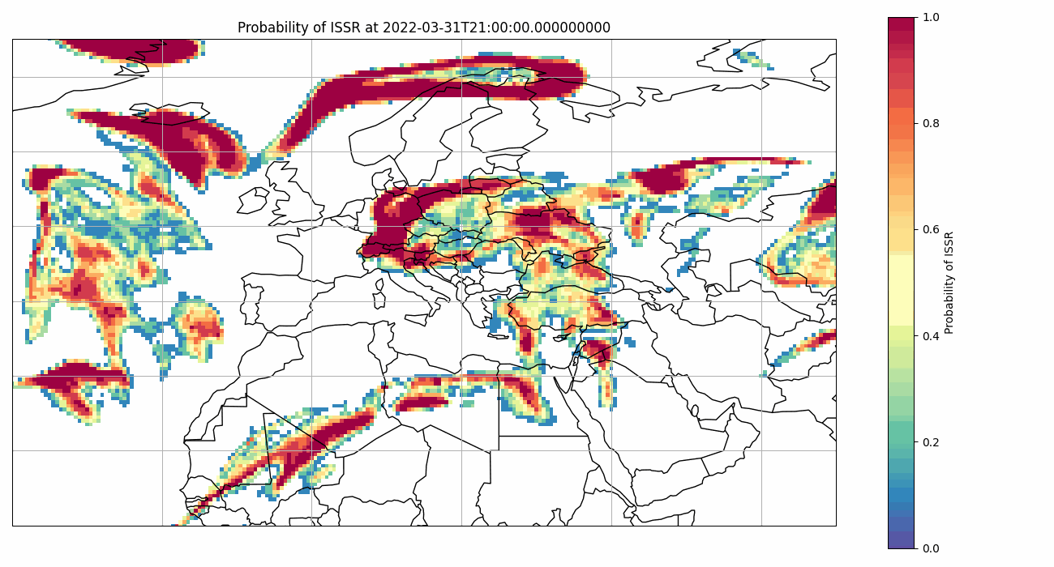

What is an ensemble forecast? From deterministic to probabilistic models
Depending on the member, this flight could equi-probably make between 0km of contrails and 800km

Slide 13
How to assess the impact of uncertainties on a mitigation strategy effectiveness
Red Flight Plan : Business as usual
Cost function = Fuel + CI x Time
Green Flight Plan : Climate aware trajectory with a certain climate incentive Using Deterministic Weather data
Cost function = Fuel + CI x Time
+ 𝛂 x Climate Impact estimation
Result : A Climate aware trajectory with 40% less climate impact than the business as usual flight according to the deterministic ERA5 data.
Notes:
Ok, so let’s get back to my example flight :
Here, according to Deterministic era5, I was supposed to reduce the flight’s climate impact by 40%.
I already presented this last year here
Mitigation potential : for this specific flight, what’s the percentage of climate impact that I can save?

Slide 14
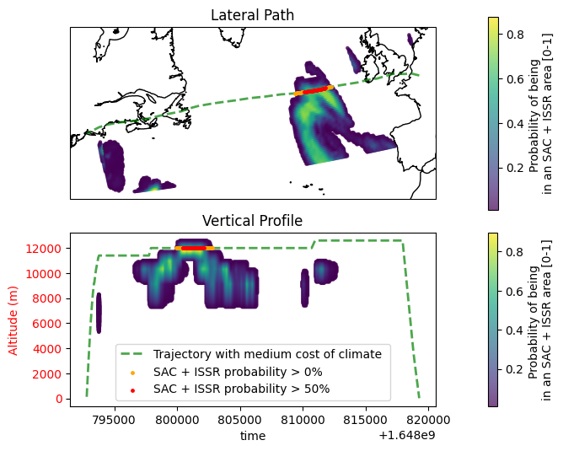
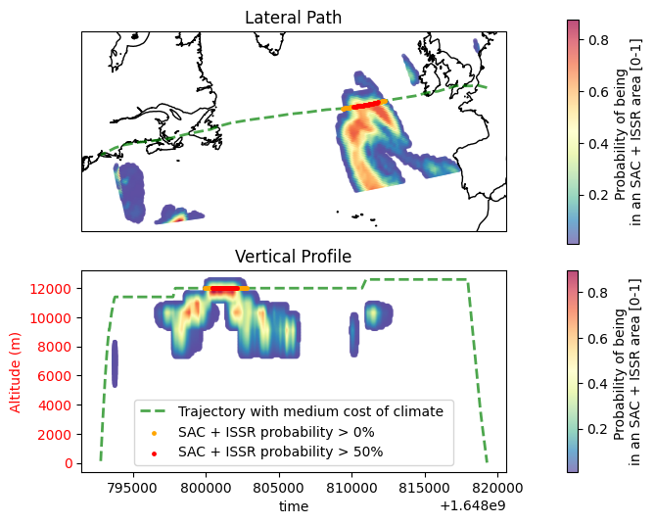
How to assess the impact of uncertainties on a mitigation strategy effectiveness
Green curve : Climate aware trajectory with a certain climate incentive Using Deterministic Weather data
This flight plan is Replayed separately in each member of the ensemble forecast.
Result :
Green curve only reduced the climate impact by 2% on average over the ensemble instead of the expected 40%.
Notes:
We expected a 40% reduction of the climate impact, we got 2% on average over the replays from the ensemble..
Ensemble weather showed that there is a high probability of contrail formation in the rerouted flight plan’s path even though it was not predicted by the deterministic forecast.
This is again a totally cherry picked example, but in 12 min I don’t really have time to show you 100.

Slide 15
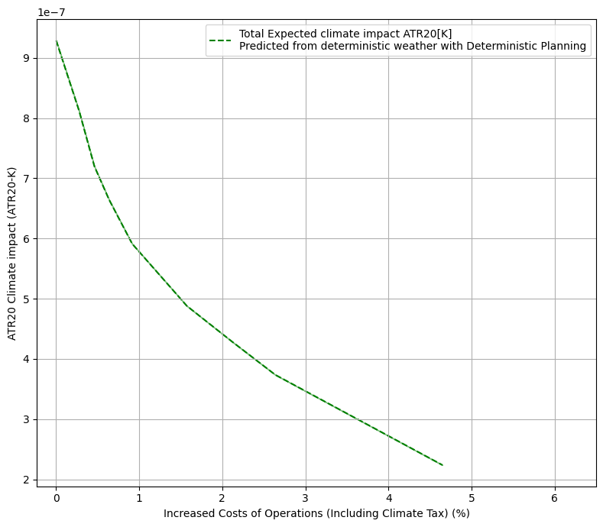
Impact of the uncertainty on the fleet
We reuse the same cost function as before :
Cost function = Fuel + CI x Time
+ 𝛂 x Climate Impact estimation
Results for a 10.000 transatlantic flights fleet over 2022
Business as usual fleet
Total Climate impact (ATR20)
Increasing
climate cost
⇒
reduction in impact
Towards Better results
Increase in Costs (%)
Notes:
So now on to a bit more statistically significant numbers.
In optimization, when we deal with a tradeoff, we look at pareto fronts (that’s the fancy name for this green curve). Basically, here, you make the cost of climate vary, and you plot the result. On the top left, the business as usual case. 0 extra cost (obviously, that’s our baseline), and a high climate impact. Then, the more alpha increases, the more you move down this line.
That’s the pareto front expected from the simulation made with the deterministic ERA5; thus neglecting all uncertainties. Again, the numbers only mean anything within the set of assumptions we made (specific ac type, ac perfo model, network of routes, etc)

Slide 16
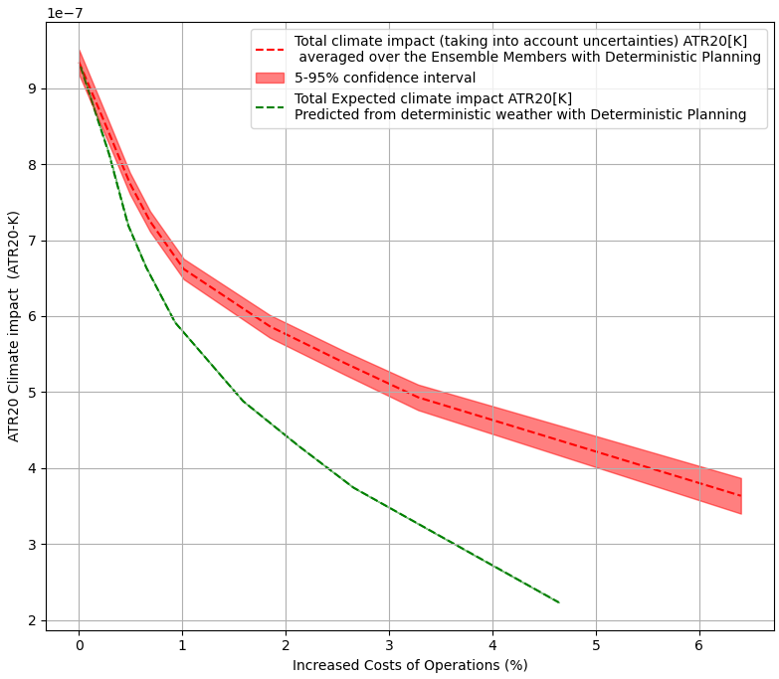
Impact of the uncertainty on the fleet
Loss of ~25-30% of mitigation potential in this experiment when taking into account the uncertainties on ERA5 reanalysis compared to predictions using deterministic ERA5
Total Climate impact (ATR20)
The impact we got with the more realistic weather
What was expected by the deterministic model
Increase in Costs (%)
Notes:
Now that’s what we get when we replay the flight plans from this experiment in ensemble reanalysis weather.

Slide 17
Impact of the uncertainty on the fleet
Loss of ~25-30% of mitigation potential in this experiment when taking into account the uncertainties on ERA5 reanalysis compared to predictions using deterministic ERA5
Total Climate impact (ATR20)
~28% climate impact increase + extra cost due to unpredicted climate impact
Increase in Costs (%)
Notes:
That’s the kind of situation we are dealing with. The uncertainties have a significant impact on the mitigation potential, and on the costs.
They don’t necessarily mean that you’ll harm the climate more than if you did nothing, although it actually happens for a certain number of flights in the fleet, but it has a significant impact. Remember what it means in terms of fairness, trust in our action.

Slide 18
Impact of the uncertainty on the fleet
Loss of ~25-30% of mitigation potential in this experiment when taking into account the uncertainties on ERA5 reanalysis compared to predictions using deterministic ERA5
Total Climate impact (ATR20)
Estimation of the mitigation potential loss due to weather reanalysis intrinsic uncertainty
(in reanalysis ⇒ integrating forecast lead time uncertainties will decrease it even more)
Increase in Costs (%)
Notes:
It’s also important to note that this is just due to the ERA5 uncertainties. Weather prediction with Zero lead time. When taking into account the lead time, the results should deteriorate even more.

Slide 19
Impact of the uncertainty on the fleet
Loss of ~25-30% of mitigation potential in this experiment when taking into account the uncertainties on ERA5 reanalysis compared to predictions using deterministic ERA5
Total Climate impact (ATR20)
Estimation of the mitigation potential loss due to weather reanalysis intrinsic uncertainty
(in reanalysis ⇒ integrating forecast lead time uncertainties will decrease it even more)
Extra cost to reach the same result
Loss $
Increase in Costs (%)

Slide 20
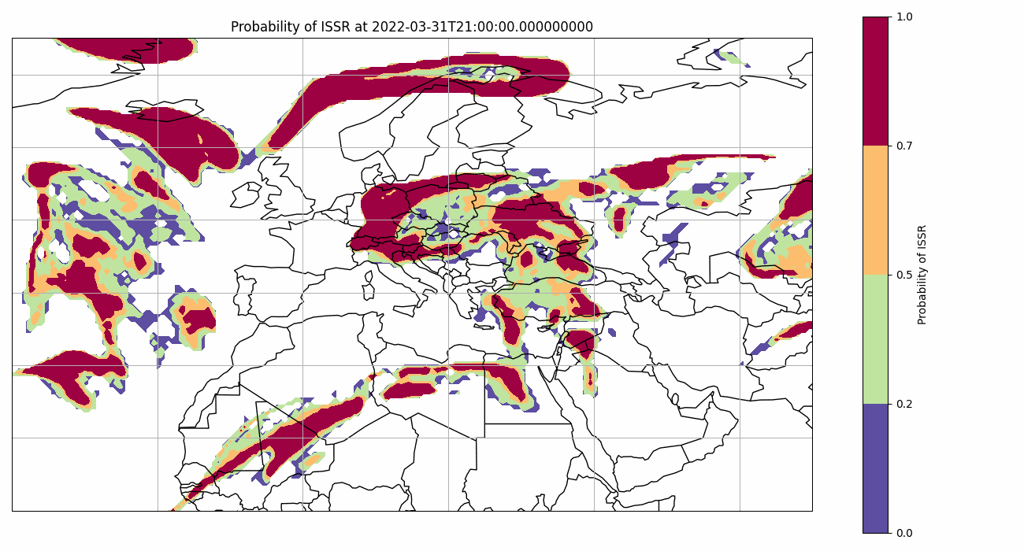
Modeling the uncertainties in trajectory optimization solutions
Notes:
Up to there the this talk has been very depressing, I’m sorry about that. I really wanted to stress the fact that uncertainties have a significant impact, that could not be neglected.
So now the more optimistic side of things :
Acknowledging the significant impact of uncertainties doesn’t mean we can’t do anything, it just means that we need to do it correctly, by modeling these uncertainties in the flight planning methods, and the climate impact evaluation tools.
Several studies have already shown the potential of such methods, Simorg et al. & other work from UC3M.
However these methods usually either mean that you need to compute one flight planning job per ensemble member (computationally expensive) or to load the ensemble forecast in memory instead of the deterministic forecast to run one stochastic or robust flight planning (meaning dealing with 50 times - or any other number of members in the ensemble - the amount of weather data previously used). This might not be compatible with current flight planning softwares/ platforms.

Slide 21
What does it mean to use ensemble weather ?
Simplified (exaggerated) example with ISSRs, Forecast with 30 ensemble members
Probability Density
0
0.5
1
Value
RHi at a 4D point in ensemble weather
Notes:
Several methods exist already. There’s one of them that is traditionally considered more compatible with current FP systems.
What does it mean to use ensemble forecast as it’s done in the second method?
Let’s get the case of the ISSR criterion as an example.
It means that for each 4D point, we will deal with 30 values instead of one. For example here, 2 members predicted a RHi of 0.5, and 4 of them a RHi of 1. This is an illustration, the spread will not be that high in reality.

Slide 22
What does it mean to use ensemble weather ?
Simplified (exaggerated) example with ISSRs, Forecast with 30 ensemble members
Probability Density
ISSR : RHi>100%
P(ISSR) = 𝚺 / 𝚺 +
0
0.5
1
Value
RHi at a 4D point in ensemble weather
Notes:
Then, we can draw information from this set of values. For example for the ISSR, we can compute a probability of ISSR by counting the number of orange boxes divided by the total number of members. You can do similar things with SAC, or with models like the aCCFs or CoCip.
This then feeds into the optimizer, which helps mitigate the impact of uncertainties. But it means loading 30 ensemble members and toasting your server.

Slide 23
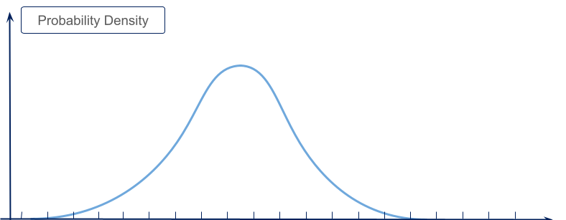
Probability Density Function Approach :
Simplified (exaggerated) example with RHi, Forecast with 30 ensemble members
Probability Density
Probability Density
0
0.5
1
Value
Normal distribution
Notes:
There are several ideas out there on how to deal with that issue. We proposed as part of my phd one method, in which instead of loading the whole ensemble, you try to just load the information required to estimate the varIability.
If the variable is following a quasi gaussian distribution, like the temperature, you can estimate the density of probability with only two values instead of 30.

Slide 24
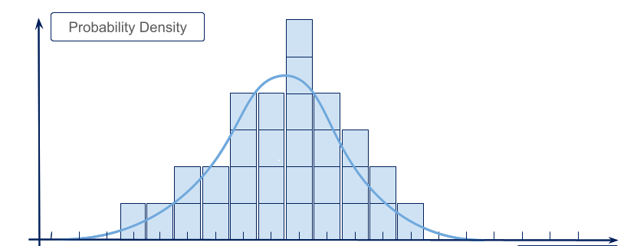
Probability Density Function Approach :
Simplified (exaggerated) example with RHi, Forecast with 30 ensemble members
Probability Density
0
0.5
1
Value
Normal distribution
Notes:
There are several ideas out there on how to deal with that issue. We proposed as part of my phd one method, in which instead of loading the whole ensemble, you try to just load the information required to estimate the varIability.
If the variable is following a quasi gaussian distribution, like the temperature, you can estimate the density of probability with only two values instead of 30.

Slide 25
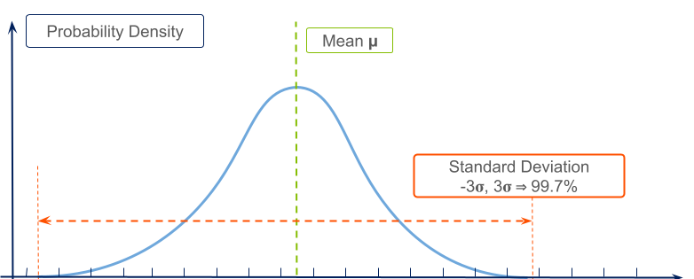
Probability Density Function Approach
Simplified (exaggerated) example with RHi,
Probability Density
Mean µ
Standard Deviation
-3𝛔, 3𝛔 ⇒ 99.7%
0
0.5
1
Value
Normal distribution

Slide 26
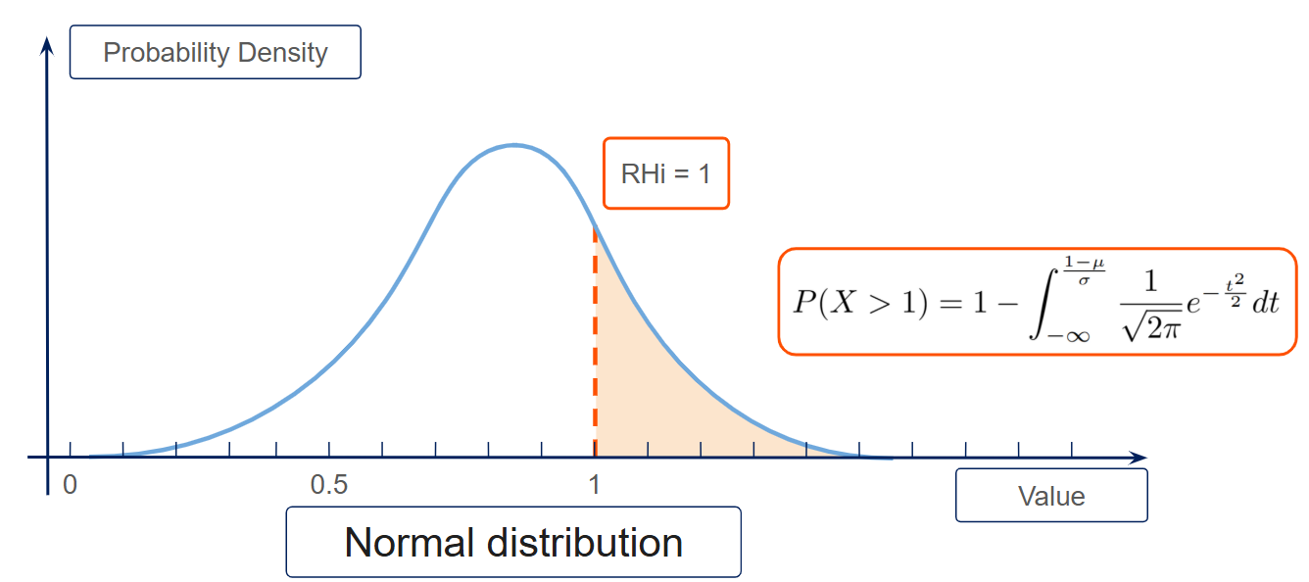
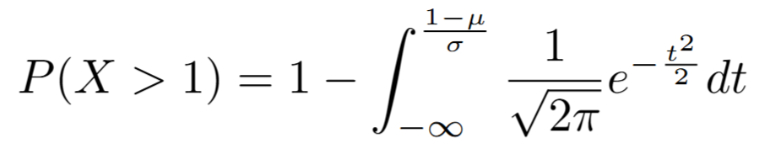
Probability Density Function Approach
Probability Density
RHi = 1
0
0.5
1
Value
Normal distribution
Notes:
All the variables don’t follow a Normal distribution, but this principle could be adapted.
Then, with this kind of very simple equation, you can estimate the probability of being in an ISSR (and it could be applied the same way to predicting an average expected climate impact, or a quantile, etc). This equation looks nasty, but it’s virtually costless for a computer.

Slide 27
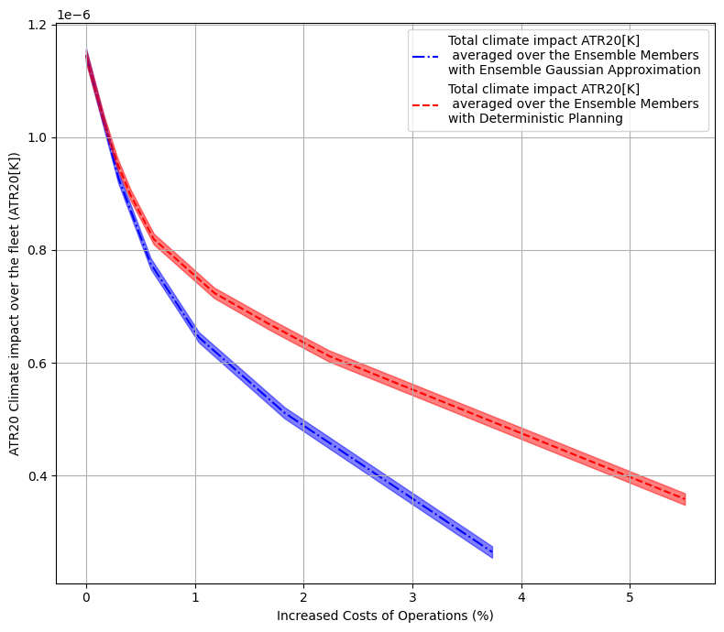
Optimize trajectories with Climate impact : Ensemble PDF approximation
Gain of 15~20% of mitigation potential in this experiment when taking into account the uncertainties on ERA5 reanalysis compared to the strategy using deterministic ERA5
Again, these numbers don’t mean anything because all the other sources of uncertainties are still neglected
Notes:
By applying this method to our climate impact estimation, we were able to improve the climate mitigation by 15-20% compared to the deterministic approach. Again, the numbers don’t mean anything because so many other uncertainties are still neglected. What I want to show is that simple methods exist that could help us mitigate the impact of uncertainties.

Slide 28
Conclusion and Takeaway Messages :
Weather Uncertainties have a significant impact even with zero lead time (reanalysed), and
could not be neglected.
Methods already exist to take into account weather uncertainties, we need to work together as a field to adapt them to the industry constraints.
Subsequent work is still required to identify, model and evaluate the impact of the other sources of uncertainties
Notes:
My takeaway messages for today :
Weather uncertainties have a significant impact, and couldn’t be neglected, even with zero lead time. This is going to be even more the case with actual forecast data.
There are already methods (mostly in the academy part) that yield great promises in dealing with uncertainties. Simple methods could also be designed, as we showed today. We have to work together as a field to propose methods compatible with our industry, while keeping its effectiveness.
And again, I only talked about one source of uncertainty. Observation studies will be key, simulations, tests in real life as well.

Slide 29




Summary of the Study :
Problem: contrail climate impact models are subject to uncertainties. Uncertainties could cause fairness issues, difficulties for incentive design, and limit overall impact reduction effectiveness.
Impact: Deterministic flight planning results in a ~25-30% loss of mitigation potential in our experiment, when faced with ERA5 intrinsic uncertainties (still neglecting many other uncertainty sources like those linked with forecast lead time or climate models parametrizations).
Solution: Flight planning must explicitly model these weather uncertainties to be effective.
Proposed Method: A stochastic optimization using a Probability Density Function (PDF) approximation of the ensemble weather forecast shows significant promise. This approach is designed to be more compatible with current flight planning systems than other computationally/memory intensive methods.
Results : The stochastic optimization using a PDF approximation of weather ensembles recovered 15-20% of this lost potential. Relatively simple methods could yield good results.
Next Steps: Further work is required to account for all other sources of uncertainty (aircraft performance, contrail evolution/ climate impact models, etc).

