Slide 1

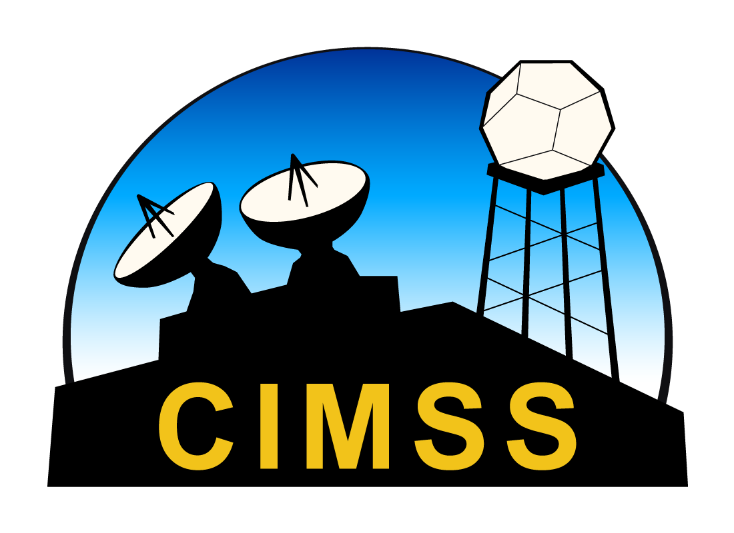


Long-term Observations of Contrail Microphysics from Ground-Based Instrumentation
Timothy J. Wagner¹ and Thomas Dean²
1. Cooperative Institute for Meteorological Satellite Studies
Space Science and Engineering Center
University of Wisconsin – Madison
2. Breakthrough Energy

Slide 2
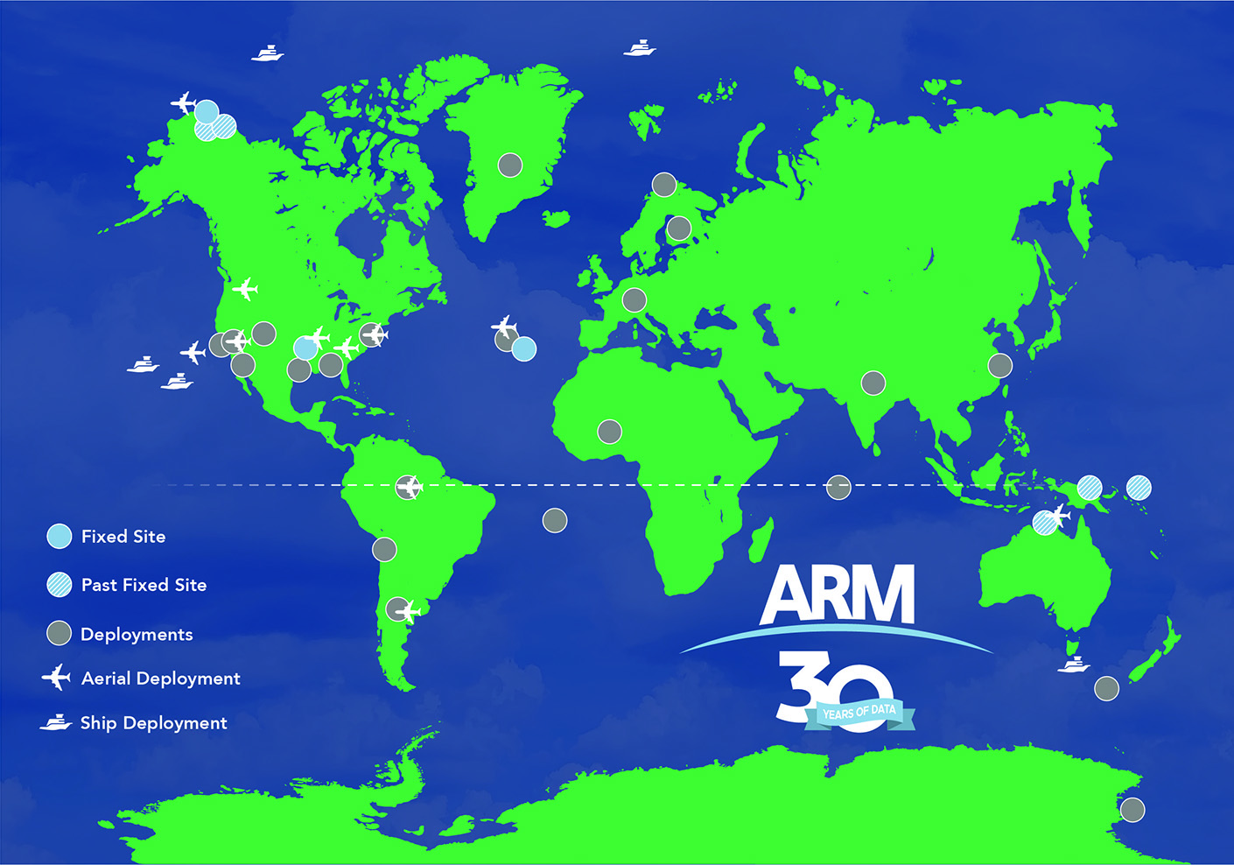
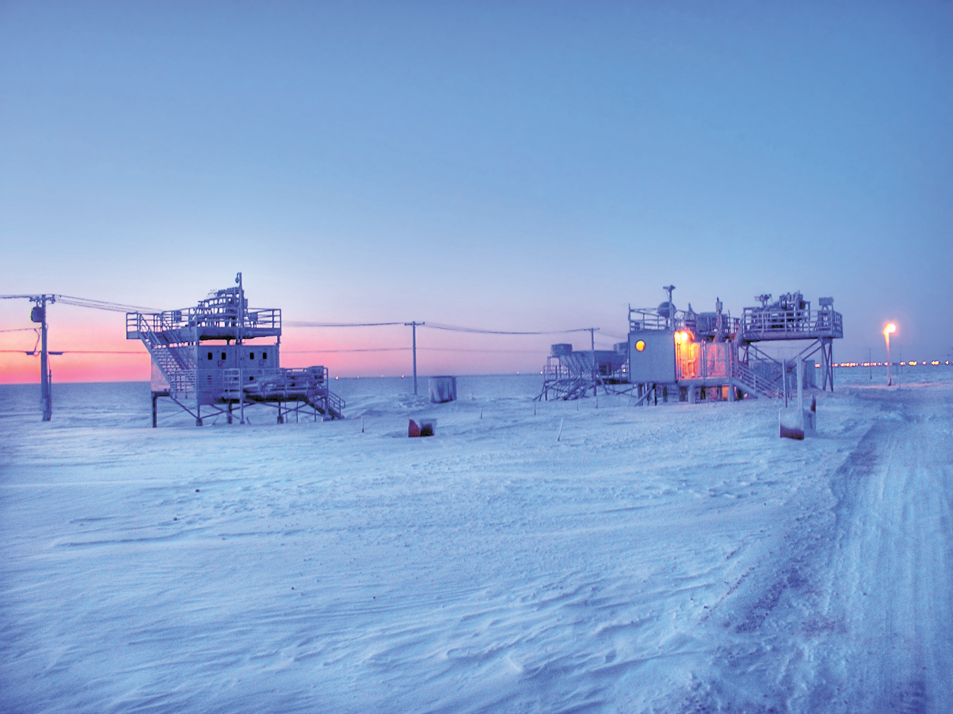
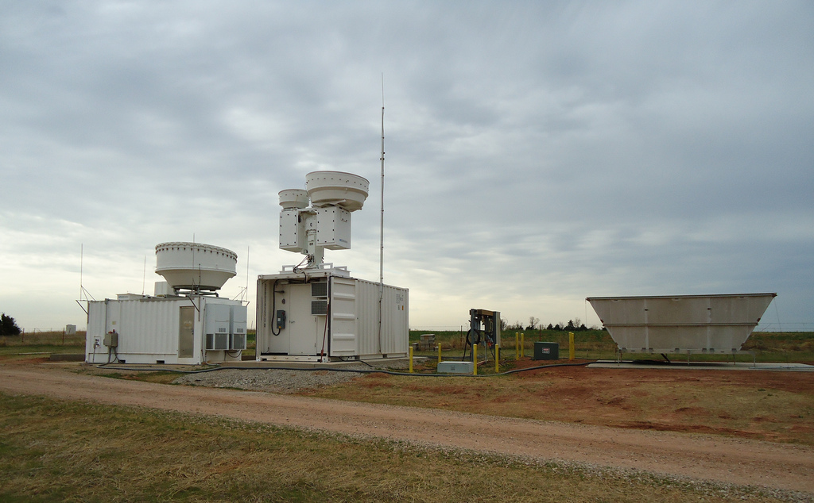
The ARM Program
US Department of Energy oversees the Atmospheric Radiation Measurement (ARM) program
Global network of permanent ground-based atmospheric and cloud observatories augmented by shorter-term deployments.
Instruments include lidars, radiometers, and radars.
Some data streams available continuously for 25+ years!

Slide 3
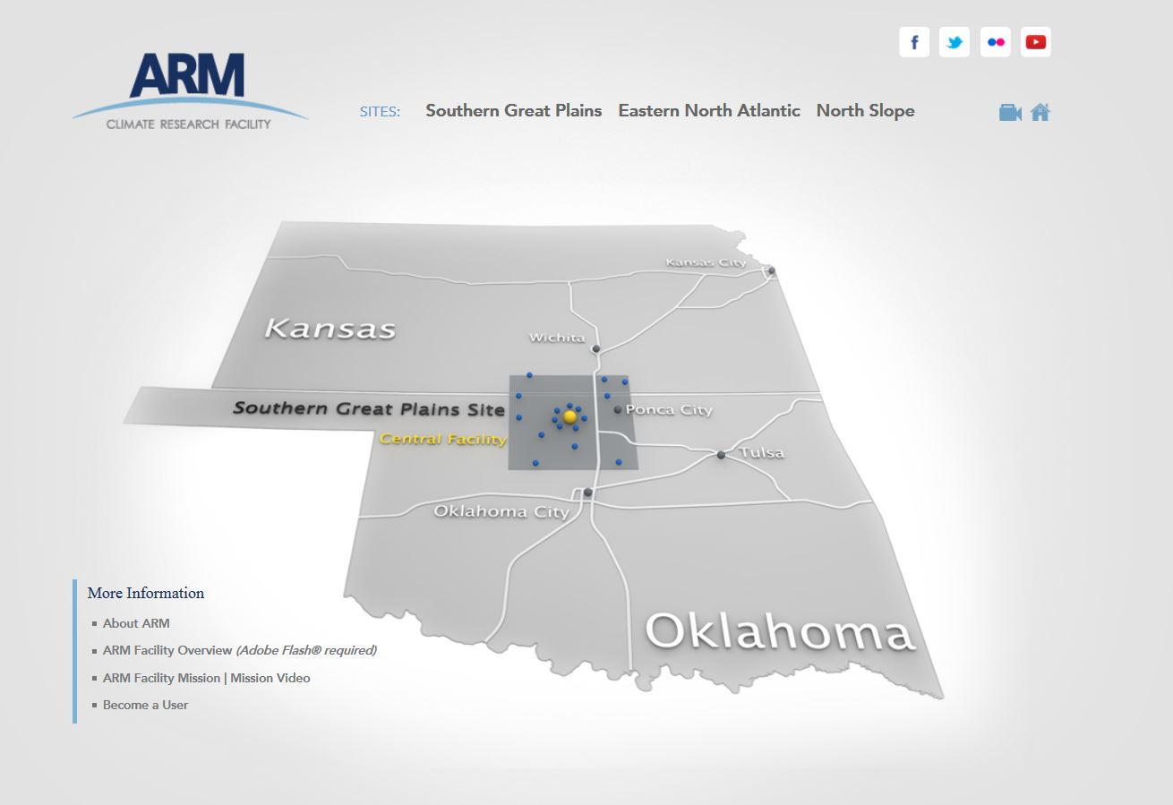
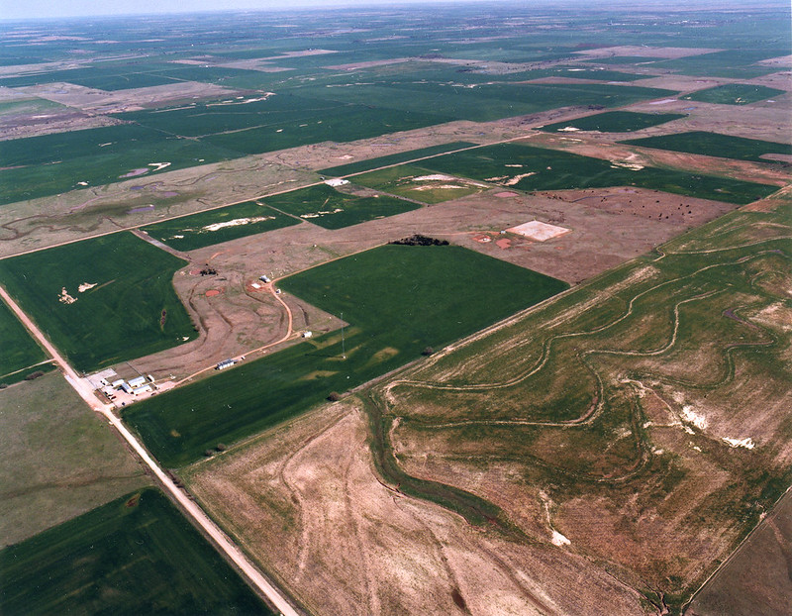
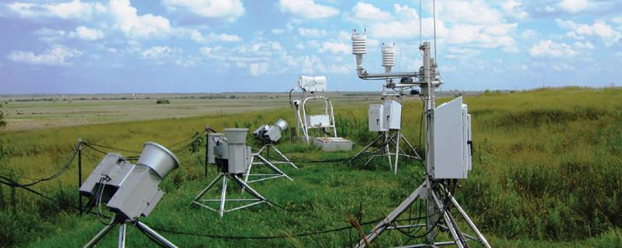
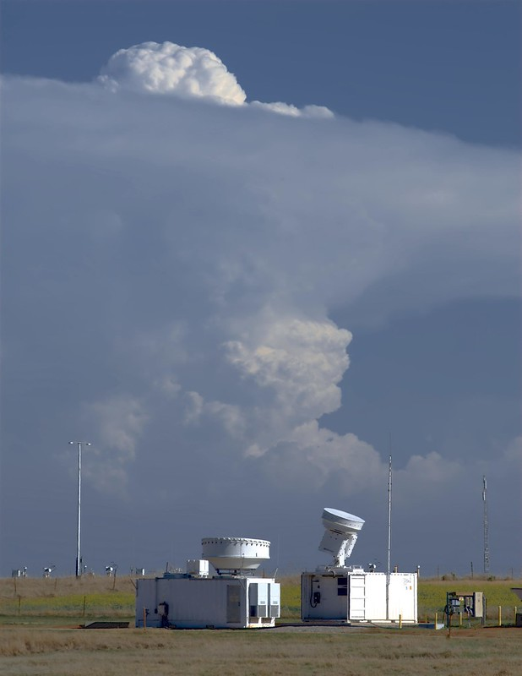
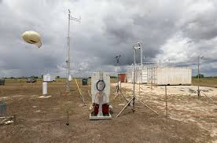
ARM Southern Great Plains
The oldest and most comprehensive ARM site is the Southern Great Plains (SGP) site in north-central Oklahoma.
More than 25 years of data
4x daily radiosondes

Slide 4
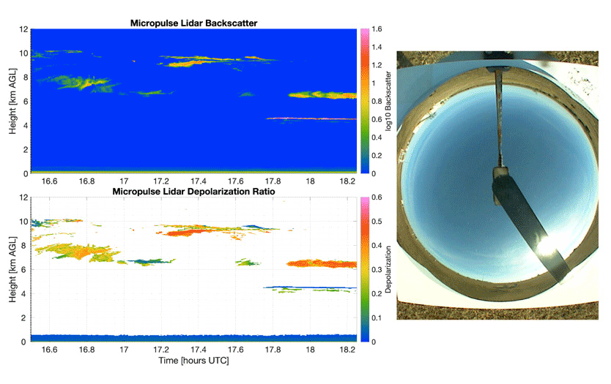
Instrument Synergies
With so many different instruments all synched together, we can learn about processes from multiple perspectives.
Example: Micropulse lidar (MPL) and Total Sky Imager (TSI).
Watch how the MPL captures different backscatter characteristics for contrails in different stages of their life cycle.

Slide 5
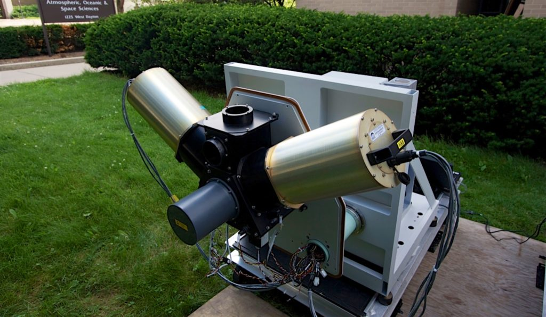
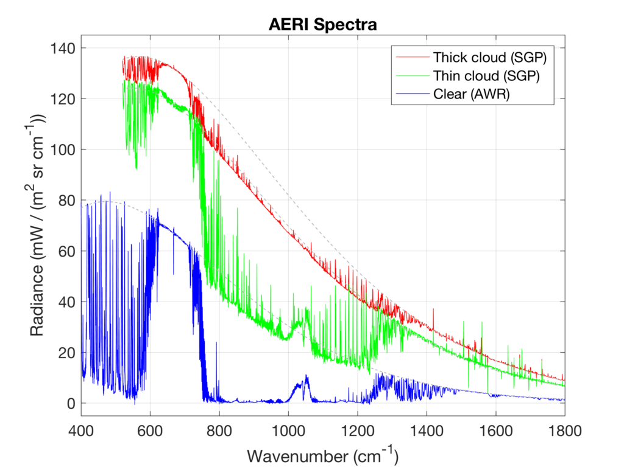
Atmospheric Emitted Radiance Interferometer
Ground-based hyperspectral infrared radiometer with continuous coverage from 3–18 μm
1 cm⁻¹ spectral resolution, 30 s temporal resolution, 1% uncertainty
Similar to satellite-based IASI or CrIS, just upside down
  This makes some things much simpler, because you know exactly where it is and what the background is supposed to look like.
Hyperspectral observations can be used to retrieve:
  Temperature and moisture profiles (TROPoe)
  Cloud microphysical properties (MIXCRA)

Slide 6

Cloud Microphysical Properties
Effective Radius: $r_{eff}=\frac{\int{n\left(r\right)r^{3}dr}}{\int{n\left(r\right)r^{2}dr}}$
Area weighted mean radius of cloud particles
Gives the radiative characteristics of a cloud assuming all cloud particles are the same size
Units are length (usually μm)
Cloud water path: $CWP= \int{W\left(z\right)dz}$
Cloud water content (in g of water per m⁻³ of air) integrated over the vertical depth of the cloud
Units are g m⁻²
Liquid water path and ice water path can be treated separately
Optical Depth: $τ= \ln{\frac{I_{in}}{I_{out}}}$
How far must radiation travel through a cloud to be reduced by 1/e (approximately 37%) of its initial value
Depends on the drop size distribution more than water path

Slide 7
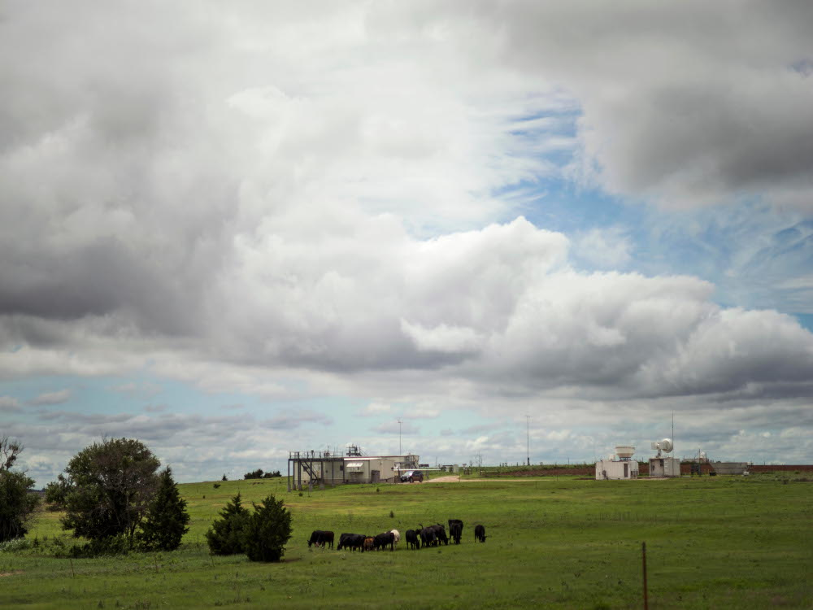
Long-term Microphysical Study: Methodology
Use CoCiP to identify when contrails are present
Filter out for “clear-sky” cases
  Stratiform clouds are opaque in the infrared
  Filter for both height and coverage:
    Cloud base height > 7000 m
    Cloud sky coverage < 50%
Apply MIXCRA algorithm to all valid cases in 2019.
  Several months of 2019 had 8x sondes daily

Slide 8
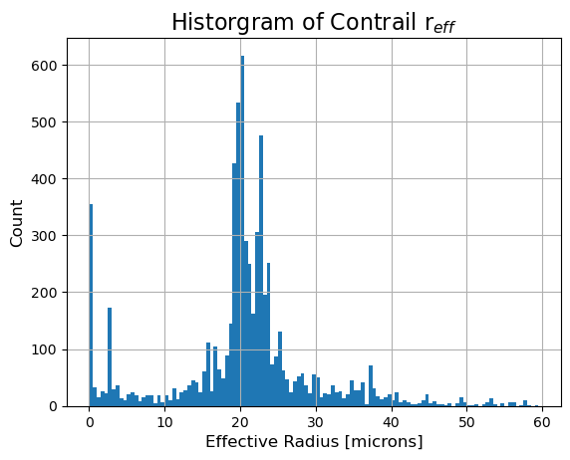
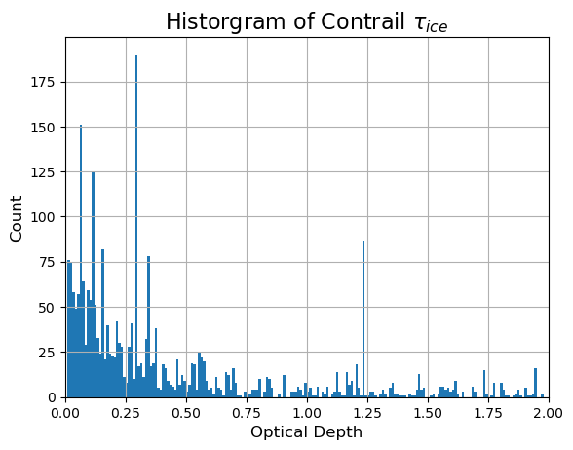
Long-term Microphysical Study: Bulk Characteristics

Slide 9
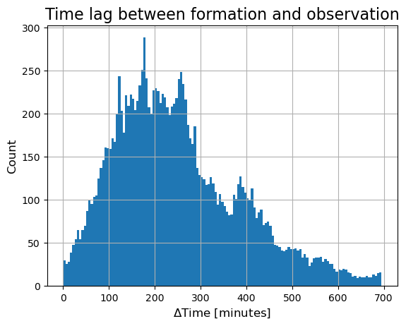
Long-term Microphysical Study
CoCiP provides contrail formation time.
With such a long-term archive, we can capture contrails at a variety of stages.
We’ll only capture a small fraction of brand-new contrails, but given enough time, we’ll get a decent number.

Slide 10
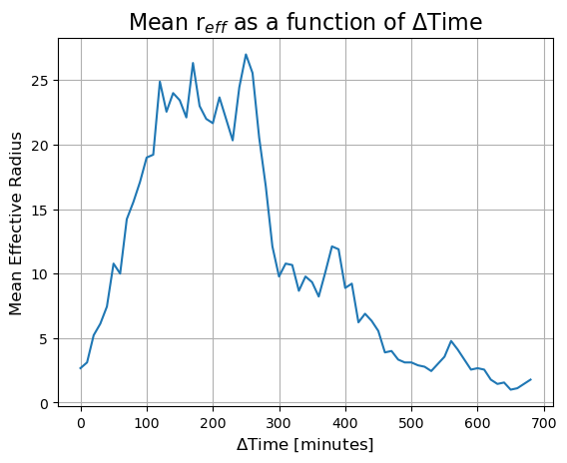
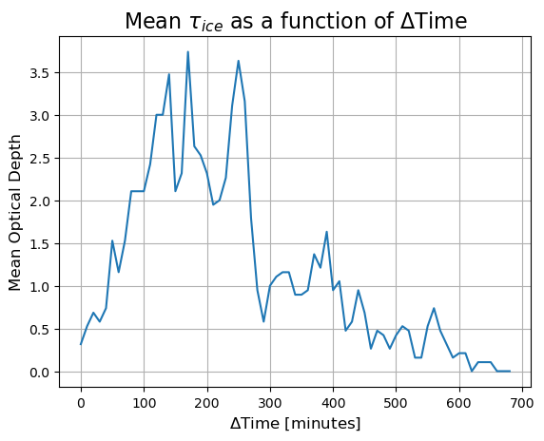
Long-term Microphysical Study
Contrail optical depth driven by particle size.
New contrails have very small particles, but crystals grow with time.
After ~3 h, sublimation exceeds deposition and crystals shrink.

Slide 11
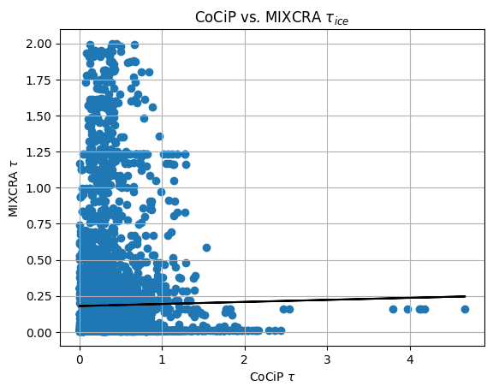
How does CoCiP compare?
CoCiP produces expected optical depth values.
Very little agreement between CoCiP and surface observations.
Finding out why is an active area of research.

Slide 12
Next Steps
Expand SGP analysis dataset:
  MIXCRA is computationally expensive, currently working with DOE to parallelize it.
Look at microphysical results as a function of airframe/engine
Expand to other sites
  ARM sites in Alabama, Azores
  Other AERIs in Wisconsin, Germany, South Korea
Calculate radiative heating rates using TROPoe algorithm
Use for model validation

Slide 13
Takeaways
Literal petabytes of cloud and atmospheric data go back 25+ years.
Active, passive, and in situ remote sensors together can help unlock contrail process understanding.
AERI instrument can be used to calculate cloud microphysical characteristics from downwelling infrared spectra.
Microphysical observations over 1 year show the life cycle of contrail ice crystals, peaking in size about 3 h after formation.
We’re just scratching the surface of what’s possible.
tim.wagner@ssec.wisc.edu

