Slide 1
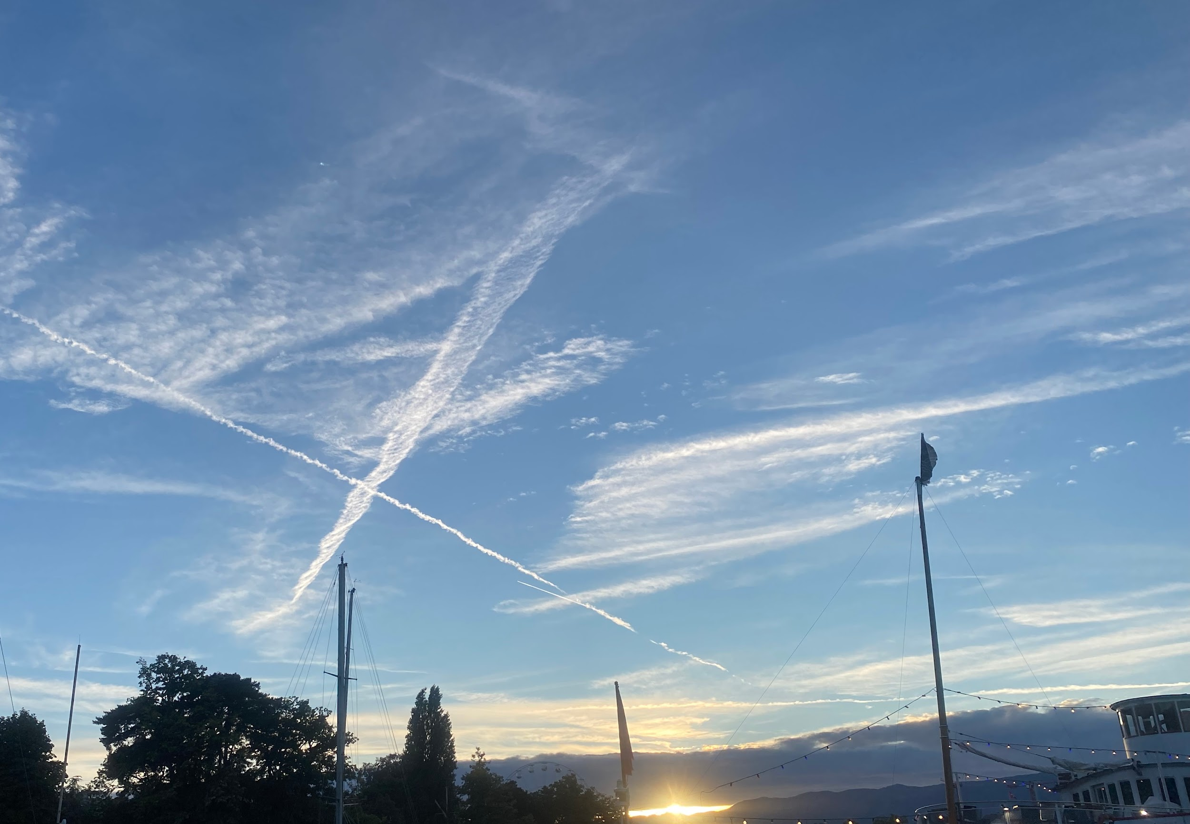







AI-Based Insights into Aviation’s Climate Impact using Satellite Imagery in E-CONTRAIL Project
Irene Ortiz¹, Ermioni Dimitropoulou², Pierre de Buyl², Nicolás Clerbaux², Javier García-Heras¹, Amin Jafarimoghaddam¹, Hugues Brenot³, Jeroen van Gent³, Manuel Soler¹
¹ Universidad Carlos III de Madrid. Madrid,Spain
² Royal Meteorological Institute of Belgium. Brussels, Belgium
³Royal Belgian Institute of Space Aeronomy. Brussels, Belgium

Slide 2
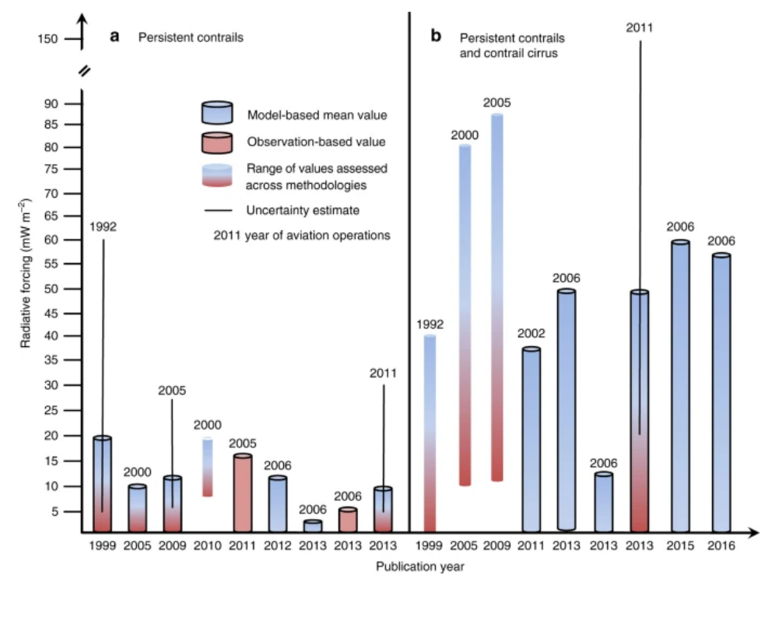
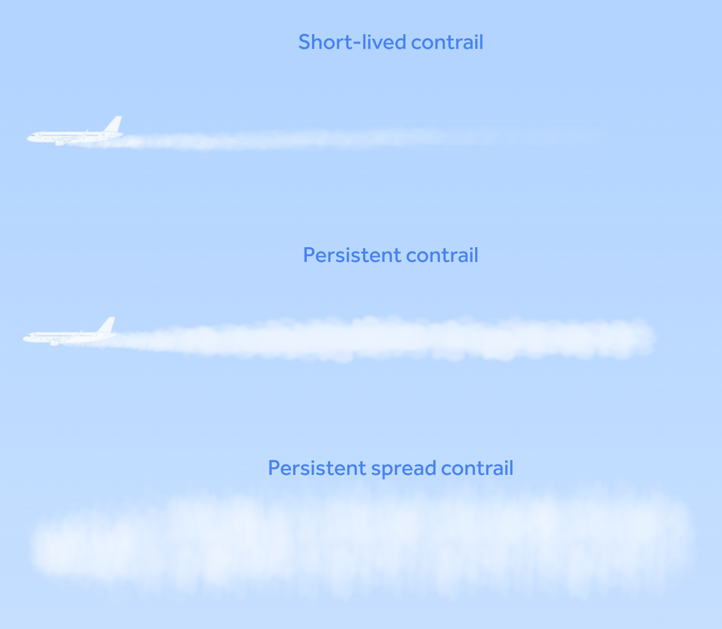
Contrails contribute to global warming (?)
On which extent ?
On global annual scales, contrail net contrail radiative effect is thought to be warming
SW
LW
Scientific Gap -> Uncertainty in the Data / Methods
Scene taken from Dharmendra et. al., 2024

Slide 3
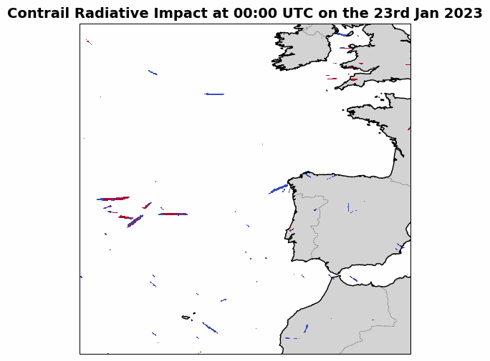
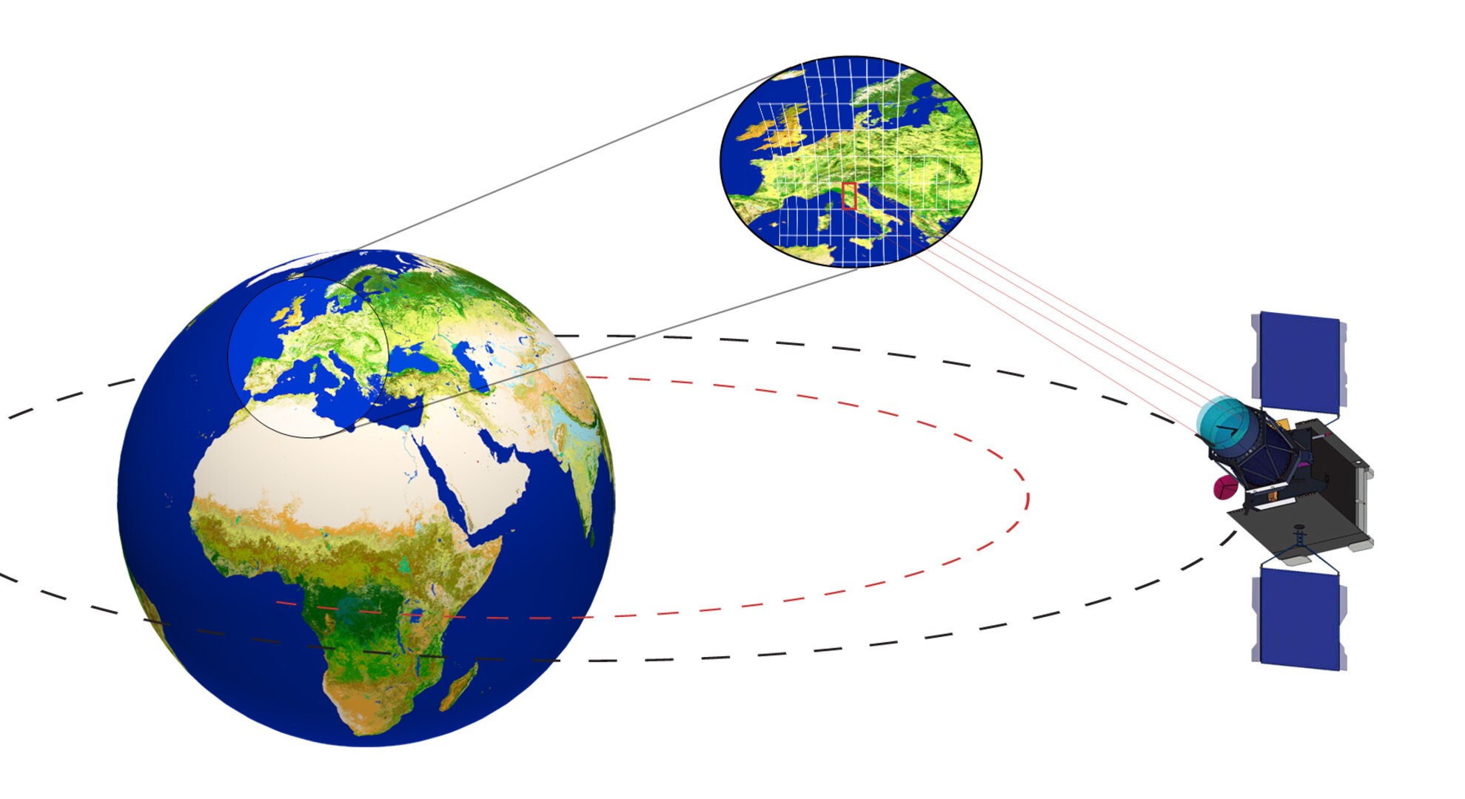
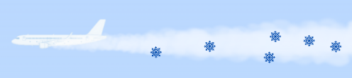
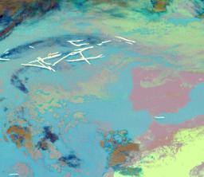
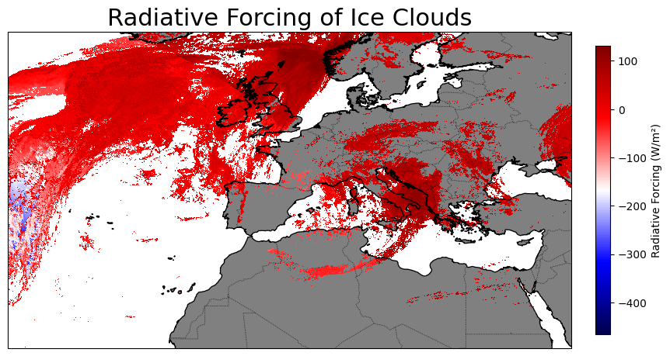
Contrail Impact Quantification in the year 2023
Contrail Detection
Radiative Forcing
Detected contrails and their attributed Radiative Forcing values
SEVIRI (MSG) Infrared Bands
Cloud Microphysics
Input
Input
AI-driven Contrail Identification
Radiative Flux Estimation

Slide 4
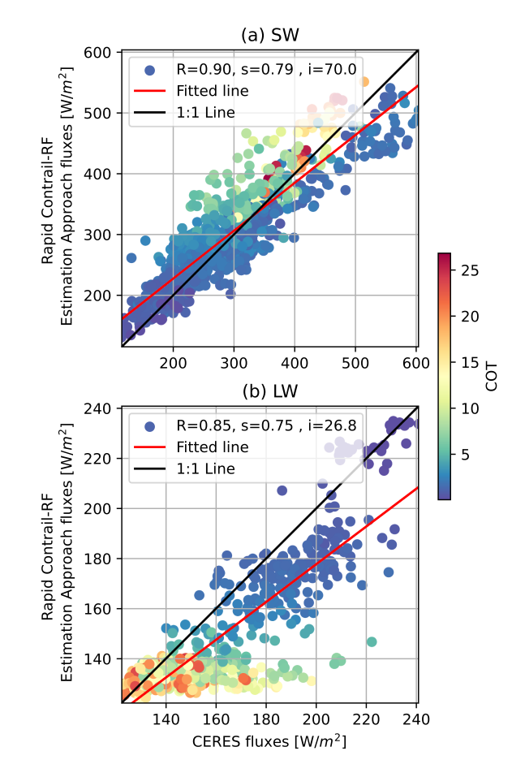
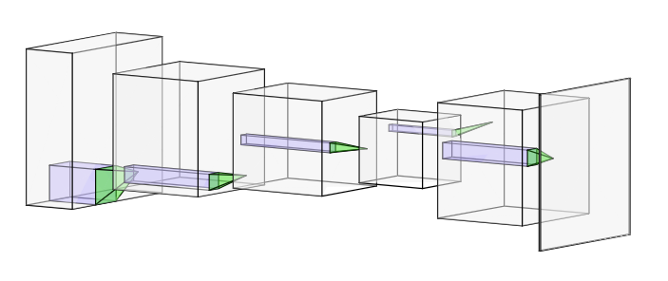
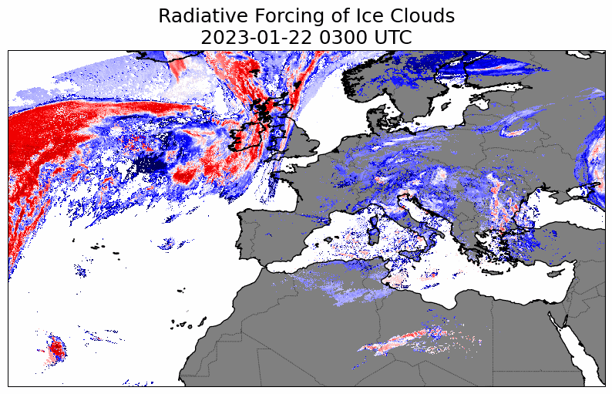
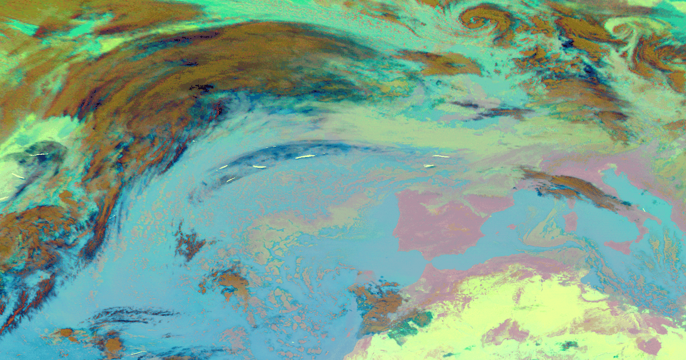
Contrail Impact Quantification in the year 2023
Data
Contrail Detection
Radiative Forcing
SEVIRI (MSG) Infrared Bands & derived OCA cloud products
(Ortiz et. al., 2025)
Method: Neural Network trained on OpenContrails dataset applied to SEVIRI ash RGB composites
Metrics: 70% Dice (80% with 1 pixel tolerance)
Limitations: Identification of evolved contrails and contrail cirrus clouds
(Dimitropoulou et. al., 2025)
Method: Rapid radiative forcing estimation via Look-Up Tables
Metrics: Correlation coefficient of 0.90 (SW flux) and 0.85 (LW flux) against CERES
Limitations: Dependent on OCA characterization (sensitive to cloud overlaps)
Temporal resolution: 15 min
Time Window: The entire 2023
Spatial Extent: [-60,40] x [20,70]

Slide 5
Results of the E-CONTRAIL Project Analysis for 2023

Slide 6
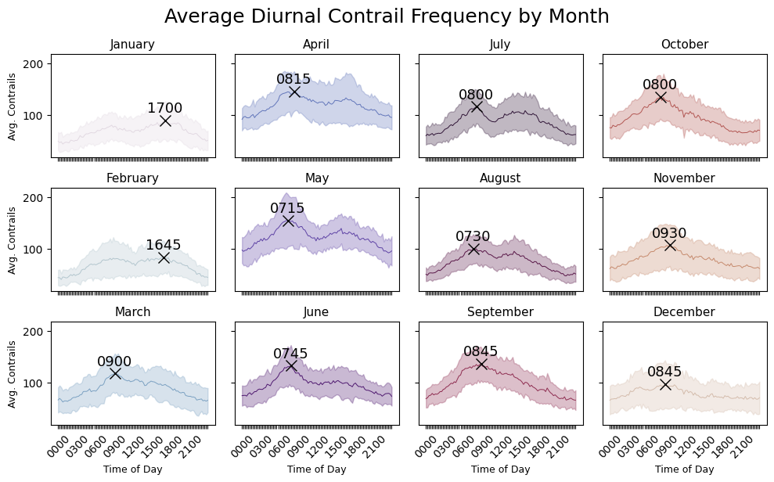
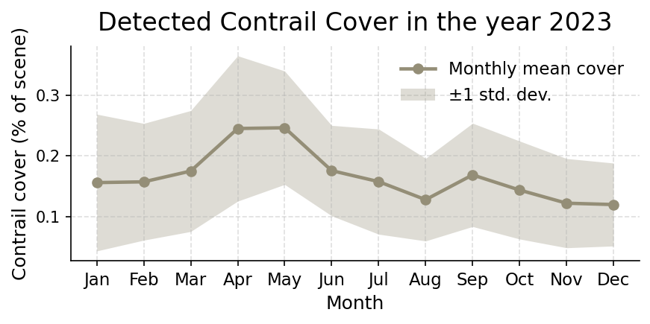
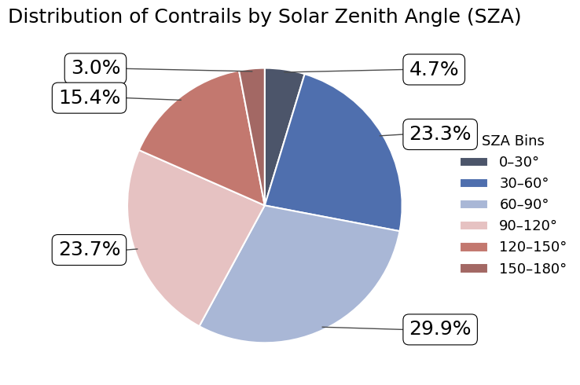
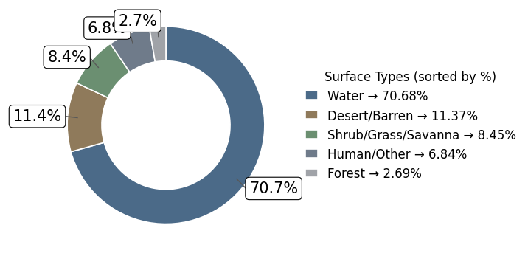
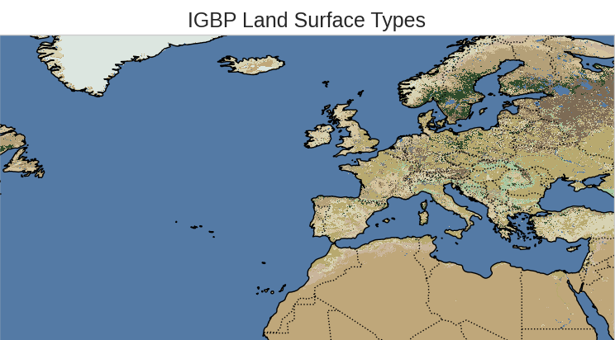
Contrail Detection Results
Monthly contrail coverage values identify April and May as the periods with the highest detected contrail occurrences.
Peak contrail detection times predominantly occur during the early morning hours.

Slide 7
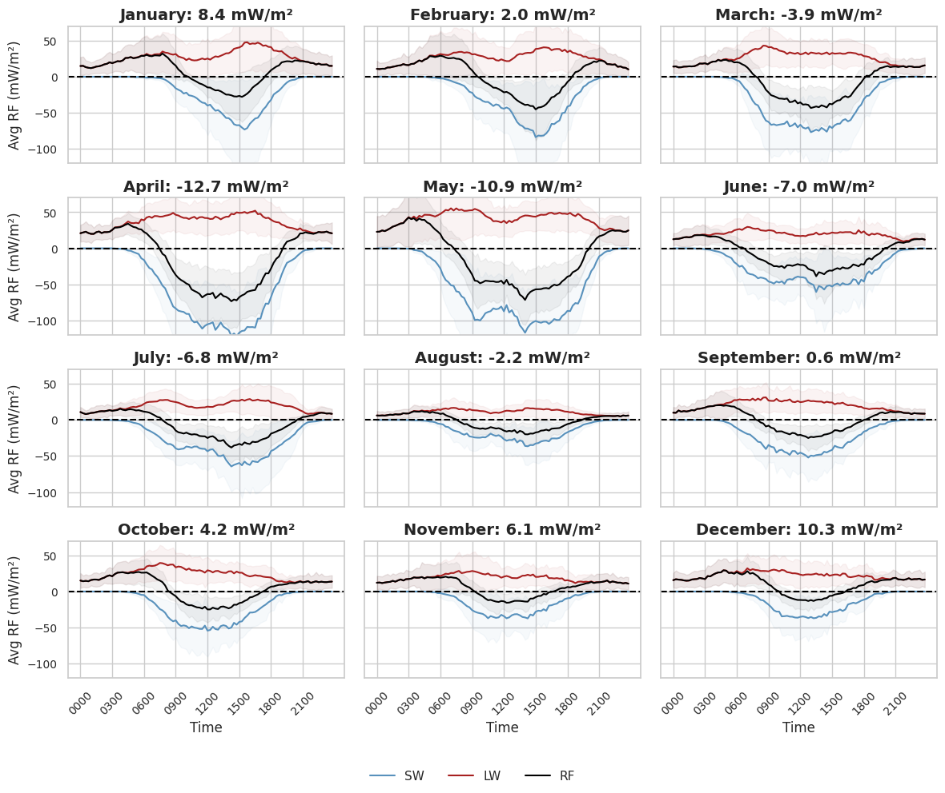
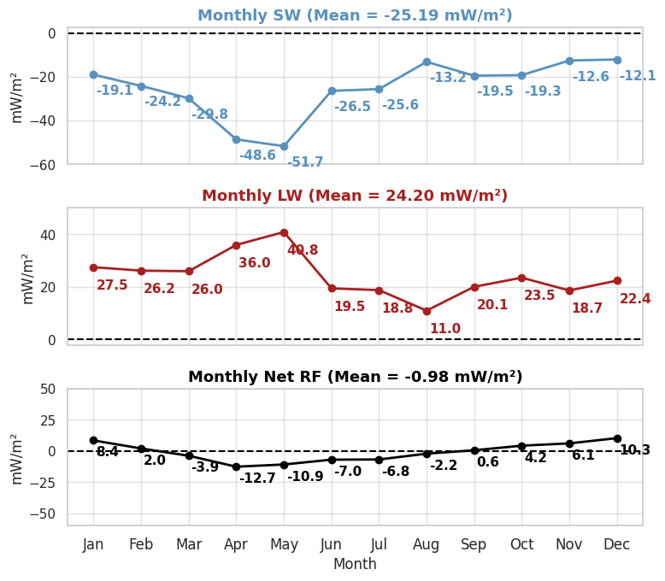
Radiative Forcing Results - Seasonal

Slide 8
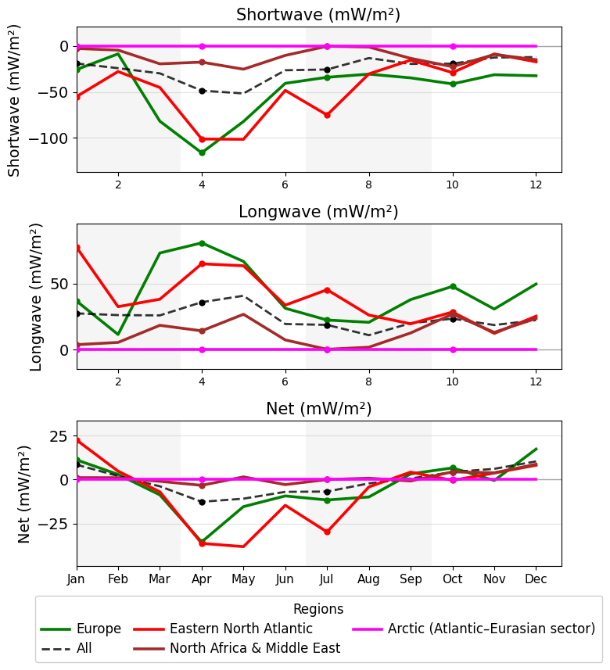
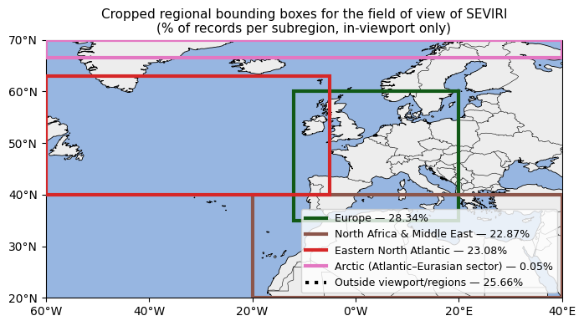
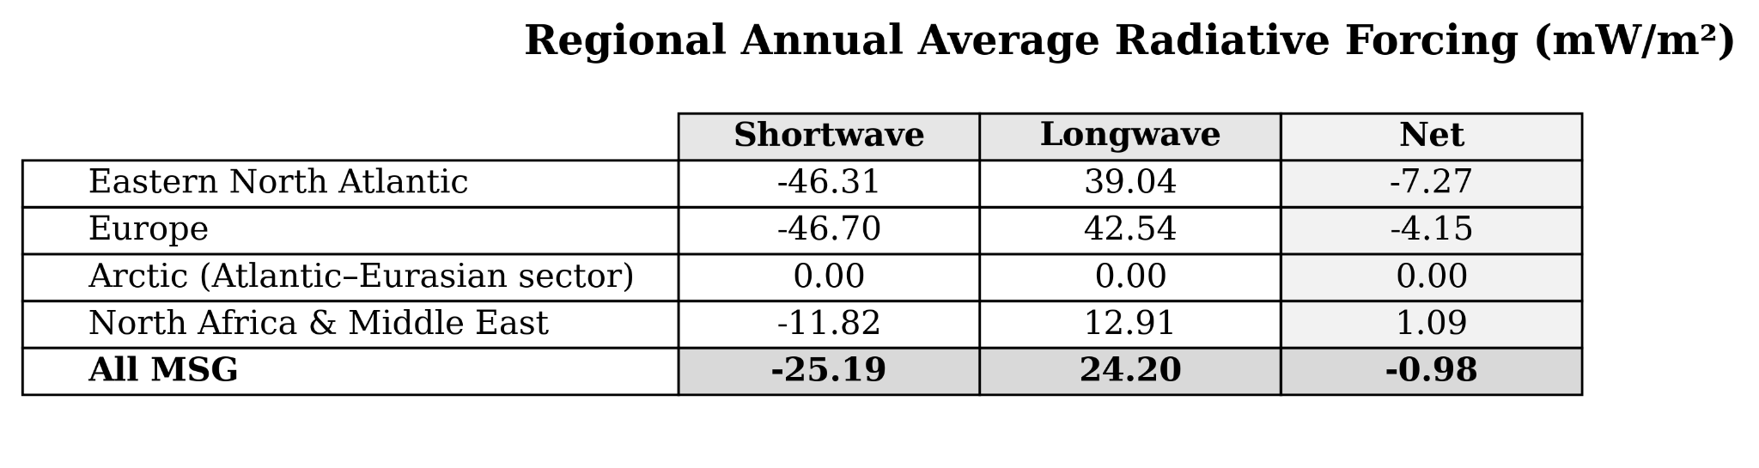
Radiative Forcing Results - Regional
Bounding boxes taken from (Teoh et. al., 2024) cropped to match the field of view of MSG satellites.

Slide 9
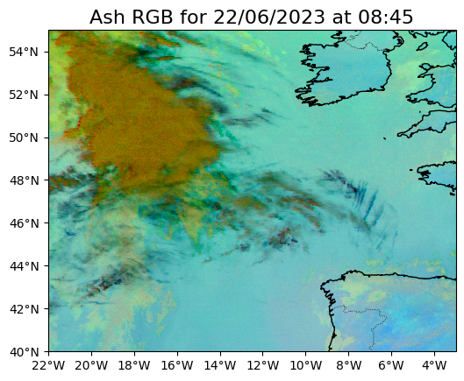
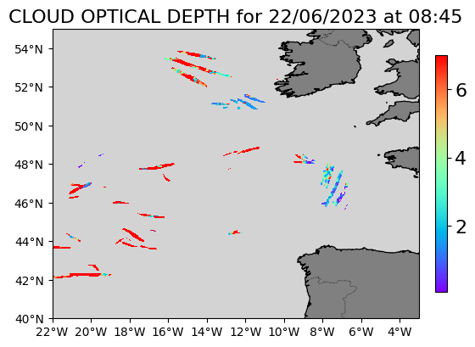
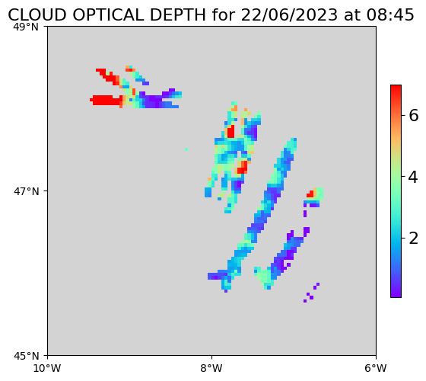
Discussion and Open Problems - Cloud Microphysics
For each detected contrail feature, we report the contrail properties as the MEDIAN of the values provided by OCA across all constituent pixels.
Contrail 1

Slide 10
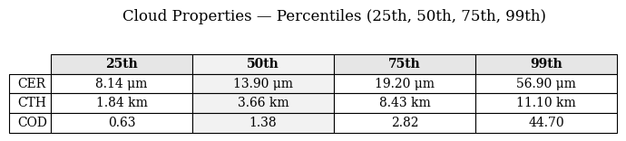
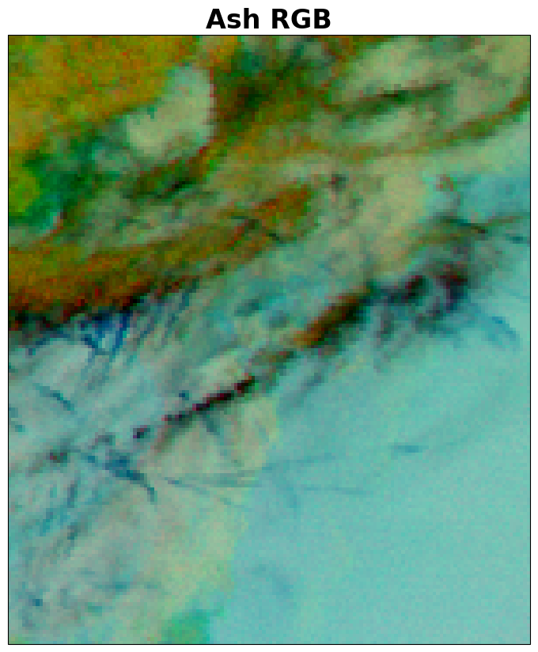
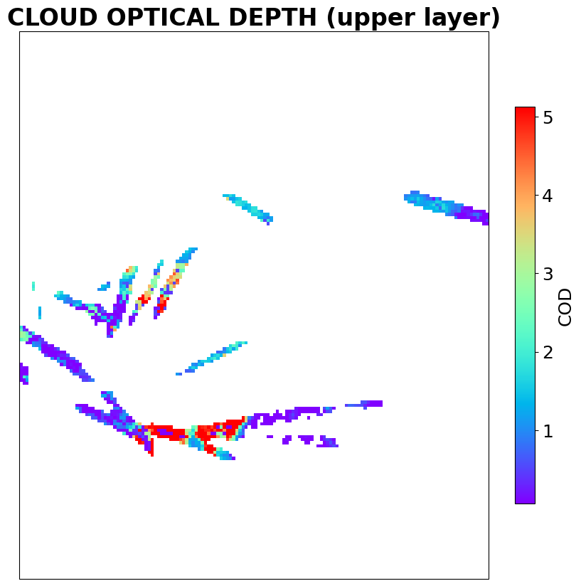
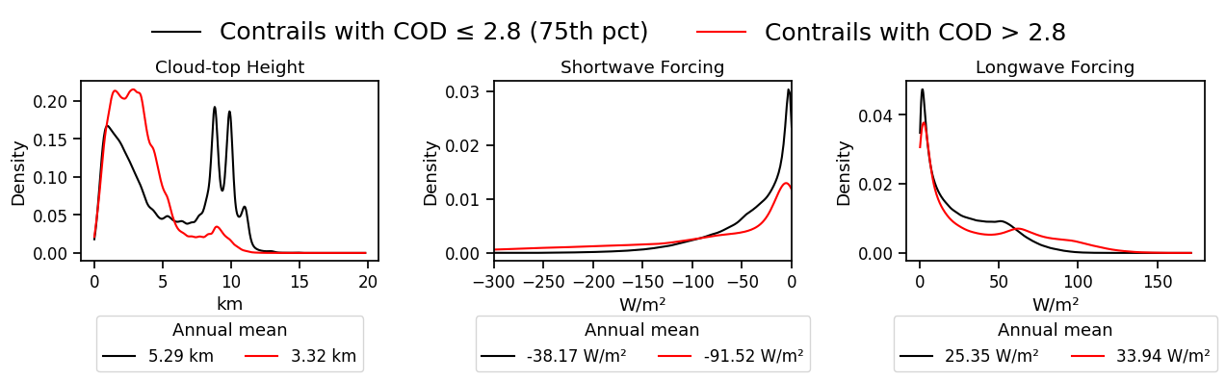
Discussion and Open Problems - Cloud Microphysics
We hypothesize that the OCA algorithm may miss contrail pixels when contrast with the underlying cloud is weak, causing retrievals to reflect cloud properties (e.g., high COD, low CTH). This can affect flux estimates, especially in the shortwave.

Slide 11
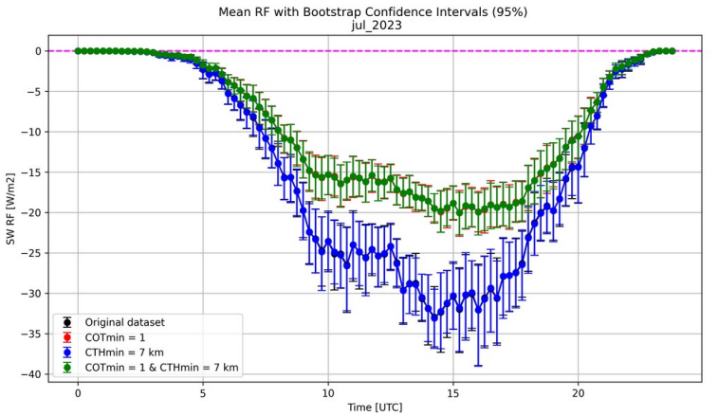
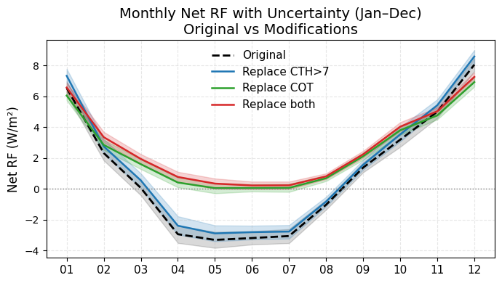
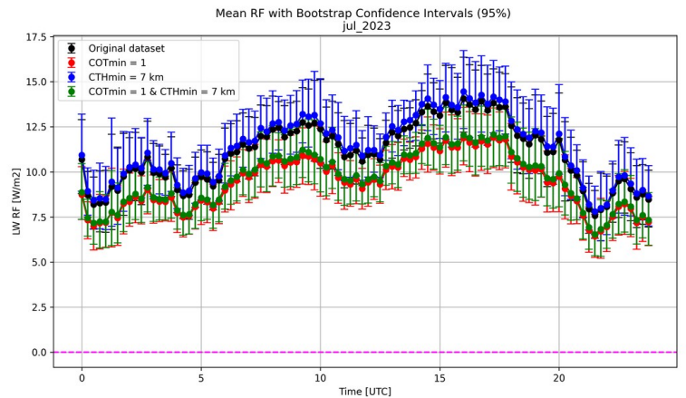
Preliminary Sensitivity Analysis
Re calculation of the SW and the LW fluxes for each single month at all pixels
Winter results are reliable.
Microphysics biases could flip the signal in summer -> contrail warming may be underestimated in summer.

Slide 12
Conclusions
Contrail Detection
Detection peaks occur during early morning.
Highest detection rates are observed in April and May.
~70% of detections are located over mid-latitude oceanic regions.
Fewer contrails are detected at extreme solar zenith angles.
Radiative Forcing
When the thermal contrast between a contrail and the underlying cloud layer is insufficient, the cloud retrieval can misattribute the contrail’s properties
According to the 2023 mean net forcing, linear contrails identified by our method produce a net warming effect with high confidence in winter months, whereas the summer net cooling may underestimate the actual impact.
Reliable Impact Estimates
Potentially Underestimated Impact

Slide 13
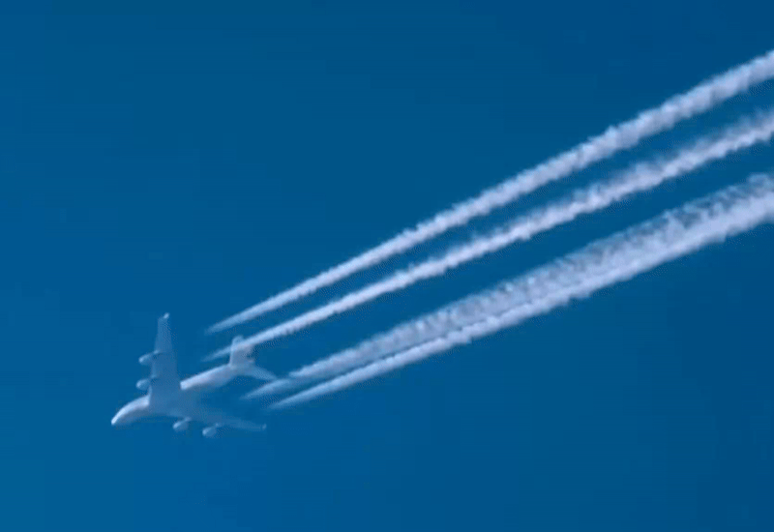
Thank you!

