Slide 1
Observing long-lived longwave contrail forcing
¹ asonabend@google.com
² mccloskey@google.com
Aaron Sonabend-W¹, Scott Geraedts, Nita Goyal, Joe Yue-Hei Ng, Christopher Van Arsdale, & Kevin McCloskey²
Notes:
Image generated by Google Gemini by Googler while working at Google

Slide 2
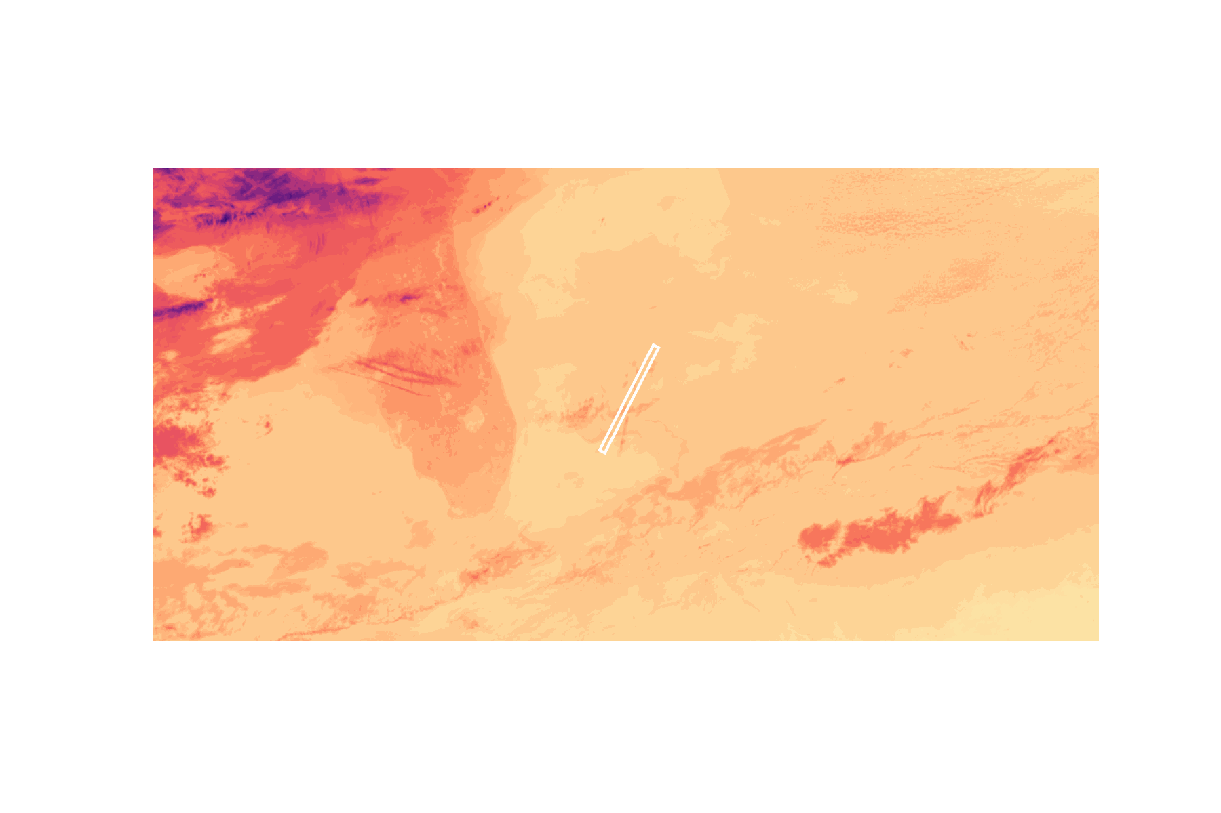
Tracking contrails is hard
Measure warming over the entire contrail lifespan is challenging as they become indistinguishable from natural clouds after a few hours.
Notes:
Image generated by Google Gemini by Googler while working at Google

Slide 3
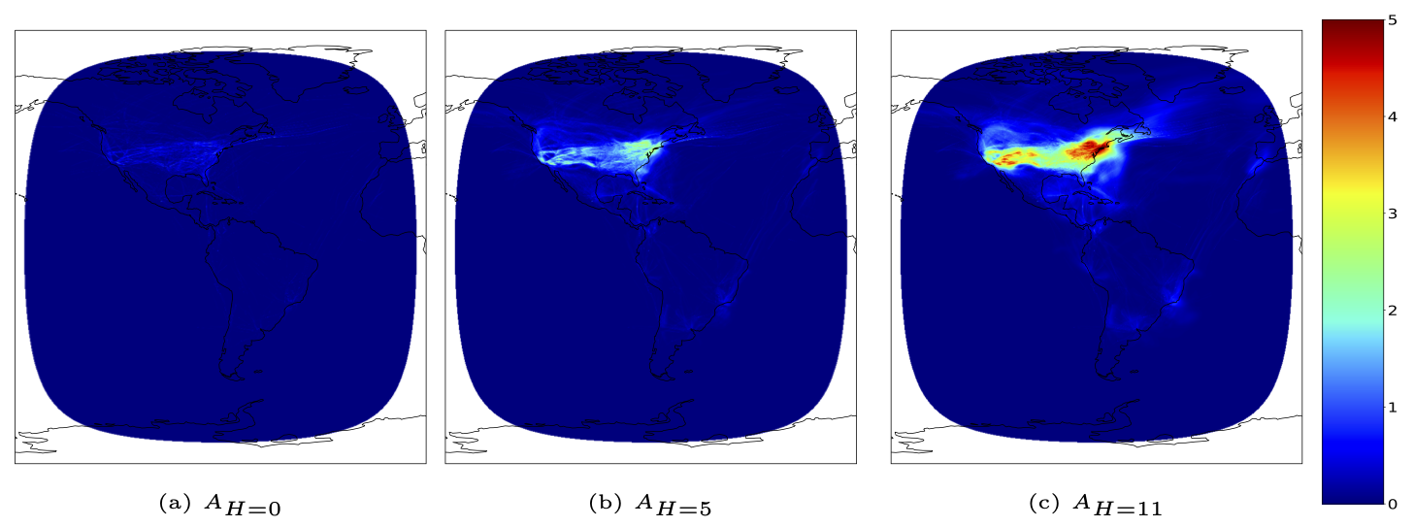
Flights are a good proxy for contrails
Advected trace density (km/km²)
To measure long-lived effects, we advect every flight path forward in time for 12 hours using ERA5 winds.
Flightpaths are licensed from
http://flightaware.com and http://aireon.com
Notes:
Image generated by Google Gemini by Googler while working at Google
To measure long-lived effects, we advect every flight path forward in time for 12 hours using ERA5 winds.
We also model growing wind uncertainty (informed by Figure 3, which shows error growing at 12.4 km/h). This realistically "spreads" the trace density as it ages.
You can see the "treatment" variable spreading from 1 hour (a) to 6 hours (b) and 12 hours (c).
This 12-hour cumulative map (AH=11​) is the full "treatment" variable we use in our model.

Slide 4
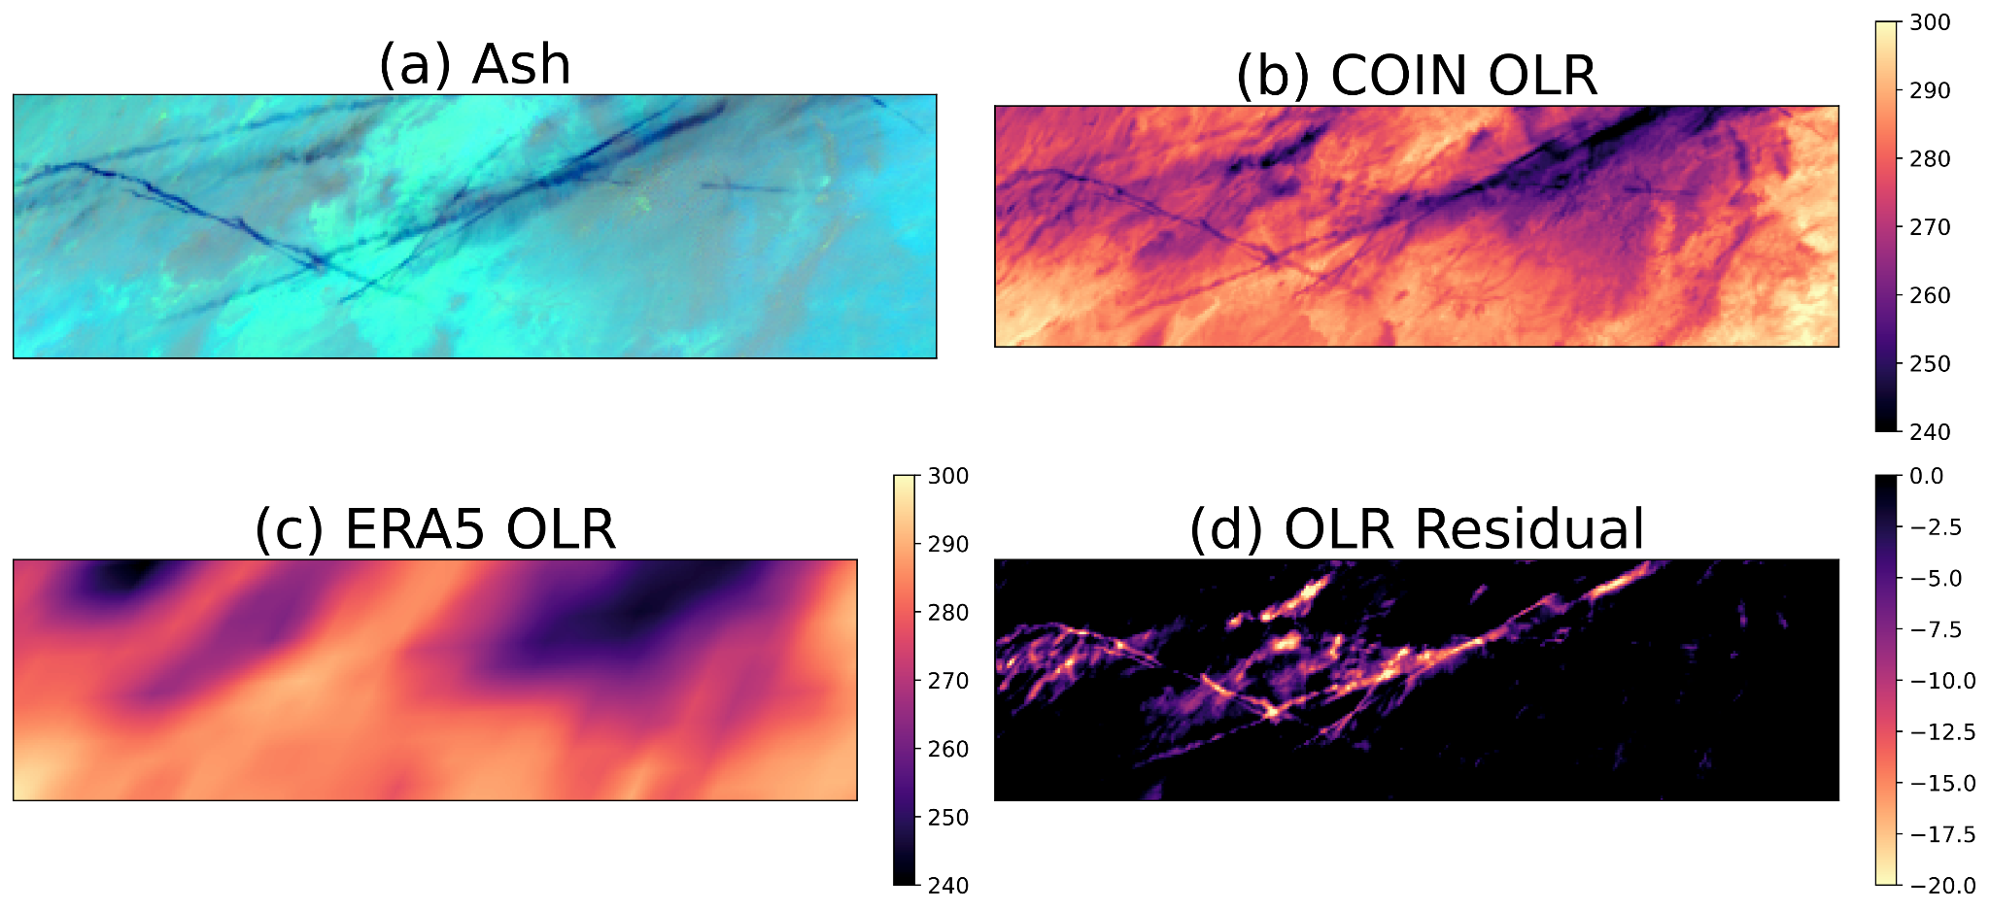
ERA5 residual
Contrail outbreak scene at 2019-07-18 14:20 UTC, southwestern United States
-
=
ERA5 doesn’t assimilate contrails, it’s what the atmosphere would look like without them.
Both young and aged contrails are visible in the residuals
Notes:
Image generated by Google Gemini by Googler while working at Google

Slide 5
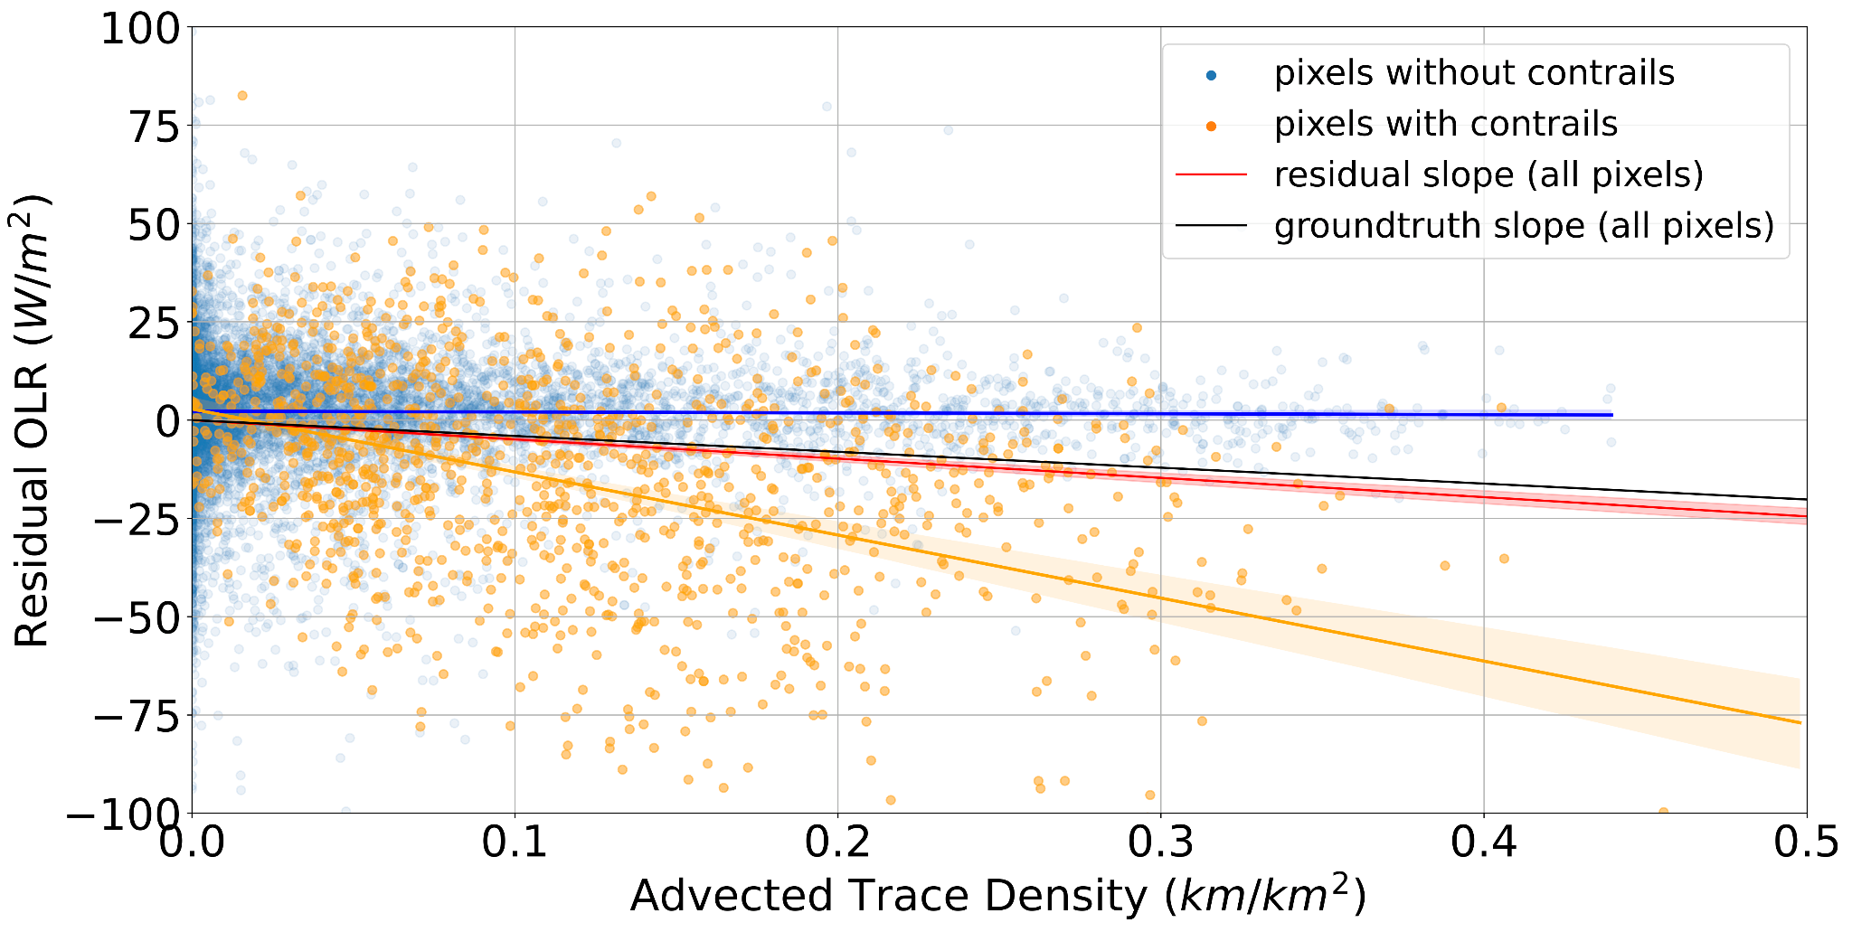
Causal inference regression
There are other sources of difference between ERA5 & COIN: we use causal inference to link flight paths to OLR, while controlling for the weather that causes both
Notes:
Image generated by Google Gemini by Googler while working at Google

Slide 6
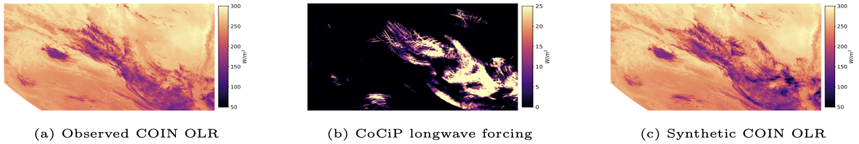
Synthetic groundtruth testbed
+
=
Real satellite data from the Southern Hemisphere: uncorrelated air traffic
Project US flight tracks on Southern Hem., CoCiP generates synthetic contrails with known OLR
Add known OLR to the real satellite data makes our final "Synthetic OLR" scenes
A working causal model should recover the "ground truth" warming we injected from (b) only using the "Synthetic OLR" scenes
Notes:
Image generated by Google Gemini by Googler while working at Google

Slide 7
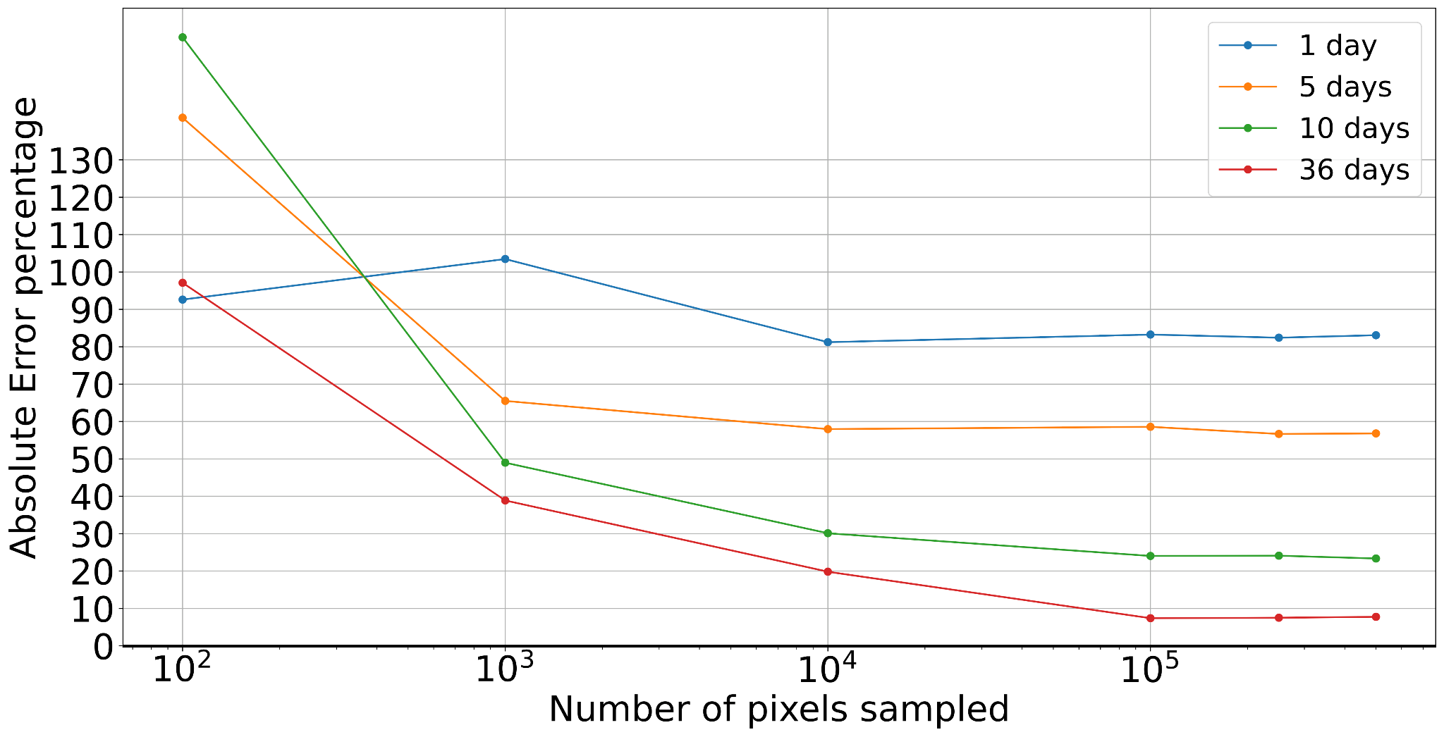
Sample size: independence matters
Accurate estimates require sampling from many different weather patterns (days), not just more pixels.
Notes:
Image generated by Google Gemini by Googler while working at Google
Our synthetic tests showed that simply sampling more pixels is not enough. Adjacent pixels are not independent observations.
Accurate, low-error estimates are only achieved by sampling from many
independent days.
You can see the error stays high for 1 or 5 days (blue/orange lines), but sampling from
36 days (red line) dramatically reduces the error and converges on the right answer.
This confirms our study design of sampling from
183 separate days is robust

Slide 8
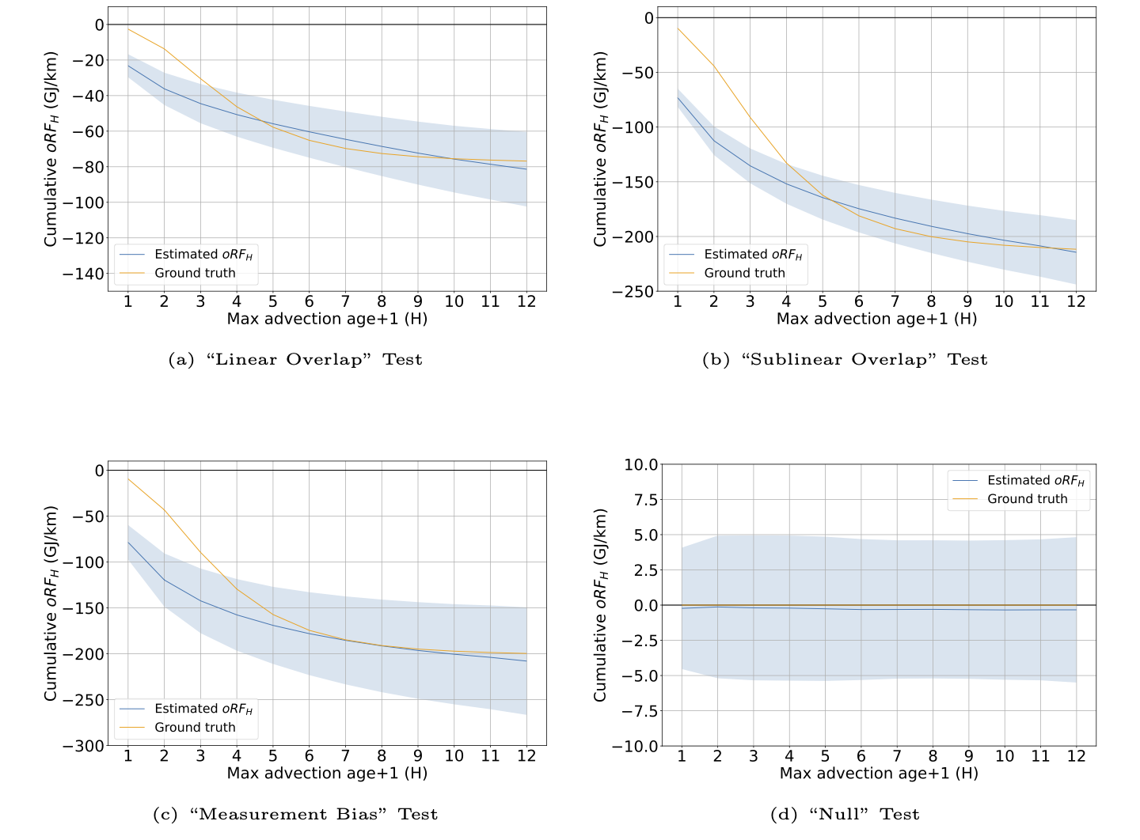
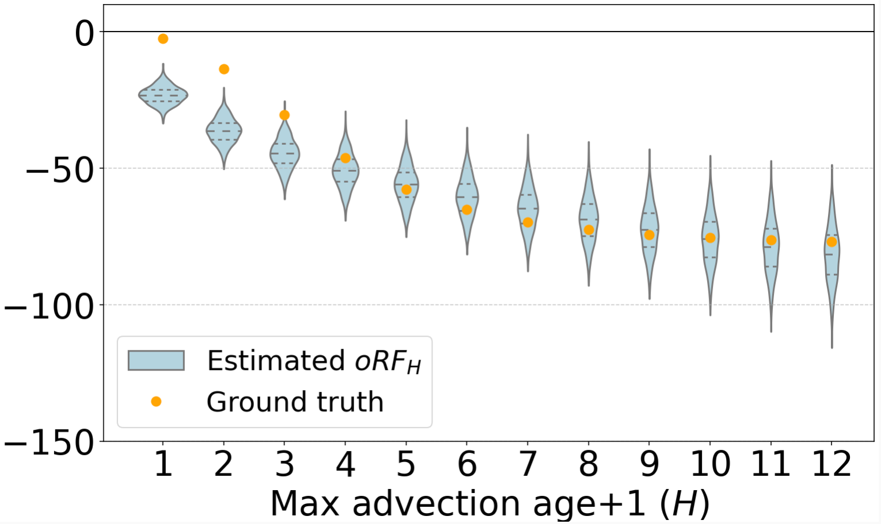
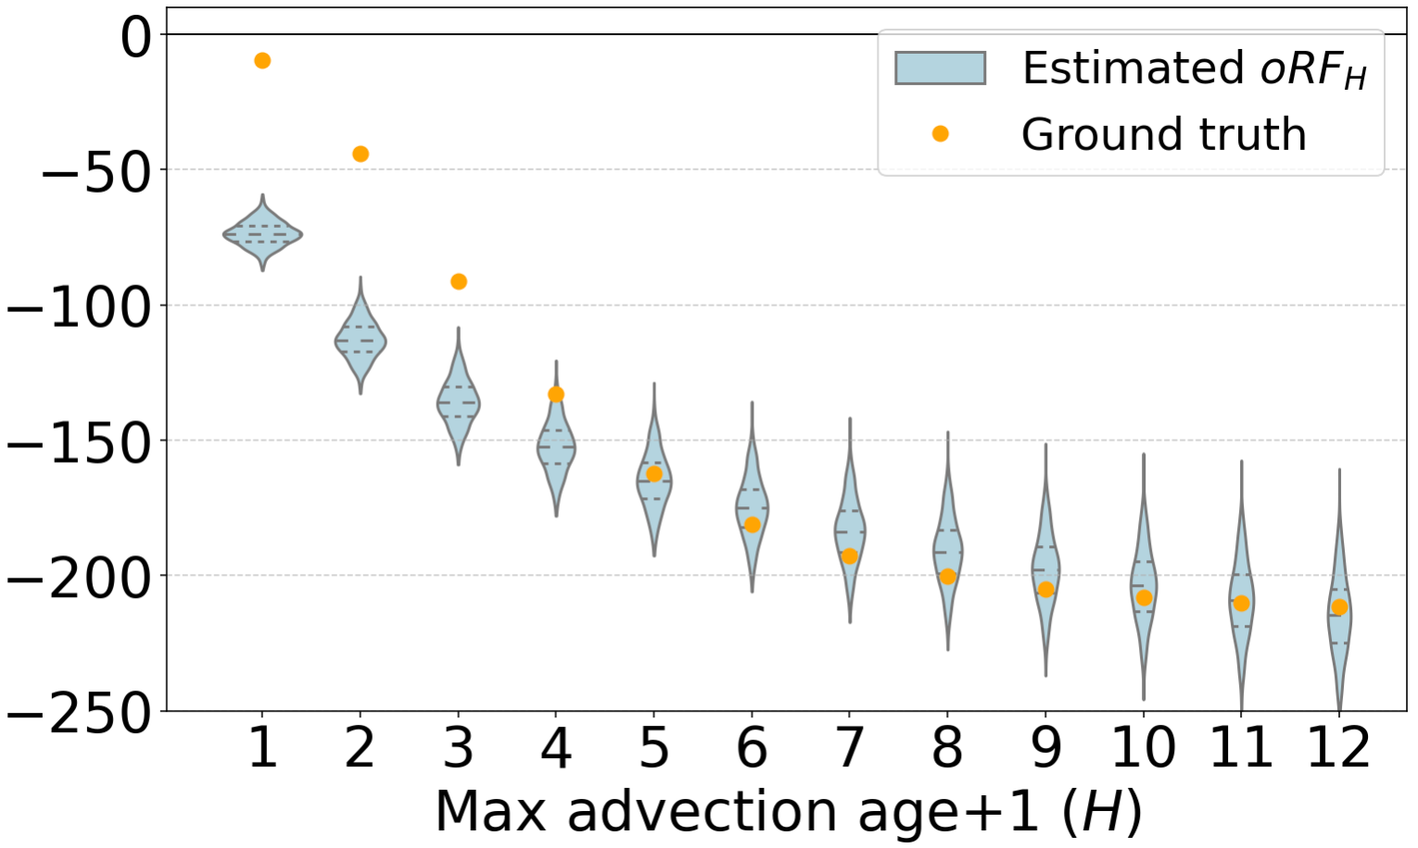
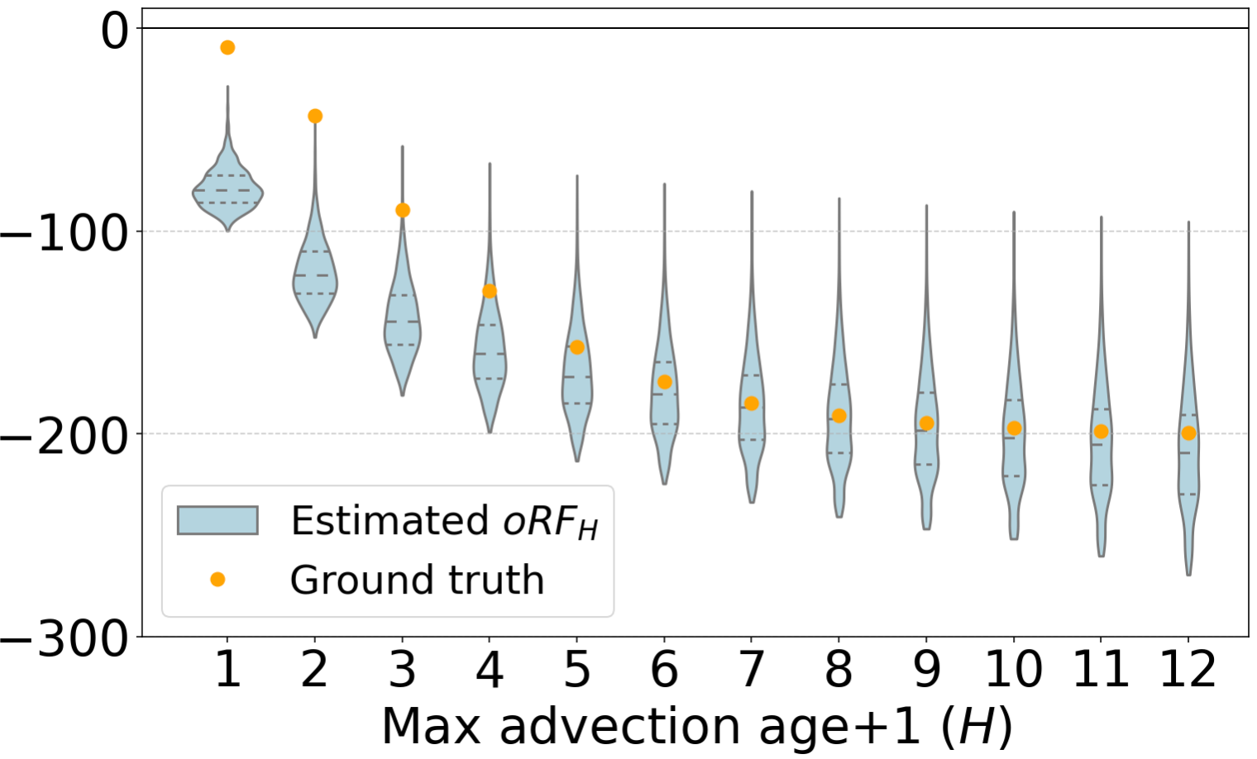
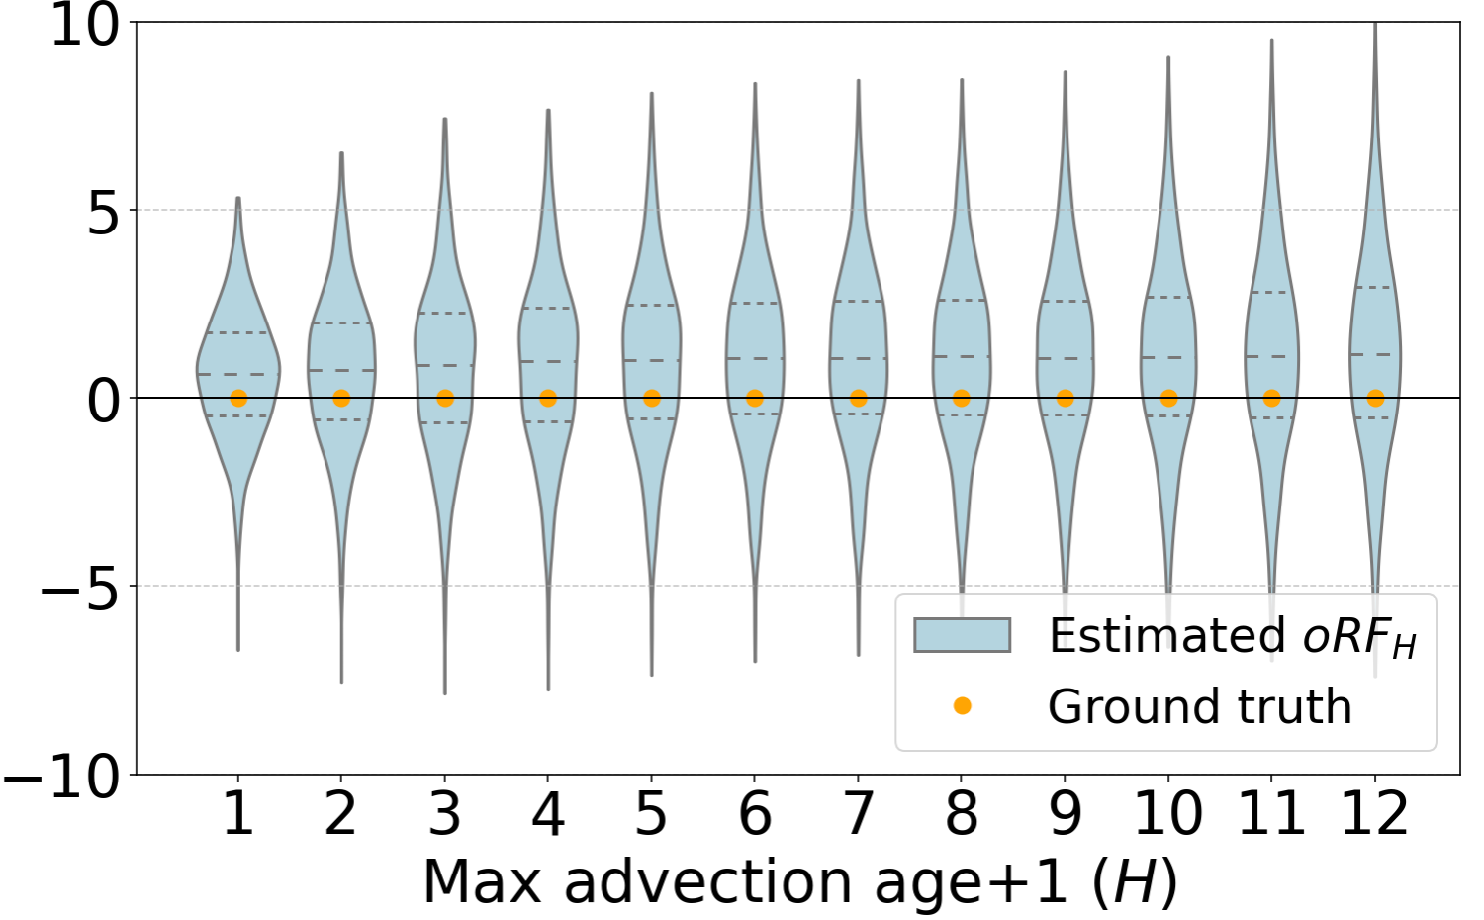
Synthetic testbed results
The model can recover the true effect in complex, noisy data: we can apply it to the real world data
Notes:
Image generated by Google Gemini by Googler while working at Google
The model is accurate. The orange line is the known "Ground Truth" forcing we injected, and the blue line is what our causal model estimated.
It recovers the truth in a simple "Linear Overlap" test (a) and a more realistic "Sublinear Overlap" test (b).
It's robust to measurement bias (c).
Most importantly: In the "Null" Test (d), where we gave the model flight paths but zero synthetic contrails, it correctly and confidently found zero forcing.
This gives us confidence to apply this model to the real world.

Slide 9
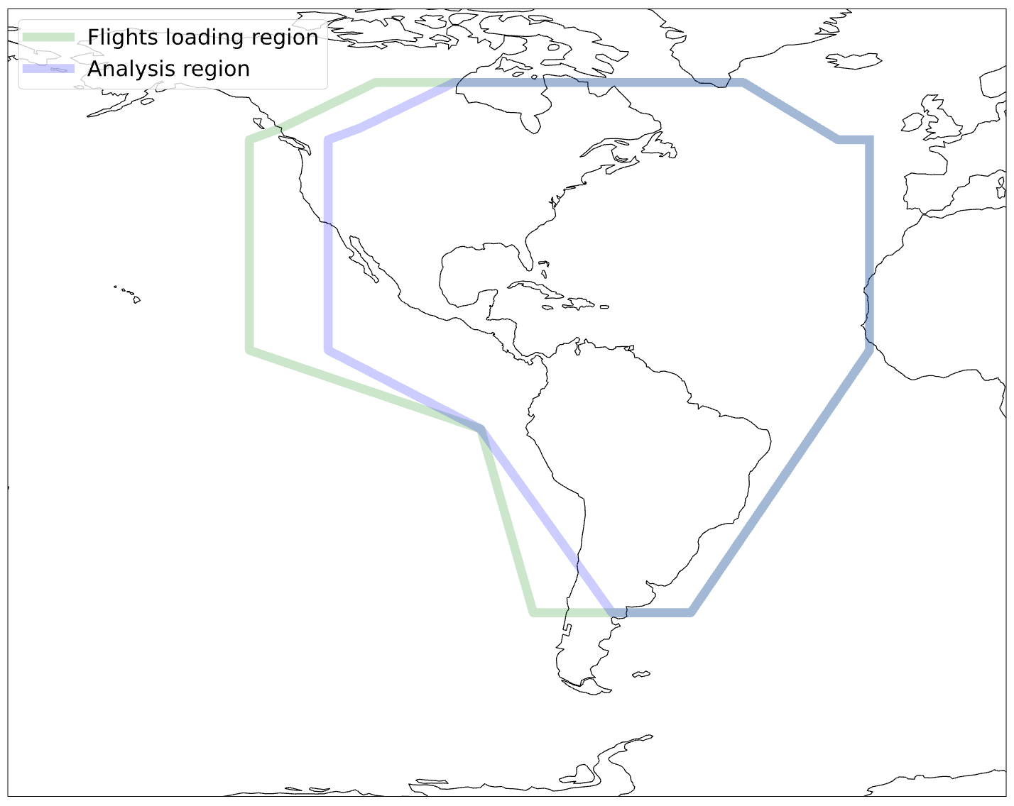
Real Data Analysis Region

Slide 10
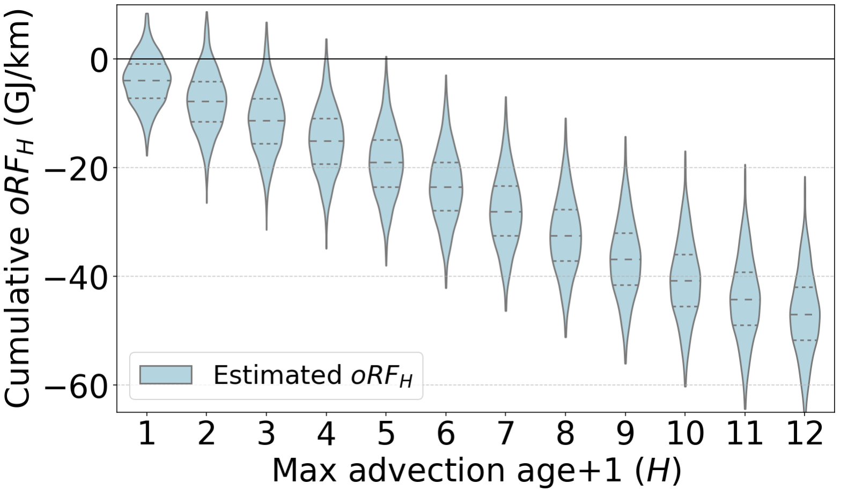
Observed longwave forcing
46.7 GJ/km
60.7 GJ/km
(CoCiP)
We find a persistent warming signal that does not level off at 12 full hours.
Notes:
Image generated by Google Gemini by Googler while working at Google
Now, applying this validated model to the
real data over the Americas:
We see a clear warming signal (a negative, or heat-trapping, change in OLR) that grows as we include older and older contrails.
The forcing does not level off. This strongly suggests contrail warming persists for at least 12 hours, and possibly longer.
Our central estimate for the total
"observational Radiative Forcing, 12 hours" (oRF12​) is 46.9 Gigajoules per flight kilometer.
This provides the first large-scale, satellite-observation-based estimate of long-lived contrail forcing.

Slide 11
Application: MRV evaluation
An MRV system computes the contrail warming of every flight
Lots of different choices when making an MRV system
Simulation-based (e.g. CoCiP, aCCF)
Weather inputs to the simulation (ERA5, ERA5 adjusted, DWD)
Satellite-observation based
Different systems maybe don’t agree with each other! How to decide which one to use?
(Even a non-optimal MRV system likely still has a positive climate impact. But a better MRV system means more contrail forcing avoided for less fuel)
Flights CoCiP says are warming
Flights both say are warming
Flights satellite says are warming
Notes:
Image generated by Google Gemini by Googler while working at Google

Slide 12
ContrailBench for MRV
 | CociP (ERA5 nominal) | CoCiP (corrected) | CoCiP(ANN) | aCCF | Satellite-based detection (Coatsac) | Your model/weather here
GVCCS cameras | # | # | # | # | # | …
GMN cameras | # | # | # | # | # | …
Lidar (Meijer et al.) | # | # | # | # | # | …
Observed forcing | # | # | # | # | # | …
Your benchmark here | … | … | … | … | … | …
Notes:
Image generated by Google Gemini by Googler while working at Google

Slide 13
Questions
Notes:
Image generated by Google Gemini by Googler while working at Google

