Slide 1
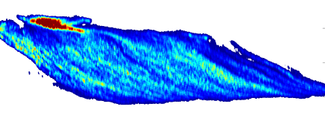
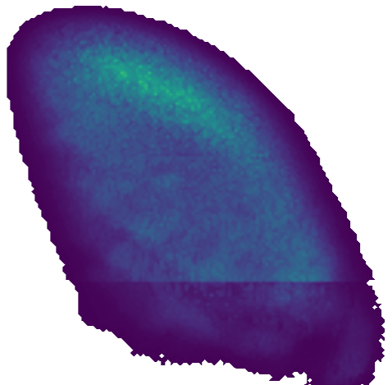
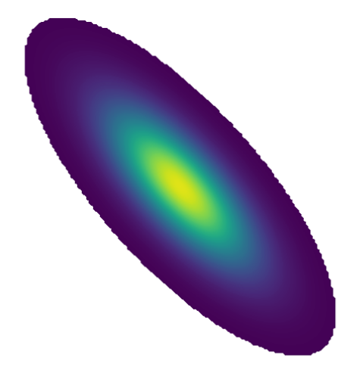
Understanding and addressing scientific compromises in simplified contrail modelling
*All are vertical slices perpendicular to the flight direction
EULAG-LCM (Fig. 2 in Unterstrasser and Sölch 2014)
APCEMM (Adapted from Fig. 2 in Akhtar Martínez et al., 2025)
Caleb Akhtar Martínez
University of Cambridge
ca525@cam.ac.uk
Sebastian D. Eastham
Imperial College London
s.eastham@imperial.ac.uk
CoCiP (Adapted from Fig. 2 in Akhtar Martínez et al., 2025)
Unterstrasser, S. and Sölch, I.: Optimisation of the simulation particle number in a Lagrangian ice microphysical model, Geosci. Model Dev., 7, 695–709, https://doi.org/10.5194/gmd-7-695-2014, 2014.
Akhtar Martínez, C., Eastham, S. D., and Jarrett, J. P.: Zero-dimensional contrail models could underpredict lifetime optical depth, EGUsphere [in press], https://doi.org/10.5194/egusphere-2025-278, 2025.
Notes:
No time spent here

Slide 2
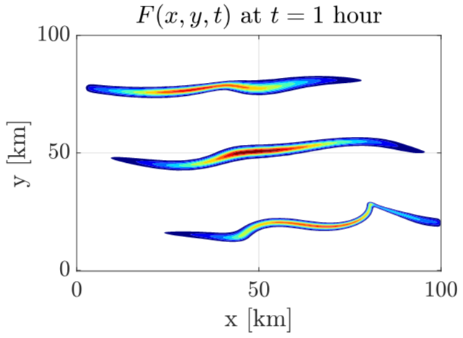
Types of Contrail Models
Contrail Models
0D (No Grid)
2D Grid
3D Grid
and
APCEMM (Adapted from Fig. 2 in Akhtar Martínez et al., 2025)
EULAG-LCM (Fig. 2 in Unterstrasser and Sölch 2014)
CoCiP (Adapted from Fig. 2 in Akhtar Martínez et al., 2025)
Plan view (Fig. 4 in Jafarimoghaddam and Soler, 2025)
Jafarimoghaddam, A., Soler, M.: A Multi-Physics Eulerian Framework for Long-Term Contrail Evolution, arXiv [in press], https://doi.org/10.48550/arXiv.2509.00965, 2025.
Notes:
Explain that different modelling choices need to be made. More accurate models (with fewer feature sacrifices) tend to be extremely computationally expensive

Slide 3
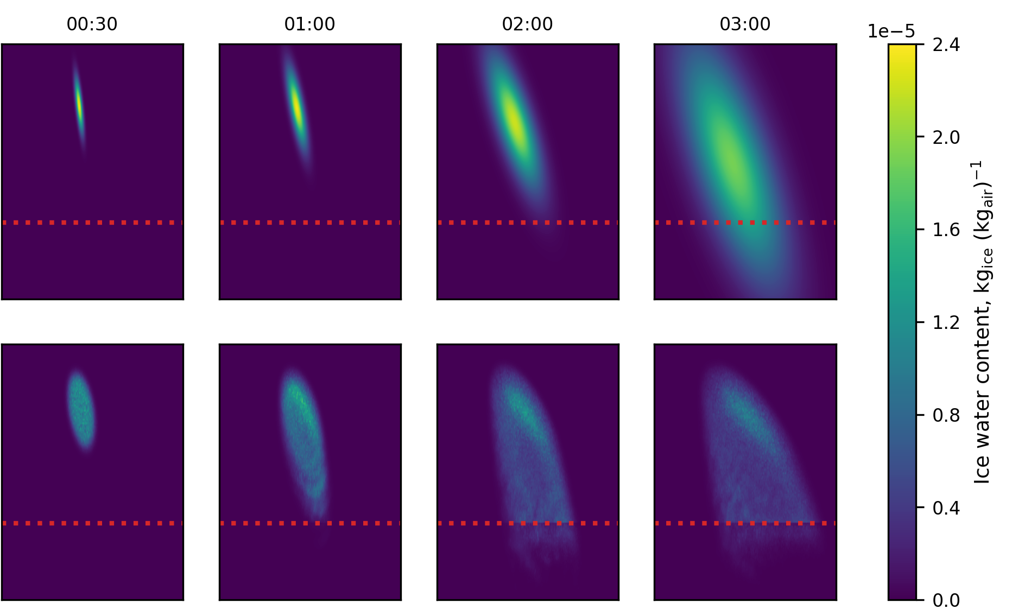

Time Evolution of CoCiP and APCEMM
CoCiP
ContrailCore
APCEMM
Precip. Plume
*Produced for and presented at EGU25

Slide 4
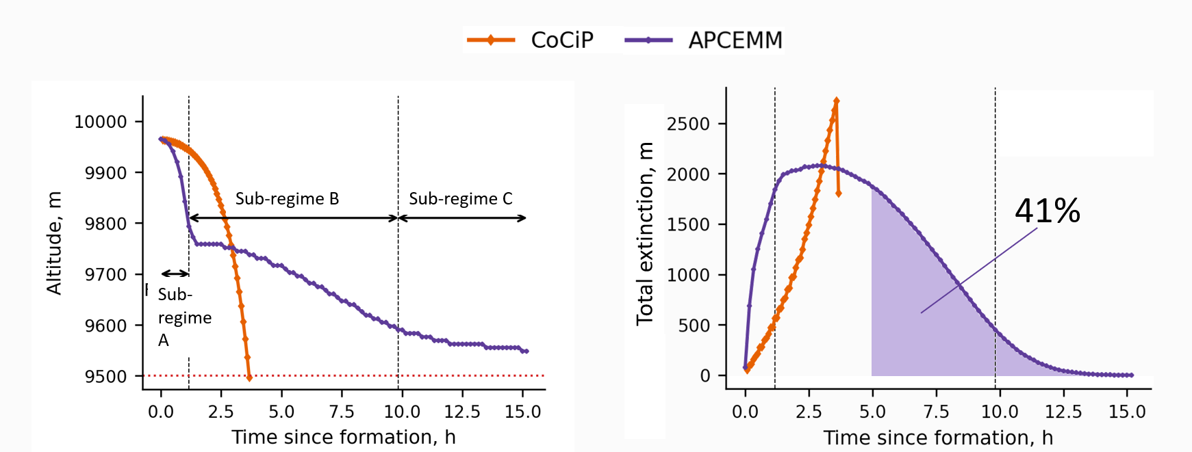
Implications (1/3)
Adapted from Fig. 5 in Akhtar Martínez, C., Eastham, S. D., and Jarrett, J. P.: Zero-dimensional contrail models could underpredict lifetime optical depth, EGUsphere [in press], https://doi.org/10.5194/egusphere-2025-278, 2025.

Slide 5
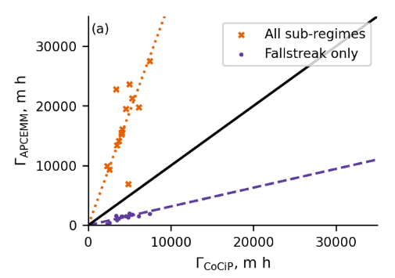
Implications (2/3)
Sub-regime A
APCEMM Time-Integrated Total Extinction, m h
CoCiP Time-Integrated Total Extinction, m h
Adapted from Fig. 6 in Akhtar Martínez, C., Eastham, S. D., and Jarrett, J. P.: Zero-dimensional contrail models could underpredict lifetime optical depth, EGUsphere [in press], https://doi.org/10.5194/egusphere-2025-278, 2025.

Slide 6
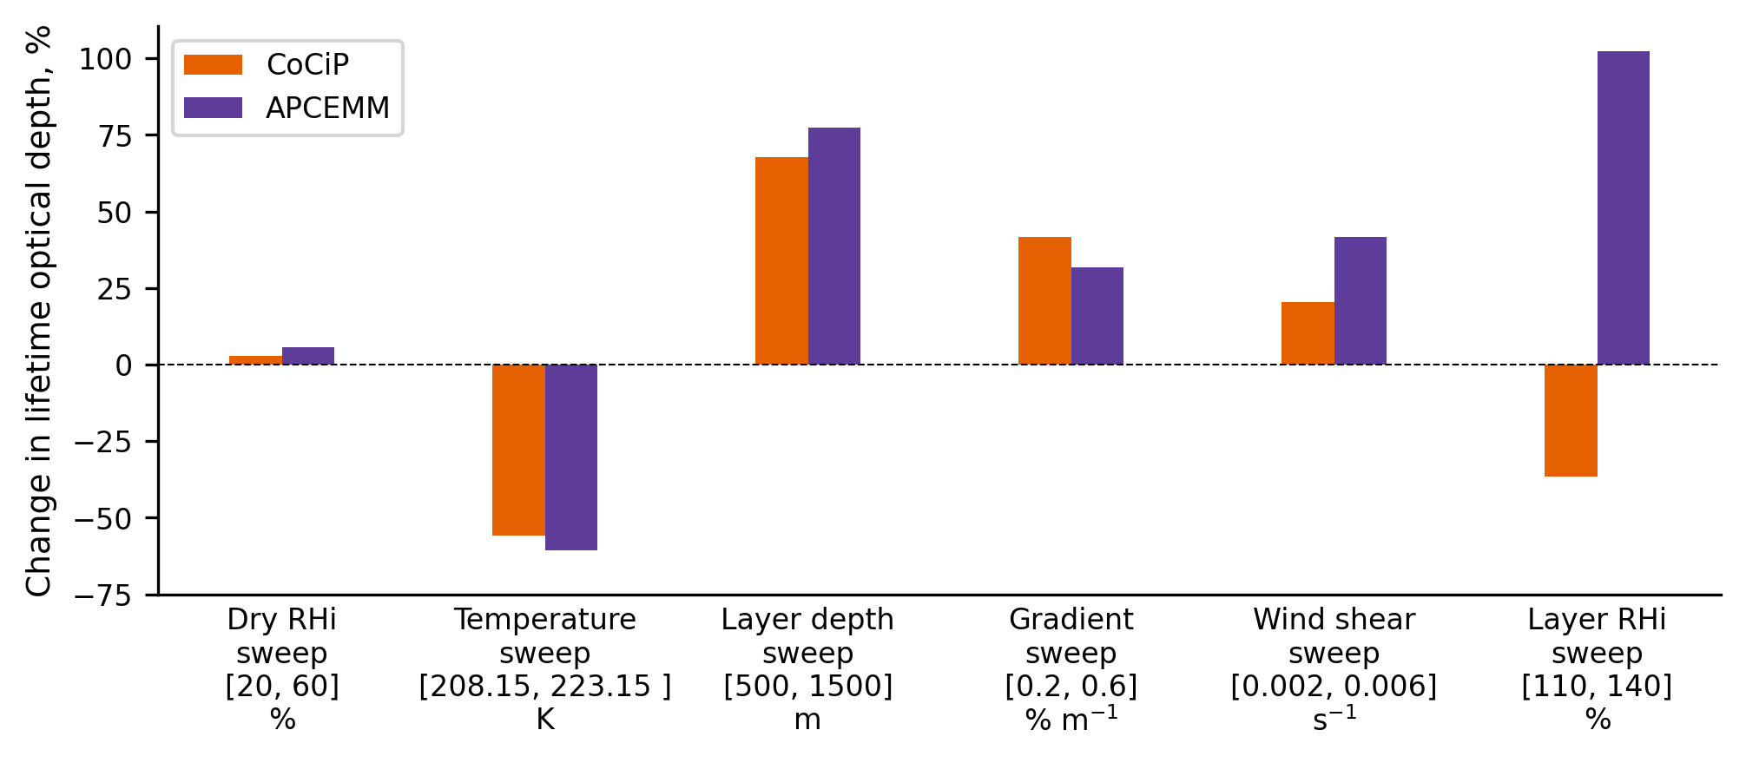
Implications (3/3)
Adapted from Fig. 7 in Akhtar Martínez, C., Eastham, S. D., and Jarrett, J. P.: Zero-dimensional contrail models could underpredict lifetime optical depth, EGUsphere [in press], https://doi.org/10.5194/egusphere-2025-278, 2025.

Slide 7
Key Compromises: 0D vs 2D
CoCiP (0D)
APCEMM (2D)
Gravitational size sorting not possible
One-way interaction with meteorology
Etc…
Very slow. Runtime ~hrs on a single core.
Absence of 3D effects (except stretching)
Etc…
What elements of a contrail model are required to capture the functional relations of real contrails?

Slide 8
What can we do about this?
Target
region
3D LES
Targeted avoidance requires models which robustly* capture functional relationships
How can we achieve sufficient* accuracy without incurring unacceptable* cost?
*Citation needed
Accuracy of modeled
RF versus inputs
APCEMM
0D
models
Cost per contrail
(log scale)
Third Annual Contrail Analysis Workshop – August 17 2025
Notes:
From a contrail science perspective, there are three needs:
Avoidance: requires accurately representing relationship between local conditions and contrail energy forcing
Science: requires maximum-accuracy models to enable deep scientific investigations
Exploration: models which are both reasonably fast and reasonably accurate

Slide 9
MANUSCRIPT IN PREP
Please do not cite or quote
Contrail Layer Approx. using Multi-crystal Parcels (CLAMP)
N Lagrangian super-particles (“clusters”) – each represents 1/N of the formed ice crystals
Contrail volume described
using a convex hull around
representative particles
Meteorological quantities held on a gridded field
80%
RH_{i}
120%
Third Annual Contrail Analysis Workshop – August 17 2025
Notes:
One approach is to revisit the way in which we approximate the contrail
Two issues identified by Caleb: we need to resolve the background humidity field, and we need to resolve heterogeneity of the crystals
A mixed Eulerian-Lagrangian approach promises to do that

Slide 10
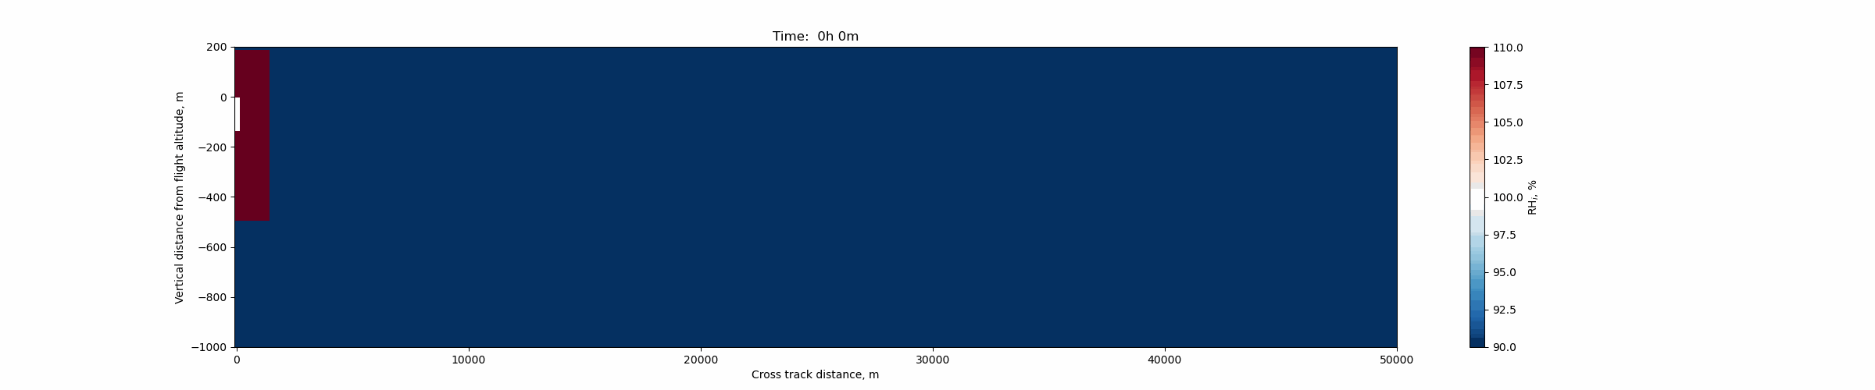
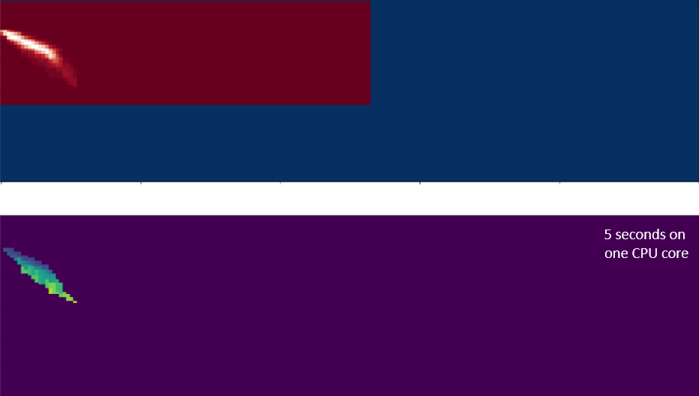
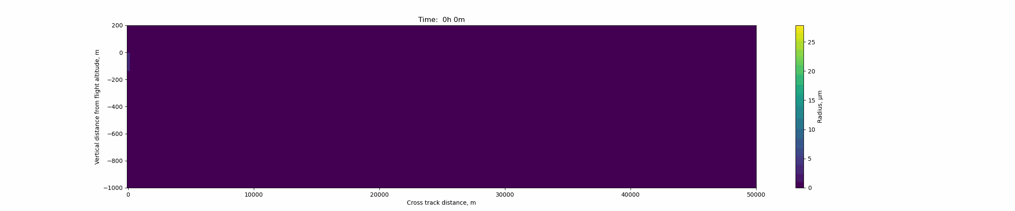
110
Flight
altitude
Upper panel:
air relative humidity
-400 m
RH_{i}, %
100
-800 m
90
14-hour simulation of one contrail: CLAMP results
Flight
altitude
5 seconds on
one CPU core
25
Vertical: distance below
the initial flight
Lower panel:
local crystal radius
(discretized)
-400 m
Radius, μm
-800 m
Horizontal: distance across the flight track
0
Flight location
20 km East of flight
40 km East of flight

Slide 11
110
Flight
altitude
-400 m
RH_{i}, %
100
-800 m
90
14-hour simulation of one contrail: CLAMP results
Flight
altitude
~60 seconds on
one CPU core
25
-400 m
Radius, μm
-800 m
0
Flight location
20 km East of flight
40 km East of flight

Slide 12
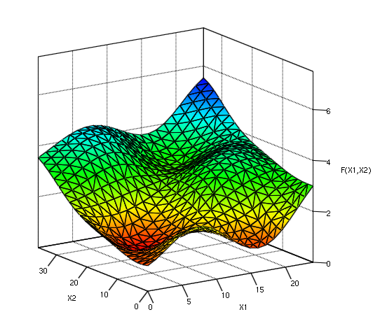
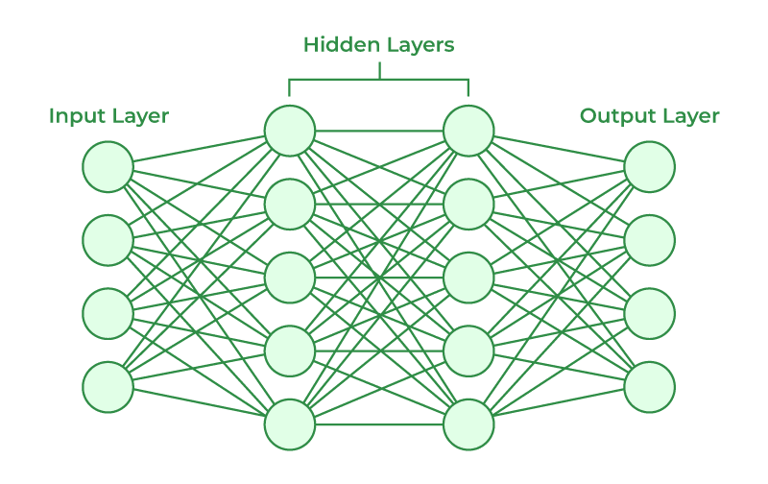
What about other approaches?
CLAMP aims to be minimal viable plume..
but likely still too expensive
Physical accuracy: Further work necessary to advance plume process models but also develop grid-scale interaction models
Computational cost: explore regression-based approaches to achieve this at scale
Third Annual Contrail Analysis Workshop – August 17 2025

Slide 13
Caleb Akhtar Martínez
University of Cambridge
ca525@cam.ac.uk
Sebastian D. Eastham
Imperial College London
s.eastham@imperial.ac.uk

