Slide 1
Update on the current status of the Poll-Schumann aircraft performance model and future developments
Professor Ian Poll

Slide 2
Origin objectives for the P-S model
Recognition of the need for a better method to estimate the cruise fuel burn and engine efficiency as a function of Mach number and altitude
Recognition of the need for
  accuracy and simplicity
  useable by non-experts
  open source
  independently verifiable

Slide 3
More specifically for the climate science community……
needs to compute fuel consumption and overall propulsion efficiency for given aircraft type (ICAO code), FL, Mach number, and mass.
• cover all subsonic airliners and business jets.
• available to the science community, with clear algorithms and open access data.

Slide 4
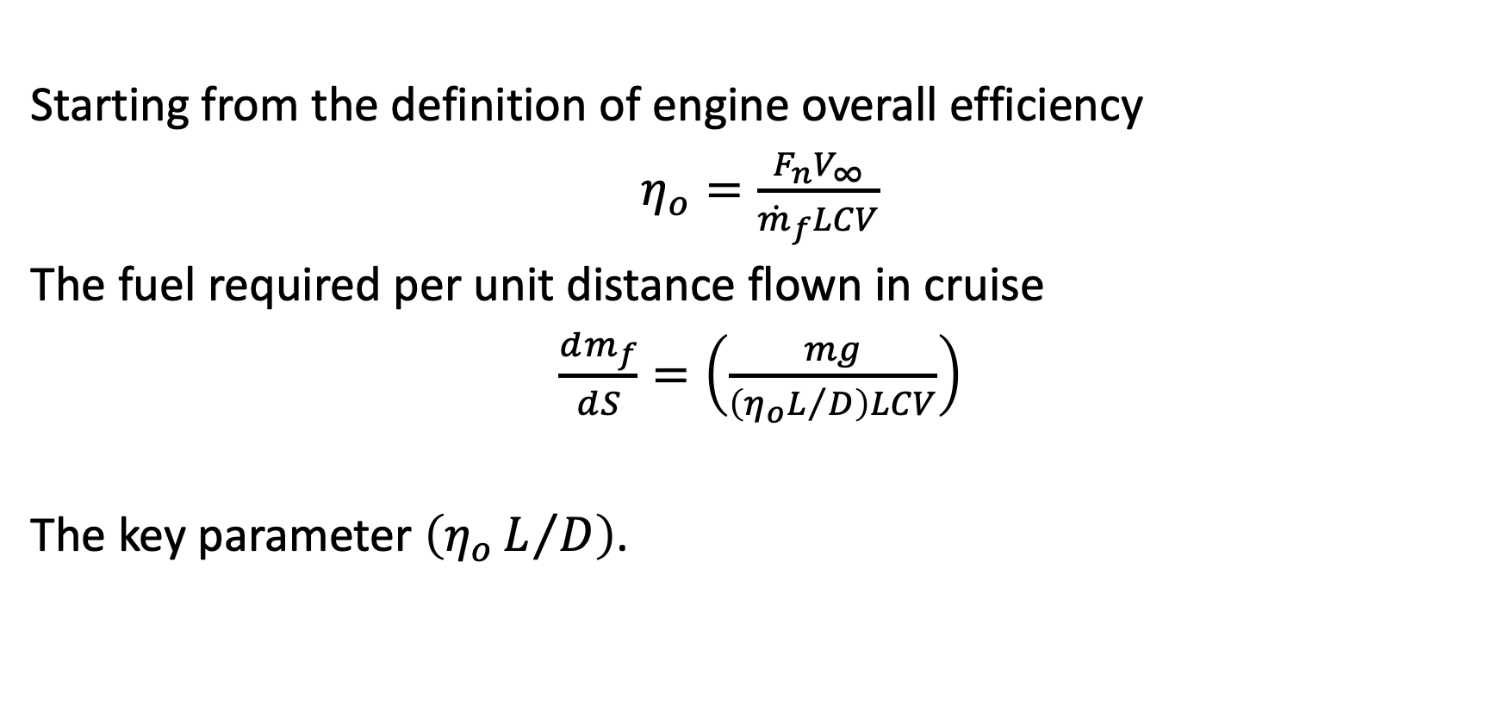
Basis for the Phase 1 method- cruise only
Starting from the definition of engine overall efficiency
$η_{o}=\frac{F_{n}V_{∞}}{{\dot{m}}_{f}LCV}$
The fuel required per unit distance flown in cruise
$\frac{dm_{f}}{dS}=\left(\frac{mg}{\left(η_{o}L/D\right)LCV}\right)$
The key parameter $\left(η_{o}L/D\right)$.

Slide 5
The basic idea – different from all other methods

Slide 6
Recognise the power of normalisation

Slide 7
and the existence of near “universal” functions

Slide 8
A model of the global fleet
For each aircraft, we needed values for
  (𝜂_{o}L/D)_{opt}
  (C_{L})_{opt}
  (L/D)_{opt}
  (M)_{opt}
The challenge was to estimate these from “first principles” or find them in public domain sources.
These are still challenging issues

Slide 9
Present position
To ensure that it can be used without restriction and is independently verifiable, only public domain data sources used. i.e.
  Type certificate data sheets (EASA and FAA)
  Airport planning Reports (freely available from manufacturers websites)
  Standard and not so standard aerodynamic theory
The data set now contains 71 aircraft (up from 53 at the last presentation).
These aircraft are responsible for about 95% of global aviation emissions.

Slide 10
Phase 2 method
Developed from first principles and established theory
Captures separately the essence of both the airframe and the engine behaviour as separate systems
Extended to cover climb, cruise and initial descent.

Slide 11
Airframe model
For low Mach numbers, model is based upon firmly established aerodynamic principles.
For high Mach numbers a new model is needed for the wave drag.

Slide 12
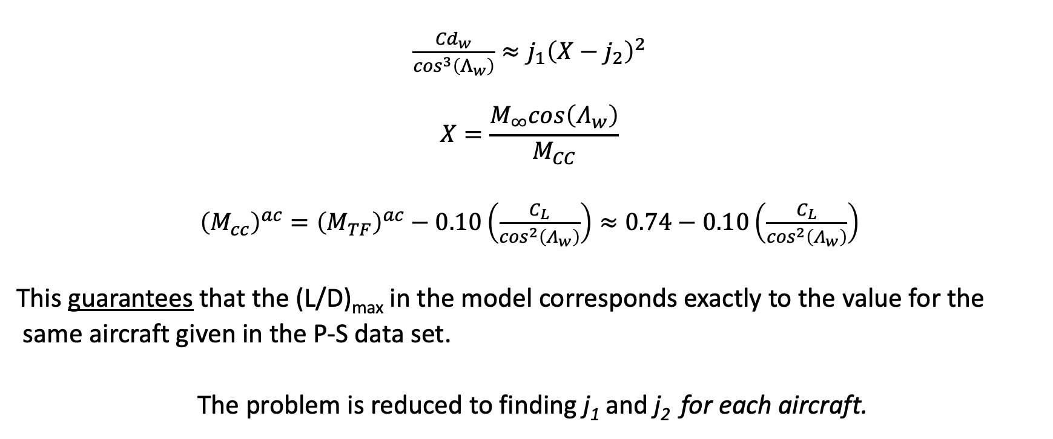
Wave drag – a novel approach based on an old idea
$\frac{{Cd}_{w}}{\cos^{3}\left(Λ_{w}\right)}≈j_{1}{\left(X−j_{2}\right)}^{2}$
$$X=\frac{M_{∞}cos\left(Λ_{w}\right)}{M_{CC}}$$
${\left(M_{cc}\right)}^{ac}={\left(M_{TF}\right)}^{ac}−0.10\left(\frac{C_{L}}{\cos^{2}\left(Λ_{w}\right)}\right)≈0.74−0.10\left(\frac{C_{L}}{\cos^{2}\left(Λ_{w}\right)}\right)$
This guarantees that the (L/D)_{max} in the model corresponds exactly to the value for the
same aircraft given in the P-S data set.
The problem is reduced to finding j₁ and j₂ for each aircraft.

Slide 13
Typical variation of normalised lift-to-drag ratio with normalised lift coefficient and normalised Mach number.

Slide 14
Engine model – also a novel approach

Slide 15
Typical variation of overall efficiency with thrust coefficient and Mach number for a civil aircraft turbofan engine.

Slide 16

Locus of local maxima represented by a power law
$η_{o}=$ $η_{1}{\left(M\right)}^{η_{2}}$

Slide 17
The variation of engine parameter 𝜂₂ with nominal bypass ratio.

Slide 18
Variation of normalised overall efficiency with normalised thrust at a fixed Mach number for engines with a range of bypass ratios

Slide 19
Variation of the normalised thrust coefficient for best 𝜂_{o} with Mach number.

Slide 20
Full solution
Simple, approximate, but fully physically representative.
Applicable everywhere in the flight envelope
Completely general atmosphere
Drag and thrust are separated and do not have to be equal.

Slide 21
Data base is now providing insight

Slide 22
Specified trajectory
If the following parameters are known
Mass
Mach number
Flight level
Vertical climb rate
Acceleration along flight path
The method gives the fuel burn rate, engine efficiency, thrust etc. automatically, i.e. no special treatment for needed for climb

Slide 23
Latest open access publications
Poll, D.I.A. and Schumann, U. On the conditions for absolute minimum fuel burn for turbofan powered, civil transport aircraft and a simple model for wave drag. The Aeronautical Journal, Vol. 128, No. 1324, pp 1071-1103, February 2024.
https://doi.org/10.1017/aer.2024.10
Poll, D.I.A. and Schumann, U. A simple model for the estimation of turbofan engine performance. The Aeronautical Journal, Vol. 128, No. 1330, pp 2725-2753, December 2024. https://doi.org/10.1017/aer.2024.92
Poll, D.I.A. and Schumann, U. An estimation method for the fuel burn and other performance characteristics of civil transport aircraft in the cruise. Part 3 Full flight profile when the trajectory is specified. The Aeronautical Journal, Vol. 129, No. 1334, pp 825-861, January 2025. https://doi.org/10.1017/aer.2024.141

Slide 24
What is happening now
The community is never satisfied. The more they are given the more they want.
A more detailed engine model is required accounting for parameters not considered in the current engine model.
Cover take-off and landing.
Provide estimates of thermodynamic characteristics in jet exhaust and in the various engine components, especially the combustor.
Provide theoretical support for the simpler methods

Slide 25
Phase 3 a better engine model
Full, though still simplified, thermodynamic model.
Engine type specific
Captures by-pass ratio, overall pressure ratio, mixed and unmixed exhausts, compressor bleeds and power off-take.
Extendable to different fuels, advanced cycles
Calibrated using the ICAO Aircraft Emissions Data Bank, i.e. open source.
First paper in preparation and to be submitted soon.

