Slide 1
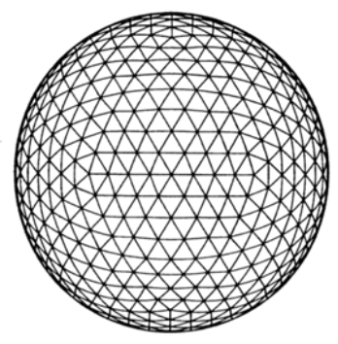
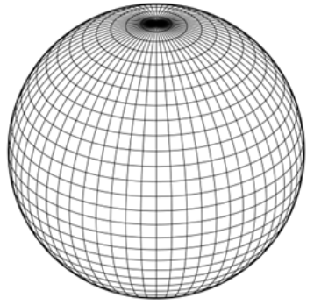


Contrail-weather interactions, based on a coupled ICON-CoCiP study
Ulrich Schumann and Axel Seifert
Contrail forecasts typically neglect feedbacks with the atmosphere.
We investigate the feedbacks effects using a two-way coupling of the CoCiP contrail model with the global NWP-model ICON, which includes two-moment cloud ice microphysics for improved humidity representation.
https://doi.org/10.5194/egusphere-2025-4512

Slide 2
ICON-CoCiP in 2-way coupling ICON on multiple processors, CoCiP on 1 processor, YAC-coupler
ICON
Integrates atmospheric dynamics
on global icosahedral (triangular) grids
with 2-moment ice microphysics
including contrail-ΔT, Δq_{v} changes.
Computes radiation using a
radiation model (ecRad) accounting for contrail cover, ice water content, and number and size of contrail ice particles
CoCiP initiates contrail segments along traffic (GAIA) in flight segments versus time, height, longitude and latitude when SAC fulfilled.
Integrates contrail properties
with nearest-neighbor or triangular interpolation in ICON data.
Performs several Runge-Kutta time steps per ICON time step
For Contrail integration:
p, T, q_{v}, q_{i}, q_{s}, u, v, w, GP, TACI
and for diagnostics:
TOA-rad, SRF-rad, T_{2m}, Prec
For ICON dynamics: ΔT, Δq_{v}
For radiation: N_{i}, r_{eff}, cover, IWC of contrails

Slide 3
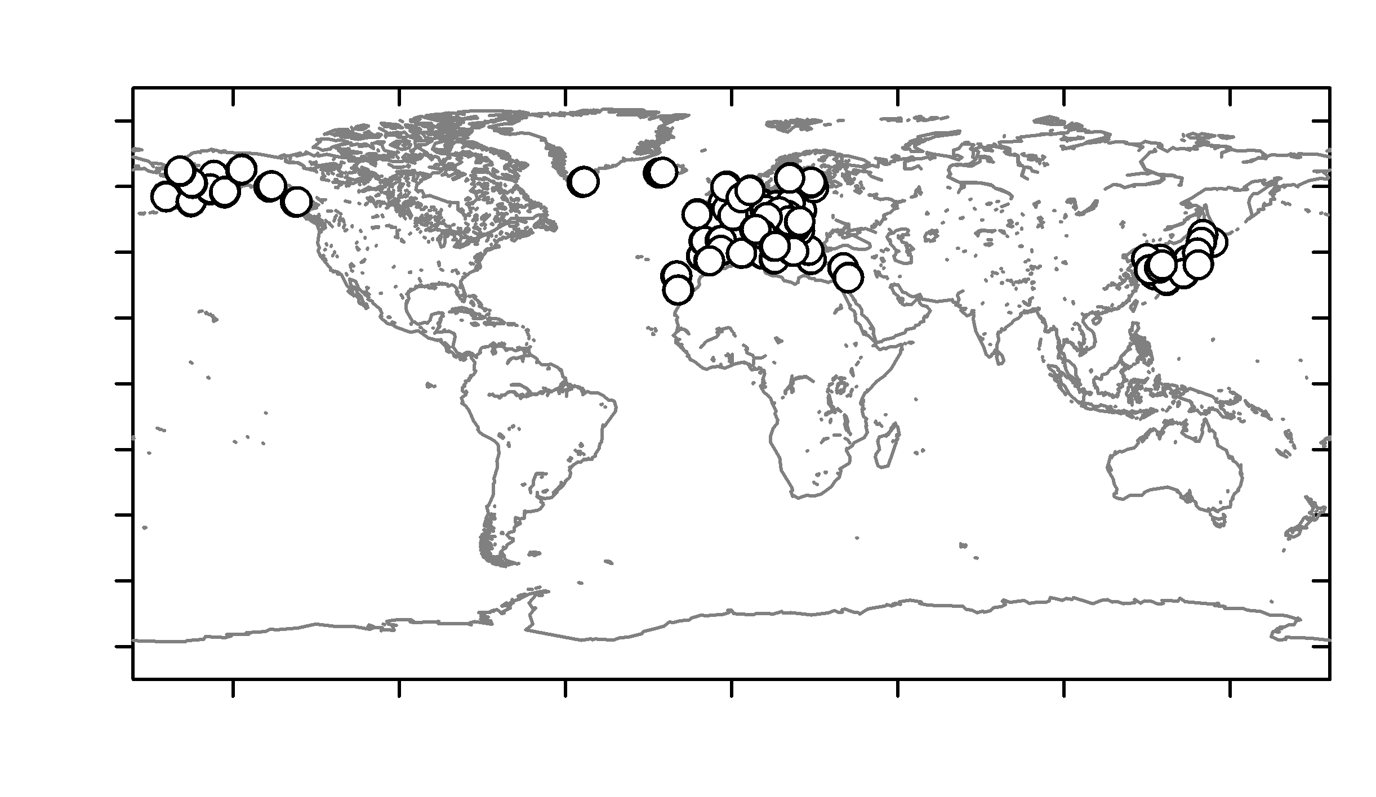
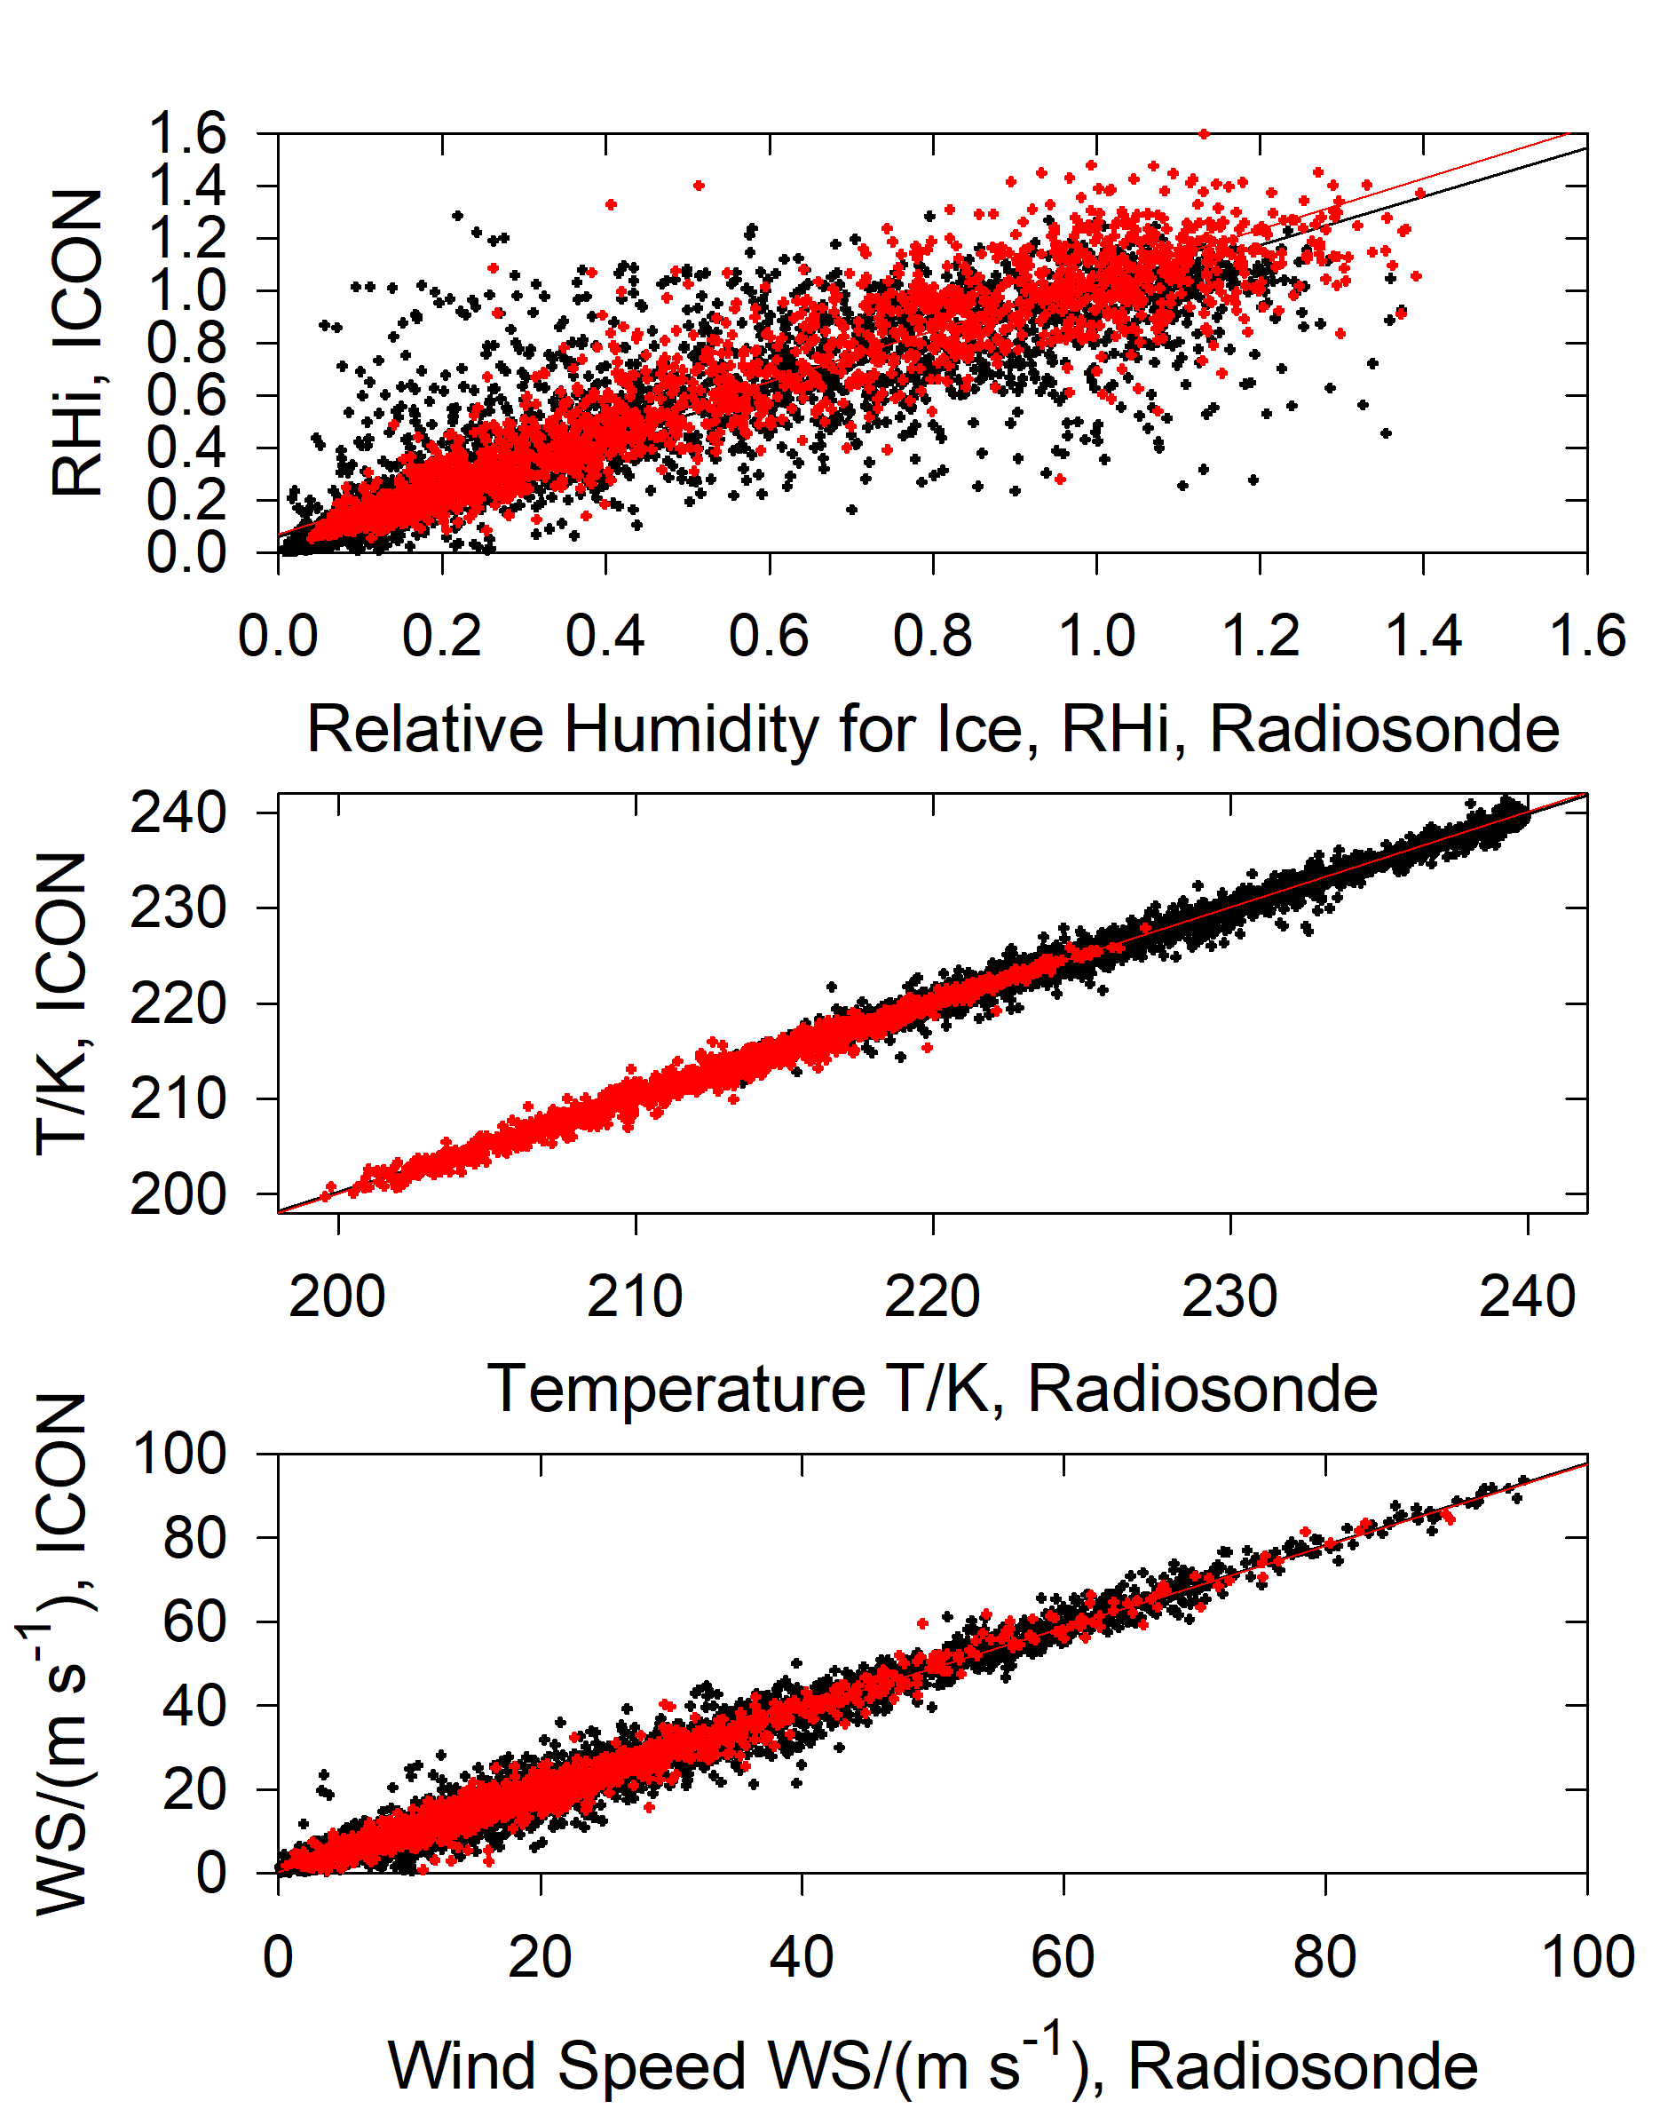
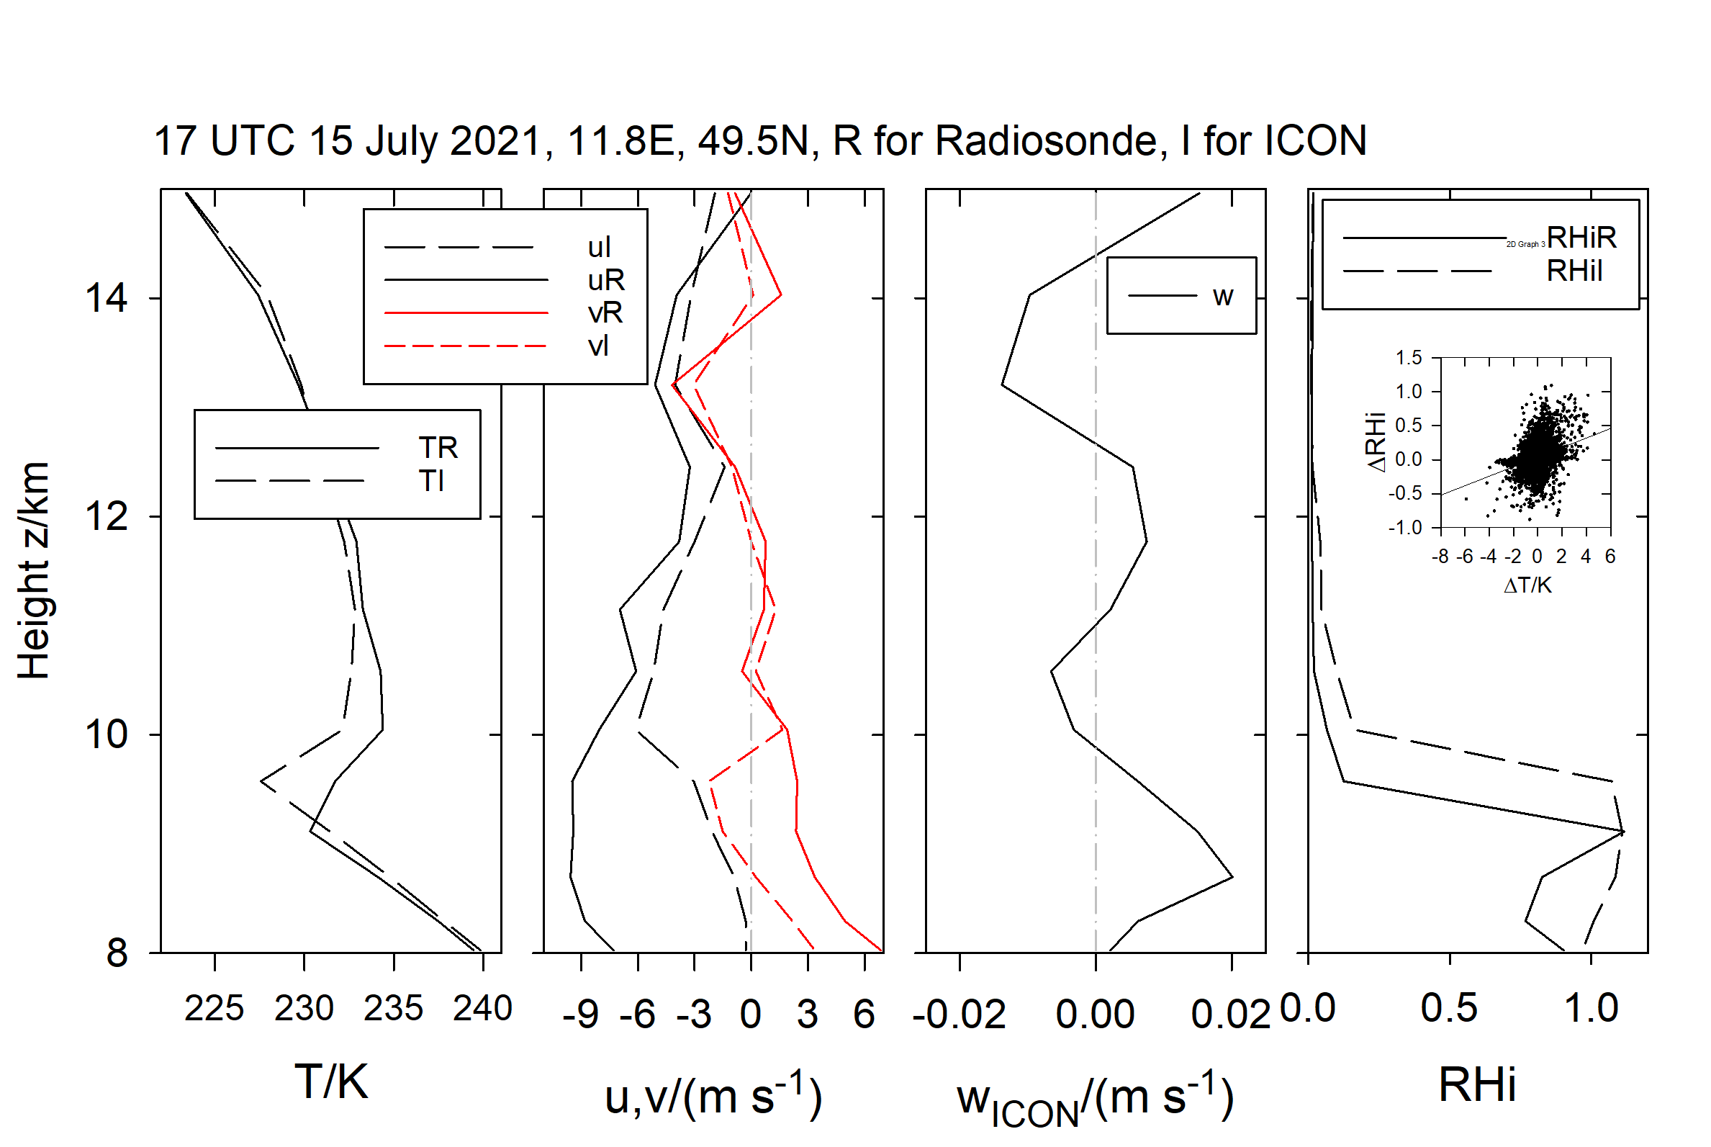
ICON-CoCiP 2-way model results compared with measurements by RS41 Vaisala radiosondes
Black: all data between 120 and 500 hPa.
Red: only those satisfying the SAC for kerosene and η=0.
-> ICON’s new new 2-moment cloud ice microphysics scheme enables skillful predictions of ice supersaturation
Case study for large model-observation Rhi-difference

Slide 4
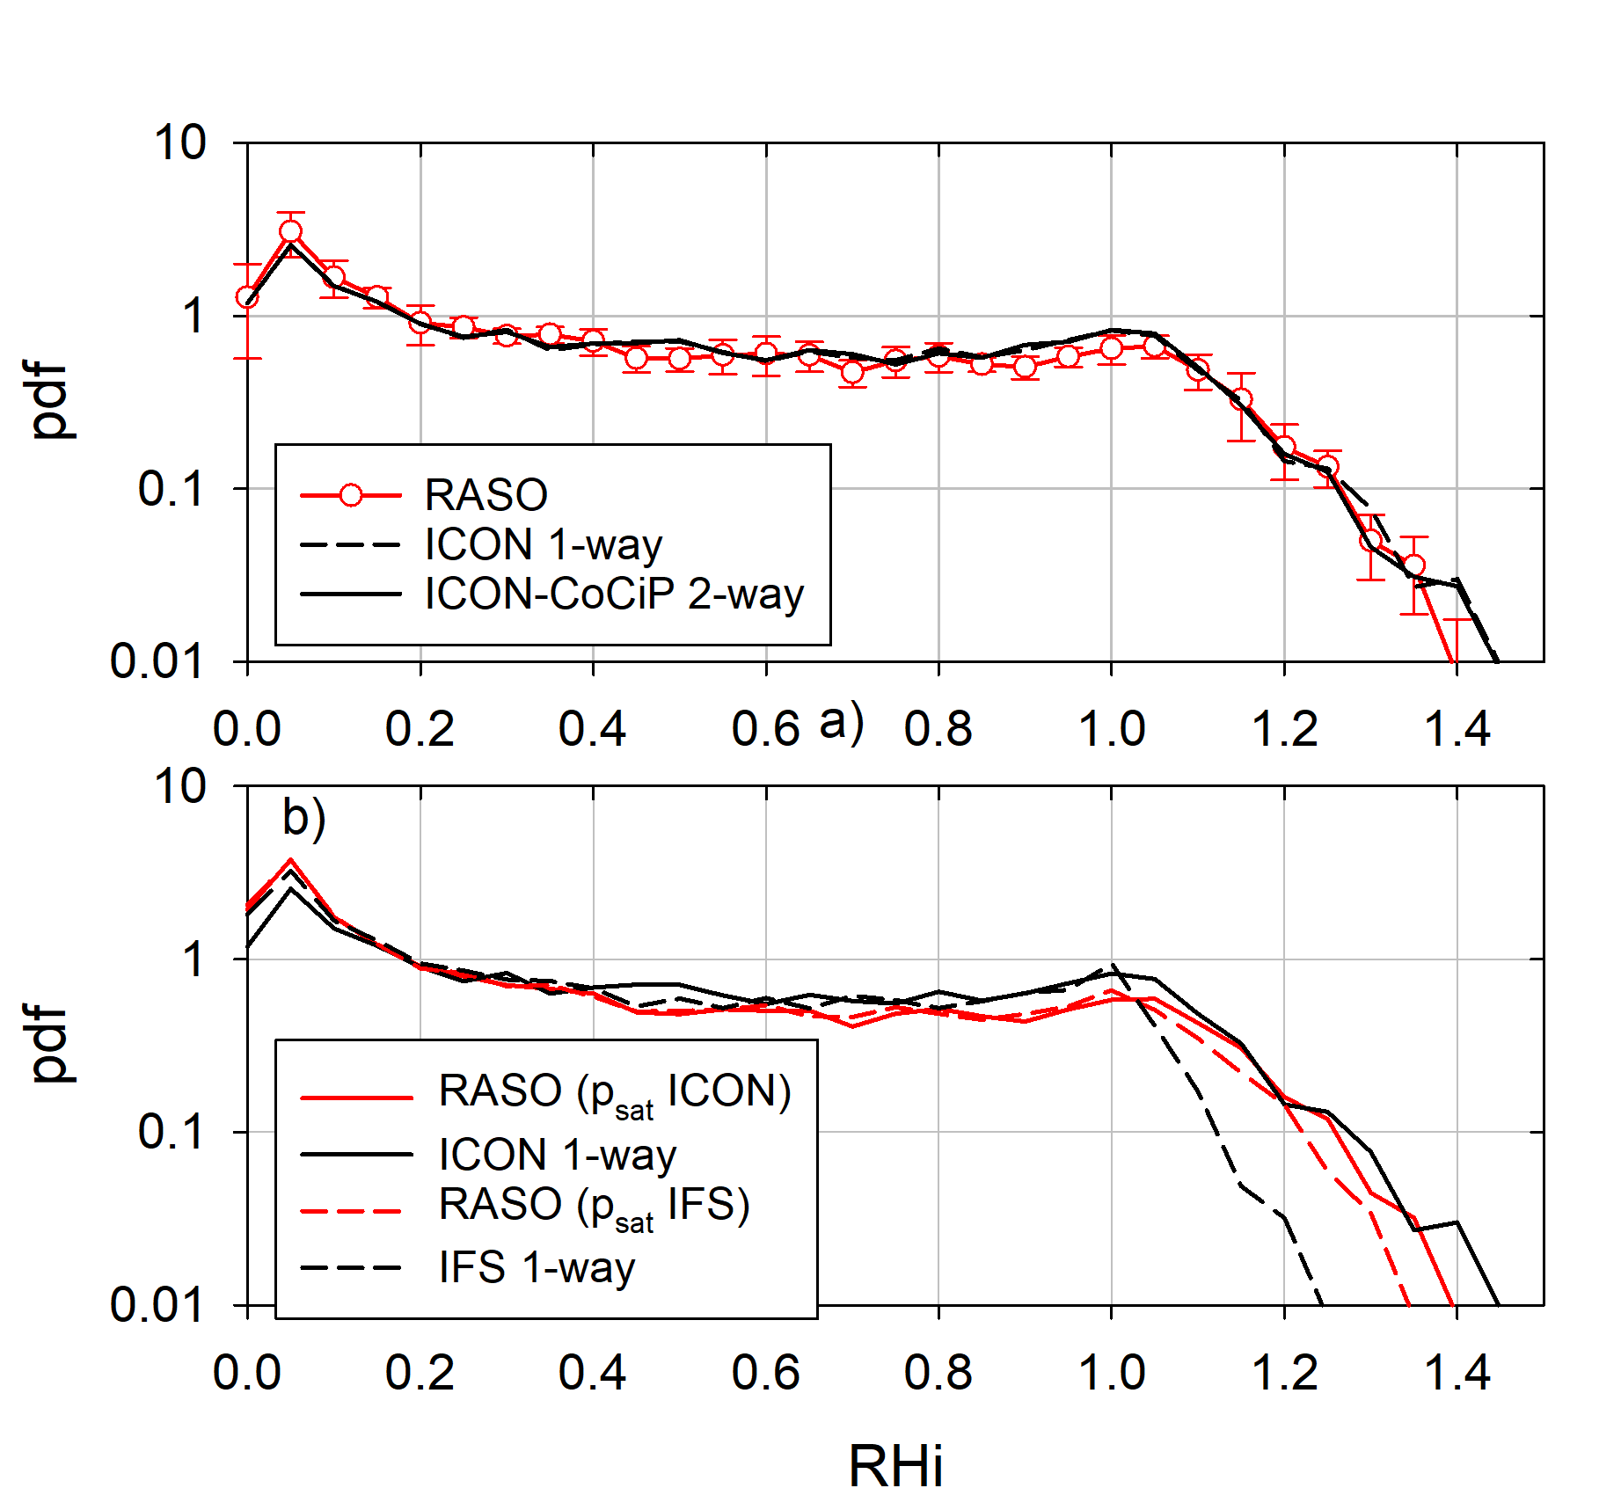
ICON-CoCiP 2-way model results compared with measurements by RS41 Vaisala radiosondes
RS41 Vaisala radiosonde sensors
ICON provides Rhi forecasts useful for contrail predictions
Better than IFS (also with Teoh-correction)

Slide 5
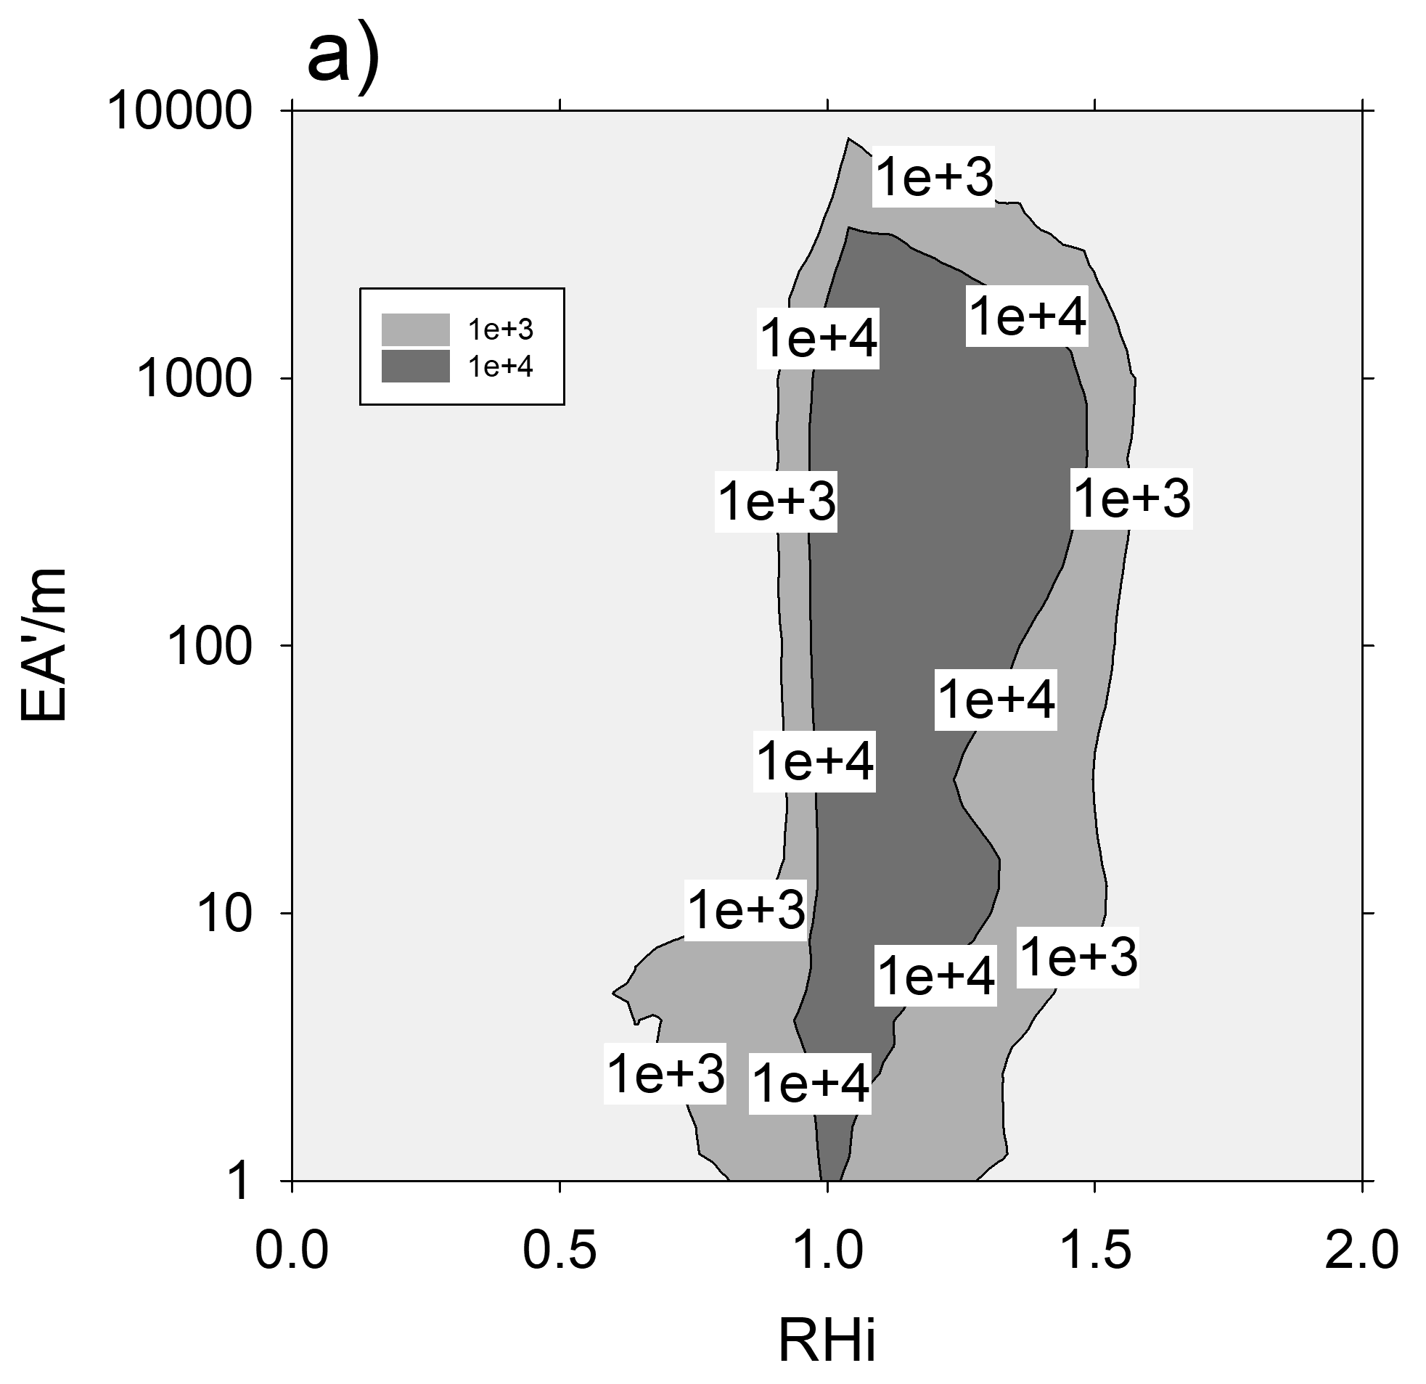
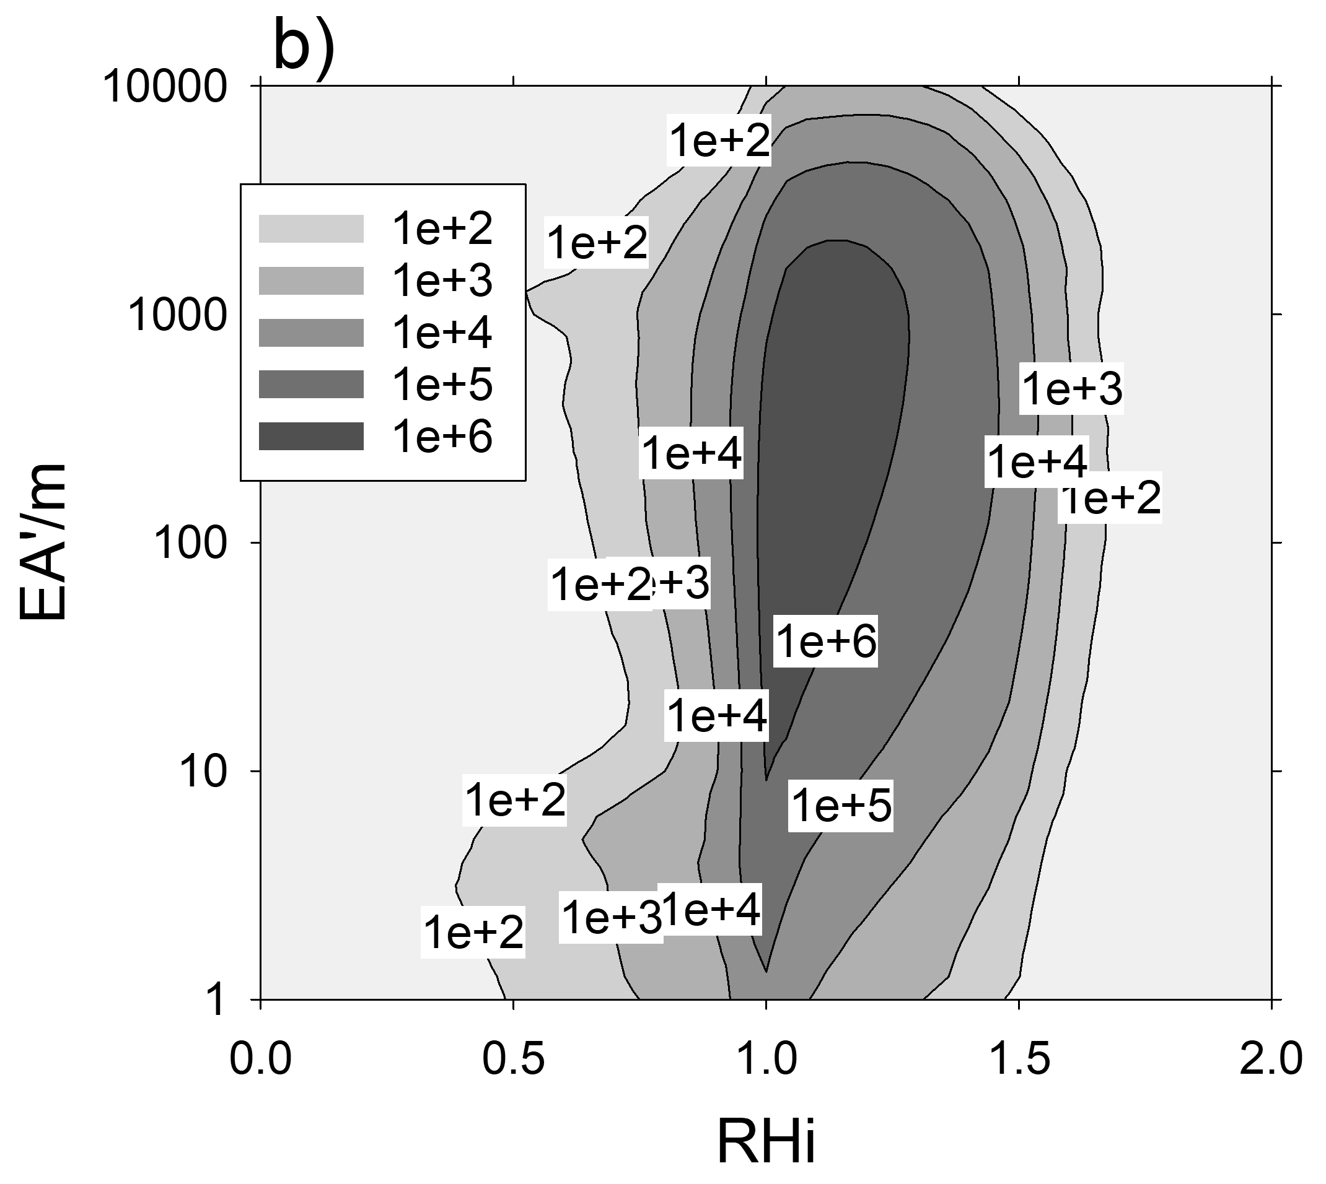
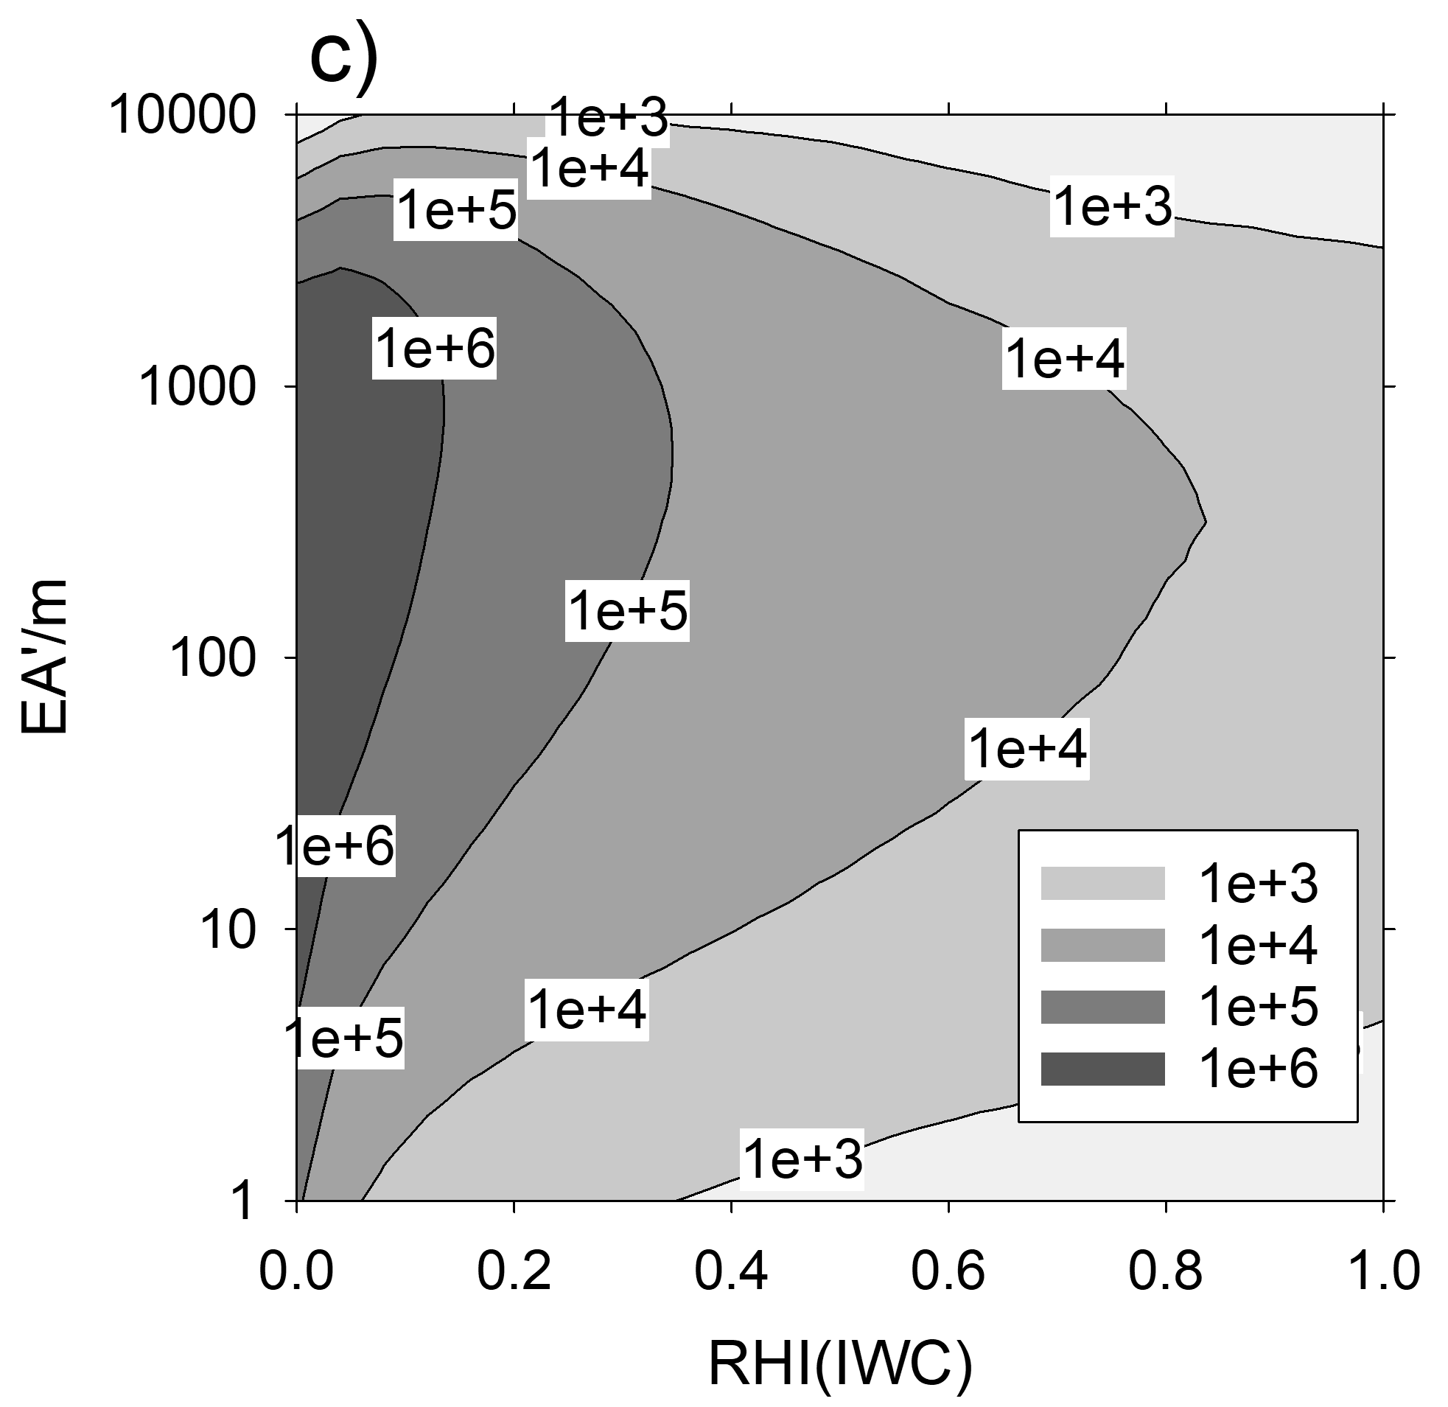
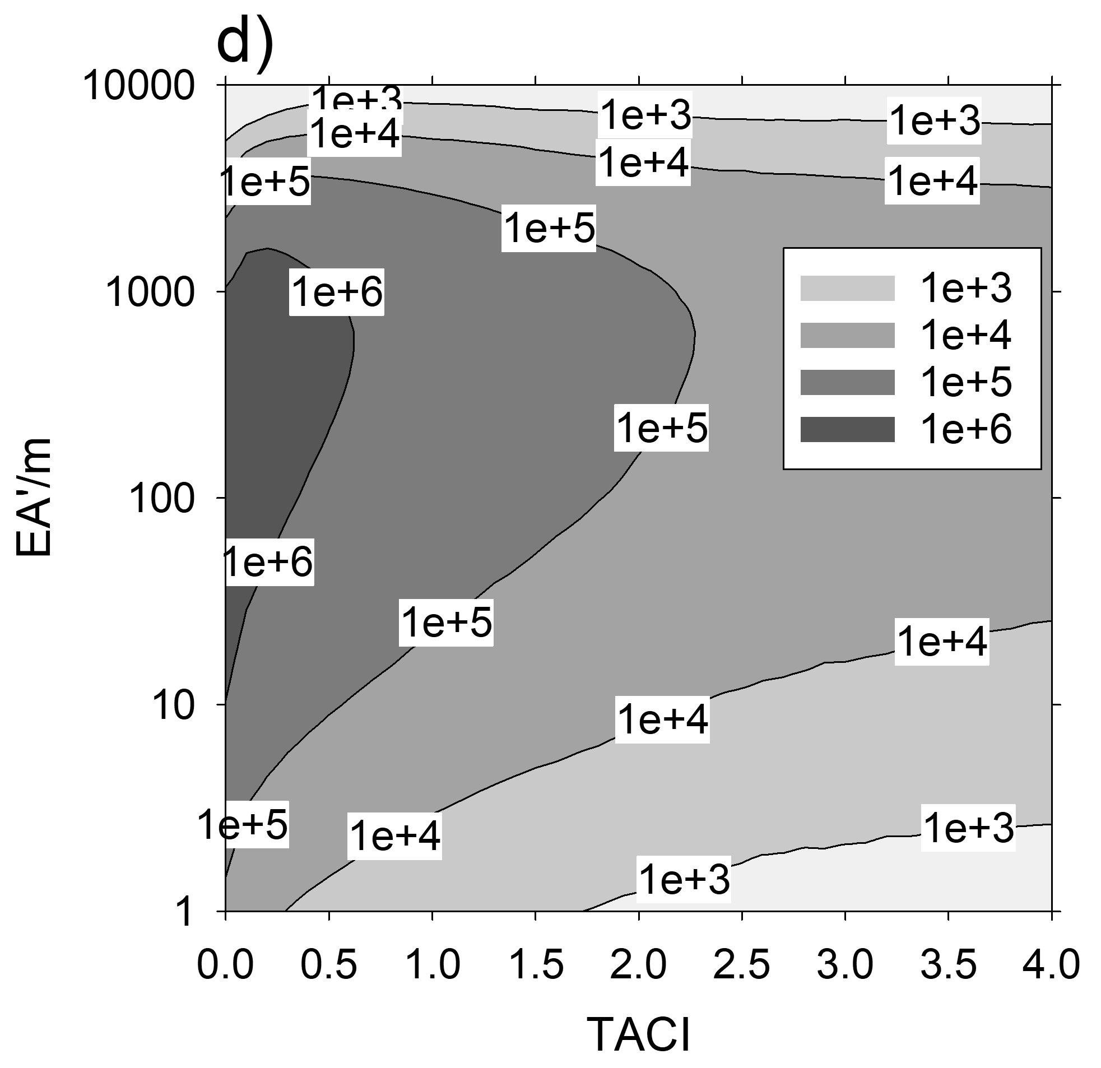
How Energy Forcing -effective are contrails in other cirrus? Occurrence frequency of contrail effective cross-section EA’ = EA’ = EA × exp(-0.2 τ_{cirrus}) -> Contrails are forcing energy effectively also when forming inside and below thin cirrus
At contrail formation
b) to d): Ageing contrail

Slide 6
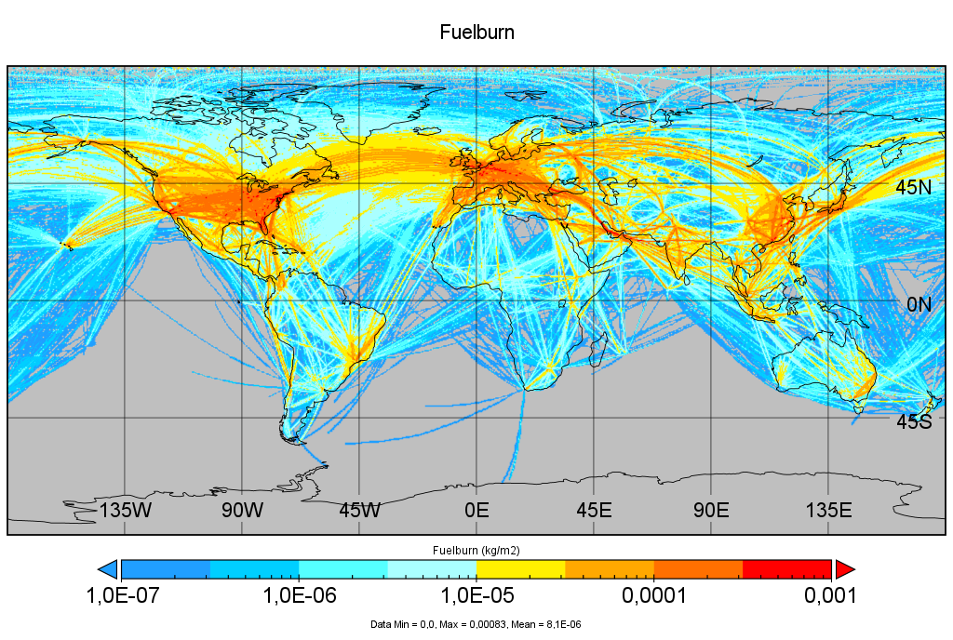
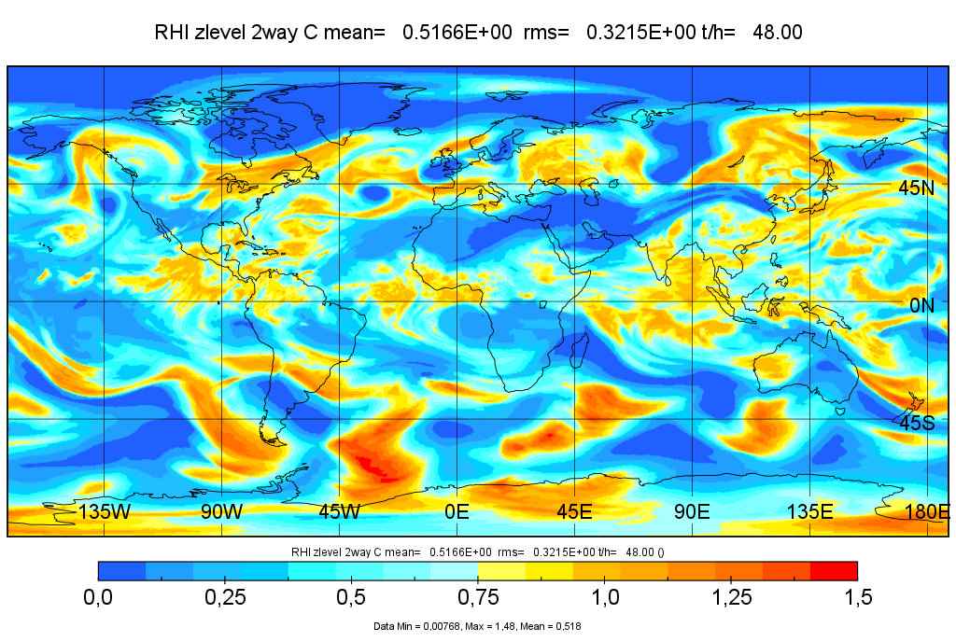
Case study for 25 June: Traffic from GAIA
Relative humidity over ice (RHi) from ICON
Aviation fuel burn above 5.5 km height within 48 h since 0 UTC 25 June 2021, in kg/m², color coded in logarithmic scales. Maximum over USA and Europe.
Data are based on GAIA (Teoh et al., 2024a).
The 24-h mean RHi field at 11 km above mean sea level for this day from ICON
Ice supersaturated domains are often sharply bounded

Slide 7
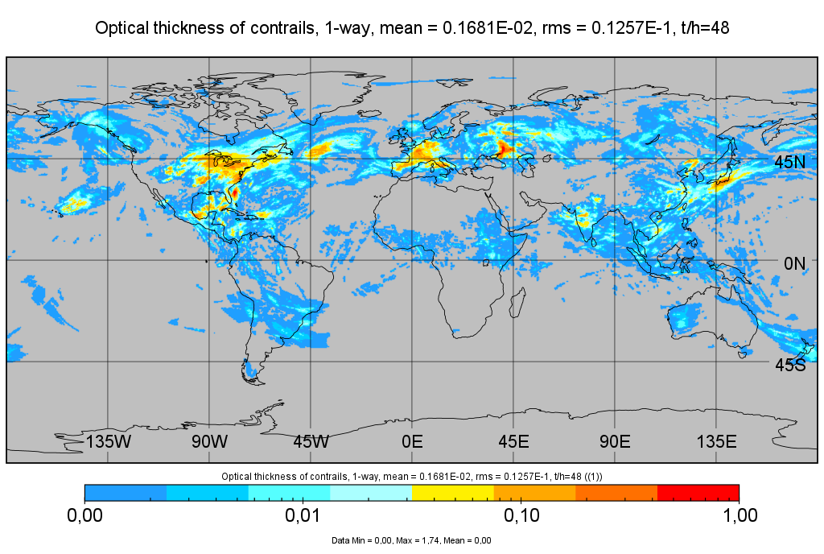
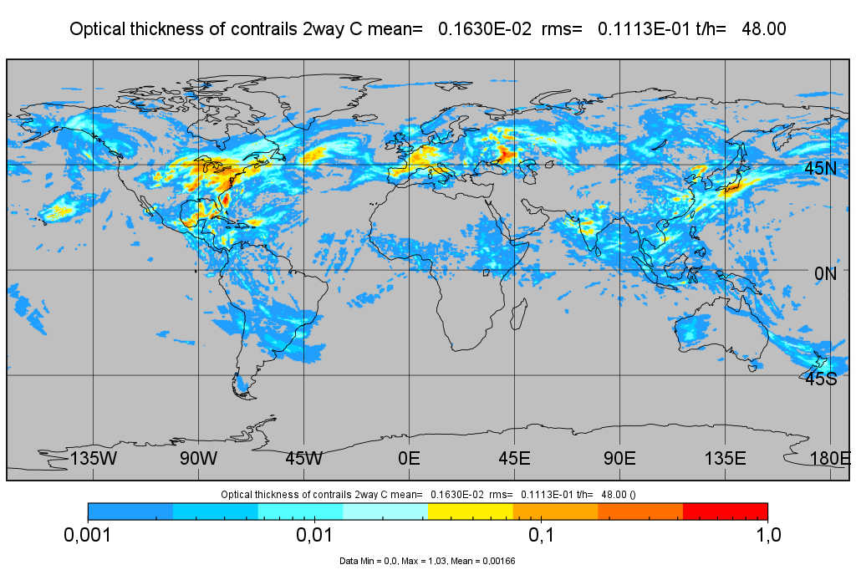
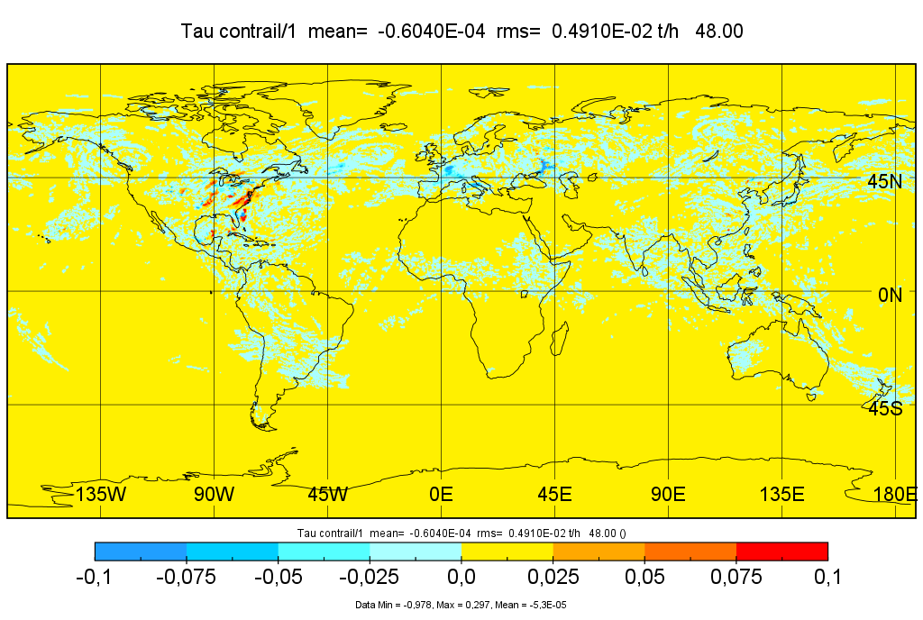
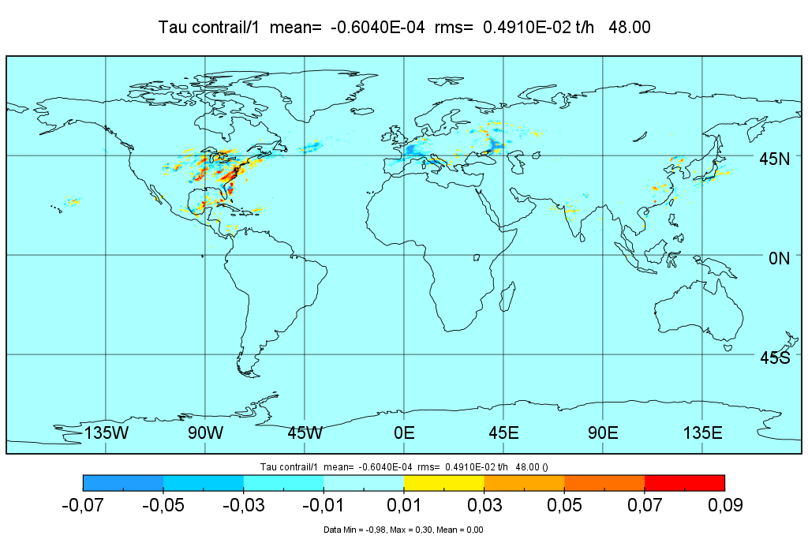
Optical thickness of contrails in 1-way (left) and 2-way (right)coupling -> small difference
1-way
2-way
Difference (2-way – 1-way) of Optical thicknesses in two color scalings
We see low amplitude Noise
Difference
Difference

Slide 8
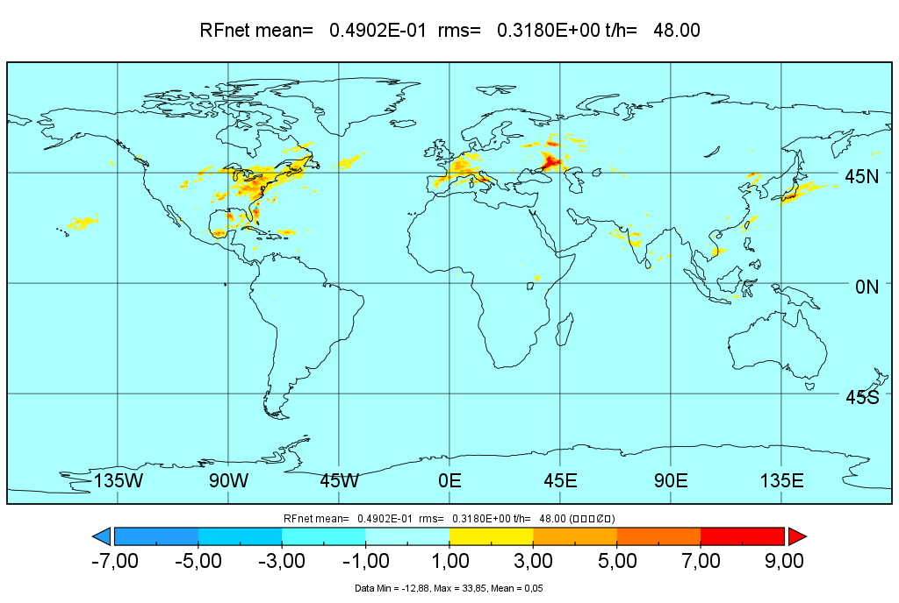
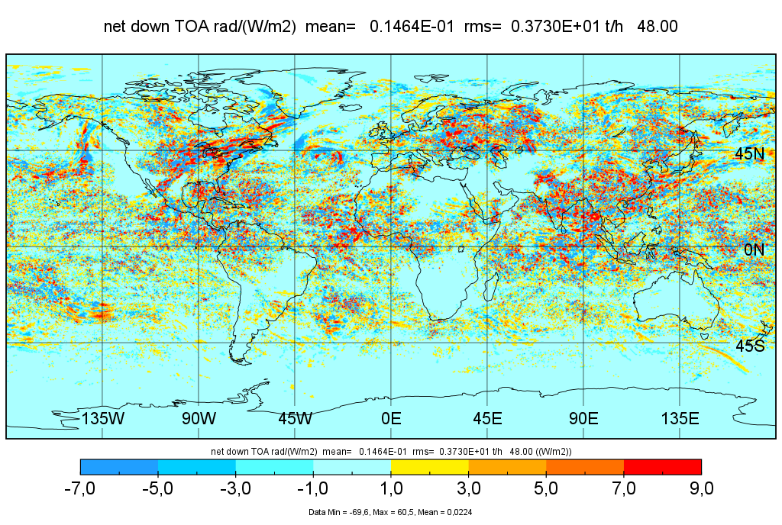
Daily mean Radiative Forcing from contrails in 1-way and 2-way coupling (here for 25 June 2021)
1-way
-> In 1-way coupling:
We see maxima over USA and Europe in domains with high Rhi this day, as expected
2-way
-> In two-way coupling:
We see maxima over USA and Europe, as expected,
but also noise, in particular in domains with deep convection

Slide 9
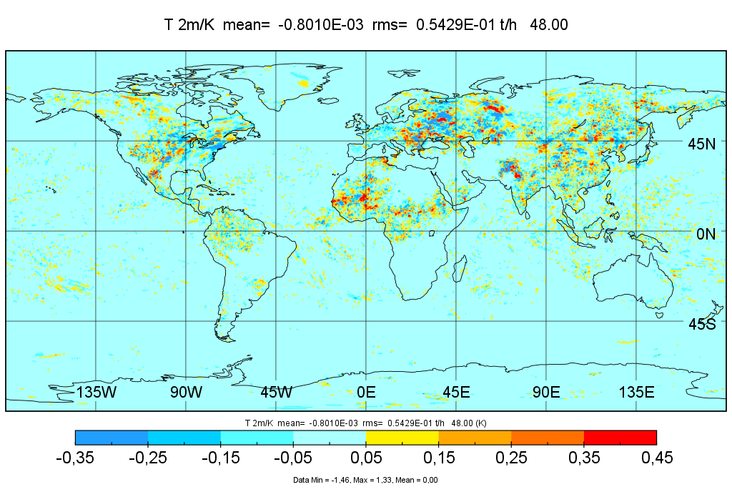
2-way surface temperature change due to contrails
on average over 2nd day of forecast starting 00 UTC 25 June 2021
-> In two-way coupling:
We see maxima and minima over USA and Europe,
but also noise, in particular in domains with deep convection

Slide 10
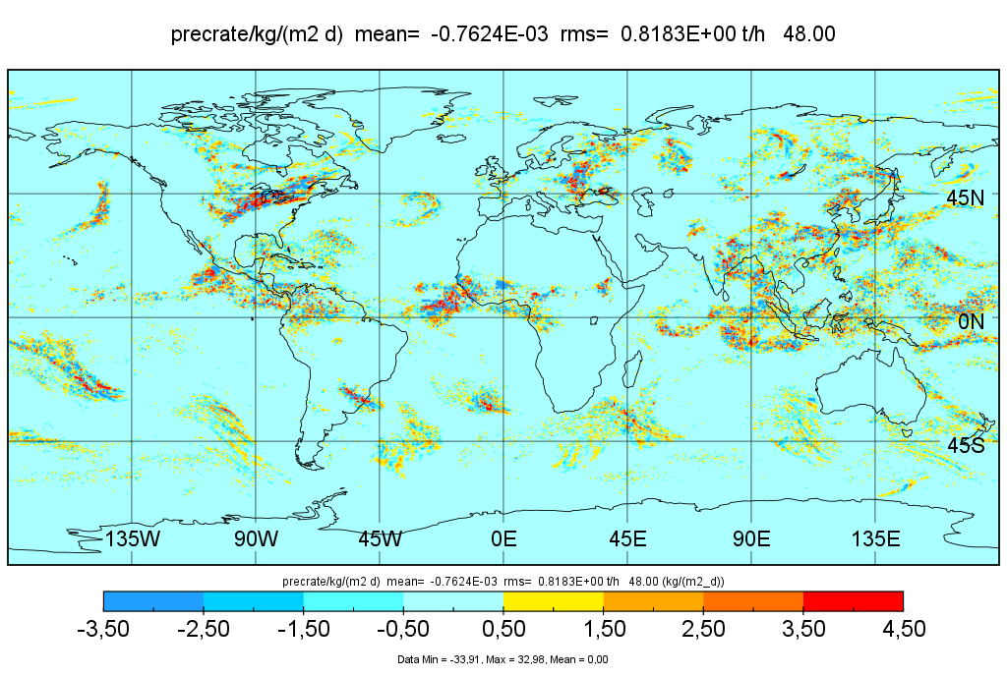
Same for precipitation change in 2-way due to contrails
on average over 2nd day of forecast of 25 June 2021
-> In two-way coupling:
We see maxima over USA and Europe,
but also noise, in particular in domains with deep convection

Slide 11
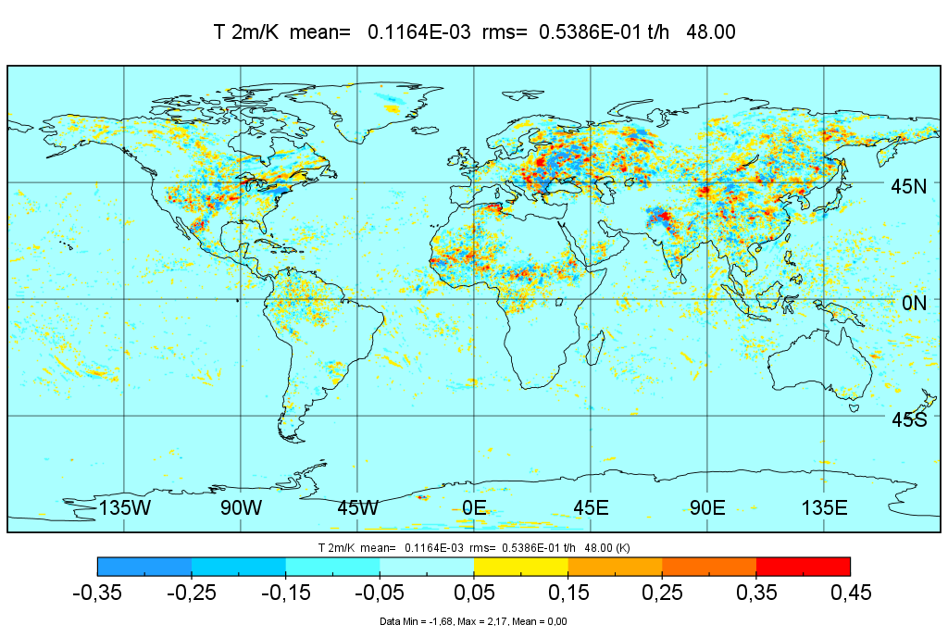
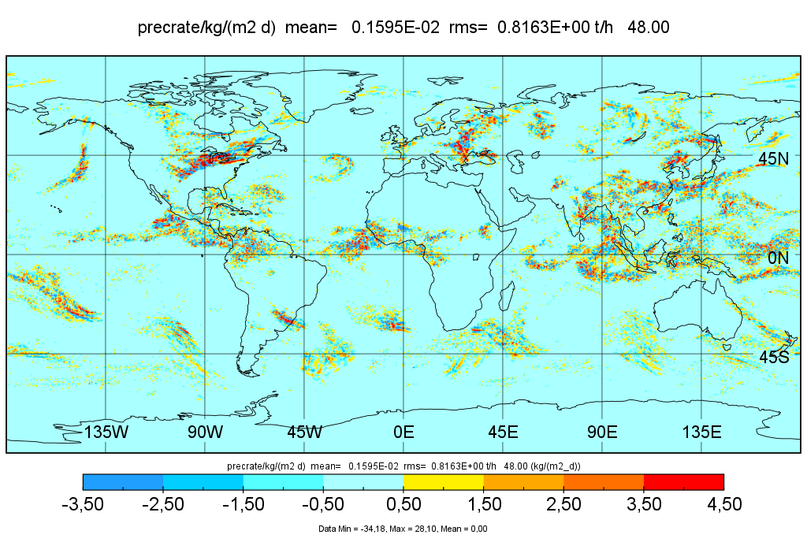
Surface Temperature and Precipitation changes
from contrails (left) and random disturbances (right)
Contrails change weather similar to noise

Slide 12
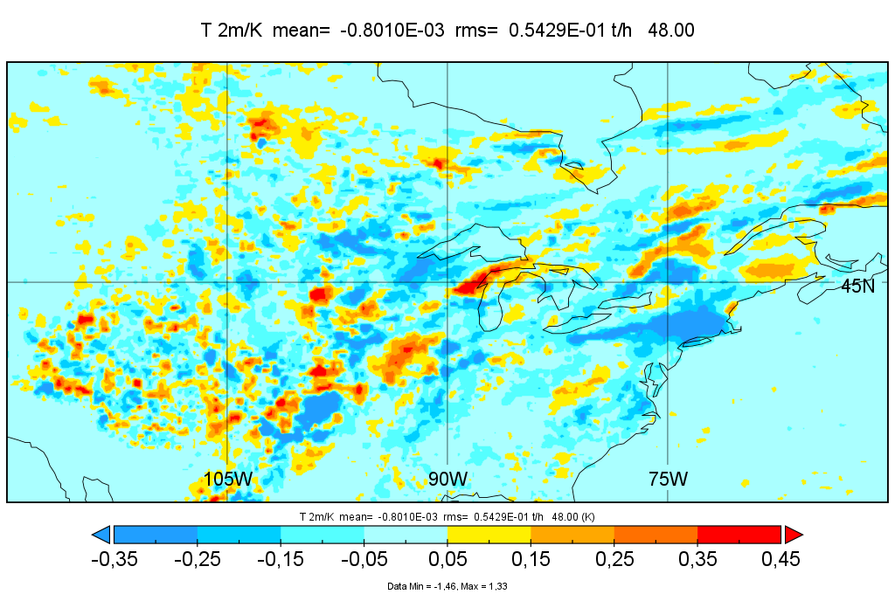
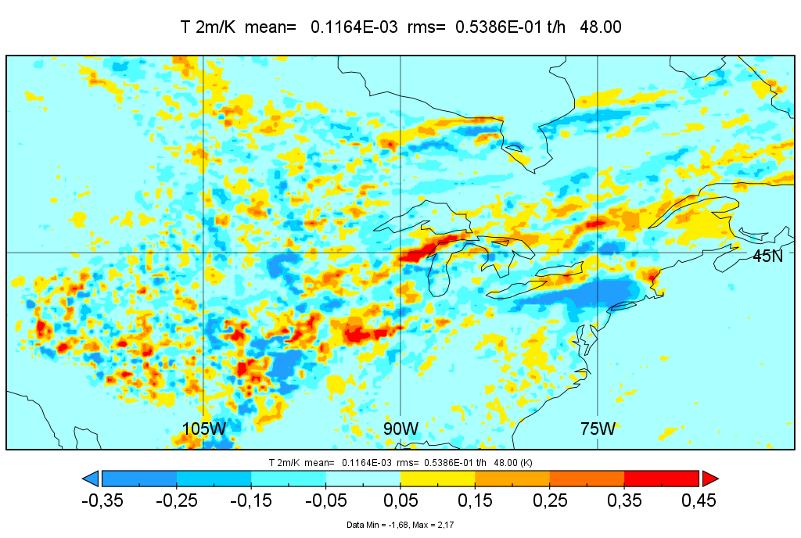
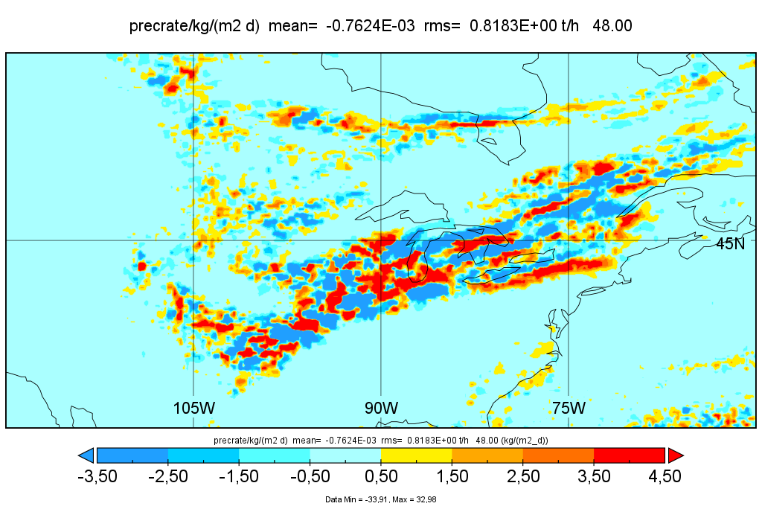
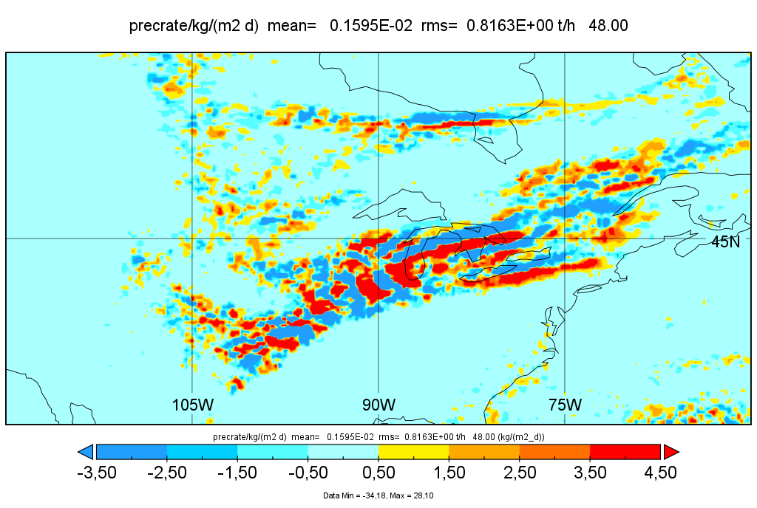
Same regionally: Surface Temperature and Precipitation changes
due to contrails (left) and due to random disturbances (right)
Contrails shift temperature and rainbands, similar to noise,
mainly when the weather is convectively unstable

Slide 13
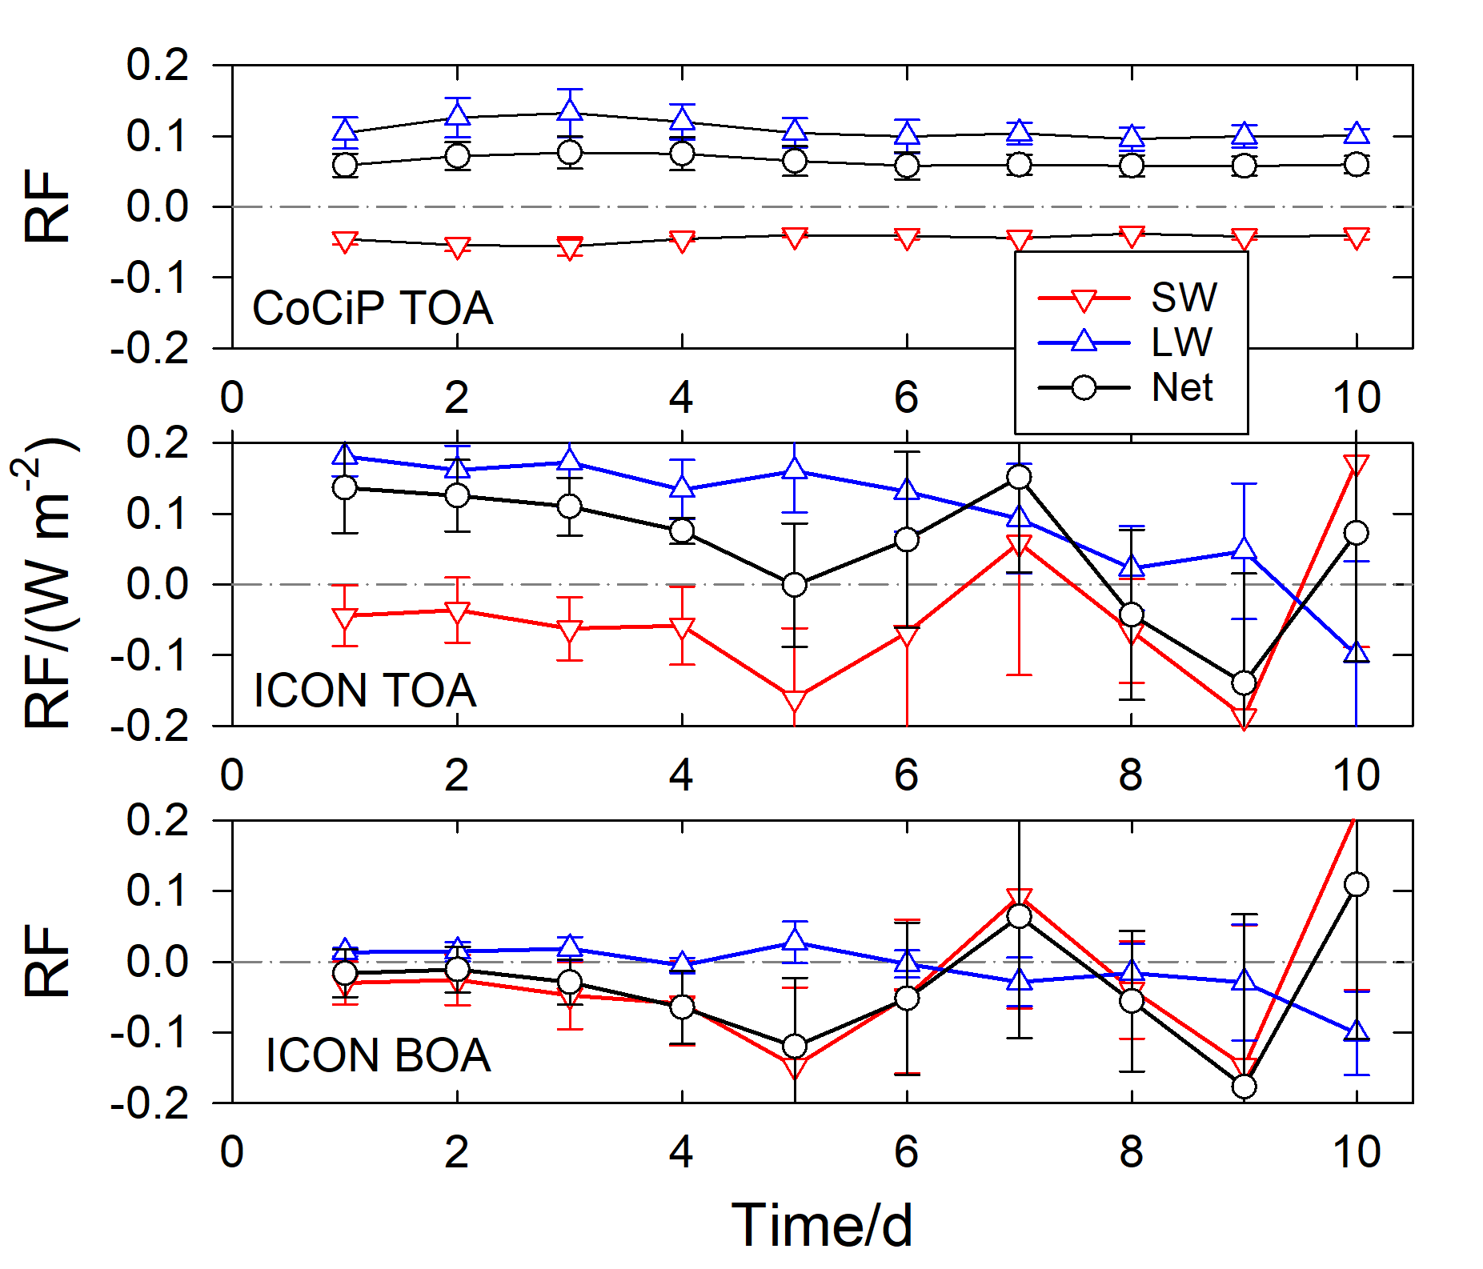
Daily mean RF values (average over 4 days in 2021) versus forecast time.
Errors bars: rms values from the 4 simulations.
Top: RF as computed with CoCiP.
Middle: RF from differences between ICON runs with and without contrail feedback. (larger than from CoCiP)
Bottom: the same for the surface fluxes.
We see increasing oscillations after about 3 to 5 days caused by noise amplified nonlinearly

Slide 14
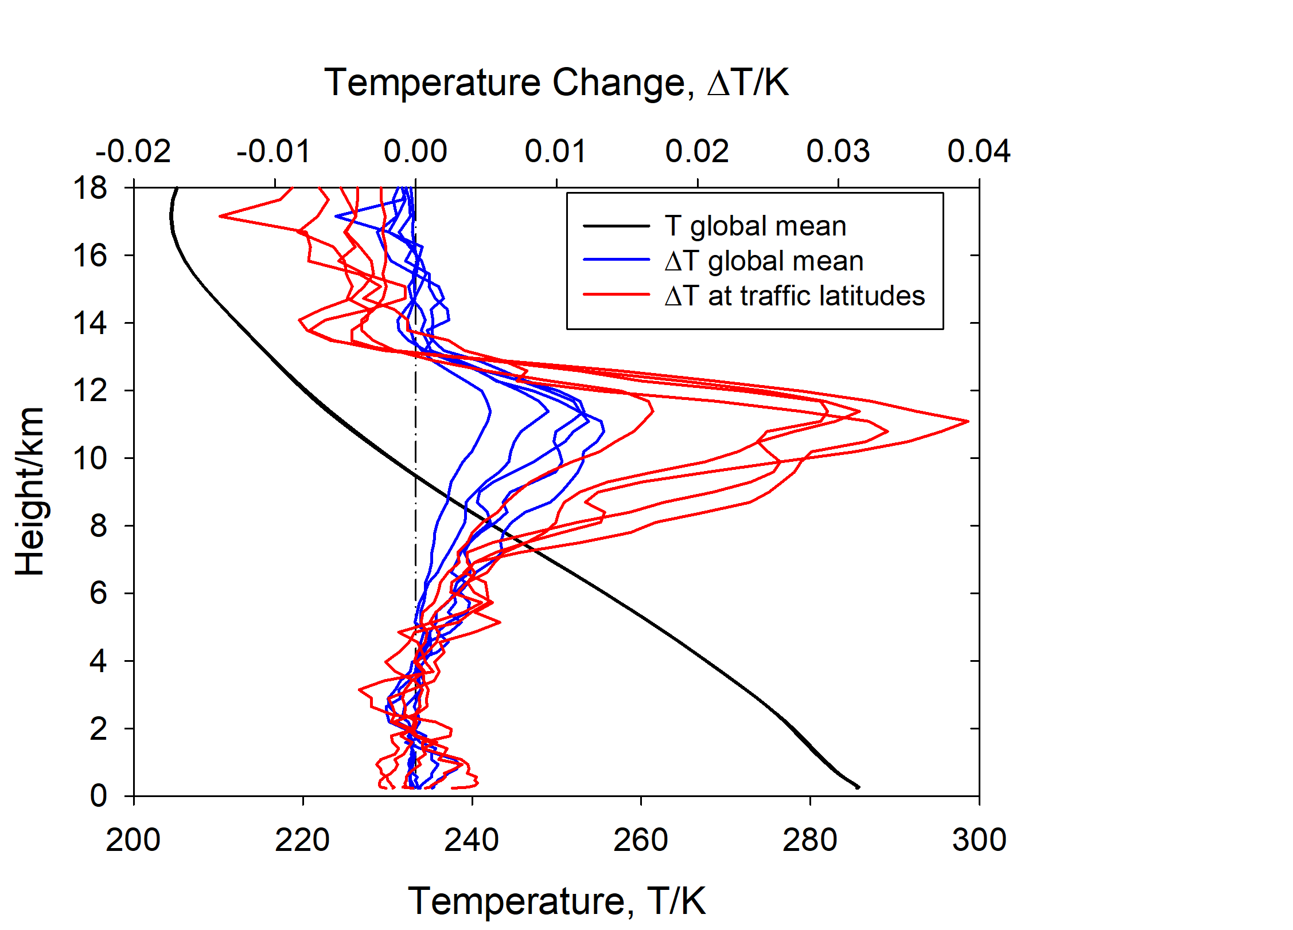
Daily and global mean profiles of temperature profiles for 5 subsequent days
Blue: global mean temperature change from contrail feedback
Red: same weighted with the annual mean air traffic fuel consumption
Contrails heat the upper troposphere in the first 5 days.
Later: random noise stronger than contrail effects
Mean ΔT
Mean T

Slide 15
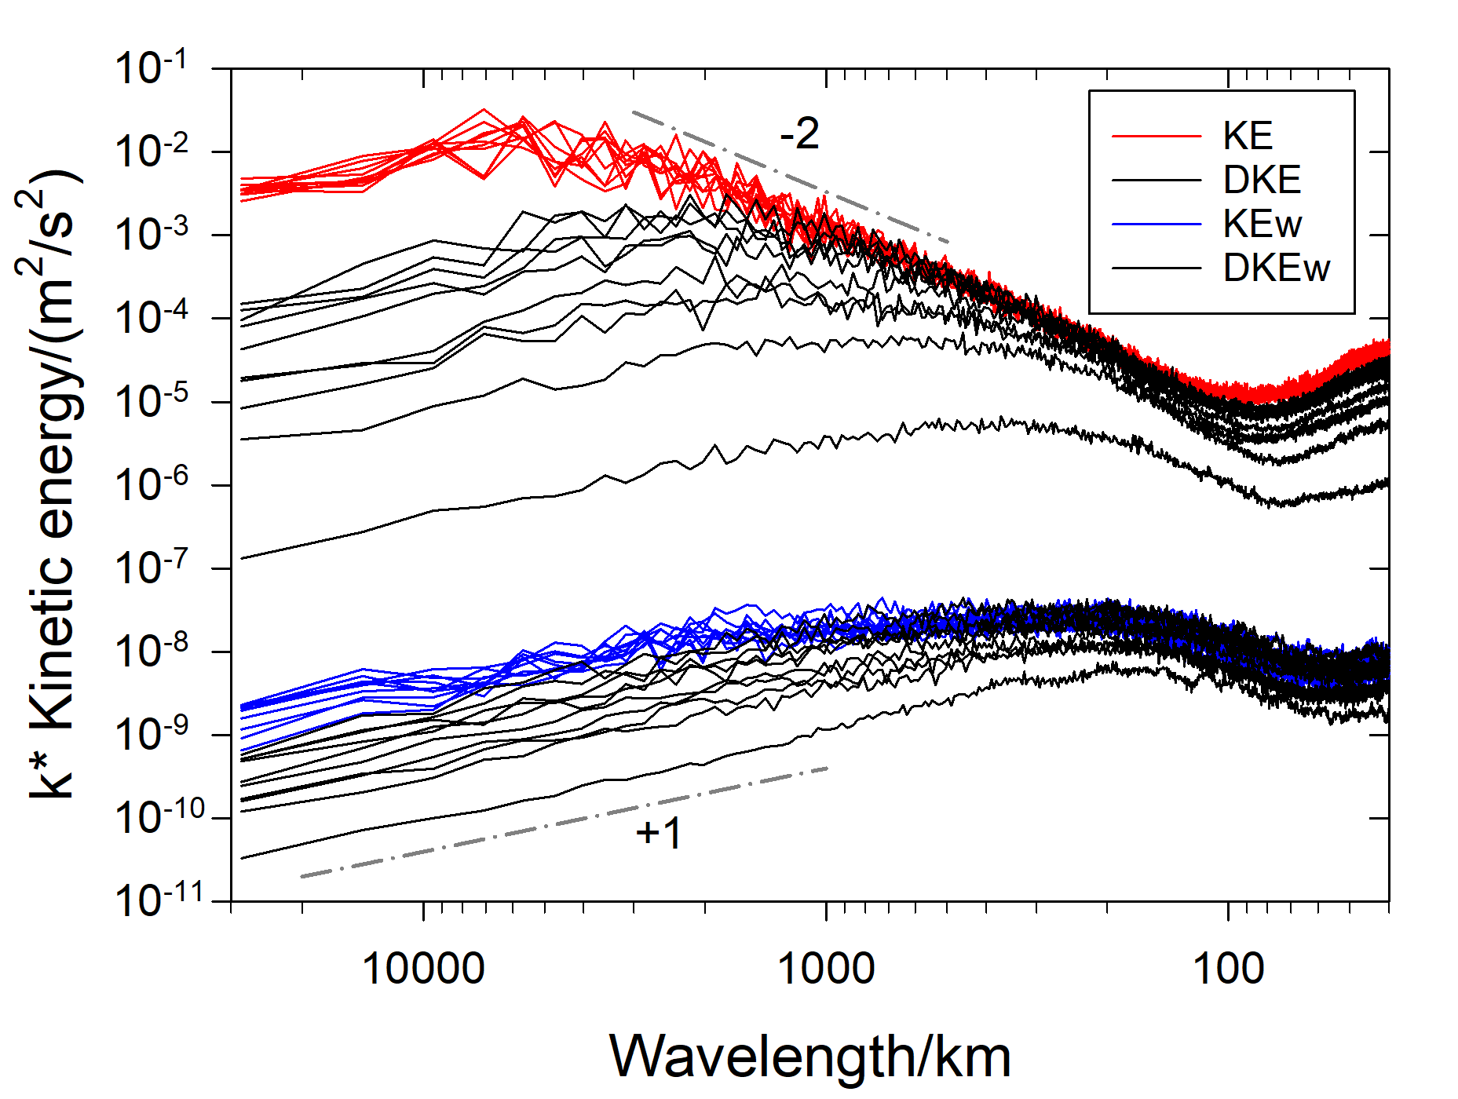
Contrail impact on weather predictability
Spectra of kinetic energy
of
horizontal velocities (KE) and vertical velocity (KEw) from ICON
and of
the velocity differences (DKE and DKEw) between ICON-CoCiP 1-way and 2-way runs,
for the ten-day forecasts of 25 June 2021.
Predictability gets lost due do contrail disturbances quickest for vertical velocity and short wavelengths

Slide 16
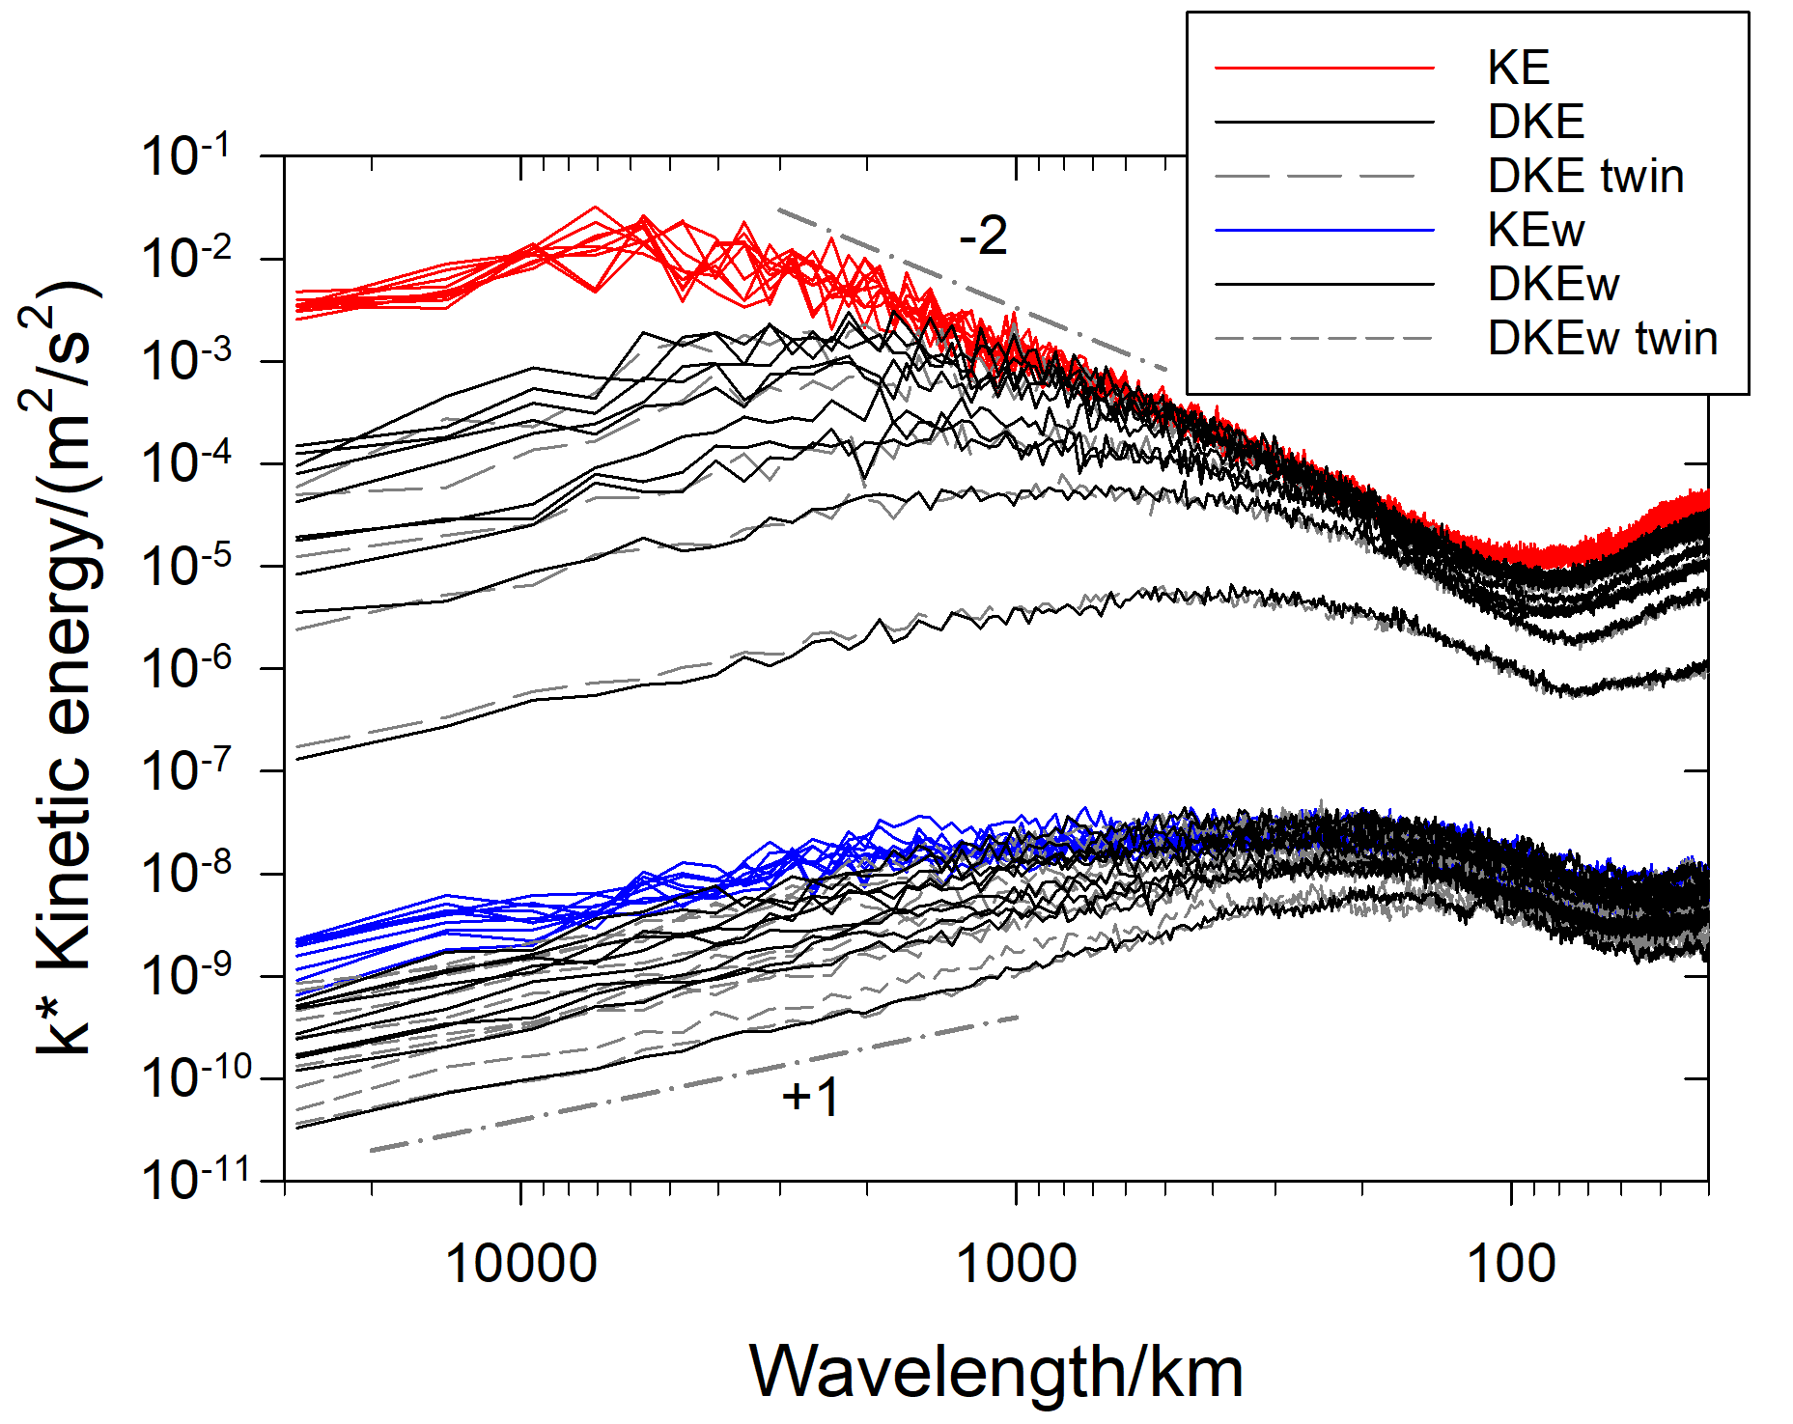
Contrail impact on weather predictability
Spectra of kinetic energy
of
horizontal velocities (KE) and vertical velocity (KEw) from ICON
and of
the velocity differences (DKE and DKEw) between ICON-CoCiP 1-way and 2-way runs,
for the ten-day forecasts of 25 June 2021.
Predictability gets lost due do contrail disturbances quickest for vertical velocity and short wavelengths
Very similar to the loss of predictability due to small noise in the initial conditions

Slide 17
Conclusions
ICON-CoCiP coupling works with reasonable results
Contrails are predictable - but only for a finite time
Surface warming expected after 5 days is hidden by random response to small disturbances
Assessment of surface warming requires ensemble predictions over more than 10 days

Slide 18
Acknowledgments
The authors thank everyone who made this work possible,
especially Moritz Hanke, who wrote essential parts of the ICON-CoCiP coupling using YAC.
Further we thank Robin Hogan (ecRad),
Tobias Göcke (DWD computing access),
Carmen Köhler (ice microphysics modelling),
Daniel Reinert (ICON infrastructure),
Mahnoosh Haghighatnasab (YAC),
Linda Schlemmer (DWD-DLR cooperation),
Günther Zängl (ICON damping parameters),
Florian Prill (ICON grid details),
Mareike Burba (radiation modeling in ICON),
Roger Teoh (GAIA),
Markus Rapp (DLR-DWD cooperation),
Christiane Voigt (DLR support),
Almut Gassmann (ICON performance),
Tobias Selz (butterfly effect),
Andreas Dörnbrack (energy spectra),
Winfried Beer (computing support),
Dennis Piontek (computing at DWD and, very valuable, internal review of the manuscript),
and Robert Sausen (35 years of intense cooperation) who died far too early in January 2025.

