Slide 1

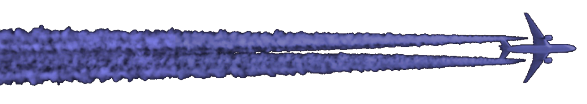
Integrating a vPM activation model into global contrail simulations
Roger Teoh¹, Joel Ponsonby¹, Zebediah Engberg², Christiane Voigt^{3,4}, George Dalakos⁵, Daniel Prada⁶, Raphael Satoru Märkl^{3,4}, Ulrich Schumann³, Thomas Dean² and Marc E.J. Stettler¹
¹: Department of Civil and Environmental Engineering, Imperial College London, London, SW7 2AZ, United Kingdom
²: Breakthrough Energy, 4110 Carillon Point, Kirkland, WA 98033, United States
³: Institute of Atmospheric Physics, Deutsches Zentrum für Luft- und Raumfahrt, 82234 Oberpfaffenhofen, Germany
⁴: Institute of Atmospheric Physics, University Mainz, 55099 Mainz, Germany
⁵: GE Aerospace, Niskayuna, NY 12309, United States
⁶: GE Aerospace, Schenectady, NY 12308, United States
Third Annual Aircraft Contrail Analysis Workshop
17th September 2025
Notes:
Thank you to the session organisers for providing us with the opportunity to talk about our research.
Today, I’m going to present the latest updates made to the contrail simulation workflow, mainly on incorporating the potential activation of vPM to form contrail ice crystals.
Before I begin, I would like to highlight that this research is done in collaboration with my colleagues at Imperial College, Breakthrough Energy, the German Aerospace Center, and GE Aerospace.

Slide 2

Contrail formation pathway
jet regime (1 s)
vortex regime (< 5 min)
Emission
of nvPM
Nucleation
of vPM
Activation
of particles to form droplets
Ice nucleation
to form ice crystals
Sublimation
Notes:
* Comment that we may have seen this previously, but this is for clarity *
Contrail formation takes place in a number of discrete stages
(1) At the engine exit plane, we have emission of solid nvPM and gaseous vPM.
(2) Later downstream, some of this vPM can either nucleate new particles or condense on pre-existing particles i.e., nvPM.
(3) As the engine continues to cool, if the plume becomes supersaturated with respect to water, some of these particles may ”activate” to form water droplets
(4) These subsequently freeze to form ice crystals
(5) the above stages take place approximately 1 s behind the aircraft, following this, the ice crystal evolution depends on local ambient conditions, which dictate the eventual rate of sublimation

Slide 3
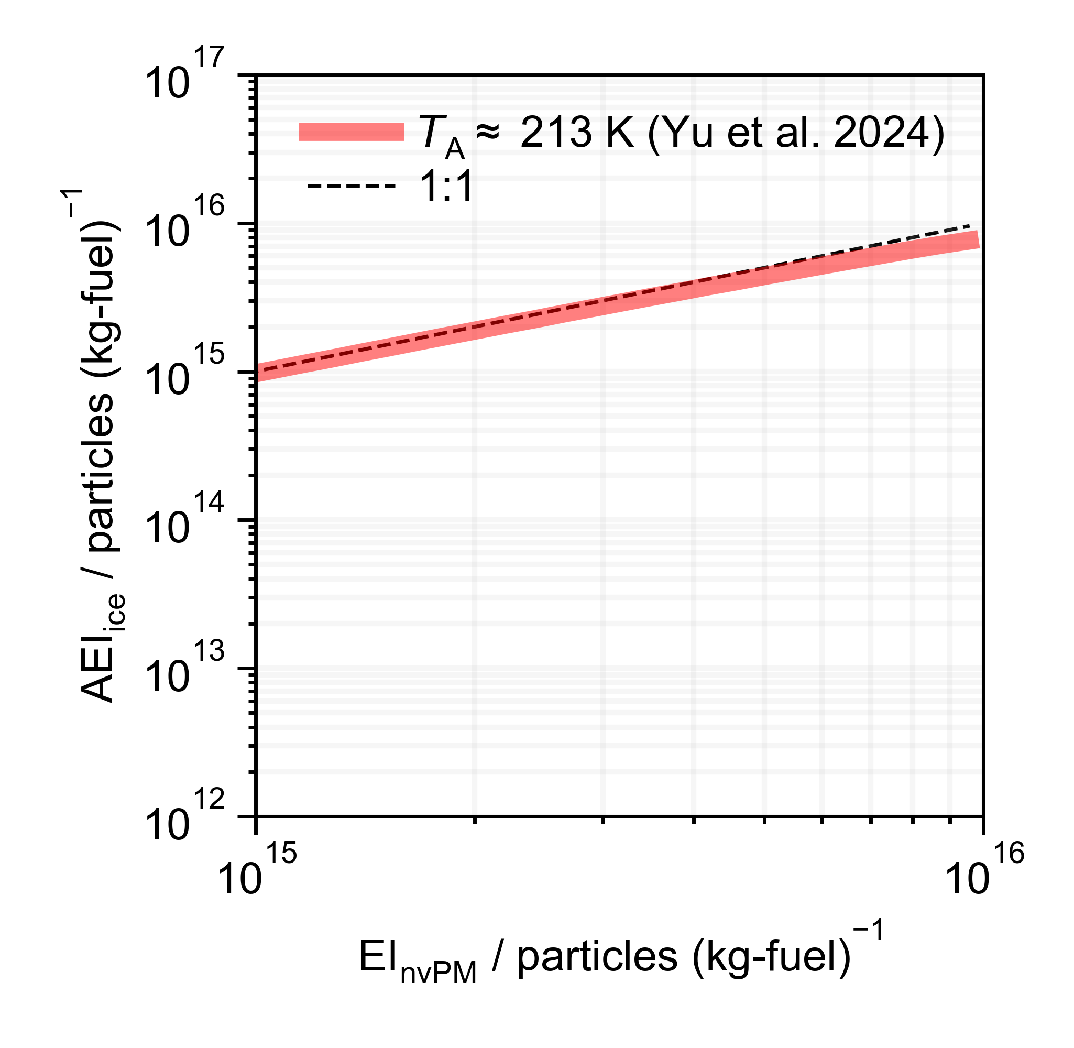

The “Kärcher-curve” (soot-rich)
Most aircraft operate in the soot-rich regime
Most existing global contrail simulations assume that the initial AEI_{contrail} ≈ EI_{nvPM}
Contrail properties and climate forcing strongly influenced by the initial AEI_{contrail}
nvPM
ERF
-90%
-60%
[Figure] F Yu et al., (2024). Revisiting Contrail Ice Formation: Impact of Primary Soot Particle Sizes and Contribution of Volatile Particles, DOI: https://doi.org/10.1021/acs.est.4c04340.
Notes:
Now I’m going to discuss the relationship between contrail ice crystals and emissions in slightly more detail using the so-called “Kärcher-curve” after some modelling work performed in 2009 (with Fangqun and other coauthors)
Most in-service aircraft operate in the soot-rich regime, releasing approximately 10^15 particles per kg of fuel burned (as an emission index).
Under these conditions, model and experimental studies show that the number of ice crystals (or their apparent emission index at cruise) scales linearly with the number of soot particles (or it’s emission index at cruise)
Therefore, nearly all modelling studies (at least those used to inform IPCC estimates) assume that these two quantities are equivalent.
These (and other) models also show that climate impact (ERF) is dependent on the initial contrail ice crystal number (scaling numbers are from (Bier and Burkhardt 2022; Lottermoser and Unterstrasser 2025; Rubin-Zuzic et al. 2025).
Therefore, it is critical that the apparent emission index of ice crystals is estimated appropriately.

Slide 4
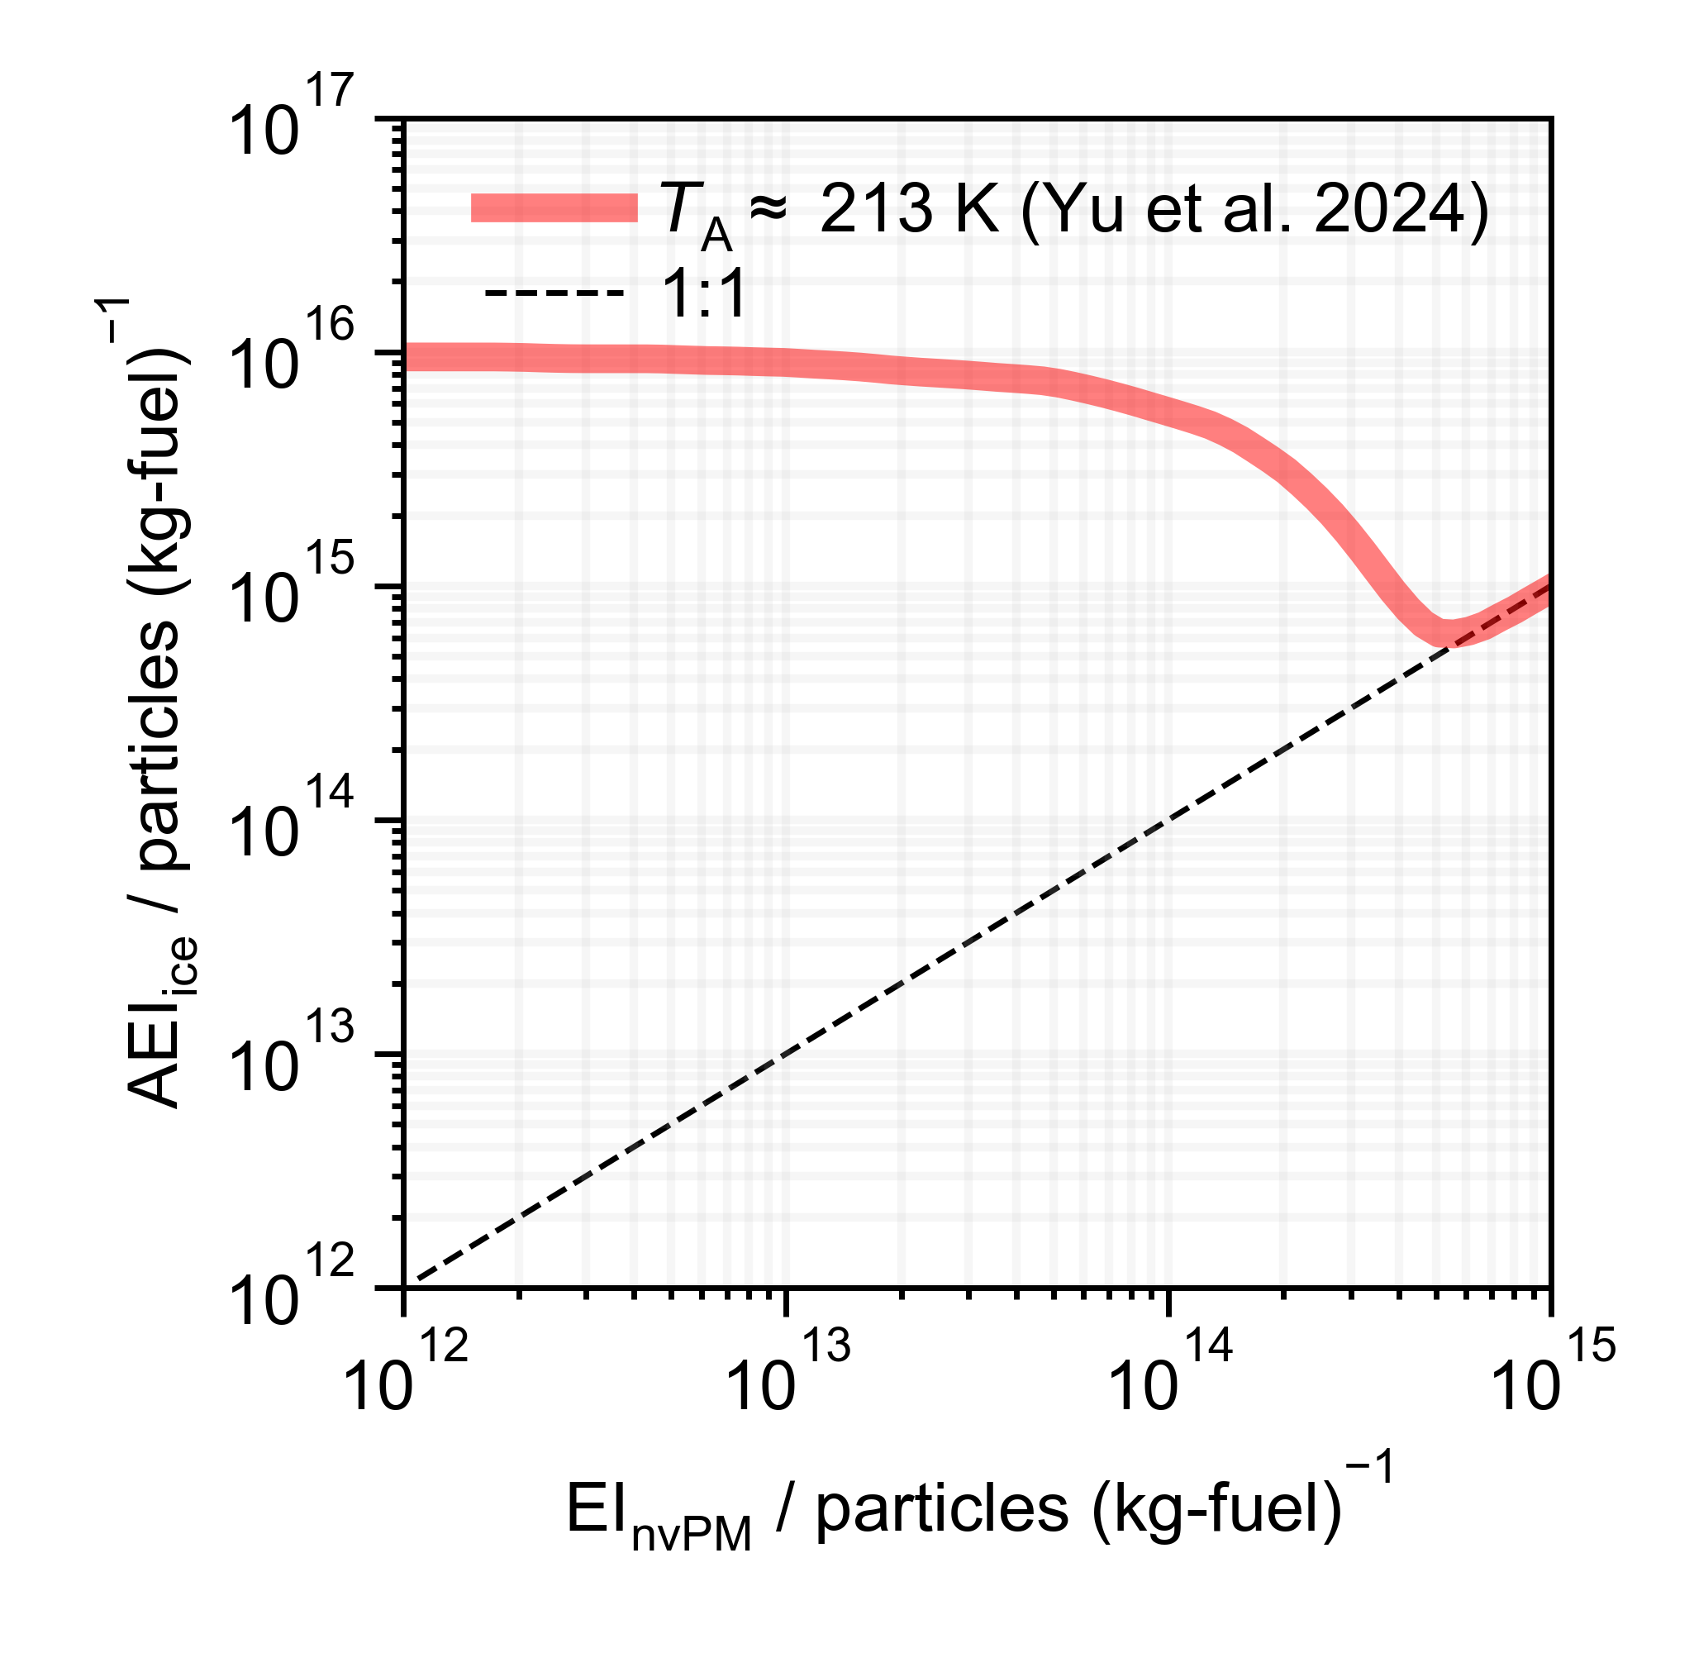
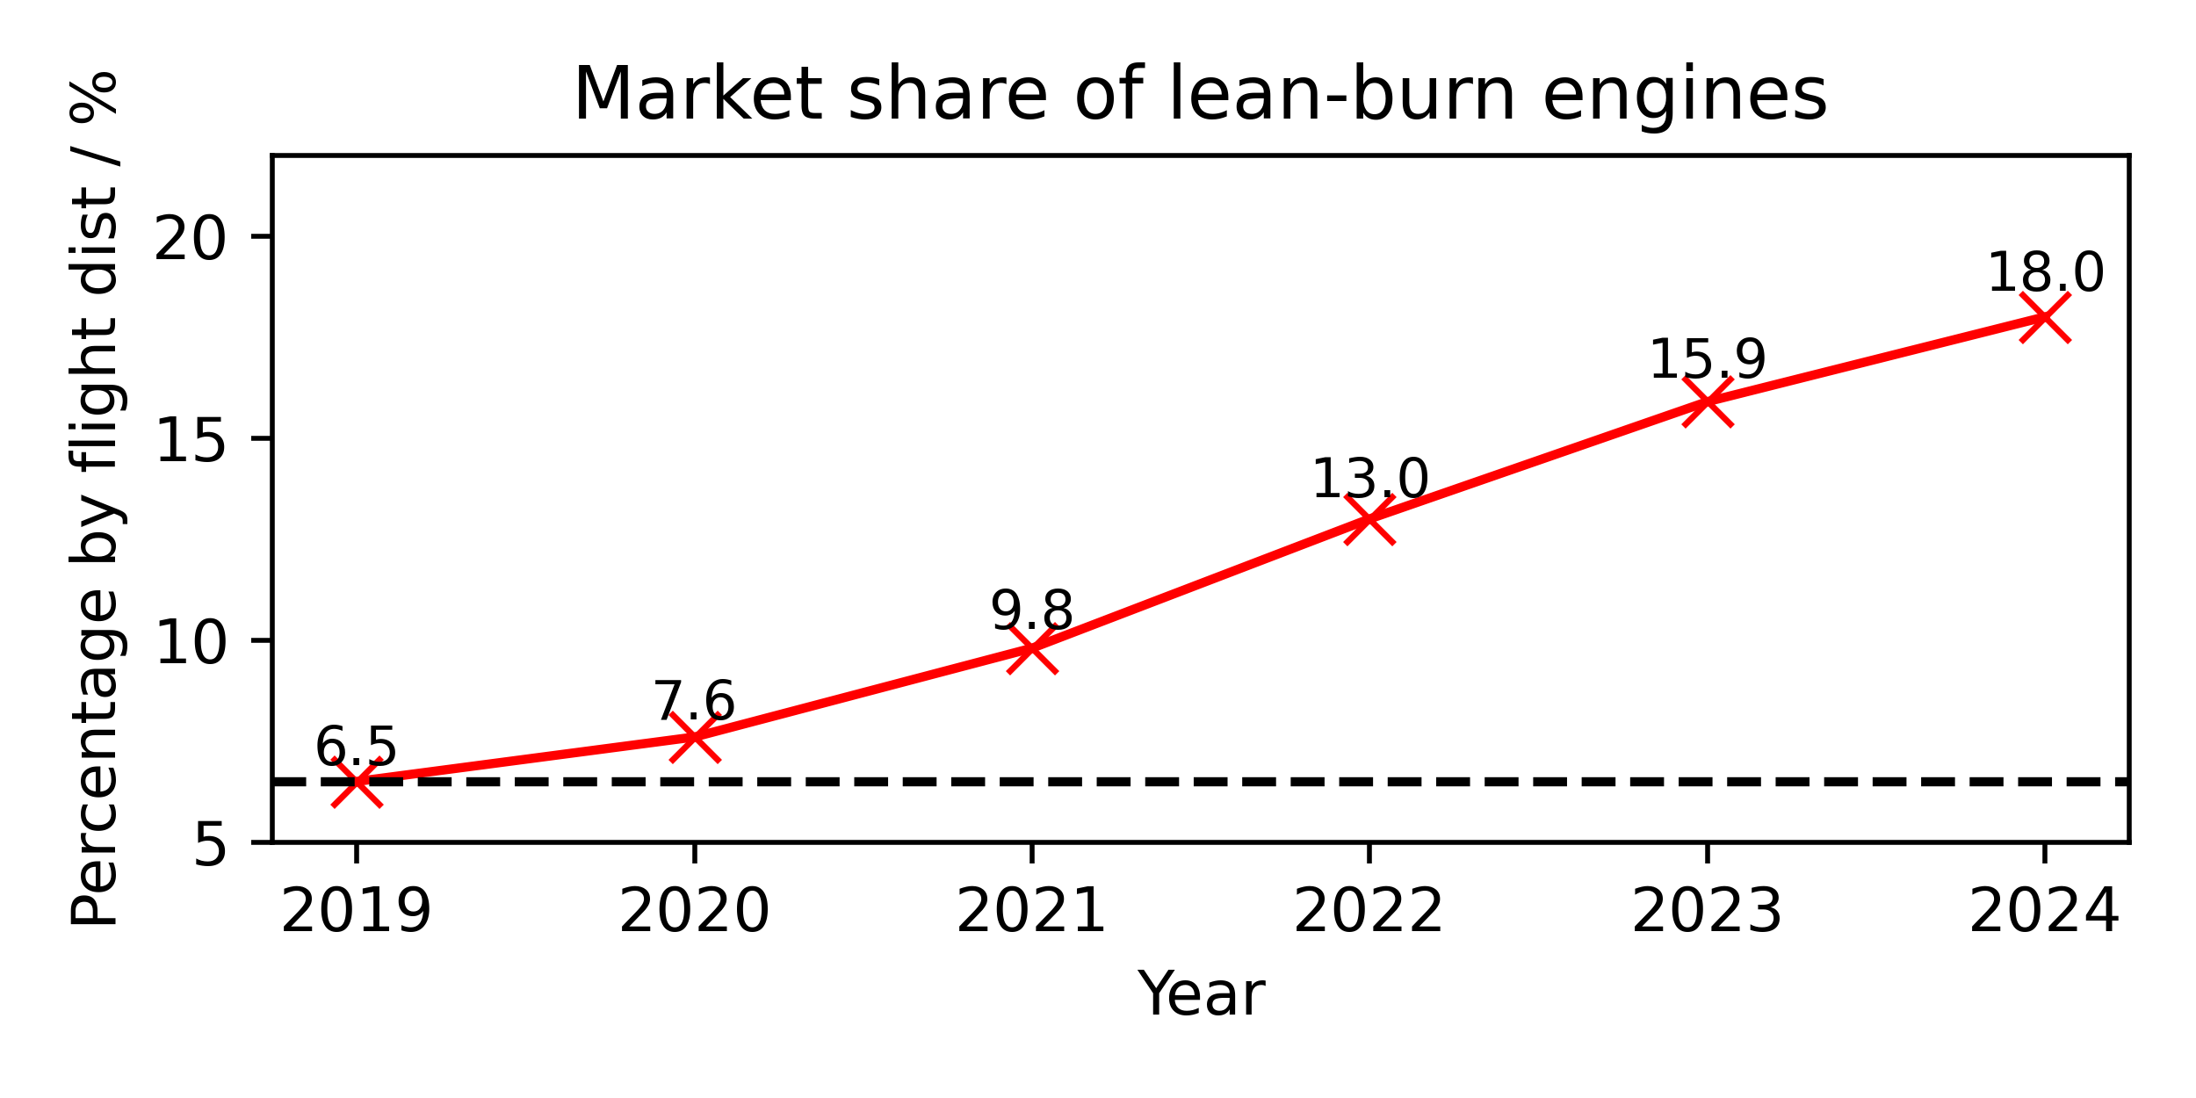
The “Kärcher-curve” (soot-poor)
Short-term: adoption of sustainable aviation fuels (SAF) and lean-burn engines
Long-term: development of electric/hydrogen aircraft
underestimated
AEI_{ice}
[Figure] F Yu et al., (2024). Revisiting Contrail Ice Formation: Impact of Primary Soot Particle Sizes and Contribution of Volatile Particles, DOI: https://doi.org/10.1021/acs.est.4c04340.
Notes:
However, the industry is projecting lower emission index of soot particles.
This is because of both (a) short-term “” and (b) long-term influences.
This takes us from the soot-rich regime into the soot-poor regime (so the diagram on the right hand side shows some model simulations for ice crystal emission indices when we bring the emission index of soot particles below the current 10^15 kg^-1 level).
In this so-called soot-poor regime, we have reduced numbers of soot particles in the exhaust, which can enable vPM particles to activate and later freeze to form contrail ice crystals.
Therefore, under these conditions, we do not see a linear decrease as anticipated if soot were the only particle of interest. Rather, the apparent emission index of contrail ice crystals can be enhanced by several orders of magnitude.
As I mentioned this increase in apparent ice emission indices can then impact the contrail radiative forcing… however, this feature is not currently incorporated in global model simulations.
Therefore, we need a simple framework to introduce this effect in global-scale simulations.

Slide 5
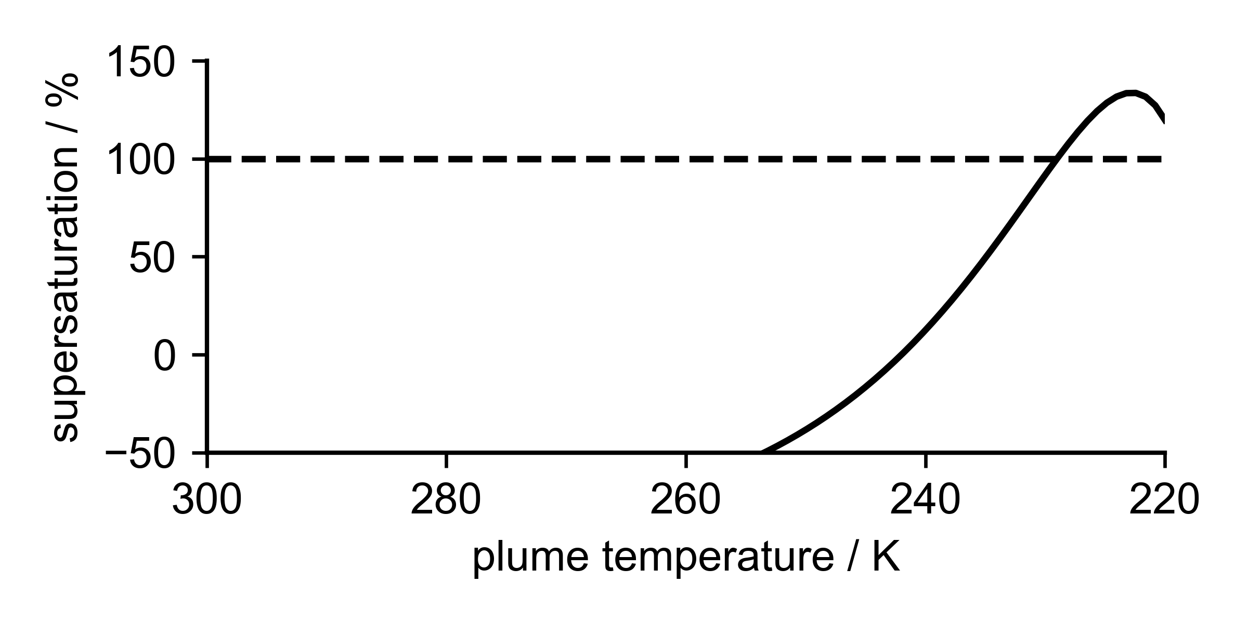
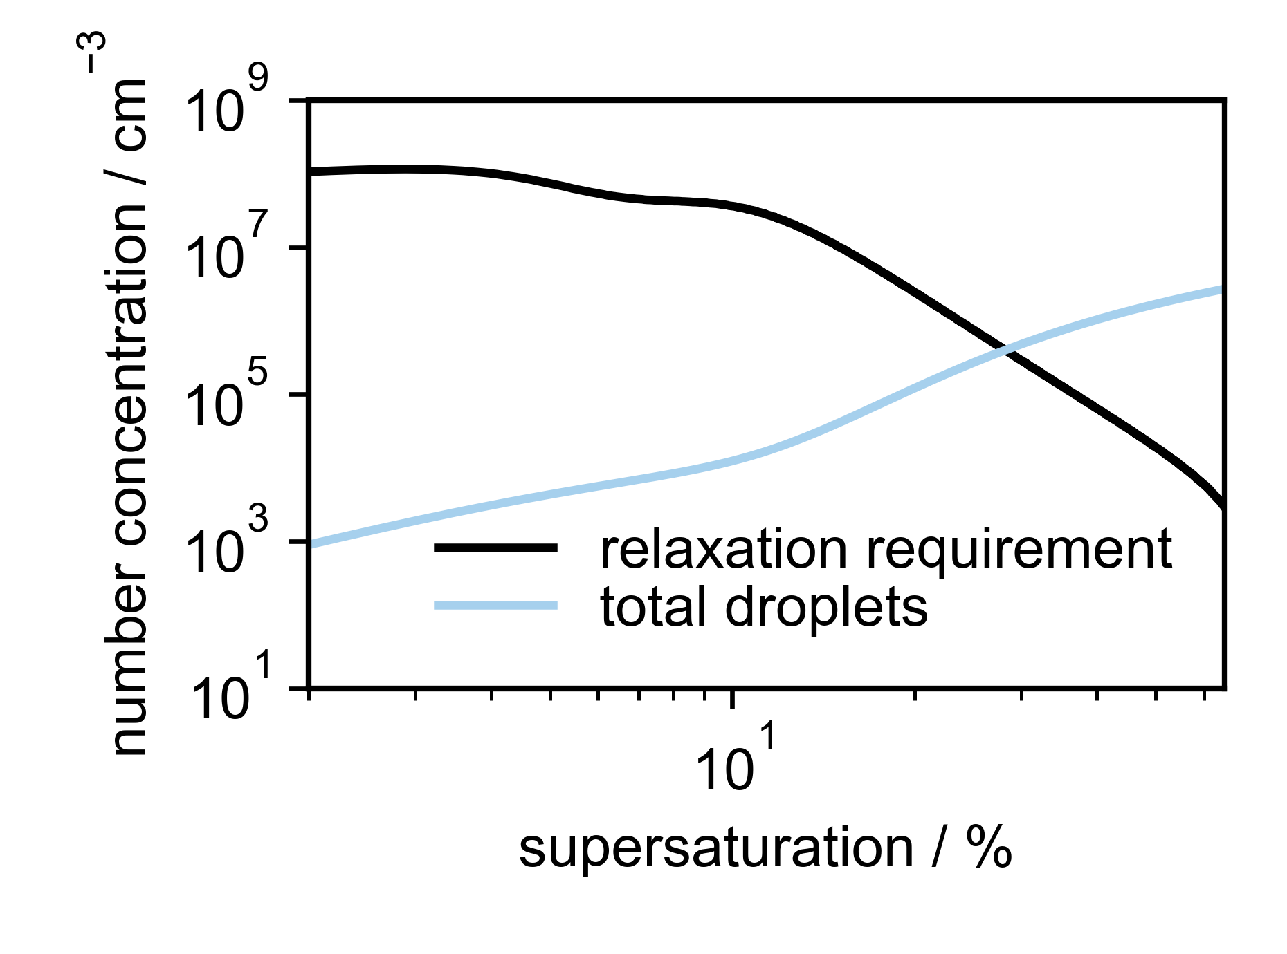
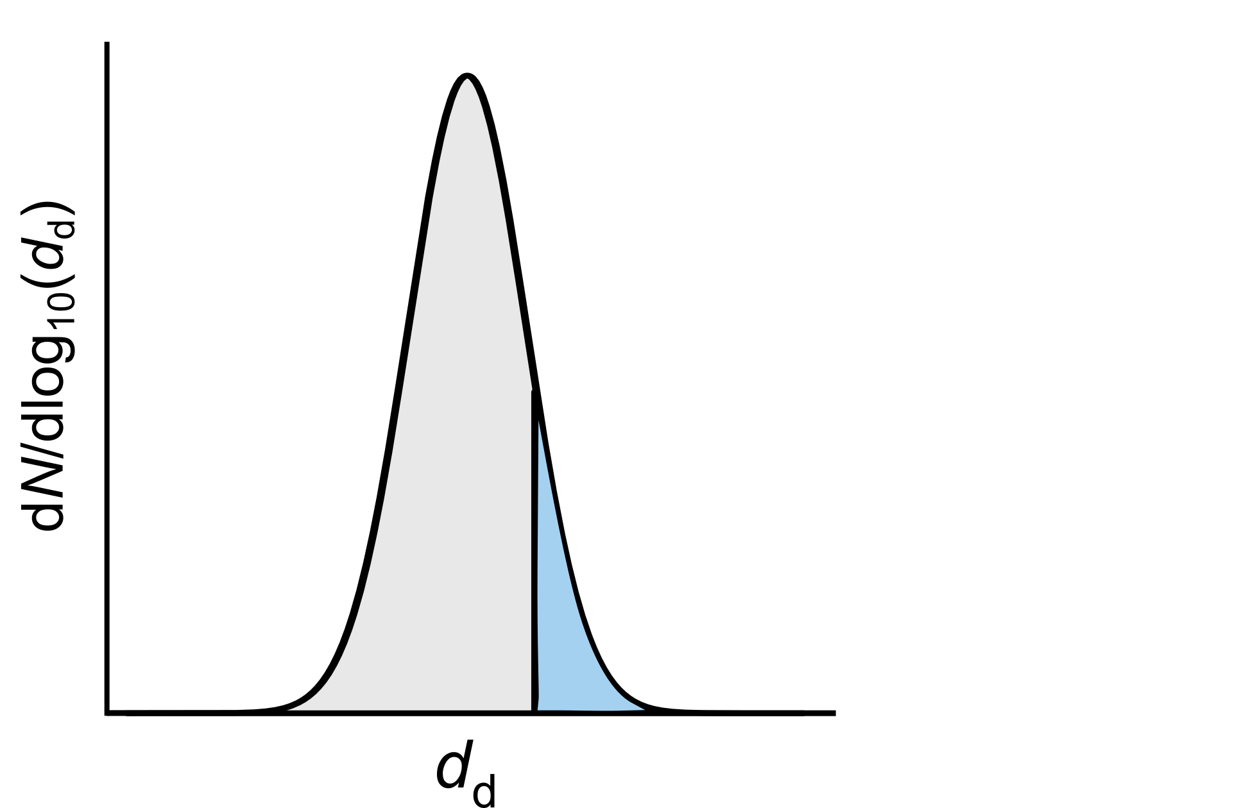
Original K15 model
Plume cooling increases plume supersaturation
Define plume particle properties
Define plume dilution
nvPM
ambient
Particle activation reduces plume supersaturation
Evaluate contrail ice crystal number concentration ( ) *
More particles activated as plume supersaturation increases
Growing droplets “quench” the plume at a threshold concentration (the relaxation requirement)
Particles able to activate
* Kärcher et al. (2015) The microphysical pathway to contrail formation, DOI: https://doi.org/10.1002/2015JD023491
Notes:
We decided to use the minimal microphysical framework proposed by Bernd Kärcher and coauthors in 2015. In this framework:
Firstly, we define plume particle properties.
Secondly, we define plume dilution (which tells us about how quickly the supersaturation – or the relative humidity) increases with time or temperature
So, the plume dilution tends to increase the plume supersaturation, which increases proportion of particles able to activate.
However, this activation and subsequent droplet growth reduces the available plume supersaturation.
Therefore, we have two competing processes
We can reframe this by considering the number of droplets required to quench the plume at a given point (this is the black curve, denoted the relaxation requirement)
When the number of activated particles (now water droplets) (blue curve) is equal to this number required for relaxation, this gives us an estimate for the total number concentration of water droplets (and hence contrail ice crystals).
Therefore, for a given set of plume particle properties and plume dilution conditions, we have a way of estimating contrail ice crystal numbers (which can be converted to apparent emission indices).

Slide 6
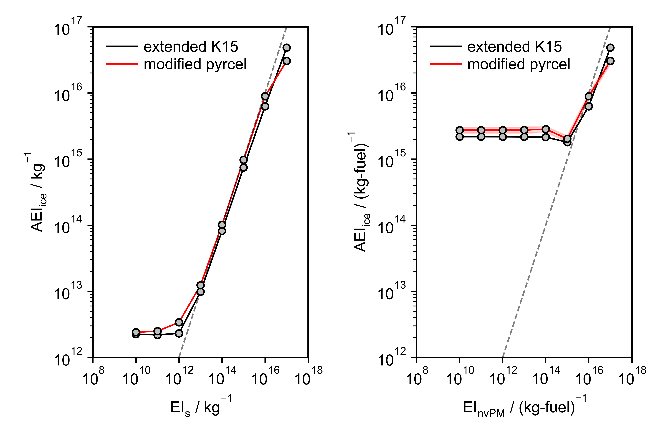
Extending the K15 model to include vPM
omitting vPM
including vPM
Introduced vPM as an additional particle type
Estimated activated particle concentrations numerically using κ-Köhler theory
Added updated description for droplet growth
Verified using sophisticated parcel model (pyrcel)*
[Figure] Ponsonby et al., (2025) [accepted] An updated microphysical model for particle activation in contrails: the role of volatile plume particles, DOI: 10.5194/egusphere-2025-1717
* Rothenberg and Wang et al., (2016) Metamodeling of Droplet Activation for Global Climate Models, DOI: 10.1175/JAS-D-15-0223.
Notes:
There were several extensions that were necessary to make this “K15” model apt for treating vPM
Firstly, we needed to introduce vPM as a particle type. This is prescribed at the timescale of activation in the exhaust and diluted appropriately. We do not consider any complex chemistry or size evolution.
Next, we introduced several numerical solutions to analytic approximations, which would otherwise have underestimated the impact of vPM.
Finally, we verified the extended microphysical framework with a more sophisticated parcel model (pyrcel), which demonstrated good agreement.
I then handed this model over to Roger and the team at Breakthrough who introduced it into pycontrails.
So, I’ll hand over to Roger to outline the next steps of this work.
So we will now integrate the extended K15 model into the contrail simulation workflow.
(timi7:07, 6:30)

Slide 7
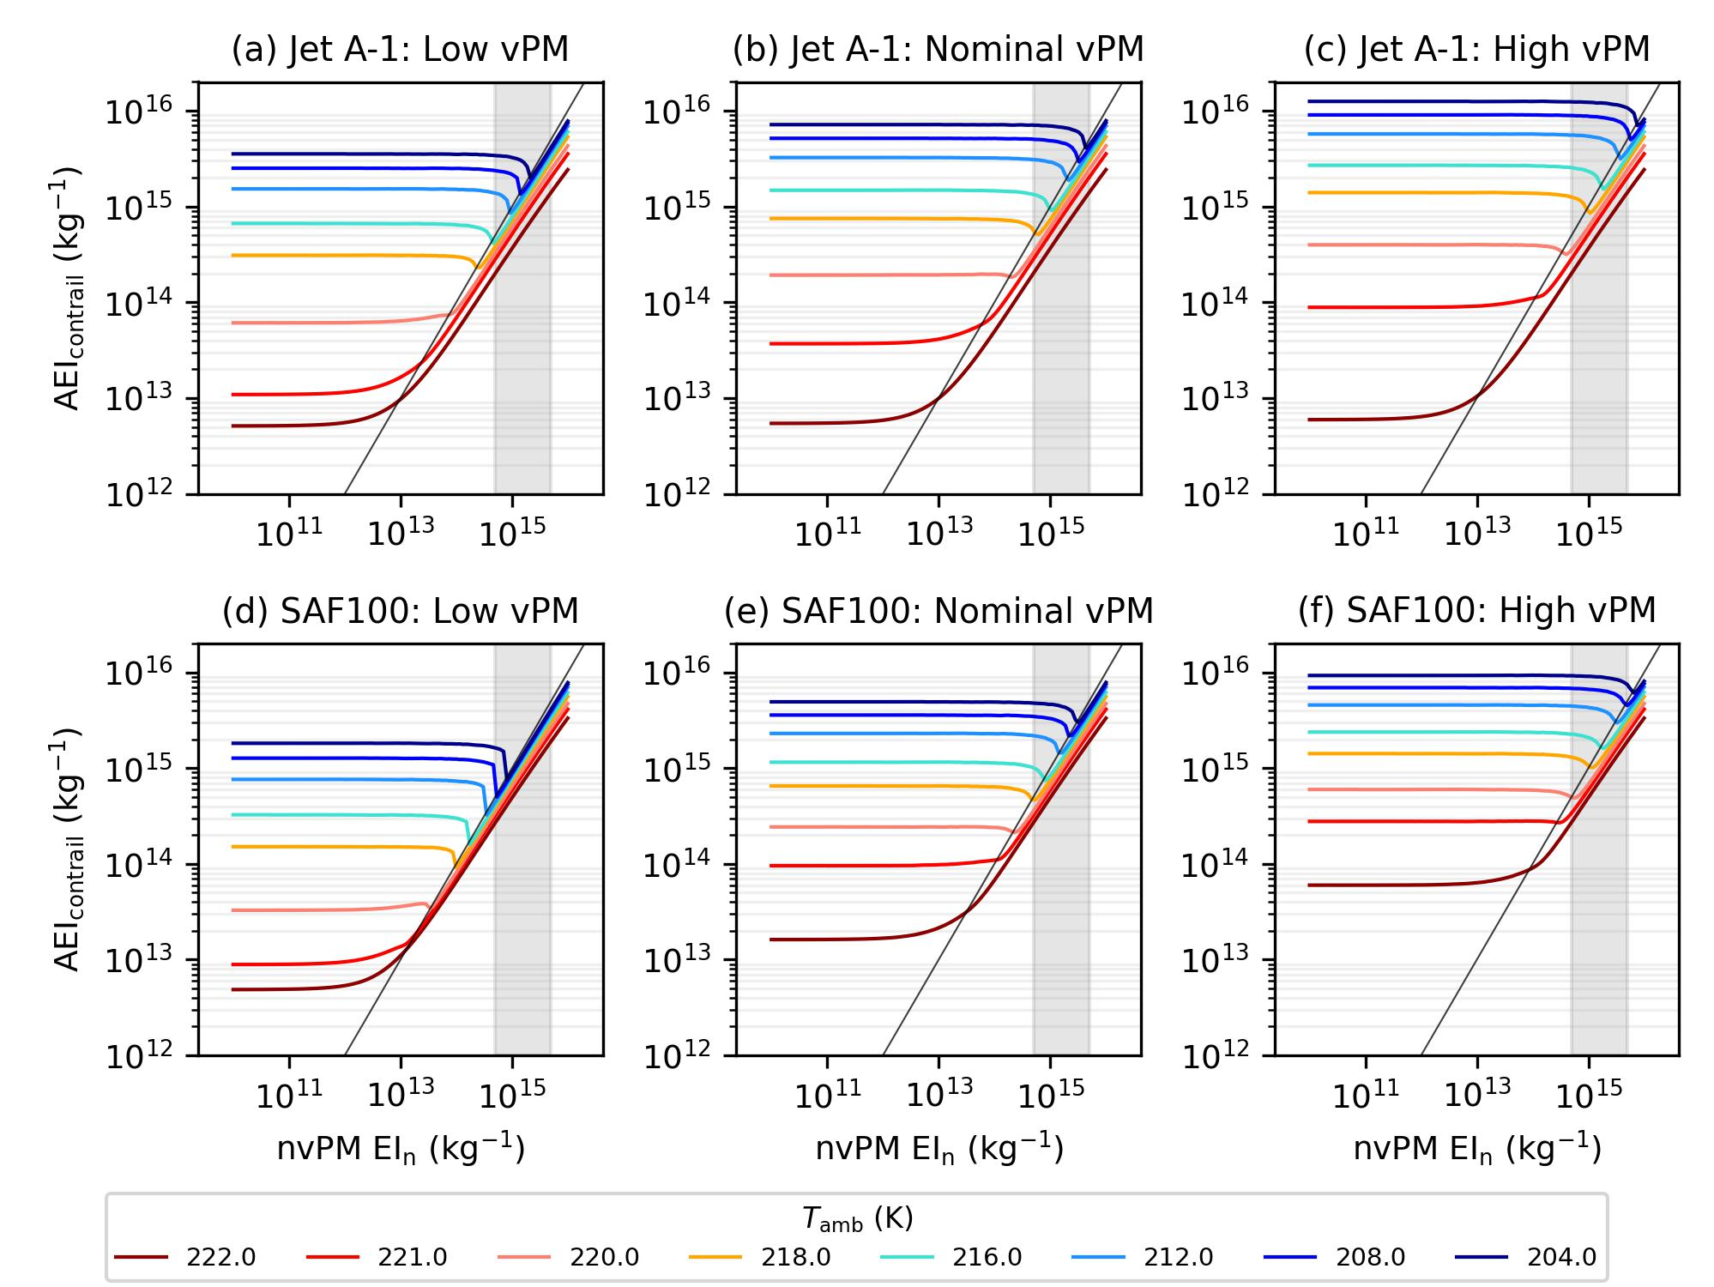
Extended K15 model: Assumed vPM properties
Scenarios: Jet A-1 | vPM EI_{n} (kg⁻¹) | vPM GMD (nm) | vPM GSD | vPM κ | Reference dataset
Low vPM activation | 2.0 ×10¹⁷ | 1.80 | 1.50 | 0.20 | Boeing ecoDemonstrator dataset
Nominal vPM activation | 3.0 ×10¹⁷ | 2.10 | 1.45 | 0.30 | Best fit to both ecoD and VOLCAN datasets
High vPM activation | 4.0 ×10¹⁷ | 2.40 | 1.40 | 0.40 | NEOFUELS/VOLCAN dataset
vPM activation depends on:
Assumed vPM properties,
Temperature,
nvPM EI_{n}
Notes:
Thank you, Joel.
Unlike soot, vPM properties are dynamic and evolves over time. So, we need to assume the vPM properties when the plume age is around 0.1 s, which corresponds to the time of contrail formation.
To account for the significant uncertainties in these vPM properties, we run the global contrail simulation with three different scenarios that represents low, nominal, and high vPM activation. [Informed by?]
Here are some examples showing the behaviour of the extended K15 model for the low, nominal, and high vPM scenarios. Describe x-axis, y-axis, and shaded region (range of nvPM from conventional engines).
In summary, the extent of vPM activation depends on the: (i) assumed vPM properties; (ii) temperature; and (iii) nvPM EIn

Slide 8
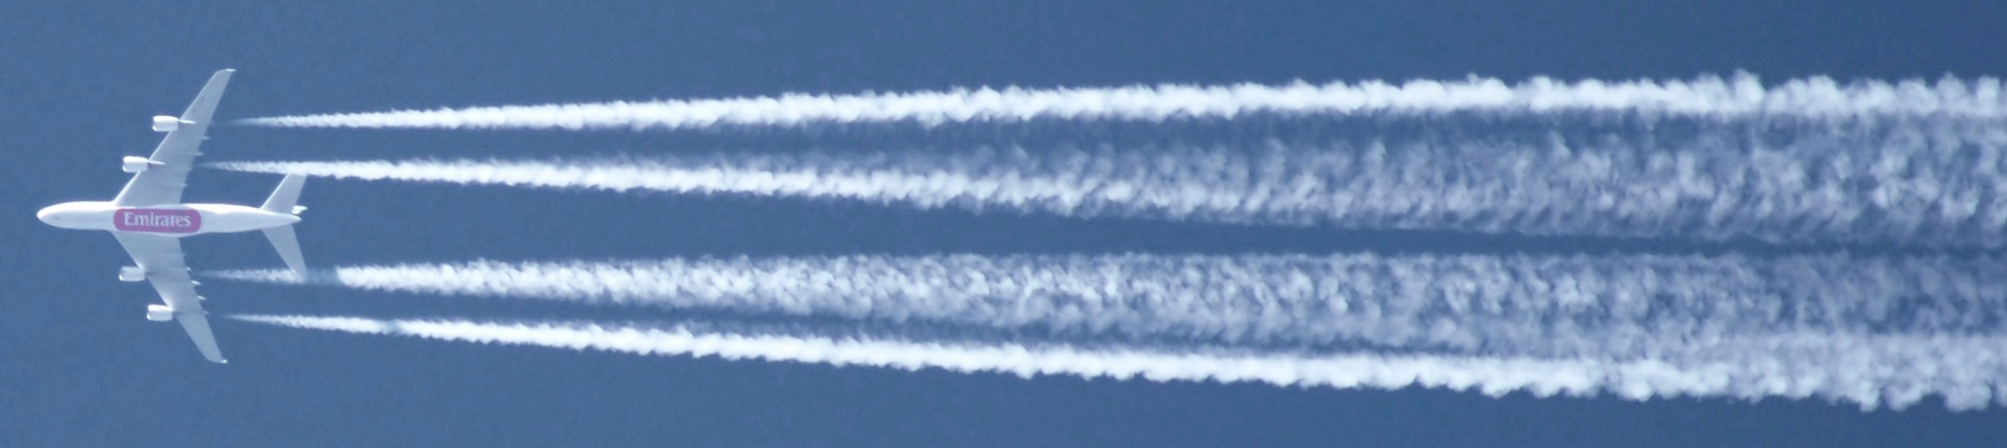
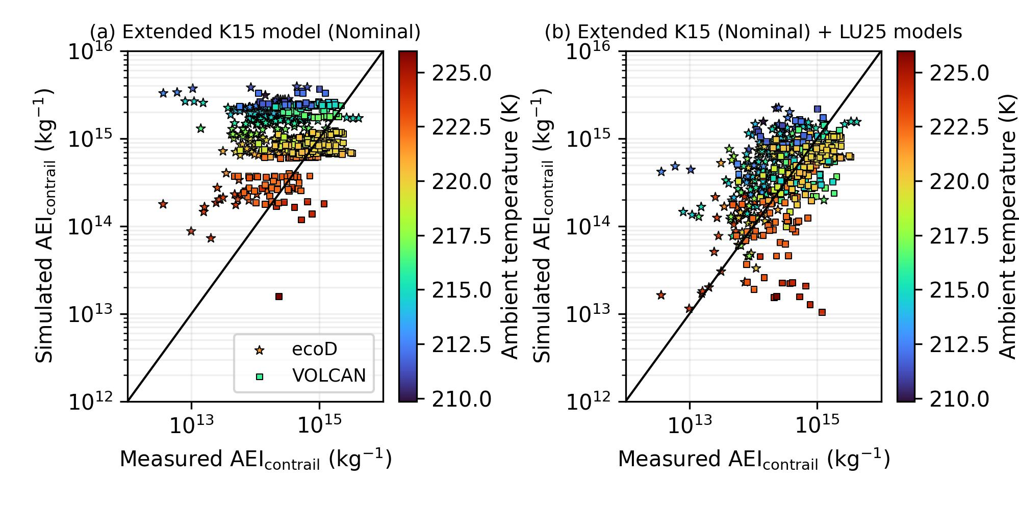
Comparing measured and simulated AEI_{contrail}
Extended K15 model simulates AEI_{contrail} at t_{plume} ≈ 0.1 s
AEI_{contrail} measured at t_{plume} ≈ 20 – 120 s, which may be affected by ice crystal losses in the wake vortex downwash
(a)
(b)
Simulated AEI_{contrail} shows improved agreement with measurements when it partially accounts for ice crystal losses*
*: Lottermoser & Unterstraßer (2025):
https://doi.org/10.5194/acp-25-7903-2025
VOLCAN: Voigt et al. (2025): https://doi.org/10.21203/rs.3.rs-6559440/v1 ; Boeing ecoD: https://www.boeing.com/features/2023/12/737-10-dc-8-team-up-to-test-sustainable-fuel
Notes:
We compared the simulated contrail ice crystal numbers with the contrail measurements from the Boeing ecoDemonstrator and VOLCAN campaigns.
Here, you see that the extended K15 model tend to overestimate the contrail ice crystal numbers, because it simulates the number of contrail ice crystals at a plume age of 0.1 s.
However, measurements were made at plume ages of 20 to 120 s, and there is a much better agreement between the measured and simulated ice crystals numbers after we partially account for ice crystal losses in the wake vortex downwash.

Slide 9
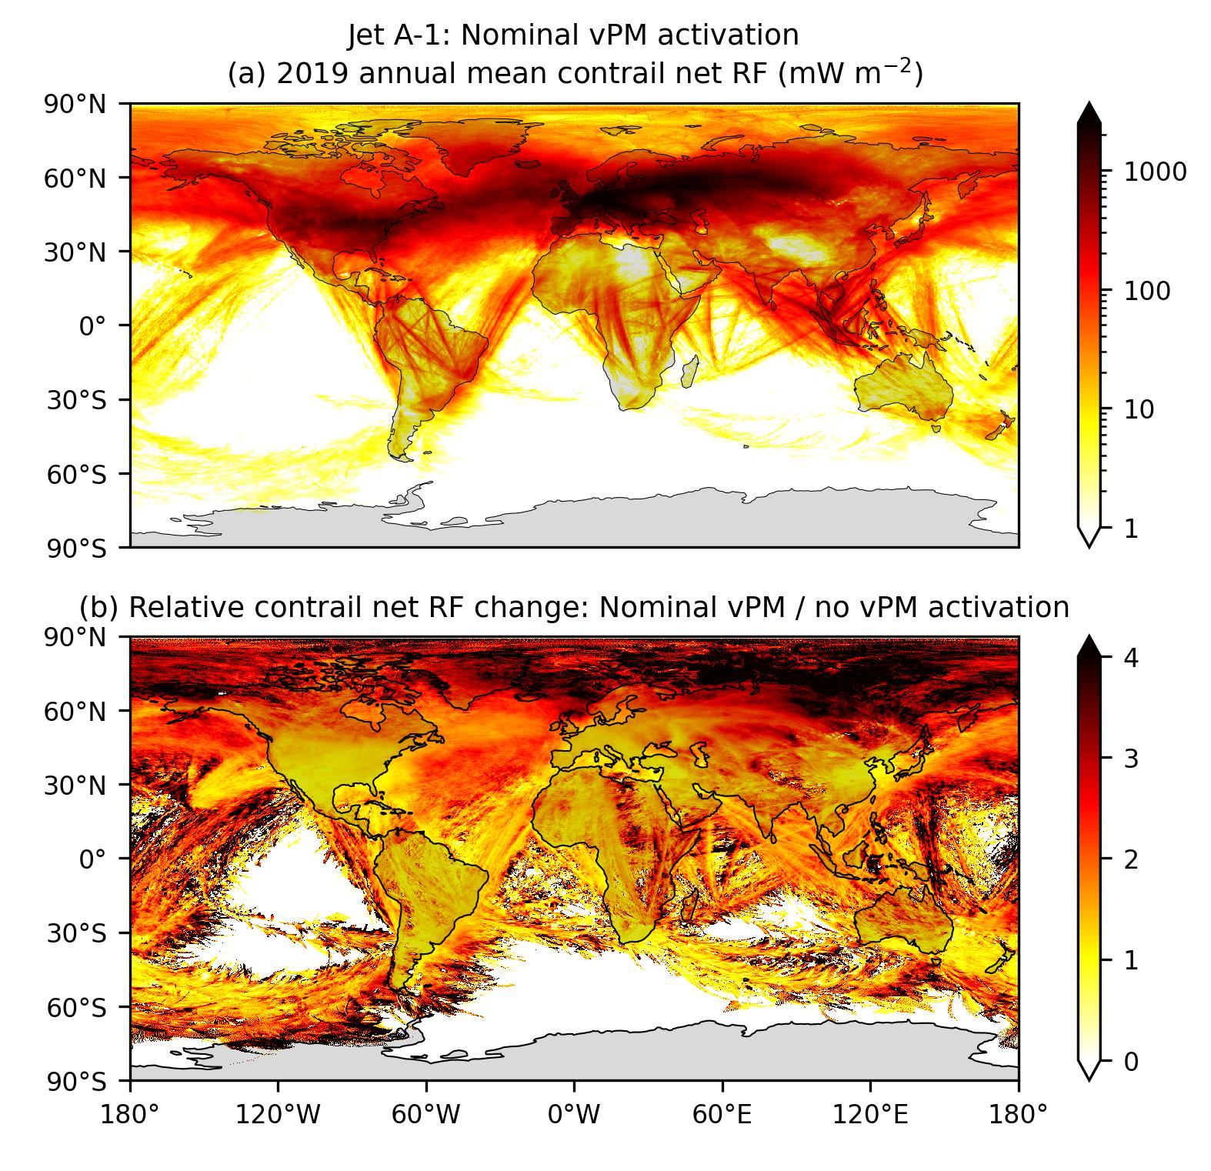

Change in global contrail net RF due to vPM activation
2019 annual mean contrail net RF (nominal vPM)
2019 annual mean contrail net RF with vPM activation:
79.8 [58.8, 102] mW m⁻²
Relative change in contrail net RF = $\frac{Nominal vPM}{No vPM}$
vPM activation increases global contrail net RF by 65 [21, 110] % vs. no-vPM simulation.

Slide 10
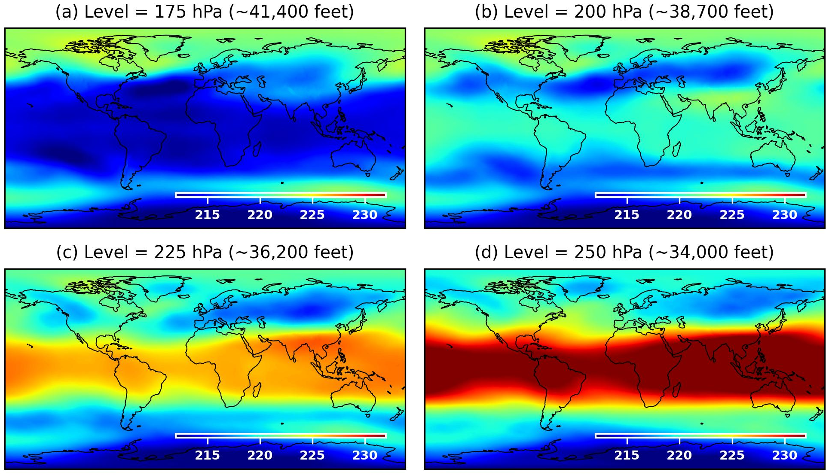
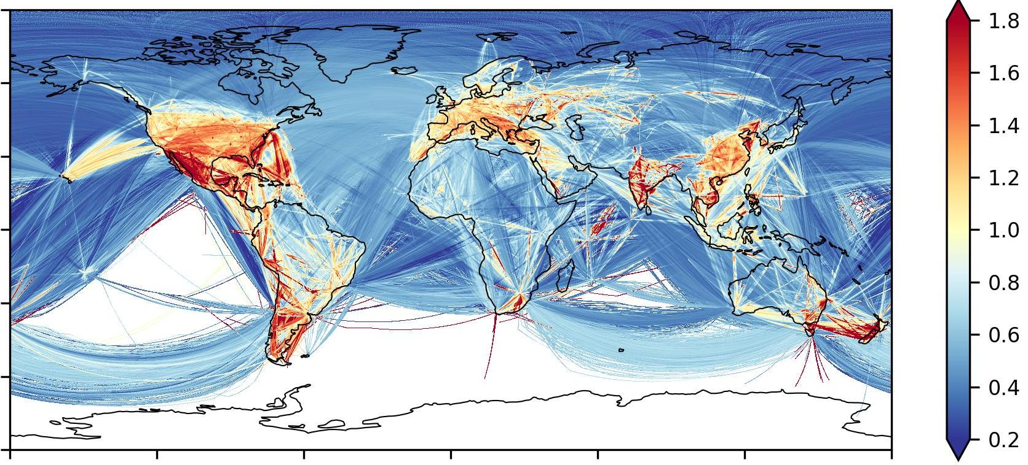


vPM activation is sensitive to temperature and nvPM EI_{n}
Relative change in contrail net RF = $\frac{Nominal vPM}{No vPM}$
Temperature effect
nvPM effect
Relative nvPM = $\frac{Local mean nvPM EI_{n}}{Global mean nvPM EI_{n}(1.02×10^{15} kg^{−1})}$
Notes:
Arctic, Siberia and the North Atlantic
The US, Europe, and East Asia have a higher nvPM number emissions index relative to the global mean due to a higher prevalence of narrowbody aircraft, and that can suppress vPM activation.

Slide 11
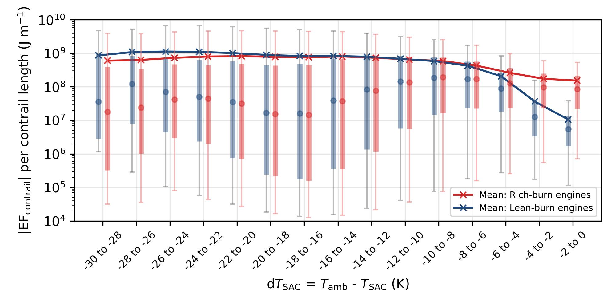
Contrail climate forcing: rich vs. lean-burn engines
Rich burn engines:
A19N, A20N, A21N (Pratt & Whitney GTF)
B788, B789 and B78X (Rolls Royce Trent)
Lean burn engines:
A19N, A20N, A21N, B38M, B39M (CFM LEAP)
B748, B788, B789, B78X (GEnx)
*:Error bars indicate the 5th and 95th percentile, and boxes represent the interquartile range.
Annual mean EF_{contrail} per contrail length from lean-burn engines may be 9.5 [23, 5.6] % lower than those from rich burn engines
Notes:
EF_{contrail} from lean-burn engines tends to be lower than rich-burn engines at warmer temperatures (dT_{SAC} > -5 K), but higher at very cold conditions (dT_{SAC} < -15 K).

Slide 12
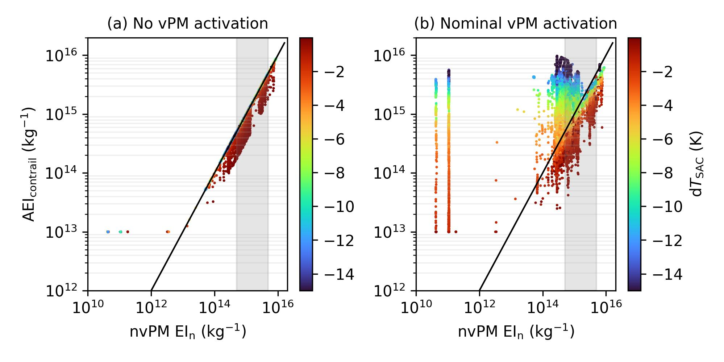
vPM activation is critical for lean-burn contrail modelling
Neglecting vPM activation may underestimate the EF_{contrail} from lean-burn engines by a factor of 33 [22, 42].
Notes:
No vPM activation: ${AEI}_{contrail}=max\left(nvPM {EI}_{n}, {10}^{13}\right)×f_{activation}$

Slide 13
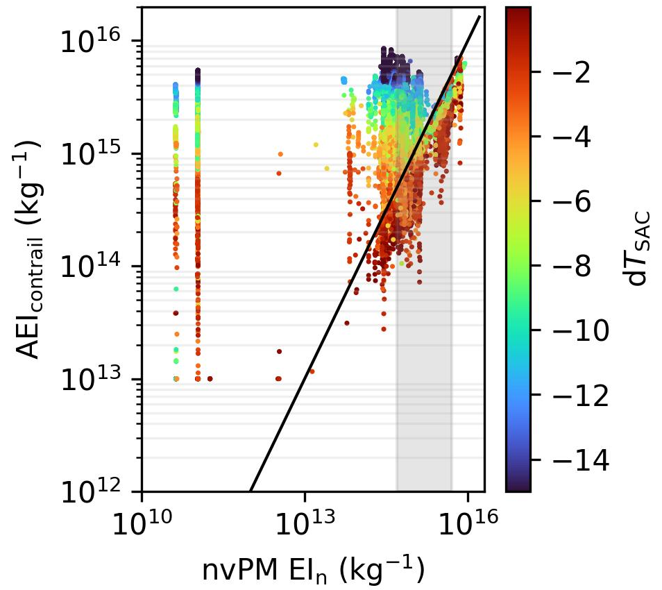

Summary
Developed a contrail parcel model using Kärcher et al., 2015 that incorporates vPM, and integrated into CoCiP [1]
Assumed vPM properties – which strongly influences the simulated AEI_{contrail} – informed by contrail measurements from lean-burn engines.
After including vPM activation, 2019 global contrail net RF may rise by 65 [21, 110] % to 79.8 [58.8, 102] mW m⁻².
Annual EF_{contrail} from lean-burn engines may be underestimated by 33 [22, 42]-fold if vPM is excluded.
Ponsonby et al. (2025) An updated microphysical model for particle activation in contrails: the role of volatile plume particles. https://doi.org/10.5194/egusphere-2025-1717
Teoh et al. (2025) Impact of Volatile Particulate Matter on Global Contrail Radiative Forcing and Mitigation Assessments [In preparation]

Slide 14


Extended K15 model source code:
Integration into pycontrails workflow:
Contacts
roger.teoh15@imperial.ac.uk
j.ponsonby21@imperial.ac.uk
zeb.engberg@breakthroughenergy.org
m.stettler@imperial.ac.uk

Slide 15
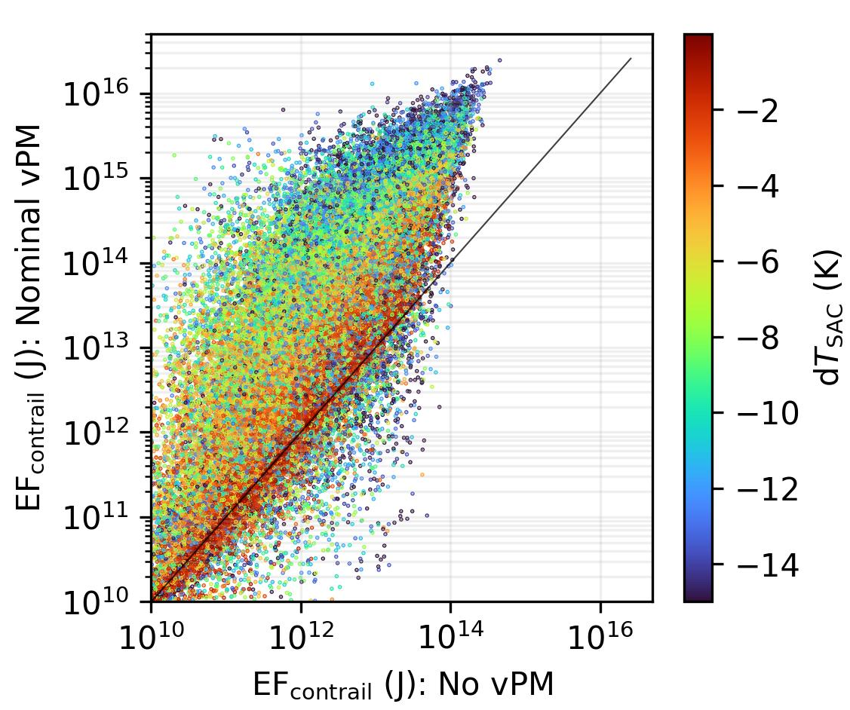
vPM activation is critical for lean-burn contrail modelling
AEI_{contrail}
EF_{contrail}: lean-burn engines
Neglecting vPM activation may underestimate the annual contrail climate forcing from lean-burn engines by a factor of 33 [22, 42].
Notes:
No vPM activation: ${AEI}_{contrail}=max\left(nvPM {EI}_{n}, {10}^{13}\right)×f_{activation}$

Slide 16
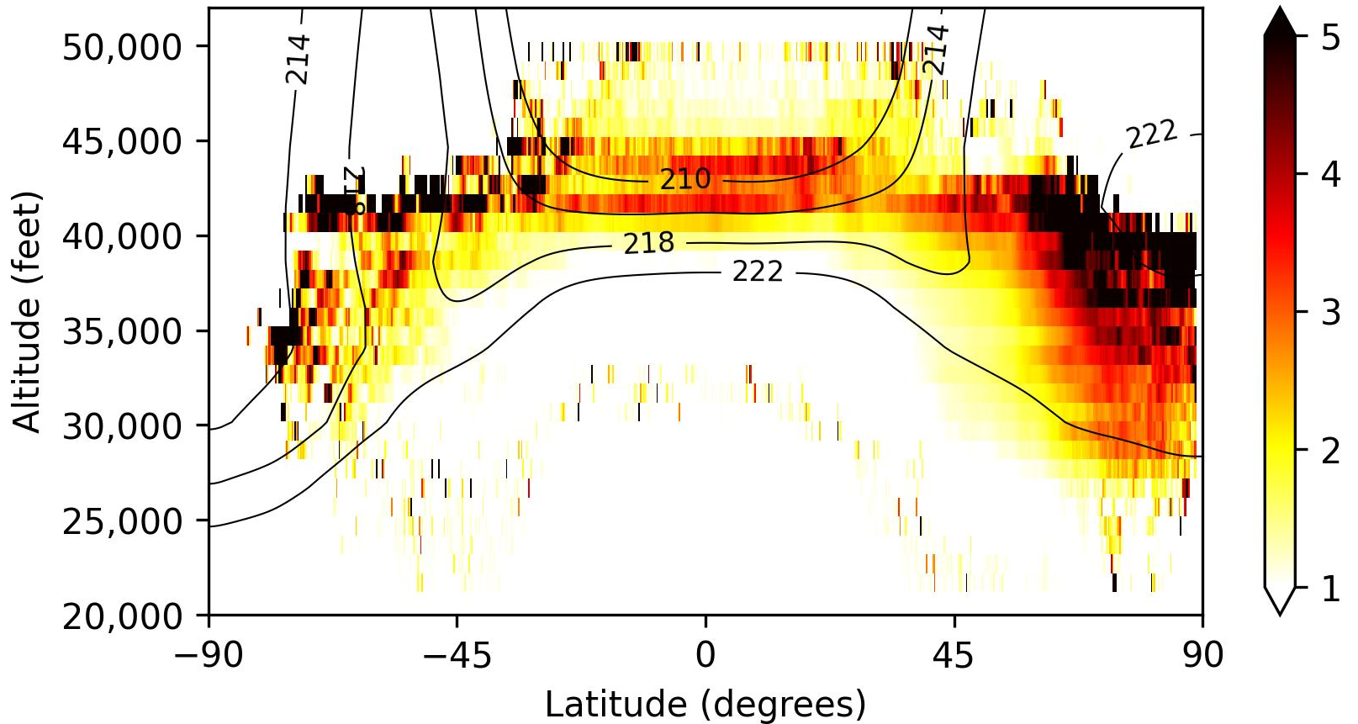

vPM activation is sensitive to temperature and nvPM EI_{n}
Relative change in contrail net RF = $\frac{Nominal vPM}{No vPM}$
Temperature effect
nvPM effect
Relative change in EF_{contrail} = $\frac{Nominal vPM}{No vPM}$
Relative nvPM = $\frac{Local mean nvPM EI_{n}}{Global mean nvPM EI_{n}(1.02×10^{15} kg^{−1})}$
Notes:
^{Contour isolines}
The US, Europe, and East Asia have a higher relative nvPM number emissions index relative to the global mean due to a higher prevalence of narrowbody aircraft, and that can suppress vPM activation.

